Slide 1
Note on Posted Slides
These are the slides that I intended to show in class on Mon. Jan. 21, 2013.
They contain important ideas and questions from your reading.
Due to time constraints, I was probably not able to show all the slides during class.
They are all posted here for completeness.

Slide 2
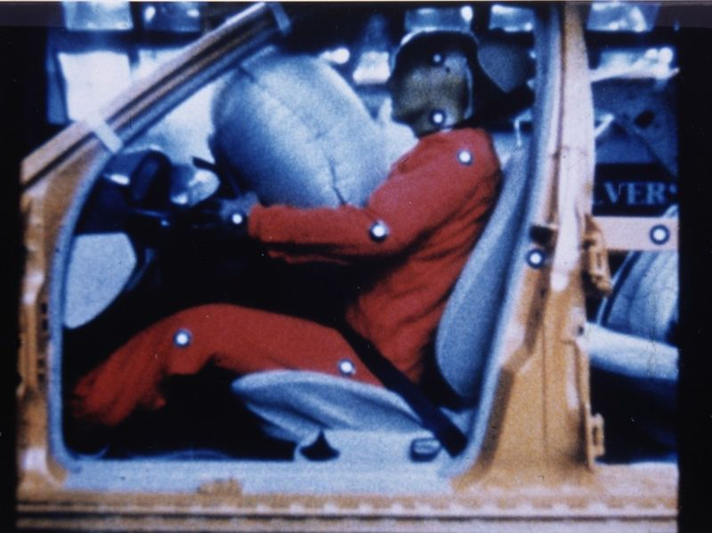
PHY205H1S Physics of Everyday Life Class 5
Momentum
Impulse
Impulse Changes Momentum
Bouncing
Conservation of Momentum
Collisions
[image from http://en.wikipedia.org/wiki/File:Airbag2.jpg ]

Slide 3
Chapter 6 Pre-Class Reading Question
What is the law of conservation of momentum?
Every object continues in a state of rest or uniform speed in a straight line unless acted on by a nonzero net force.
In the absence of an external force, the momentum of a system remains unchanged.
There exists in nature a stabilizing tendency for momentum to be restored within a closed system.
When an external force is applied to an object, its momentum is preserved.

Slide 4
Chapter 6 Pre-Class Reading Question
What is impulse?
Any influence that tends to accelerate an object.
The product of the mass and the velocity of an object.
The product of the force acting on an object and the time during which it acts.
That which can change the condition of matter.
A spontaneous act, such as a kiss.

Slide 5
Chapters 6 and 7: The Big Idea
Introduce the ideas of momentum and energy. These concepts give us new useful ways of analyzing motion.
In life, some quantities stay the same while other things around them change.
For example, when a bomb explodes, if you add up the mass of all the products, it will be the same as the mass of the original bomb. This is “Conservation of Mass”: M_{f} = M_{i}.
Similarly, we have “Conservation of Momentum” (${\vec{p}}_{f}={\vec{p}}_{i})$ and “Conservation of Energy” (E_{f} = E_{i}) : two new and useful principles which are introduced in chapters 6 and 7.

Slide 6
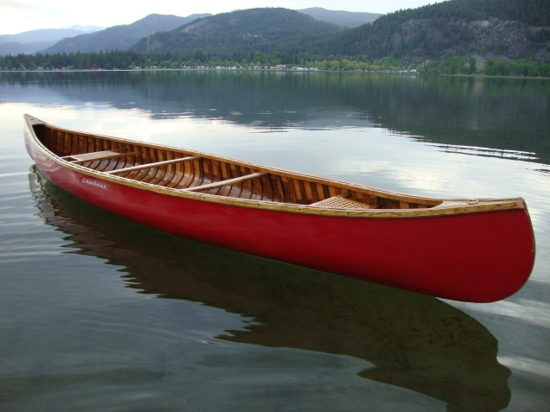
Last Wednesday I asked…
Imagine you are trapped in a canoe in the middle of a still lake with no paddles. There is a large pile of heavy rocks in the canoe. If you start throwing rocks, can you propel the canoe this way?
Answer: Yes! This is a result of conservation of momentum.
If so, and you want to get to shore, which way should you throw the rocks?
Answer: Away from shore!
[image downloaded Jan.16 2013 from http://campbellpost.wordpress.com/2012/01/26/canoe/ ]

Slide 7
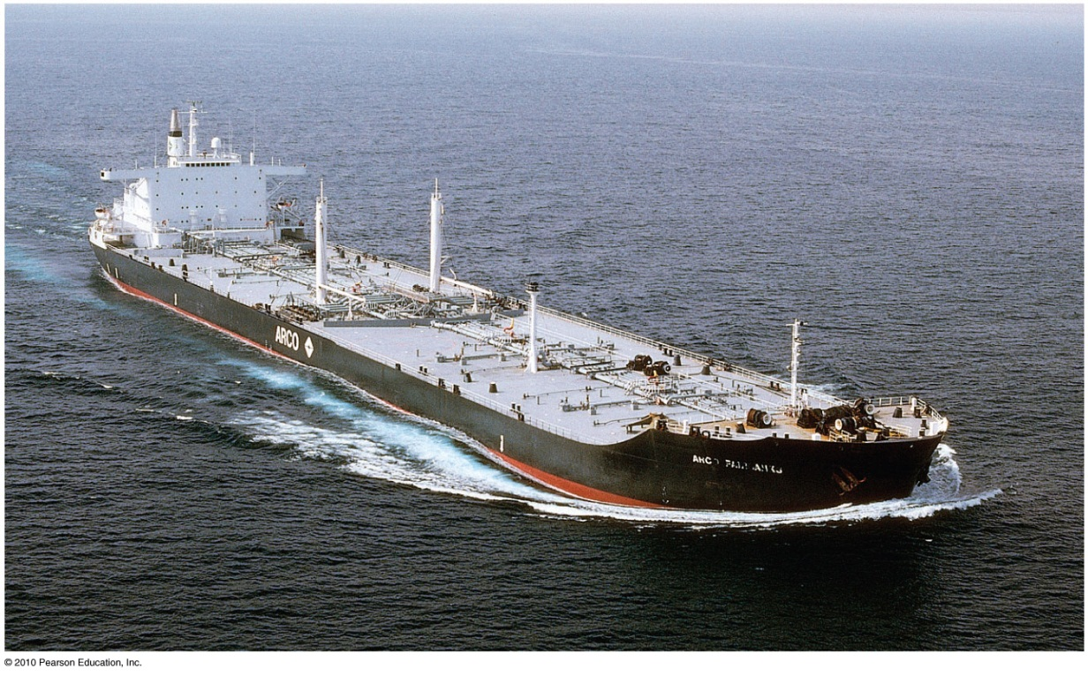
Momentum
a property of moving things
means inertia in motion
more specifically, mass of an object multiplied by its velocity
in equation form:
Momentum = mass × velocity

Slide 8
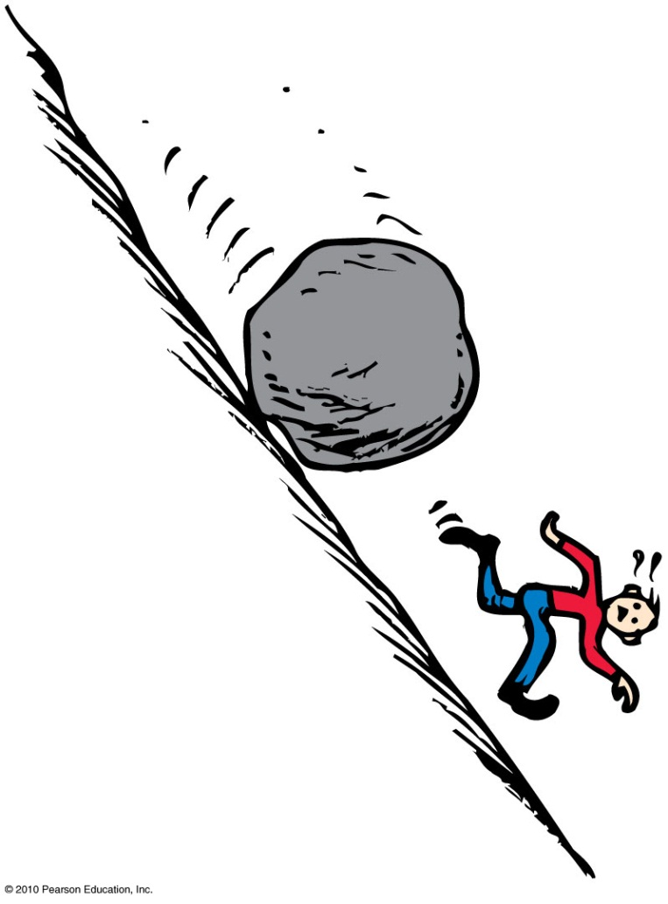
Momentum
Examples:
A moving boulder has more momentum than a stone rolling at the same speed.
A fast boulder has more momentum than a slow boulder.
A boulder at rest has no momentum.

Slide 9
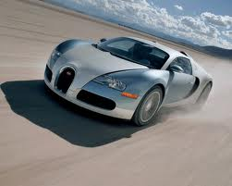
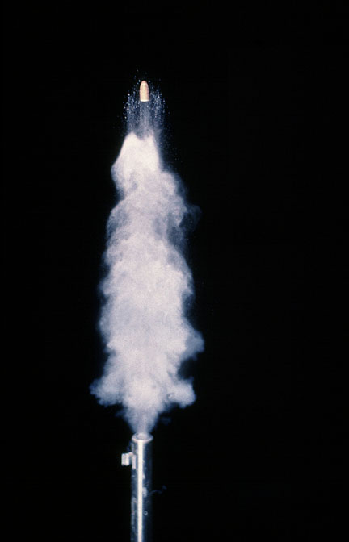
Examples
A 1000 kg car travels west at 25 m/s. What is its momentum?
A 0.01 kg bullet is fired straight up, and leaves the gun with a muzzle speed of 1000 m/s. What is its momentum?

Slide 10
Discussion Question. Can you do the math?
A 10 kg cart is moving to the left at 2 m/s. Define positive as “towards the right”, so its initial velocity is –2 m/s.
The cart suddenly stops. What is the change in momentum of the cart?
–20 kg m/s
–10 kg m/s
0 kg m/s
10 kg m/s
20 kg m/s
Notes:
Answer: A

Slide 11
Impulse
Product of force and time (force × time)
In equation form: Impulse = Ft
Example:
A brief force applied over a short time interval produces a smaller change in momentum than the same force applied over a longer time interval.
or
If you push with the same force for twice the time, you impart twice the impulse and produce twice the change in momentum.

Slide 12
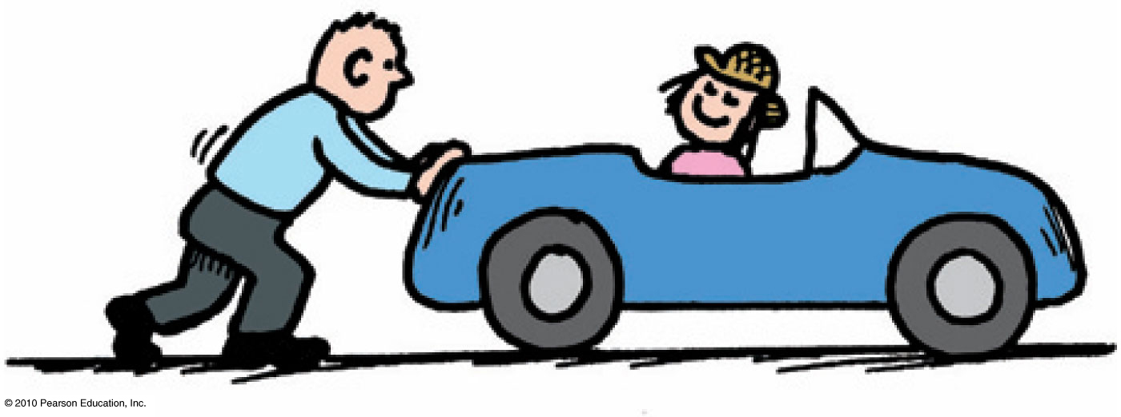
Impulse Momentum Theorem
The impulse on an object equals its change in momentum.
In equation form: Ft = Δ(mv)

Slide 13
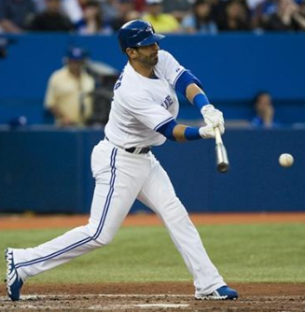
Baseball Example
A 0.15 kg baseball flies to the left with an initial velocity of -30 m/s.
José Bautista hits it, and provides an average force during the hit of 12,000 N to the right (+12,000 N). The duration of the hit is one millisecond.
What is the impulse delivered to the ball by the bat?
What is the velocity of the ball immediately after the hit?
[Image of José Bautista of the Toronto Blue Jays downloaded Jan.21 2013 from http://bigstory.ap.org/content/encarnacion-johnson-lead-blue-jays-over-orioles ]

Slide 14
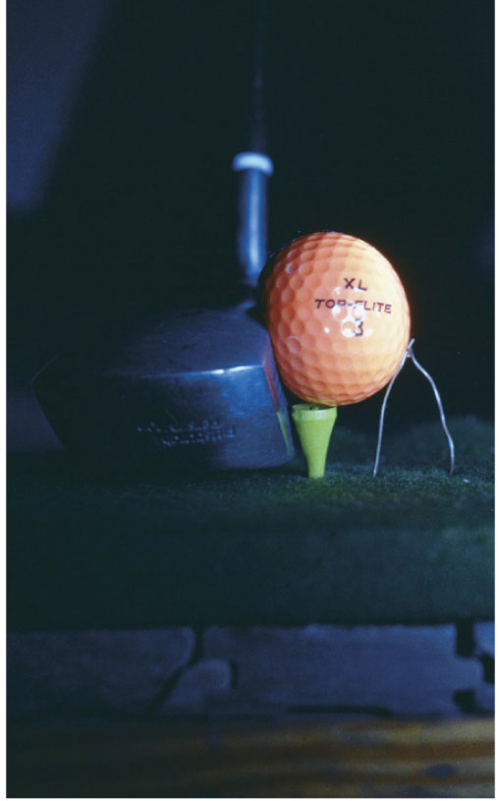
Impulse Changes Momentum
Case 1: increasing momentum
Apply the greatest force for as long as possible and you extend the time of contact.
Force can vary throughout the duration of contact.
Examples:
Golfer swings a club and
follows through.
Baseball player hits a ball and
follows through.

Slide 15
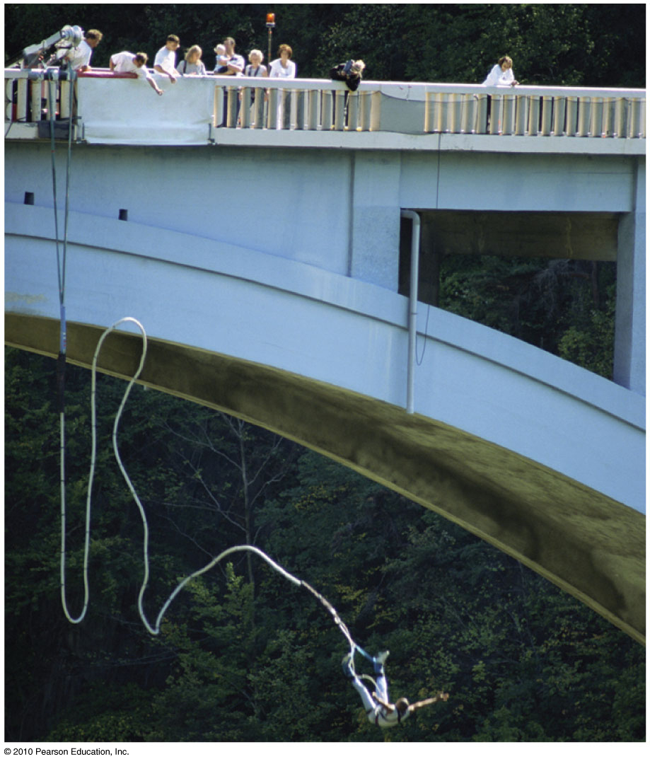
Impulse Changes Momentum
Case 2: decreasing momentum over a long time
extend the time during which momentum is reduced

Slide 16
A fast-moving car hitting a haystack or a cement wall produces vastly different results. 1. Do both experience the same change in momentum? 2. Do both experience the same impulse? 3. Do both experience the same force?
Impulse Changes Momentum
CHECK YOUR NEIGHBOR
A. Yes for all three
Yes for 1 and 2
No for all three
No for 1 and 2
Notes:
B. Yes for 1 and 2.

Slide 17
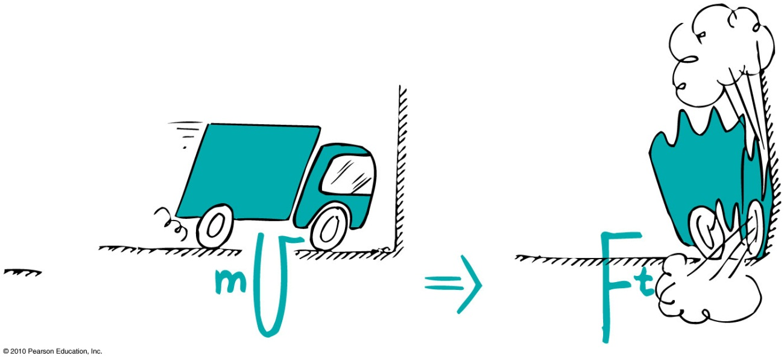
Impulse Changes Momentum
Examples:
When a car is out of control, it is better to hit a haystack than a concrete wall.
Physics reason: Same impulse either way, but extension of hitting time reduces the force.

Slide 18
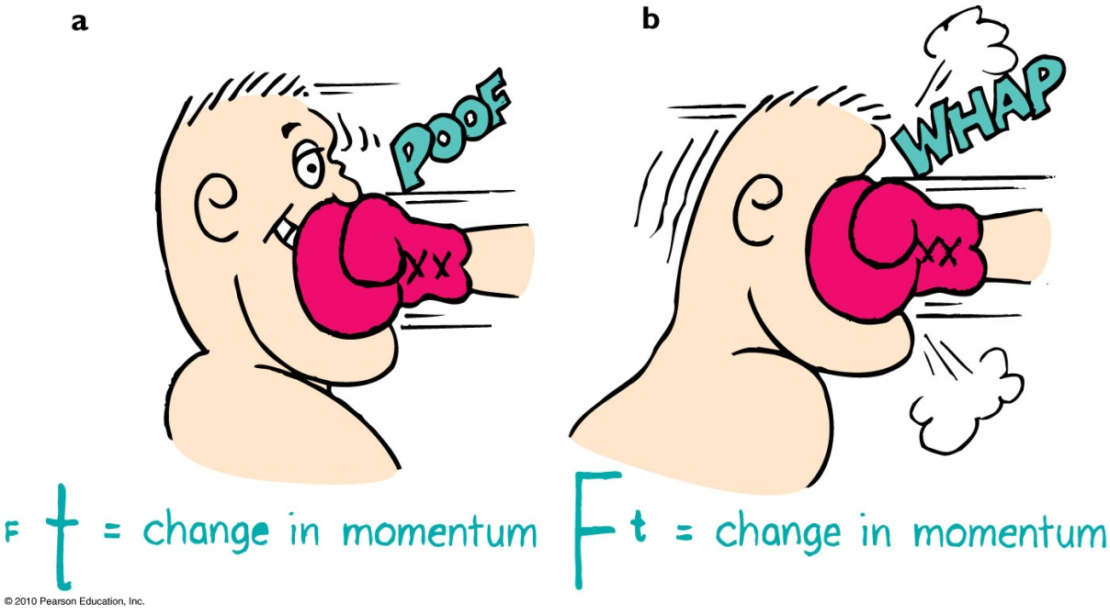
Impulse Changes Momentum
Example (continued):
In jumping, bend your knees when your feet make contact with the ground because the extension of time during your momentum decrease reduces the force on you.
In boxing, ride with the punch.

Slide 19
Airbags
When you crash, your momentum must be reduced by a fixed amount.
This means the impulse is fixed..
The force needed (which can cause injury) can be reduced if the time of the collision is increased.
Airbags “soften” the impact by increasing the time of the collision.
[image from http://en.wikipedia.org/wiki/File:Airbag2.jpg ]

Slide 20
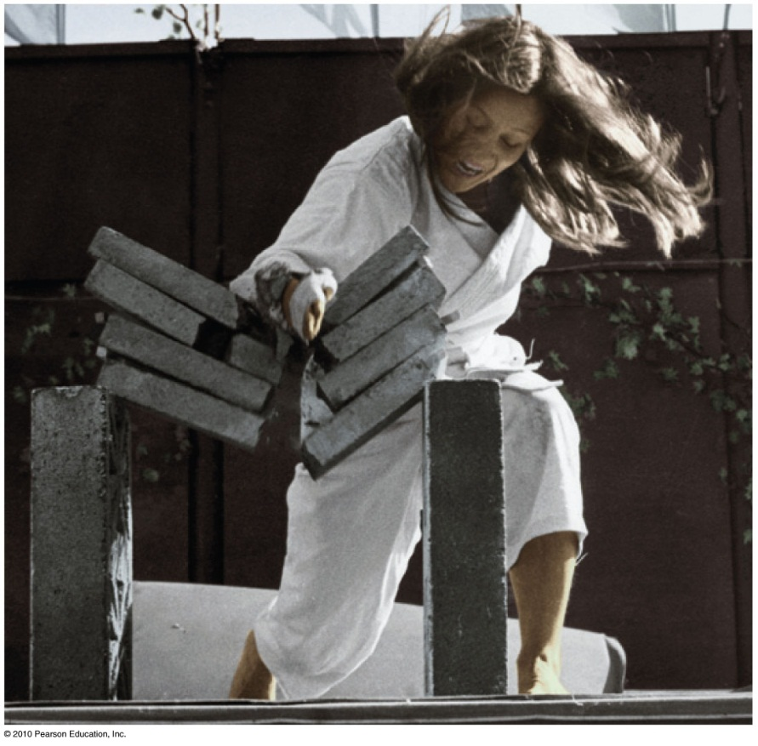
Impulse Changes Momentum
Case 3: decreasing momentum over a short time
short time interval produces large force.
Example: Karate expert splits a
stack of bricks by bringing her arm and hand swiftly against
the bricks with considerable
momentum. Time of contact is
brief and force of impact is huge.

Slide 21
Demonstration Prediction
Two balls of the same mass and the same speed collide with a block of wood.
One ball is made of putty, and stops when it hits the block of wood.
One ball is made of rubber, and bounces backward when it hits the block of wood. Which ball delivers the larger impulse to the block of wood?
They exert equal impulses.
The putty ball exerts a larger impulse.
The rubber ball exerts a larger impulse.
Notes:
STT9.2

Slide 22
Bouncing
Impulses are generally greater when objects bounce.
Example:
Catching a falling flower pot from a shelf with your hands. You provide the impulse to reduce its momentum to zero. If you throw the flower pot up again, you provide an additional impulse. This “double impulse” occurs when something bounces.

Slide 23
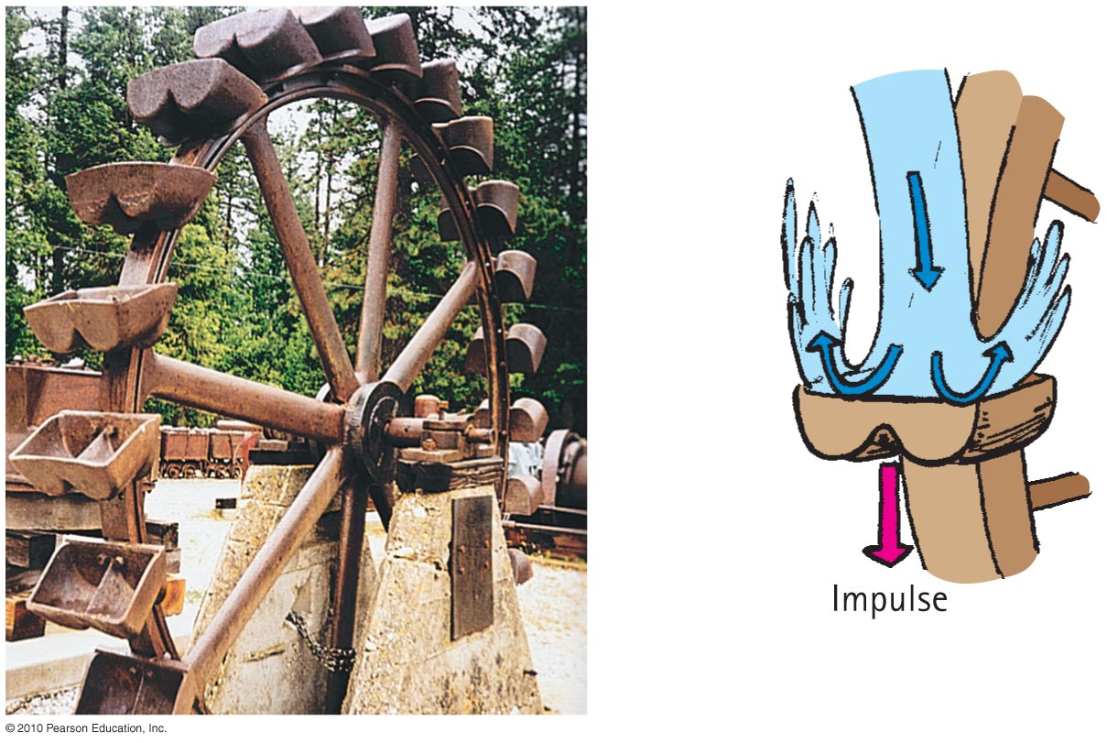
Bouncing
Pelton wheel designed to “bounce” water when it makes a U-turn on impact with the curved paddle

Slide 24
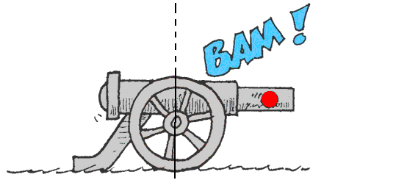
Law of conservation of momentum:
In the absence of an external force, the momentum of a system remains unchanged.
When a cannon is fired, the force on the cannonball inside the cannon barrel is equal and opposite to the force of the cannonball on the cannon.
The cannonball gains momentum, while the cannon gains an equal amount of momentum in the opposite direction—the cannon recoils.

Slide 25
Conservation of Momentum
Examples:
Internal molecular forces within a baseball come in pairs, cancel one another out, and have no effect on the momentum of the ball.
Molecular forces within a baseball have no effect on its momentum.
Pushing against a car’s dashboard has no effect on its momentum.

Slide 26
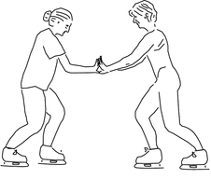
Two ice skaters, Paula and Ricardo, push off from each other. They were both initially at rest. Ricardo has a greater mass than Paula. Which skater has the greater magnitude of momentum after the push-off?
Ricardo
Paula
neither

Slide 27
Two ice skaters, Paula and Ricardo, push off from each other. They were both initially at rest. Ricardo has a greater mass than Paula. Which skater has the greater speed after the push-off?
Ricardo
Paula
neither

Slide 28
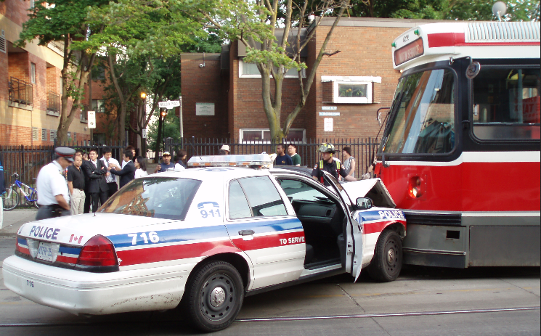
Collisions
For most collisions, the forces involved in the collision itself are much greater than any external forces, such as friction.
Therefore, the net momentum before collision equals net momentum after collision.
in equation form:
(net mv)_{before} = (net mv)_{after}
[image downloaded Jan.21 2013 from http://findcheaperinsurance.ca/blog/7-common-car-accident-causes-part-2/ ]

Slide 29
Example
Laura, whose mass is 35 kg, is stranded without a paddle in a 65 kg canoe in a still lake, 5 m from shore.
She has 10 kg of rocks on board the canoe.
If she throws all these rocks away from shore, and can throw rocks at 10 m/s, what is the maximum speed she can give herself and the canoe toward the shore?
[image downloaded Jan.16 2013 from http://campbellpost.wordpress.com/2012/01/26/canoe/ ]

Slide 30
Two particles collide, one of which was initially moving, and the other initially at rest. Is it possible for both particles to be at rest after the collision? [Assume no outside forces act on the particles.]
Yes
No

Slide 31
Two particles collide, one of which was initially moving, and the other initially at rest. Is it possible for one particle to be at rest after the collision? [Assume no outside forces act on the particles.]
Yes
No

Slide 32
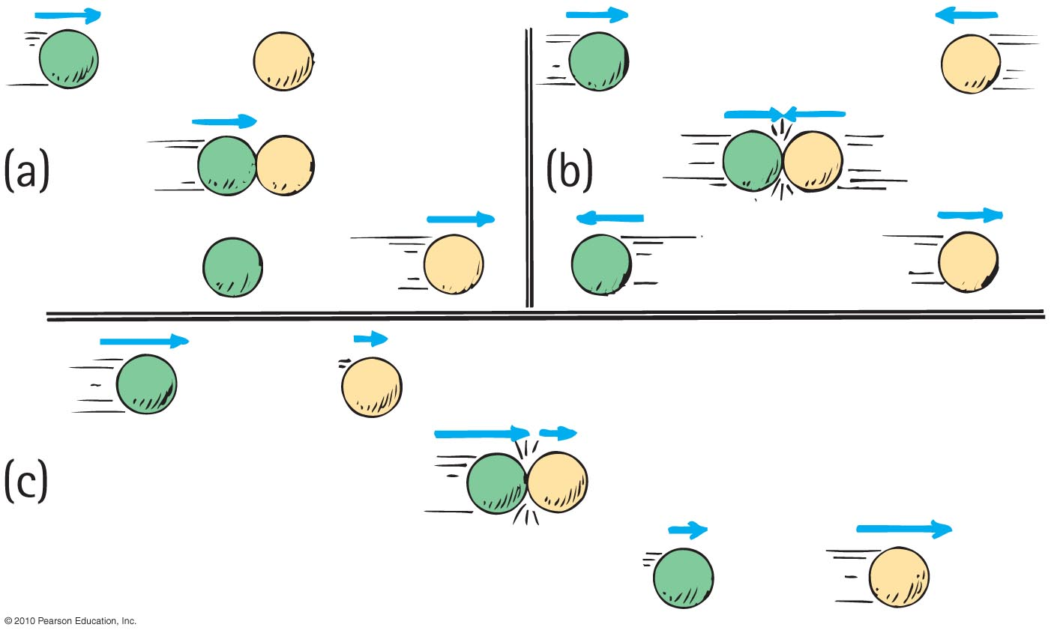
Elastic collision
occurs when colliding objects rebound without lasting deformation or any generation of heat.

Slide 33
Inelastic collision
occurs when colliding objects result in deformation and/or the generation of heat.
Single car moving at 10 m/s collides with another car of the same mass, m, at rest.
From the conservation of momentum,
(net mv)_{before} = (net mv)_{after}
(m × 10)_{before} = (2m × V)_{after}
V = 5 m/s

Slide 34
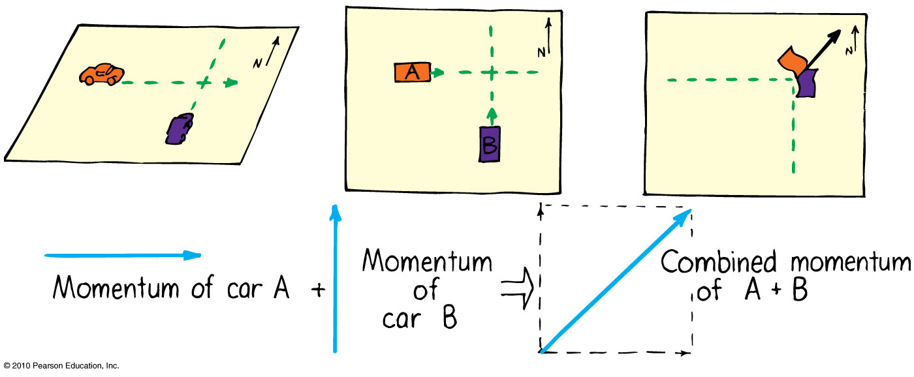
Sometimes the colliding objects are not moving in the same straight line.
In this case you create a parallelogram of the vectors describing each initial momentum to find the combined momentum.
Example: collision of two cars at a corner

Slide 35
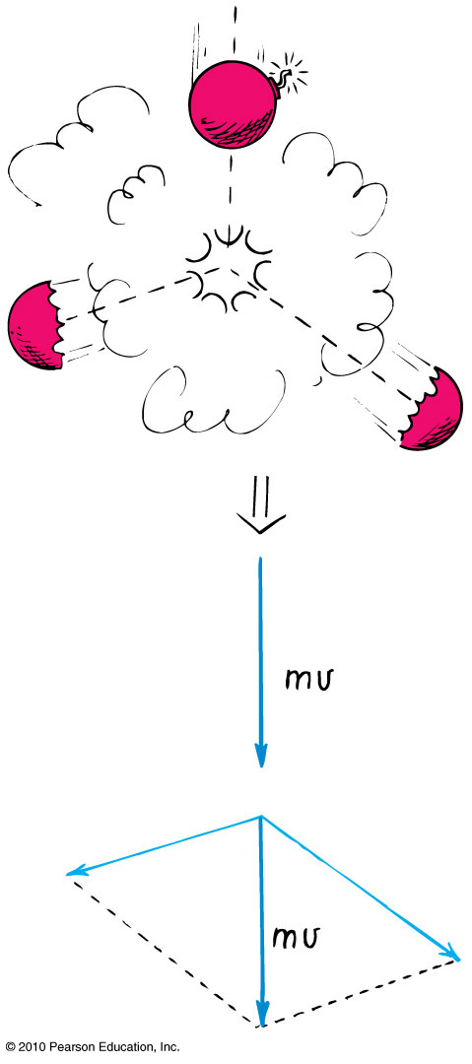
Explosions
Another example:
A firecracker exploding; the total momentum of the pieces after the explosion can be added vectorially to get the initial momentum of the firecracker before it exploded.
[animated gif downloaded Jan.21 2013 from http://bestanimations.com/Holidays/Fireworks/Fireworks.html ]

Slide 36
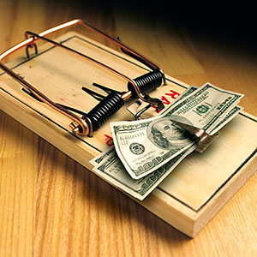
Before Class 6 on Wednesday
Please read Chapter 7, or at least watch the 10-minute pre-class video for class 6
Something to think about:
There are two seemingly identical mouse traps sitting on the floor. They have the same mass, size, colour, shape and smell.
One has been set by bending the spring back and hooking it.
The other is not set.
What is the physical difference between the two traps? Why is one so much scarier than the other?
[image retrieved Jan.20 2013 from http://money.msn.com/credit-cards/3-nasty-credit-card-marketing-traps ]

