Slide 1
Note on Posted Slides
These are the slides that I intended to show in class on Wed. Jan. 23, 2013.
They contain important ideas and questions from your reading.
Due to time constraints, I was probably not able to show all the slides during class.
They are all posted here for completeness.

Slide 2
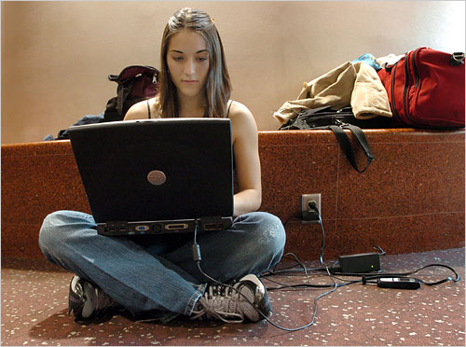
PHY205H1S Physics of Everyday Life Class 6: Energy
Energy
Power
Potential and Kinetic
Conservation of Energy
Efficiency
Recycled Energy
Energy for Life
Sources of Energy
[image from http://www.nytimes.com/imagepages/2006/11/28/business/28plug.ready.html]

Slide 3
Ch. 6 Review Question on Conservation of Momentum
An object is flying through the air with nothing touching it.
Neglect air resistance.
Is momentum of the object conserved?
Yes
No

Slide 4
Chapter 7. Pre-Class Reading Question
When the useful energy output of a machine is 100 J, and total energy input is 200 J, what is the efficiency?
25%
50%
75%
100%
200%

Slide 5
Chapter 7. Pre-Class Reading Question
Chapter 7 opens with a story about the physicist who first advocated the correct equation for kinetic energy. Who was this physicist?
Du Châtelet
Einstein
GaliJustin
Leibniz
Newton

Slide 6
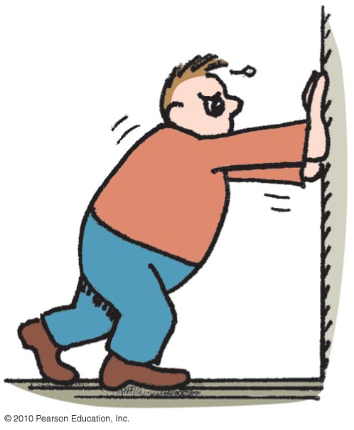
Work
involves force and distance.
is force × distance.
in equation form: W = Fd.
Two things occur whenever work is done:
application of force
movement of something by that force
Unit of work:
newton-meter (N·m)
or joule (J)

Slide 7
Work can be positive, zero or negative
When the force and the distance are in the same direction, you are helping the motion with the force, so the work done on the object is positive.
The force is adding energy to the object + environment.
Maybe this force is speeding the object up.
F
d

Slide 8
Work can be positive, zero or negative
When the force and the distance are at right angles, you are not helping the motion with the force, so the work is zero.
This force is not changing the energy of the object.
This force won’t speed the object up or slow it down.
F
d

Slide 9
Work can be positive, zero or negative
When the force and distance are in opposite directions, you are hindering the motion with the force, so the work done on the object is negative.
This force is reducing the energy of the object.
Maybe this force is slowing the object down.
F
d

Slide 10
Discussion Question
Justin is doing a bench press, and he slowly pushes the bar up a distance of 0.30 m while pushing upwards on the bar with a force of 200 N. The bar moves with a constant velocity during this time.
During the upward push, how much work does Justin do on the bar?
60 J
120 J
0 J
-60 J
-120 J

Slide 11
Discussion Question
Justin is doing a bench press, and he slowly lowers the bar down a distance of 0.30 m while pushing upwards on the bar with a force of 200 N. The bar moves with a constant velocity during this time.
During the downward lowering, how much work does Justin do on the bar?
60 J
120 J
0 J
-60 J
-120 J

Slide 12
Discussion Question
Justin is doing a bench press, and he slowly lowers the bar down a distance of 0.30 m while pushing upwards on the bar with a force of 200 N. He then pushes it up slowly the same distance of 0.30 m back to its starting position, also pushing upwards on the bar with a force of 200 N.
During the complete downward and upward motion, how much total work does Justin do on the bar?
60 J
120 J
0 J
-60 J
-120 J

Slide 13
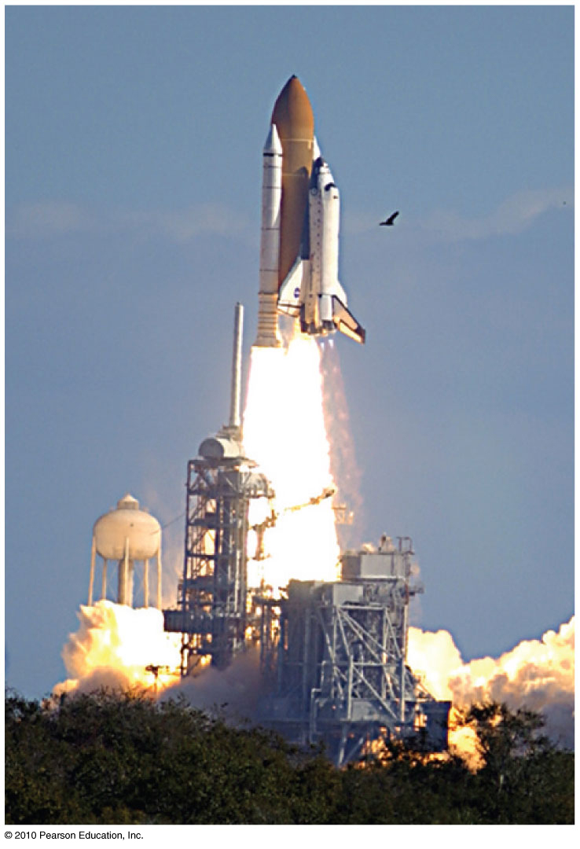
Power
Measure of how fast work is done
In equation form:
Unit of power
joule per second, called the watt after James Watt, developer of the steam engine
1 joule/second = 1 watt
1 kilowatt = 1000 watts

Slide 14
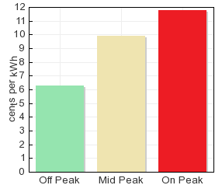
Power
The unit of power is the watt, which is defined as 1 watt = 1 W = 1 J/s
Energy is measured by Ontario Hydro in kWh “kiloWatt hours”.
1 kWh is the amount of energy used by a power of 1kW over 1 hour
1 kWh = 1000 J/s * 60 min/hour * 60 s/min
1 kWh = 3.6 million Joules
[Chart downloaded Jan.23 2013 from http://www.ontario-hydro.com/index.php?page=current_rates ]

Slide 15
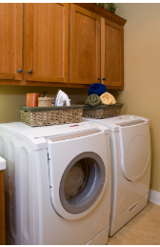
Example
Your clothes dryer uses 5000 Watts and you need to run it for 1 hour to dry your clothes.
If you run it during “on peak” time, such as between 7 and 11am on a weekday, the cost is 12 cents/kWh.
If you run it during “off peak” on the weekend the price for Ontario Hydro electricity is 6 cents/kWh.
How much money do you save per load by doing your laundry on the weekend?
[image downloaded Jan.23 2013 from http://www.sierraclubgreenhome.com/go-green/appliances/washers-and-dryers/ ]

Slide 16
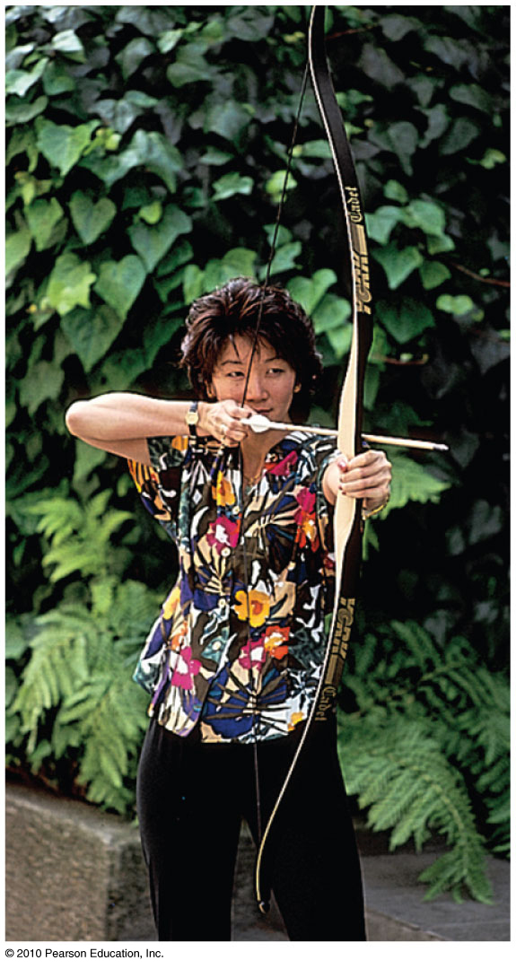
Elastic Potential Energy
Stored energy held in readiness with a potential for doing work
Examples:
A stretched bow has stored energy that can do work on an arrow.
A stretched rubber band of a slingshot has stored energy and is capable of doing work.
Demonstration: A mousetrap that is “set” has elastic potential energy that is capable of killing the mouse!

Slide 17
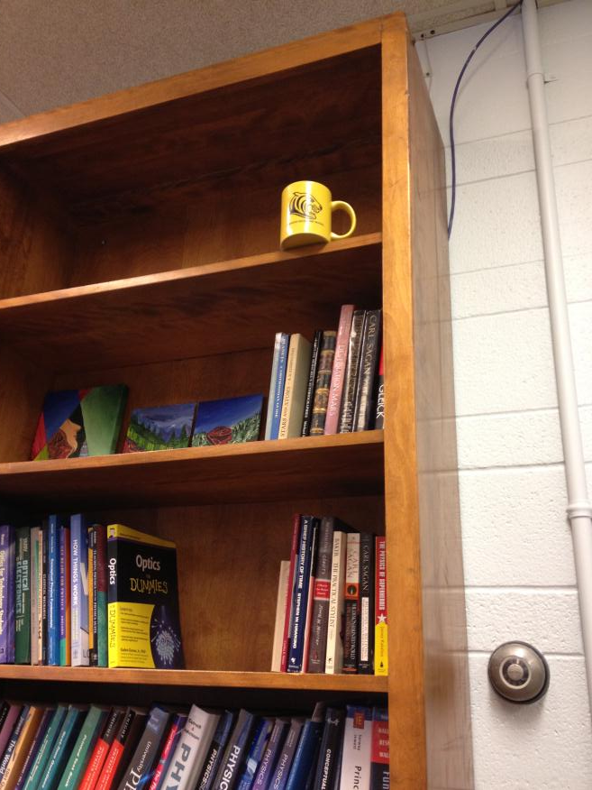
Gravitational Potential Energy
Potential energy due to elevated position
Example:
coffee mug on the top shelf
In equation form:
Potential energy
= mass × acceleration due to gravity × height
$$U_{g}=mgh$$

Slide 18
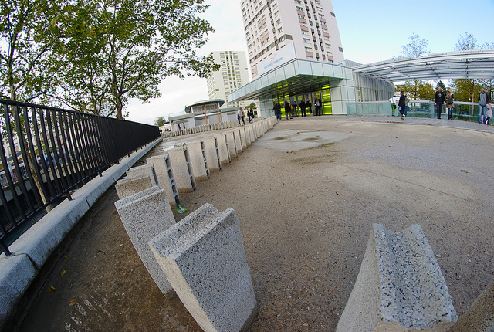
Gravitational Potential Energy
Demonstration
A rectangular solid such as a domino has more gravitational potential energy when it is tipped up on its edge, because its centre of mass is higher
The energy is added to the domino by the work you do in tipping it up on its edge.
[image retrieved Jan.23 2013 from http://www.decodedscience.com/a-quick-explanation-of-mathematical-induction/1420 ]
$$U_{g}=mgh$$

Slide 19
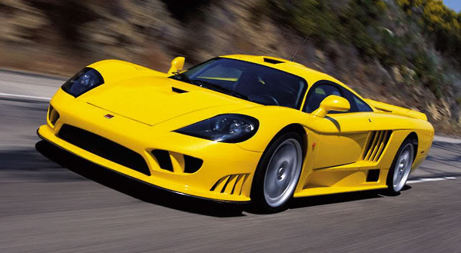
Kinetic Energy
Energy of motion
Depends on the mass of the object and square of its speed:
If object speed is doubled ⇒ kinetic energy is quadrupled.
$$K=\frac{1}{2}mv^{2}$$

Slide 20
What is “energy”?
Energy is a property of an object, like age or height or mass.
Every object that is moving has some Kinetic Energy.
Objects in a gravitational or electric field may also have Potential Energy.
Energy has units, and can be measured.
Energy is relative; kinetic energy of car is different for an observer in the car than it is for an observer standing on the side of the road.

Slide 21
Work and Kinetic Energy
If an object starts from rest and there is a net force doing work on it, the work done will be equal to the final kinetic energy of the object.
In equation form:
$$Fd=\frac{1}{2}mv^{2}$$

Slide 22
Work-Energy Theorem
Work-energy theorem
Gain or reduction of energy is the result of work.
In equation form: work = change in kinetic energy (W = ΔK).
Doubling speed of an object requires 4 times the work.

Slide 23
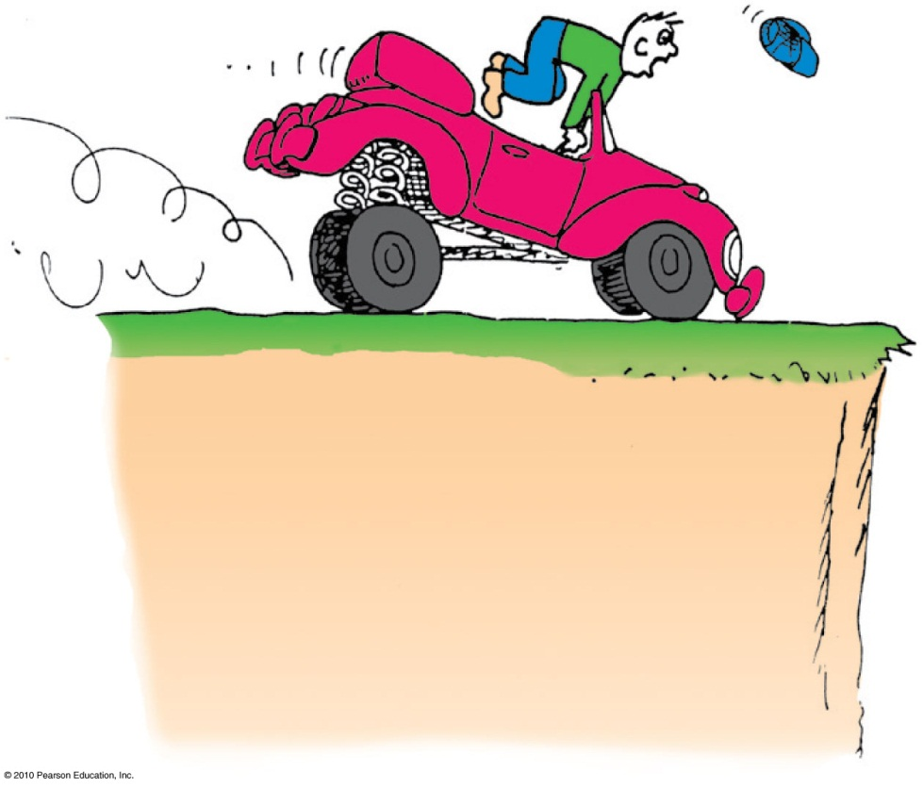
Work-Energy Theorem
Applies to decreasing speed:
reducing the speed of an object or bringing it to a halt
Example: Applying the brakes to slow a moving car, work is done on it (the friction force supplied by the brakes × distance).

Slide 24
The work done in bringing a moving car to a stop is the force of tire friction × stopping distance. If the initial speed of the car is doubled, the stopping distance is
Work-Energy Theorem
CHECK YOUR NEIGHBOR
A. actually less.
about the same.
twice.
None of the above.
Notes:
D. none of the above.

Slide 25
Chapter 7 big idea: “Conservation of Energy”
A system of particles has a total energy, E.
If the system is isolated, meaning that there is no work or heat being added or removed from the system, then:
E_{f} = E_{i}
This means the energy is “conserved”; it doesn’t change over time.
This is also the first law of thermodynamics; “You can’t get something for nothing.”

Slide 26
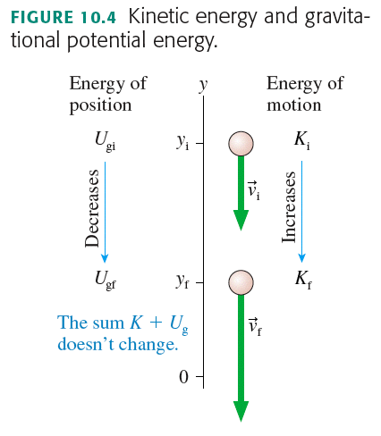

Slide 27
EXAMPLE 1: The speed of a sled
Claire runs forward with her sled at 2 m/s.
She hops at the top of a very slippery slope.
The slope is 7° below the horizontal, and extends down a total vertical distance of 5 m.
What is her speed at the bottom? [neglect friction]

Slide 28
EXAMPLE 2: The speed of a sled
Claire runs forward with her sled at 2 m/s.
She hops at the top of a very slippery valley.
The valley goes down to 5 m below her starting position, then back up to the same initial height.
What is her speed when she reaches the other side of the valley? [neglect friction]

Slide 29
Discussion Question on Conservation of Energy
An object is flying through the air with nothing touching it.
Neglect air resistance.
Is energy of the object conserved?
Yes
No

Slide 30
Discussion Question
A 1 kg object is dropped from rest a height of 3 m above the ground.
Just before it hits the ground, what is its kinetic energy? [Neglect air resistance.]
3 J
15 J
30 J
90 J
150 J

Slide 31
Suppose the potential energy of a drawn bow is 50 joules and the kinetic energy of the shot arrow is 40 joules. Then
A situation to ponder…
CHECK YOUR NEIGHBOR
A. energy is not conserved.
10 joules go to warming the bow.
10 joules go to warming the target.
10 joules are mysteriously missing.
Notes:
B. 10 joules go to warming the bow.

Slide 32
Machines
Devices for multiplying forces or changing the direction of forces
Cannot create energy but can transform energy from one form to another, or transfer energy from one location to another
Cannot multiply work or energy

Slide 33
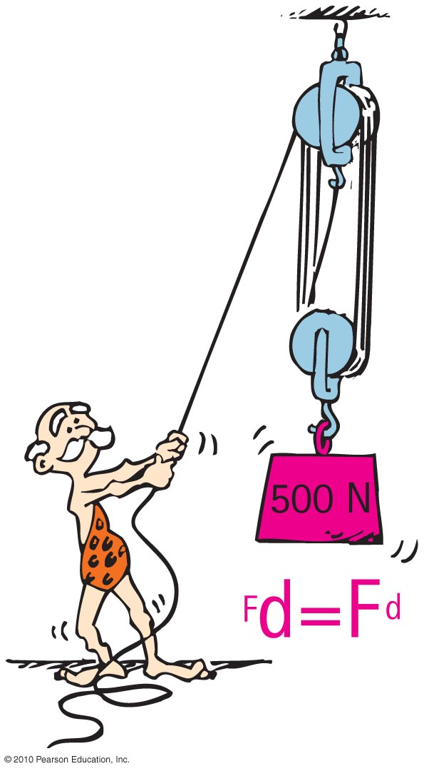
Machines
Principles of a machine:
Conservation of energy concept:
Work input = work output
Input force × input distance =
Output force × output distance
(Force × distance)_{input} = (force × distance)_{output}

Slide 34
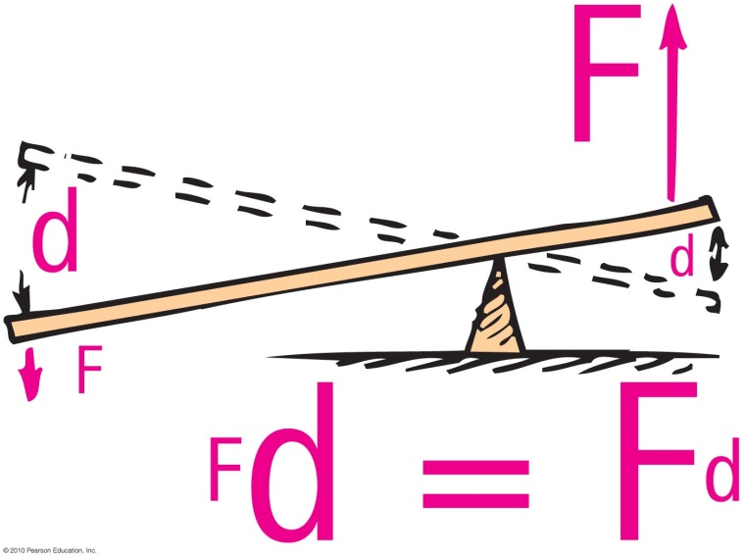
Simplest machine:
Lever
rotates on a point of support called the fulcrum
allows small force over a large distance and large force over a short distance

Slide 35
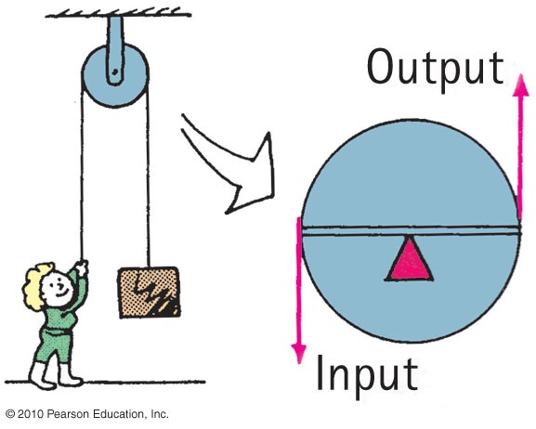
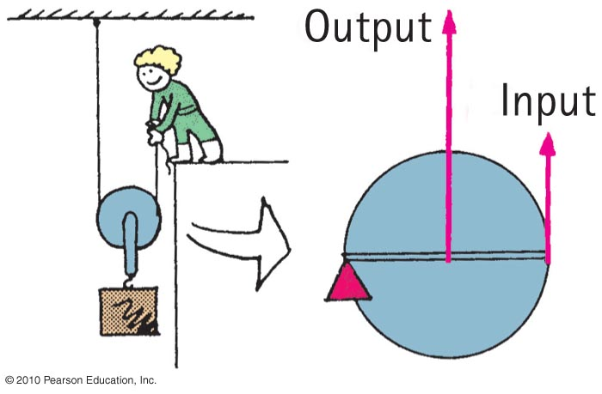
Pulleys
This arrangement operates like a lever with equal arms— changes the direction of the input force:
This arrangement can allow a load to be lifted with half the input force:

Slide 36
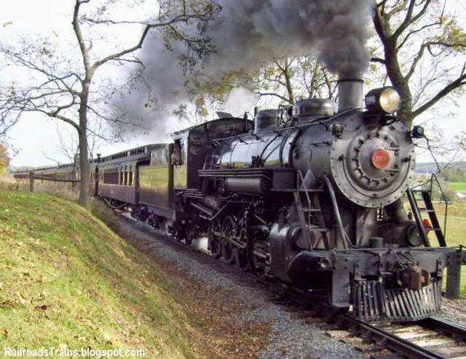
Efficiency
Percentage of work put into a machine that is converted into useful work output
In equation form:
useful energy output
Efficiency =
total energy input

Slide 37
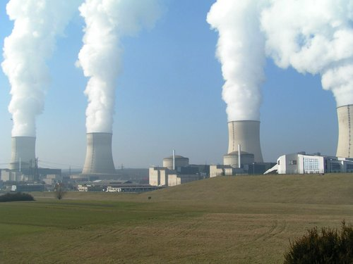
Recycled Energy
Re-employment of energy that otherwise would be wasted.
Edison used heat from his power plant in New York City to heat buildings.
Typical power plants waste about 30% of their energy to heat because they are built away from buildings and other places that use heat.

Slide 38
Sources of Energy
Sun
Examples:
Sunlight evaporates water; water falls as rain; rain flows into rivers and into generator turbines; then back to the sea to repeat the cycle.
Wind power turns generator turbines.

Slide 39
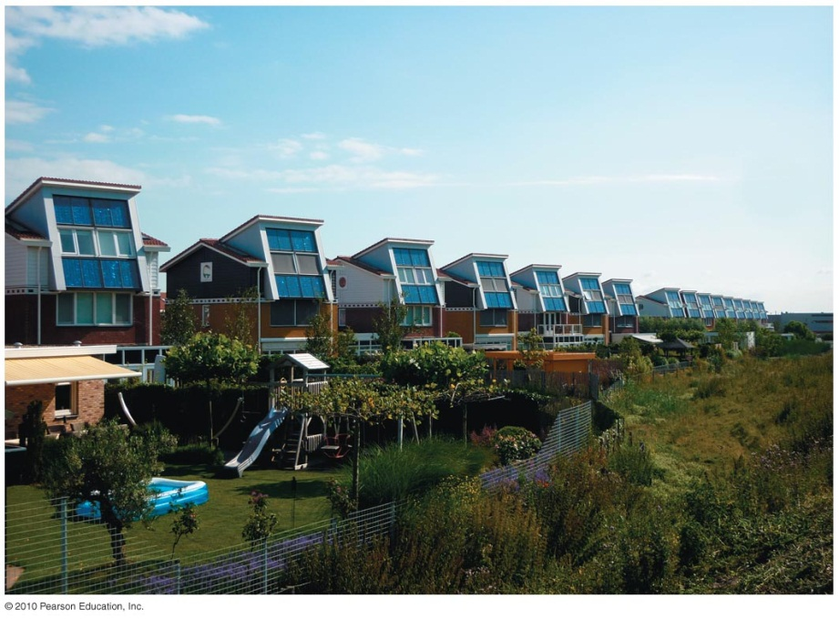
Sources of Energy
Example:
Photovoltaic cells on rooftops catch the solar energy and convert it to electricity.
More energy from the Sun hits Earth in 1 hour than all of the energy consumed by humans in an entire year!

Slide 40
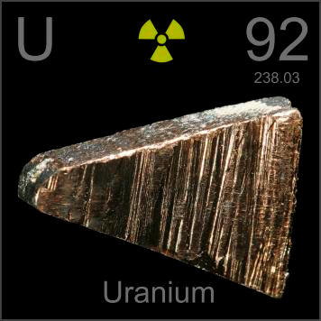
Sources of Energy
Concentrated energy
Nuclear power
stored in uranium and plutonium
doesn’t pollute our atmosphere
creates radioactive waste which, if stored near humans, can be toxic.

Slide 41
Before Class 7 on Monday
Please read Chapter 8, or at least watch the 10-minute pre-class video for class 7
Keep in mind:
Test in 1 week: Wednesday during class time in EX100, which is 255 McCaul St.
Test will begin promptly at 10 minutes past the hour and will be 50 minutes long – if you can be there a bit early that would be great.
Please bring a calculator, and, if you wish, a 3x5 notecard upon which you may write anything you wish on both sides
Test will cover Hewitt chapters 2-8, and will include some multiple choice and some short-answer

