Slide 1
Note on Posted Slides
These are the slides that I intended to show in class on Mon. Mar. 4, 2013.
They contain important ideas and questions from your reading.
Due to time constraints, I was probably not able to show all the slides during class.
They are all posted here for completeness.

Slide 2
PHY205H1S Physics of Everyday Life Class 14: Sound
Sound in Air
Media That Transmit Sound
Reflection of Sound
Refraction of Sound
Energy in Sound Waves
Resonance
Interference
Beats

Slide 3
Nature of Sound
Sound is a form of energy that exists whether or not it is heard.
[ image from http://thinkjustdoit.blogspot.ca/2012/04/phi-3000-if-tree-falls-in-forest.html ]

Slide 4
Origin of Sound
Most sounds are waves produced by the vibrations of matter.
Examples:
In a piano, a violin, and a guitar, the sound is produced by a vibrating string;
in a saxophone, by a vibrating reed;
in a flute, by a fluttering column of air at the mouthpiece;
in your voice due to the vibration of your vocal chords.
[image from http://home.cc.umanitoba.ca/~krussll/phonetics/acoustic/harmonics.html ]

Slide 5
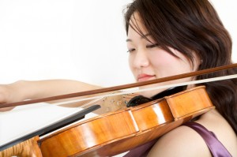
Origin of Sound
The original vibration stimulates the vibration of something larger or more massive, such as
the sounding board of a stringed instrument,
the air column within a reed or wind instrument, or
the air in the throat and mouth of a singer.
This vibrating material then sends a disturbance through the surrounding medium, usually air, in the form of longitudinal sound waves.
[image from http://umanitoba.ca/outreach/evidencenetwork/archives/9635 ]

Slide 6
Frequency and Pitch
The frequency of a sound wave is the same as the frequency of the vibrating source.
The subjective impression about the frequency of sound is called pitch.
The ear of a young person can normally hear pitches corresponding to the range of frequencies between about 20 and 20,000 Hertz.
As we grow older, the limits of this human hearing range shrink, especially at the high-frequency end.
Lowest A: 27.5 Hz
Highest C: 4186 Hz

Slide 7
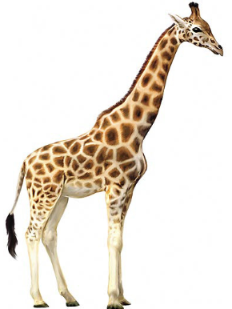
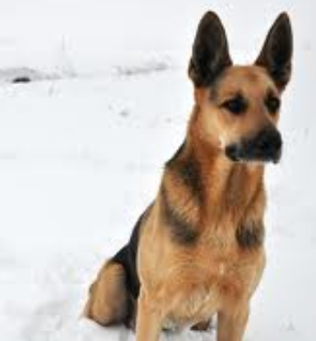
Infrasound and Ultrasound
Sound waves with frequencies below 20 hertz are infrasonic (frequency too low for human hearing).
Sound waves with frequencies above 20,000 hertz are called ultrasonic (frequency too high for human hearing).
We cannot hear infrasonic and ultrasonic sound.

Slide 8
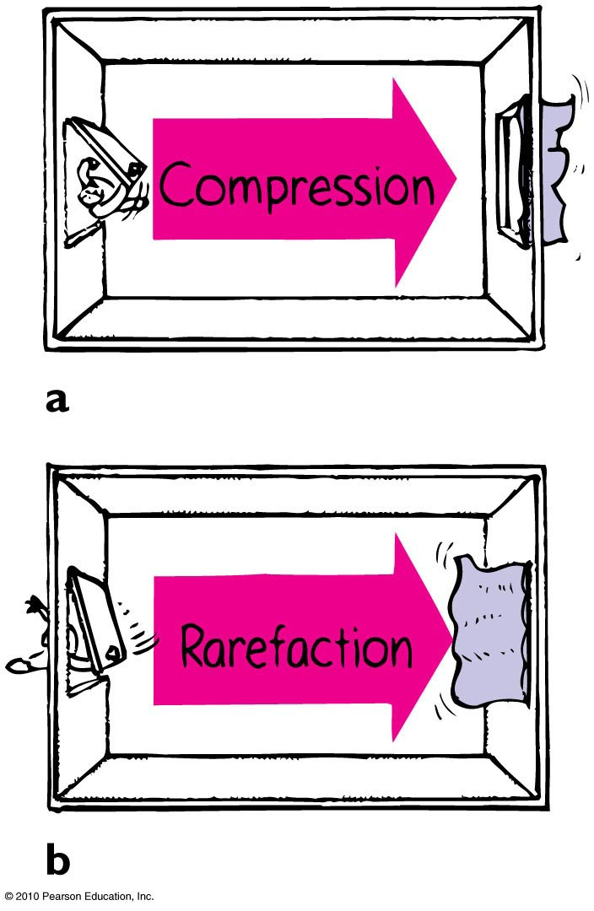
Compressions and Rarefactions
Sound waves are vibrations made of compressions and rarefactions.
In a compression region, the density and pressure are slightly greater than the average density and pressure
In a rarefaction region, the density and pressure are slightly lower than the average density and pressure

Slide 9
Wavelength of sound
Distance between successive compressions or rarefactions

Slide 10
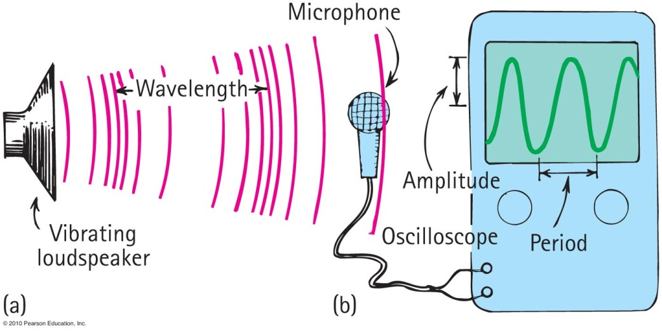
How sound is heard from a radio loudspeaker
Radio loudspeaker is a paper cone that vibrates.
Air molecules next to the loudspeaker set into vibration.
Produces compressions and rarefactions traveling in air.
Sound waves reach your ears, setting your eardrums into vibration. Or it reaches a microphone and sets up vibrations there, which are converted to an electric signal.

Slide 11
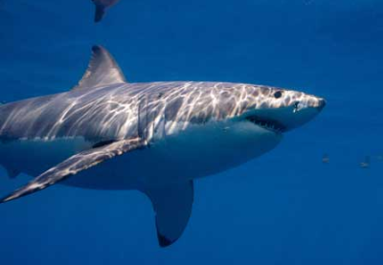
Media That Transmit Sound
Any elastic substance — solid, liquid, gas, or plasma — can transmit sound.
In liquids and solids, the atoms are relatively close together, respond quickly to one another’s motions, and transmit energy with little loss.
Sound travels about 4 times faster in water than in air and about 15 times faster in steel than in air.
[ image from http://www.flickr.com/photos/davegkelly/7457839080/ ]

Slide 12
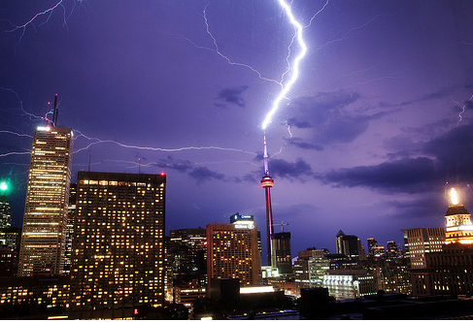
Speed of Sound in Air
Depends temperature, pressure and humidity
Speed in 0°C dry air at sea level is about 330 m/s.
In warm air faster than cold air.
Each degree rise in temperature above 0°C, speed of sound in air increases by 0.6 m/s
[image from http://www.forodecostarica.com/solaz/42155-el-jueguito-de-la-foto-13.html ]

Slide 13
You hear thunder 3 seconds after you see a lightning flash. How far away is the lightning?
Speed of Sound in Air
CHECK YOUR NEIGHBOR
A. About 340 m
About 660 m
About 1 km
More than 2 km
There’s no way to tell.
[image from http://www.forodecostarica.com/solaz/42155-el-jueguito-de-la-foto-13.html ]
Notes:
B. 660 m.

Slide 14
Speed of Sound in Air
Note that light travels almost instantaneously (300,000 km/s) and sound travels about 1/3 km/s.
So if you count the number of seconds between seeing a flash and hearing the thunder, you can divide by 3 and get the distance to the storm in kilometres.
[image from http://www.forodecostarica.com/solaz/42155-el-jueguito-de-la-foto-13.html ]

Slide 15
Speed of Sound vs Speed of Light
A situation to ponder…
Consider a person attending a concert that is being broadcast over the radio.
The person sits about 45 m from the stage and listens to the radio broadcast with a transistor radio over one ear and a nonbroadcast sound signal with the other ear.
Further suppose that the radio signal must travel all the way around the world (40,000 km!) before reaching the ear.
Notes:
Put the correct answer here including the letter designation.

Slide 16
Which signal will be heard first?
A situation to ponder…
CHECK YOUR NEIGHBOR
A. Radio signal
Nonbroadcast sound signal
Both at the same time.
None of the above.
Notes:
C. Both at the same time.

Slide 17
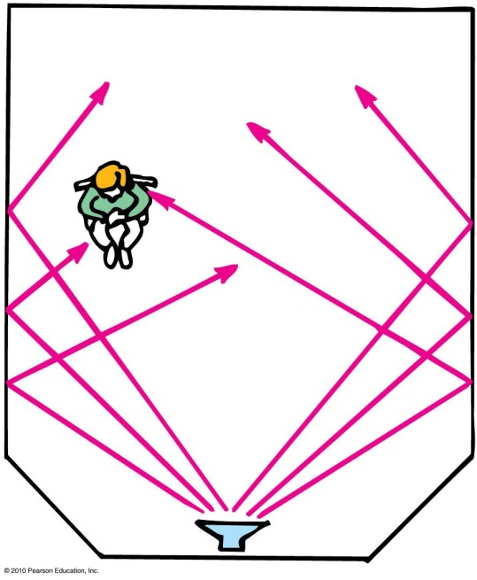
Reflection of Sound
Process in which sound encountering a surface is returned
Often called an echo
Multiple reflections—called reverberations

Slide 18
Reverberations are best heard when you sing in a room with
Reflection of Sound
CHECK YOUR NEIGHBOR
A. carpeted walls.
hard-surfaced walls.
open windows.
None of the above.
Notes:
B. hard-surfaced walls.

Slide 19
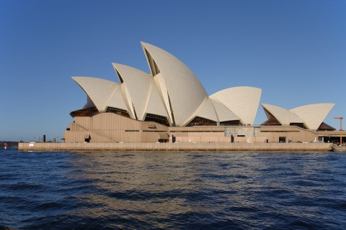
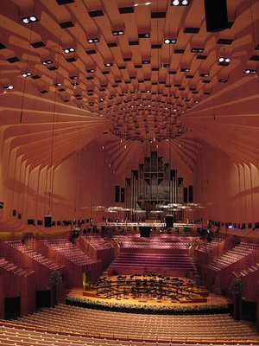
Reflection of Sound
Acoustics is the study of sound and architecture
A concert hall aims for a balance between reverberation and absorption.
Some have reflectors to direct sound
[images of the Sydney Opera House from http://shedexpedition.com/sydney-opera-house/ ]

Slide 20
Test on Wednesday during class time
Location: EX100, which is 255 McCaul St.
Test will begin promptly at 10 minutes after the hour and will be 50 minutes long – if you can be there a bit early that would be great.
Please bring a calculator, and, if you wish, a 3x5 notecard upon which you may write anything you wish on both sides
Test will cover Hewitt chapters 12-16, 19 and 20, and will include:
3 short-answer problems for which you must show your reasoning (4 points each)
12 multiple choice questions (2 points each) – you fill in a bubble sheet
Questions will be similar in style and level to the Exercises and Problems at the end of the chapters in Hewitt

Slide 21
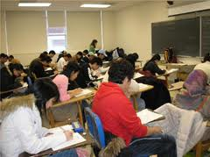
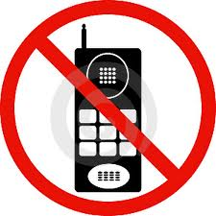
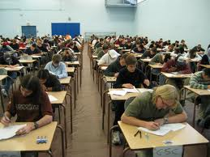
Tips for the 50 minute Test
No phones / ipods etc allowed. You will need a regular calculator, and a watch could be handy as well!
Time Management:
Skim over the entire test from front to back before you begin. Look for problems that you have confidence to solve first.
If you start a problem but can’t finish it, leave it, make a mark on the edge of the paper beside it, and come back to it after you have solved all the easy problems.
Bring your T-card or other photo ID, as we will be collecting signatures

Slide 22
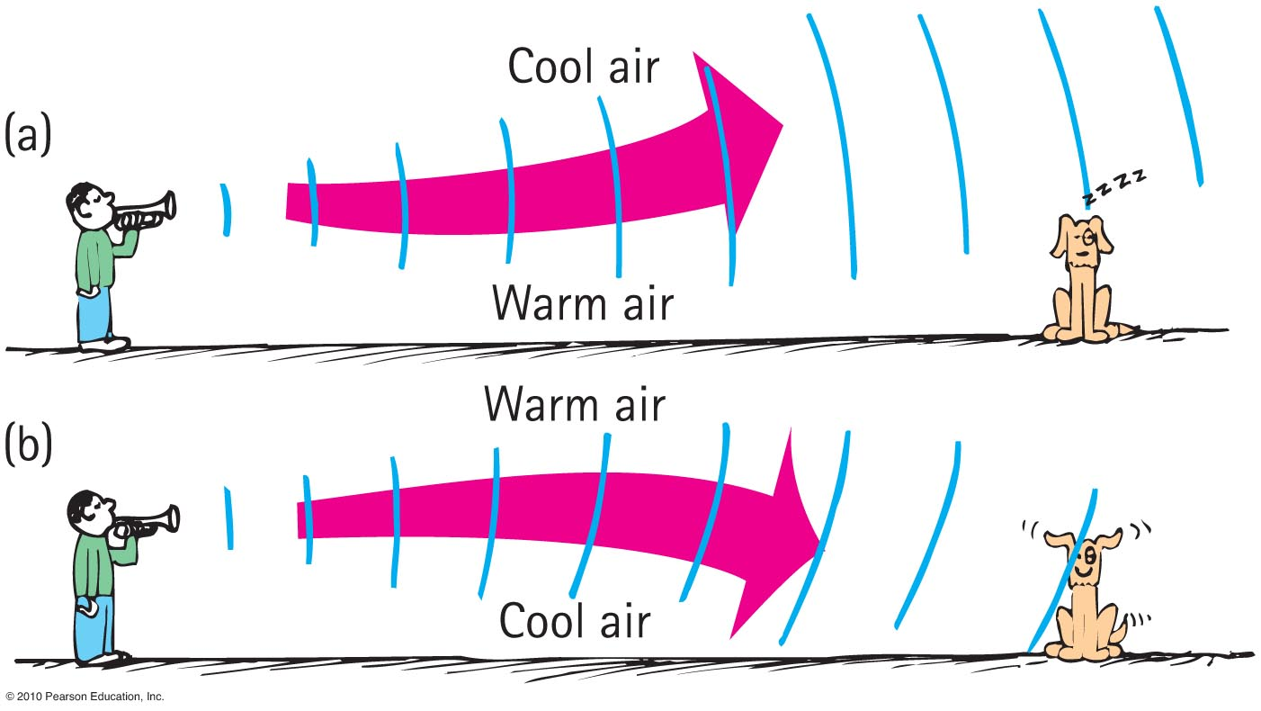
Refraction of Sound
Bending of waves—caused by changes in speed affected by temperature variations.

Slide 23
When air near the ground on a warm day is warmed more than the air above, sound tends to bend
Refraction of Sound
CHECK YOUR NEIGHBOR
A. upward.
downward.
at right angles to the ground.
None of the above.
Notes:
A. upward.

Slide 24
In the evening, when air directly above a pond is cooler than air above, sound across a pond tends to bend
Refraction of Sound
CHECK YOUR NEIGHBOR
A. upward.
downward.
at right angles to the ground.
None of the above.
Notes:
B. downward.

Slide 25
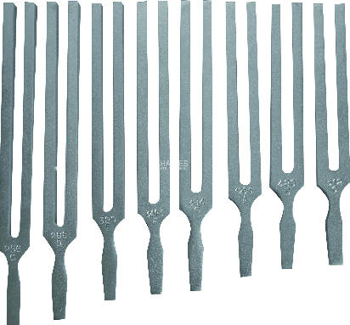
Natural Vibrations
Every object has its own unique frequency that it naturally tends to vibrate at.
Dependent on
Elasticity
Mass of object
Shape of object
Size of object
[image from http://www.haines.com.au/index.php/physics/heat-light-sound/tuning-fork-e-320-hz.html ]

Slide 26
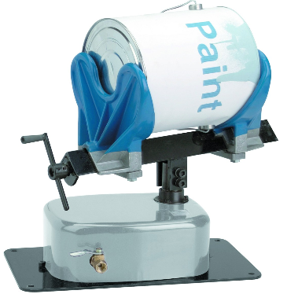
Forced Vibrations
Setting up of vibrations in an object by a vibrating force
Examples:
factory floor vibration caused by running of heavy machinery
Table vibration from paint shaker
[image from http://www.harborfreight.com/pneumatic-paint-shaker-94605.html ]

Slide 27
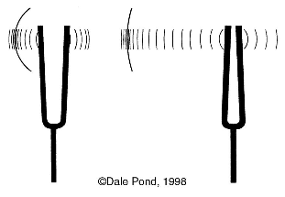
Resonance
A phenomenon in which the frequency of forced vibrations on an object matches the object’s natural frequency
Examples:
Swinging in rhythm with the natural frequency of a swing
Tuning a radio station to the “carrier frequency” of the radio station
Troops marching in rhythm with the natural frequency of a bridge (a no-no!)
[image from http://pondscienceinstitute.on-rev.com/svpwiki/tiki-index.php?page=sympathetic+vibration ]

Slide 28
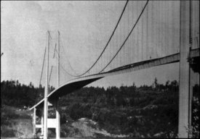
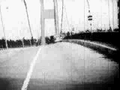
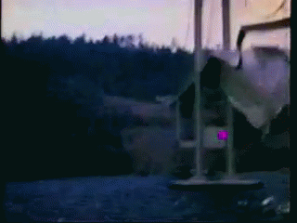
Tacoma Narrows Bridge Collapse 1940
Dramatic example of wind-generated resonance!
[left image from http://www.stkate.edu/physics/phys111/index.html ]

Slide 29
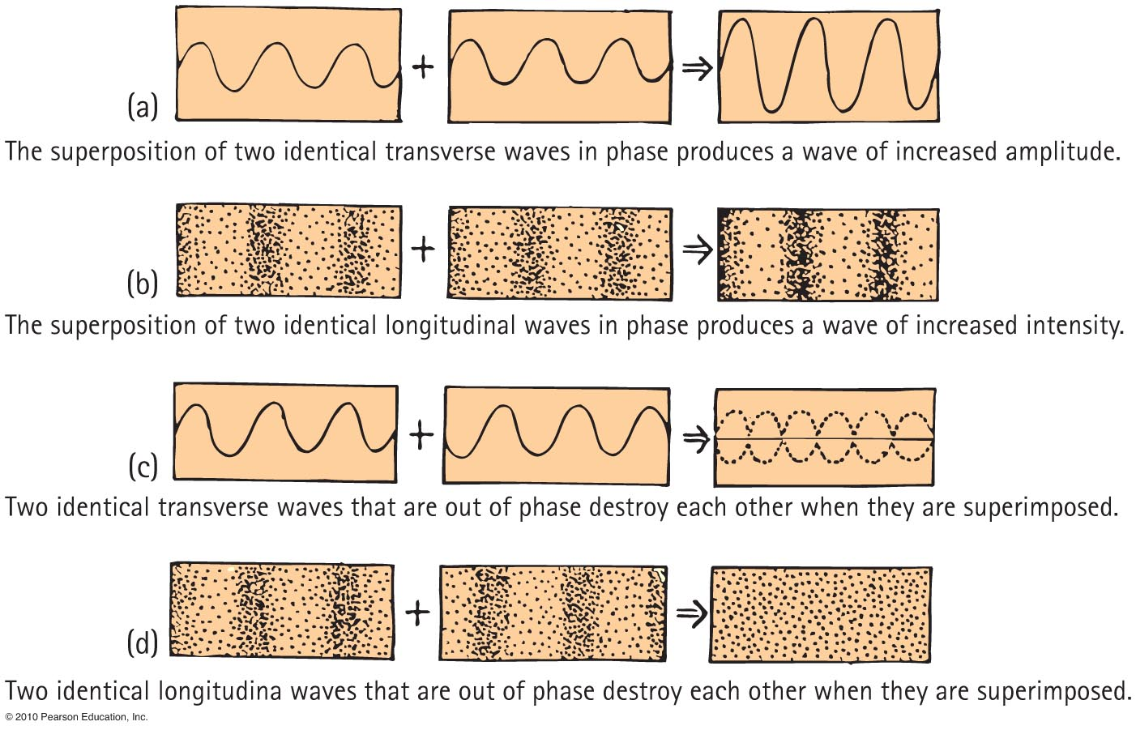
Interference

Slide 31
Two speakers, A and B, are “in phase” and emit a pure note with a wavelength 2 m. The speakers are side-by-side, 3 m apart. Point C is 4 m directly in front of speaker A.
Example
Will a listener at point C hear constructive or destructive interference?

Slide 32
Two speakers, A and B, are “in phase” and emit a pure note with a wavelength 2 m. The speakers are side-by-side, 3 m apart. Point C is 4 m directly in front of speaker A.
In Class Discussion Question
How many wavelengths are between Speaker A and Point C?
0.5
1.0
1.5
2.0
2.5

Slide 33
Two speakers, A and B, are “in phase” and emit a pure note with a wavelength 2 m. The speakers are side-by-side, 3 m apart. Point C is 4 m directly in front of speaker A.
In Class Discussion Question
How many wavelengths are between Speaker B and Point C?
0.5
1.0
1.5
2.0
2.5

Slide 34
Two speakers, A and B, are “in phase” and emit a pure note with a wavelength 2 m. The speakers are side-by-side, 3 m apart. Point C is 4 m directly in front of speaker A.
In Class Discussion Question
At point C, what is the path difference between the sounds received from speakers A and B, as measured in wavelengths?
0.5 B. 1.0 C. 1.5
D. 2.0 E. 2.5

Slide 35
Two speakers, A and B, are “in phase” and emit a pure note with a wavelength 2 m. The speakers are side-by-side, 3 m apart. Point C is 4 m directly in front of speaker A.
In Class Discussion Question
At point C, there will be
Constructive interference (Amplitude at C =2A)
Destructive interference (Amplitude at C =zero)

Slide 36
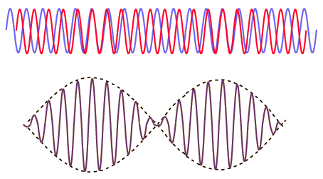
Beats
Periodic variations in the loudness of sound due to interference
Occur when two waves of similar, but not equal frequencies are superposed.
Provide a comparison of frequencies
Frequency of beats is equal to the difference between the frequencies of the two waves.
[image from http://hyperphysics.phy-astr.gsu.edu/hbase/sound/beat.html ]

Slide 37
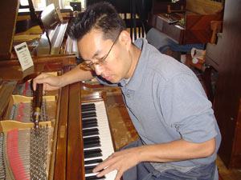
Beats
Applications
Piano tuning by listening to the disappearance of beats from a known frequency and a piano key
Tuning instruments in an orchestra by listening for beats between instruments and piano tone

Slide 38
Suppose you sound a 1056-hertz tuning fork at the same time you strike a note on the piano and hear 2 beats/second. What is the frequency of the piano string?
Refraction of Sound
CHECK YOUR NEIGHBOR
1054 Hz
1056 Hz
1058 Hz
Either A or C
Either A, B or C
Notes:
B. downward.

Slide 39
Suppose you sound a 1056-hertz tuning fork at the same time you strike a note on the piano and hear 2 beats/second. You tighten the piano string very slightly and now hear 3 beats/second. What is the frequency of the piano string?
Refraction of Sound
CHECK YOUR NEIGHBOR
1053 Hz
1056 Hz
1059 Hz
Either A or C
Either A, B or C
Notes:
B. downward.

Slide 40
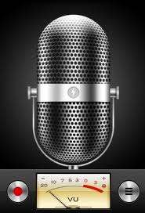
Before class on Monday…
Please read Chapter 21, or at least watch the 10-minute pre-class video for class 15.
Something to think about:
When you record the sound of music or a voice, what data is actually being stored in your computer? What is it about the sound that is being recorded?

