Slide 1
Note on Posted Slides
These are the slides that I intended to show in class on Mon. Mar. 18, 2013.
They contain important ideas and questions from your reading.
Due to time constraints, I was probably not able to show all the slides during class.
They are all posted here for completeness.

Slide 2
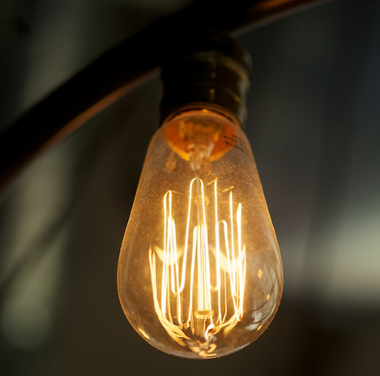
PHY205H1S Physics of Everyday Life Class 17: Electric Current
Flow of Charge
Electric Current
Voltage Sources
Electrical Resistance
Ohm’s Law
DC and AC
Speed and Source of Electrons in a Circuit
Electric Power
Light bulbs
Electric Circuits
[image from http://torontoist.com/2013/02/toronto-invents-the-incandescent-light-bulb/ ]

Slide 3
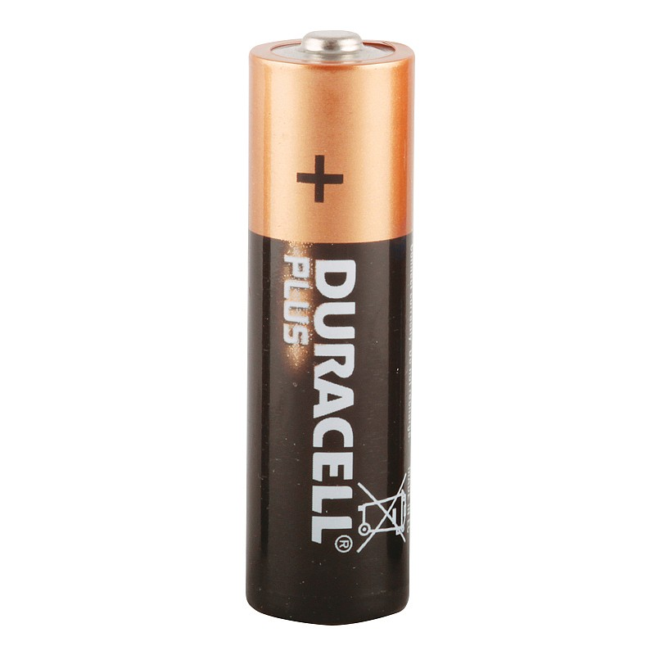
Flow of Charge
When the ends of an electrical conductor are at different electric potentials—when there is a potential difference—charge flows from one end to the other.
Electrical Conductor
Motion of charge
High Electric Potential
Low Electric Potential

Slide 4
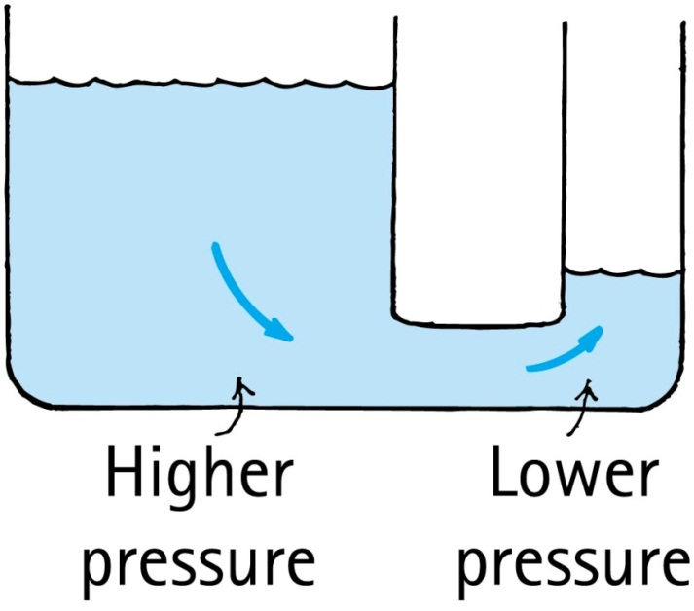
Electricity/Water Analogy:
Electric charge flows from higher potential to lower potential, if it can.
Water flows from higher pressure to lower pressure, if it can.
Higher Potential
Lower Potential

Slide 5
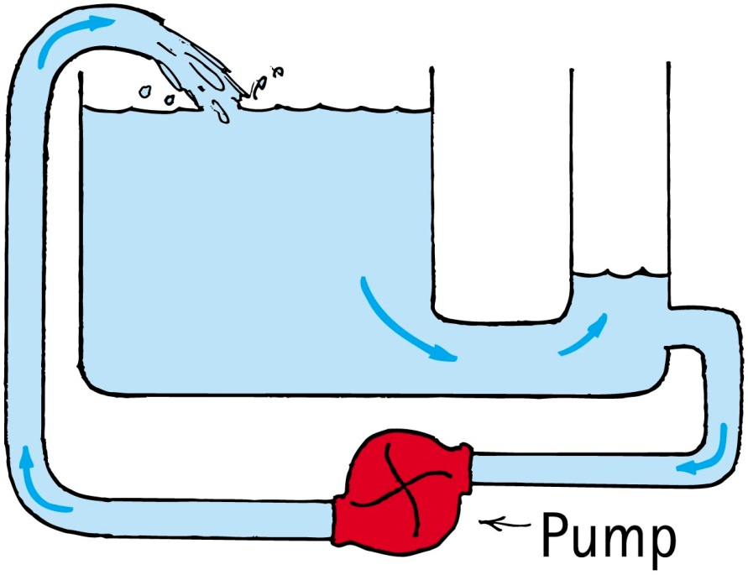
Continuing the Analogy…
To maintain a continuing flow of charge in a conductor, a battery must be provided to maintain the potential difference (=voltage).
To maintain a continuing flow of water in a pipe, a pump must be provided to maintain the pressure difference
Battery

Slide 6
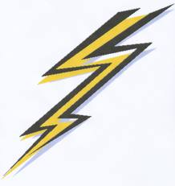
Electric Current
When charged particles move, transferring electric charge from one place to another, this is called electric current
A “conductor” is a material having free charged particles that easily flow through it when an electric force acts on them
In a conducting solid metal, negatively charged electrons are free to move around while the positive nuclei remain fixed in the atomic lattice
In certain types of solid semiconductors, positively charged electron holes are free to move around
In ionic liquids, positive or negative ions can carry electric charge from one place to another

Slide 7
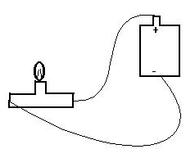
Electric Current is a Number
Electric current is the rate that charge moves from one point to another
The common symbol for current is I
The unit of current is Coulombs per second (C/s)
1 C/s = 1 Ampere = 1 Amp = 1 A
$$I=\frac{Δq}{Δt}$$
[image from http://people.oregonstate.edu/~joneski/electric.htm ]

Slide 8
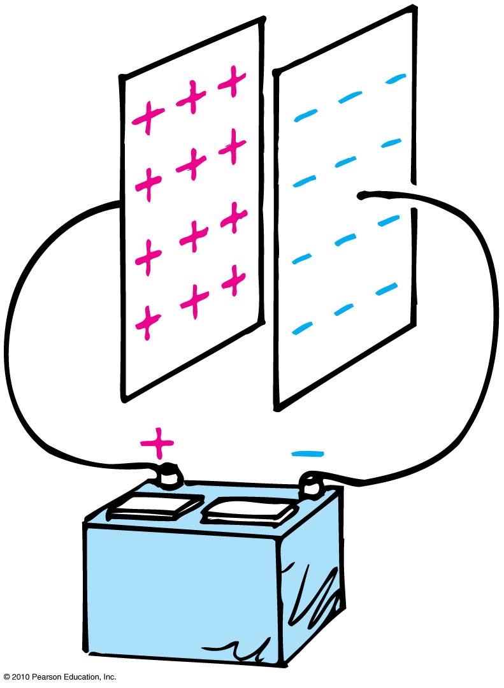
A capacitor begins with two neutral metal plates. A battery is attached and charges up the capacitor, so that 6 seconds later there is +3 Coulombs of charge on the positive plate, and -3 Coulombs of charge on the negative plate.
Electric Current
CHECK YOUR NEIGHBOR
What was the average current running through the battery as the capacitor was charging?
Zero
0.33 Amps
0.5 Amps
1 Amp
2 Amps
Notes:
A. Electric current is a flow of electric charge.

Slide 9
Voltage is a Number
Electric potential difference is called “voltage”
Voltage between two points causes electric current in a conductor flow from higher potential to lower potential.
No current flows when the voltage is zero
The unit of voltage is Volts
1 Volt = 1 V = 1 Joule per Coulomb
We say that when voltage is set up across a conducting object, it can cause a current to flow through the conducting object.
[image from http://people.oregonstate.edu/~joneski/electric.htm ]

Slide 10
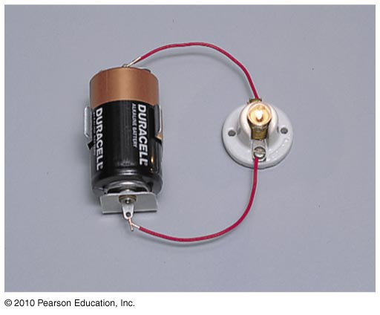
How Does a Battery Work?
Energy is stored in a battery in chemical bonds
When current flows through a battery, work is done by chemical disintegration of zinc or lead in acid
This energy is carried by the electric charges as they travel through the circuit, and can be used to power a light-bulb, for example

Slide 11
What does a good DC battery supply you with, such as this brand-new Duracell?
Electric Current
CHECK YOUR NEIGHBOR
A steady supply of current to put into a circuit.
A steady rate of energy flow into a circuit.
A constant voltage to apply across a circuit.
Notes:
A. Electric current is a flow of electric charge.

Slide 12
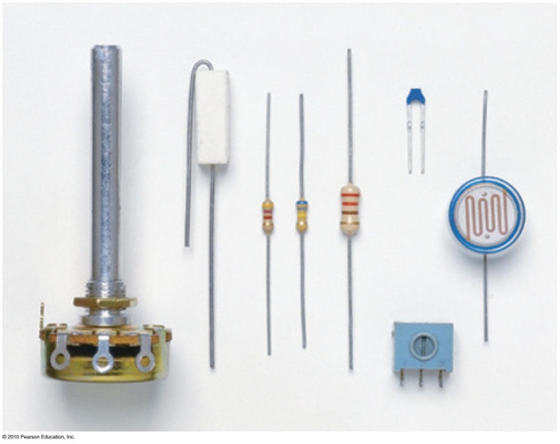
Electric Resistance
Current in a circuit depends on:
voltage.
electrical resistance.
Resistors are circuit elements that use up energy; usually they create heat
In a circuit diagram, the symbol for a resistor is:

Slide 13
Resistance is a Number
When you apply a voltage across an object, the amount of current depends on the object’s resistance.
Resistance of an object is measured in Ohms
1 Ohm = 1 Ω = 1 Volt per Amp
The higher the resistance of an object, the less current will flow through it for a given voltage.
[image from http://people.oregonstate.edu/~joneski/electric.htm ]

Slide 14
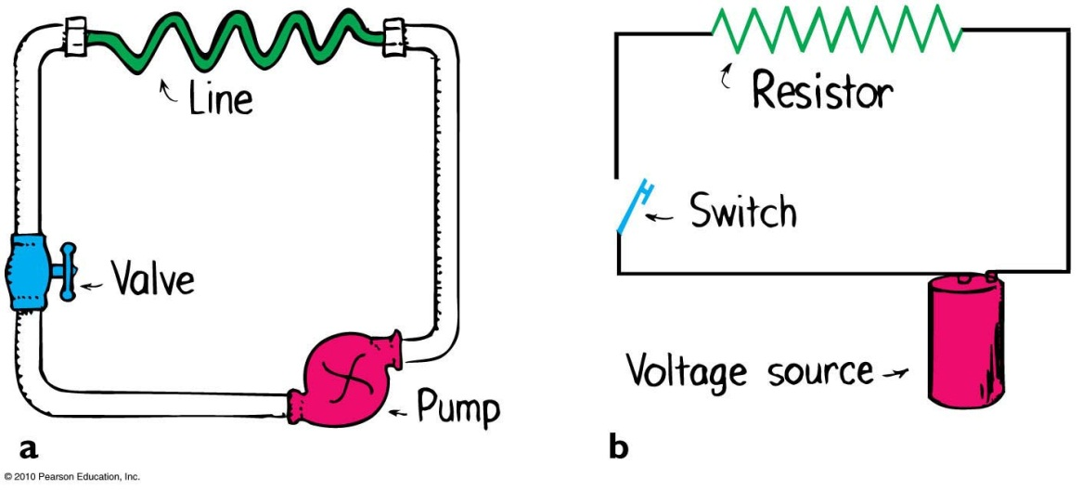
A pump is pushing water through a narrow wiggly pipe, called a “line”. If you increase the length of the line, without changing the pressure of the pump, how will this affect the rate that water flows through it?
Electric Current
CHECK YOUR NEIGHBOR
The flow rate will decrease
The flow rate will increase
The flow rate will stay the same
Notes:
A. Electric current is a flow of electric charge.

Slide 15
A pump is pushing water through a narrow wiggly pipe, called a “line”. If you increase the diameter of the line, without changing the pressure of the pump, how will this affect the rate that water flows through it?
Electric Current
CHECK YOUR NEIGHBOR
The flow rate will decrease
The flow rate will increase
The flow rate will stay the same
Notes:
A. Electric current is a flow of electric charge.

Slide 16
Electric Resistance
Factors affecting electrical resistance of an object:
Material
Rubber is much more resistive than copper
Cross-sectional area
Thin wires have more resistance than thick wires
Length
An object twice as long has twice as much resistance.

Slide 17
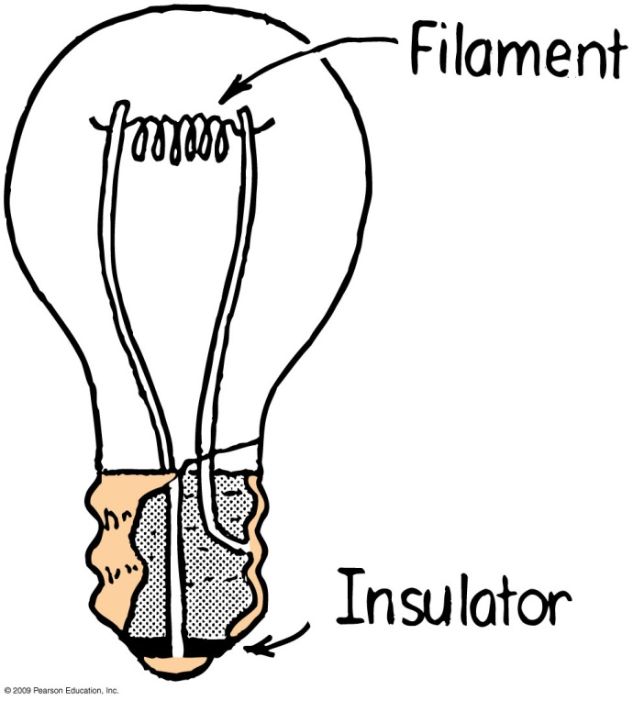
Electrical Resistance
For some materials, the resistance can increase dramatically with temperature
For example, the filament in a light bulb increases its resistance after it has been on for a short time, as it warms up.
The current is high at first, then decreases.

Slide 19
Ohm’s Law
The current in a circuit varies in direct proportion to the potential difference, or voltage, and inversely with the resistance
voltage
Current =
resistance
$$I=\frac{V}{R}$$
Examples:
For a constant resistance, current will be twice as much for twice the voltage.
For twice the resistance and twice the voltage, current will be unchanged.

Slide 20
Continuing the Analogy…
If you increase the pressure on the pump, water will flow faster through the line (analogous to increasing voltage)
If you keep the pressure the same, but make the line longer or narrower, water will flow slower through the line (analogous to increasing resistance)

Slide 21
A battery is set up to push current through a resistor. The battery has a voltage of 100 V. The resistor has a resistance of 500 Ω. When you close the switch, what is the current flowing around the circuit?
Electric Current
CHECK YOUR NEIGHBOR
0.2 A
5 A
100 A
500 A
50,000 A
Notes:
A. Electric current is a flow of electric charge.

Slide 22
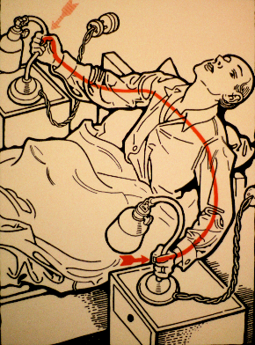
You are a resistor!!
The human body has a resistance, which depends on the exact path through your body, and whether your hands are wet or dry.
If your hands are moist, the resistance between them can be as low as 500 Ω
So if there is a voltage of 100 V between your hands, this will set up a current of 0.2 A, straight through your heart!
Electrical current traveling through your body can damage tissue, and interfere with the beating of your heart (which is electrical)
[image from http://www.retronaut.com/2012/10/30-ways-to-die-by-electrocution ]

Slide 23
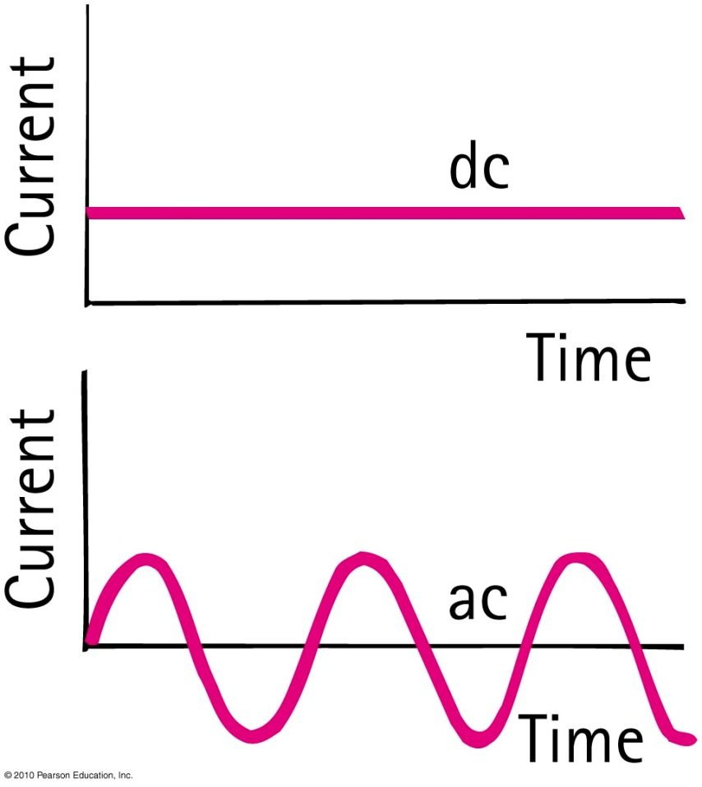
Direct and Alternating Current
Direct current (dc)
Flows in one direction only.
Current always flows from the positive terminal toward the negative terminal.
Alternating Current (ac)
Current in the circuit flows first in one direction and then in the opposite direction, alternating to and fro many times per second.
This is accomplished by alternating the polarity of voltage at the generator or other voltage source.

Slide 24
Direct and Alternating Current
Commercial electricity in North America is alternating current (ac):
60 cycles per second
Voltage is 120 V
Power transmission is more efficient at higher voltages.
Europe and China adopted 220 V as their standard.
Canada and the U.S. continued with 120 V because so much equipment was already installed.

Slide 25
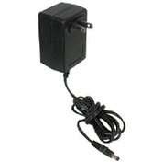
Direct and Alternating Current
Converting from ac to dc
Household current is ac, but current in laptop or cell phone is dc.
The AC to DC converter uses a diode, a tiny electronic device that acts as a one-way valve to allow electron flow in one direction only.
AC in
DC out

Slide 26
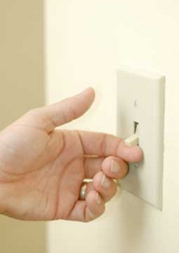
When you turn on a light switch,
Electric Current
CHECK YOUR NEIGHBOR
An electric field is set up in along the wire, which immediately begins pushing electrons in the light.
Electric current immediately begins flowing in the switch, which pushes electrons who bump into neighbouring electrons, all the way up to the light, like a sequence of dominoes.
The switch sends a stream of electrons toward the light, which, when it reaches the light, makes the light go on.
Notes:
A. Electric current is a flow of electric charge.

Slide 27
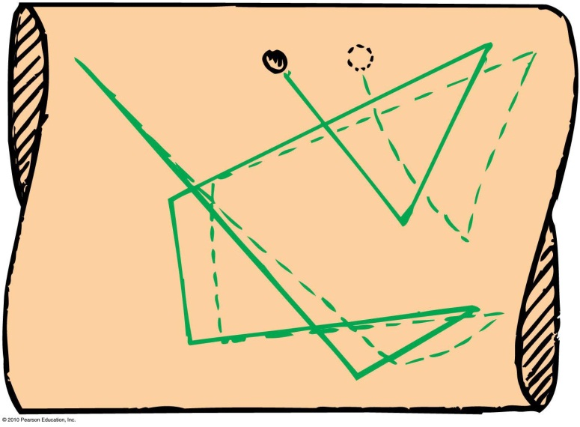
Speed and Source of Electrons in a Metal Wire
When we flip the light switch on a wall and the circuit, an electric field is established inside the conductor.
The electrons continue their random motions while simultaneously being nudged by the electric field.
Current is established through the wires at nearly the speed of light.
It is not the electrons that move at this speed.
It is the electric field that can travel through a circuit at nearly the speed of light.

Slide 28
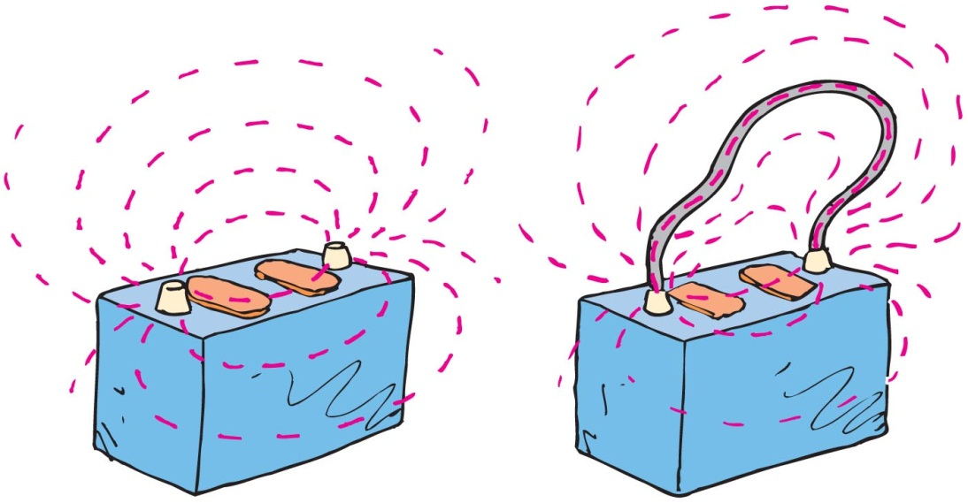
Speed and Source of Electrons in a Circuit
If the voltage source is dc, like the battery, electric field lines are maintained in one direction in the conductor.
Conduction electrons are accelerated by the field in a direction parallel to the field lines.
Before they gain appreciable speed, they “bump into” the anchored metallic ions in their paths and transfer some of their kinetic energy to them.

Slide 29
Speed and Source of Electrons in a Circuit
Misconceptions about electric current:
“Current is propagated through the conducting wires by electrons bumping into one another.”
NOT true: Electrons that are free to move in a conductor are accelerated by the electric field impressed upon them.
True, they do bump into one another and other atoms, but this slows them down and offers resistance to their motion.
Electrons throughout the entire closed path of a circuit all react simultaneously to the electric field.

Slide 30
Speed and Source of Electrons in a Circuit
Misconceptions about electric current:
“Electrical outlets in the walls of the homes are a source of electrons.”
NOT true: The outlets in homes are ac. Electrons make no net migration through a wire in an ac circuit.
When you plug a lamp into an outlet, energy flows from the outlet into the lamp, not electrons. Energy is carried by the pulsating electric field and causes vibratory motion.
Electrical utility companies sell energy. You provide the electrons.

Slide 31
Electric Power
Power is the rate at which electric energy is used up in a circuit.
Power = current × voltage
In units:
$$Amps×Volts=\left(\frac{Coulombs}{second}\right)×\left(\frac{Joules}{Coulomb}\right)=\left(\frac{Joules}{second}\right)=Watts$$

Slide 32
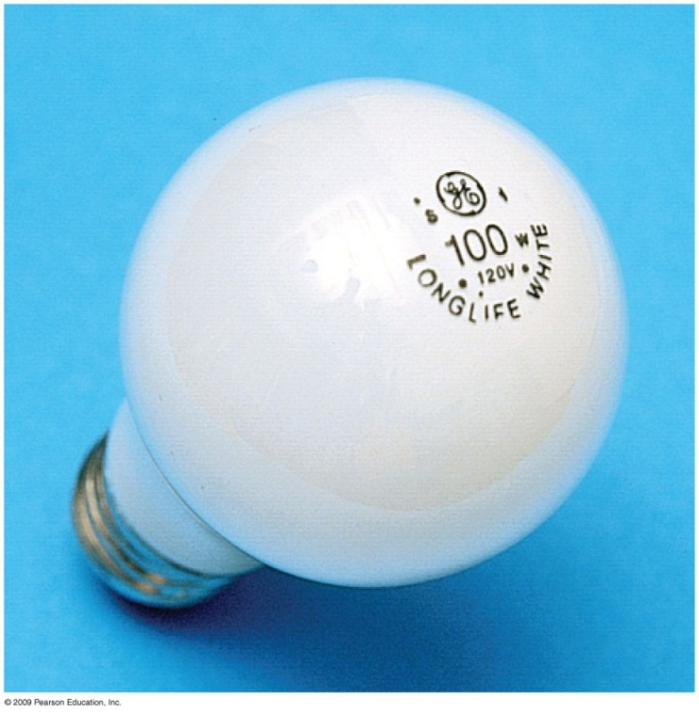
Check your neighbour
How much current is drawn by a 100 Watt light bulb, when used with a normal 120 Volt power supply?
0.8 A
1.2 A
100 A
120 A
12,000 A

Slide 33
Example
An electric iron is connected to a 120 Volt source, and draws 9 A of current.
How much heat does the iron generate in one minute?
How much charge flows through the iron in one minute?

Slide 34
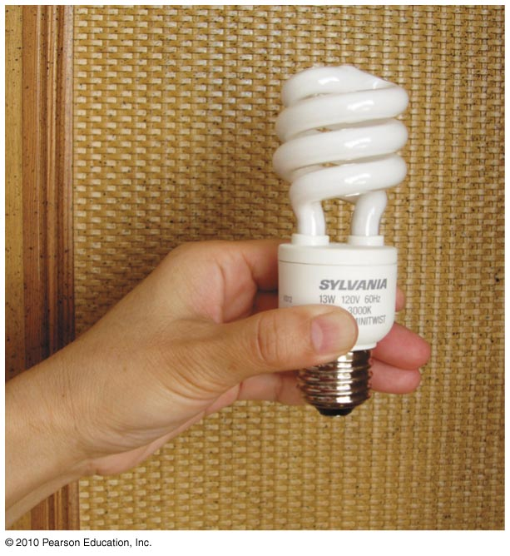
Compact Fluorescent Lamps (CFLs)
Incandescent bulbs dissipate most of their energy in the form of heat, not light. So, they are not energy efficient.
Fluorescent lamps, on the other hand, emit much less heat, which is why you can touch them without burning yourself.
Compact fluorescent lamps (CFLs) are a type of fluorescent lamp that fits into a standard lightbulb socket.
For the same wattage, CFLs emit much more light and much less heat than incandescent bulbs.

Slide 35
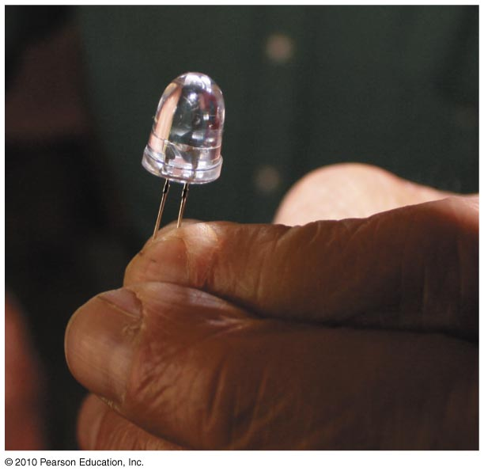
Light-Emitting Diodes (LEDs)
Another light source even more long-lasting is the light-emitting diode (LED).
The most primitive being the little red lights that tell you whether your stereo is on or off
Between CFLs and LEDs, common-use incandescent bulbs will soon be history!

Slide 36
Electric Circuits
Connected in two common ways:
Series
forms a single pathway for electron flow between the terminals of the battery, generator, or wall outlet
Parallel
forms branches, each of which is a separate path for the flow of electrons

Slide 37
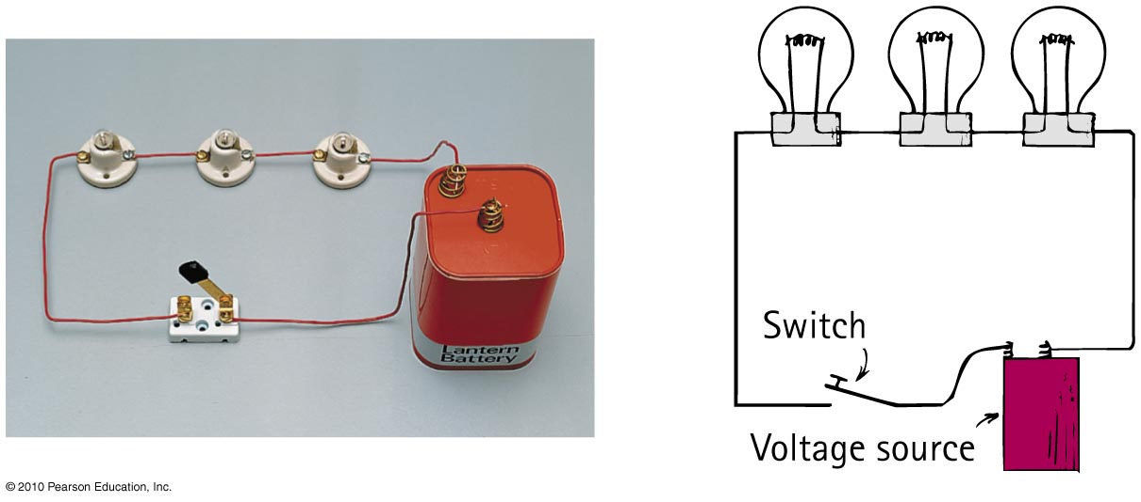
Series Circuits
Characteristics of series circuits
1. Electric current through a single pathway.
2. Total resistance to current is the sum of individual resistances.
3. Current is equal to the voltage supplied by the source divided by the total resistance of the circuit.

Slide 38
Series Circuits
Characteristics of series circuits
4. The sum of the voltage drops across the series resistors is equal to the total voltage supplied by the source.
5. The voltage drop across each device are proportional to its resistance.
6. If one device fails, current in the entire circuit ceases.

Slide 39
When two identical lamps in a circuit are connected in series, the total resistance is
Electric Circuits
CHECK YOUR NEIGHBOR
A. less than the resistance of either lamp.
the same as the resistance of each lamp.
more than the resistance of either lamp.
Notes:
A. less than the resistance of either lamp.

Slide 40
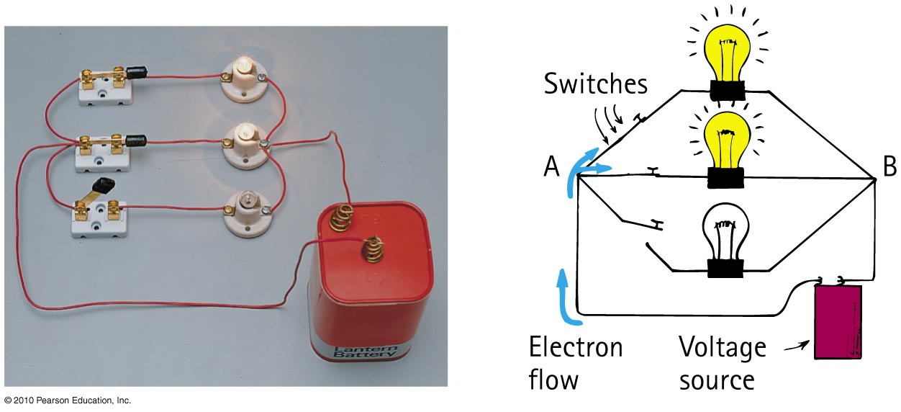
Parallel Circuits
Characteristics of parallel circuit
1. Voltage is the same across each device.
2. The total current in the circuit divides among the parallel branches.
3. The total current in the circuit equals the sum of the currents in its parallel branches.

Slide 41
Parallel Circuits
Characteristics of parallel circuit
4. As the number of parallel branches is increased, the overall resistance of the circuit is decreased.
5. A break in one path does not interrupt the flow of charge in the other paths.

Slide 42
When two identical lamps in a circuit are connected in parallel, the total resistance is
Electric Circuits
CHECK YOUR NEIGHBOR
A. less than the resistance of either lamp.
the same as the resistance of each lamp.
more than the resistance of either lamp.
Notes:
A. less than the resistance of either lamp.

Slide 43
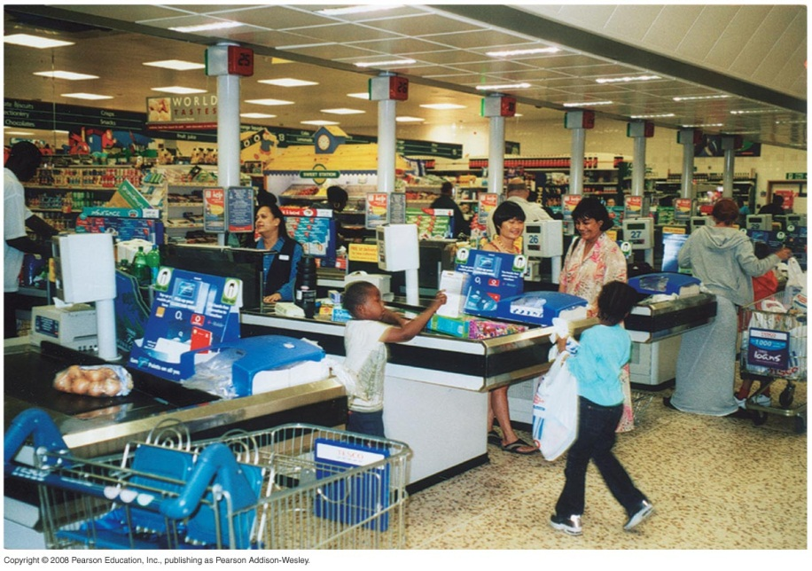
Parallel Circuits
The more parallel resistors are added, the lower the total resistance of the circuit, since there are more paths for the current to go through
If one path breaks, the current continues through the remaining paths

Slide 44
Before class on Wednesday
Please read Chapter 24, or at least watch the 10-minute pre-class video for class 18.
Something to think about:
What is an electromagnet, and how does it work?

