Slide 1
Conceptual Physics 11th Edition
Chapter 25:
ELECTROMAGNETIC INDUCTION
Electromagnetic Induction
Faraday’s Law
Generators and Alternating Current
Power Production
Self-Induction
Power Transmission
Field Induction

Slide 2
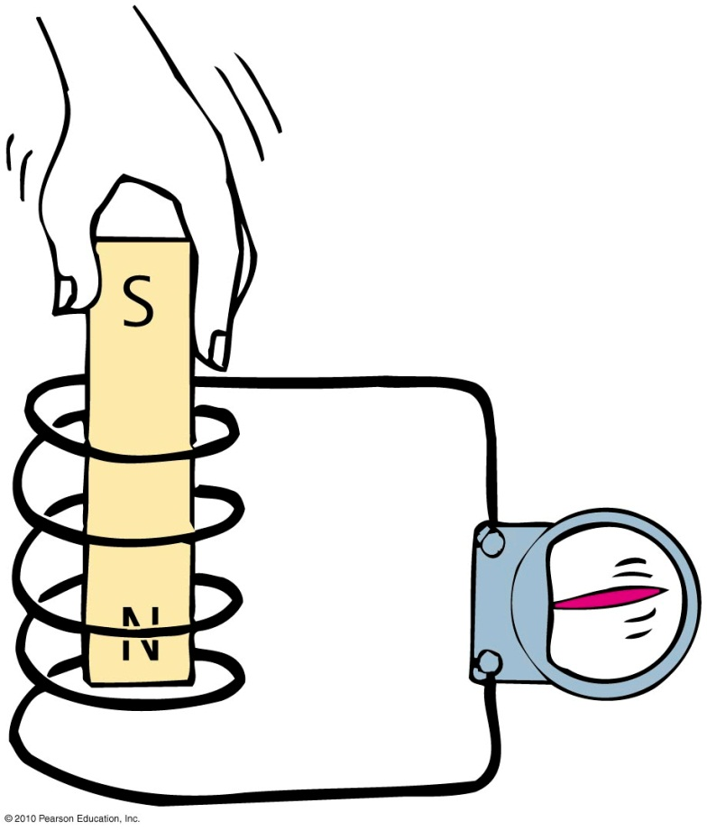
Electromagnetic Induction
Discovered by Faraday and Henry in 1831
When you plunge a magnet into a coil of wire, voltage is induced in the coil, and a current is produced

Slide 3
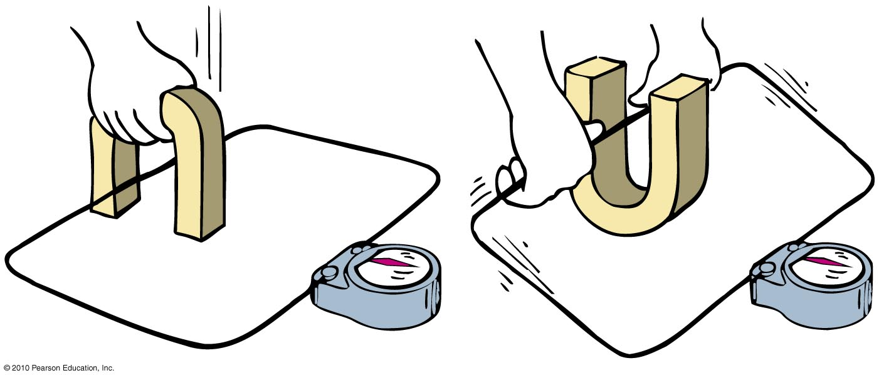
Electromagnetic Induction
Voltage is induced in the wire loop whether the magnetic field moves past the wire or the wire moves through the magnetic field.

Slide 4
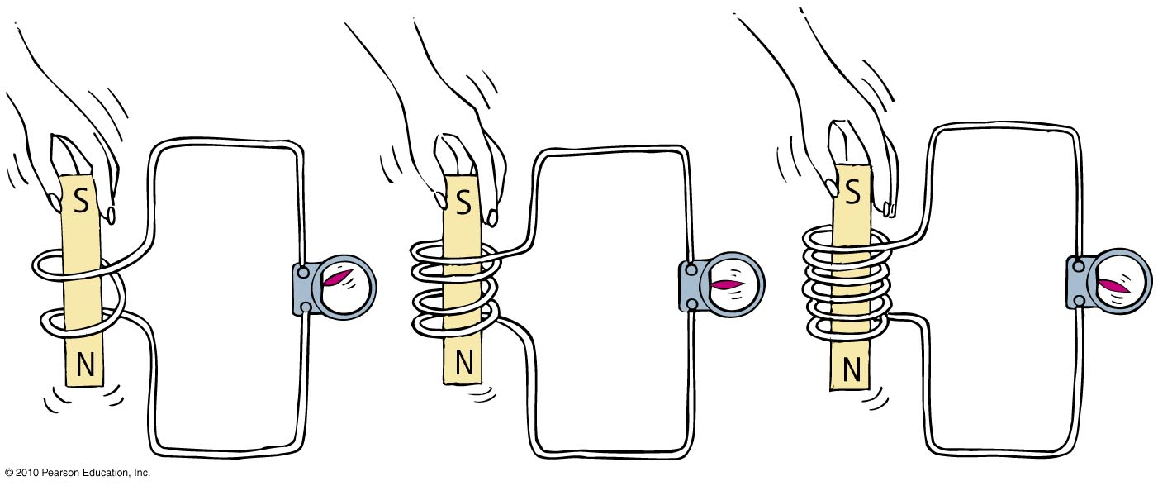
Electromagnetic Induction
When a magnet is plunged into a coil with twice as many loops as another, twice as much voltage is induced. If the magnet is plunged into a coil with 3 times as many loops, 3 times as much voltage is induced.

Slide 5
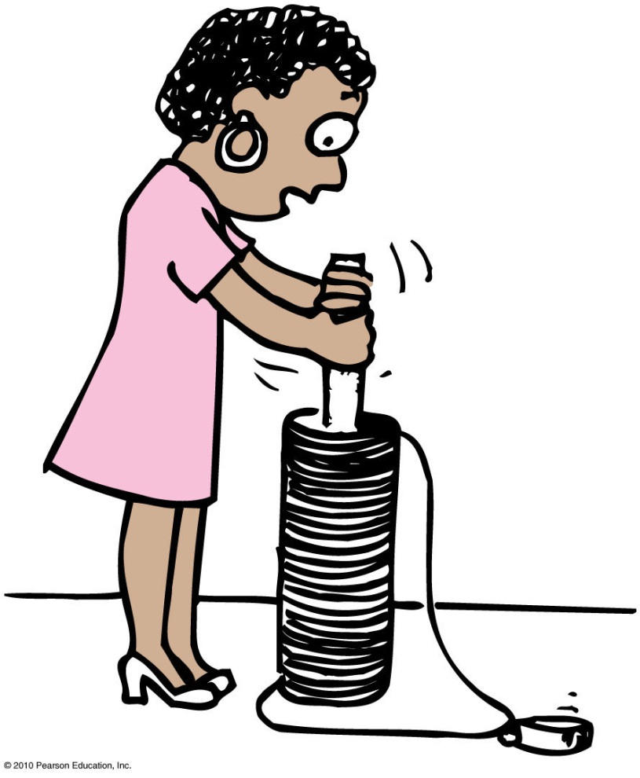
Electromagnetic Induction
It is more difficult to push the magnet into a coil with many loops.
This is because the induced voltage makes a current, which makes an electromagnet, which repels the magnet in our hand.
More loops mean more voltage, which means we do more work to induce it.

Slide 6
Faraday’s Law
The induced voltage in a coil is proportional to the number of loops, multiplied by the rate at which the magnetic field changes within those loops.
Amount of current produced by electromagnetic induction is dependent on:
resistance of the coil,
circuit that it connects,
induced voltage.

Slide 7
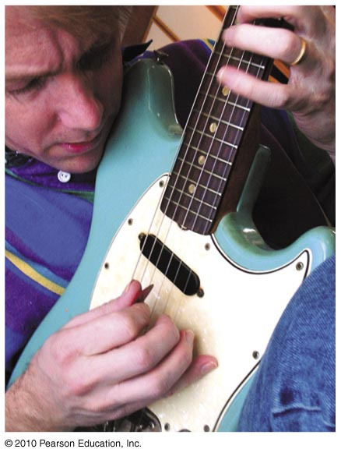
Faraday’s Law
Voltage is induced in a wire by changing the magnetic field passing through a loop of wire.
This can be done by:
moving the loop near a magnet,
moving a magnet near a loop,
changing the current in a nearby loop.

Slide 8
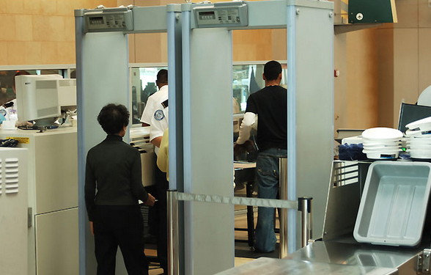
Faraday’s Law
Application of Faraday’s law
Activation of traffic lights by a car moving over underground coils of wire
Triggering security system at the airport by altering magnetic field in the coils as one walks through
Scanning magnetic strips on back of credit cards
Recording of sound on tape
Electronic devices in computer hard drives, iPods

Slide 9
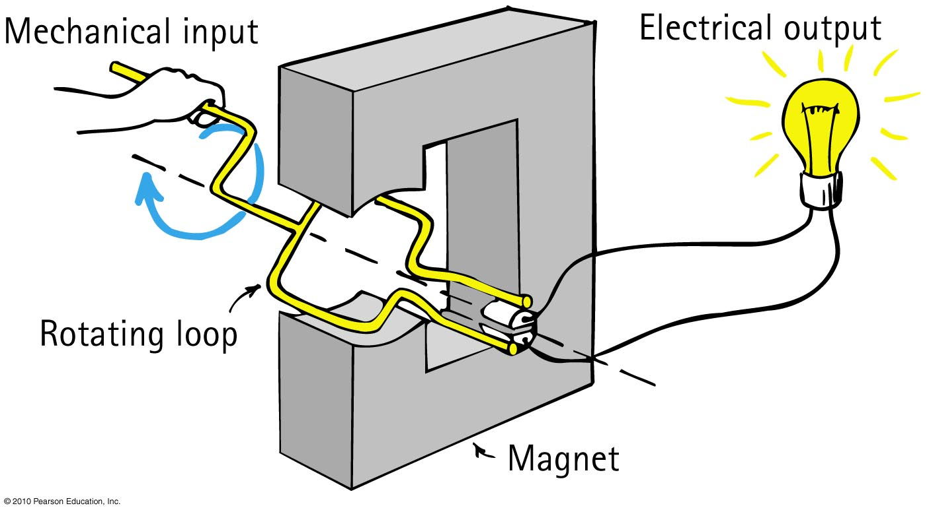
Electrical Generator
Opposite of a motor
Converts mechanical energy into electrical energy via coil motion
Produces alternating voltage and current

Slide 10
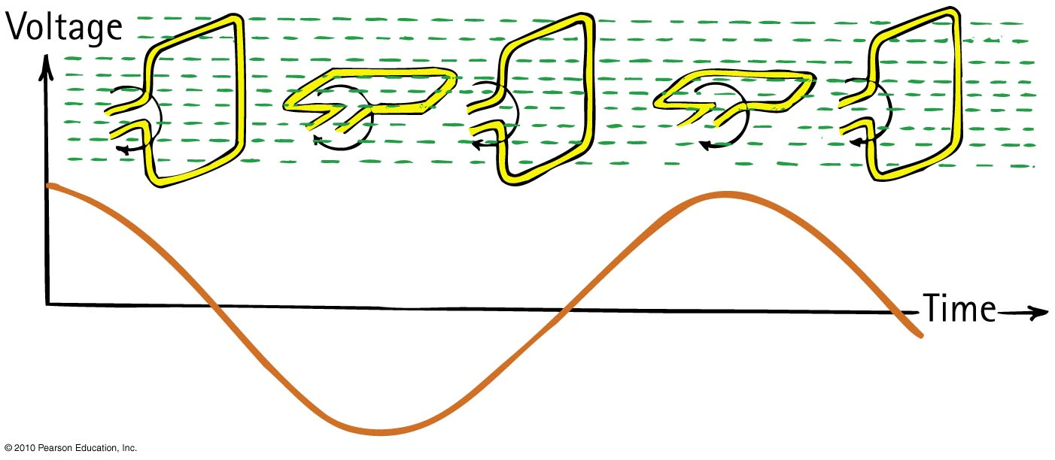
Electrical Generator
The frequency of alternating voltage induced in a loop is equal to the frequency of the changing magnetic field within the loop.

Slide 11
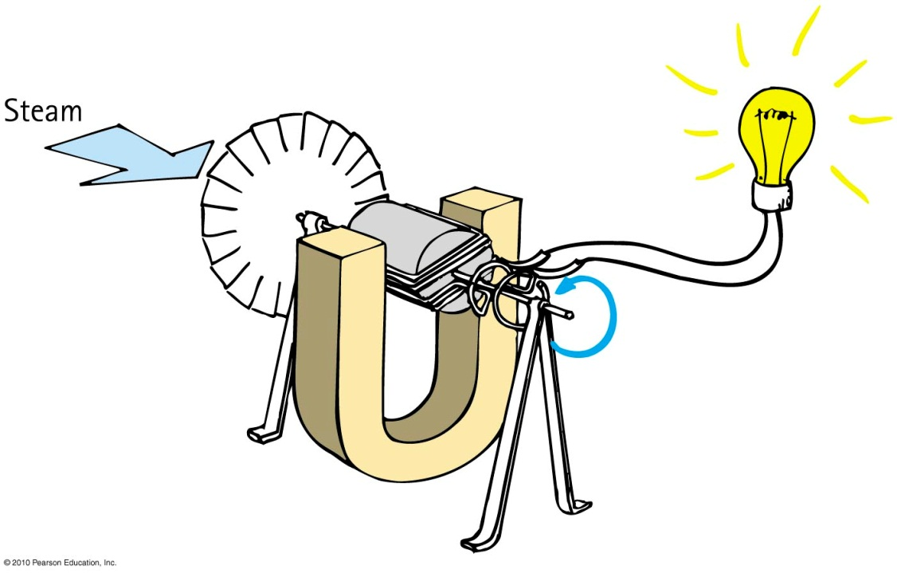
Power Production
Using Faraday and Henry’s discovery of electromagnetic induction, Nikola Tesla and George Westinghouse showed that electricity could be generated in sufficient quantities to light cities.

Slide 12
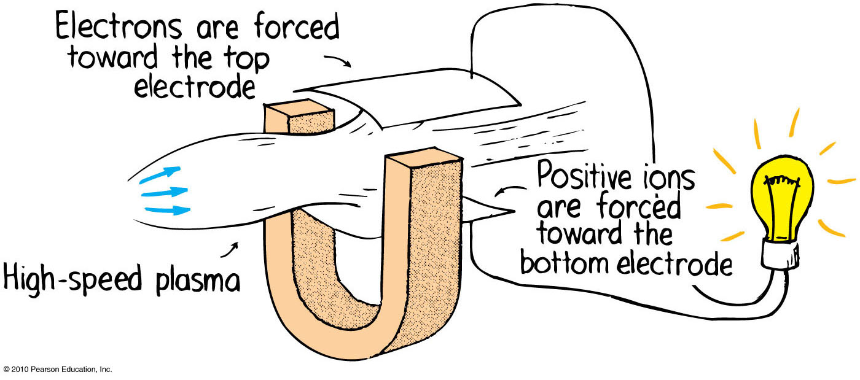
Power Production
MHD (MagnetoHydroDynamic) generator
Eliminates the turbine and spinning armature altogether.
A plasma of electrons and positive ions expands through a nozzle and moves at supersonic speed through a magnetic field.
The motion of charges through a magnetic field gives rise to a voltage and flow of current as per Faraday’s law.

Slide 13
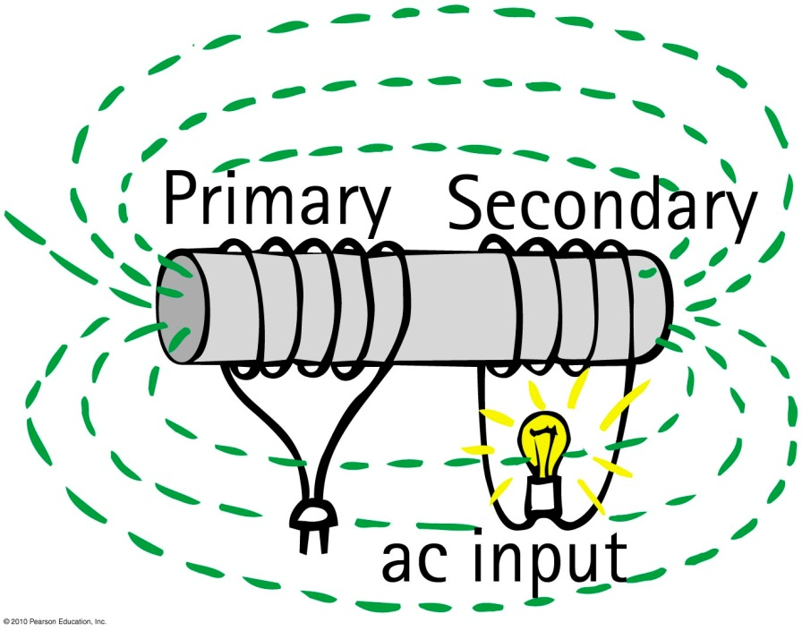
Transformers
output
Input coil of wire—the primary powered by ac voltage source
Output coil of wire—the secondary connected to an external circuit

Slide 14
Transformers
Step-up transformer
produces a greater voltage in the secondary than supplied by the primary
secondary has more turns in coil than the primary
Step-down transformer
produces a smaller voltage in the secondary than supplied by the primary
secondary has less turns in coil than the primary

Slide 15
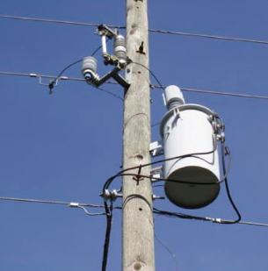
Transformers
Transformer relationship:
Primary voltage
secondary
voltage
=
Number of primary turns
number
of
secondary
turns
A common neighbourhood transformer typically steps 2400 volts down to 240 volts for houses and small businesses.

Slide 16
Transformers
Transformer transfers energy from one coil to another.
Rate of energy transfer is power.
Power into primary ≥ power out of secondary
or, neglecting small heat losses:
(Voltage × current)_{primary} = (voltage × current)_{secondary}

Slide 17
Power Transmission
Almost all electric energy sold today is in the form of ac because of the ease with which it can be transformed from one voltage to another.
Large currents in wires produce heat and energy losses, so power is transmitted great distances at high voltages and low currents.
Power is generated at 25,000 V or less and is stepped up near the power station to as much as 750,000 V for long-distance transmission.
It is then stepped down in stages at substations and distribution points to voltages needed in industrial applications (often 440 V or more) and for the home (240 and 120 V).

Slide 18
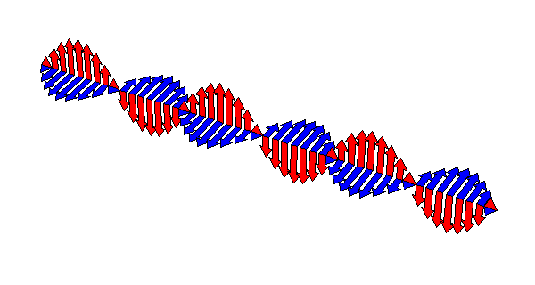
Electromagnetic induction is a “two-way street.”
Faraday’s law
States that an electric field is induced in any region of space in which a magnetic field is changing with time
Maxwell’s counterpart to Faraday’s law
States that a magnetic field is induced in any region of space in which an electric field is changing with time

