Slide 1
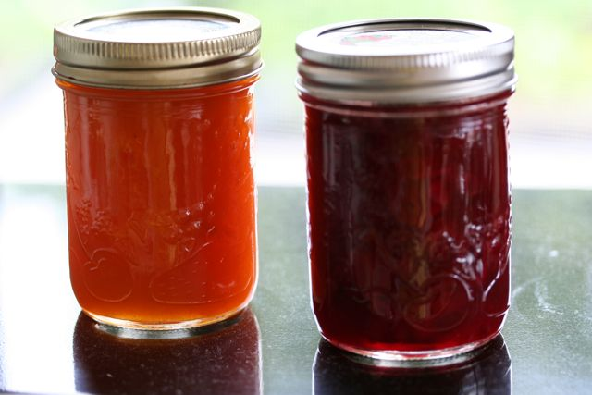
Jason Harlow
Thursday Dec. 5
12:00-1:00
SS2102
PHY131
1st half
Exam
Jam
Position, Velocity, Acceleration
Significant Figures, Measurements, Errors
Vectors, Relative Motion
Studying Tips
Equilibrium and Non-equilibrium Problems
Circular Motion, Centripetal Force

Slide 2
The Particle Model
Often motion of the object as a whole is not influenced by details of the object’s size and shape
We only need to keep track of a single point on the object
So we can treat the object as if all its mass were concentrated into a single point
A mass at a single point in space is called a particle
Particles have no size, no shape and no top, bottom, front or back
Below us a motion diagram of a car stopping, using the particle model

Slide 3
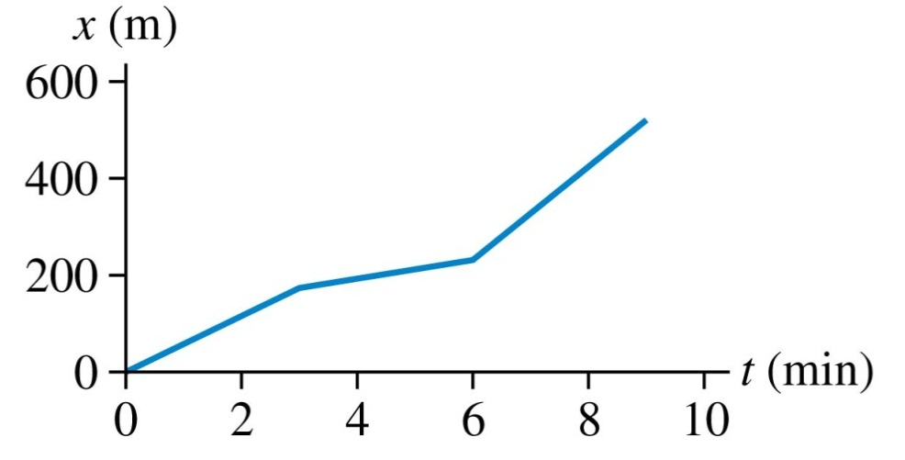
Position-versus-Time Graphs
Below is a motion diagram, made at 1 frame per minute, of a student walking to school.
A motion diagram is one way to represent the student’s motion.
Another way is to make a graph of x versus t for the student:

Slide 4
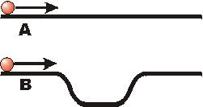
Two balls are launched along a pair of tracks with equal velocities, as shown. Both balls reach the end of the track. Predict: Which ball will reach the end of the track first?
A
B
C: They will reach the end of the track at the same time

Slide 5
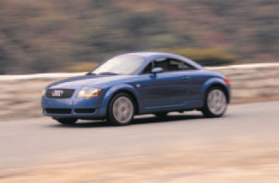
Acceleration
Sometimes an object’s velocity is constant as it moves
More often, an object’s velocity changes as it moves
Acceleration describes a change in velocity
Consider an object whose velocity changes from v₁ to v₂ during the time interval Δt
The quantity Δv = v₂ – v₁ is the change in velocity
The rate of change of velocity is called the average acceleration:

Slide 6
Acceleration (a.k.a. “instantaneous acceleration”)
Units of
are m/s.
Units of
are m/s².

Slide 7
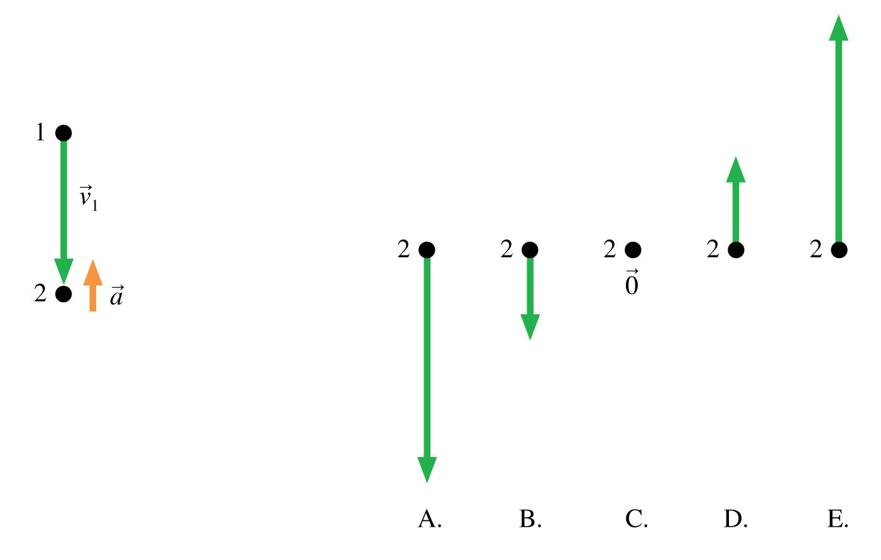
A particle has velocity as it accelerates from 1 to 2. What is its velocity vector as it moves away from point 2 on its way to point 3?

Slide 8
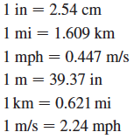
Unit Conversions
It is important to be able to convert back and forth between SI units and other units
One effective method is to write the conversion factor as a ratio equal to one
Because multiplying by 1 does not change a value, these ratios are easily used for unit conversions
For example, to convert the length 2.00 feet to meters, use the ratio:
So that:

Slide 9
Suggested Problem Solving Strategy
MODEL
VISUALIZE
SOLVE
ASSESS
Think about and simplify the situation, guess at what the right answer might be.
Draw a diagram. It doesn’t have to be artistic: stick figures and blobs are okay!
Set up the equations, solve for what you want to find. (This takes time..)
Check your units, significant figures, do a “sanity check”: does my answer make sense?
This is just a suggested strategy. Whatever method works for you is fine, as long as you don’t make a mistake, and you show how you got to the correct answer, it’s 100%!

Slide 10
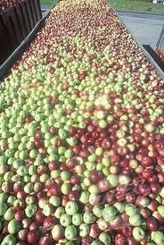
Error Analysis
Almost every time you make a measurement, the result will not be an exact number, but it will be a range of possible values.
The range of values associated with a measurement is described by the uncertainty, or error.
1600 ± 100 apples:
1600 is the value
100 is the error
Exactly 3 apples (no error)

Slide 11
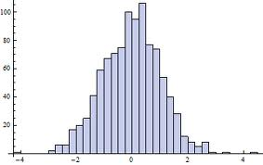
Errors
Errors eliminate the need to report measurements with vague terms like “approximately” or “≈”.
Errors give a quantitative way of stating your confidence level in your measurement.
Saying the answer is 10 ± 2 means you are 68% confident that the actual number is between 8 and 12.
It also implies that and 14 (the 2-σ range).
N
A histogram of many, many measurements of the same thing:
±1 σ
±2 σ

Slide 12
Estimating the Mean from a Sample
Suppose you make N measurements of a quantity x, and you expect these measurements to be normally distributed
Each measurement, or trial, you label with a number i, where i = 1, 2, 3, etc
You do not know what the true mean of the distribution is, and you cannot know this
However, you can estimate the mean by adding up all the individual measurements and dividing by N:

Slide 13
Estimating the Standard Deviation from a Sample
Suppose you make N measurements of a quantity x, and you expect these measurements to be normally distributed
It is impossible to know the true standard deviation of the distribution
The best estimate of the standard deviation is:
The quantity N – 1 is called the number of degrees of freedom
In this case, it is the number of measurements minus one because you used one number from a previous calculation (mean) in order to find the standard deviation.

Slide 14
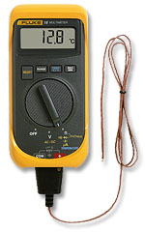
Reading Error (Digital)
For a measurement with an instrument with a digital readout, the reading error is usually “± one-half of the last digit.”
This means one-half of the power of ten represented in the last digit.
With the digital thermometer shown, the last digit represents values of a tenth of a degree, so the reading error is ½ × 0.1 = 0.05°C
You should write the temperature as 12.80 ± 0.05 °C.

Slide 15
Propagation of Errors
Rule #1 (sum or difference rule):
If z = x + y
or z = x – y
then
Rule #2 (product or division rule):
If z = xy
or z = x/y
then

Slide 16
Propagation of Errors
Rule #2.1 (multiply by exact constant rule):
If z = xy or z = x/y
and x is an exact number, so that Δx=0
then
Rule #3 (exponent rule):
If z = x^{n}
then

Slide 17
The Error in the Mean
Many individual, independent measurements are repeated N times
Each individual measurement has the same error Δx
Using error propagation you can show that the error in the estimated mean is:

Slide 18
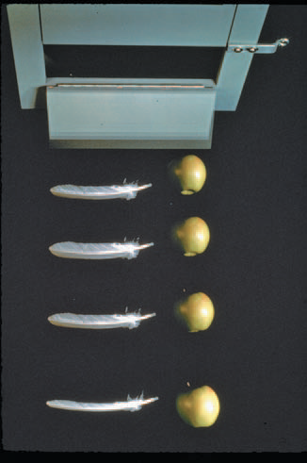
Free Fall
The motion of an object moving under the influence of gravity only, and no other forces, is called free fall
Two objects dropped from the same height will, if air resistance can be neglected, hit the ground at the same time and with the same speed
Consequently, any two objects in free fall, regardless of their mass, have the same acceleration:
The apple and feather seen here are falling in a vacuum.

Slide 19
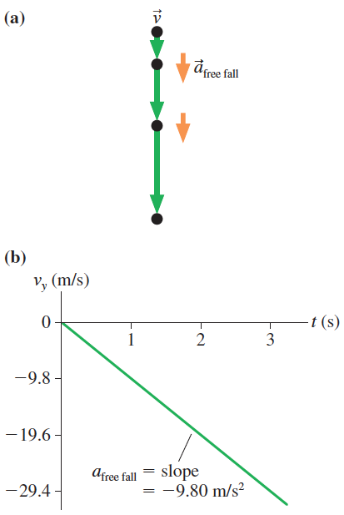
Free Fall
Figure (a) shows the motion diagram of an object that was released from rest and falls freely
Figure (b) shows the object’s velocity graph
The velocity graph is a straight line with a slope:
where g is a positive number which is equal to 9.80 m/s² on the surface of the earth
Other planets have different values of g

Slide 20
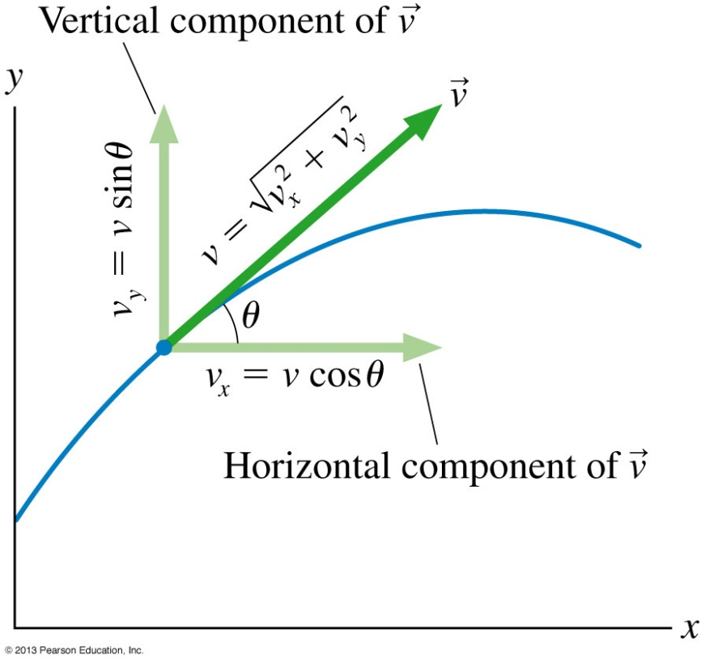
Two-Dimensional Kinematics
If the velocity vector’s angle θ is measured from the positive x-direction, the velocity components are
where the particle’s speed is
Conversely, if we know the velocity components, we can determine the direction of motion:

Slide 21
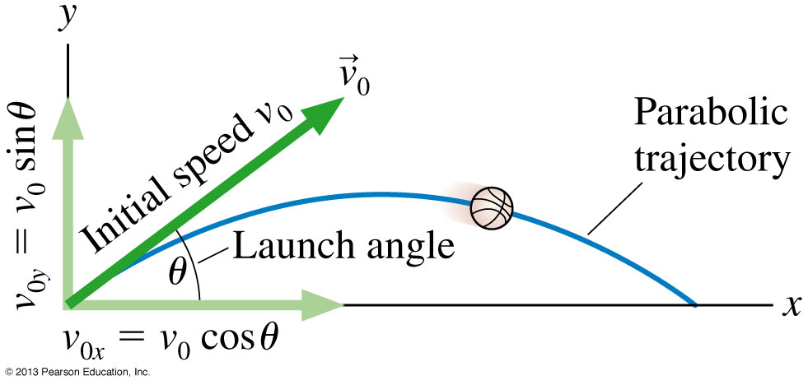
Projectile Motion
The start of a projectile’s motion is called the launch
The angle θ of the initial velocity v₀ above the x-axis is called the launch angle
The initial velocity vector can be broken into components
where v₀ is the initial speed

Slide 22
Projectile Motion
Gravity acts downward
Therefore, a projectile has no horizontal acceleration
Thus
The vertical component of acceleration a_{y} is −g of free fall
The horizontal component of a_{x} is zero
Projectiles are in free fall

Slide 23
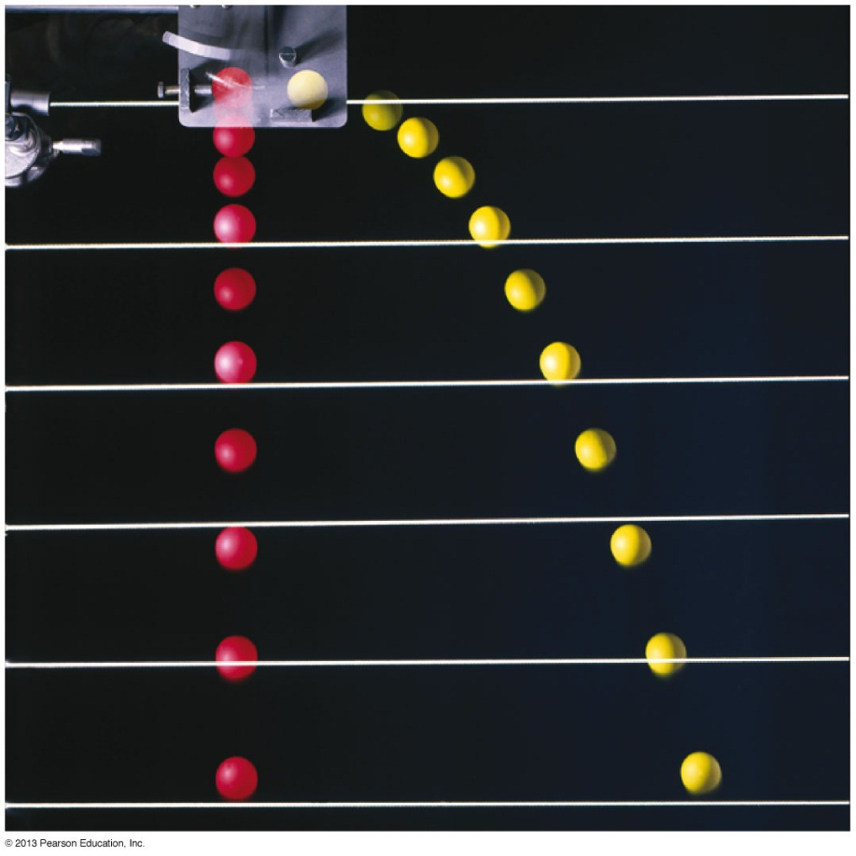
Reasoning About Projectile Motion
A heavy ball is launched exactly horizontally at height h above a horizontal field. At the exact instant that the ball is launched, a second ball is simply dropped from height h. Which ball hits the ground first?
If air resistance is neglected, the balls hit the ground simultaneously
The initial horizontal velocity of the first ball has no influence over its vertical motion
Neither ball has any initial vertical motion, so both fall distance h in the same amount of time

Slide 24
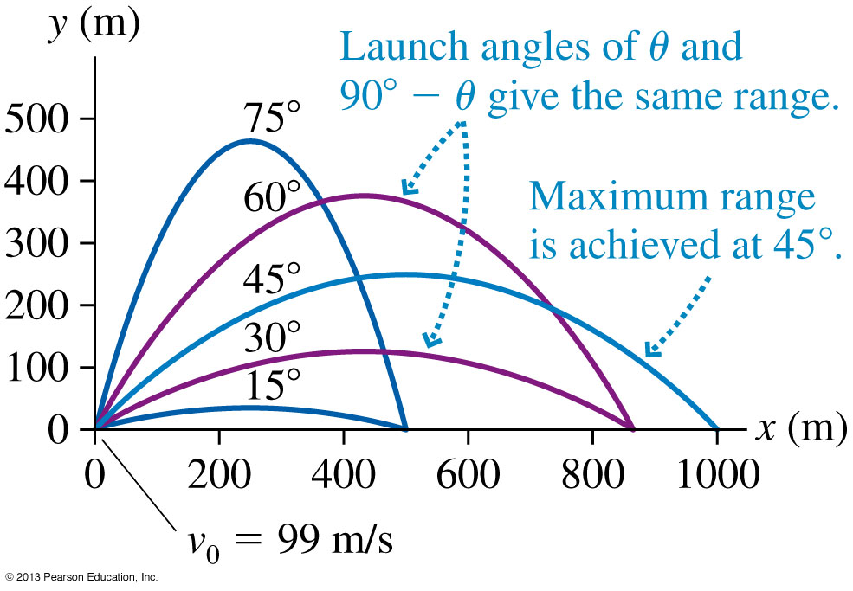
Range of a Projectile
A projectile with initial speed v₀ has a launch angle of θ above the horizontal. How far does it travel over level ground before it returns to the same elevation from which it was launched?
Trajectories of a projectile launched at different angles with a speed of 99 m/s.
This distance is sometimes called the range of a projectile
Example 4.5 from your textbook shows:
The maximum distance occurs for θ = 45°

Slide 25
Reference Frames
Relative Velocity
Relative velocities are found as the time derivative of the relative positions.
_{CA} is the velocity of C relative to A.
_{CB} is the velocity of C relative to B.
_{AB} is the velocity of reference frame A relative to reference frame B.
This is known as the Galilean transformation of velocity.
Slide 4-69

Slide 26
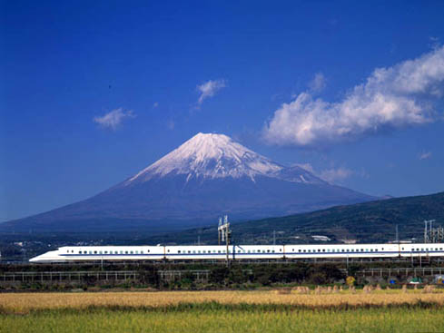
Relative Motion
Note the “cancellation”
v_{TG} = velocity of the Train relative to the Ground
v_{PT} = velocity of the Passenger relative to the Train
v_{PG} = velocity of the Passenger relative to the Ground
v_{PG} = v_{PT} + v_{TG}
Inner subscripts disappear

Slide 27
What is a force?
A force is a push or a pull
A force acts on an object
Pushes and pulls are applied to something
From the object’s perspective, it has a force exerted on it
The S.I. unit of force is the Newton (N)
1 N = 1 kg m s^{–2}

Slide 28
Tactics: Drawing force vectors

Slide 29
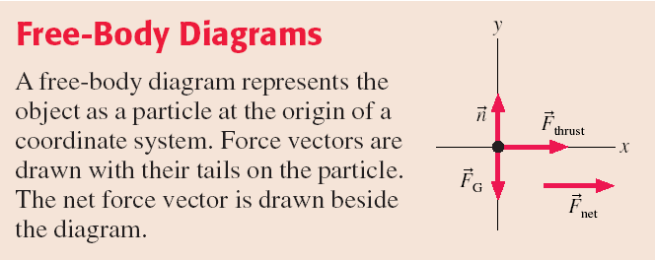

Slide 30
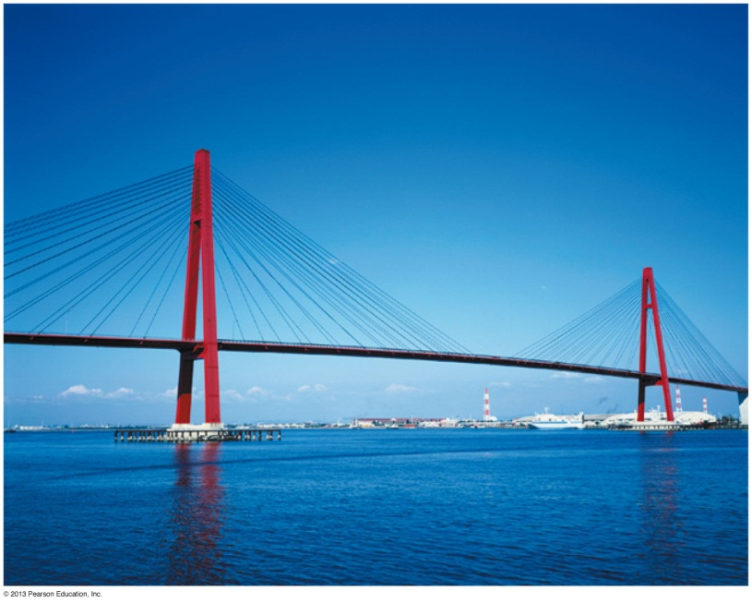
Equilibrium
An object on which the net force is zero is in equilibrium
If the object is at rest, it is in static equilibrium
If the object is moving along a straight line with a constant velocity it is in dynamic equilibrium
The requirement for either type of equilibrium is:
The concept of equilibrium is essential for the engineering analysis of stationary objects such as bridges.

Slide 31
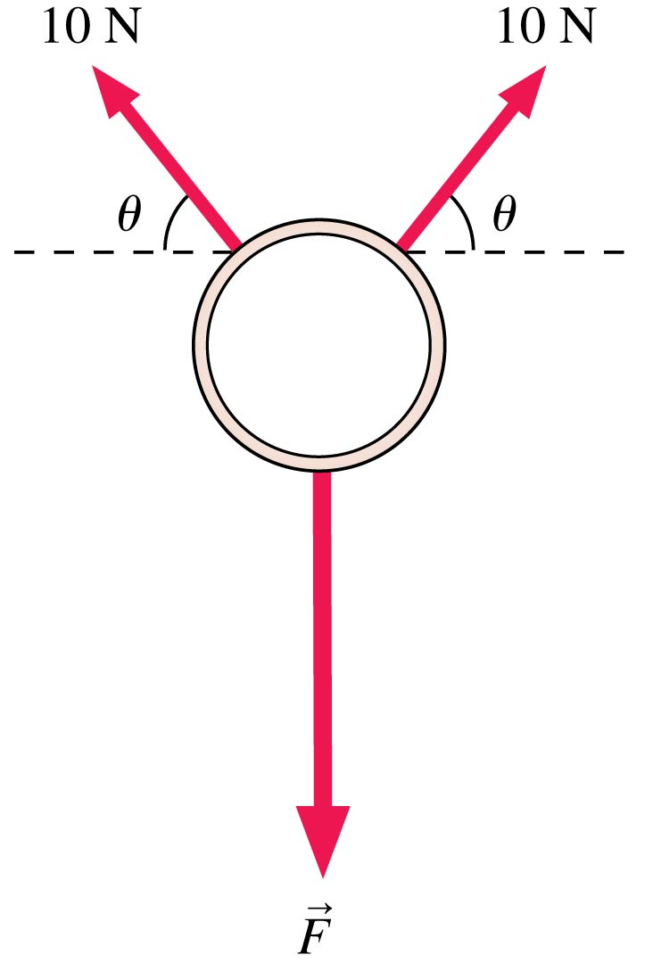
A ring, seen from above, is pulled on by three forces. The ring is not moving. How big is the force F?
20 N
10cosθ N
10sinθ N
20cosθ N
20sinθ N

Slide 32
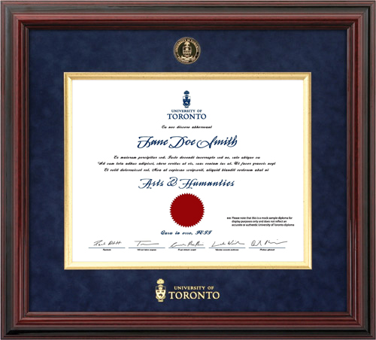
Why are you at University?
To get a pretty degree with a red sticker, which I can frame and hang on my wall
My parents said I “have to”
You can’t get a good job without a university education
I’m just here to learn interesting stuff
…other, or combo of above.
Notes:
U of T does not exist in a vacuum. Things you learn in class may actually apply to real life. [House, cars, microwave ovens, telephones, drugs, medical procedures, investing money, etc]

Slide 33
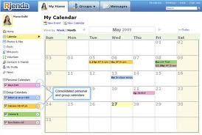
Time Management
Having a daily and weekly schedule and sticking to it will improve your marks.
Organize your time so that “all-nighters” never happen!
Most nights you should get an adequate amount of sleep. An adequate amount of sleep is such that you do not feel sleepy during the rest of the day.

Slide 34
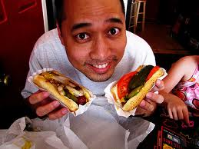
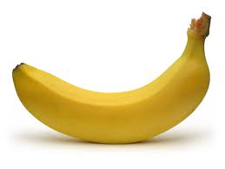
Food and Exercise
There are four food groups:
Vegetables and Fruit
Grain Products
Dairy
Meat and Alternatives (like nuts, tofu, eggs)
Physical activity not only improves health but it improves circulation of blood to the brain.
Try to get 35-40 minutes of brisk physical activity, 5 or 6 times per week. (I ♥ DDR!)

Slide 35
Study Groups – working with Peers
Find student (students) in class that you work well with on MasteringPhysics, end-of-chapter suggested problems, and past tests.
The best way to learn is to teach! If you can’t explain to someone else what you have done, you haven’t really understood it! (This is harder than you think!)

Slide 36
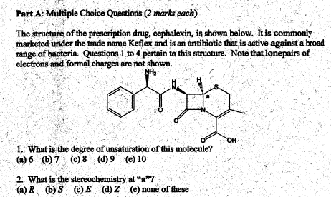
Past Tests and Exams
The purpose of obtaining and going through old tests and exams is to get to know “the system”.
Each course and prof will have a certain pattern and style. Knowing the pattern in advance gives you an edge.
Don’t count on lightning to strike twice – memorizing old test questions rarely works!

Slide 37
The Final Exam Cometh…
Course | Last Name | Date | Time | Location
PHY131H1F | A-DO | TUE 17 DEC | AM 9-11 | BN 2S
PHY131H1F | DR-KA | TUE 17 DEC | AM 9-11 | BN 2N
PHY131H1F | KE-N | TUE 17 DEC | AM 9-11 | EX 100
PHY131H1F | O-Z | TUE 17 DEC | AM 9-11 | EX 200
BN 2N is Benson Building, 320 Huron Street (south of Harbord Street), Second Floor, North end of the Gymnasium
BN 2S is Benson Building, 320 Huron Street (south of Harbord Street), Second Floor, South end of the Gymnasium
EX is Central Exams Facility, 255 McCaul St. (just south of College St.)

Slide 38
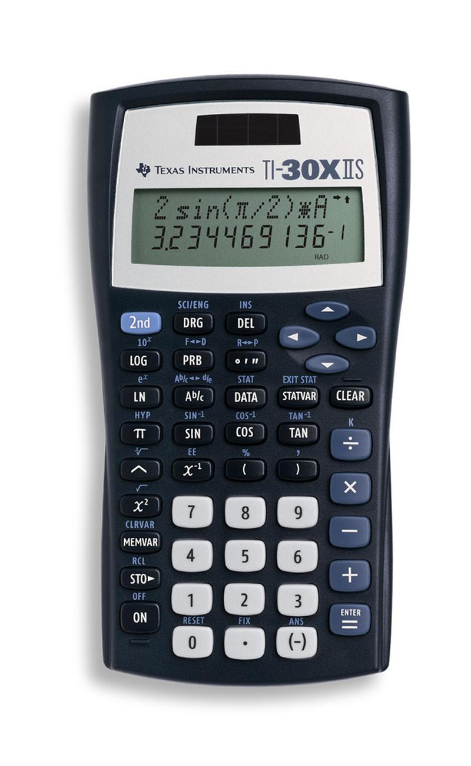
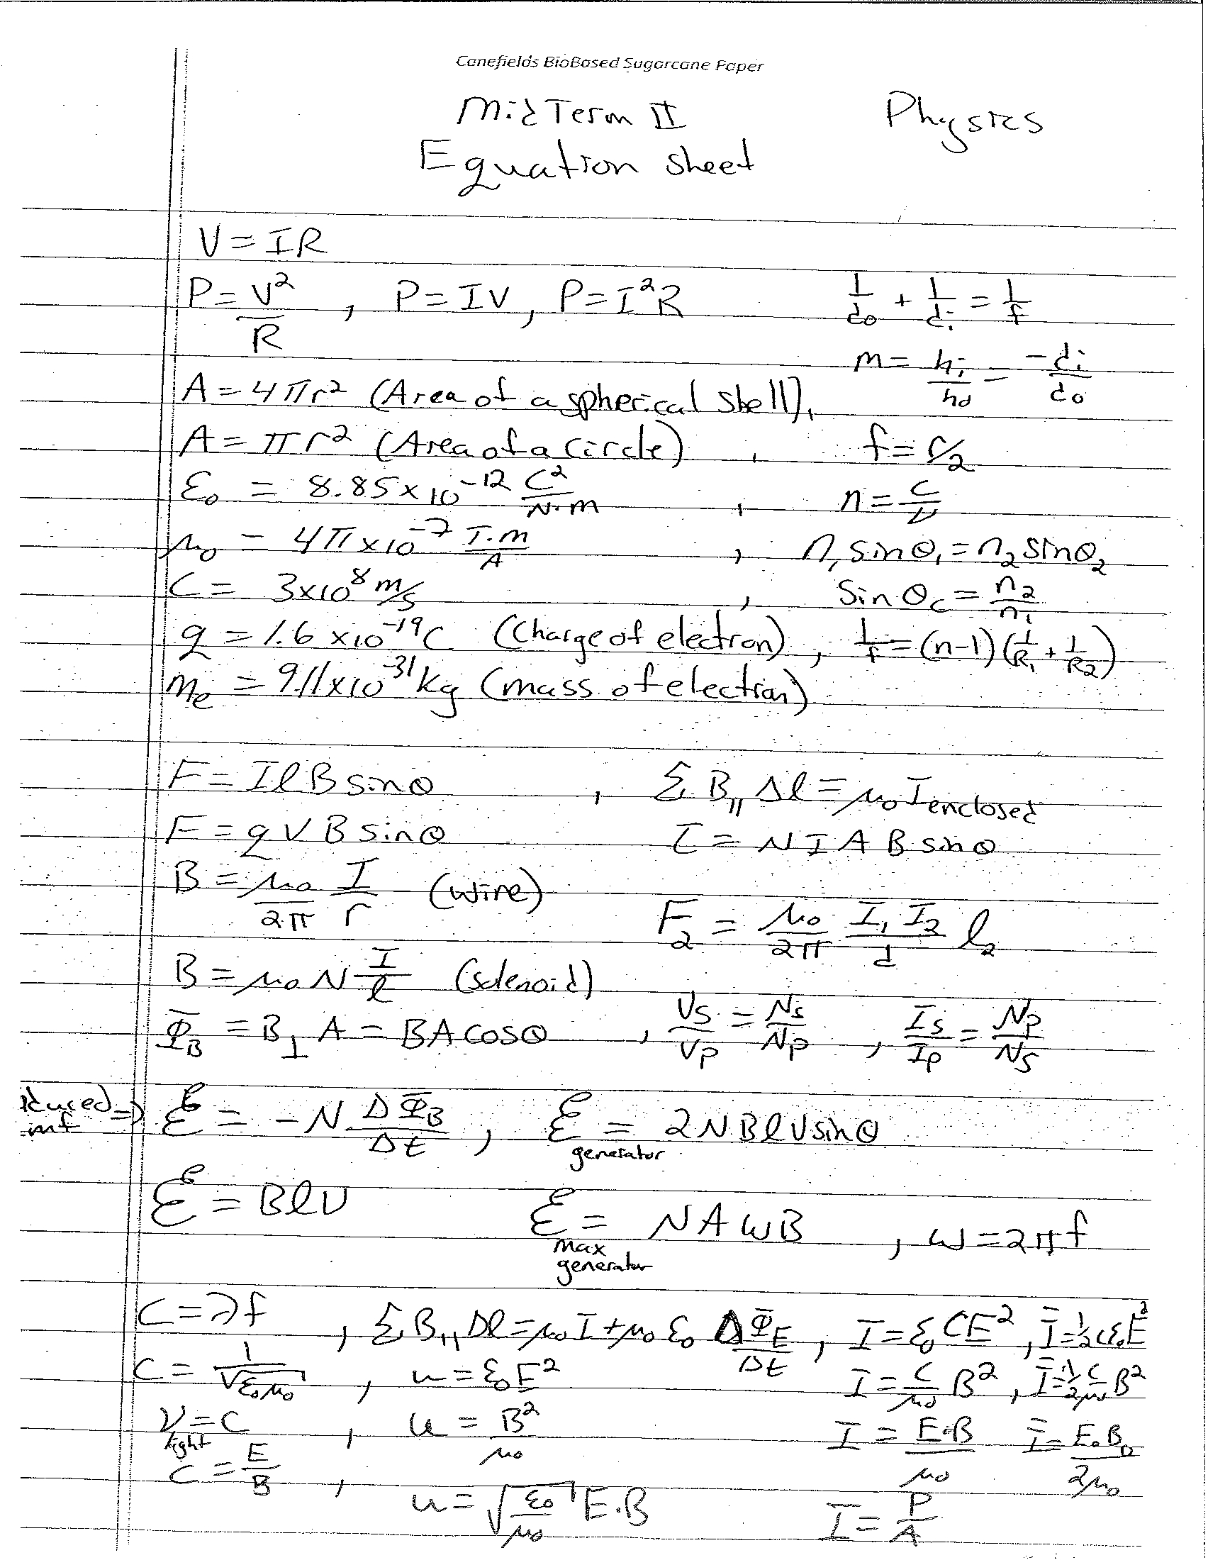
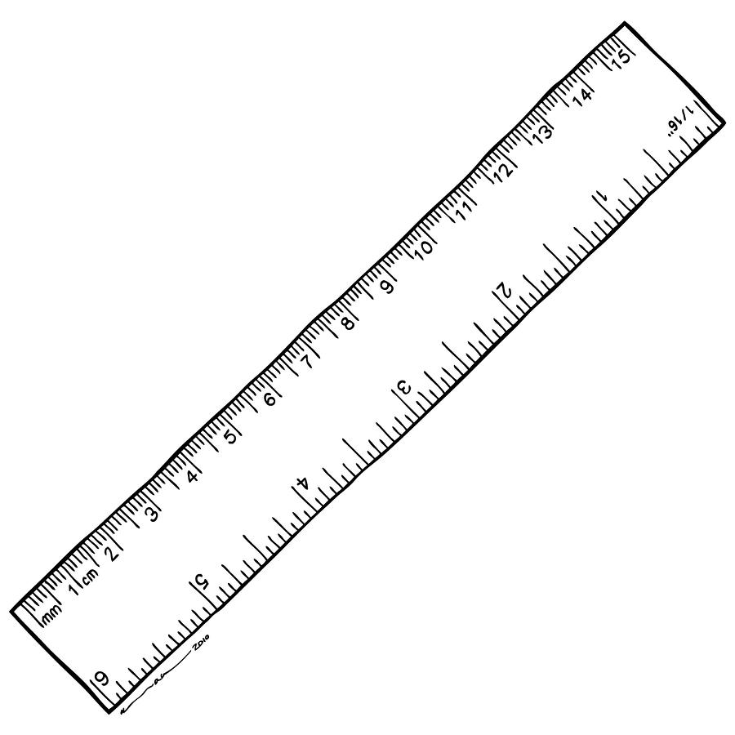
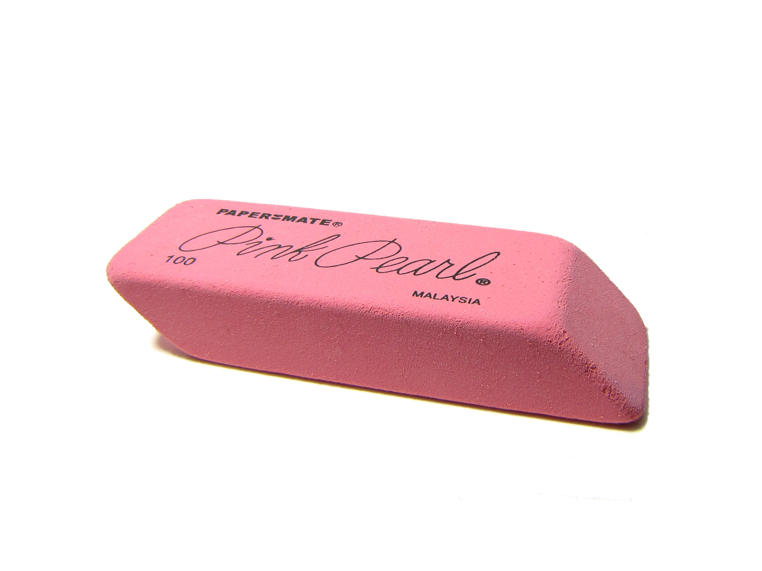
Aids Allowed on the Final Exam
Any calculator without communication capability.
Aid sheet: one single, original, handwritten 8 1/2 × 11 inch sheet of paper, which may be written on both sides.
A ruler.
A paper copy of an English translation dictionary.
Also:

Slide 39
Mon. Dec. 16 evening: Go see an early movie!
The evening before a test is NOT the best time to study (it is just the most popular)
Don’t worry – you have been studying since the 1st week of classes!
Go to bed early! You should arrive at the exam by 8:30am to be safe!

Slide 40
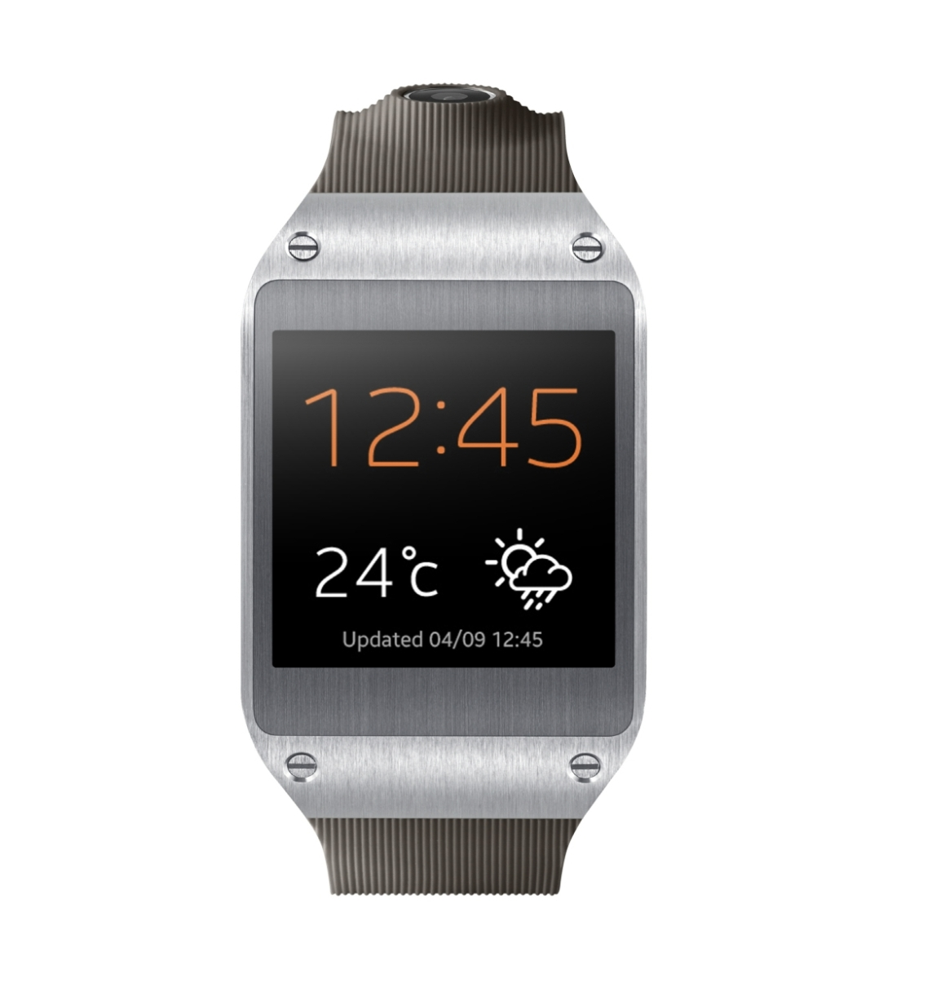
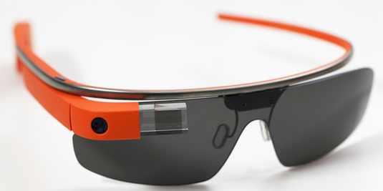
During the Exam
Exam begins at 9:00am SHARP!!!
Skim over the entire exam from front to back before you begin. Look for problems that you have confidence to solve first.
If you start a problem but can’t finish it, leave it, make a mark on the edge of the paper beside it, and come back to it after you have solved all the easy problems.
When you are in a hurry and your hand is not steady, you can make little mistakes; if there is time, do the calculation twice and obtain agreement.
Bring a snack or drink.
Don’t leave a test early!

Slide 41
Non-Equilibrium
Suppose the x- and y-components of acceleration are independent of each other
That is, a_{x} does not depend on y or v_{y}, and a_{y} does not depend on x or v_{x}
Your problem-solving strategy is to:
Draw a free-body diagram
Use Newton’s second law in component form:
The force components (including proper signs) are found from the free-body diagram

Slide 42
Gravity: F_{G} = mg is just a short form!
and
are the same equation, with different notation!
The only difference is that in the second equation we have assumed that m₂ = M (mass of the earth) and r ≈ R (radius of the earth).

Slide 43
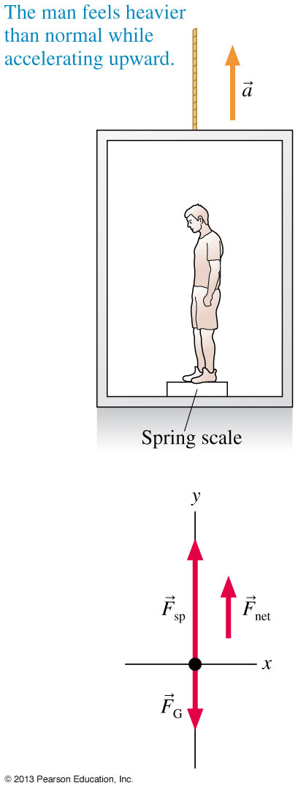
Weight: A Measurement
The figure shows a man weighing himself in an accelerating elevator
Looking at the free-body diagram, the y-component of Newton’s second law is:
The man’s weight as he accelerates vertically is:
You weigh more as an elevator accelerates upward!

Slide 44
QuickCheck 6.7
An astronaut takes her bathroom scales to the moon, where g = 1.6 m/s². On the moon, compared to at home on earth:
Her weight is the same and her mass is less.
Her weight is less and her mass is less.
Her weight is less and her mass is the same.
Her weight is the same and her mass is the same.
Her weight is zero and her mass is the same.
Slide 6-60
Notes:
44
Answer: B

Slide 45
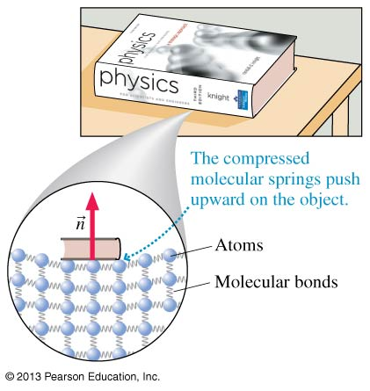
Normal Force
When an object sits on a table, the table surface exerts an upward contact force on the object
This pushing force is directed perpendicular to the surface, and thus is called the normal force
A table is made of atoms joined together by molecular bonds which can be modeled as springs
Normal force is a result of many molecular springs being compressed ever so slightly

Slide 46
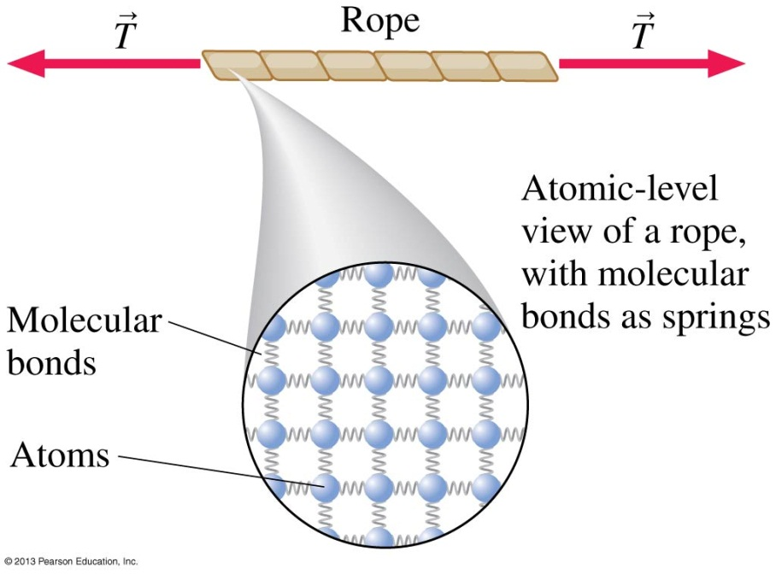
Tension Force
When a string or rope or wire pulls on an object, it exerts a contact force called the tension force
The tension force is in the direction of the string or rope
A rope is made of atoms joined together by molecular bonds
Molecular bonds can be modeled as tiny springs holding the atoms together
Tension is a result of many molecular springs stretching ever so slightly

Slide 47
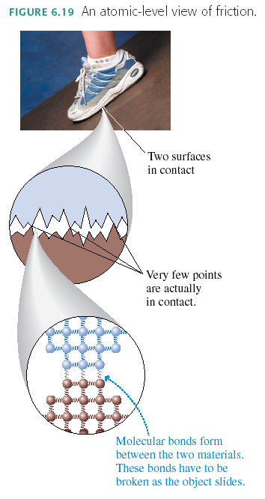
Why does friction exist?
Because at the microscopic level, nothing is smooth!

Slide 48
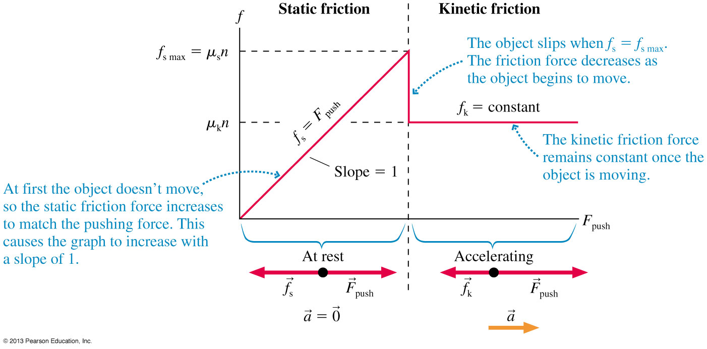
A Model of Friction
The friction force response to an increasing applied force.

Slide 49
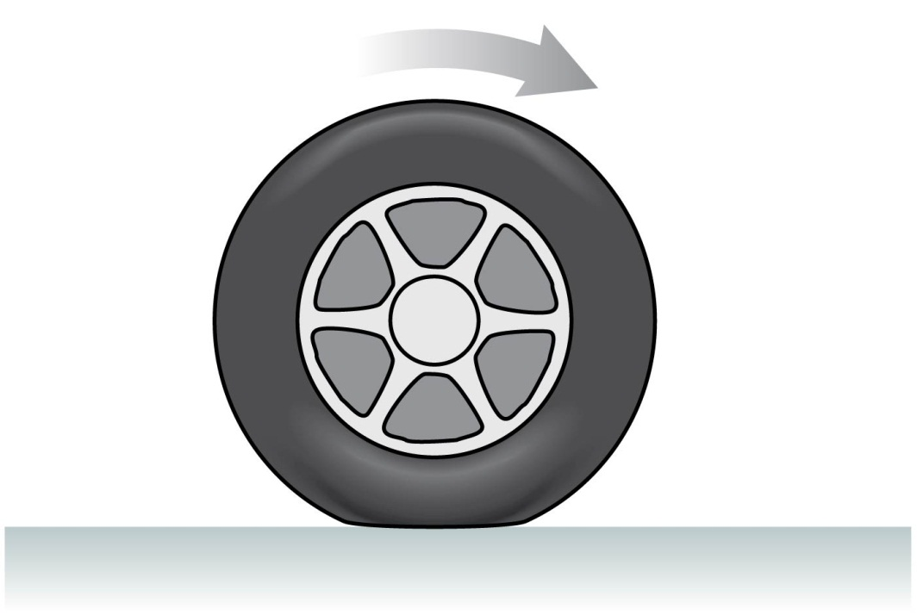
Rolling Motion
If you slam on the brakes so hard that the car tires slide against the road surface, this is kinetic friction
Under normal driving conditions, the portion of the rolling wheel that contacts the surface is stationary, not sliding
If your car is accelerating or decelerating or turning, it is static friction of the road on the wheels that provides the net force which accelerates the car

Slide 50
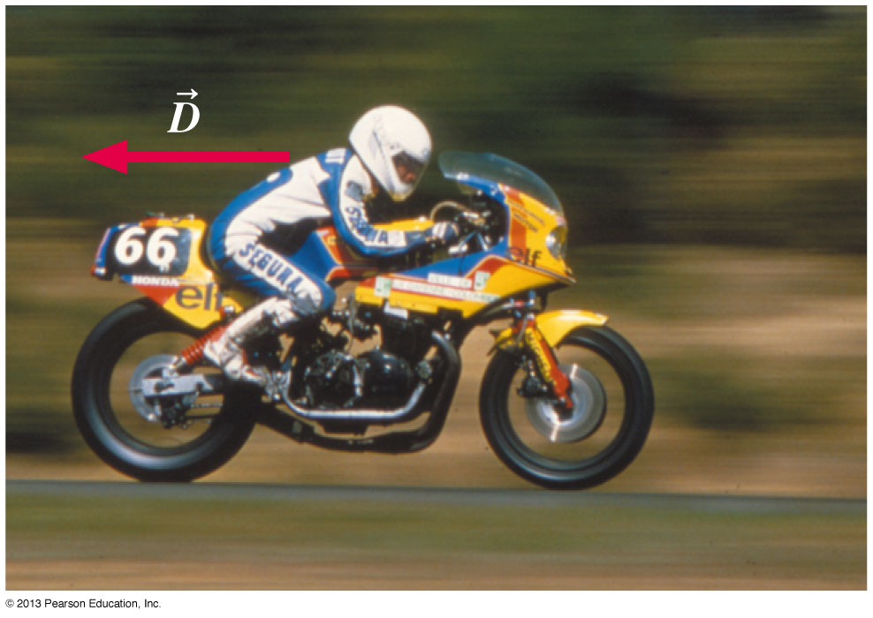
Drag
The air exerts a drag force on objects as they move through the air
Faster objects experience a greater drag force than slower objects
The drag force on a high-speed motorcyclist is significant
The drag force direction is opposite the object’s velocity

Slide 51
Drag
For normal sized objects on earth traveling at a speed v which is less than a few hundred meters per second, air resistance can be modeled as:
A is the cross-section area of the object
ρ is the density of the air, which is about 1.2 kg/m³
C is the drag coefficient, which is a dimensionless number that depends on the shape of the object

Slide 52
Cross Sectional Area depends on size, shape, and direction of motion.
…Consider the forces on a falling piece of paper, crumpled and not crumpled.

Slide 53
Terminal Speed
The drag force from the air increases as an object falls and gains speed
If the object falls far enough, it will eventually reach a speed at which D = F_{G}
At this speed, the net force is zero, so the object falls at a constant speed, called the terminal speed v_{term}

Slide 54
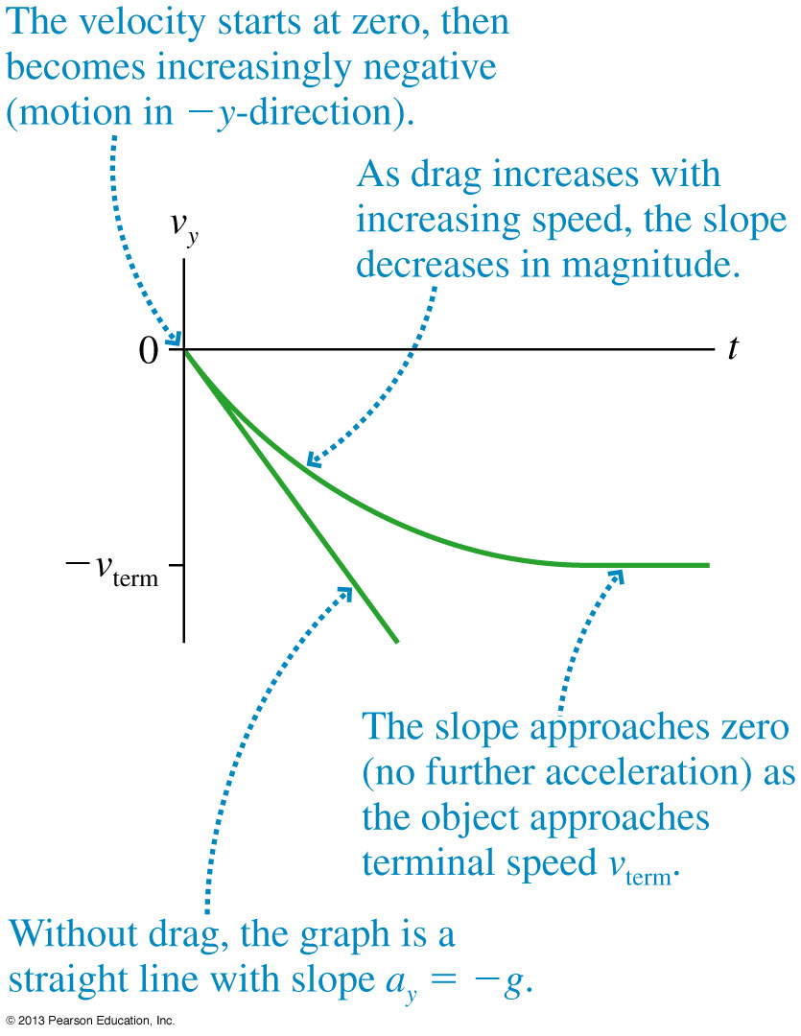
Terminal Speed
The figure shows the velocity-versus-time graph of a falling object with and without drag
Without drag, the velocity graph is a straight line with a_{y} = −g
When drag is included, the vertical component of the velocity asymptotically approaches −v_{term}

Slide 55
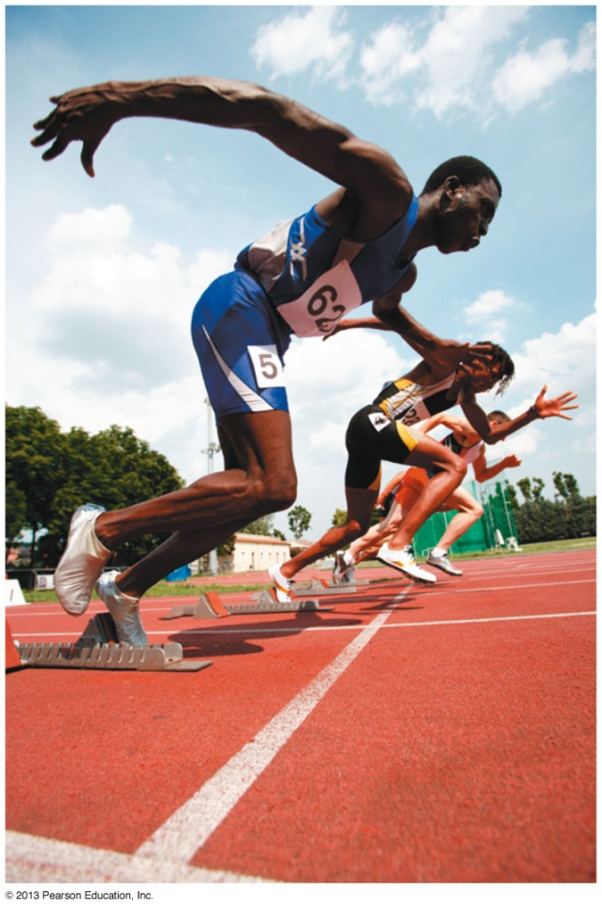
Propulsion
If you try to walk across a frictionless floor, your foot slips and slides backward
In order to walk, your foot must stick to the floor as you straighten your leg, moving your body forward
The force that prevents slipping is static friction
The static friction force points in the forward direction
It is static friction that propels you forward!
What force causes this sprinter to accelerate?

Slide 56
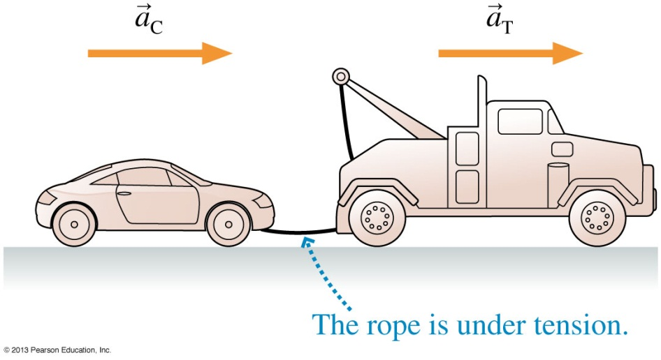
Acceleration Constraints
If two objects A and B move together, their accelerations are constrained to be equal: a_{A} = a_{B}
This equation is called an acceleration constraint
Consider a car being towed by a truck
In this case, the acceleration constraint is a_{Cx} = a_{Tx} = a_{x}
Because the accelerations of both objects are equal, we can drop the subscripts C and T and call both of them a_{x}

Slide 57
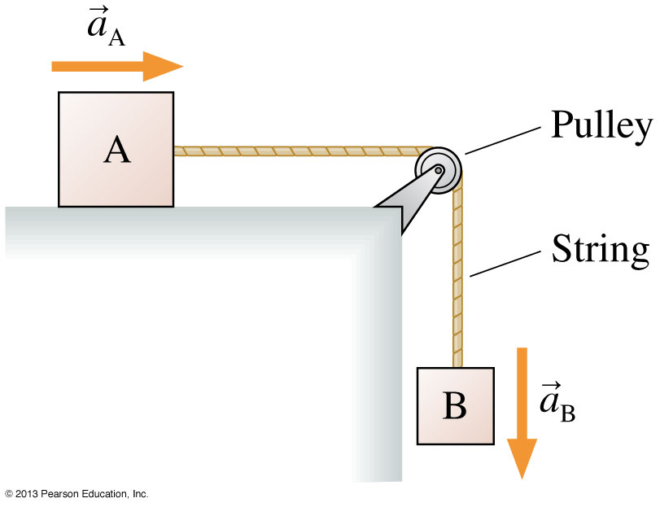
Acceleration Constraints
Sometimes the acceleration of A and B may have different signs
Consider the blocks A and B in the figure
The string constrains the two objects to accelerate together
But, as A moves to the right in the +x direction, B moves down in the −y direction
In this case, the acceleration constraint is a_{Ax} = −a_{By}

Slide 58
The Massless String Approximation
Often in physics problems the mass of the string or rope is much less than the masses of the objects that it connects. In such cases, we can adopt the following massless string approximation:

Slide 59
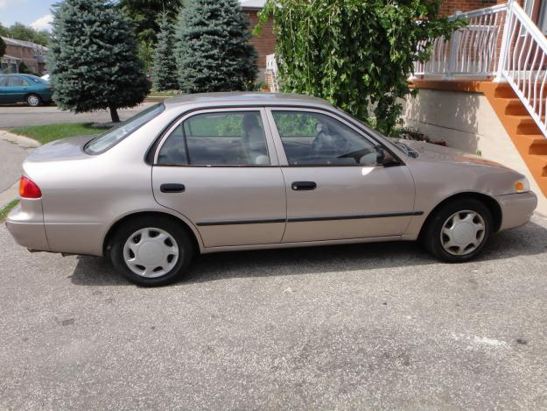
A car is parked on a flat surface.
The car has a mass, m, and a downward force of gravity on it of magnitude F_{G} = mg.
Why is the normal force equal to mg?
Because that is the equation for normal force: n = mg
Because acceleration is zero, so the forces must balance
Because of Newton’s 3rd Law: the two forces must be equal and opposite

Slide 60
Good Luck!!
I’ll see you on Tuesday, Dec. 17 at 9:00am
Then I hope to see you again on Monday, January 6 for the first class of PHY132!
I will start by talking about Waves – Chapter 20!
PHY132 goes on to cover Sound, Optics, Electricity, Magnetism and Einstein’s Theory of Relativity!
Next up: Andrew at 1:00pm

