Slide 1
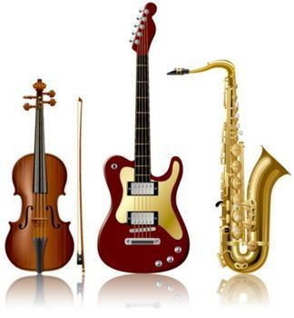
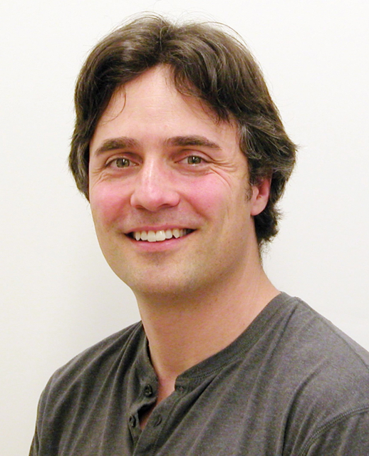
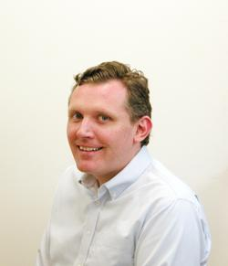
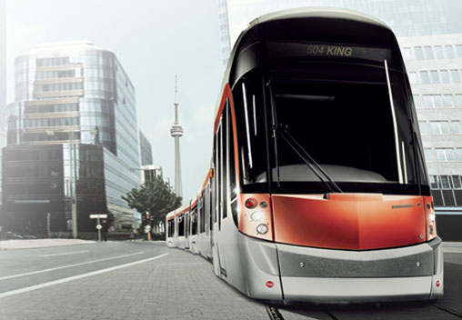
PHY131H1F Introduction to Physics I Class 1
Welcome - please make yourself comfortable!
We are Jason Harlow and Andrew Meyertholen. We will be sharing the teaching between now and December.
Today will be an introduction and team lecture
On Wednesday Dr. Harlow will take over for the first half of the semester, starting with Chapter 1!

Slide 2
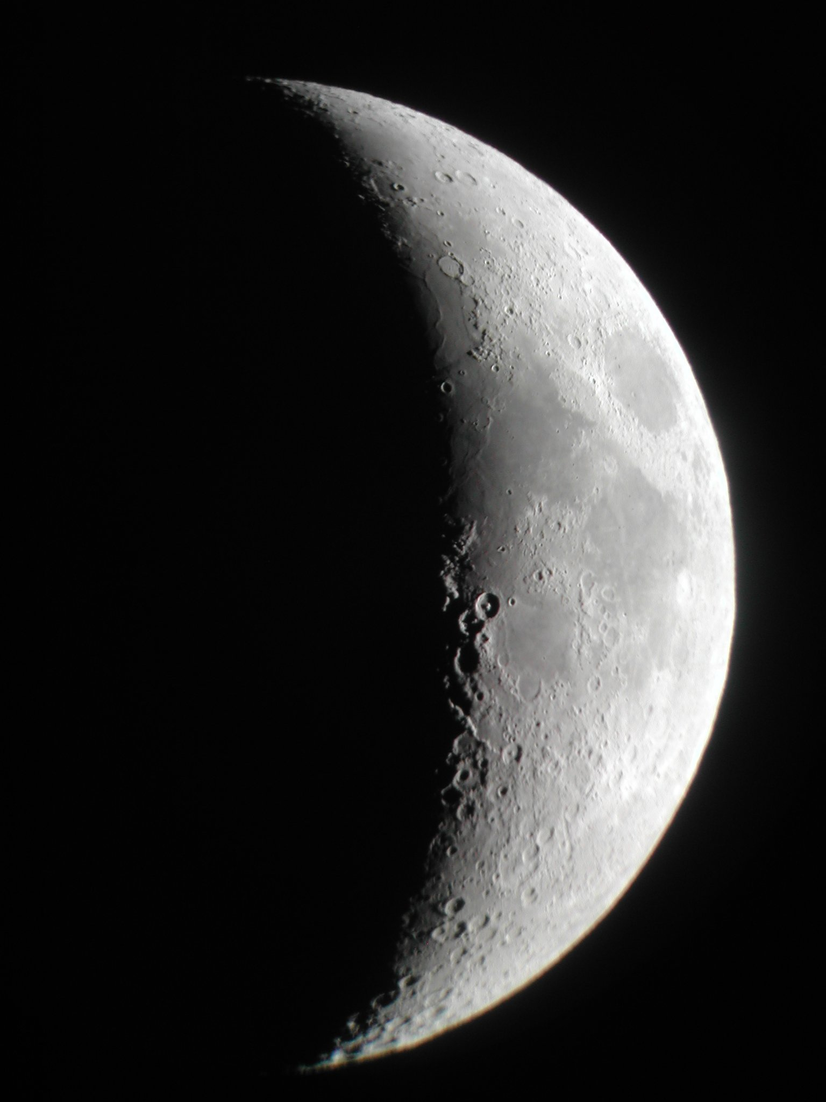
Today’s Outline
Introduction Who are we? What is physics?
Run of the Course Online Assignments, Practicals, Tests and Exam
Physics Education Research Why all the clickers, pre-class quizzes, practicals?
Why are We in This Class?
Tips for Class Success

Slide 3
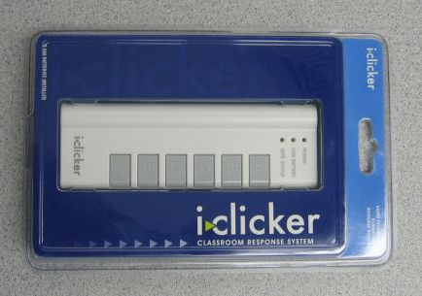
Clickers…
Beginning Wednesday, we will be asking in-class clicker questions every class.
You will receive marks participation only; there is no penalty for getting the wrong answer.
Clicker Participation is worth 2% of your course mark.
Clickers cost $42 at the bookstore new, and can be sold back for half-price after you are done. Many courses at U of T use these clickers.
In this course you have the option of using an i>clicker, i>clicker+, or i>clicker2 remote, or using i>clicker GO, which enables you to vote via a web-enabled device like a laptop or smart phone.
i>clicker GO is a free app for iphone or android, but an account costs $10 per semester, non-refundable.

Slide 4
Who is teaching this course?
First half, now until late October:
Jason Harlow
B.Sc. University of Toronto 1993
Ph.D. Pennsylvania State University 2000
Second half, October 28 to December 4:
Andrew Meyertholen

Slide 5
My contact information
Jason Harlow, teaching first half of course
jharlow@physics.utoronto.ca
Office: MP121B
www.facebook.com/harlowphysics
Twitter @jasonjbharlow
Voice line (no texts): 416-946-4071
Fall 2013 office hours: T2, R10 and F10, starting tomorrow.

Slide 6
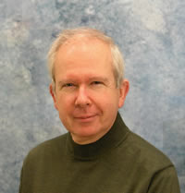
Other important contacts
Dr. Pierre Savaria, Course Coordinator
phy131@physics.utoronto.ca
Office: MP129E
Voice line: 416-978-4135
Ms. April Seeley, Course Administrator
seeley@physics.utoronto.ca
Office: MP129
Voice line: 416-946-0531
Office hours: Monday,Tuesday, Thursday, Friday 9:30am to 5:00pm, and Wednesdays from 9:30am to 4:30pm

Slide 7
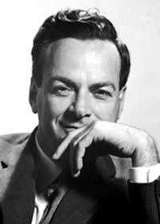
What is Physics?
“Physics is like sex. Sure you can get some interesting results, but that's not why we do it.”
Richard Feynman, 1918-1988

Slide 8
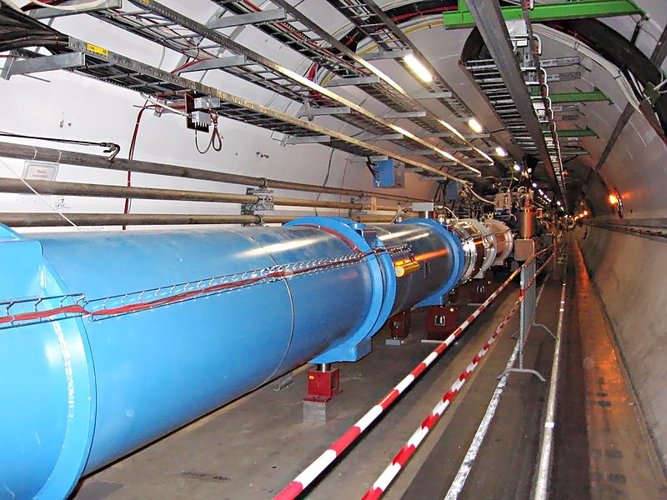
What is Physics?
The main purpose of this course is to teach you the methods by which physicists have come to understand the laws of nature.
By the time you finish this course, you will be able to recognize the evidence upon which our present knowledge of the universe is based.

Slide 9
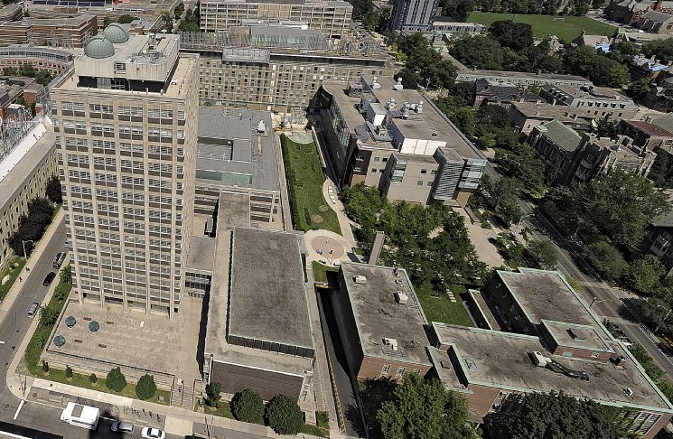
http://www.physics.utoronto.ca/
55 Researching Faculty
6 Teaching Faculty
4 Specialist Programs
Major and Minor options available

Slide 10
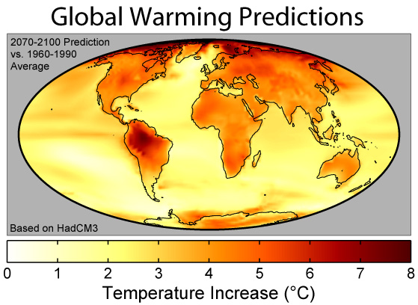
Physics at U of T

Slide 11
Superconductivity
For some materials, the resistivity vanishes at some low temperature; they become Superconductive. Superconductors have the ability to conduct electrical current with no resistance(!!!), thus no loss of energy.

Slide 12
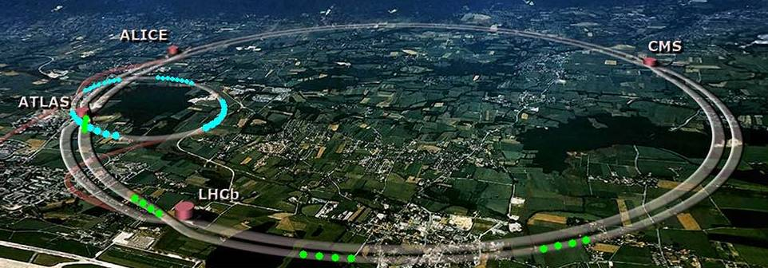
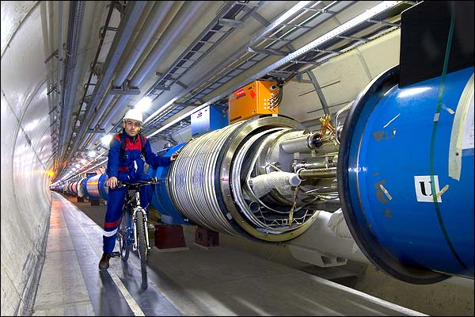
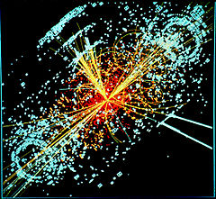
The Large Hadron Collider
[image from http://www.universetoday.com/17905/large-hadron-collider-worst-case-scenario/ ]
Higgs Boson discovered July 4, 2012
[Photo courtesy of BBC News, credited to Cern/Maximilien Brice, from http://news.bbc.co.uk/nol/shared/spl/hi/pop_ups/05/sci_nat_the_large_hadron_collider/img/1.jpg ]
[http://en.wikipedia.org/wiki/Higgs_boson ]

Slide 13
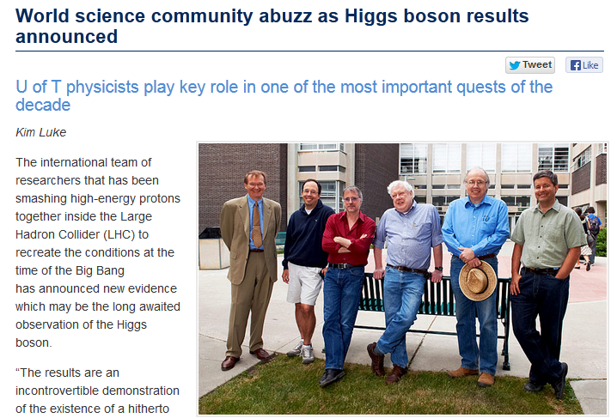
July 4, 2012

Slide 14
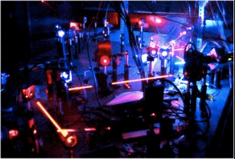
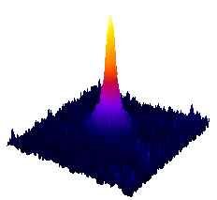
Physics at U of T

Slide 15
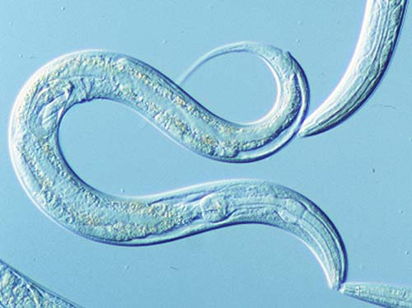
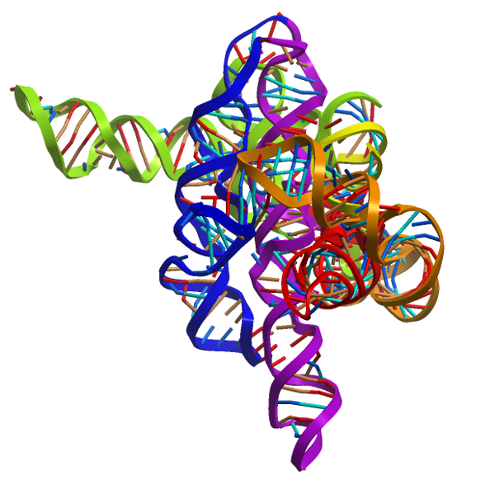
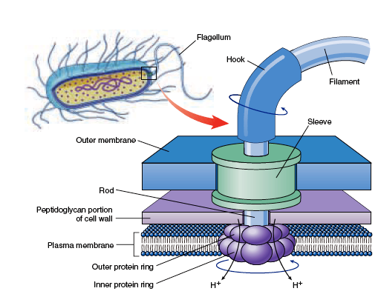
Biological Physics at U of T
How do simple creatures like C. elegans make decisions?
What is the physics behind RNA folding, molecular motors and DNA replication?
How do nano-motors transport molecules into, out of, and within cells?

Slide 16
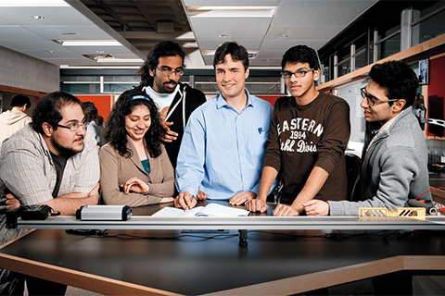
What Does Taking PHY131/132 Get You?
Lots of fun!
PHY131/132 is an acceptable pre-requisite for all second-year physics courses in case you decide to switch and pursue a POST in physics
This course will help prepare you for the physics portion of the Medical College Admission Test (MCAT) in case you want to be a doctor some day
Many health-science post-graduate programs require 2 semesters of lab-based physics

Slide 17
Does Taking PHY131 Exclude Me From Any Other Courses?
Yes: After taking this course, you cannot take “breadth courses” in physics, such as PHY100 “Magic of Physics” or PHY205 “Physics of Everyday Life” - - these courses are meant to be taken by non-science students.

Slide 18
Pre-Requisite for PHY131:
To be able to do PHY131H1 a student must have Grade 12 Calculus or Functions or their equivalent from another province or country.
Co-Requisite for PHY131:
To be able to do PHY131H1 a student must do (or have done already) MAT135H1 or MAT137Y1 or MAT157Y1, or equivalent from another university or campus.

Slide 19
What can you expect of me?
To try to teach well and explain physics clearly, at an appropriate level
To treat you with courtesy, respect and kindness
To be fair
To be in my office at scheduled office hours
To answer emails within 48 hours
To begin class at 11:10am and end class at or slightly before noon

Slide 20
What do I expect of you?
To read the assigned reading before coming to class (or at least watch the pre-class video)
To keep up with the online homework
To be seated and ready for class at 11:10
To not have more than one clicker with you (bringing a friend’s clicker to class is an academic offense called impersonation)
To not make lots of noise during class or do stuff which distracts your neighbours
To be patient with me when I make mistakes, and also to point out any mistakes I don’t notice right away

Slide 21
Online Homework
You should purchase a Student Access Kit, either as part of the textbook package or as a stand-alone
Register with your name (same name on your student card) and UTORid
Enrol in this course: MPPHY131F13
Problem Sets (worth 9% of course mark) are quite long – make take between 1 and 3 hours per week

Slide 22
Pre-Class Reading Quizzes
In order to get the best out of our classes (which will include lots of clicker questions and discussion) you must read the chapters before coming to class
If you hate reading, I have also posted pre-class videos, which go over the main points from each day’s reading
Beginning this Wednesday, there will be a short online multiple choice quiz on due by 8:00am before class.
The quiz will be based on your reading or watching of the pre-class video.
The questions are not too tricky – if you’ve read the material, you should find them quite straightforward.
These quizzes are worth 3% of your course mark

Slide 23
Tests and Exam
Test 1 is Tuesday October 8, 8:00-9:30PM in room(s) to be announced
An alternate sitting will be scheduled just before the main sitting of the test for students who demonstrate a conflict with another academic activity at U of T – you must visit April in MP129
Test 1 is worth 15% of the course mark, and covers Chapters 1-5, and the Error Analysis Document
Test 2, also worth 15%, is Tue. Nov. 19, 8:00PM
The Final Exam is worth 40% of the course mark, covers the entire course, and will be held some time TBA between Dec.9-20

Slide 24
How to get more information
The main way of keeping up with what’s going on in the course is the web-site at:
https://portal.utoronto.ca
The Course Information page on the portal page for this course has all the rules for the course – PLEASE READ IT!
Also, we will email you from time to time at your utoronto.ca email address
The above forms of electronic communication are mandatory – please use them!

