Slide 1
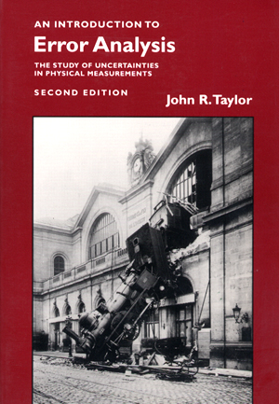
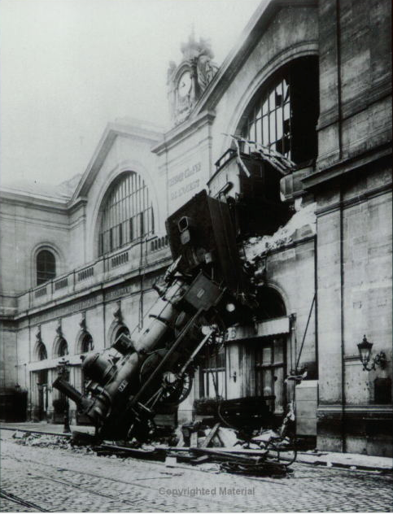
PHY131H1F Class 3
Today: Error Analysis
Significant Figures
Unit Conversion
Normal Distribution
Standard Deviation
Reading Error
Propagation of Errors
Error in the Mean

Slide 2
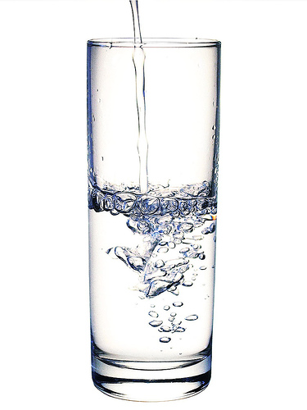
Clicker Question 1
What is the approximate density of water?
10⁻⁵ kg/m³
0.01 kg/m³
0.1 kg/m³
1 kg/m³
1000 kg/m³
Notes:
Answer: A

Slide 3
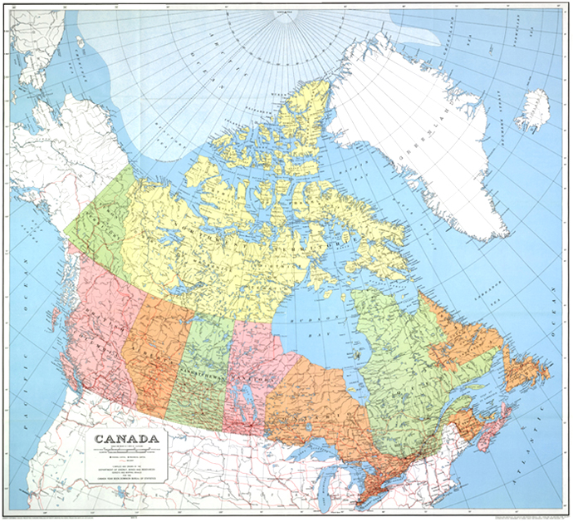
Clicker Question 2
What is the approximate width of Canada? (West to East)
50 km
500 km
5000 km
50,000 km
500,000 km
Notes:
Answer: A

Slide 4
Class 3 Preclass Quiz on MasteringPhysics
This was due this morning at 8:00am
864 students submitted the quiz on time
69% correct: If a digital thermometer reads 12.8°C and the error specified in the manual is “half the last digit”, in this case it would be ±0.05°C.
78% correct: In the physical sciences, an “error” is the number to the right of the ± symbol, also known as an uncertainty.
80% correct: In an equation for the normal distribution (Gaussian) sigma is related to the width of the distribution.
97% correct: “Mean” is the same as “average”.

Slide 5
Class 3 Preclass Quiz on MasteringPhysics
Some common student comments/feedback:
“Everything seems fine except for the terms and the formulas that gets me dizzy. I hope I wouldn't need to memorize complicated looking formulas in the near future.”
propagation of errors of precision
Standard deviation
“I want to know if there are specidic problem sets that i can practice from in the book without doing every single question at the end of each chapter?”
“I am wondering if anyone would click the ‘song by Taylor Swift’ option for kicks, though.”

Slide 6
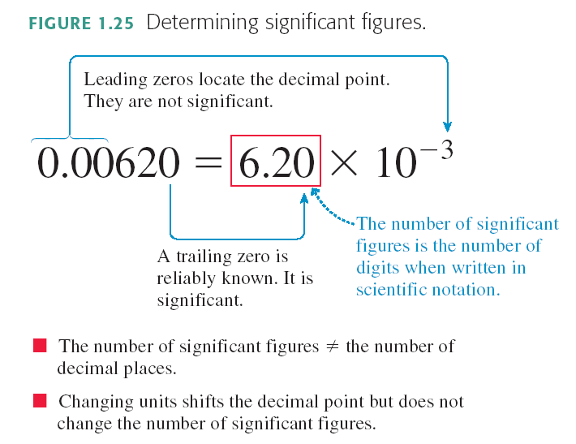
From Knight Chapter 1:

Slide 7
Example Problem - Rounding
A cart begins at rest, and accelerates down a ramp with acceleration: a = 0.518 m/s².
After 3.2 s, how far has it traveled?
Use d = ½ a t².

Slide 8
Clicker Question 3
A cart begins at rest, and accelerates down a ramp with acceleration: a = 0.518 m/s². After 3.2 s, how far has it traveled? d = ½ a t² gives the result 2.65216 on your calculator. How should you best report this answer in your “Final Answer” box?
2.65216 m
2.65 m
2.60 m
2.6 m
2.7 m

Slide 9
Example Problem – Rounding Early
A cart begins at rest, and accelerates down a ramp with acceleration: a = 0.518 m/s².
After 3.2 s, how far has it traveled?
Use d = ½ a t².
t = 3.2 s
t ² = 10.24 s ²

Slide 10
When do I round?
The final answer of a problem should be displayed to the correct number of significant figures
Numbers in intermediate calculations should not be rounded off
It’s best to keep lots of digits in the calculations to avoid round-off error, which can compound if there are several steps

Slide 11
An important skill: Unit Conversion
Example
Knight Ch. 1 Problem 24d (page 30):
Convert 14 in² to SI units.
Known:
1 in = 2.54 cm
100 cm = 1 m
The SI unit of area is m².

Slide 12
Convert 14 in² to m².
$$1=\left(\frac{1 in}{2.54 cm}\right)=\left(\frac{2.54 cm}{1 in}\right)$$
$$1=\left(\frac{100 cm}{1 m}\right)=\left(\frac{1 m}{100 cm}\right)$$

Slide 14
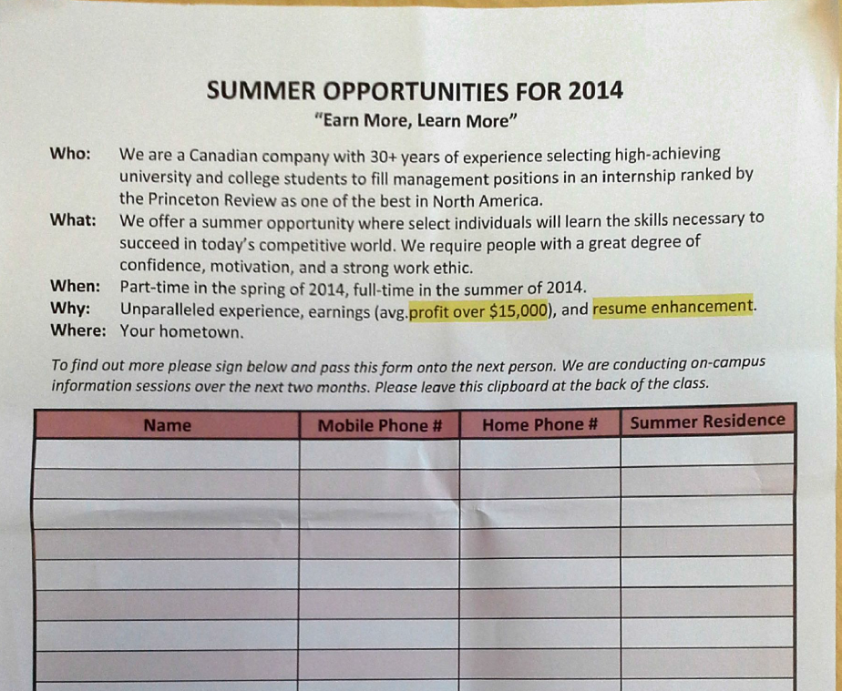
I have been informed that a clipboard was being passed around in Convocation Hall last week with a “sign-in sheet”.
I will never authorize a clipboard to be passed around this room.
In the future, if you see something like this being passed around, please place it on the floor and refuse to pass it on.
Thanks!

Slide 15
Real 2-hour Practicals begin this week!
Check out my video
All you need is a calculator, your textbook and something to write with.
Dr. Meyertholen has posted a good 6 minute video with answers to lots of FAQs about Practicals at:
http://youtu.be/DVsLJgxJVgo

Slide 16
Last Wednesday I asked at the end of class:
If your height is 150 cm, is there an error in that number?
ANSWER: YES! Almost every measured number has an error, even if it is not stated. If you told me your height was 150 cm, I would guess the error is probably between 1 and 5 cm. [But there is no way to know this, unless you investigate how the 150 was measured.]

Slide 17
Demo and Example: What is the Period of a Swinging Ball? (Pendulum)
Procedure: Measure the time for 5 oscillations, t₅.
The period is calculated as T = t₅ / 5.
t₅ data:

Slide 18
Here were Harlow’s measurements of t₅:
7.53 s
7.38 s
7.47 s
7.43 s
Which of the following might be a good estimate for the error in Harlow’s first measurement of 7.53 seconds?
0.005 s
0.05 s
0.5 s
5 s
Impossible to determine
Clicker Question 4

Slide 19
7.53 s
7.38 s
7.47 s
7.43 s

Slide 20
7.53 s
7.38 s
7.47 s
7.43 s
7.44 s
7.56 s
7.48 s
7.40 s

Slide 24
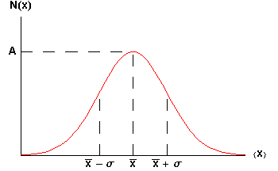
The Gaussian:
When you integrate this curve, you find that 68% of area lies between the dotted lines on the graph.

Slide 25
Heights of some People (London, 1886)
Gaussian Distributions turn up everywhere!
inches

Slide 26
Random Walk
Where does an object end up, if it takes N steps randomly left or right?
The final distribution is described by a Gaussian function!

Slide 27
The t₅ data
Numerically:
7.53 s 7.38 s 7.47 s 7.43 s
+ 0.06 s + 0.06 s + 0.06 s + 0.06 s

Slide 28
Propagation of Errors
Rule #1 (sum or difference rule):
If z = x + y
or z = x – y
then
Rule #2 (product or division rule):
If z = xy
or z = x/y
then

Slide 29
Propagation of Errors
Rule #2.1 (multiply by exact constant rule):
If z = xy
and x is an exact number, so that Δx = 0
then
Rule #3 (exponent rule):
If z = x^{n}
then

Slide 30
What is the error in the mean of N measurements with the same error Δx ?

Slide 31
The Error in the Mean
Many individual, independent measurements are repeated N times
Each individual measurement has the same error Δx
Using error propagation you can show that the error in the estimated mean is:

Slide 32
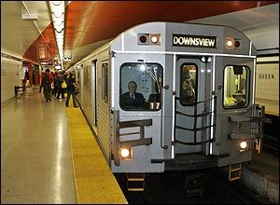
You wish to know the time it takes to travel from Finch station to Yonge/Bloor by subway. You ask 10 people to take a stopwatch and time the trip. After analyzing all the data you find that it takes an average of 26 minutes and 40 seconds, with an error in this average of ± 100 seconds.
If you expand your survey and ask 1000 people to time the trip, when you analyze the data, what would you expect to be the error in the average time?
100 seconds
50 seconds
10 seconds
1 second
0.05 seconds
Clicker Question 5

Slide 33
Significant Figures
Discussed in Section 1.8 of Knight Ch.1
The rules for significant figures when errors are involved are:
Errors should be specified to one or two significant figures.
The most precise column in the number for the error should also be the most precise column in the number for the value.

Slide 34
Clicker Question 6
Example: If a calculated result is d = 7.056 +/- 0.705 m, how should you report this?
7.1 ± 0.7 m
7.06 ± 0.71 m
7.056 ± 0.705 m
Any of the above
Either A or B, but not C

Slide 35
Before Class 4 on Wednesday
Please read Chapter 2, Sections 2.1-2.4 of Knight (or at least watch the pre-class video for Class 4)
Please do the pre-class quiz before Wednesday at 8:00am.
Don’t forget to start the Problem Set due Sunday – there’s no time limit, just a deadline
Something to think about: Does constant velocity imply constant acceleration? Does constant acceleration imply constant velocity?

