Slide 1
PHY131H1F Class 4
Today, Chapter 2, Sections 2.1 to 2.4
Uniform Motion
Average velocity / Instantaneous Velocity
Differentiating position to get velocity
Integrating velocity to get position
Equations of Constant Acceleration

Slide 2
Clicker Question 1
t
x
If the Position versus Time graph of an object moving in 1D is a straight line, what does this mean?
The object is not moving
The object is moving with a constant velocity
The object is moving with a constant acceleration

Slide 3
Class 4 Preclass Quiz on MasteringPhysics
This was due this morning at 8:00am
899 students submitted the quiz on time
63% answered correctly: If the position-versus-time graph is a straight line, it means it has uniform motion. (Note: a horizontal straight line means it is stationary.)
72% answered correctly: Speeding up when velocity is in the negative direction means negative acceleration.
76% answered correctly: The area under a velocity-versus-time graph is the displacement of the object (it can be negative or positive, indicating direction)
88% answered correctly: The slope of a position-versus-time graph is the object’s velocity (it can be negative or positive, indicating forward or backward direction in 1D)

Slide 4
Class 4 Preclass Quiz on MasteringPhysics
Some common student comments/feedback:
“The integral explanations were very confusing, we never learned integrals as it was not part of my grade 12 Ontario curriculum, and we haven't learned them yet in MAT135.”
“Integrals make me dizzy (why stop the running joke now?)”
Harlow and Meyertholen say: “We will not expect you to perform integrals on a test or exam. We use the language of calculus to describe concepts in this course, but the math you are required to do is limited to algebra, and maybe differentiation, at the most.”
From https://piazza.com : “Is it OK to write the derivative of a function as f ' (x)? Instead of d / dt?”

Slide 5
Class 4 Preclass Quiz on MasteringPhysics
You don’t need to know this for this course, but in upper level physics courses and research, the tradition is to use primes for spatial derivatives, and dots for time derivatives..
$$y^{′}≡\frac{dy}{dx}$$
$$\dot{y}≡\frac{dy}{dt}$$
$$y^{′}′≡\frac{d^{2}y}{{dx}^{2}}$$
$$\ddot{y}≡\frac{d^{2}y}{{dt}^{2}}$$
Feel free to use these notations if you wish; I’m sure the graders and TAs in this course will understand what you mean.

Slide 6
Last day I asked at the end of class:
Does constant velocity imply constant acceleration?
ANSWER: YES, and even more, it implies zero acceleration! (zero is a constant!)
Does constant acceleration imply constant velocity?
ANSWER: NO! Unless that constant happens to be zero! Constant acceleration normally means constantly changing velocity!

Slide 7
Uniform Motion = Constant Velocity
$$x_{f}=x_{i}+v_{x}t$$
In the absence of friction, all objects tend to move with constant velocity.
This is “Newton’s First Law of Motion.”
x
t

Slide 8
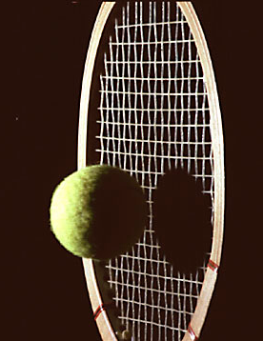
No force
Not squished
Images from http://people.rit.edu/andpph/exhibit-8.html ; taken by Andrew Davidhazy
External force on ball
Ball is squished

Slide 9
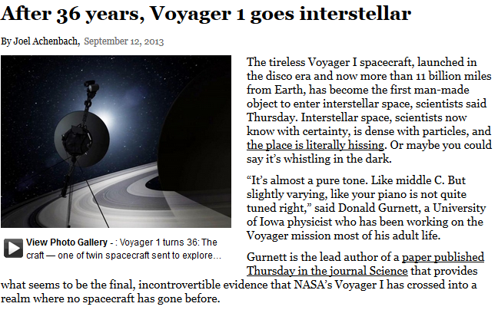
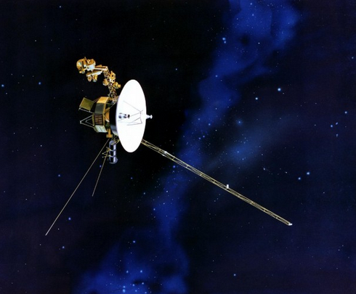
http://articles.washingtonpost.com/2013-09-12/national/42010179_1_heliosphere-solar-particles-charged-particles
The farthest manmade object from Earth.
Currently 125 A.U. from the Sun (Earth is 1 A.U.)
Moving at a constant velocity in a straight line of 17 km/s through interstellar space

Slide 10
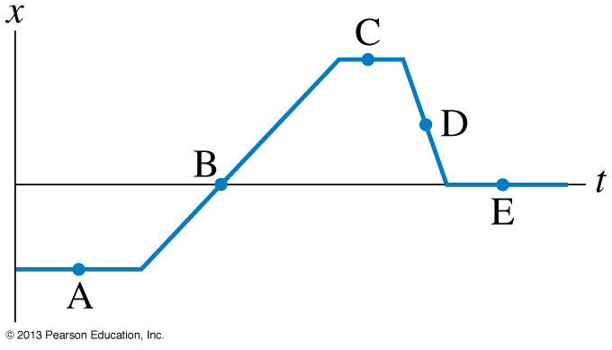
Clicker Question 2
At which point is the object moving the fastest? (highest speed)

Slide 11
Clicker Question 3
At which point is the object moving the to the left?

Slide 12
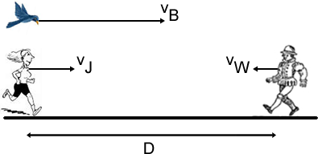
From a Past PHY131 Test (2006):
A jogger runs at a constant velocity ${\vec{v}}_{J}=10 \frac{km}{hr} to the right.$
A walker walks at a constant velocity ${\vec{v}}_{W}=5 \frac{km}{hr} to the left.$
When the jogger and the runner are D = 3 km apart, a bird flying at a constant velocity ${\vec{v}}_{B}=30 \frac{km}{hr} to the right$ passes the jogger.
When the bird reaches the walker, it turns around and flies back to the jogger at the same speed. When it reaches the jogger it turns around again and flies to the walker. It continues flying back and forth between the jogger and the walker.
When the jogger and walker meet each other, how far has the bird flown?

Slide 13
From a Past PHY131 Test (2006):
30 km/hr
5 km/hr
How far has bird flown when Jogger and Walker meet?
Bird has constant speed, so d_{B} = v_{B} t
Need to find t.
10 km/hr
= 3 km

Slide 14
Curved Line = Not-Constant Velocity
$$v_{x}= \frac{dx}{dt}$$
x
t

Slide 15
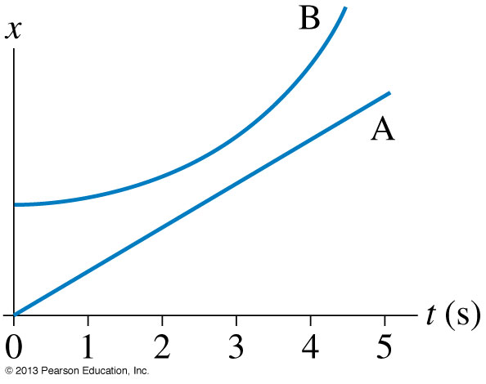
Clicker Question 4
When do objects A and B have the same velocity?
t = 0 s
t = 1 s
t = 3 s
t = 5 s
Objects A and B never have the same velocity

Slide 16
Clicker Question 5
Which velocity-versus-time graph goes best with the position-versus-time graph on the left?
Notes:
Answer: C

Slide 17
Announcements
Pre-course diagnostic quiz on mechanics done during zeroth practical last week.
Did you miss it? Still want your 0.25%? Here are two make-up times to choose from:
Tues Sept. 24 - 11:10 am in MP125C Wed. Sept 25 - 6:10 pm in MP125C

Slide 18
Announcements
Don’t change your Practical Section on ROSI – your TAs will never know, and you won’t get your marks!
You must go to MP129 and fill out a form if you want to change Practical Sections. (or do the online form)
If you’ve already switched Practicals on ROSI recently and you aren’t sure if your new and old TAs have the updated information, please go to MP129 and ask April Seeley.

Slide 19
University of
Toronto
Peer
Tutoring
Letter of Recognition
& Certificate .____________________________________________________________________
Looks great on your résumé or CV! ._____________________________________________________________________
Test your knowledge and review past material
FREE one-on-one tutoring sessions
._____________________________________________________________________________________________________
FREE exam help sessions
_____________________________________________________________________________________________________
Tips from students who have already taken the courses
Visit us at /UofT.peertutoring or utpt.c-ut.ca

Slide 20
Acceleration in 1-D (along a line)
Velocity is the time-derivative of position.
Acceleration is the time-derivative of velocity.
S.I. unit of acceleration is m/s per second, also called m/s².
Acceleration is like the “speed of the speed”
Acceleration is “how fast fast changes!”
It is possible to be momentarily stopped (v=0) with a non-zero acceleration!

Slide 21
Constant Acceleration
$$v_{f}=v_{i}+a_{x}t$$
$$x_{f}=x_{i}+\int_{0}^{t}{vdt}$$
v
t

Slide 22
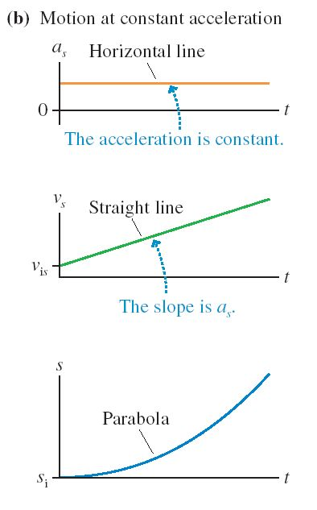

Slide 23
Clicker Question 6
v
An object has a constant velocity of +10 m/s for 5 seconds.
10 m/s
How far does the object travel over these 5 seconds?
10 m
25 m
50 m
100 m
500 m
t
5 s

Slide 24
Clicker Question 7
v
An object has an initial velocity of +10 m/s.
It is slowing down, with a constant value of acceleration.
After 5 seconds, it has stopped.
10 m/s
How far does the object travel over these 5 seconds?
10 m
25 m
50 m
100 m
500 m
t
5 s

Slide 25
Average Velocity
v
10 m/s
$$v_{avg}=5 m/s$$
For 1D motion with constant acceleration, the average velocity is ½(initial velocity + final velocity)
t
5 s
$$v_{avg}=\frac{v_{i}+v_{f}}{2}$$
$$v_{avg}=\frac{d}{t}$$

Slide 26
The 4 Equations of Constant Acceleration:
1.
Does not contain position!
2.
Does not contain v_{f} !
3.
Does not contain Δt !
Does not contain a ! (but you know it’s constant)
4.
Strategy: When a = constant, you can use one of these equations. Figure out which variable you don’t know and don’t care about, and use the equation which doesn’t contain it.

Slide 27
Example.
You are traveling at 30 m/s, and suddenly hit the brakes.
Your maximum acceleration is 10 m/s².
What is your minimum stopping distance?

Slide 28
Clicker Question 8
You are driving along a straight highway at a steady speed.
A driver in the left lane passes you at a steady speed.
At the moment when the front of her car is exactly even with the front of your car, you both turn and your eyes meet briefly.
At this instant, do you have equal velocities?
Yes
No
Not possible to determine with information given.
[image downloaded Sep.17 2013 from http://blog.famousfootwear.com/2013/03/save-your-car-and-money-with-driving-shoes/ ]

Slide 29
Before Class 5 on Monday
If you haven’t already done it, remember there is a MasteringPhysics.com problem set due this weekend! Please submit this before 11:59pm Sunday.
Please finish reading Chapter 2 of Knight.
Something to think about: Which is easier to see: velocity or acceleration? Which is easier to feel: velocity or acceleration?

