Slide 1
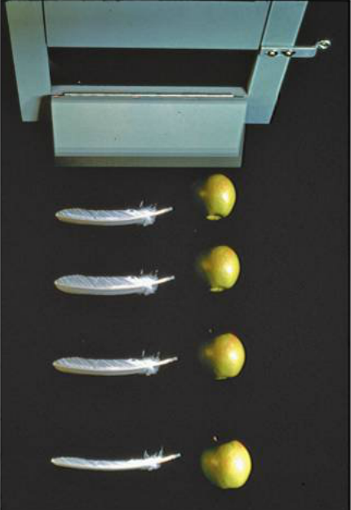
PHY131H1F Class 5
Today, Chapter 2, Sections 2.5 to 2.7
Freefall
Acceleration due to gravity
Motion on an inclined plane
Differentiating velocity to get acceleration
Integrating acceleration to get velocity
Non-constant acceleration

Slide 2
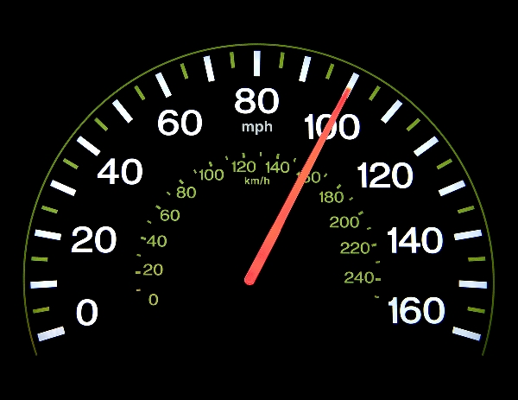
Clicker Question 1
What does the speedometer in your car measure?
distance traveled
average speed
average velocity
instantaneous speed
instantaneous velocity
[image downloaded Jan. 9 2013 from http://phoneky.com/applications/?p=preview&id=a1a32446&st=2]

Slide 3
Class 5 Preclass Quiz on MasteringPhysics
This was due this morning at 8:00am
902 students submitted the quiz on time
64% answered correctly: When a ball is thrown exactly upward, at the top of its path its instantaneous acceleration, a_{y}, is negative (downward)
76% answered correctly: When two objects of different mass slip down a frictionless hill, they do so with the same acceleration (g sin θ ).
80% answered correctly: The acceleration of an object on a frictionless plane is g sin θ .

Slide 4
Class 5 Preclass Quiz on MasteringPhysics
Some common or interesting student comments/feedback:
“The most confusing topic was the acceleration of a mass down an incline plane.”
“Everything was great. But sometimes, I feel like my dreams are accelerating towards the Earth at 9.8m/s². (I'm trying to be funny so I can finally be featured in the Powerpoint.)”
“Non-constant acceleration is a completely new concept, so it will take some time getting used to.”
“I once saw a video of a feather and a hammer being dropped on the surface of the moon, and it totally blew my mind. Now learning that Galileo figured this out 400 years ago just blew it again.”
“what did the ocean say to the beach? Nothing it just waved, and thought about how much fun physics could be if it didn't have 5 other courses.”

Slide 5
Problem Set 1 on MasteringPhysics
This was due last night at 11:59pm
935 students did the problem set by the deadline
It took an average of 1 hour 23 minutes for students to complete the problem set
The average for the 935 students who submitted on time was 98.4%!
We hope that with hints, multiple tries, and enough time, you should be able to do very well on these problem sets.
The point is that you should be learning by doing them, so you will succeed better on the midterm tests and final exam.

Slide 6
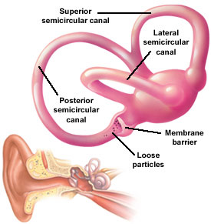
Last day I asked at the end of class:
Which is easier to see: velocity or acceleration?
ANSWER: velocity. Our eyes are very good at noticing when things are moving, but it is difficult to tell if an object is accelerating or not just by looking at it.
Which is easier to feel: velocity or acceleration?
ANSWER: acceleration. Since velocity is relative, it is actually impossible to feel if you are moving or not! But it is very easy to feel if you are accelerating. The semicircular canals in your ears are designed specifically to detect acceleration.

Slide 7
Clicker Question 2
Your car starts at rest, and then you speed up to a maximum of 120 km/hr over a time of 25 seconds. During this time:
both your velocity and acceleration were constant.
your velocity was constant, but your acceleration was changing.
your velocity was changing, but your acceleration was constant.
both your velocity and acceleration were changing.

Slide 8
Very few things in real life have constant acceleration!!!
For something to have constant acceleration, all the forces on the object must remain constant as it moves.
This is rare; it is usually NOT true for people that are running or walking, automobiles, trains, or animals.
Two things actually do have constant acceleration:
Objects in freefall (flying through space under the influence of gravity only with negligible air resistance)
Objects sliding or rolling down an inclined plane (with negligible friction)

Slide 9
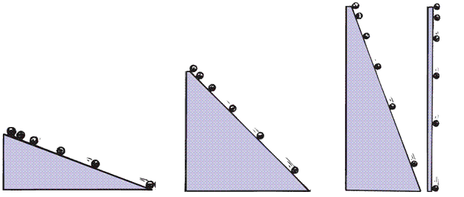
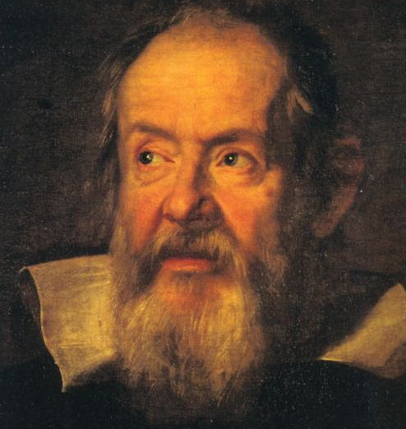
Acceleration due to Gravity
In ~1600, Galileo measured the acceleration of marbles rolling down inclined planes. He found:
Steeper inclines gave greater accelerations.
When the incline was vertical, acceleration was a certain maximum, same as that of a freely falling object.
When air resistance was negligible, all objects fell with the same unchanging acceleration.
Image of Galileo downloaded Sep. 20 2013 from: http://commons.wikimedia.org/wiki/File:Galileo-sustermans.jpg ]

Slide 10
Free Fall
= Falling under the influence of gravity only, with no air resistance.
Freely falling objects on Earth accelerate at the rate of 9.8 m/s/s, i.e., 9.8 m/s²
The exact value of free fall acceleration depends on altitude and latitude on the earth.

Slide 11
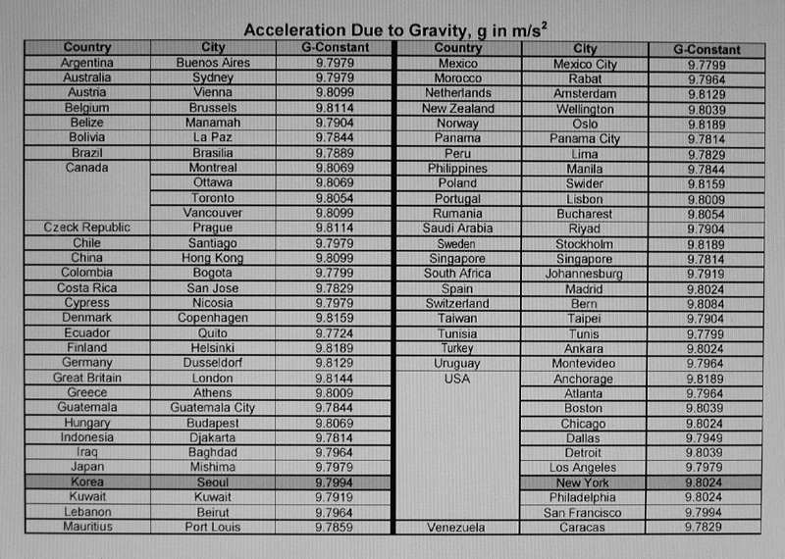
Average: 9.799 m/s²
For Problem Sets, Tests and the Exam in this class: let’s use g = 9.80 m/s²

Slide 12
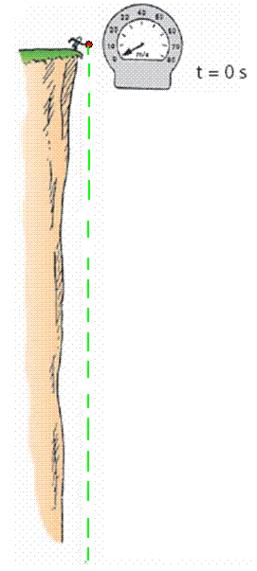
Free Fall—How Fast?
The velocity acquired by an object starting from rest is
So, under free fall, when acceleration is 9.8 m/s², the speed is
9.8 m/s after 1 s.
19.6 m/s after 2 s.
29.4 m/s after 3 s.
And so on.

Slide 13
Clicker Question 3
A tennis ball is thrown directly upward, and air resistance on the ball is negligible as it flies.
At one instant, it is traveling upward with a speed of 4.9 m/s.
1.0 seconds later, what will its speed be?
0
4.9 m/s
9.8 m/s
15 m/s
20 m/s
Notes:
13

Slide 14
Free Fall—How Far?
The distance covered by an accelerating object starting from rest is
So, under free fall, when acceleration is 9.8 m/s², the distance is:
4.9 m after 1 s,
20 m after 2 s,
44 m after 3 s,
and so on…

Slide 15
Freefall Example
What is the instantaneous velocity of a freely falling object 10.0 s after it is released from a position of rest?
What is its average velocity during this 10.0 s interval?
How far will it fall during this time?

Slide 16
A 600 g basketball and a 60 g tennis ball are dropped from rest at a height of 3 m above the ground. As they fall to the ground, air resistance is negligible. Which of the following statements is true for the balls as they fall?
Clicker Question 4
The force of gravity is 10 times greater on the basketball than on the tennis ball
The force of gravity is the same on both balls
The force of gravity is slightly larger on the basketball than on the tennis ball
Notes:
B. the same.

Slide 17
A 600 g basketball and a 60 g tennis ball are dropped from rest at a height of 3 m above the ground. As they fall to the ground, air resistance is negligible. Which of the following statements is true for the balls as they fall?
Clicker Question 5
The acceleration of the basketball is 10 times greater than the acceleration of the tennis ball
The acceleration of both balls is the same
The acceleration of the basketball is slightly larger than the acceleration of the tennis ball
Notes:
B. the same.

Slide 18
Motion on an Inclined Plane
Consider an object sliding down a straight, frictionless inclined plane

Slide 19
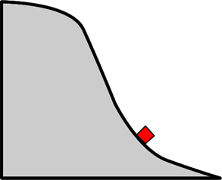
A cart slides without friction down a track as shown. As the cart slides beyond the point shown, what happens to its acceleration and its speed, both in the direction of its motion?
Clicker Question 6
(From the PHY131H1F Final Examination, December 2011.)
Both decrease.
The speed decreases, but the acceleration increases.
Both remain constant.
The speed increases, but the acceleration decreases.
Both increase.
Notes:
B. the same.

Slide 20
Instantaneous Acceleration
The instantaneous acceleration a_{s} at a specific instant of time t is given by the derivative of the velocity
Note: Knight uses “s” to denote a distance in a general direction. Usually in problems we substitute x or y instead of s.

Slide 21
Finding Velocity from the Acceleration
If we know the initial velocity, v_{is}, and the instantaneous acceleration, a_{s}, as a function of time, t, then the final velocity is given by
Or, graphically,

Slide 22
Clicker Question 7
a
An object starts at rest, and has a constant acceleration of +10 m/s² for 5 seconds.
10 m/s²
How fast is the object going after 5 seconds?
10 m/s
25 m/s
50 m/s
100 m/s
500 m/s
t
5 s

Slide 23
Clicker Question 8
An object starts at rest, and has an initial acceleration of +10 m/s².
As it speeds up, its acceleration decreases at a constant rate.
After 5 seconds, it is traveling at a constant velocity (a = 0).
a
10 m/s²
t
How fast is the object going after 5 seconds?
10 m/s
25 m/s
50 m/s
100 m/s
500 m/s
5 s

Slide 24
When Acceleration Changes Abruptly
Consider an object that has a constant acceleration, a₁, from t_{A} until t_{B}
At t_{B} its acceleration suddenly changes to a₂, and remains constant until t_{C}.
Strategy:
Divide the motion into segments 1 & 2.
You can use the equations of constant acceleration in each segment
The final position and velocity of segment 1 become the initial position and velocity of segment 2.

Slide 25
Challenge Problem 2.77
A rocket is launched straight up with constant acceleration. Four seconds after liftoff, a bolt falls off the side of the rocket. The bolt hits the ground 6.0 s later. What was the rocket’s acceleration?

Slide 27
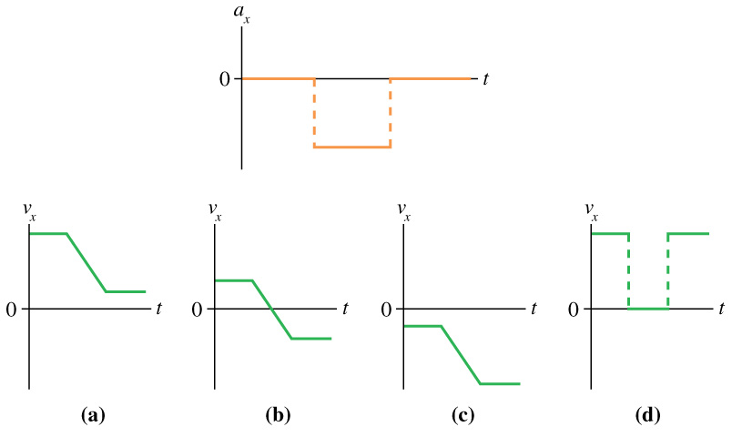
Clicker Question 9
Which velocity-versus-time graph or graphs goes with this acceleration-versus-time graph? The particle is initially moving to the right and finally to the left.
Notes:
Answer: B

Slide 28
Before Class 6 on Wednesday
Please read Chapter 3 of Knight.
There is a MasteringPhysics PreClass Quiz on chapter 3 due Wed. 8am.
Something to think about: Can you add a scalar to a vector? Can you multiply a vector by a scalar?

