Slide 1
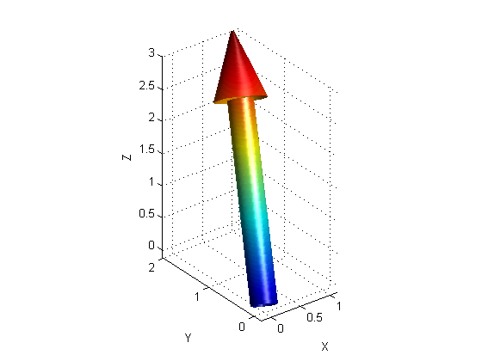
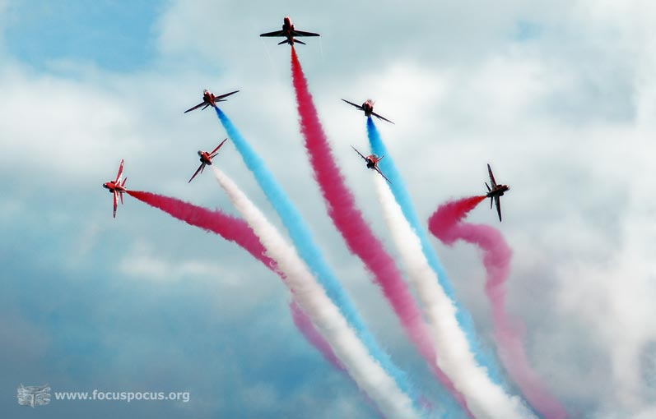
PHY131H1F - Class 6
Today:
Scalars and vectors
Coordinate systems, Components
Vector Algebra

Slide 2
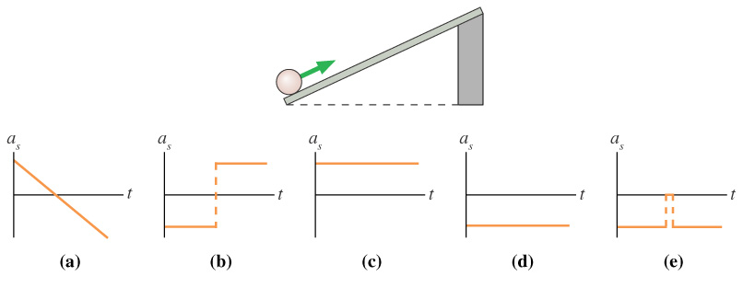
Clicker Question 1
The ball rolls up the ramp, then back down. Which is the correct acceleration graph? [Define positive s as up and to the right, parallel to the ramp..]
Notes:
Answer: D

Slide 3
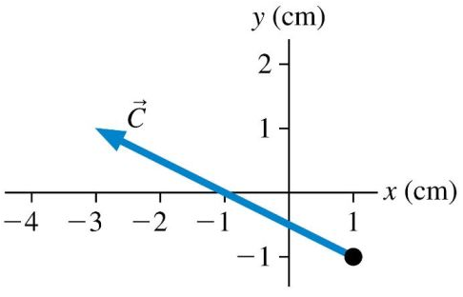
Class 6 Preclass Quiz on MasteringPhysics
This was due this morning at 8:00am
881 students submitted the quiz on time
77% answered correctly: The (x,y) components of the vector shown are (-4,2)
82% answered correctly: The vector shown can be written as $−4\hat{i}+2\hat{j}$
79% answered correctly: The unit-vector $\hat{j}$ has magnitude 1, and points in the +y direction.
94% answered correctly: A vector is a quantity having both size and direction. It is not a number, but a set of 2 or 3 numbers.

Slide 4
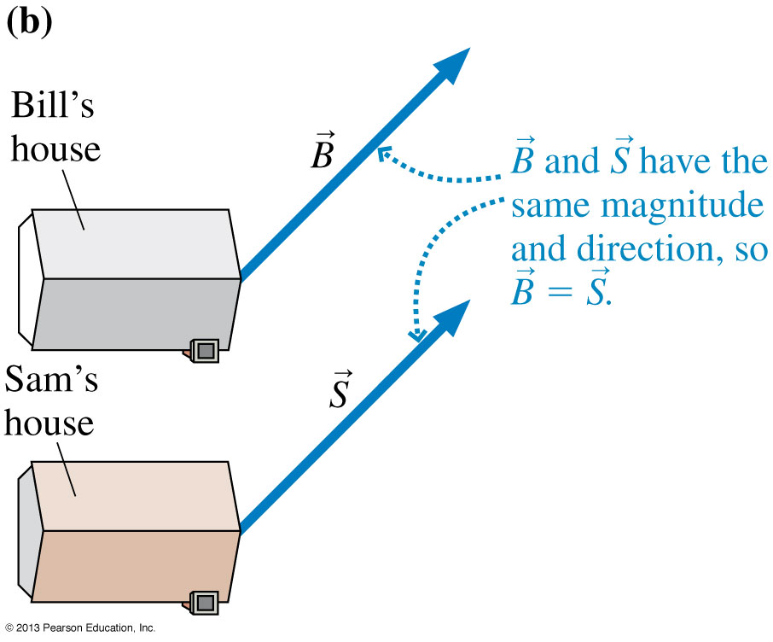
Class 5 Preclass Quiz on MasteringPhysics
Some common or interesting student comments/feedback:
“The only confusing part was the i-hat and j-hat instead of x and y”
“I would like if you could do an example with all of the vectors starting out from the origin. I just don't really understand the point of moving them all there. Also, I get a bit confused as to which direction the arrow of the ‘net’ vector should point when adding and subtracting vectors.”
“The vector was walking down Spadina Avenue when he bumped into a confused Scalar. The vector asked him what was wrong and he replied, ‘Help I have no direction.’”
Tilted axes (many questions)
“The elegant design of both Bill and Sam's house is quite intriguing...”

Slide 5
Last day I asked at the end of class:
Can you add a scalar to a vector?
ANSWER: No. A 2-D vector is represented by a pair of numbers (ie x- and y- components, or magnitude and direction), and you can’t add a scalar number to this.
Can you multiply a vector by a scalar?
ANSWER: YES! When you multiply a vector by a scalar, you can either:
Multiply both the x and y components by this scalar, or
Multiply the magnitude by the scalar, and keep the direction unchanged (but you flip direction 180° for a negative scalar)

Slide 6
Right Triangle Trigonometry
This is one of the most common things people are rusty with.
$\sin\left(θ\right)=\frac{opp}{hyp}$
$\cos\left(θ\right)=\frac{adj}{hyp}$
$\tan\left(θ\right)=\frac{opp}{adj}$
Hypotenuse
SOH CAH TOA
Opposite
θ
Adjacent

Slide 7
Clicker Question 2:
If the hypotenuse below is 6m and the angle is 38°, what is the length of the adjacent side?
$\left(6 m\right)sin⁡(38°)$
$\left(6 m\right)tan⁡(38°)$
$\left(6 m\right)cos⁡(52°)$
$\left(6 m\right)cos(38°)$
Not enough information
Hypotenuse
Opposite
θ
Adjacent

Slide 8
Clicker Question 3:
If the adjacent side below is 6 m and the opposite side is 4 m, what is the angle θ ?
$\tan^{−1}⁡(6/4)$
$\cos^{−1}⁡(6/4)$
$\cos^{−1}⁡(4/6)$
$\tan^{−1}⁡(4/6)$
$\sin^{−1}⁡(4/6)$
Hypotenuse
Opposite
θ
Adjacent

Slide 9
Vectors
There are two kinds of Physical quantities we will deal with:
Scalar (Only has a size)
Quantity that can be described with only one number.
Examples: time, speed (just a magnitude say 5 miles per hour)
Vector: (Has size and a direction)
Quantity that is described with two numbers:
Magnitude
Direction
Examples: Position, velocity (magnitude say “5 m/s” and direction say “north”)

Slide 11
Distance vs Displacement Example
From High Park, you ride your bike 4 miles East on Bloor St, then 3 miles North on Yonge St to the corner of Yonge and Eglinton.
What is the distance traveled?
What is your displacement?

Slide 12
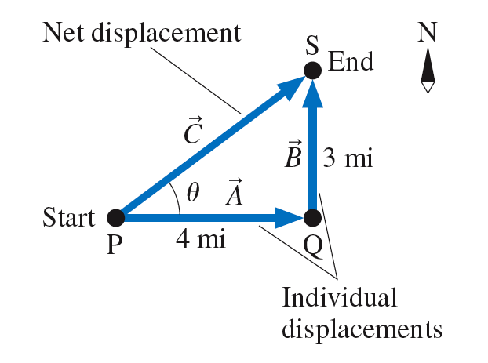

Slide 13
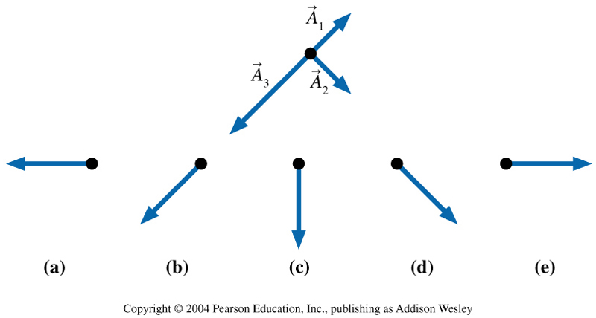
Clicker Question 4:
Which figure shows ?
Notes:
Answer C

Slide 14
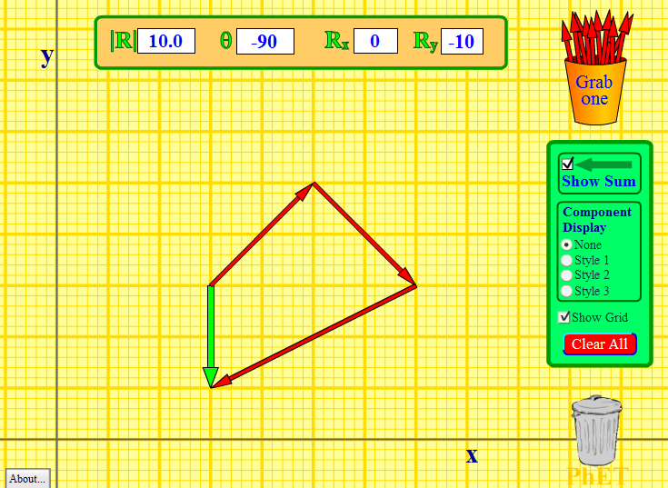
http://phet.colorado.edu/en/simulation/vector-addition

Slide 15
Announcements
The first term test will be on Tuesday, October 8, from 8:00pm to 9:30pm.
Test 1 will cover chapters 1-5 plus the Error Analysis Mini-Document, plus what was done in Practicals
You must bring a calculator and one 8.5x11’ aid sheet which you prepare, double-sided
I have posted on MasteringPhysics a Practice Set (not for marks) of end-of-chapter material for chapters 1-5.
If you have a conflict at that time with an academic activity (test, lecture, tutorial, lab), you must register to write at the alternate sitting of this test by filling out the online form no later than October 3 by 11:59pm.
http://goo.gl/0K4Smi

Slide 16
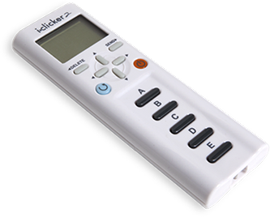
Survey Question 1 of 5
What kind of clicker are you voting with today?
i-clicker regular
i-clicker+
i-clicker2 (with screen)
i-clickerGO on a smartphone
i-clickerGO on a tablet or laptop

Slide 17
Survey Question 2 of 5
Who is the president of the United States?
Barack Obama
George Bush
Joe Biden
John Kerry
I honestly don’t know and would rather not guess

Slide 18
Survey Question 3 of 5
Who is the prime minister of Canada?
David Cameron
Kathleen Wynne
Jean Chrétien
Stephen Harper
I honestly don’t know and would rather not guess

Slide 19
Survey Question 4 of 5
Who is the president of the University of Toronto?
David Naylor
David Cameron
Michael Wilson
Stephen Julian
I honestly don’t know and would rather not guess

Slide 20
Survey Question 5 of 5
Who am I?
Andrew Meyertholen
Jason Harlow
Paul Kushner
Pierre Savaria
I honestly don’t know and would rather not guess

Slide 21
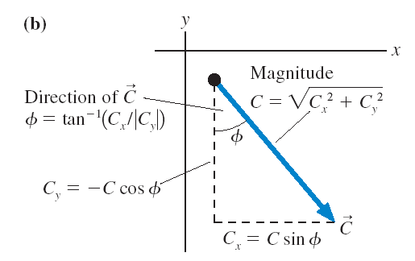
Components add and subtract like scalars!

Slide 22
Vector Addition By Components
${\vec{A}}_{1}=1.41 m$, up and to the right, 45.0° above the horizontal.
${\vec{A}}_{2}=1.41 m$, down and to the right, 45.0° below the horizontal.
${\vec{A}}_{3}=2.24 m$, down and to the left, 26.6° below the horizontal.
Find the sum ${\vec{A}}_{1}+{\vec{A}}_{2}+{\vec{A}}_{3}$.

Slide 23
Vector Addition By Components (Let’s tilt the axes!)
${\vec{A}}_{1}=1.41 m$, up and to the right, 45.0° above the horizontal.
${\vec{A}}_{2}=1.41 m$, down and to the right, 45.0° below the horizontal.
${\vec{A}}_{3}=2.24 m$, down and to the left, 26.6° below the horizontal.
Find the sum ${\vec{A}}_{1}+{\vec{A}}_{2}+{\vec{A}}_{3}$.

Slide 24
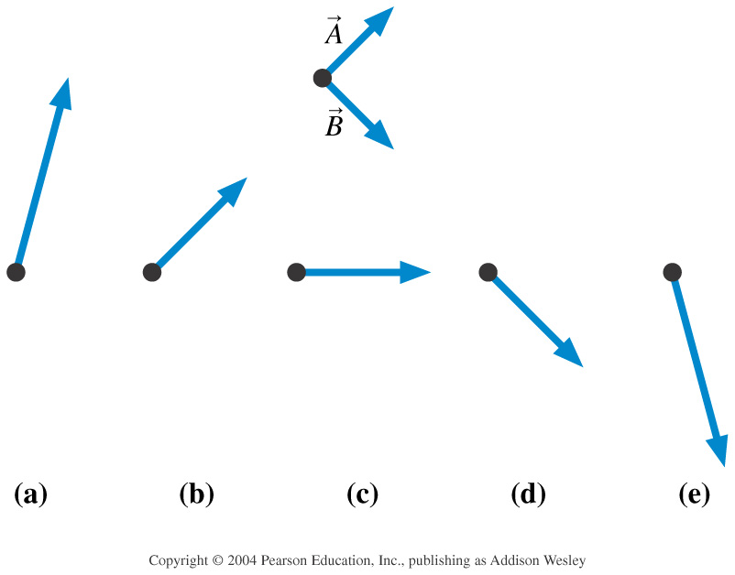
Clicker Question 5:
Which figure shows 2 − ?
Notes:
Answer A

Slide 25
Clicker Question 6:
The sum ${\vec{F}}_{1}+{\vec{F}}_{2}+{\vec{F}}_{3}$ points to the left.
Two of three forces are shown. Which is the missing third force?
A.
B.
C.
D.

Slide 26
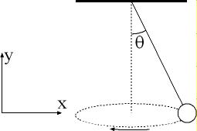
Example from a previous PHY131 Mid-Term Test
A ball is suspended on a string, and moves in a horizontal circle as shown in the figure. The string makes a constant angle θ = 10.0° with the vertical. The tension in the string is 8.46 N, and the force of gravity on the ball is 8.33 N, in the negative-y direction. What is the sum of these two forces on the ball?

Slide 28
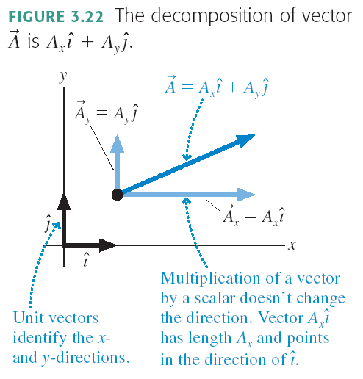

Slide 29
Clicker Question 7:
$\vec{A}=−3\hat{i}+3\hat{j}$
$\vec{B}=3\hat{i}+4\hat{j}$
What is the sum $\vec{A}+\vec{B}$?
$3\hat{j}$
$7\hat{i}+7\hat{j}$
$−3\hat{i}+7\hat{j}$
$7\hat{j}$
$−3\hat{i}−3\hat{j}$

Slide 30
Before Class 7 on Monday
Please read Chapter 4, sections 4.1 through 4.4
Problem Set 2 is due Sunday by 11:59pm
Pre-class Quiz for Class 7 is due Monday morning by 8:00am.
Something to think about: One bullet is fired horizontally at a very high speed. The other bullet is initially at rest, but is dropped at the exact same moment the first bullet is fired. Which bullet hits the ground first?

