Slide 1
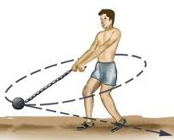
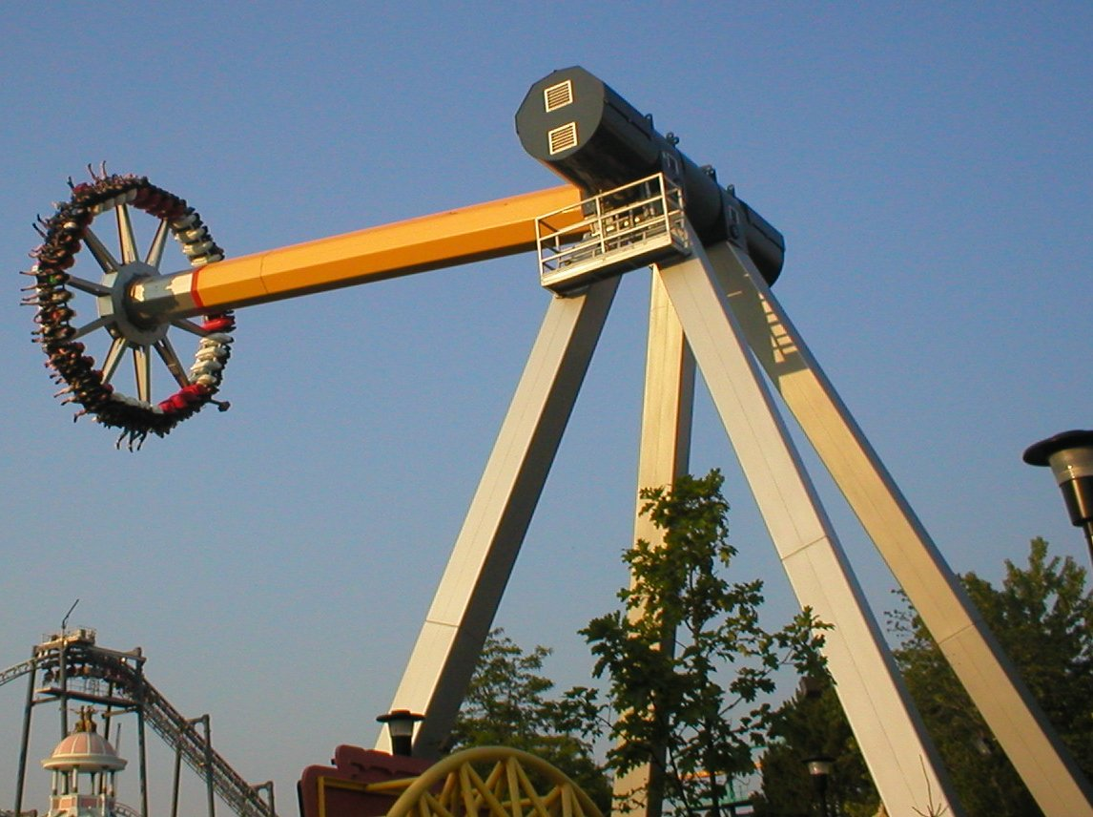
PHY131H1F - Class 8
Today, finishing off Chapter 4:
Circular Motion
Rotation

Slide 2
Clicker Question 1
Angular Notation: it’s all Greek to me!
θ is an angle, and the S.I. unit of angle is radians. (NOT degrees!)
The time derivative of θ is ω.
What are the S.I. units of ω ?
m/s²
rad / s
N/m
rad
rad /s²
Notes:
Answer: A

Slide 3
Clicker Question 2
Angular Notation: it’s all Greek to me!
The time derivative of ω is α.
What are the S.I. units of α ?
m/s²
rad / s
N/m
rad
rad /s²
Notes:
Answer: A

Slide 4
Class 8 Preclass Quiz on MasteringPhysics
This was due this morning at 8:00am
841 students submitted the quiz on time
91% answered correctly: For uniform circular motion, the acceleration points toward the centre of the circle.
88% answered correctly: ω is angular velocity.
62% answered correctly: When you are traveling on a circular path, not speeding up or slowing down, you have a constant speed, but you are accelerating!

Slide 5
Class 8 Preclass Quiz on MasteringPhysics
Some common or interesting student comments/feedback:
“Trying to do this pre quiz while watching hockey, GO LEAFS GO !!!!!!!!”
“The fact that you are always accelerating in circular motion, even if you're revolving at a constant velocity.”
Harlow note: this is actually impossible. You can’t be on a curved path and have a constant velocity. You can be on a curved path and have a constant speed.
“I've heard that centripetal acceleration is part of how speed limits on highway ramps are designated. This is a great starting point and I'm really hoping to learn more about this topic!”
Harlow note: Right. There is a maximum value of $a=\frac{v^{2}}{r}$ that a car can have without skidding off the road. r is the radius of the curve, so if r is smaller, it is a tighter curve and you must also reduce v² in order not to lose control of your car.

Slide 6
Class 8 Preclass Quiz on MasteringPhysics
Some common or interesting student comments/feedback:
“A bar walks into a horse...My bad! Wrong frame of reference!”
“I feel like I'm going in circles...”
“Why did Air Resistance dump her boyfriend? She was tired of being neglected.” [Harlow note: I think he’s better off, she’s really a drag.]
“I can't wait to go on a ferris wheel and calculate my centripetal acceleration! (Look at what physics has done to me)”
“Angular velocity and how it holds a cursive w as its symbol!!!”
Harlow note: Keep in mind, it’s not a double-you, it’s an omega.
On MasteringPhysics use the pull-down menu with Greek letters:

Slide 7
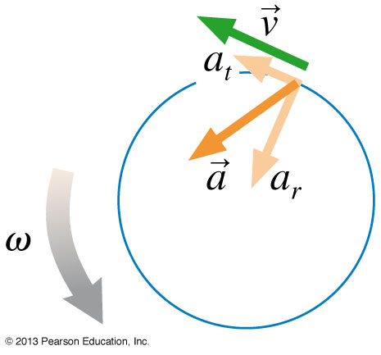
Last day at the end of class I asked:
Consider a wheel that is rotating, and speeding up.
Is a point on the edge of the wheel accelerating toward the centre? [Yes, it must have a centre-pointing component in order to stay on the circular path!]
Is this point accelerating in the forward direction? [Yes, it must have a forward component in order to speed up!]
Or is it doing both? [Yes – the actual acceleration vector is on a diagonal!]

Slide 8
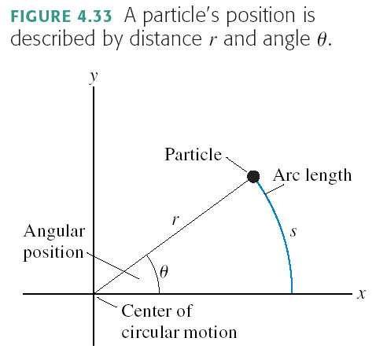
Circular Motion
r = constant
s and θ both change as the particle moves
s = “arc length”
θ = “angular position”
when θ is measured in radians

Slide 9
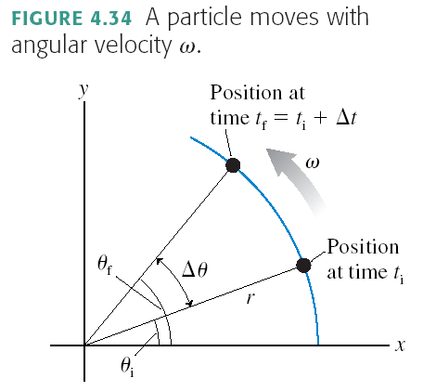
Angular Velocity
when ω is measured in rad/s

Slide 10
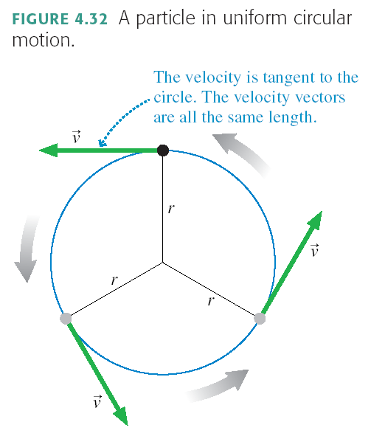
Special case of circular motion:
Uniform Circular Motion
Tangential velocity is constantly changing direction
Tangential speed is constant
where T = Period [s]

Slide 11
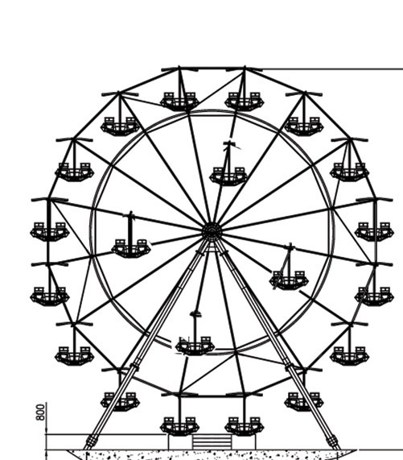
Clicker Question 3
A carnival has a Ferris wheel where some seats are located halfway between the center and the outside rim. Compared with the seats on the outside rim, the inner cars have
Smaller angular speed and greater tangential speed
Greater angular speed and smaller tangential speed
The same angular speed and smaller tangential speed
Smaller angular speed and the same tangential speed
The same angular speed and the same tangential speed

Slide 12
Demo and Discussion Question A ball rolls in a horizontal circular track (shown from above). Which arrow best represents the ball’s path after it leaves the track?
Clicker Question 4

Slide 13
Announcements
Don’t forget: Midterm Test 1 will be on Tuesday, October 8, from 8:00pm to 9:30pm.
The Room you write in will depend on your Practicals group. It will be announced on the Portal by tomorrow.
If you have a conflict at that time with an academic activity (test, lecture, tutorial, lab), you must register to write at the alternate sitting by filling and submitting the online form available on portal.
The alternate sitting will be held on Wednesday morning, October 9, from 7:40am to 9:00. The location will be emailed to registered students by the end of the day on October 4.
The deadline for registration is Thursday, October 3.

Slide 14
What will the midterm test cover?
Test 1 is on:
Knight Chapters. 1-4
the Error Analysis in Experimental Physical Science “Mini-Version” 10-page document available on portal.
A single, conceptual multiple choice question on Chapter 5.

Slide 15
Midterm Test 1
The midterm test will have:
8 multiple-choice questions
3 related long-answer problems counting for a total of 16 marks, which will be graded in detail; part marks may be awarded, but only if you show your work.
Please bring:
Your student card.
A calculator without any communication capability.
A soft-lead 2B or 2HB pencil with an eraser.
A single, original, handwritten 8 1/2 × 11 inch sheet of paper on which you may have written anything you wish, on both sides.

Slide 16
Where to get extra help
The Physics Drop In Help Centre is in MP125 (BACK CORNER):
Monday to Thursday - 12:00 to 5:00 pm
Monday 6:00 to 7:00pm
Friday 11:00 am to 2:00 pm
TA Office hours: Contact your Practicals TAs!! Office Hours where they can help with studying is part of their contract!
My office hours in MP121B: T2, RF10.
Meyertholen’s office hours in MP129A: M2, R2, F10, F11
Academic Success Centre. Tuesdays 3-5pm, Thursdays 10am-12pm

Slide 17
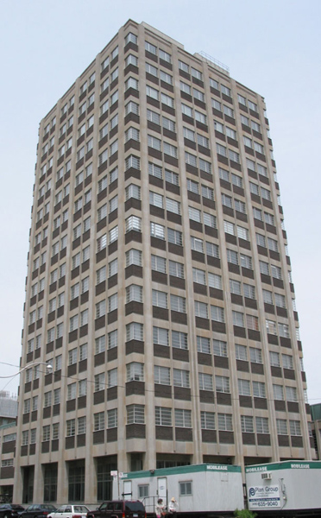
Preparation for Practicals next week:
Take a ride on the Burton Tower elevators!
All 4 elevators in the 14-storey tower of McLennan Physical Labs are equipped with a hanging spring-scale.
It measures the upward force necessary to support a 750 g mass. (a.k.a. “weight”)
You may find that the measured weight of this object changes as you accelerate – check it out!
(see Mechanics Module 3, Activity 2)

Slide 18
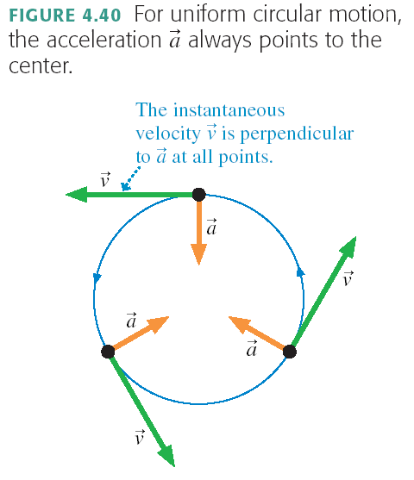
Centripetal Acceleration

Slide 19
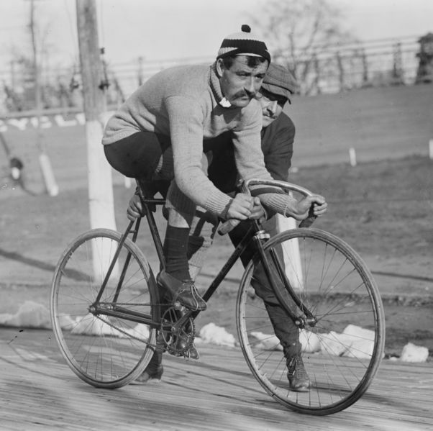
Centripetal Acceleration
A bike wheel of diameter 1.0 m turns 20 times per second. What is the magnitude of the centripetal acceleration of a yellow dot on the rim?

Slide 20
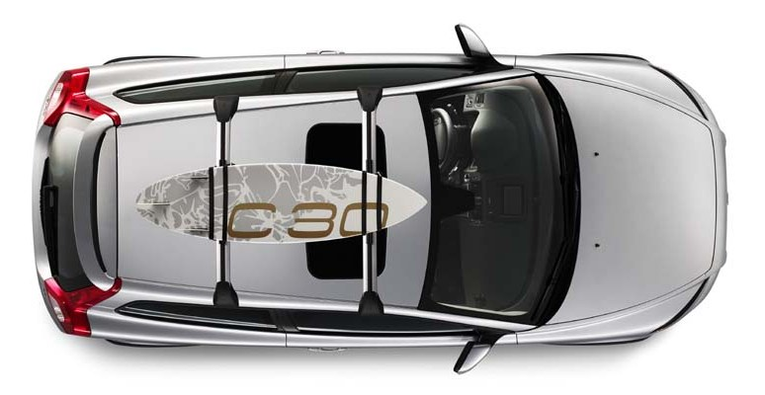
Clicker Question 5
A car is traveling East at a constant speed of 100 km/hr. Without speeding up of slowing down, it is turning left, following the curve in the highway. What is the direction of the acceleration?
N
W
E
S
North
East
North-East
North-West
None; the acceleration is zero.

Slide 21
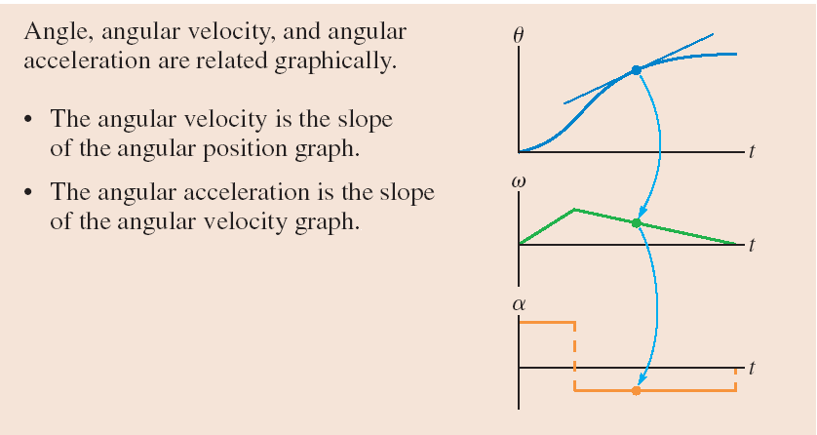
Determines the Tangential acceleration, NOT centripetal acceleration!

Slide 22
Summary of definitions:
θ is angular position. The S.I. Unit is radians, where 2π radians = 360°.
s is the path length along the curve: s = θr when θ is in [rad].
ω is angular velocity. The S.I. Unit is rad/sec.
v_{t} is the tangential speed: v_{t} = ωr when ω is in [rad/s].
α is angular acceleration. The S.I. Unit is rad/sec².
a_{t} is the tangential acceleration: a_{t} = αr when α is in [rad/s²].

Slide 23
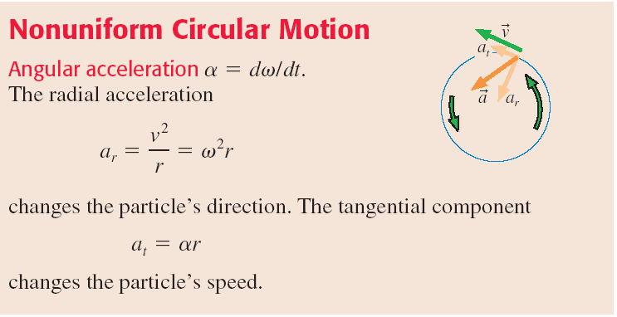
Nonuniform Circular Motion
Any object traveling along a curved path has centripetal acceleration, equal to v²/r.
If, as it is traveling in a circle, it is speeding up or slowing down, it also has tangential acceleration, equal to rα
The total acceleration is the vector sum of these two perpendicular components

Slide 24
The 4 Equations of Constant Linear Acceleration, a:
The 4 Equations of Constant Angular Acceleration, α:
$$v_{f}=v_{i}+at$$
$$ω_{f}=ω_{i}+αt$$
$$x_{f}=x_{i}+v_{i}t+\frac{1}{2}at^{2}$$
$$θ_{f}=θ_{i}+ω_{i}t+\frac{1}{2}αt^{2}$$
$${v_{f}}^{2}={v_{i}}^{2}+2a(x_{f}−x_{i})$$
$${ω_{f}}^{2}={ω_{i}}^{2}+2α(θ_{f}−θ_{i})$$
$$x_{f}=x_{i}+\left(\frac{v_{i}+v_{f}}{2}\right)t$$
$$θ_{f}=θ_{i}+\left(\frac{ω_{i}+ω_{f}}{2}\right)t$$

Slide 25
Clicker Question 6
Problem: A pebble is dropped from rest off a high balcony, and has an acceleration of 9.8 m/s² as it falls. It falls for 2.5 seconds, then hits the ground. How far does it fall in this 2.5 seconds?
Which equation would you use?
A.
$$v_{f}=v_{i}+at$$
C.
$${v_{f}}^{2}={v_{i}}^{2}+2a(x_{f}−x_{i})$$
$$x_{f}=x_{i}+v_{i}t+\frac{1}{2}at^{2}$$
$$x_{f}=x_{i}+\left(\frac{v_{i}+v_{f}}{2}\right)t$$
B.
D.
Notes:
Answer: B

Slide 26
Clicker Question 7
Problem: A centrifuge loaded with two test-tubes starts from rest, and has an angular acceleration of 150 rad/s² as it spins up. It speeds up with this angular acceleration for 2.5 seconds, then it has reached its maximum spin rate. How many times has it rotated in this 2.5 seconds?
Which equation would you use?
A.
$$ω_{f}=ω_{i}+αt$$
C.
$${ω_{f}}^{2}={ω_{i}}^{2}+2α(θ_{f}−θ_{i})$$
$$θ_{f}=θ_{i}+ω_{i}t+\frac{1}{2}αt^{2}$$
$$θ_{f}=θ_{i}+\left(\frac{ω_{i}+ω_{f}}{2}\right)t$$
B.
D.
Notes:
Answer: B

Slide 27
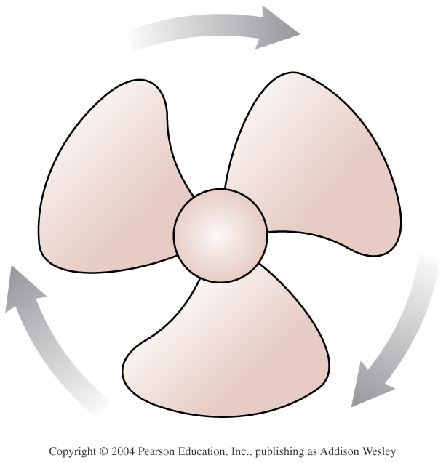
Example.
A fan is spinning at 30 rad/s, and suddenly starts slowing down.
It’s angular acceleration as it slows is 10 rad/s².
How long does it take to stop spinning?

Slide 28
Example.
A fan is spinning at 30 rad/s, and suddenly starts slowing down.
It’s maximum angular acceleration as it slows is 10 rad/s².
What is the minimum angle that it must turn as it stops?
How many revolutions is this?

Slide 29
Clicker Question 8
The fan blade is slowing down. What are the signs of ω and α?
[Let’s define, as Knight often does, positive to be counter-clockwise.]
Α. ω is positive and α is positive.
B. ω is negative and α is positive.
C. ω is positive and α is negative.
D. ω is negative and α is negative.
Notes:
Answer: B

Slide 30
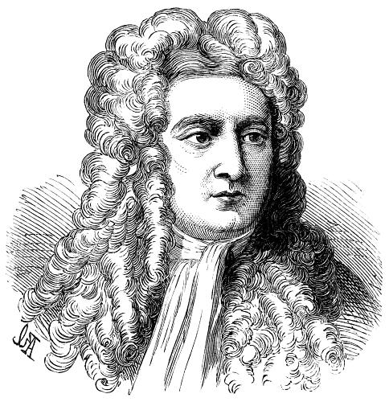
Moving on to Chapters 5 and 6..
Up until now, we have been studying kinematics, a description of HOW things move and how to describe this.
In Chapter 5 we begin to study WHY things move the way they do: This is dynamics, which includes the important concepts of Force and Energy.

Slide 31
Before Class 9 on Monday
Please read Chapter 5 of Knight.
Don’t forget the pre-class quiz due Mon. at 8am.
Something to think about: A paperback novel has a mass of 0.3 kg and slides at a constant velocity. A physics textbook has a mass of 3.0 kg, and slides at the same constant velocity. How does the net force on the textbook compare to the net force on the novel?

