Slide 1
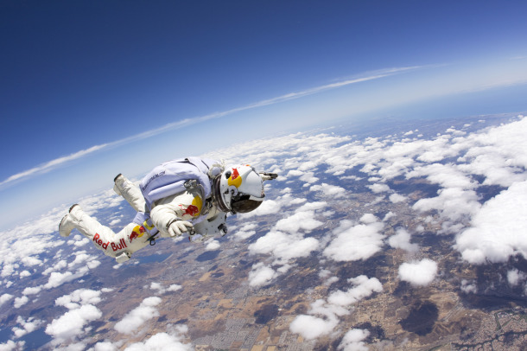
PHY131H1F - Class 10
Today, Chapter 6:
Equilibrium
Mass, Weight, Gravity

Slide 2
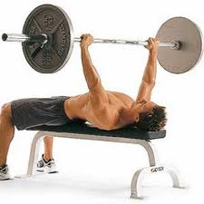
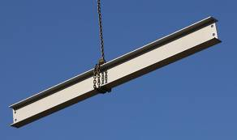
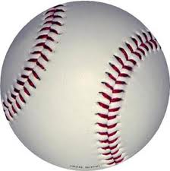
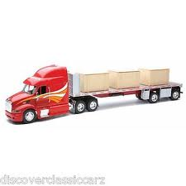
Clicker Question 1
Which of the following objects described below is in dynamic equilibrium?
A 100 kg barbell is held at rest over your head.
A steel beam is lifted upward at constant speed by a crane.
A baseball is flying through the air and air resistance is negligible.
A steel beam is being lowered into place. It is slowing down.
A box in the back of a truck doesn’t slide as the truck is slowing down.
Notes:
Answer: A

Slide 3
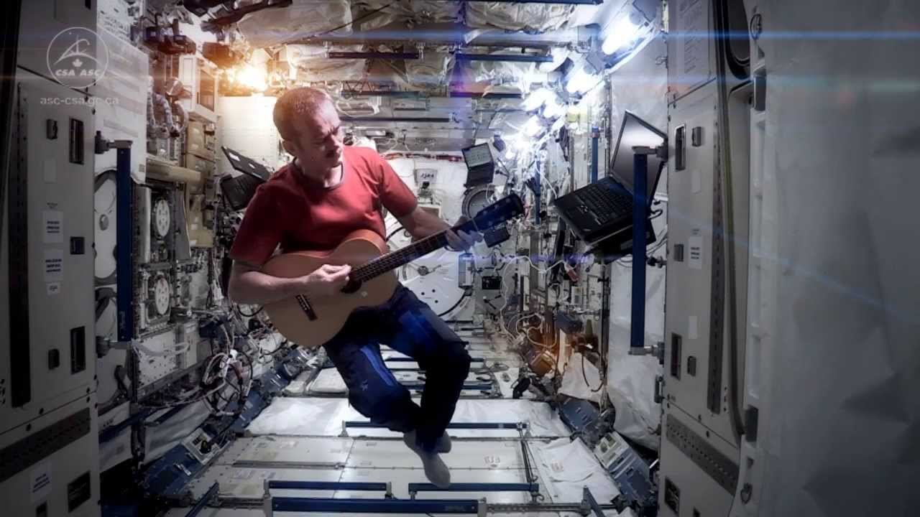
Last day I asked at the end of class:
When astronauts are floating in a space station, are they really weightless?
ANSWER: YES!
Knight’s definition of weight means the amount of force needed to support an object in your frame of reference.

Slide 4
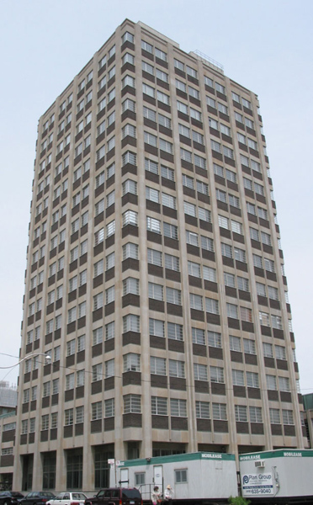
Preparation for Practicals today, tomorrow and Friday:
Take a ride on the Burton Tower elevators!
All 4 elevators in the 14-storey tower of McLennan Physical Labs are equipped with a hanging spring-scale.
It measures the upward force necessary to support a 750 g mass. (a.k.a. “weight”)
You may find that the measured weight of this object changes as you accelerate – check it out!

Slide 5
Last-night’s Midterm Test
Thanks for writing the test last night
If you missed it, please bring medical documentation to April Seeley in MP129
I have posted solutions on the course web-site under “Lectures – Harlow”
We will get it marked as soon as possible – probably 1 or 2 weeks, then return it to you in Practicals

Slide 6
Last-night’s Midterm Test
Survey
Often students find that preparing an aid-sheet is a good way to study before a test.
How useful was your aid-sheet to you during the midterm test?
Very useful (I referred to it for more than half the questions)
Useful
A little bit useful (I may have checked it once or twice)
Not useful
Honestly, I did not need the aid-sheet at all during the test!

Slide 7
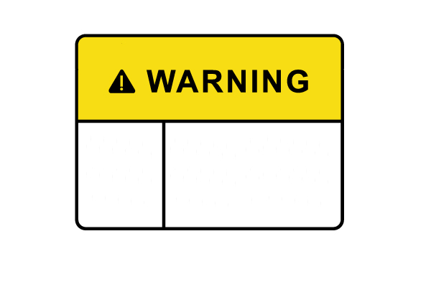
Newton’s Laws only apply in a “inertial reference frames”. They are not valid if your reference frame is accelerating!
An inertial reference frame is one that is not accelerating.

Slide 8
A: Inertial Reference Frame B: Not an inertial reference frame
Clicker Question 2
A car is driving at a steady speed on a straight and level road.
Quick quiz [1/4]: inside the car, is it…

Slide 9
A: Inertial Reference Frame B: Not an inertial reference frame
Clicker Question 3
A car is driving at a steady speed up a 10° incline.
Quick quiz [2/4]: inside the car, is it…

Slide 10
A: Inertial Reference Frame B: Not an inertial reference frame
Clicker Question 4
A car is speeding up after leaving a stop sign, on a straight and level road.
Quick quiz [3/4]: inside the car, is it…

Slide 11
A: Inertial Reference Frame B: Not an inertial reference frame
Clicker Question 5
A car is driving at a steady speed around a curve on a level road.
Quick quiz [4/4]: inside the car, is it…

Slide 12
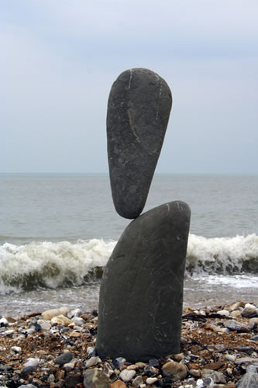
Equilibrium
An important problem solving technique is to identify when an object is in equilibrium.
An object has zero acceleration if and only if the net force on it is zero.
This is called “equilibrium”.
If an object is in vertical equilibrium (ie it is confined to a stationary horizontal surface) then (F_{net})_{y} = 0. The sum of y-components of all forces = 0.
If an object is in horizontal equilibrium (ie freefall) then (F_{net})_{x} = 0.

Slide 13
Gravity for the universe
It was Newton who first recognized that gravity is an attractive, long-range force between any two objects. Somewhat more loosely, gravity is a force that acts on mass. When two objects with masses m₁ and m₂ are separated by distance r, each object pulls on the other with a force given by Newton’s law of gravity, as follows:
(Sometimes called “Newton’s 4th Law”, or “Newton’s Law of Universal Gravitation”)

Slide 14
Gravity Example
A mass, m, rests on the surface a giant spherical rock which is floating in space.
The giant rock has a mass of 6 × 10²⁴ kg and a radius of 6400 km.
What is the force of gravity on the mass due to the giant rock?

Slide 15
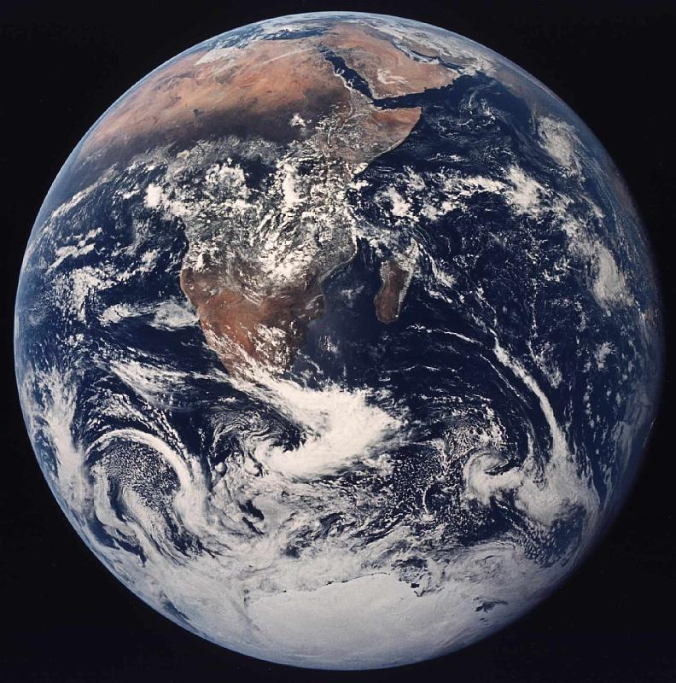
Gravity for Earthlings
If you happen to live on the surface of a large planet with radius R and mass M, you can write the gravitational force more simply as
where the quantity g is defined to be:
At sea level, g = 9.83 m/s².
At 39 km altitude, g = 9.71 m/s².

Slide 16
Gravity: F_{G} = mg is just a short form!
and
are the same equation, with different notation!
The only difference is that in the second equation we have assumed that m₂ = M (mass of the earth) and r ≈ R (radius of the earth).

Slide 17
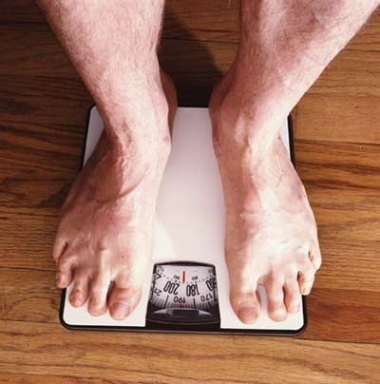
Weight ≠ Weight ??!?
Physics textbooks and physics teachers do not all agree on the definition of the word “weight”!
Sometimes “weight” means the exact same thing as “force of gravity”. That is not how Randall Knight uses the word. (I will follow Knight’s definitions.)
In Knight, “weight” means the magnitude of the upward force being used to support an object.
If the object is at rest or moving at a constant velocity relative to the earth, then the object is in equilibrium. The upward supporting force exactly balances the downward gravitational force, so that weight = mg.

Slide 18
Clicker Question 6
When I stand on a scale in my bathroom it reads 185 pounds. 2.2 pounds = 9.8 Newtons, so this means the upward force on my feet when I am standing still is 185 lbs (9.8 N / 2.2 lbs) = 824 N.
If I ride an elevator which is accelerating upward at 1.5 m/s², what is the upward force on my feet?
With no calculations, take a wild guess from this list:
824 N
950 N
698 N
0 N
–824 N

Slide 19
Knight’s Definition of weight
Eq. 6.10, page 147:

Slide 20
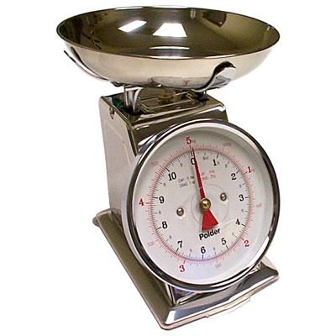
Spring scale on an elevator
Clicker Question 7
You are attempting to pour out 1.0 kg of flour, using a kitchen scale on an elevator which is accelerating upward at 1.5 m/s².
The amount of flour you pour will be
too much.
too little.
the correct amount.
$$\vec{a}$$

Slide 21
Pan balance on an elevator
Clicker Question 8
You are attempting to pour out 100 g of salt, using a pan balance on an elevator which is accelerating upward at 1.5 m/s². Will the amount of salt you pour be
Too much
Too little
The correct amount
$$\vec{a}$$

Slide 22
Self-adjusting forces
Gravity, F_{G}, has an equation for it which predicts the correct magnitude (it’s always mg here on Earth).
Normal force, Tension and Static friction are all self-adjusting forces: there is no equation for these!!
Normal force is whatever is needed to keep the object from crashing through the surface.
Tension is whatever is needed to keep the string or rope from breaking.
Static friction is whatever is needed to keep the object from slipping along the surface.
In all these cases, you must draw a free-body diagram and figure out by using equilibrium and Newton’s 2nd law what the needed force is.

Slide 23
Getting the piano on the truck
A piano has a mass of 225 kg.
What force is required to push the piano up a frictionless ramp at a constant velocity into the truck? Assume the ramp is 3.00 m long and the floor of the truck is 1.00 m high?
A piano has a mass of 225 kg.
What force is required to push the piano upwards at a constant velocity as you lift it into the back of a truck?

Slide 24
Getting the piano on the truck
A piano has a mass of 225 kg.
What force is required to push the piano up a frictionless ramp at a constant velocity into the truck? Assume the ramp is 3.00 m long and the floor of the truck is 1.00 m high?

Slide 25
Clicker Question 9
Bob stands under a low concrete arch, and presses upwards on it with a force of 100 N. Bob’s mass is 82 kg. He is in equilibrium. What is the total normal force of the ground on Bob? (Note that 82 × 9.8 = 800.)
800 N, upward
800 N, downward
900 N, upward
700 N, upward
900 N, downward

Slide 26
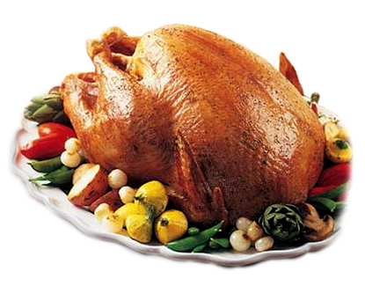
Before Class 11 next Wednesday
Please finish reading Chapter 6
Problem Set 4 is due Sunday night.
Take a ride on the Burton Tower elevators, do prep-work for Mechanics Module 3 Activity 2.
Please read the rest of Knight Chapter 6.
Something to think about:
Does friction always slow things down? Can friction ever speed things up?
Happy Thanksgiving!

