Slide 1
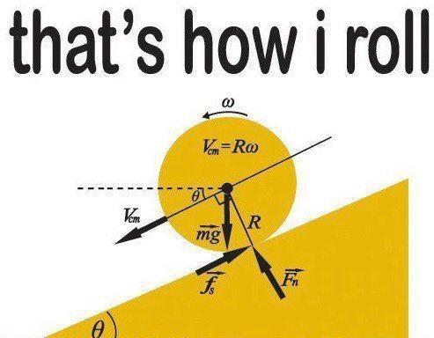
PHY131H1F - Class 12
Today, Chapter 7:
Newton’s Third Law
Force Interaction Pairs
Ropes and Pulleys

Slide 2
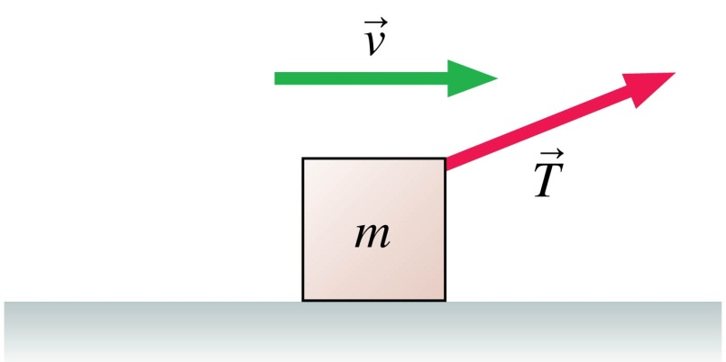
Clicker Question 1
A box is being pulled to the right at steady speed by a rope that angles upward. In this situation:
n > mg.
n = mg.
n < mg.
n = 0.
Not enough information to judge the size of the normal force.

Slide 3
Class 12 Preclass Quiz on MasteringPhysics
This was due this morning at 8:00am
828 students submitted the quiz on time.
71% of students answered correctly that the mosquito exerts the same amount of force on the truck as the truck exerts on the mosquito.
61% of students answered correctly that the propulsion force which accelerates a car is actually static friction!! (18% answered “the car engine”)
61% of students answered correctly that the “acceleration constraint” in Chapter 7 problems is that two objects have accelerations with the same magnitude.

Slide 4
Class 12 Preclass Quiz on MasteringPhysics
Some interesting student comments/feedback:
I don't like mosquitos
The part about static friction really "propelled" me through the reading. I also found Newton's Third Law to be very "interactive“
Dynamics is like accounting. …We are keeping track of forces and balancing the second law of newton like accountants balance their cash statements.
I like Newton's third law, if action-reaction force is equal, why someone likes to punch the other? dont they get hurt?
Being able to watch Gravity (with Sandra Bullock and George Clooney) and truly understand the concepts of constant velocity, zero acceleration and what it must be like to drift in outer space makes taking Physics worthwhile!!! P.S. Gravity was Amazing

Slide 5
Last day I asked at the end of class:
Consider the following reasoning, and identify the mistake:
“When you pull a wagon, Newton’s 3rd Law states that the wagon pulls back on you with an equal and opposite force. These forces should cancel each other. So it is impossible to accelerate the wagon!”
ANSWER:
First sentence is correct: the wagon really does pull back on you with an equal opposite force that you pull on the wagon!
Second and third sentences are not correct: forces cannot cancel each other if they are on different objects.
The forward static friction on your feet is larger than the backward rolling friction on the wheels of the wagon, so the system of you and the wagon has a forward net force, provided by the Earth (static friction). That is why you both accelerate.

Slide 6
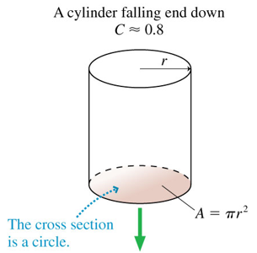
Recall from Chapter 6: Drag force in air
For objects on Earth, with speeds between 1 and 100 m/s and size between 1 cm and 2 m, there is an approximate equation which predicts the magnitude of air resistance:
$$\vec{D}$$

Slide 7
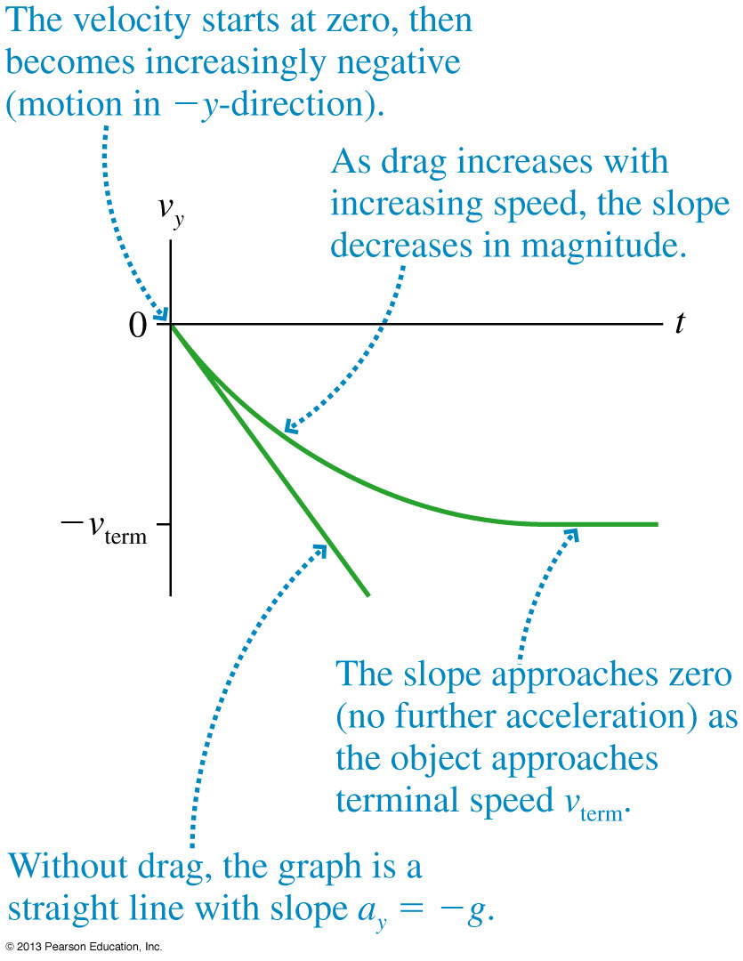
Terminal Speed

Slide 8
Example (suggested by student)
I throw my roommate out the window (we're on the fourth floor of Elmsley Hall). She has a mass of approximately 55 kg (her opinion), and a radius of 12 inches. The density of air at standard atmospheric pressure and "room temperature" is 1.2 kg/m³. Not very bright, she tries to land feet first (a.k.a., assume the drag coefficient is that of an upright cylinder = .8). What is her terminal velocity?

Slide 9
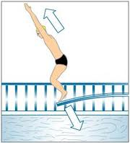
3
Newton’s Third Law
If object 1 acts on object 2 with a force, then object 2 acts on object 1 with an equal force in the opposite direction.

Slide 10
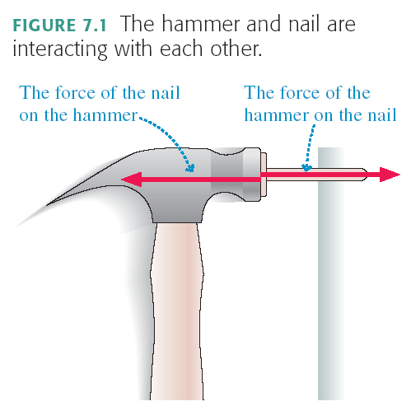

Slide 11
A Mack Truck drives North on the highway, and collides head-on with a mosquito. Which is true?
Clicker Question 2
The Mack Truck does more damage to the mosquito than the mosquito does to the Mack Truck.
The mosquito does more damage to the Mack Truck than the Mack Truck does to the mosquito.
The Mack Truck does the same amount of damage to the mosquito as the mosquito does to the Mack Truck.
Impossible to determine without knowing the speeds of the truck and mosquito.
Don’t know or none of the above

Slide 12
F = ma or a = F / m
If the force is equal on the truck and the mosquito, is the acceleration equal?
Acceleration is higher if m is lower ( F divided by m)
Mosquito accelerates more, so it receives more damage.

Slide 13
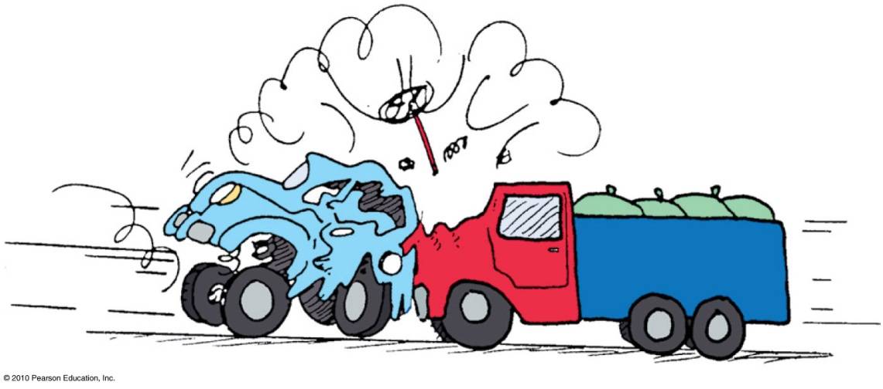
Forces always come in pairs
Every force interaction involves two objects, and two forces.
These forces
are equal in strength and opposite in direction.
are always the same kind of force (ie gravity, normal, friction, tension, etc.)
always act on different objects.

Slide 14
The entire Earth accelerates toward the Moon, due to this pulling force.
To find the total acceleration, you use the force as calculated for the centre-to-centre distance.
Since F_{G} = GMm/r², the force on the ocean nearer to the moon will be greater, so it will accelerate more than the rest of the Earth, bulging out.

Slide 15
Similarly, since F_{G} = GMm/r², the force on the ocean further from the moon will be less, so it will accelerate less than the rest of the Earth, remaining behind, forming a bulge.
In general, tidal effects tend to stretch objects both toward and away from the object causing the tides.

Slide 16
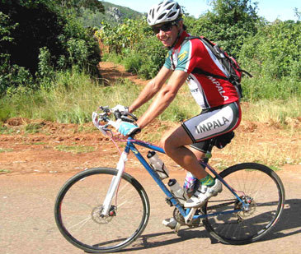
Clicker Question 3
A cyclist is pushing on his pedals, and therefore accelerating to the left.
What is the direction of the force of static friction of the ground on the back wheel?
Left
Right
Up
Down
zero

Slide 17
Clicker Question 4
A cyclist is pushing on his pedals, and therefore accelerating to the left.
What is the direction of the force of static friction of the ground on the front wheel?
Left
Right
Up
Down
zero

Slide 18
Announcement
Image from http://introcomm101final.blogspot.ca/
Starting tomorrow in Practicals you will be in NEW TEAMS! Your TAs will assign you to a new pod and you will work with your new team for the rest of the semester.
Forming effective teams with strangers is a life skill.

Slide 19
Test 1 results
A+
B
C
A
D
F
Average test mark was 72%
42% of the class got A
20% got B
14% got C
11% got D
14% failed
12% of the class got 100% (ie perfect) on the test!

Slide 20
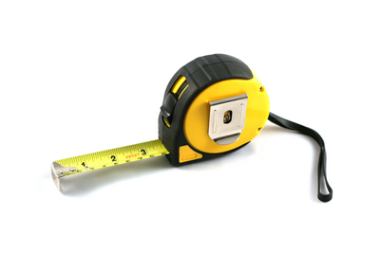
Survey Question
Have you ever used a tape-measure?
Yes
No
I would rather not answer that

Slide 21
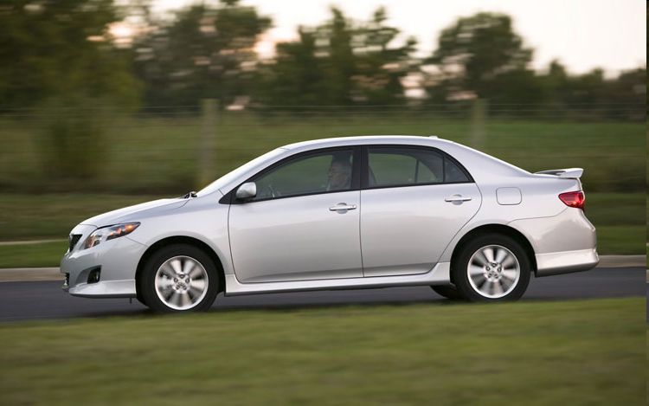
Car/Earth Friction Interaction
Consider an accelerating car.
The tires of the car are pushing backward on the Earth (static friction).
The Earth is pushing forward on the tires of the car (static friction).

Slide 22
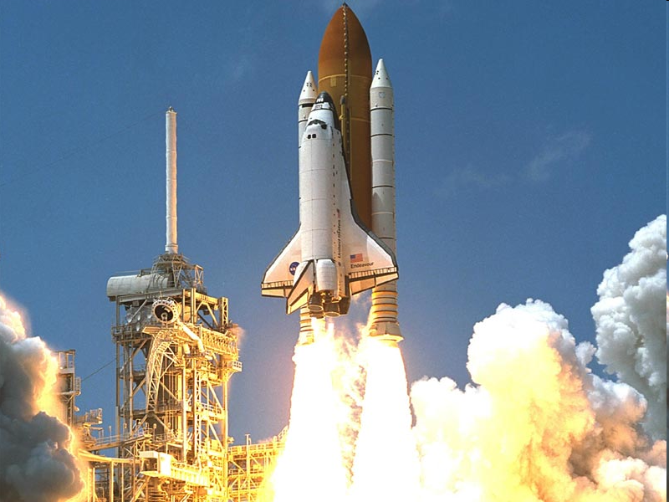
Rocket/Gas Pressure Interaction
Consider a rocket accelerating upward.
The rocket is pushing down on the expelled gas (pressure).
The expelled gas is pushing up on the rocket (pressure).

Slide 23
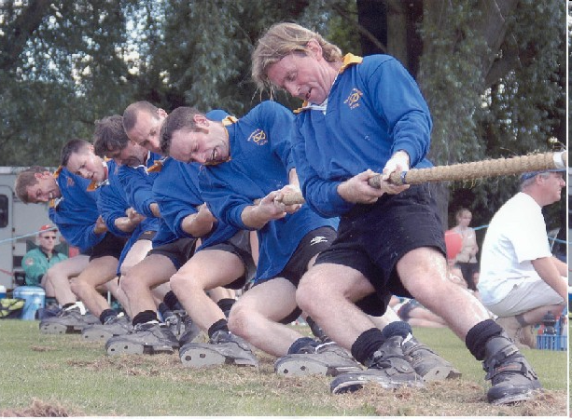
Man/Rope Tension Interaction
Clicker Question 5
This man is pulling the rope to the left.
What is the other force in this interaction?
His feet are pushing the ground to the right.
The ground is pushing his feet to the left.
The rope is pulling the man to the right.
Gravity of the Earth is pulling the man down.
Gravity of the man is pulling the Earth up.

Slide 24
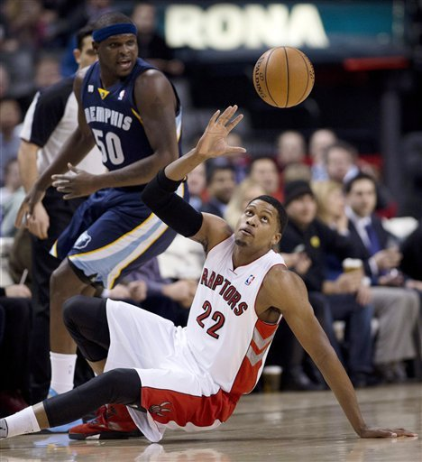
Basketball/Earth Gravity Interaction
Clicker Question 6
Consider a basketball in freefall.
Gravity is pulling this ball down.
What is the other force in this interaction?
The thrower’s feet are pushing the ground down.
The ground is pushing the thrower’s feet up.
Gravity of Earth is pulling the thrower down.
Gravity of the ball is pulling the Earth up.
Air is pushing the ball up.

Slide 25
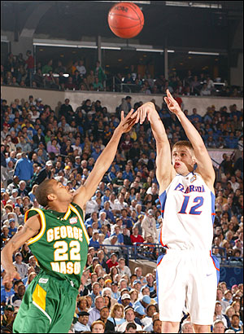
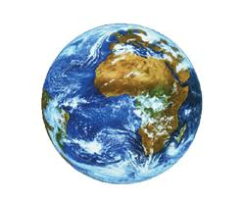
Basketball/Earth Gravity Interaction
F
a =
m
m
F
a =
The Earth is pulling down on the ball.
The ball is pulling up on the Earth.

Slide 26
The Massless String Approximation
Often in physics problems the mass of the string or rope is much less than the masses of the objects that it connects. In such cases, we can adopt the following massless string approximation:

Slide 27
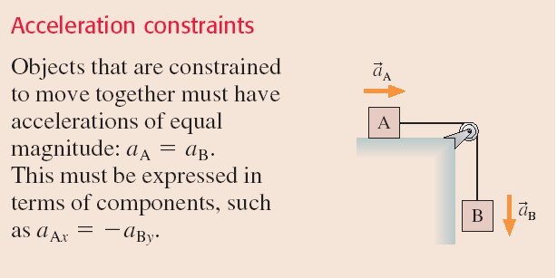
Pulleys

Slide 28
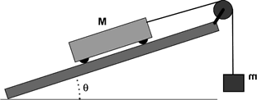
Example
A cart of mass M is on a track which is at an angle of θ above the horizontal.
The cart is attached to a string which goes over a pulley; the other end of the string is attached to a hanging mass, m.
What is the acceleration of the cart?

Slide 30
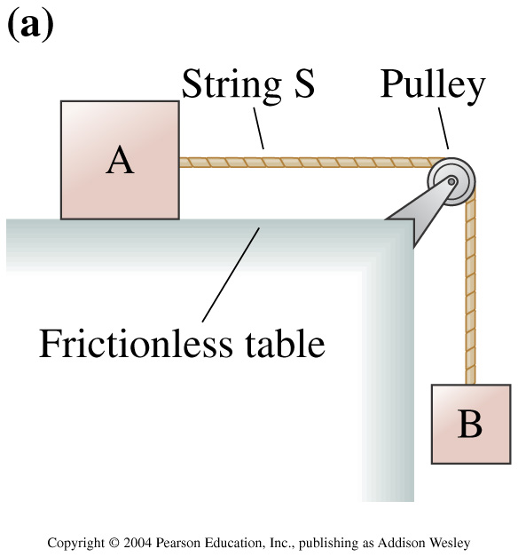
Clicker Question 7
In the figure to the right, is the tension in the string greater than, less than, or equal to the force of gravity on block B?
Equal to
Greater than
Less than
Notes:
Answer: C

Slide 31
Before Class 13 on Wednesday … my last class!
Please read the first 3 sections of Knight Chapter 8
If you haven’t done Problem Set 5 yet – it’s due tonight by 11:59pm!
Something to think about: A ball is whirled on a string in a vertical circle. As it is going around, the tension in the string is
constant.
greatest at the top of the motion
greatest at the bottom of the motion
greatest somewhere in between the top and bottom.

