Slide 1
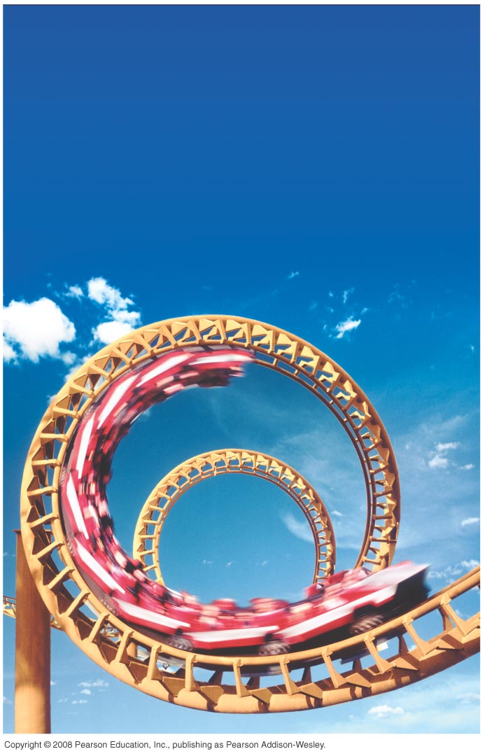
PHY131H1F - Class 13 Harlow’s Last Class this semester ☹ on Monday Prof. Meyertholen takes over! ☺
Today, starting Chapter 8:
Dynamics in Two Dimensions
Dynamics of Uniform Circular Motion
Banked Curves
Orbits

Slide 2
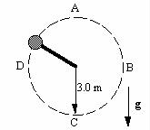
Clicker Question 1
Last day at the end of class I asked:
A ball is whirled on a string in a vertical circle. As it is going around, the tension in the string is
greatest at the top of the motion
constant.
greatest at the bottom of the motion
greatest somewhere in between the top and bottom.

Slide 3
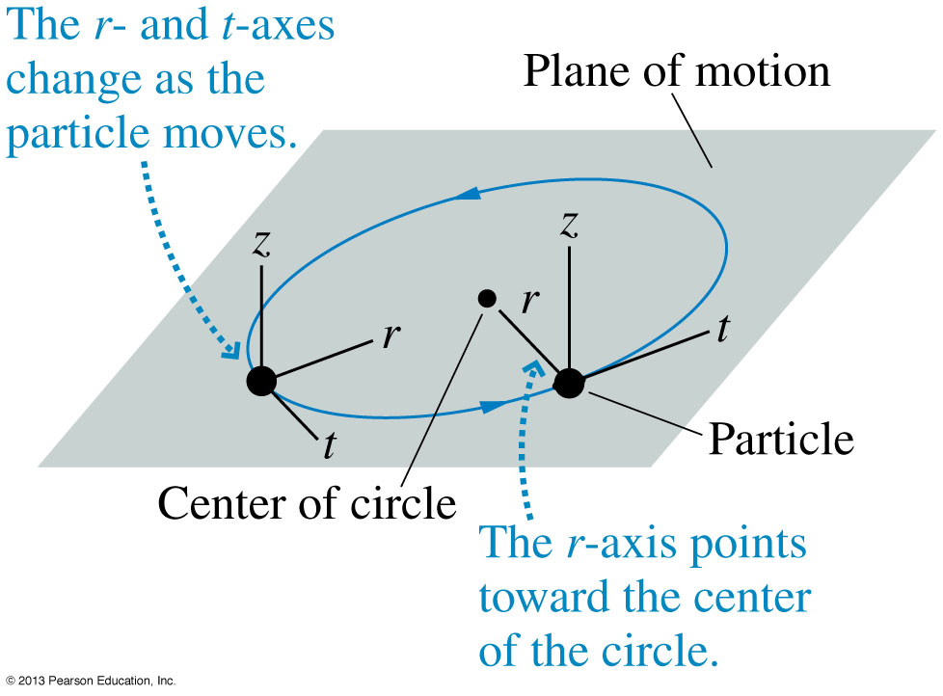
Class 13 Preclass Quiz on MasteringPhysics
This was due this morning at 8:00am
731 students submitted the quiz on time
53% of students answered correctly: Circular motion is best analized in a coordinate system with r-, t- and z- axes. If you use x- and y- axes, the x- and y- components are constantly changing!

Slide 4
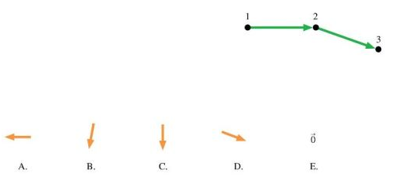
Class 13 Preclass Quiz on MasteringPhysics
Clicker Question 2 – retry this morning’s pre-class reading question.
35% of students answered correctly: The diagram shows three points of a motion diagram. The particle changes direction with no change of speed. What is the acceleration at point 2?

Slide 5
Class 13 Preclass Quiz on MasteringPhysics
25% of students answered correctly: A string is attached to the rear-view mirror of a car. A ball is hanging on the other end of the string. The car is driving around in a circle, at a constant speed. Which of the following lists gives all of the forces directly acting on the ball?
Correct answer: Tension and Gravity ONLY.
Centripetal Force is the Net force on an object moving in uniform circular motion.
This net force is the vector sum of all the actual forces on the free body diagram.
You do NOT draw centripetal force as an extra force acting on the object.

Slide 6
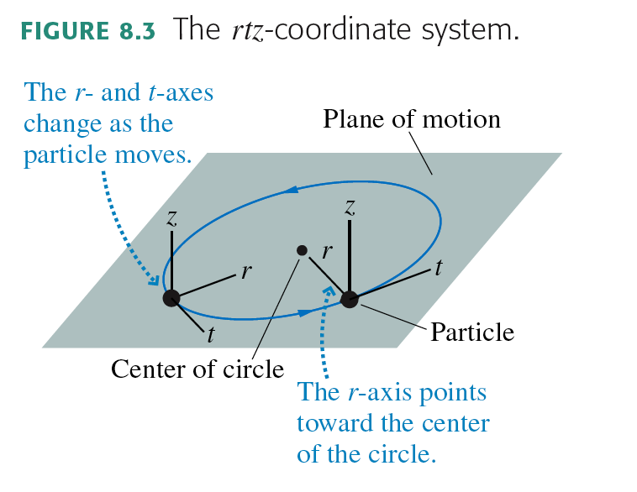
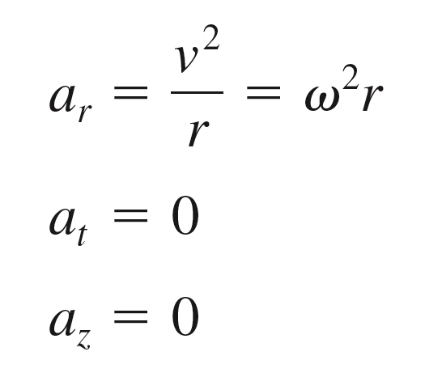
Uniform Circular Motion

Slide 7
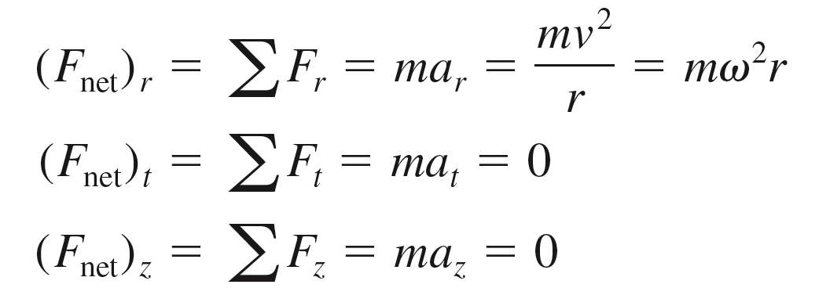
Dynamics of Uniform Circular Motion

Slide 8
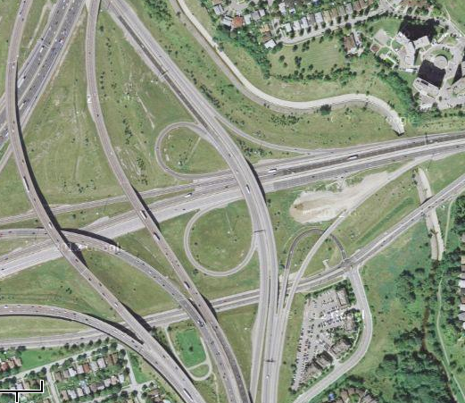
Every curve has a radius
r = 730 m
r = 75 m
r = 410 m
Intersection of Highway 427
And Highway 401

Slide 9
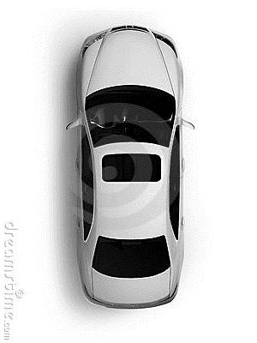
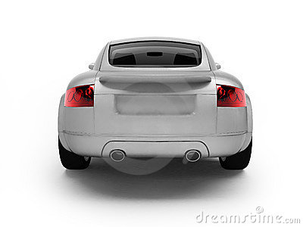
Unbanked Curve
Clicker Question 3
Top View
r
Back View
Gravity
Normal
Kinetic Friction
Static Friction
Rolling Friction
What horizontal force acts on the car to keep it on the curved path?

Slide 10
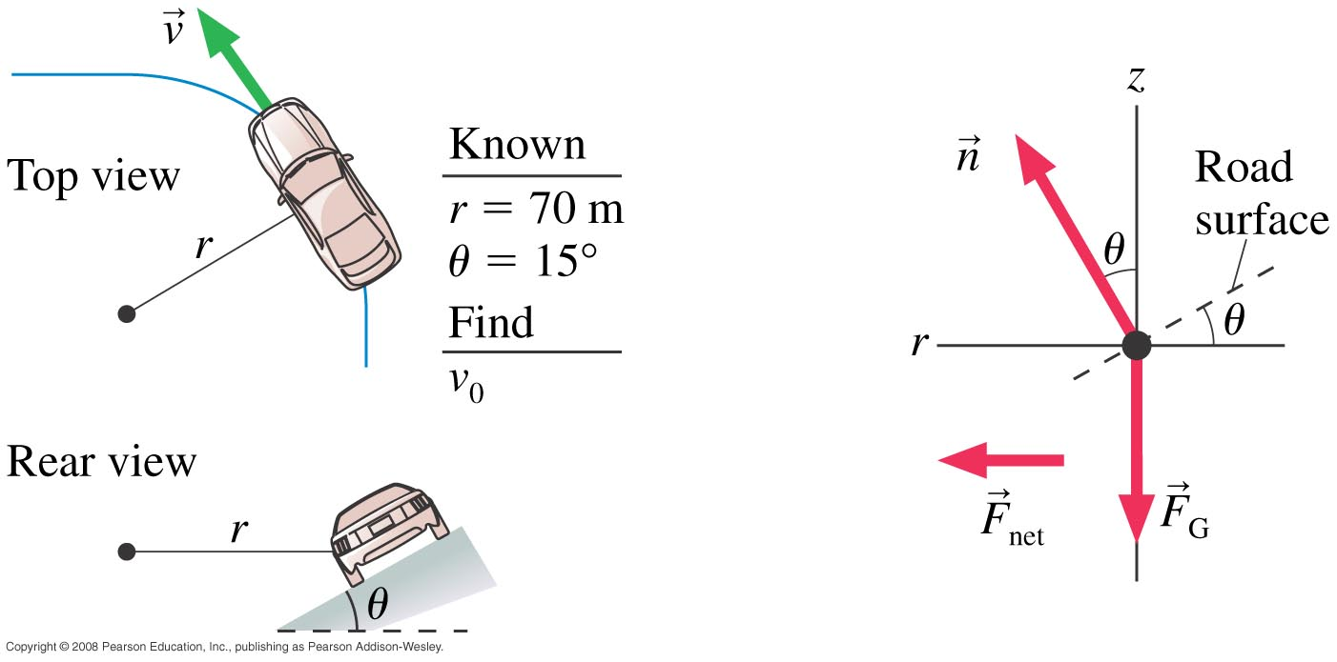
Banked Curve Example 8.5, pg. 197
A highway curve of radius 70.0 m is banked at a 15° angle. At what speed v₀ can a car take this curve without assistance from friction?

Slide 11
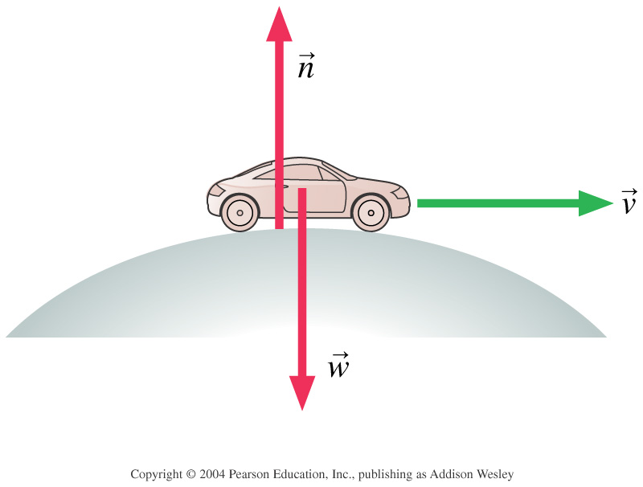
Clicker Question 4
A car is rolling over the top of a hill at speed v. At this instant,
n > F_{G}.
n < F_{G}.
n = F_{G}.
We can’t tell about n without knowing v.
Notes:
STT7.4
Answer: B

Slide 12
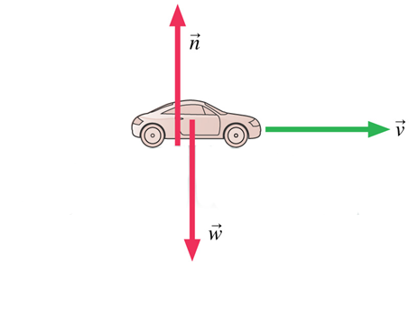
Clicker Question 5
A car is driving at the bottom of a valley at speed v. At this instant,
n > F_{G}.
n < F_{G}.
n = F_{G}.
We can’t tell about n without knowing v.
Notes:
STT7.4
Answer: B

Slide 13
Class 13 Preclass Quiz on MasteringPhysics
Some common or interesting student comments/feedback:
“Is the next test going to be of the same difficulty level as the one we just wrote?”
“Is the next test supposed to be super difficult to on bring down thr average?”
“I got 100 in test!!hahahah!!!”
Recall the average on Test 1 was 72%, which is the highest test 1 average I’ve had since I started teaching this course in 2004.
Message from Paul Kushner, the Undergraduate Chair of Physics (my boss): “This test was easier than what you might normally expect for the course. The tests need to generally be more challenging, and the next one will be. Expected average on PHY131 tests are 65%, and this class did unexpectedly well on Test 1.”

Slide 14
Class 13 Preclass Quiz on MasteringPhysics
Some common or interesting student comments/feedback:
“I think in the first practical you said you were competing with a colleague at Ryerson to see who's class would to better in the pre-course assessment. Who ended up winning?”
Harlow note: At Ryerson 155 students wrote it in their PCS120 calculus-based physics course, their average was 35%. In this class 978 students wrote it and your average was 50%.
“My roommate says not to underestimate her abilities to reach high terminal velocities when only thrown out of a fourth floor window.”
“What does a Greek cow say? $μ$”
“A student riding in a train looks up and sees Einstein sitting next to him. Excited he asks, ‘Excuse me, professor. Does Boston stop at this train?’”
+ Lots of nice messages of farewell – thank you!! I will miss you too!!

Slide 15
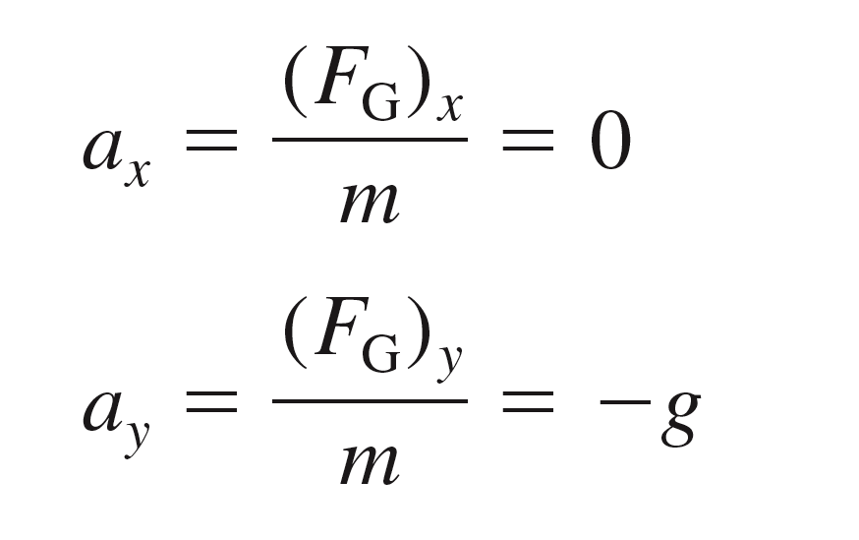
Projectile Motion
In the absence of air resistance, a projectile has only one force acting on it: the gravitational force, F_{G} = mg, in the downward direction. If we choose a coordinate system with a vertical y-axis, then
The vertical motion is free fall, while the horizontal motion is one of constant velocity.

Slide 16
A girl throws a ball in a horizontal direction (dashed line). After the ball leaves the girl’s hand, 1.0 seconds later it will have fallen
Clicker Question 6
A. 9.8 meters.
4.9 meters below the dashed line.
less than 4.9 meters below the straight-line path.
more than 4.9 meters below the straight-line path.

Slide 17
The Curvature of the Earth
Earth surface drops a vertical distance of 5 meters for every 8000 meters tangent to the surface.

Slide 18
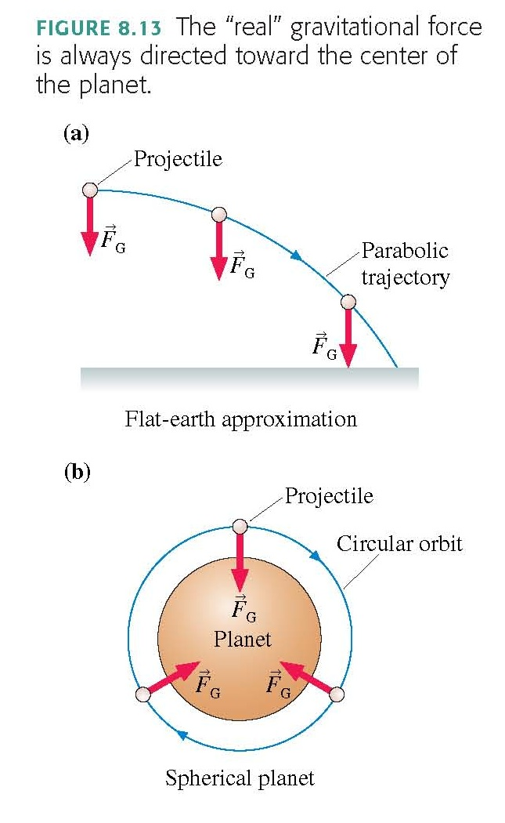

Slide 19
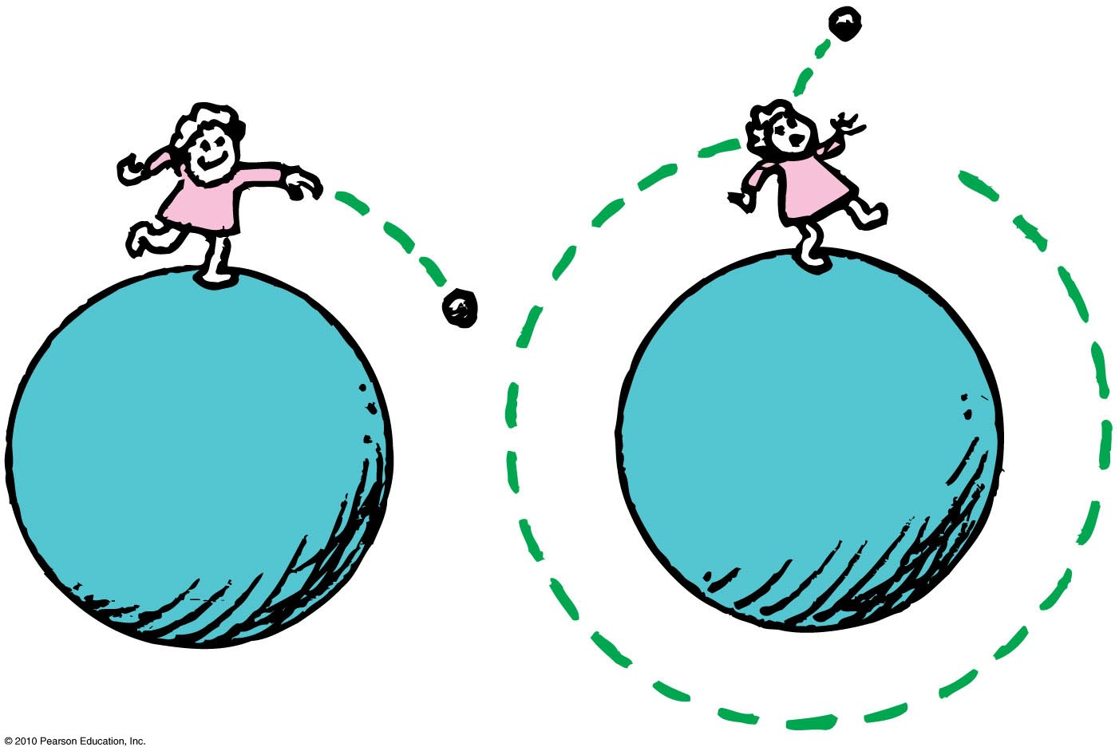
Circular Satellite Orbits
Satellite in circular orbit
Speed
must be great enough to ensure that its falling distance matches Earth’s curvature.
is constant—only direction changes.
is unchanged by gravity.

Slide 20
Example
How fast would you have to drive in order to be “weightless” – ie, no normal force needed to support your car?
How long would it take to drive around the world at this speed?

Slide 21
Circular Orbits
An object moving in a circular orbit of radius r at speed v_{orbit} will have centripetal acceleration of
That is, if an object moves parallel to the surface with the speed
then the free-fall acceleration provides exactly the centripetal acceleration needed for a circular orbit of radius r.
An object with any other speed will not follow a circular orbit.

Slide 22
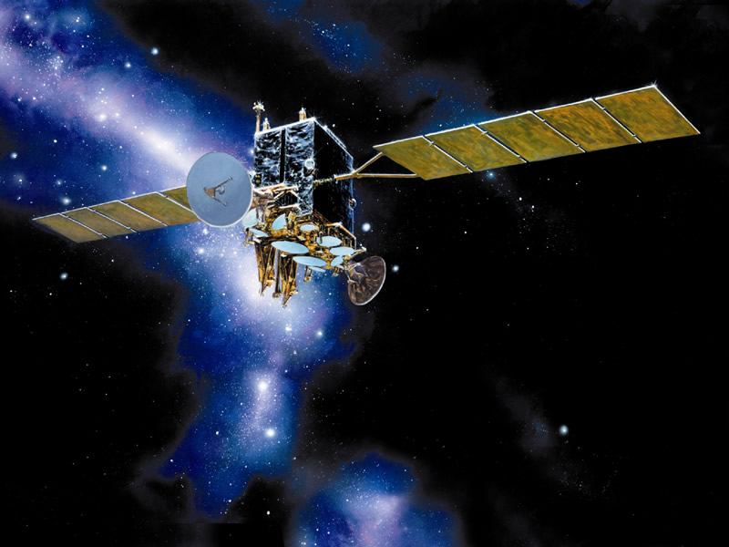
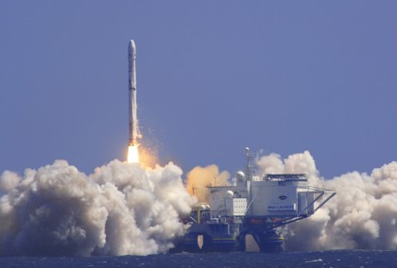
Why are communications satellites typically launched with rockets to heights of more than 100 km?
Clicker Question 7
To get above the Earth’s atmosphere in order to avoid air resistance
To get closer to the Sun in order to collect more solar power
To get away from radio interference on Earth
To get outside Earth’s gravitational pull so the satellite doesn’t fall down
Image from http://www.defenseindustrydaily.com/special-report-the-usas-transformational-communications-satellite-system-tsat-0866/
Image from http://www.zatznotfunny.com/2009-02/sirius-xm-headed-for-bankruptcy/ ]

Slide 23
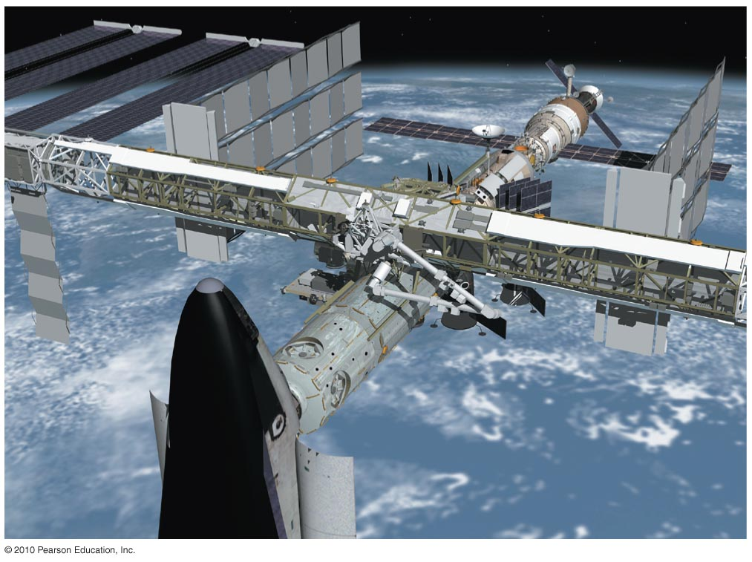
Circular Satellite Orbits
Positioning: beyond Earth’s atmosphere, where air resistance is almost totally absent
Example: Low-earth orbit communications satellites are launched to altitudes of 150 kilometers or more, in order to be above air drag
But even the ISS, as shown, experiences some air drag, which is compensated for with periodic upward boosts.

Slide 24
Before Class 14 on Monday
Please read the rest of Knight Chapter 8, and/or watch the Pre-Class Video, now on portal
MasteringPhysics Problem Set 6 is due on Monday evening.
It’s been a lot of fun – you are an excellent class!
I’ll be back! You will see me again in January for PHY132!
I hope you keep coming to my office hours T2-3 and RF10-11 – I’d love to help!
The next test is Nov. 19 on Chs. 6-10, which includes momentum and energy
And I will definitely see you at the Final Exam Dec. 17 9:00am!
Image from http://wifflegif.com/tags/211457-i-ll-be-back-gifs

