Slide 1
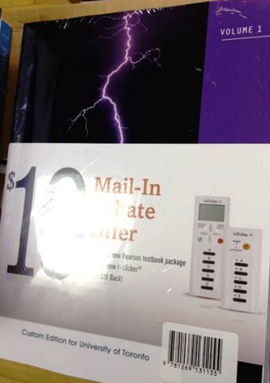
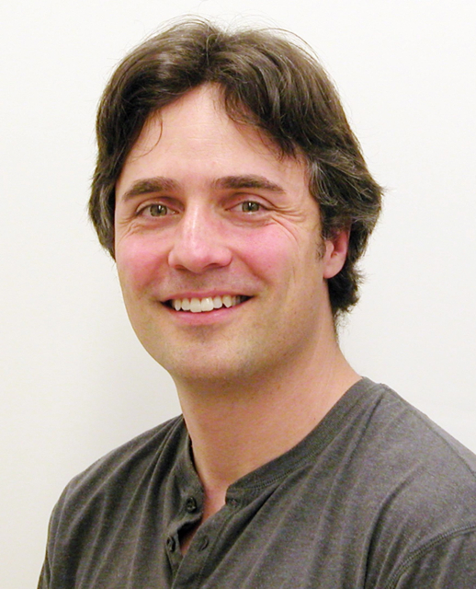
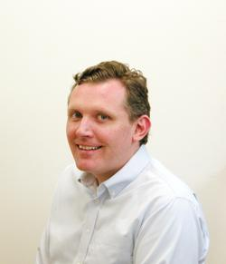
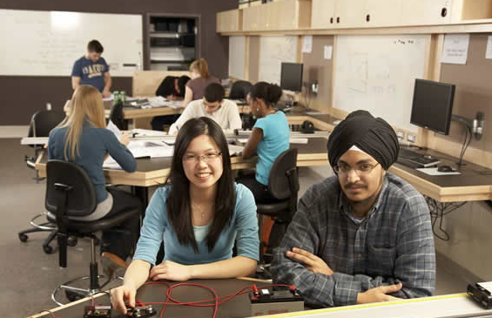
PHY131H1F Introduction to Physics I Class 1
Welcome - please make yourself comfortable!
We are Jason Harlow and Andrew Meyertholen. We will be sharing the teaching between now and December.
Today will be an introduction and team lecture
On Wednesday Dr. Harlow will take over for the first half of the semester, starting with Chapter 1!

Slide 2
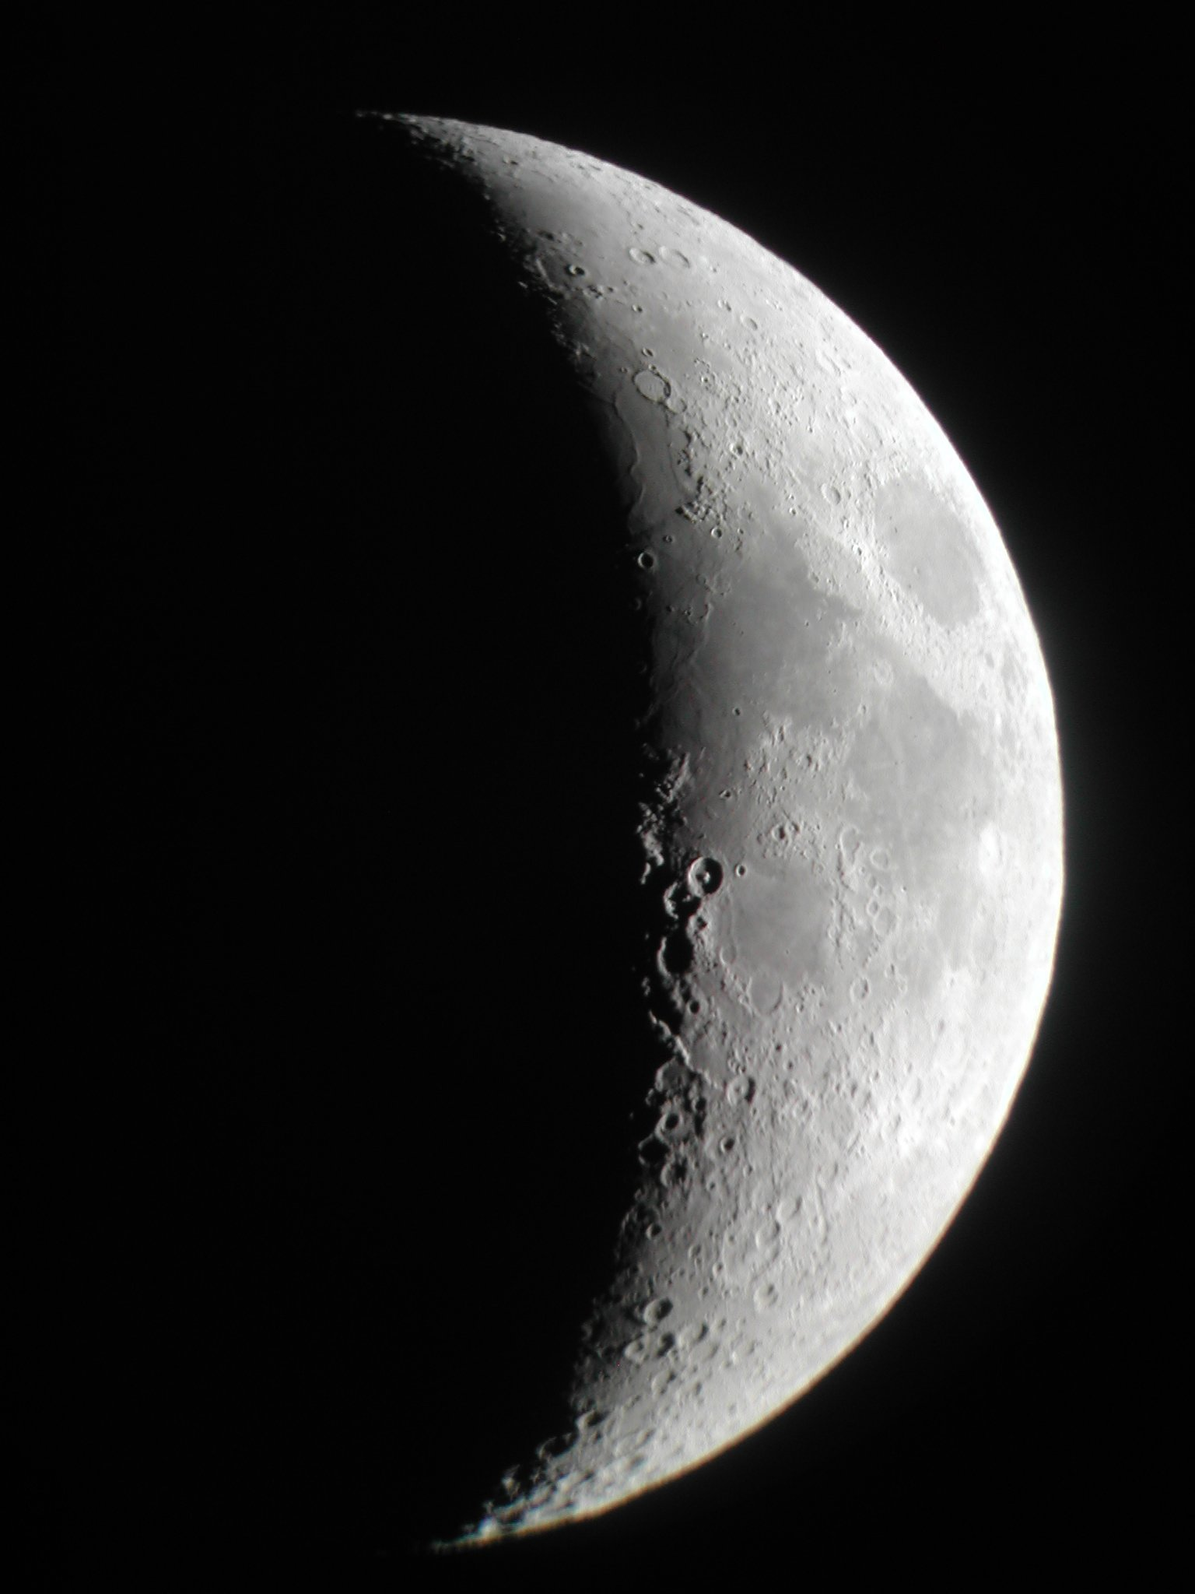
Today’s Outline
Introduction Who are we? What is physics?
Run of the Course Online Assignments, Practicals, Tests and Exam
Physics Education Research Why all the clickers, pre-class quizzes, practicals?
Why are We in This Class?
Tips for Class Success

Slide 3
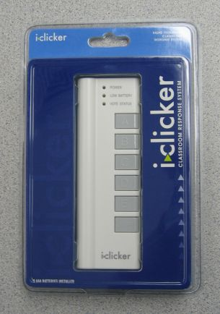
Clickers…
Beginning Wednesday, we will be asking in-class clicker questions every class.
You will receive marks 100 marks per question for participation only; getting the correct answer gets you one extra mark (so 101 per correct question).
Clicker Participation is worth 2% of your course mark.
Clickers cost $46 at the bookstore new, $32 used, and can be sold back for half-price after you are done. Many courses at U of T use these clickers.
i>clicker GO app registration costs $10 per semester, non-refundable.
You must register your iclicker ID on portal in order to obtain marks

Slide 4
Who is teaching this course?
First half, now until late October:
Jason Harlow
B.Sc. University of Toronto 1993
Ph.D. Pennsylvania State University 2000
Second half, October 28 to December 4:
Andrew Meyertholen

Slide 5
My contact information
Jason Harlow, teaching first half of course
jharlow@physics.utoronto.ca
Office: MP121B
/harlowphysics
/phy131uoft (77 “likes” as of this morning)
@jasonjbharlow
Voice line (no texts): 416-946-4071
Fall 2014 office hours: T12 and F10, starting tomorrow.

Slide 6
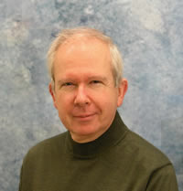
Other important contacts
Dr. Pierre Savaria, Course Coordinator
phy131@physics.utoronto.ca
Office: MP129E
Voice line: 416-978-4135
Ms. April Seeley, Course Administrator
seeley@physics.utoronto.ca
Office: MP129
Voice line: 416-946-0531
Office hours: Monday,Tuesday, Thursday, Friday 9:30am to 5:00pm, and Wednesdays from 9:30am to 4:30pm

Slide 7
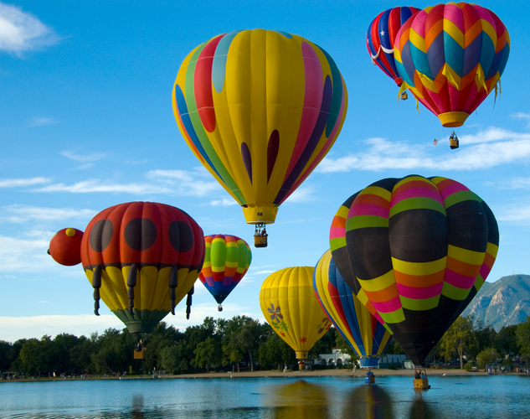
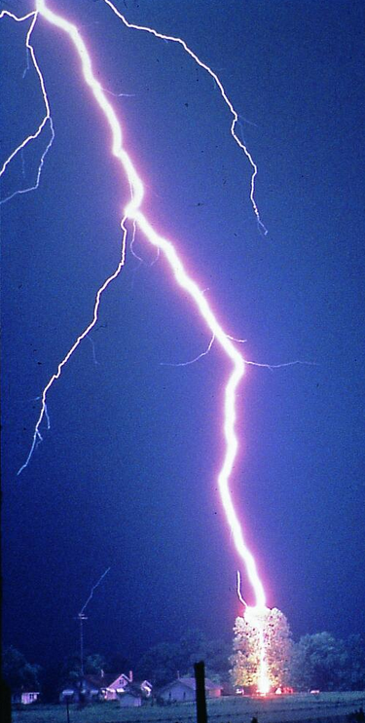
What is Physics?
“Physics is the natural science that involves the study of matter and its motion through space and time, along with related concepts such as energy and force.
More broadly, physics is the general analysis of nature, conducted in order to understand how the universe behaves.”
- http://en.wikipedia.org/wiki/Physics

Slide 8
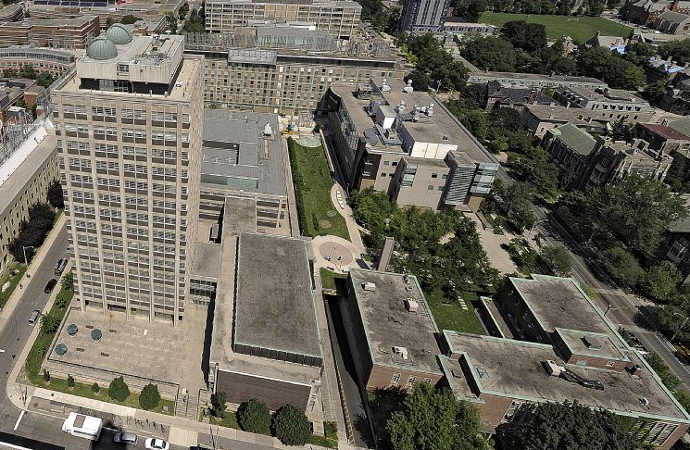
http://www.physics.utoronto.ca/
55 Researching Faculty
6 Teaching Faculty
2 Librarians
20 Technologists and Information Technology Specialists
20 Administrators

Slide 9
Physics at U of T
Some of the top research fields in our department are:
Atmospheric – Observational and Computational
Biological Physics
Condensed Matter Physics – Theoretical and Experimental
High Energy Particle Physics – Theoretical and Experimental
Geophysics
Quantum Optics
Physics Education Research

Slide 10
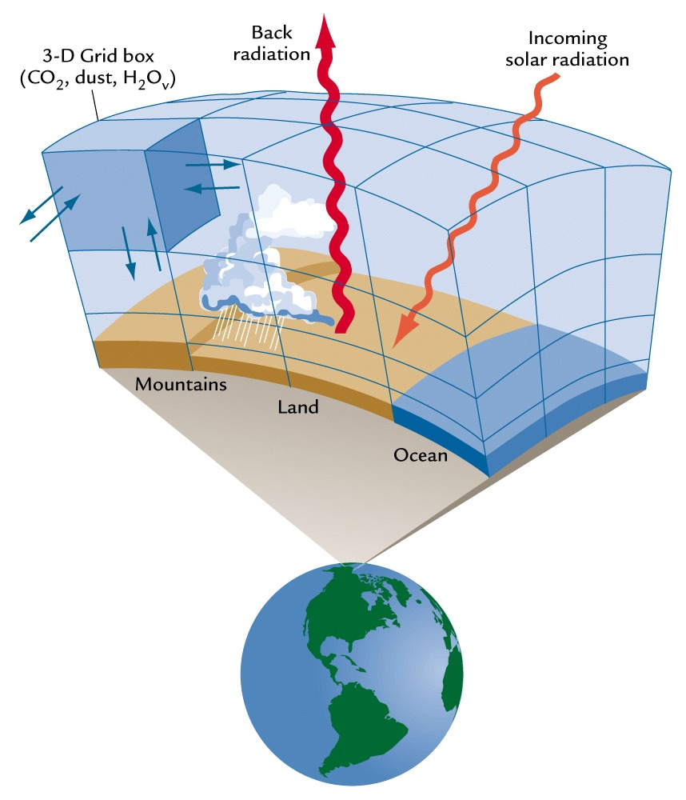
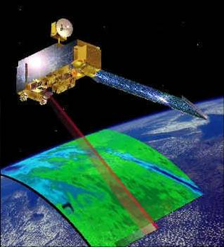
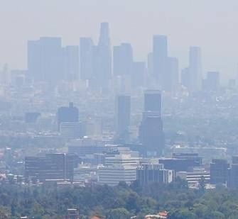
Atmospheric Physics at U of T

Slide 11
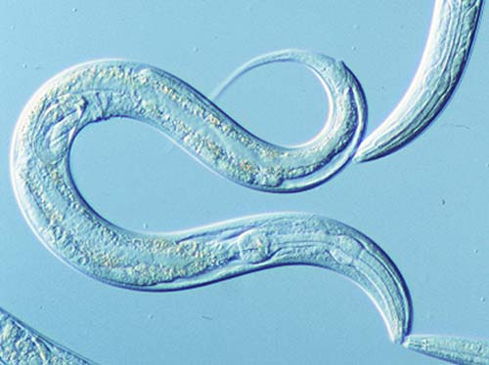
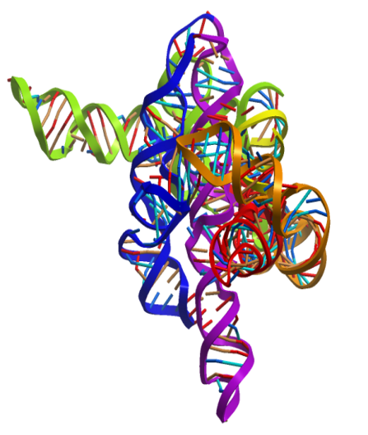
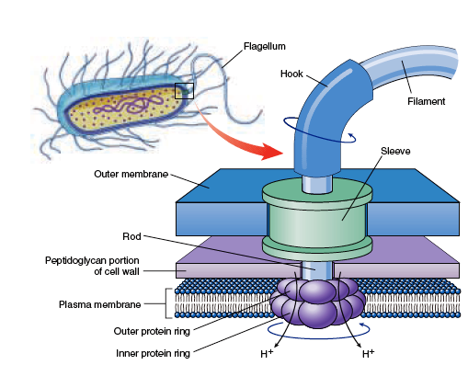
Biological Physics at U of T
How do simple creatures like C. elegans make decisions?
What is the physics behind RNA folding, molecular motors and DNA replication?
How do nano-motors transport molecules into, out of, and within cells?

Slide 12
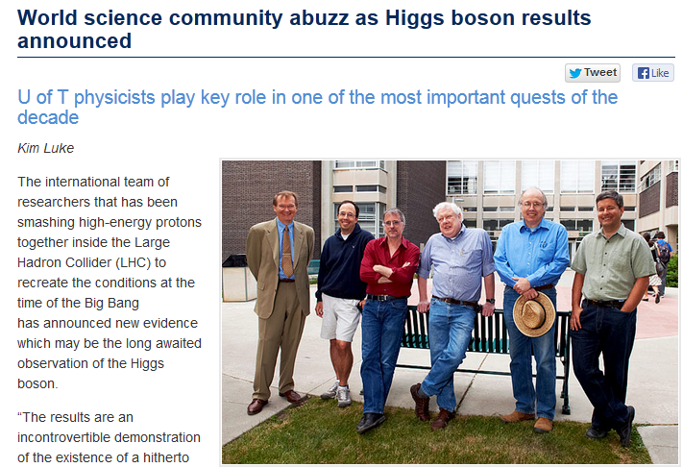
July 4, 2012

Slide 13
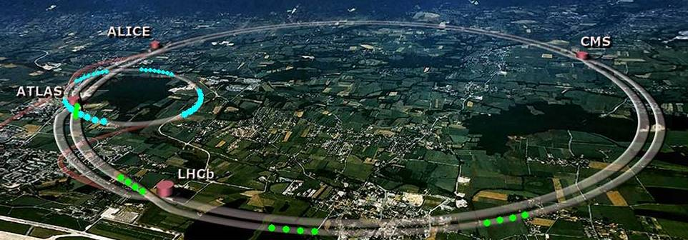
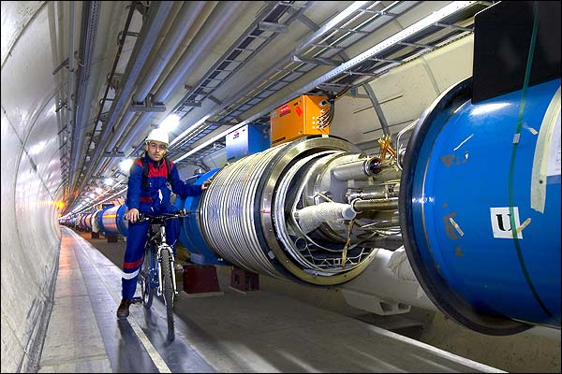
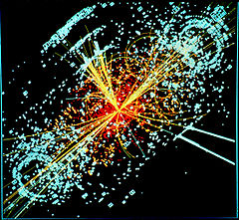
The Large Hadron Collider
[image from http://www.universetoday.com/17905/large-hadron-collider-worst-case-scenario/ ]
Higgs Boson discovered July 4, 2012
[Photo courtesy of BBC News, credited to Cern/Maximilien Brice, from http://news.bbc.co.uk/nol/shared/spl/hi/pop_ups/05/sci_nat_the_large_hadron_collider/img/1.jpg ]
[http://en.wikipedia.org/wiki/Higgs_boson ]

Slide 14
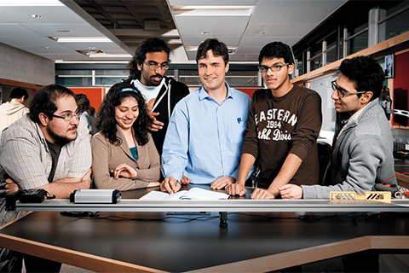
What Does Taking PHY131/132 Get You?
Lots of fun!
PHY131/132 is an acceptable pre-requisite for all second-year physics courses in case you decide to switch and pursue a POST in physics
This course will help prepare you for the physics portion of the Medical College Admission Test (MCAT) in case you want to be a doctor some day
Many health-science post-graduate programs require 2 semesters of lab-based physics
Important knowledge and skills which will last a lifetime.

Slide 15
Pre-Requisite for PHY131:
MCV4U Calculus and Vectors or MHF4U Functions and Calculus or course equivalent from another province, country.
Co-Requisite for PHY131:
To be able to do PHY131H1 a student must do (or have done already) MAT135H1 or MAT137Y1 or MAT157Y1 or course equivalent from another college/university.

Slide 16
Note on MAT135/137/157 Co-Requisite:
Students who are on the waitlist for any of the co-requisite courses can stay in the PHY131H1 until such time as the waitlists close (September 14).
If you were on the waitlist and were not put into one of the co-requisite courses then you will have to remove yourself from PHY131H1. If you find that after the waitlists close you are put into one of the co-requisite courses then you can stay in PHY131H1.
Also if you leave the co-requisite course at anytime during the term then you will have to remove yourself from PHY131H1.

Slide 17
What can you expect of me?
To try to teach well and explain physics clearly, at an appropriate level
To treat you with courtesy, respect and kindness
To be fair
To be in my office at scheduled office hours
To answer emails within 48 hours
To begin class at 11:10am and end class at or slightly before noon

Slide 18
What do I expect of you?
To read the assigned reading before coming to class (or at least watch the pre-class video)
To keep up with the online homework
To be seated and ready for class at 11:10
To not have more than one clicker with you (bringing a friend’s clicker to class is an academic offense called impersonation)
To not make lots of noise during class or do stuff which distracts your neighbours
To be patient with me when I make mistakes, and also to point out any mistakes I don’t notice right away

Slide 19
Online Homework
You should purchase a Student Access Kit, either as part of the textbook package or as a stand-alone
Register with your name (same name on your student card) and UTORid
Enrol in this course: MPPHY131F14
Problem Sets (worth 9% of course mark) are quite long – make take between 1 and 3 hours per week

Slide 20
Pre-Class Reading Quizzes
In order to get the best out of our classes (which will include lots of clicker questions and discussion) you must read the chapters before coming to class
If you hate reading, I have also posted pre-class videos, which go over the main points from each day’s reading
Beginning this Wednesday, there will be a short online multiple choice quiz on due by 8:00am before class.
The quiz will be based on your reading or watching of the pre-class video.
The questions are not too tricky – if you’ve read the material, you should find them quite straightforward.
These quizzes are worth 3% of your course mark

Slide 21
Tests and Exam
Test 1 is Tuesday September 30, 6:00-7:30PM in room(s) to be announced (only 3 weeks away!)
An alternate sitting will be scheduled just before the main sitting of the test for students who demonstrate a conflict with another academic activity at U of T – you must visit April in MP129
Test 1 is worth 15% of the course mark, and covers Chapters 1-3, and the Error Analysis Document
Test 2, also worth 15%, is Tue. Nov. 11, 6:00PM
The Final Exam is worth 40% of the course mark, covers the entire course, and will be held some time TBA between Dec.8-19

Slide 22
How to get more information
The main way of keeping up with what’s going on in the course is the web-site at:
https://portal.utoronto.ca
The Course Information page on the portal page for this course has all the rules for the course – PLEASE READ IT!
Also, we will email you from time to time at your utoronto.ca email address
The above forms of electronic communication are mandatory – please use them!
Wednesday’s reading assignment is Chapter 1.
Please go on MasteringPhysics today or tomorrow and complete the Chapter 1 Preclass Quiz!
This is for marks!
Don’t forget your clicker on Wednesday!

