Slide 1
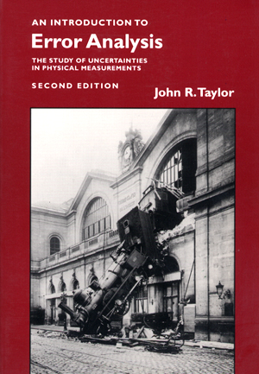
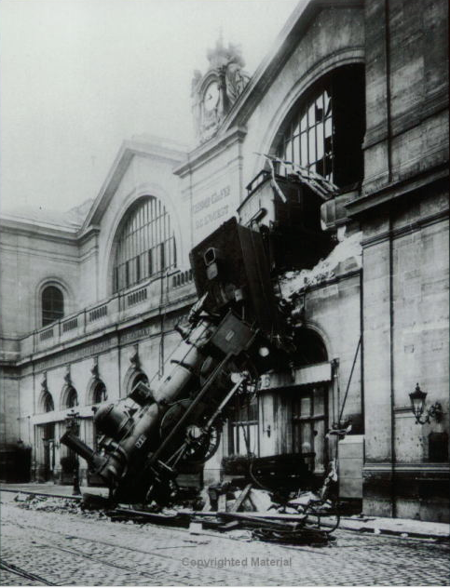
PHY131H1F Class 3
Today: Error Analysis
Significant Figures
Unit Conversion
Normal Distribution
Standard Deviation
Reading Error
Propagation of Errors
Error in the Mean

Slide 2
Clicker Question
A cart begins at rest, and accelerates down a ramp with acceleration: a = 0.518 m/s². After 3.2 s, how far has it traveled? d = ½ a t² gives the result 2.65216 on your calculator. How should you best report this answer in your “Final Answer” box?
2.65216 m
2.65 m
2.60 m
2.6 m
2.7 m

Slide 3
Student comment on preclass quiz
“The question about ranking Significant Figures was the most challenging for me because I had to let go of the notion that "more is more".”
Harlow comment: Right! It is not always better to say “2.65216” if “2.7” is actually more honest.

Slide 4
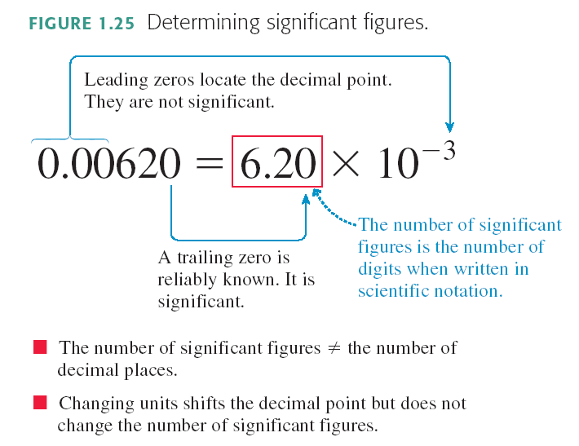
From Knight Chapter 1:

Slide 5
Significant Figures
Which of the following has the most number of significant figures?
8200
0.0052
0.430
4 × 10^{–23}
8000.01

Slide 6
Student comment on last week’s preclass quiz
“Does 8200 have two or four significant figures?”
Harlow Answer: I don’t know!
It would depend on the context. If someone was selling oil barrels and charged you for 8200 barrels, probably there are 4 significant figures since there’s a lot of money involved. If someone says the distance from here to the nearest hospital is 8200 m, probably there are 2 significant figures, because it was rounded.
Best practice in science: use scientific notation!
8.200 ×10³ has 4 sig figs
8.2 ×10³ has 2 sig figs

Slide 7
When do I round?
The final answer of a problem should be displayed to the correct number of significant figures
Numbers in intermediate calculations should not be rounded off
It’s best to keep lots of digits in the calculations to avoid round-off error, which can compound if there are several steps

Slide 8
Student comment on last week’s preclass quiz
“If the last digit is 5, how do we round the number if the second last digit is odd/even?”
I always round 0,1,2,3,4 down and 5,6,7,8,9 up (seems fair)
So 3.45 to two sig figs is 3.5
And 3.35 to two sig figs 3.4
The importance of significant figures when it comes to tests, exams, practicals, and homework questions (i.e. will we lose a mark if we have the incorrect number of significant figures?) would be useful to know.
For Test 1 only, you will lose a small amount of marks for incorrect sig figs

Slide 9
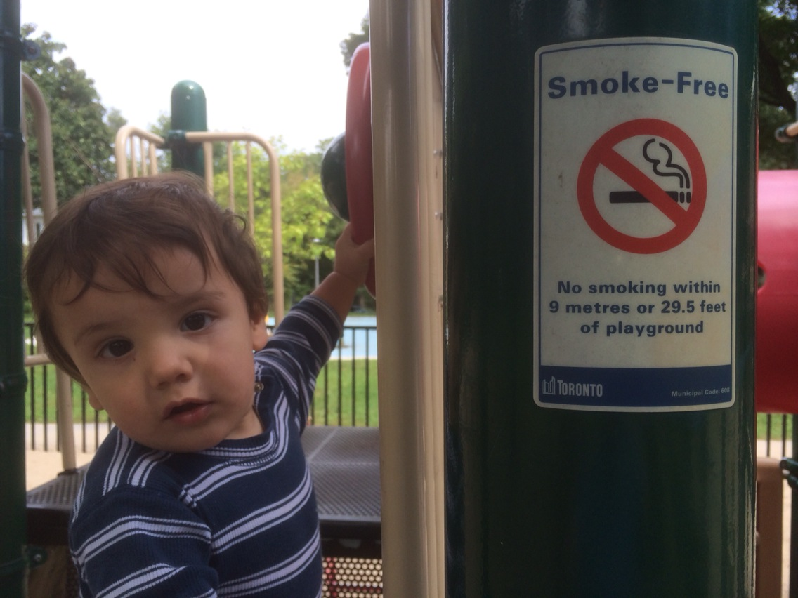
Unit Conversion: What’s wrong with this picture?
I don’t like the sig figs on that conversion, Daddy!
Neither do I, Son, neither do I….
Maraj Harlow
Age: 10 months

Slide 10
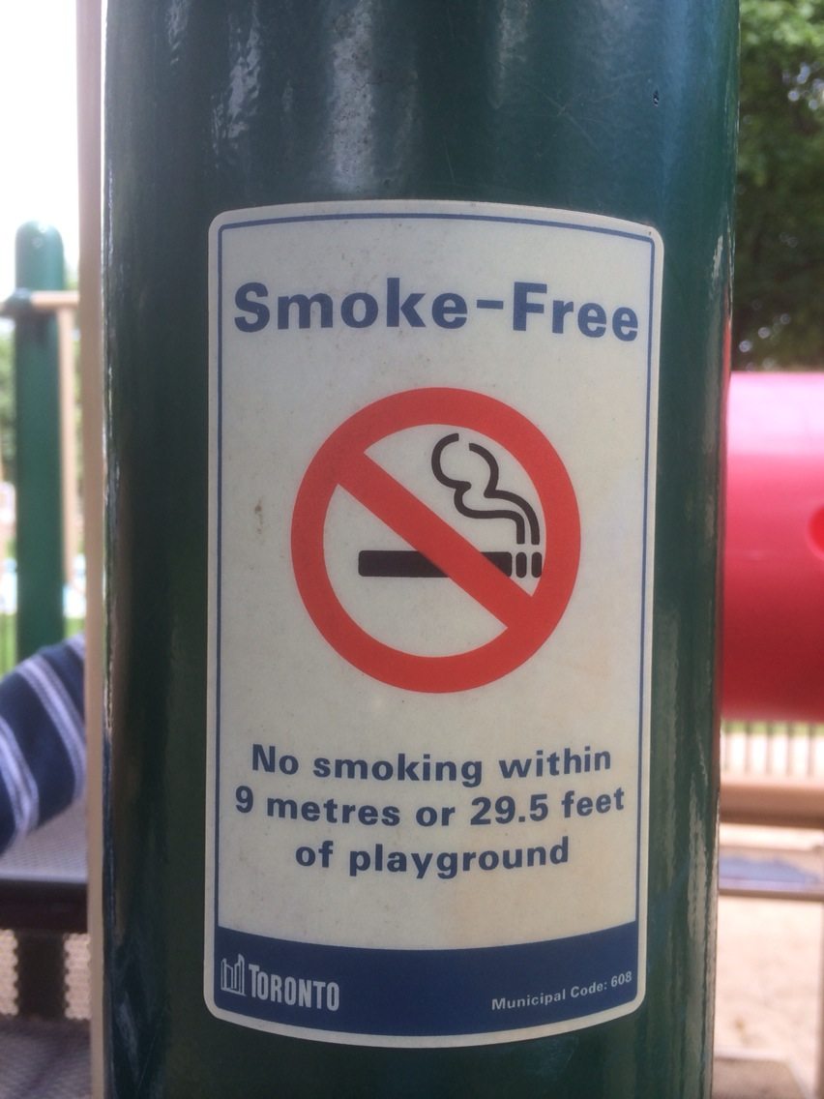
Convert 9 m to feet
$$1=\left(\frac{1 in}{2.54 cm}\right)=\left(\frac{2.54 cm}{1 in}\right)$$
Facts you are given:
$$1=\left(\frac{100 cm}{1 m}\right)=\left(\frac{1 m}{100 cm}\right)$$
$$1=\left(\frac{12 in}{1 foot}\right)=\left(\frac{1 foot}{12 in}\right)$$

Slide 11
Real 2-hour Practicals begin this week!
Check out my video
All you need is a calculator, your textbook and something to write with.
Dr. Meyertholen has posted a good 6 minute video with answers to lots of FAQs about Practicals at:
http://youtu.be/DVsLJgxJVgo

Slide 12
Class 3 Preclass Quiz on MasteringPhysics
This was due this morning at 8:00am
962 students submitted the quiz on time
73% correct: If a digital thermometer reads 12.8°C and the error specified in the manual is “half the last digit”, in this case it would be ±0.05°C.
79% correct: In the physical sciences, an “error” is the number to the right of the ± symbol, also known as an uncertainty.
82% correct: In an equation for the normal distribution (Gaussian) sigma is related to the width of the distribution.
98% correct: “Mean” is the same as “average”.

Slide 13
Class 3 Preclass Quiz on MasteringPhysics
Some common student comments/feedback:
I was most confused by the equation used to calculate standard deviation, as well as the meaning of "number of degrees of freedom".
i was confused by how to use the three rules to propagate errors and find a final value
I really wanted to chose the song by taylor swift for the definition of the mean, but I didn't.
The concepts revolving around the histogram are a little confusing to me. I was wondering how some of the statistics were created. e.g., "68%" area under the curve of a Gaussian lies between the mean minus the standard deviation.

Slide 14
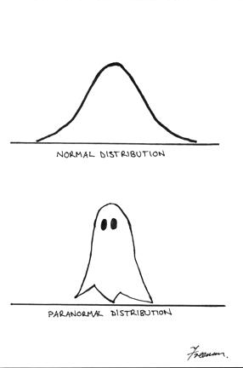
Class 3 Preclass Quiz on MasteringPhysics
Some common student comments/feedback:

Slide 15
Last Wednesday I asked at the end of class:
If your height is 150 cm, is there an error in that number?
ANSWER: YES! Almost every measured number has an error, even if it is not stated. If you told me your height was 150 cm, I would guess the error is probably between 1 and 5 cm. [But there is no way to know this, unless you investigate how the 150 was measured.]

Slide 16
Demo and Example: What is the Period of a Swinging Ball? (Pendulum)
Procedure: Measure the time for 5 oscillations, t₅.
The period is calculated as T = t₅ / 5.
t₅ data:

Slide 17
Here were Harlow’s measurements of t₅:
7.53 s
7.38 s
7.47 s
7.43 s
Which of the following might be a good estimate for the error in Harlow’s first measurement of 7.53 seconds?
0.005 s
0.05 s
0.5 s
5 s
Impossible to determine
Clicker Question

Slide 18
7.53 s
7.38 s
7.47 s
7.43 s

Slide 19
7.53 s
7.38 s
7.47 s
7.43 s
7.44 s
7.56 s
7.48 s
7.40 s

Slide 23
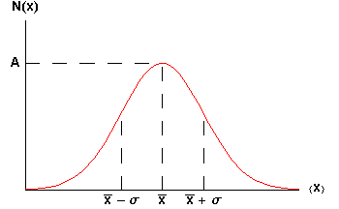
The Gaussian:
When you integrate this curve, you find that 68% of area lies between the dotted lines on the graph.

Slide 24
Heights of some People (London, 1886)
Gaussian Distributions turn up everywhere!
inches

Slide 25
Random Walk
Where does an object end up, if it takes N steps randomly left or right?
The final distribution is described by a Gaussian function!

Slide 26
The t₅ data
Numerically:
7.53 s 7.38 s 7.47 s 7.43 s
+ 0.06 s + 0.06 s + 0.06 s + 0.06 s

Slide 27
Propagation of Errors
Rule #1 (sum or difference rule):
If z = x + y
or z = x – y
then
Rule #2 (product or division rule):
If z = xy
or z = x/y
then

Slide 28
Propagation of Errors
Rule #2.1 (multiply by exact constant rule):
If z = xy
and x is an exact number, so that Δx=0
then
Rule #3 (exponent rule):
If z = x^{n}
then

Slide 29
What is the error in the mean of N measurements with the same error Δx ?

Slide 30
The Error in the Mean
Many individual, independent measurements are repeated N times
Each individual measurement has the same error Δx
Using error propagation you can show that the error in the estimated mean is:

Slide 31
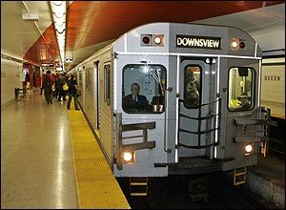
You wish to know the time it takes to travel from Finch station to Yonge/Bloor by subway. You ask 10 people to take a stopwatch and time the trip. After analyzing all the data you find that it takes an average of 26 minutes and 40 seconds, with an error in this average of ± 100 seconds.
If you expand your survey and ask 1000 people to time the trip, when you analyze the data, what would you expect to be the error in the average time?
100 seconds
50 seconds
10 seconds
1 second
0.05 seconds
Clicker Question

Slide 32
Significant Figures
The rules for significant figures when errors are involved are:
Errors should be specified to one or two significant figures.
The most precise column in the number for the error should also be the most precise column in the number for the value.

Slide 33
Clicker Question
Example: If a calculated result is d = 7.056 +/- 0.705 m, how should you report this?
7.1 ± 0.7 m
7.06 ± 0.71 m
7.056 ± 0.705 m
Any of the above
Either A or B, but not C

Slide 34
Before Class 4 on Wednesday
Please read Chapter 2, Sections 2.1-2.4 of Knight (or at least watch the pre-class video for Class 4)
Please do the pre-class quiz before Wednesday at 8:00am.
Don’t forget to start the Problem Set due Sunday – there’s no time limit, just a deadline
Something to think about: Does constant velocity imply constant acceleration? Does constant acceleration imply constant velocity?

