Slide 1
PHY131H1F Class 4
Today, Chapter 2, Sections 2.1 to 2.4
Uniform Motion
Average velocity / Instantaneous Velocity
Differentiating position to get velocity
Integrating velocity to get position
Equations of Constant Acceleration

Slide 2
Clicker Question
x
t
If the Position versus Time graph of an object moving in 1D is a straight line, what does this mean?
The object is not moving
The object is moving with a constant velocity
The object is moving with a constant acceleration

Slide 3
Class 4 Preclass Quiz on MasteringPhysics
Student comment:
“If a straight line is uniform motion in a position-time graph, then does stationary not count as a straight line? they both are technically straight... except one line is horizontal and the other is on an angle. but they are both "straight" aren't they??”
Harlow answer: Yes, stationary is a straight line. I agree! Also, “zero” is a constant velocity! It’s just a very specific constant velocity.

Slide 4
Class 4 Preclass Quiz on MasteringPhysics
This was due this morning at 8:00am
986 students submitted the quiz on time
74% answered correctly: If the position-versus-time graph is a straight line, it means it has uniform motion. (Note: a horizontal straight line means it is stationary.)
75% answered correctly: Speeding up when velocity is in the negative direction means negative acceleration.
84% answered correctly: The area under a velocity-versus-time graph is the displacement of the object (it can be negative or positive, indicating direction)
92% answered correctly: The slope of a position-versus-time graph is the object’s velocity (it can be negative or positive, indicating forward or backward direction in 1D)

Slide 5
Class 4 Preclass Quiz on MasteringPhysics
Some common student comments/feedback:
“Does infinite speed count as uniform motion?”
Harlow answer: Not allowed! In physics, no speed can be greater than the speed of light, which is 3 x 10⁸ m/s. (more about this in PHY132)
Lots of nerves about calculus and integration
Harlow comment: Remember, this is a calculus-based course. We use derivatives and integrals in our descriptions of concepts. However, you will not be asked to perform an integral on a test. (but maybe the occasional derivative of a simple polynomial, for example)

Slide 6
Class 4 Preclass Quiz on MasteringPhysics
Lots of people admitting they didn’t do the reading.
Harlow comment: I appreciate your honesty, however… The entire point of these pre-class quizzes is to force you to do the reading before coming to class. The clicker questions are meant to be times to discuss what everyone here has already read.
[…Although, if you were at the Black Keys concert last night, that is an excellent excuse. How was it? *jealous* ]
“this one was pree eeezz dawg :) tanks for the marks doe”
Harlow comment: Google translate could not detect the language

Slide 7
Class 4 Preclass Quiz on MasteringPhysics
“how strict you are about notation? Do we have to use the exact same notation demonstrated in the book?”
Harlow answer: Not strict at all! You should be able to reason properly without making mistakes and get to the correct answer (ie that the ball took 4.5 seconds to hit the ground). Whether you call the initial velocity v₀ or v_{i} or v₁ or w_{Bieber}, I don’t care!

Slide 8
Last day I asked at the end of class:
Does constant velocity imply constant acceleration?
ANSWER: YES, and even more, it implies zero acceleration! (zero is a constant!)
Does constant acceleration imply constant velocity?
ANSWER: NO! Unless that constant happens to be zero! Constant acceleration normally means constantly changing velocity!

Slide 9
Uniform Motion = Constant Velocity
$$x_{f}=x_{i}+v_{x}t$$
In the absence of friction, all objects tend to move with constant velocity.
This is “Newton’s First Law of Motion.”
x
t

Slide 10
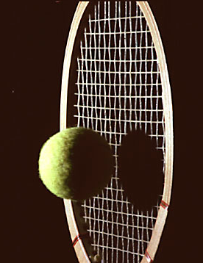
No force
Not squished
Images from http://people.rit.edu/andpph/exhibit-8.html ; taken by Andrew Davidhazy
External force on ball
Ball is squished

Slide 11
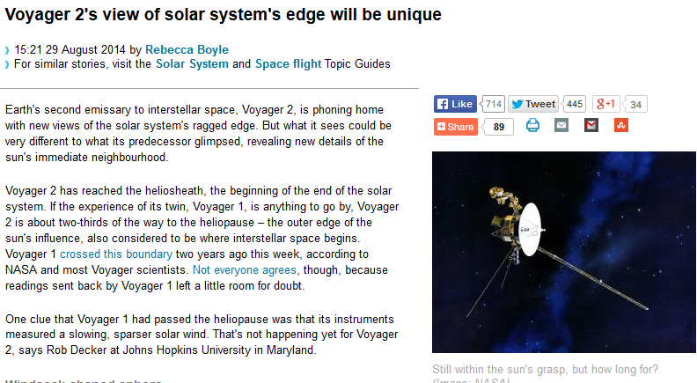
http://www.newscientist.com/article/dn26121-voyager-2s-view-of-solar-systems-edge-will-be-unique.html#.VBhrChYXOAZ
Currently 105 A.U. from the Sun (Earth is 1 A.U.)
Moving at a constant velocity in a straight line of 15.428 km/s through interstellar space

Slide 12
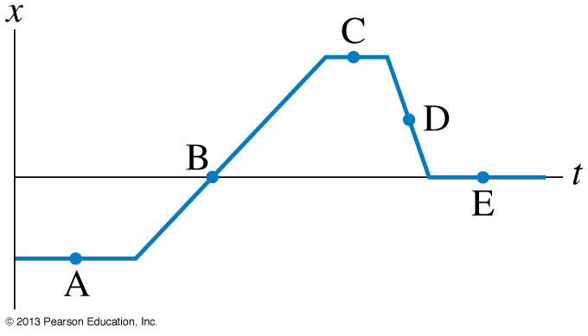
Clicker Question
At which point is the object moving the fastest? (highest speed)

Slide 13
Clicker Question
At which point is the object moving the to the left?

Slide 14
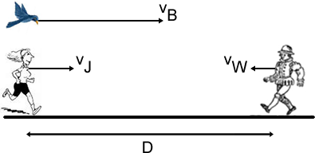
From a Past PHY131 Test:
A jogger runs at a constant velocity ${\vec{v}}_{J}=10 \frac{km}{hr} to the right.$
A walker walks at a constant velocity ${\vec{v}}_{W}=5 \frac{km}{hr} to the left.$
When the jogger and the runner are D = 3 km apart, a bird flying at a constant velocity ${\vec{v}}_{B}=30 \frac{km}{hr} to the right$ passes the jogger.
When the bird reaches the walker, it turns around and flies back to the jogger at the same speed. When it reaches the jogger it turns around again and flies to the walker. It continues flying back and forth between the jogger and the walker.
When the jogger and walker meet each other, how far has the bird flown?

Slide 15
From a Past PHY131 Test:
30 km/hr
5 km/hr
How far has bird flown when Jogger and Walker meet?
Bird has constant speed, so d_{B} = v_{B} t
Need to find t.
10 km/hr
= 3 km

Slide 16
Curved Line = Not-Constant Velocity
$$v_{x}= \frac{dx}{dt}$$
x
t

Slide 17
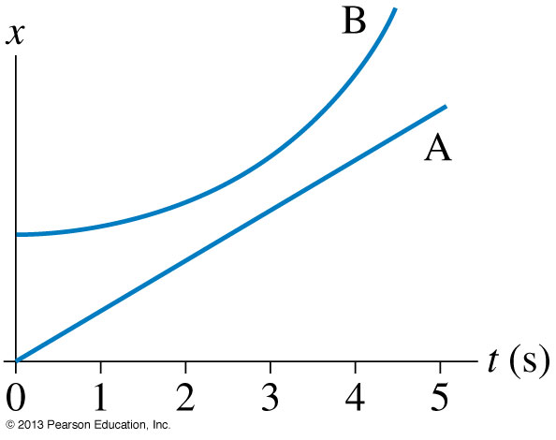
Clicker Question
When do objects A and B have the same velocity?
t = 0 s
t = 1 s
t = 3 s
t = 5 s
Objects A and B never have the same velocity

Slide 18
Clicker Question
Which velocity-versus-time graph goes best with the position-versus-time graph on the left?
Notes:
Answer: C

Slide 19
Announcements
Pre-course diagnostic quiz on mechanics done during zeroth practical last week.
Did you miss it? Still want your 0.5%? Here are two make-up times to choose from:
Tues Sept. 23 - 11:10 am in MP125C Wed. Sept 24 - 4:10 pm in MP125C

Slide 20
Announcements
Don’t change your Practical Section on ROSI – your TAs will never know, and you won’t get your marks!
You must go to portal and fill out an online form if you want to change Practical Sections.

Slide 21
Announcements
The first term test will be on Tuesday, Sep 30, from 6:00pm to 7:30pm.
Test 1 will cover chapters 1-3 plus the Error Analysis Mini-Document, plus what was done in Practicals
You must bring a calculator and one 8.5x11’ aid sheet which you prepare, double-sided
If you have a conflict at that time with an academic activity (test, lecture, tutorial, lab), you must register to write at the alternate sitting of this test by going to portal and filling out the online form no later than Sep. 25 by 4:00pm.

Slide 22
Acceleration in 1-D (along a line)
Velocity is the time-derivative of position.
Acceleration is the time-derivative of velocity.
S.I. unit of acceleration is m/s per second, also called m/s².
Acceleration is like the “speed of the speed”
Acceleration is “how fast fast changes!”
It is possible to be momentarily stopped (v=0) with a non-zero acceleration!

Slide 23
Constant Acceleration
$$v_{f}=v_{i}+a_{x}t$$
$$x_{f}=x_{i}+\int_{0}^{t}{vdt}$$
v
t

Slide 24
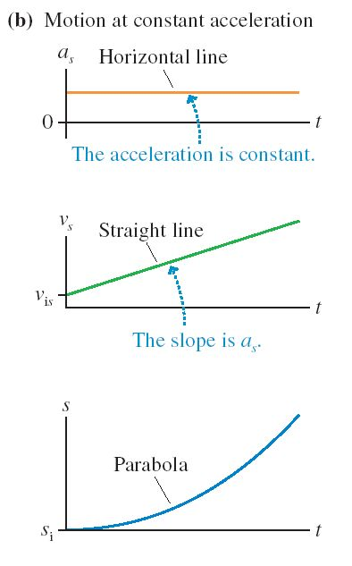

Slide 25
Clicker Question
v
An object has a constant velocity of +10 m/s for 5 seconds.
10 m/s
How far does the object travel over these 5 seconds?
10 m
25 m
50 m
100 m
500 m
t
5 s

Slide 26
Clicker Question
v
An object has an initial velocity of +10 m/s.
It is slowing down, with a constant value of acceleration.
After 5 seconds, it has stopped.
10 m/s
How far does the object travel over these 5 seconds?
10 m
25 m
50 m
100 m
500 m
t
5 s

Slide 27
Average Velocity
v
10 m/s
$$v_{avg}=5 m/s$$
For 1D motion with constant acceleration, the average velocity is ½(initial velocity + final velocity)
t
5 s
$$v_{avg}=\frac{v_{i}+v_{f}}{2}$$
$$v_{avg}=\frac{d}{t}$$

Slide 28
The 4 Equations of Constant Acceleration:
1.
Does not contain position!
2.
Does not contain v_{f} !
3.
Does not contain Δt !
Does not contain a ! (but you know it’s constant)
4.
Strategy: When a = constant, you can use one of these equations. Figure out which variable you don’t know and don’t care about, and use the equation which doesn’t contain it.

Slide 29
Clicker Question
You are driving along a straight highway at a steady speed.
A driver in the left lane passes you at a steady speed.
At the moment when the front of her car is exactly even with the front of your car, you both turn and your eyes meet briefly.
At this instant, do you have equal velocities?
Yes
No
Not possible to determine with information given.
[image downloaded Sep.17 2013 from http://blog.famousfootwear.com/2013/03/save-your-car-and-money-with-driving-shoes/ ]

Slide 30
Before Class 5 on Monday
If you haven’t already done it, remember there is a MasteringPhysics.com problem set due this weekend! Please submit this before 11:59pm Sunday.
Please finish reading Chapter 2 of Knight.
Something to think about: Which is easier to see: velocity or acceleration? Which is easier to feel: velocity or acceleration?

