Slide 1
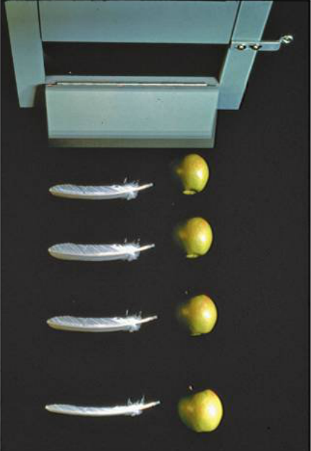
PHY131H1F Class 5
Today, Chapter 2, Sections 2.5 to 2.7
Freefall
Acceleration due to gravity
Motion on an inclined plane
Differentiating velocity to get acceleration
Integrating acceleration to get velocity
Non-constant acceleration

Slide 2
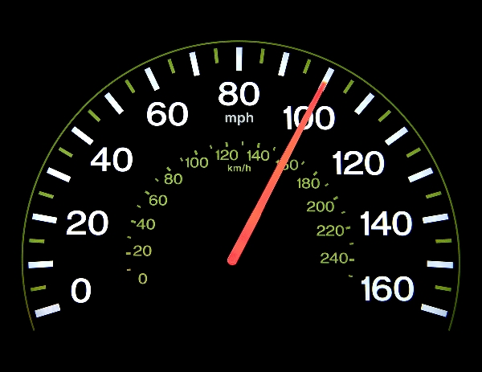
Clicker Question
What does the speedometer in your car measure?
distance traveled
average speed
average velocity
instantaneous speed
instantaneous velocity
[image downloaded Jan. 9 2013 from http://phoneky.com/applications/?p=preview&id=a1a32446&st=2]

Slide 3
Problem Set 1 on MasteringPhysics
This was due last night at 11:59pm
1017 students did the problem set by the deadline
It took an average of 41 minutes for students to complete the problem set. Note: this time is measured only while online, staring at the problem. Many students printed out the question, thought about it while offline, and then went back to type in final answers. So 41 minutes is a minimum.
The average for the 1017 students who submitted on time was 99%!
We hope that with hints, multiple tries, and enough time, you should be able to do very well on these problem sets.
The point is that you should be learning by doing them, so you will succeed better on the midterm tests and final exam.

Slide 4
Class 5 Preclass Quiz on MasteringPhysics
This was due this morning at 8:00am
994 students submitted the quiz on time
68% answered correctly: When a ball is thrown exactly upward, at the top of its path its instantaneous acceleration, a_{y}, is negative (downward)
87% answered correctly: When two objects of different mass slip down a frictionless hill, they do so with the same acceleration (g sin θ ).
87% answered correctly: The acceleration of an object on a frictionless plane is g sin θ .

Slide 5
Class 5 Preclass Quiz on MasteringPhysics
Some common or interesting student comments/feedback:
Lots of confusion regarding the signs of a and g, especially a = ±g sin(θ)
Harlow comments:
The acceleration of some object, $\vec{a}$, is a vector, so it has magnitude and direction. If you define an x-y coordinate system, then the directions of the components of the acceleration can be specified by the signs of a_{x} or a_{y}.
g is a number in the inside-cover of your textbook. It is a constant, called “the acceleration due to gravity near the surface of the earth”. g has been measured to be g = 9.80 m/s². It is positive.
If you define the y-axis to point up, then the acceleration of an object in freefall near the surface of the earth is a_{y} = −g.

Slide 6
Class 5 Preclass Quiz on MasteringPhysics
Some common or interesting student comments/feedback:
“The whole reading really got the ball rolling for me.”
Someone cut-and-pasted all the lyrics to “Rap God” by Eminem… Hmmmm…not sure what this has to do with physics?
“Hi, I hope this message gets put up on the slideshow at the lecture. It would really mean a lot to me”
Harlow comment: wish granted

Slide 7
Class 5 Preclass Quiz on MasteringPhysics
Some common or interesting student comments/feedback:
“OKAY. In class you said that when you toss a ball in the air, the acceleration is never zero. However, in the textbook it showed how the velocity is zero for the ball at the highest point (where it momentarily stops moving)…”??
v_{y} (m/s)
What is the slope of the green line when v_{y} = 0?
Going up
Time (seconds)
Going down

Slide 8
Class 5 Preclass Quiz on MasteringPhysics
How quickly our lofty ideals can fade…
Same student, two different comments on different days:
Tue. Sep. 9, 2014 11:30am: “Having no internet at home really motivates one to complete assignments ahead of time. Save money and get good grades kids, don't get internet.”
Sun. Sep. 21, 2014 12:31pm: “MY APARTMENT FINALLY HAS INTERNET PRAISE THE LORD I CAN WATCH NETFLIX NOW. Also, free fall is cool.”

Slide 9
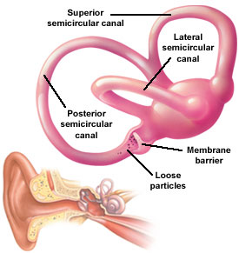
Last day I asked at the end of class:
Video by Aaron Lazare http://youtu.be/sxkcHnogPLE ]
Which is easier to see: velocity or acceleration?
ANSWER: velocity. Our eyes are very good at noticing when things are moving, but it is difficult to tell if an object is accelerating or not just by looking at it.
Which is easier to feel: velocity or acceleration?
ANSWER: acceleration. Since velocity is relative, it is actually impossible to feel if you are moving or not! But it is very easy to feel if you are accelerating. The semicircular canals in your ears are designed specifically to detect acceleration.

Slide 10
Clicker Question
Your car starts at rest, and then you speed up to a maximum of 120 km/hr over a time of 25 seconds. During this time:
both your velocity and acceleration were constant.
your velocity was constant, but your acceleration was changing.
your velocity was changing, but your acceleration was constant.
both your velocity and acceleration were changing.

Slide 11
Very few things in real life have constant acceleration!!!
For something to have constant acceleration, all the forces on the object must remain constant as it moves.
This is rare; it is usually NOT true for people that are running or walking, automobiles, trains, or animals.
Two things actually do have constant acceleration:
Objects in freefall (flying through space under the influence of gravity only with negligible air resistance)
Objects sliding or rolling down an inclined plane (with negligible friction)

Slide 12
Free Fall
= Falling under the influence of gravity only, with no air resistance.
Freely falling objects on Earth accelerate at the rate of 9.8 m/s/s, i.e., 9.8 m/s²
The exact value of free fall acceleration depends on altitude and latitude on the earth.
For this course, let’s use g = 9.80 m/s²

Slide 13
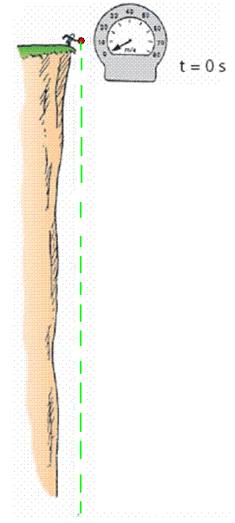
Free Fall—How Fast?
The velocity acquired by an object starting from rest is
So, under free fall, when acceleration is 9.8 m/s², the speed is
9.8 m/s after 1 s.
19.6 m/s after 2 s.
29.4 m/s after 3 s.
And so on.

Slide 14
Clicker Question
A tennis ball is thrown directly upward, and air resistance on the ball is negligible as it flies.
At one instant, it is traveling upward with a speed of 4.9 m/s.
1.0 seconds later, what will its speed be?
0
4.9 m/s
9.8 m/s
15 m/s
20 m/s
Notes:
14

Slide 15
Free Fall—How Far?
The distance covered by an accelerating object starting from rest is
So, under free fall, when acceleration is 9.8 m/s², the distance is:
4.9 m after 1 s,
20 m after 2 s,
44 m after 3 s,
and so on…

Slide 16
Class 5 Preclass Quiz on MasteringPhysics
Some common or interesting student comments/feedback:
“The part that I found most confusing was the part about free-fall. The text said that an objects acceleration during free-fall is the same, regardless of their masses. I just don't understand this b/c according to the equation: F=ma, mass is dependent in finding the acceleration: a=F/m. I just don't understand why the mass doesn't matter!”
Harlow answer: because it cancels out..

Slide 17
A 600 g basketball and a 60 g tennis ball are dropped from rest at a height of 3 m above the ground. As they fall to the ground, air resistance is negligible. Which of the following statements is true for the balls as they fall?
Clicker Question
The force of gravity is 10 times greater on the basketball than on the tennis ball
The force of gravity is the same on both balls
The force of gravity is slightly larger on the basketball than on the tennis ball

Slide 18
A 600 g basketball and a 60 g tennis ball are dropped from rest at a height of 3 m above the ground. As they fall to the ground, air resistance is negligible. Which of the following statements is true for the balls as they fall?
Clicker Question
The acceleration of the basketball is 10 times greater than the acceleration of the tennis ball
The acceleration of both balls is the same
The acceleration of the basketball is slightly larger than the acceleration of the tennis ball

Slide 19
Motion on an Inclined Plane
Consider an object sliding down a straight, frictionless inclined plane

Slide 20
Announcements
The first term test will be on Tuesday, Sep 30, from 6:00pm to 7:30pm.
Test 1 will cover chapters 1-3 plus the Error Analysis Mini-Document, plus what was done in Practicals
You must bring a calculator and one 8.5x11’ aid sheet which you prepare, double-sided
If you have a conflict at that time with an academic activity (test, lecture, tutorial, lab), you must register to write at the alternate sitting of this test by going to portal and filling out the online form no later than Sep. 25 by 4:00pm.

Slide 21
At time t = 0, small red marble is released from rest at the top of a smooth, frictionless incline that is at an angle θ relative to the horizontal. The red marble begins rolling down the incline. A short time later, when t = T, a blue marble is released from rest at the top of the same incline, and begins to roll in the same direction as the red marble. At a time t = 2T, what is the speed of the red marble relative to the blue marble?
Clicker Question
(From the PHY131H1F Midterm Test 1, Fall 2013.)
$Tg sin\left(θ\right)$
$2Tg sin\left(θ\right)$
$\frac{1}{2}T^{2}g sin\left(θ\right)$
$\frac{3}{2}T^{2}g sin\left(θ\right)$
zero

Slide 22
Instantaneous Acceleration
The instantaneous acceleration a_{s} at a specific instant of time t is given by the derivative of the velocity
Note: Knight uses “s” to denote a distance in a general direction. Usually in problems we substitute x or y instead of s.

Slide 23
Finding Velocity from the Acceleration
If we know the initial velocity, v_{is}, and the instantaneous acceleration, a_{s}, as a function of time, t, then the final velocity is given by
Or, graphically,

Slide 24
Clicker Question
a
An object starts at rest, and has a constant acceleration of +10 m/s² for 5 seconds.
10 m/s²
How fast is the object going after 5 seconds?
10 m/s
25 m/s
50 m/s
100 m/s
500 m/s
t
5 s

Slide 25
Clicker Question
An object starts at rest, and has an initial acceleration of +10 m/s².
As it speeds up, its acceleration decreases at a constant rate.
After 5 seconds, it is traveling at a constant velocity (a = 0).
a
10 m/s²
t
How fast is the object going after 5 seconds?
10 m/s
25 m/s
50 m/s
100 m/s
500 m/s
5 s

Slide 26
When Acceleration Changes Abruptly
Consider an object that has a constant acceleration, a₁, from t_{A} until t_{B}
At t_{B} its acceleration suddenly changes to a₂, and remains constant until t_{C}.
Strategy:
Divide the motion into segments 1 & 2.
You can use the equations of constant acceleration in each segment
The final position and velocity of segment 1 become the initial position and velocity of segment 2.

Slide 27
Challenge Problem 2.77
A rocket is launched straight up with constant acceleration. Four seconds after liftoff, a bolt falls off the side of the rocket. The bolt hits the ground 6.0 s later. What was the rocket’s acceleration?

Slide 29
Before Class 6 on Wednesday
Please read Chapter 3 of Knight.
There is a MasteringPhysics PreClass Quiz on chapter 3 due Wed. 8am.
Something to think about: Can you add a scalar to a vector? Can you multiply a vector by a scalar?

