Slide 1
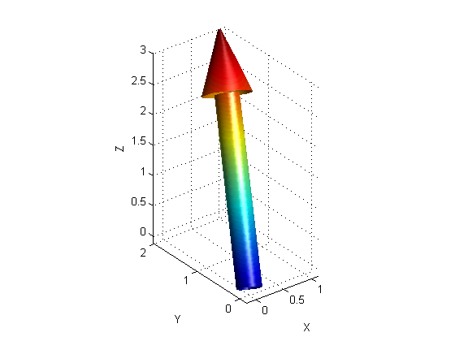
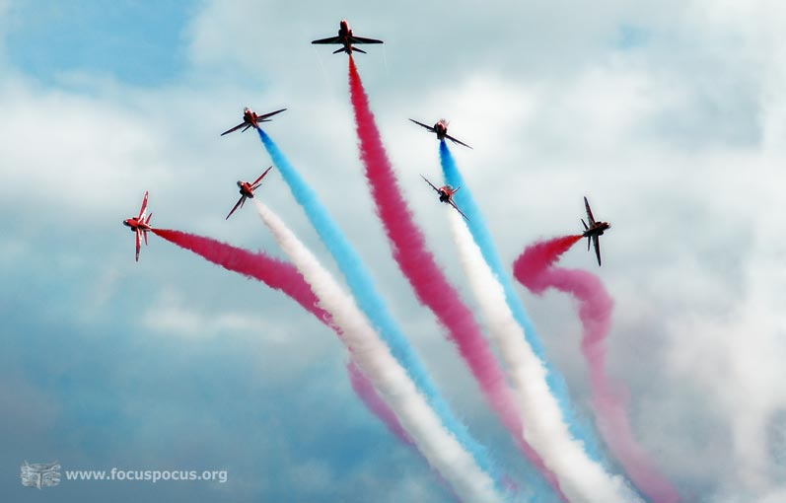
PHY131H1F - Class 6
Today:
Scalars and vectors
Coordinate systems, Components
Vector Algebra

Slide 2
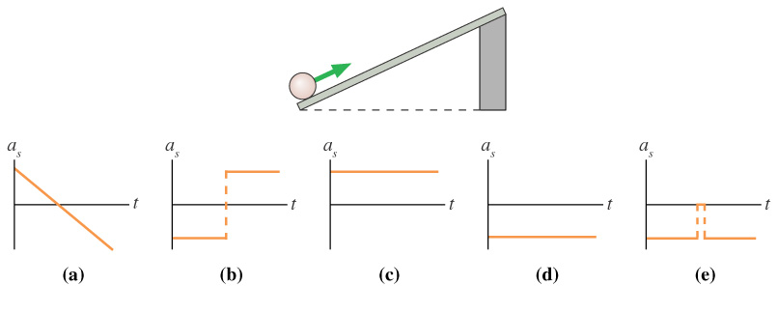
Clicker Question
The ball rolls up the ramp, then back down. Which is the correct acceleration graph? [Define positive s as up and to the right, parallel to the ramp..]
Notes:
Answer: D

Slide 3
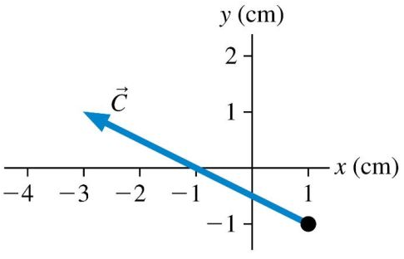
Class 6 Preclass Quiz on MasteringPhysics
This was due this morning at 8:00am
996 students submitted the quiz on time
82% answered correctly: The (x,y) components of the vector shown are (-4,2)
87% answered correctly: The vector shown can be written as $−4\hat{i}+2\hat{j}$
88% answered correctly: The unit-vector $\hat{j}$ has magnitude 1, and points in the +y direction.
94% answered correctly: A vector is a quantity having both size and direction. It is not a number, but a set of 2 or 3 numbers.

Slide 4
Class 6 Preclass Quiz on MasteringPhysics
“Do you want us to put the little arrow on top of letters when we do a solution to show that it's a vector?????”
Harlow answer: It’s generally a good idea in order to keep things clear, but you won’t lose points on a test for leaving it out
“Someone mentioned to me that v without an arrow on top is not a vector, and v with an arrow on top is a vector. I thought velocity was always a vector, regardless. Just wondering if you could clarify?”
Harlow answer: I would say $v$ is “speed”, $\vec{v}$ is “velocity”

Slide 5
Class 5 Preclass Quiz on MasteringPhysics
“I was just wondering how much these quizzes/ problem sets count for towards our final marks”
Here is the marking scheme, from the Course Information web site:
Final Exam: 40%
Two midterm tests (Sep.30, Nov. 11): 30%
Practicals notebooks marks: 15%
MasteringPhysics Problem Sets: 9%
MasteringPhysics Pre-class quizzes: 3%
In-class i-clicker questions: 2%
Pre- and post-course diagnostic quizzes: 1%

Slide 6
Class 5 Preclass Quiz on MasteringPhysics
“The textbook mentioned 3D vectors, and the 3rd component z. What does this mean?”
Harlow answer: In this universe there are three mutually perpendicular spatial dimensions. “north” and “up” are perpendicular to one another
“Why do we use degrees rather than radians? I'm not asking this because I believe one ought to be used over the other. I'm just wondering out of shear curiosity.”
Harlow answer: It is a historical convention. Actually, radians is a much better unit, and we will be using radians when we get to chapter 12.
“Do we have physics practical every week?”
Harlow answer: yes

Slide 7
Class 5 Preclass Quiz on MasteringPhysics
“Do you even read these?”
Harlow answer: yes
“By posting this on the projector screen on the date of 24 September 2014 at 11:00 a.m you will have squashed any doubts that the dubious looking gentleman with the full-rimmed glasses on the third floor balcony closest to the right has of the legitimateness that are these posts which induce laughter.”
“My girlfriend is really sick and maybe if she has the support of this entire class (by this message being displayed on the screen) she will feel better.”
“Tomorrow is one of my best friends Judith's birthday, she is from Mexico! Can we all say Happy Birthday to her?”

Slide 8
Last day I asked at the end of class:
Can you add a scalar to a vector?
ANSWER: No. A 2-D vector is represented by a pair of numbers (ie x- and y- components, or magnitude and direction), and you can’t add a scalar number to this.
Can you multiply a vector by a scalar?
ANSWER: YES! When you multiply a vector by a scalar, you can either:
Multiply both the x and y components by this scalar, or
Multiply the magnitude by the scalar, and keep the direction unchanged (but you flip direction 180° for a negative scalar)

Slide 9
Right Triangle Trigonometry
This is one of the most common things people are rusty with.
$\sin\left(θ\right)=\frac{opp}{hyp}$
$\cos\left(θ\right)=\frac{adj}{hyp}$
$\tan\left(θ\right)=\frac{opp}{adj}$
Hypotenuse
SOH CAH TOA
Opposite
θ
Adjacent

Slide 10
Clicker Question:
If the hypotenuse below is 6m and the angle is 38°, what is the length of the adjacent side?
$\left(6 m\right)sin⁡(38°)$
$\left(6 m\right)tan⁡(38°)$
$\left(6 m\right)cos⁡(52°)$
$\left(6 m\right)cos(38°)$
Not enough information
Hypotenuse
Opposite
θ
Adjacent

Slide 11
Clicker Question:
If the adjacent side below is 6 m and the opposite side is 4 m, what is the angle θ ?
$\tan^{−1}⁡(6/4)$
$\cos^{−1}⁡(6/4)$
$\cos^{−1}⁡(4/6)$
$\tan^{−1}⁡(4/6)$
$\sin^{−1}⁡(4/6)$
Hypotenuse
Opposite
θ
Adjacent

Slide 12
Vectors
There are two kinds of Physical quantities we will deal with:
Scalar (Only has a size)
Quantity that can be described with only one number.
Examples: time, speed (just a magnitude say 5 miles per hour)
Vector: (Has size and a direction)
Quantity that is described with two numbers:
Magnitude
Direction
Examples: Position, velocity (magnitude say “5 m/s” and direction say “north”)

Slide 14
Distance vs Displacement Example
From High Park, you ride your bike 4 miles East on Bloor St, then 3 miles North on Yonge St to the corner of Yonge and Eglinton.
What is the distance traveled?
What is your displacement?

Slide 15
Class 6 Preclass Quiz on MasteringPhysics
“Does it matter to you if we denote a vector that is 37° North of East as [E 37° N]?”
Harlow answer: I would NOT recommend that you do this. I have only seen Ontario high school students do this, and it is not a world-wide accepted notation. To me it seems confusing, and it’s safer to just say “37° North of East”

Slide 16
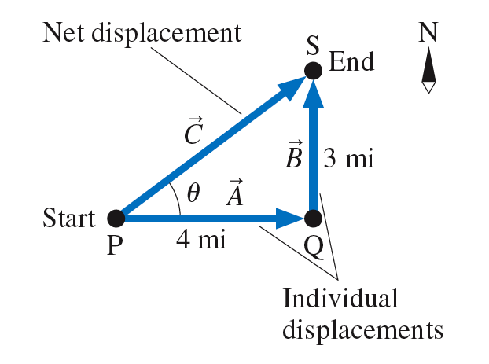

Slide 17
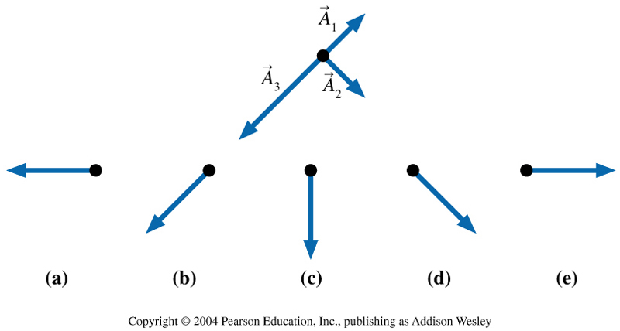
Clicker Question:
Which figure shows ?
Notes:
Answer C

Slide 18
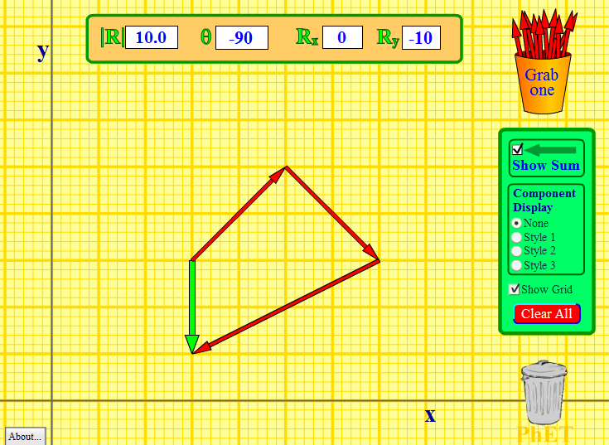
http://phet.colorado.edu/en/simulation/vector-addition

Slide 19
Announcements
The first term test will be on Tuesday, Sep 30, from 6:00pm to 7:30pm.
Test 1 will cover chapters 1-3 plus the Error Analysis Mini-Document, plus what was done in Practicals
You must bring a calculator and one 8.5x11’ aid sheet which you prepare, double-sided
If you have a conflict at that time with an academic activity (test, lecture, tutorial, lab), you must register to write at the alternate sitting of this test by going to portal and filling out the online form no later than Sep. 25 by 4:00pm.

Slide 20
Private companies will try to scare you about courses.
A message from the Arts and Science Student Union:
Tell you its IMPOSSIBLE
to do well or not fail
without them.
They just want your
$$$$$.

Slide 21
Don’t listen to them.
YOU CAN DO WELL WITHOUT THEM.
UofT offers free resources to help you study: check them out at uoft.me/free
A message from ASSU.

Slide 22
Where to get good help for free
Your classmates: form a study group
The course web-site: Go to Lectures-Harlow – notice that every PHY131 midterm I’ve ever given is there including full solutions – all organized and for free
Your two graduate student TAs. Learn their email address, office hours, and office location.
Me. After class, office hours are T12, F10 in MP121-B, email
Professor Meyertholen, office hours are M2, F12-2 in MP129-A, email
The Physics Drop-In Centre in MP125, back corner MTWR 12-3, F11-2
Vic College Tutoring Centre in LM204A, R10-12, F3
Academic Success Centre in Koffler 1st floor, inside the Career Centre

Slide 23
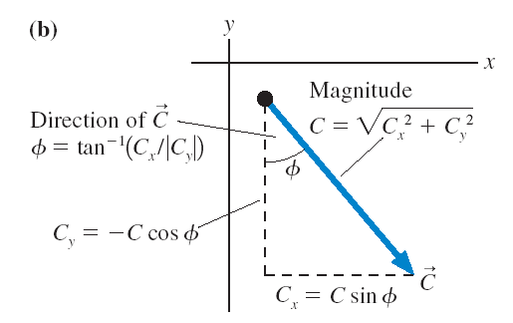
Components add and subtract like scalars!

Slide 24
Vector Addition By Components
${\vec{A}}_{1}=1.41 m$, up and to the right, 45.0° above the horizontal.
${\vec{A}}_{2}=1.41 m$, down and to the right, 45.0° below the horizontal.
${\vec{A}}_{3}=2.24 m$, down and to the left, 26.6° below the horizontal.
Find the sum ${\vec{A}}_{1}+{\vec{A}}_{2}+{\vec{A}}_{3}$.

Slide 25
Vector Addition By Components (Let’s tilt the axes!)
${\vec{A}}_{1}=1.41 m$, up and to the right, 45.0° above the horizontal.
${\vec{A}}_{2}=1.41 m$, down and to the right, 45.0° below the horizontal.
${\vec{A}}_{3}=2.24 m$, down and to the left, 26.6° below the horizontal.
Find the sum ${\vec{A}}_{1}+{\vec{A}}_{2}+{\vec{A}}_{3}$.

Slide 26
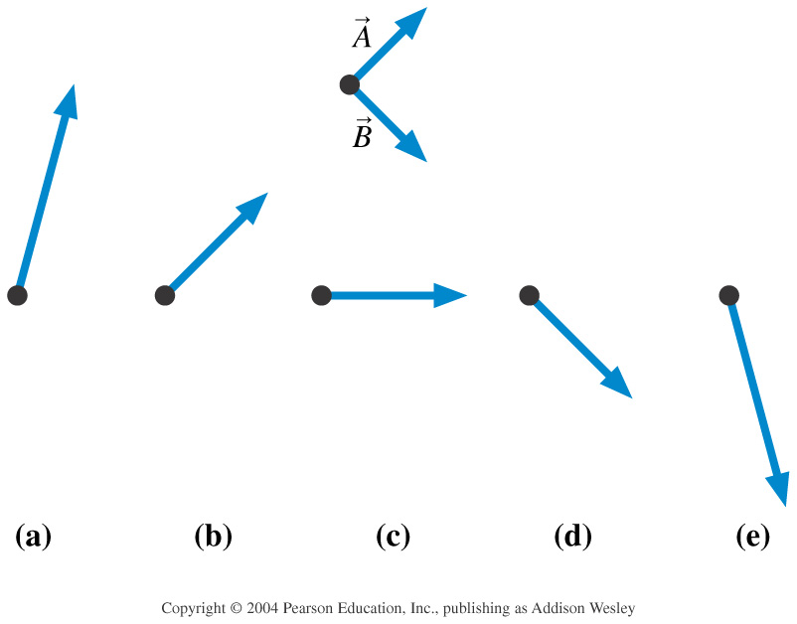
Clicker Question:
Which figure shows 2 − ?
Notes:
Answer A

Slide 27
Clicker Question:
The sum ${\vec{F}}_{1}+{\vec{F}}_{2}+{\vec{F}}_{3}$ points to the left.
Two of three forces are shown. Which is the missing third force?
A.
B.
C.
D.

Slide 28
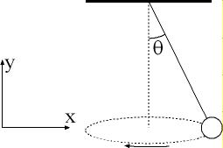
Example from a previous PHY131 Mid-Term Test
A ball is suspended on a string, and moves in a horizontal circle as shown in the figure. The string makes a constant angle θ = 10.0° with the vertical. The tension in the string is 8.46 N, and the force of gravity on the ball is 8.33 N, in the negative-y direction. What is the sum of these two forces on the ball?

Slide 30
Class 6 Preclass Quiz on MasteringPhysics
“why have the circumflex accent on i? are we doing physics in french?”
Harlow comment: In physics, we call that a “hat”. It just means that it is a vector with a length of 1, and no units (dimensionless)
“Why they have a hat above the i and j, I used the arrow above the i and the j in school, can I still use that or is that like a crime in physics?”
Harlow comment: Not a crime. We like hats. You won’t lose points if you use arrows instead of hats – the marker will be able to figure it out

Slide 31
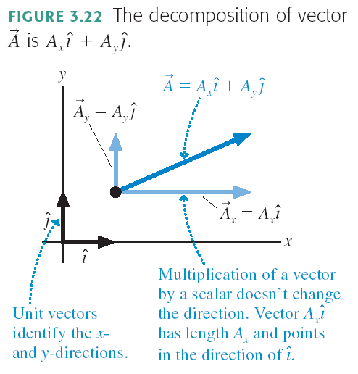

Slide 32
Clicker Question:
$\vec{A}=−3\hat{i}+3\hat{j}$
$\vec{B}=3\hat{i}+4\hat{j}$
What is the sum $\vec{A}+\vec{B}$?
$3\hat{j}$
$7\hat{i}+7\hat{j}$
$−3\hat{i}+7\hat{j}$
$7\hat{j}$
$−3\hat{i}−3\hat{j}$

Slide 33
Before Class 7 on Monday
Please read Chapter 4, sections 4.1 through 4.4
Problem Set 2 is due Sunday by 11:59pm
Pre-class Quiz for Class 7 is due Monday morning by 8:00am.
Something to think about: One bullet is fired horizontally at a very high speed. The other bullet is initially at rest, but is dropped at the exact same moment the first bullet is fired. Which bullet hits the ground first?

