Slide 1
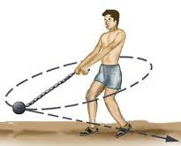
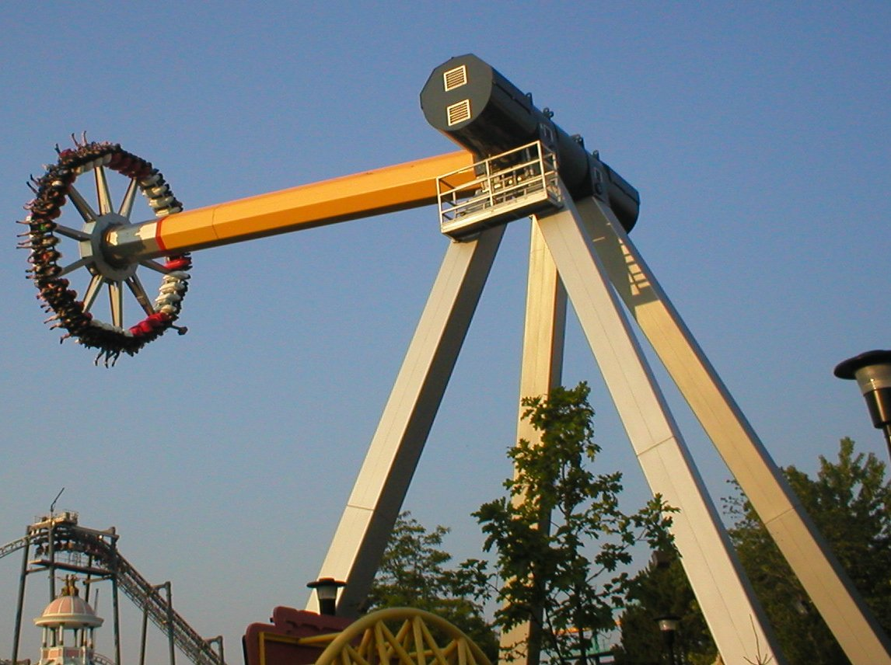
PHY131H1F - Class 8
Today, finishing off Chapter 4:
Circular Motion
Rotation

Slide 2
Clicker Question
Angular Notation: it’s all Greek to me!
θ is an angle, and the S.I. unit of angle is radians. (NOT degrees!)
The time derivative of θ is ω.
What are the S.I. units of ω ?
m/s²
rad / s
N/m
rad
rad /s²

Slide 3
Clicker Question
Angular Notation: it’s all Greek to me!
The time derivative of ω is α.
What are the S.I. units of α ?
m/s²
rad / s
N/m
rad
rad /s²

Slide 4
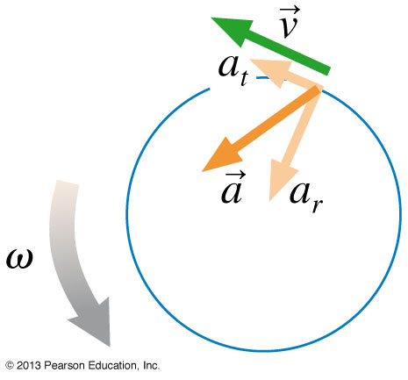
Last day at the end of class I asked:
Consider a wheel that is rotating, and speeding up.
Is a point on the edge of the wheel accelerating toward the centre? [Yes, it must have a centre-pointing component in order to stay on the circular path!]
Is this point accelerating in the forward direction? [Yes, it must have a forward component in order to speed up!]
Or is it doing both? [Yes – the actual acceleration vector is on a diagonal!]

Slide 5
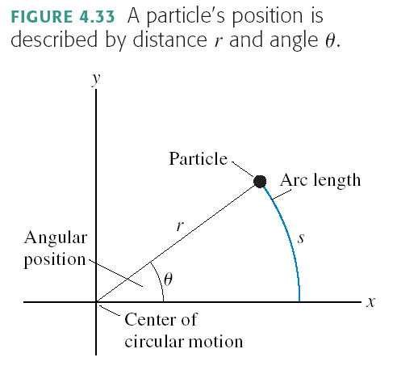
Circular Motion
r = constant
s and θ both change as the particle moves
s = “arc length”
θ = “angular position”
when θ is measured in radians

Slide 6
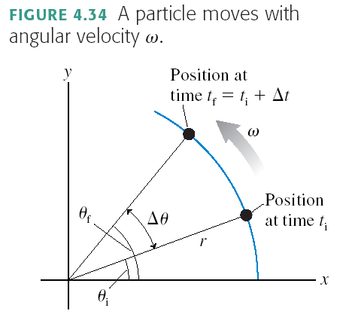
Angular Velocity
when ω is measured in rad/s

Slide 7
Note on MasteringPhysics
ω: It’s not a double-you, it’s an omega.
On MasteringPhysics use the pull-down menu with Greek letters:

Slide 8
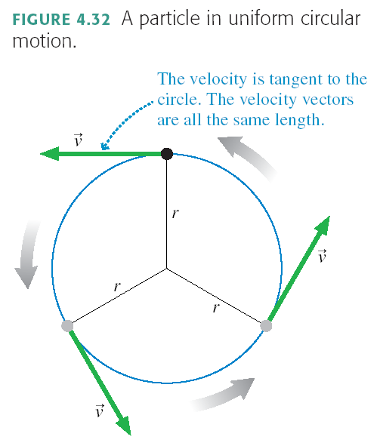
Special case of circular motion:
Uniform Circular Motion
Tangential velocity is constantly changing direction
Tangential speed is constant
where T = Period [s]

Slide 9
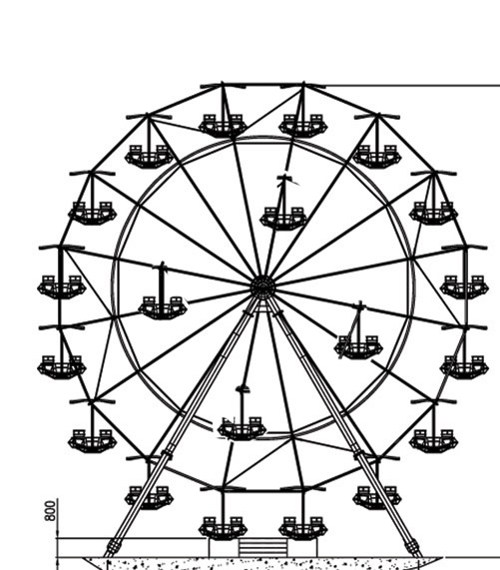
Clicker Question
A carnival has a Ferris wheel where some seats are located halfway between the center and the outside rim. Compared with the seats on the outside rim, the inner cars have
Smaller angular speed and greater tangential speed
Greater angular speed and smaller tangential speed
The same angular speed and smaller tangential speed
Smaller angular speed and the same tangential speed
The same angular speed and the same tangential speed

Slide 10
Demo and Discussion Question A ball rolls in a horizontal circular track (shown from above). Which arrow best represents the ball’s path after it leaves the track?
Clicker Question

Slide 11
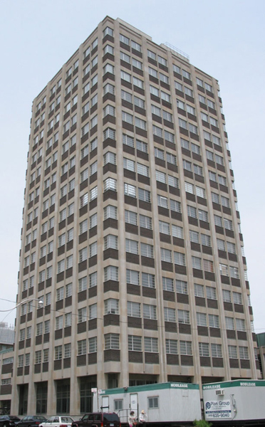
Preparation for Practicals next week:
Take a ride on the Burton Tower elevators!
All 4 elevators in the 14-storey tower of McLennan Physical Labs are equipped with a hanging spring-scale.
It measures the upward force necessary to support a 750 g mass. (a.k.a. “weight”)
You may find that the measured weight of this object changes as you accelerate – check it out!

Slide 12
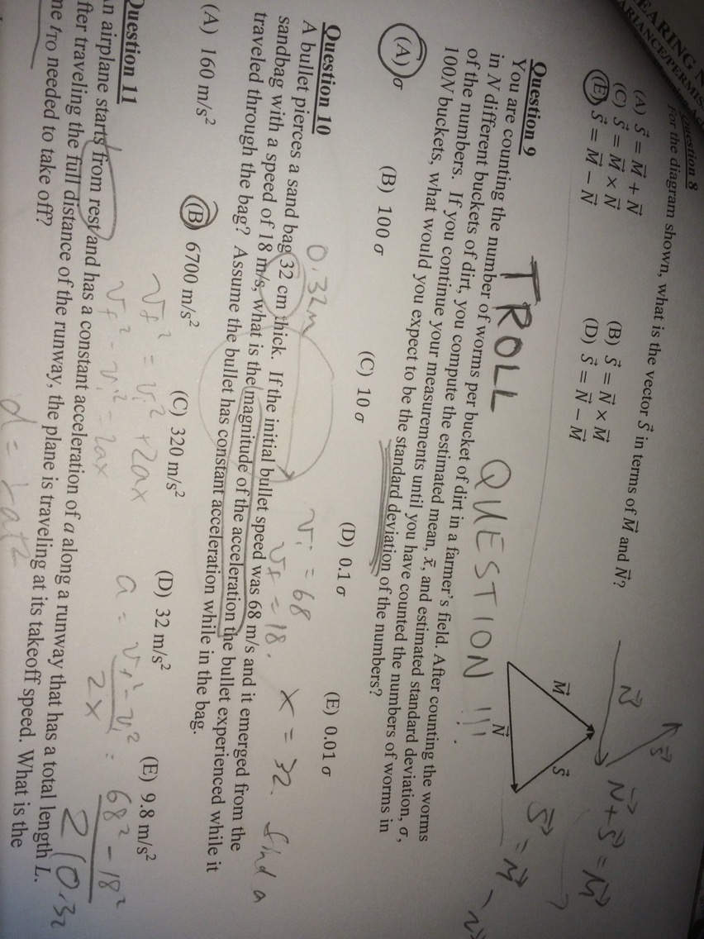

Slide 13
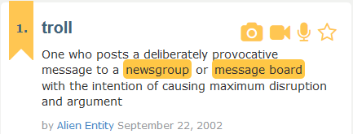

Slide 14
The Pointing Game
There are three pairs of orthogonal directions in this room.
Within a pair, each direction is anti-parallel to the other.
Each pair is perpendicular to the other two pairs.
North - South
West - East
Up - Down

Slide 15
Survey
How was length of the test yesterday?
80 minutes was more than enough time; I left early or was tempted to
I had enough time to complete the test with a few minutes to spare
I felt a little rushed but got the test done
I felt very rushed and needed more time
The test was FAR TOO LONG – no possible way to do in 80 minutes

Slide 16
Survey
Given a choice on Test 2, would you prefer
12 multiple choice questions worth 5 points each
8 multiple choice questions worth 7.5 points each
Other / I prefer not to answer this question

Slide 17
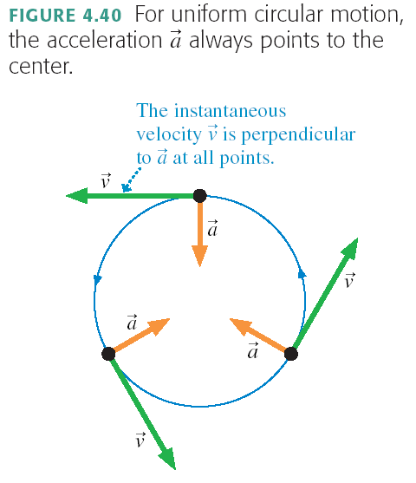
Centripetal Acceleration

Slide 18
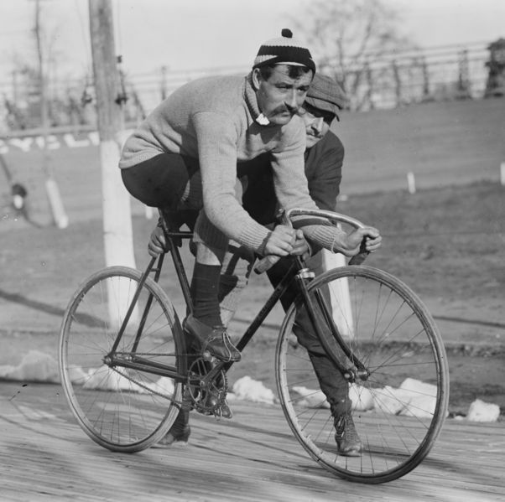
Centripetal Acceleration
A bike wheel of diameter 1.0 m turns 20 times per second. What is the magnitude of the centripetal acceleration of a yellow dot on the rim?

Slide 19
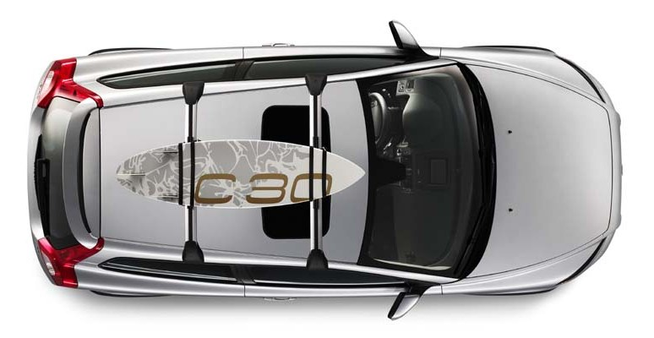
Clicker Question
A car is traveling East at a constant speed of 100 km/hr. Without speeding up of slowing down, it is turning left, following the curve in the highway. What is the direction of the acceleration?
N
W
E
S
North
East
North-East
North-West
None; the acceleration is zero.

Slide 20
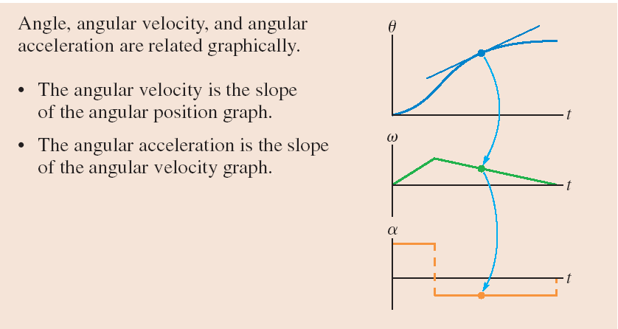
Determines the Tangential acceleration, NOT centripetal acceleration!

Slide 21
Summary of definitions:
θ is angular position. The S.I. Unit is radians, where 2π radians = 360°.
s is the path length along the curve: s = θr when θ is in [rad].
ω is angular velocity. The S.I. Unit is rad/sec.
v_{t} is the tangential speed: v_{t} = ωr when ω is in [rad/s].
α is angular acceleration. The S.I. Unit is rad/sec².
a_{t} is the tangential acceleration: a_{t} = αr when α is in [rad/s²].

Slide 22
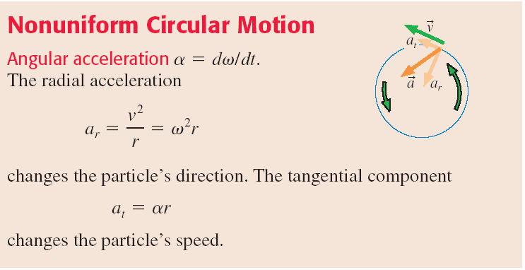
Nonuniform Circular Motion
Any object traveling along a curved path has centripetal acceleration, equal to v²/r.
If, as it is traveling in a circle, it is speeding up or slowing down, it also has tangential acceleration, equal to rα
The total acceleration is the vector sum of these two perpendicular components

Slide 23
The 4 Equations of Constant Linear Acceleration, a:
The 4 Equations of Constant Angular Acceleration, α:
$$v_{f}=v_{i}+at$$
$$ω_{f}=ω_{i}+αt$$
$$x_{f}=x_{i}+v_{i}t+\frac{1}{2}at^{2}$$
$$θ_{f}=θ_{i}+ω_{i}t+\frac{1}{2}αt^{2}$$
$${v_{f}}^{2}={v_{i}}^{2}+2a(x_{f}−x_{i})$$
$${ω_{f}}^{2}={ω_{i}}^{2}+2α(θ_{f}−θ_{i})$$
$$x_{f}=x_{i}+\left(\frac{v_{i}+v_{f}}{2}\right)t$$
$$θ_{f}=θ_{i}+\left(\frac{ω_{i}+ω_{f}}{2}\right)t$$

Slide 24
Clicker Question
Problem: A pebble is dropped from rest off a high balcony, and has an acceleration of 9.8 m/s² as it falls. It falls for 2.5 seconds, then hits the ground. How far does it fall in this 2.5 seconds?
Which equation would you use?
A.
$$v_{f}=v_{i}+at$$
C.
$${v_{f}}^{2}={v_{i}}^{2}+2a(x_{f}−x_{i})$$
$$x_{f}=x_{i}+v_{i}t+\frac{1}{2}at^{2}$$
$$x_{f}=x_{i}+\left(\frac{v_{i}+v_{f}}{2}\right)t$$
B.
D.
Notes:
Answer: B

Slide 25
Clicker Question
Problem: A centrifuge loaded with two test-tubes starts from rest, and has an angular acceleration of 150 rad/s² as it spins up. It speeds up with this angular acceleration for 2.5 seconds, then it has reached its maximum spin rate. How many times has it rotated in this 2.5 seconds?
Which equation would you use?
A.
$$ω_{f}=ω_{i}+αt$$
C.
$${ω_{f}}^{2}={ω_{i}}^{2}+2α(θ_{f}−θ_{i})$$
$$θ_{f}=θ_{i}+ω_{i}t+\frac{1}{2}αt^{2}$$
$$θ_{f}=θ_{i}+\left(\frac{ω_{i}+ω_{f}}{2}\right)t$$
B.
D.

Slide 26
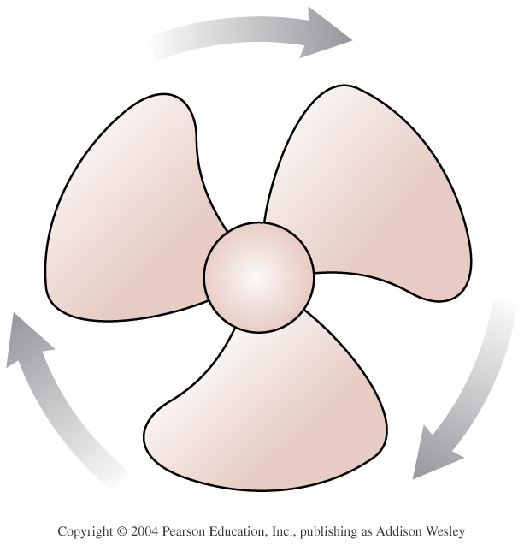
Example.
A fan is spinning at 30 rad/s, and suddenly starts slowing down.
It’s angular acceleration as it slows is 10 rad/s².
How long does it take to stop spinning?

Slide 27
Example.
A fan is spinning at 30 rad/s, and suddenly starts slowing down.
It’s maximum angular acceleration as it slows is 10 rad/s².
What is the minimum angle that it must turn as it stops?
How many revolutions is this?

Slide 28
Clicker Question
The fan blade is slowing down. What are the signs of ω and α?
[Let’s define, as Knight often does, positive to be counter-clockwise.]
Α. ω is positive and α is positive.
B. ω is negative and α is positive.
C. ω is positive and α is negative.
D. ω is negative and α is negative.

Slide 29
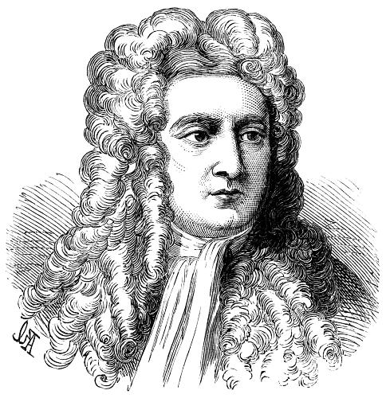
Moving on to Chapters 5 and 6..
Up until now, we have been studying kinematics, a description of HOW things move and how to describe this.
In Chapter 5 we begin to study WHY things move the way they do: This is dynamics, which includes the important concepts of Force and Energy.

Slide 30
Before Class 9 on Monday
Please read Chapter 5 of Knight.
Don’t forget the pre-class quiz due Mon. at 8am.
Something to think about: A paperback novel has a mass of 0.3 kg and slides at a constant velocity. A physics textbook has a mass of 3.0 kg, and slides at the same constant velocity. How does the net force on the textbook compare to the net force on the novel?

