Slide 1
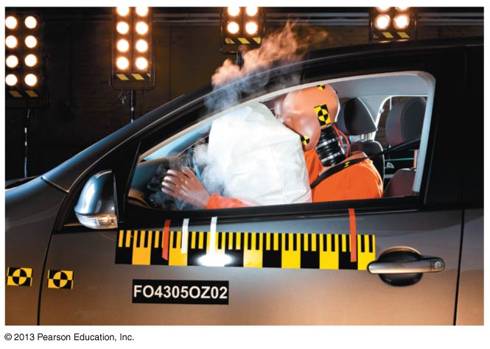
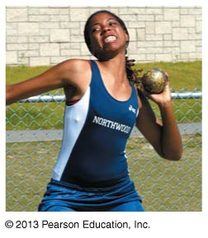
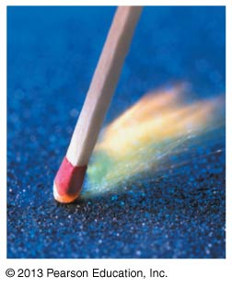
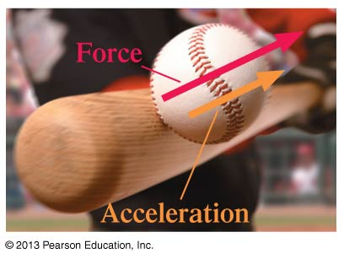
PHY131H1F - Class 9
Today, Chapter 5 “Force and Motion”:
Forces
Free Body Diagrams
Newton’s First Law
Newton’s Second Law

Slide 2
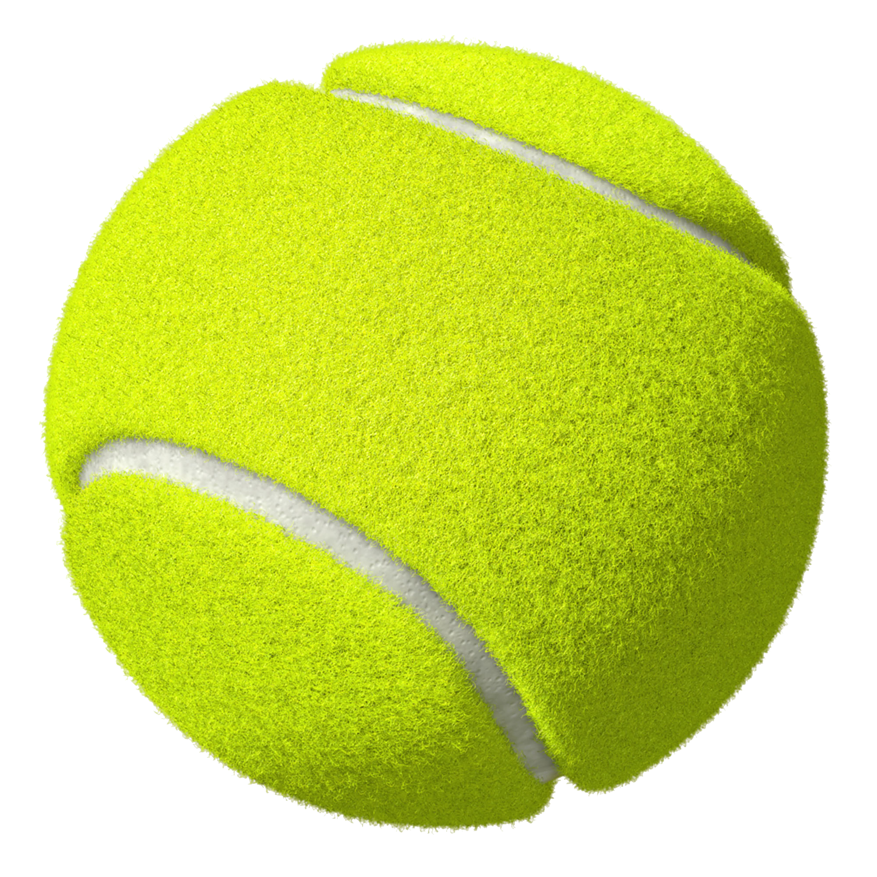
Clicker Question
You toss a ball straight up in the air.
Immediately after you let go of it, what forces are acting on the ball?
The downward force of gravity from the Earth.
An upward throwing force from your hand.
A small downward drag-force from air resistance.
1, 2 and 3
1 and 3
1 and 2
1 only
2 and 3

Slide 3
Last day I asked at the end of class:
A paperback novel has a mass of 0.3 kg and slides at a constant velocity of 5 m/s, to the right. A physics textbook has a mass of 3.0 kg, and slides at a constant velocity of 5 m/s, to the right. How does the net force on the textbook compare to the net force on the novel?
ANSWER: SAME – zero!
The net force on any object is proportional to its acceleration.
In the case of these two books, they are both traveling at a constant velocity, meaning acceleration is zero.
Any friction must be offset by some pushing force, not mentioned in the question.

Slide 4
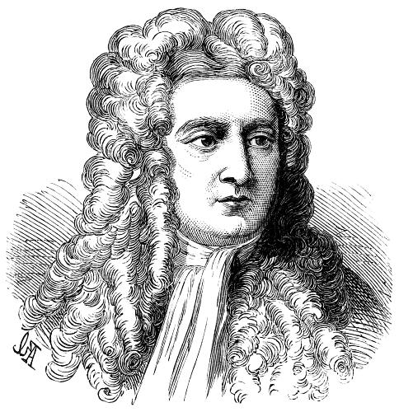
Isaac Newton
Born in 1643, the year Galileo died.
Was a “physicist, mathematician, astronomer, natural philosopher, alchemist, and theologian and one of the most influential people in human history.” (http://en.wikipedia.org/wiki/Isaac_Newton)
In Philosophiæ Naturalis Principia Mathematica, published 1687, he described universal gravitation and the three laws of motion, laying the groundwork for classical mechanics.

Slide 5
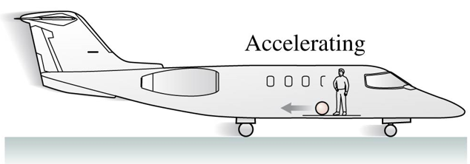
Clicker Question
You are in a plane which is accelerating forward on a runway.
Some careless person has left a tennis ball in the aisle. You notice this tennis ball is accelerating toward the back of the plane.
Newton’s Second Law states that F_{net} = ma, so there must be a net force on the tennis ball. What is the source of this backward net force?
Air resistance
The plane must be at an angle, so a component of gravity provides the net force toward the back of the plane.
The inertial force
The normal force
Newton’s second law is not valid in your reference frame.

Slide 6
SI Units
The SI unit of mass is the kilogram. What is the SI unit of weight?
m/s²
the newton
metric mass
the kilogram
the joule

Slide 7
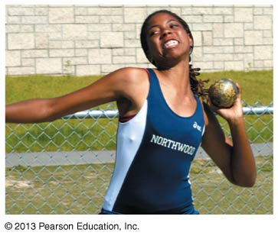
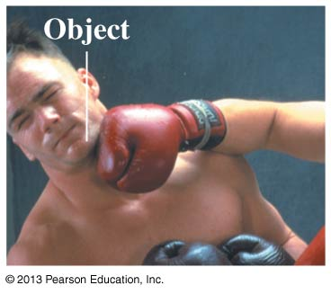
What is a force?
A force is a push or a pull on an object.
Pushes and pulls are applied to something
From the object’s perspective, it has a force exerted on it
A force is either a contact force (like normal) or a long-range force (like gravity).
The S.I. unit of force is the Newton (N)
N is not a fundamental unit; it can be broken down into fundamental units:
$$1 N=1 kg m s^{−2}$$

Slide 8
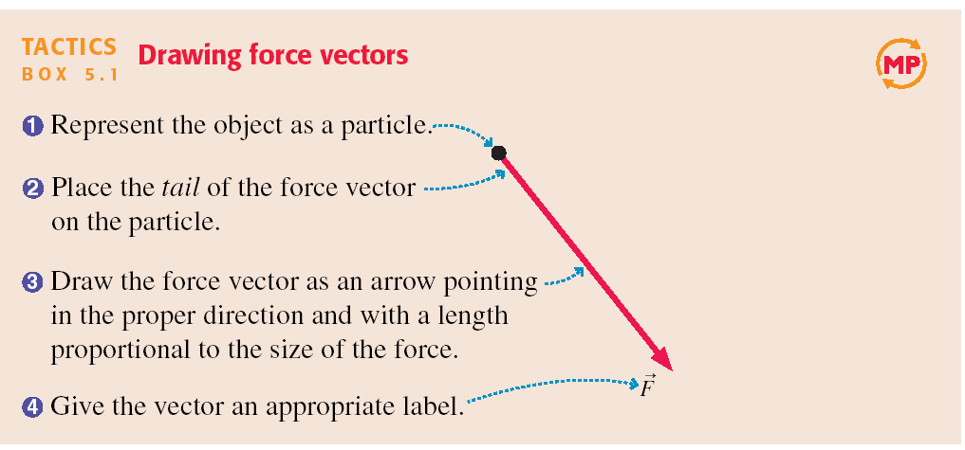
Tactics: Drawing force vectors

Slide 9
A Short Catalog of Forces
The forces we deal with most often in PHY131/132 are:
Gravity (F_{g} = mg)
Normal Force
Tension
Kinetic Friction ( f_{k} = μ_{k}n)
Static Friction
Spring Force
Electric
Magnetic
Thrust (like from a rocket)
Drag (fluid resistance)
Muscle

Slide 10
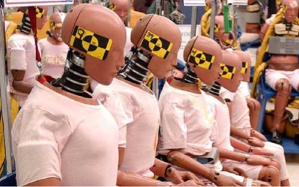
Crash test dummies model the muscles of the neck as springs

Slide 11
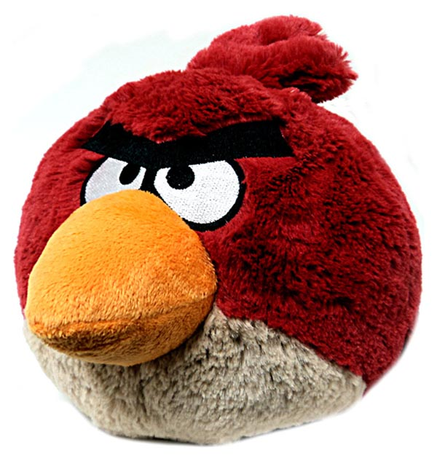
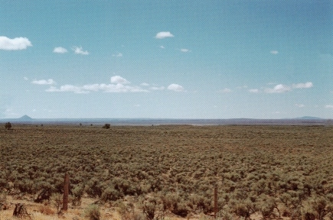
Gravity
${\vec{F}}_{G}=m\vec{g}$ when the object is near the surface of Earth
$\vec{g}=9.80\frac{N}{kg}, down$
Sometimes called “weight”
“The Earth exerts a gravity force on the angry bird.”

Slide 12
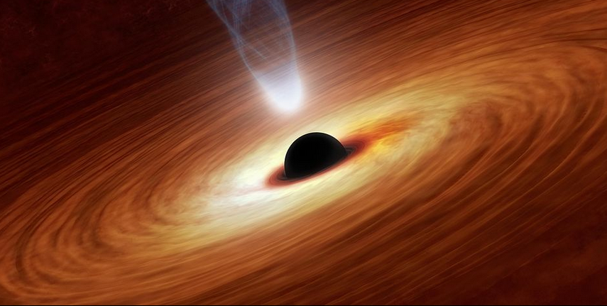
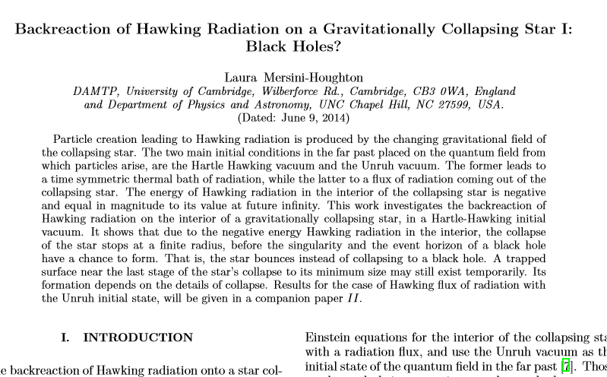
Gravity Research
There was a paper this year claiming that, mathematically speaking, black holes cannot exist.
Certainly, from an astronomer’s point of view, black holes (or something very much like them) are very prevalent and numerous in the universe!
The first black hole for which there was strong evidence was Cygnus X-1, discovered by U of T professor Tom Bolton in 1972
Since then over 100 of black holes have been discovered
http://arxiv.org/pdf/1406.1525v1.pdf

Slide 13
Normal Force
“The diving board exerts a normal force on the dog.”

Slide 14
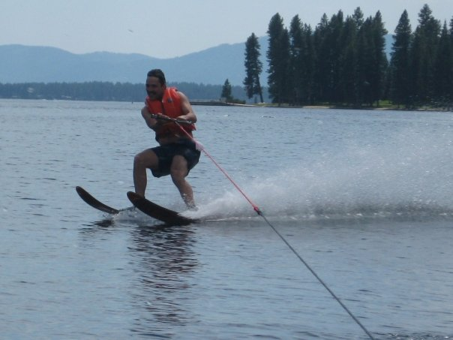
Tension
“The rope exerts a tension force on Harlow.”

Slide 15
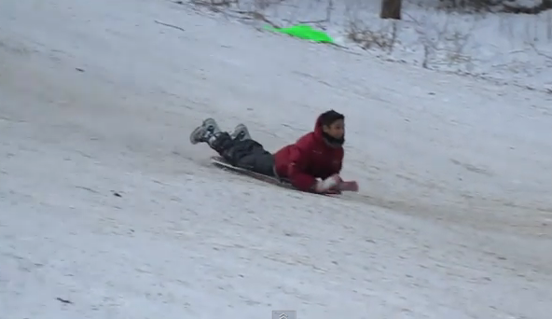
Kinetic Friction
“The ground exerts a kinetic friction force on Suleyman.”
where n is the magnitude of the normal force, and μ_{k} is a constant, which happens to be low for plastic on snow.

Slide 16
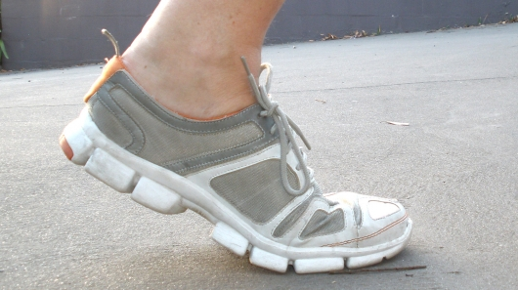
Static Friction
“The ground exerts a static friction force on the shoe.”

Slide 17
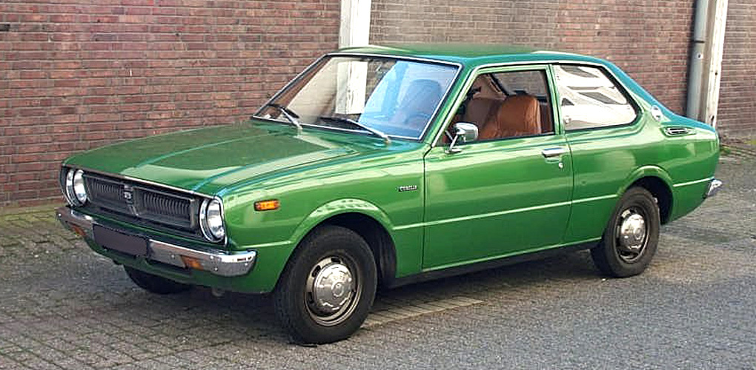
Clicker Question
A car is parked on flat, horizontal pavement.
Which of the following forces are acting on the car?
Gravity
Normal
Static friction
Both A and B
A, B and C

Slide 18
Clicker Question
The Net Force
A car is parked on flat, horizontal pavement.
The “net force” is the vector sum of all the forces on the car.
What is the direction of the net force on the car?
Up
Down
The net force is zero

Slide 19
An Even Shorter Catalog of Forces
The four fundamental forces in the universe are:
Gravity (F_{g} = mg)
Electric & Magnetic
“Strong Nuclear” – holds the nucleus together
“Weak Nuclear” – governs beta-decay
Every force you can experience is a manifestation of one or more of the above.

Slide 20
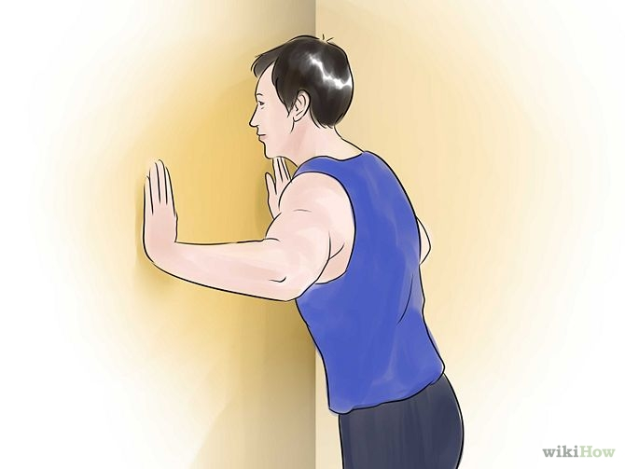
A Person Exerts a Force on A Wall
This contact force is an example of:
Gravity Force
Electric & Magnetic Force
Strong (holds nucleus together)
Weak (radioactive decay)
None of the above

Slide 21
The Fundamental Forces of Nature
The four fundamental forces of nature:
Gravity
Electromagnetism
Weak Nuclear Force
Strong Nuclear Force
Gravity is always attractive, and acts between any two objects.
Electromagnetism causes repulsion and attraction between charged particles, such as the protons and electrons in matter. This gives rise to almost all of the forces we deal with in PHY131/132: Normal, Tension, etc.
Weak and Strong Nuclear forces are important in understanding how atomic nuclei are held together and certain forms of radiation – not important for PHY131/132.

Slide 22
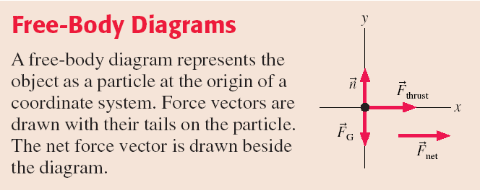

Slide 23
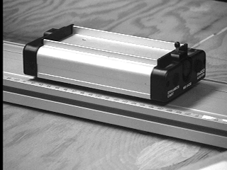
1
Newton’s First Law
The natural state of an object with no net external force on it is to either remain at rest or continue to move in a straight line with a constant velocity.

Slide 24
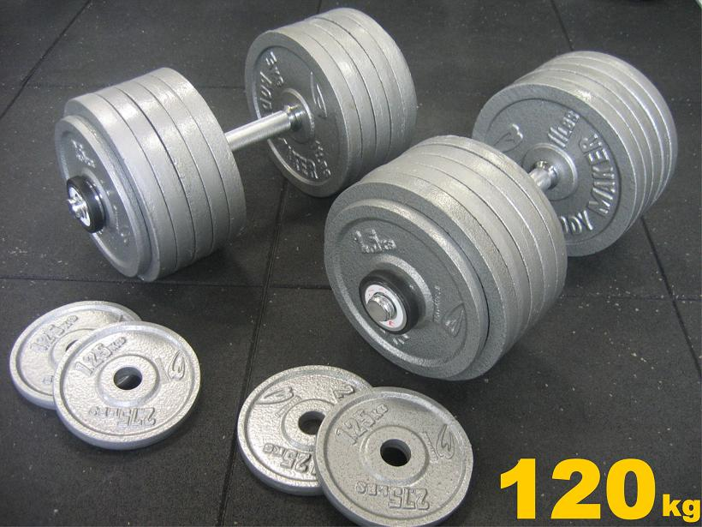
What is Mass?
Mass is a scalar quantity that describes an object’s inertia.
It describes the amount of matter in an object.
Mass is an intrinsic property of an object.
It tells us something about the object, regardless of where the object is, what it’s doing, or whatever forces may be acting on it.

Slide 25
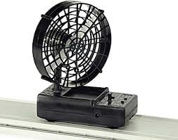
2
Newton’s Second Law
The acceleration of an object is directly proportional to the net force acting on it, and inversely proportional to its mass.

Slide 26
Clicker Question
A fan attached to a cart causes it to accelerate at 2 m/s².
Suppose the same fan is attached to a second cart with smaller mass.
The mass of the second cart plus fan is half the mass of the first cart plus fan. The acceleration of the second cart is
16 m/s².
8 m/s².
4 m/s².
2 m/s².
1 m/s².
Notes:
Answer: D

Slide 27
Projectile Motion Example
An angry bird of mass m = 0.12 kg is flying through the air. His wings are tucked in, and air resistance is negligible.
What is the acceleration of the bird?

Slide 28
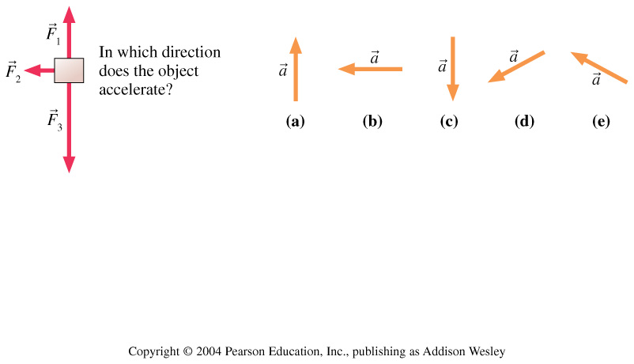
Clicker Question
Three forces act on an object. In which direction does the object accelerate?
Notes:
Answer: D

Slide 29
Mass on Frictionless Inclined Plane Example
A cart of mass m = 0.195 kg is rolling on a track that is inclined at an angle θ above the horizontal. Friction is negligible.
What is the acceleration of the cart?
θ

Slide 30
Problem Solving Strategy
Acceleration is the link between dynamics and kinematics.
From F_{net}, find a.
From a and initial conditions, find v_{x}, v_{y}, x, y.
a = 0 is the condition for equilibrium.
“static equilibrium” is when a = 0 and v = 0.
“dynamic equilibrium” is when a = 0 and v ≠ 0.
Equilibrium occurs if and only if F_{net} = 0.

Slide 31
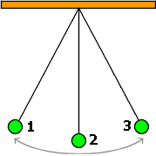
Clicker Question
A green ball swings back and forth between positions 1, 2 and 3. F_{g} is the magnitude of the force of gravity on the ball. T is the magnitude of the tension force on the ball. At the instant the ball is in position 2,
F_{g} > T
F_{g} < T
F_{g} = T

Slide 32
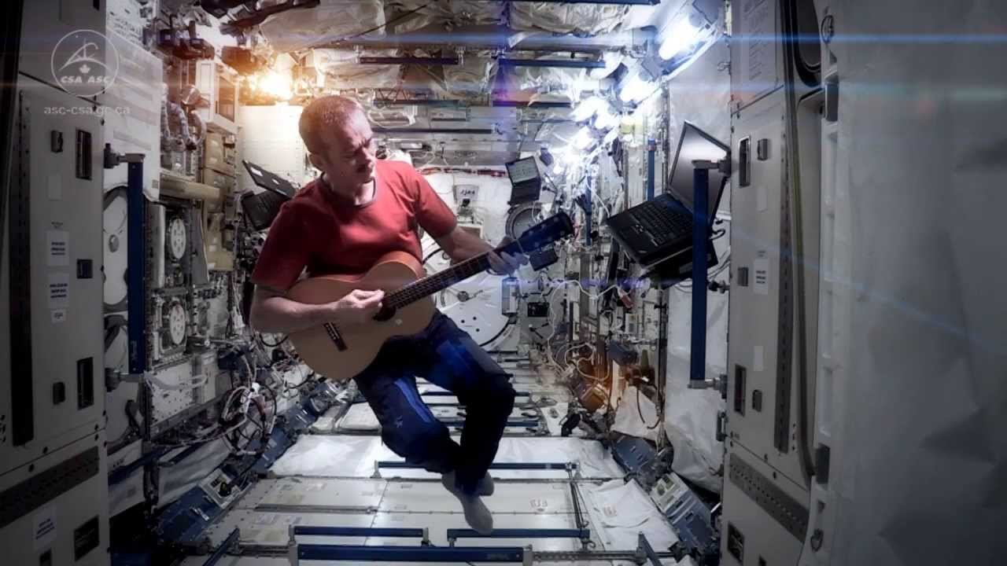
Before Class 10 on Wednesday
Please read Chapter 6 of Knight, sections 6.1 through 6.3.
Something to think about:
When astronauts are floating in a space station, are they really weightless?
Have you seen Canadian Astronaut Chris Hadfield singing a revised version of David Bowie’s “Space Oddity” on the International Space Station? http://youtu.be/KaOC9danxNo .

