Slide 1
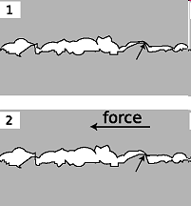

PHY131H1F - Class 11
Today, finishing Chapter 6:
Friction, Drag
Rolling without slipping
Examples of Newton’s Second Law
Microscopic bumps and holes crash into each other, causing a frictional force.

Slide 2


Clicker Question
Astronaut Reid Wiseman ( @astro_reid) is currently living on the International Space Station, which orbits at 370 km above the surface of the Earth (low earth orbit).
Assuming Reid has not changed his mass since moving to space, what is the force of gravity on Reid?
Zero
The same as the force of gravity on him while he was on earth.
A little bit less than the force of gravity on him while he was on earth.
Not exactly zero, but much, much less than the force of gravity on him while he was on earth.

Slide 3




International Space Station
Orbit is drawn to scale
$$F_{g}=mg$$
Reid feels weightless because he is in freefall!
Radius of the Earth: 6400 km, g = 9.8 m/s²
Altitude of Space Station: 370 km, g = 8.9 m/s² (about 10% less)

Slide 4
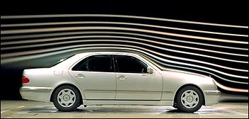
Class 11 Preclass Quiz on MasteringPhysics
This was due this morning at 8:00am
859 students submitted the quiz on time
52% of students answered correctly: Which of the following list determine the drag force from air resistance?
[image from http://www.autospeed.com/cms/A_108676/article.html ]
the mass of the object.
the normal force.
the acceleration due to gravity.
the cross-section area of the object.
the acceleration of the object.
the speed of the object.
66% answered correctly: The effect of the perpendicular component of acceleration on the motion of an object is to change the direction of the velocity.
88% answered correctly: The coefficient of static friction is usually larger than the coefficient of kinetic friction.

Slide 5
Class 11 Preclass Quiz on MasteringPhysics
Some common or interesting student comments/feedback:
“I feel like there is more and more work that i have to do and i have less and less time. Everything seems easy but when I do examples I get it all wrong. What is happening?”
Harlow answer: This is a very common type of comment I get. My advice is to hang in there! If you know how to do a problem when you first look at it, then it’s not a problem, it’s an exercise.
  Sometimes a university education is compared to drinking from a fire hose: you can’t get it all.
  Prioritize your time, stick to a daily study schedule.
  Many people consider dropping one course in their first semester to free up some precious time.
  Also when I quit my job bartending my academic life improved (but I had no money!)

Slide 6
Class 11 Preclass Quiz on MasteringPhysics
Some common or interesting student comments/feedback:
“I agree the best way to learn is by sitting down and actually trying to solve the problems myself (great analogy with swimming)!”
“I am still struggling with chapter 4. Do you think you could please maybe just redo the whole thing?”
Harlow answer: Nope. It is a very important chapter to review on your own time, though.
“is perpendicular acceleration to the moving object circular motion?”
Harlow answer: Yes! Furthermore, it’s uniform circular motion.
“If you were to try and push a piano up a frictionless ramp, wouldn't you just slip down and be unable to push it up the ramp?”
Harlow answer: Yes! That’s true! I guess there is no friction on the piano, but there is friction on your feet. Maybe the piano is on wheels and you are not.

Slide 7
Class 11 Preclass Quiz on MasteringPhysics
Some common or interesting student comments/feedback:
“I will not leave any comments from now on since they are not going to be shown in lecture anyways... =[“
“We have a chem midterm tonight :(”
Good luck!!
“I found the hybridization of sp3 orbitals and acid base reactions very confusing. Also can you take up conformations and Newman projections. That would be very helpful”
Harlow answer: Um…. wha?
“I like you, professor, although I cannot remember your name.”
Harlow answer: It’s Jason.
What did the cat say to the other cat when it walked across the carpet?
µ

Slide 8
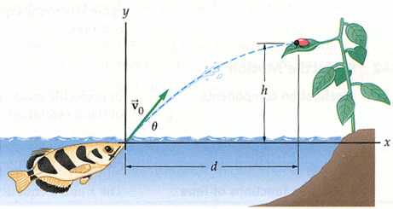
Problem Set 4 on MasteringPhysics
This was due Monday night at 11:59pm
939 students did the problem set by the deadline
It took an average of 68 minutes for students to complete the problem set
The most difficult problem seemed to be “The Archerfish”

Slide 9
Final Exam Schedule Posted
The PHY131H1F exam will be:
Monday Dec. 15, 2:00-4:00pm
Last name A-HA in EX 100
Last name HE-OT in EX 200
Last name OV-SET in EX 300
Last name SEW-UM in EX 310
Last name UN-X in EX 320
Last name Y-Z in HA 403
Students who have two Faculty final examinations in the same time slot, or three consecutive Faculty final examinations (e.g., morning, afternoon, evening; or afternoon, evening, next morning), should report the conflict in person at the Office of the Faculty Registrar, Room 1006, Sidney Smith Hall, by Nov. 27, 2014.

Slide 10
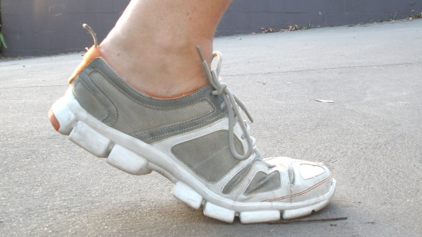
Last day I asked at the end of class:
Does friction always slow things down?
ANSWER: No!
Kinetic friction does oppose the relative motion of two surfaces. If the one of these surfaces is stationary, then it will tend to slow down the moving object.
Can friction ever speed things up?
ANSWER: Yes!
Static friction between your feet and the floor is what allows you to walk! Walking certainly involves speeding up, and this would not be possible if the floor were frictionless or covered in marbles!

Slide 11
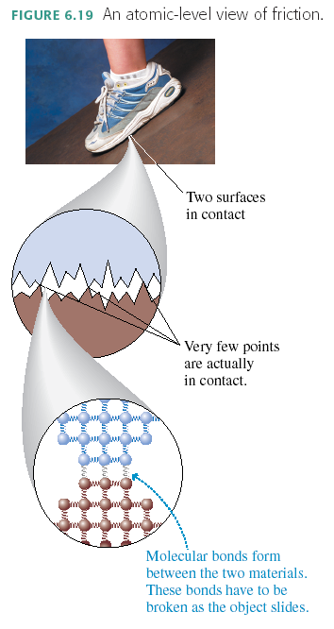
Why does friction exist?
Because at the microscopic level, nothing is smooth!

Slide 12
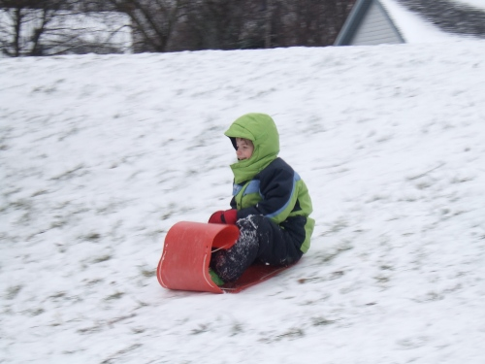
“Kinetic Friction”
Also called “sliding friction”
When two flat surfaces are in contact and sliding relative to one another, heat is created, so it slows down the motion (kinetic energy is being converted to thermal energy).
Many experiments have shown the following approximate relation usually holds for the magnitude of f_{k}:
where n is the magnitude of the normal force.
The direction of f_{k} is opposite the direction of motion.

Slide 13
Clicker Question
A wooden block weighs 100 N, and is sliding to the right on a smooth horizontal concrete surface at a speed of 5 m/s. The coefficient of kinetic friction between wood and concrete is 0.1.
A 5 N horizontal force is applied to the block, pushing toward the right. What is the force of kinetic friction of the concrete on the block?
100 N, to the left
10 N, to the left
5 N, to the left
10 N, to the right
5 N, to the right

Slide 14
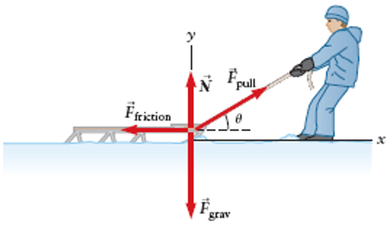
Example
A sled of mass 5.0 kg is pulled at a constant velocity by a rope which makes an angle of 20.0° above the horizontal.
The coefficient of kinetic friction between the sled and the snow is 0.030.
What is the tension in the rope? (F_{pull} in the diagram)

Slide 16
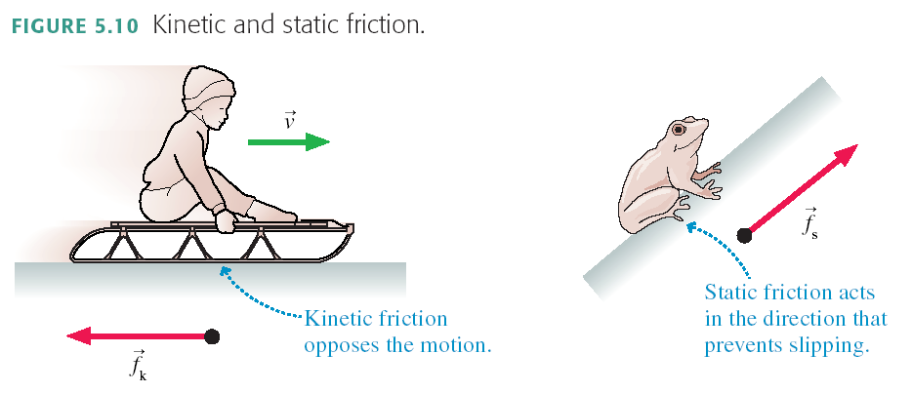
“Static Friction”
When two flat surfaces are in contact but are not moving relative to one another, they tend to resist slipping. They have “locked” together. This creates a force perpendicular to the normal force, called static friction.
There is no general equation for f_{s}.
The direction of f_{s} is whatever is required to prevent slipping.

Slide 17

Maximum Static Friction
There’s a limit to how big f_{s} can get. If you push hard enough, the object slips and starts to move. In other words, the static friction force has a maximum possible size f_{s max}.
The two surfaces don’t slip against each other as long as f_{s} ≤ f_{s max}.
A static friction force f_{s} > f_{s max} is not physically possible. Many experiments have shown the following approximate relation usually holds:
where n is the magnitude of the normal force, and the proportionality constant μ_{s} is called the “coefficient of static friction”.

Slide 18

Clicker Question
A wooden block weighs 100 N, and is sitting stationary on a smooth horizontal concrete surface. The coefficient of static friction between wood and concrete is 0.2.
A 5 N horizontal force is applied to the block, pushing toward the right, but the block does not move. What is the force of static friction of the concrete on the block?
100 N, to the left
20 N, to the left
5 N, to the left
20 N, to the right
5 N, to the right

Slide 19
Clicker Question
A wooden block weighs 100 N, and is sitting stationary on a smooth horizontal concrete surface. The coefficient of static friction between wood and concrete is 0.2.
A horizontal force is applied to the block, pushing toward the right. What is the magnitude of the maximum pushing force you can apply and have the block remain stationary?
200 N
100 N
20 N
10 N
5 N

Slide 20
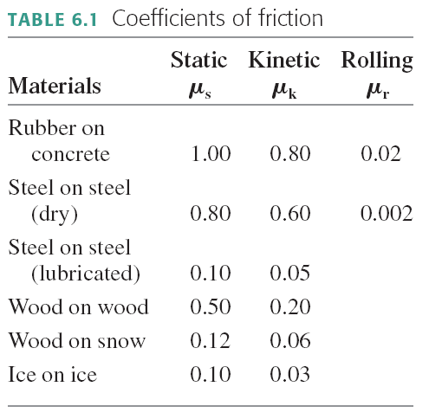

Slide 21
Class 11 Preclass Quiz on MasteringPhysics
Some common or interesting student comments/feedback:
“Why is the static friction slightly larger than the kinetic friction?”
Harlow answer: Good question! Friction is complicated, but basically when two surfaces are at rest relative to one another, they have the opportunity to lock together better, creating more contact points for the friction force.
“I found rolling friction to be the most confusing aspect of this reading.”
Harlow answer: Look carefully at the “Lectures – Harlow” page: We are skipping the material on rolling friction in this course. We do cover “rolling without slipping”, but we assume that only static friction occurs in this case, not the dissipative force of rolling friction.

Slide 22
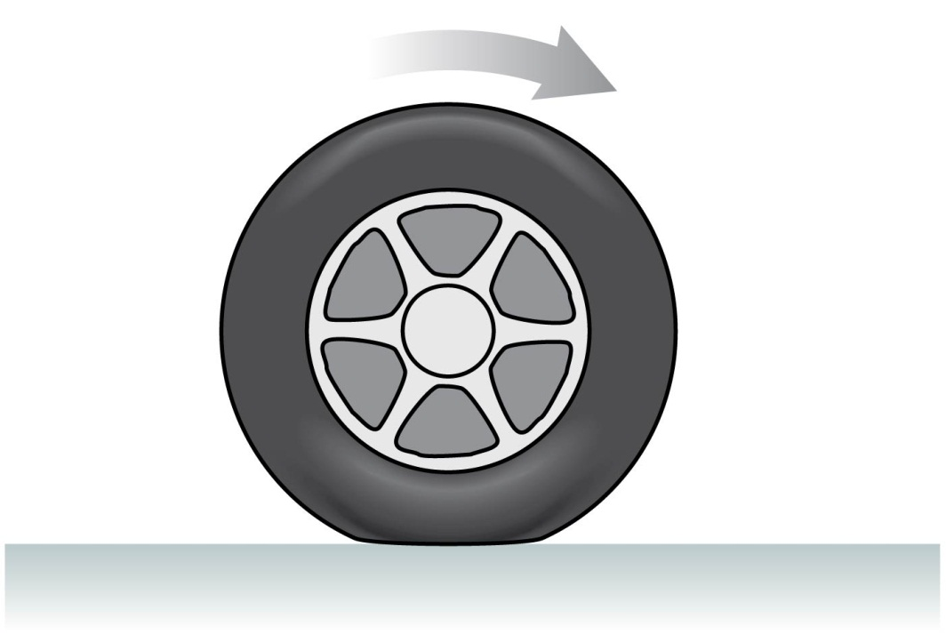
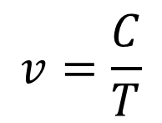
Rolling Without Slipping
Under normal driving conditions, the portion of the rolling wheel that contacts the surface is stationary, not sliding
In this case the speed of the centre of the wheel is:
$$v=\frac{C}{T}$$
where C = circumference [m] and T = Period [s]
If your car is accelerating or decelerating or turning, it is static friction of the road on the wheels that provides the net force which accelerates the car

Slide 23
Rolling without slipping
The axle of the wheel moves relative to the ground
Reference frame: the ground
ω
The wheel rotates with angular speed ω.
The tangential speed of a point on the rim is v = ωr, relative to the axle.
In “rolling without slipping”, the axle moves at speed v.

Slide 24
Rolling without slipping
The axle reference frame
The ground reference frame
1
4
2
3

Slide 25
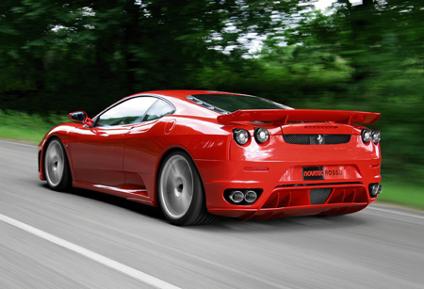
Four points on this Ferrari are at rest!

Slide 26
Clicker Question
When an object moves through the air, the magnitude of the drag force due to air resistance
  increases as the object’s speed increases.
  decreases as the object’s speed increases.
  does not depend on the object’s speed.

Slide 27
Drag force in a fluid, such as air
Air resistance, or drag, is complex and involves fluid dynamics.
For objects on Earth, with speeds between 1 and 100 m/s and size between 1 cm and 2 m, there is an approximate equation which predicts the magnitude of air resistance
where A is the cross-sectional area of the object, ρ is the density of the air, C is the drag coefficient, and v is the speed.
The direction of air resistance, or Drag Force, is opposite to the direction of motion.
It depends on size and shape, but not mass.

Slide 28
Class 11 Preclass Quiz on MasteringPhysics
Some common or interesting student comments/feedback:
“I'm a little confused, is drag the same as air resistance? Thanks.”
Harlow answer: Yes! But drag is more general – there is drag when an object travels through water, other fluids, etc.
“The formula of drag force consists of velocity, area, density and its coefficient. Does mass affect drag force because density is mass per unit volume?”
Harlow answer: Don’t get confused: the density ρ refers to density of the fluid, not the object. The object’s mass really doesn’t matter.

Slide 29
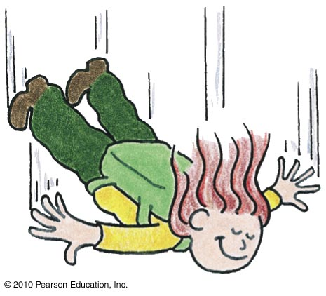
Non-Free Fall—Example
A skydiver jumps from plane.
Weight is the only force until air resistance acts.
As falling speed increases, air resistance on diver builds up, net force is reduced, and acceleration becomes less.
When air resistance equals the diver’s weight, net force is zero and acceleration terminates.
Diver reaches terminal velocity, then continues the fall at constant speed.

Slide 30
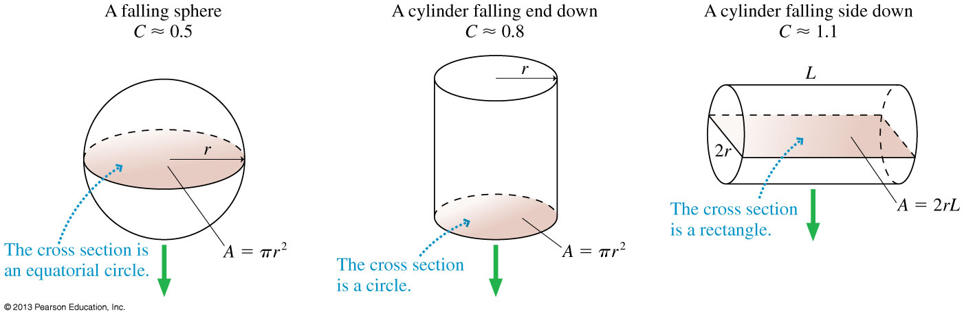
Cross Sectional Area depends on size, shape, and direction of motion.
…Consider the forces on a falling piece of paper, crumpled and not crumpled.

Slide 31
Example
A 6.5 cm diameter tennis ball has a terminal speed of 26 m/s.
What is the ball’s mass?

Slide 32
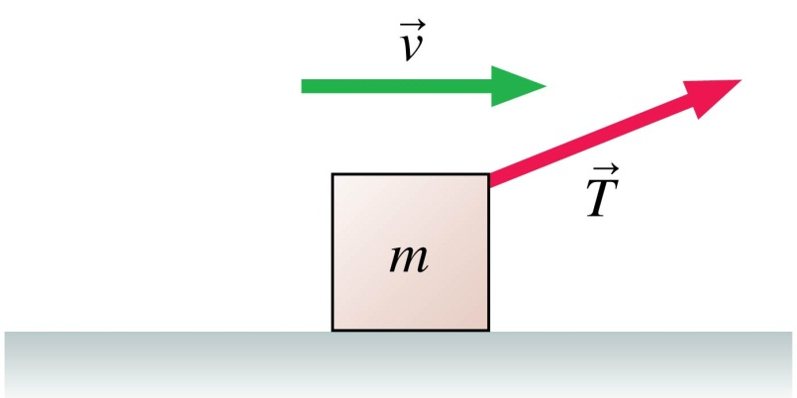
Clicker Question
A box is being pulled to the right at steady speed by a rope that angles upward. In this situation:
n > mg.
n = mg.
n < mg.
n = 0.
Not enough information to judge the size of the normal force.

Slide 33
Before Class 12 on Monday
Do the MasteringPhysics Problem Set 5 by Monday evening!
Please read Knight Chapter 7.
Something to think about:
Consider the following reasoning, and identify the mistake:
“When you pull a wagon, Newton’s 3rd Law states that the wagon pulls back on you with an equal and opposite force. These forces should cancel each other. So it is impossible to accelerate the wagon!”

