Slide 1
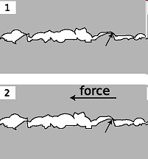
PHY131H1F - Class 11
Today, finishing Chapter 6:
Friction, Drag
Rolling without slipping
Examples of Newton’s Second Law
Microscopic bumps and holes crash into each other, causing a frictional force.

Slide 2
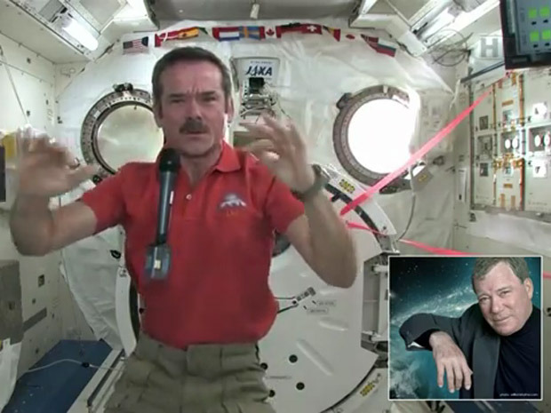
Clicker Question 1
Chris Hadfield recently spent nearly five months in orbit around the Earth. He was living on the International Space Station, which orbits at 370 km above the surface of the Earth (low earth orbit).
What was the force of gravity on Chris Hadfield while he was on the space station?
Zero
The same as the force of gravity on him while he was on earth.
A little bit less than the force of gravity on him while he was on earth.
Not exactly zero, but much, much less than the force of gravity on him while he was on earth.

Slide 3
International Space Station
Orbit is drawn to scale
$$F_{g}=mg$$
Radius of the Earth: 6400 km, g = 9.8 m/s²
Altitude of Space Station: 370 km, g = 8.9 m/s² (about 10% less)

Slide 4
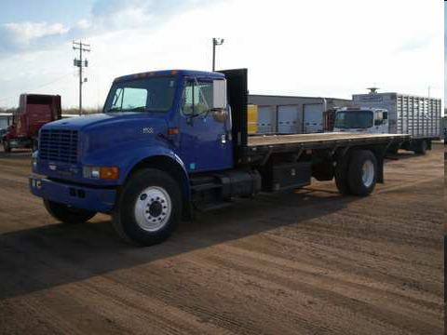
Which is true? “Friction
Clicker Question
always causes objects to slow down.”
always causes objects to speed up.”
can cause objects to speed up or slow down, depending on the situation.”

Slide 5
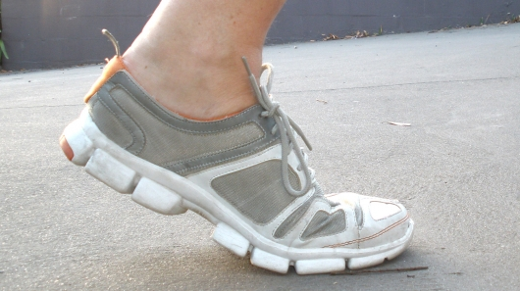
Last day I asked at the end of class:
Does friction always slow things down?
ANSWER: No!
Kinetic friction does oppose the relative motion of two surfaces. If the one of these surfaces is stationary, then it will tend to slow down the moving object.
Can friction ever speed things up?
ANSWER: Yes!
Static friction between your feet and the floor is what allows you to walk! Walking certainly involves speeding up, and this would not be possible if the floor were frictionless or covered in marbles!

Slide 6
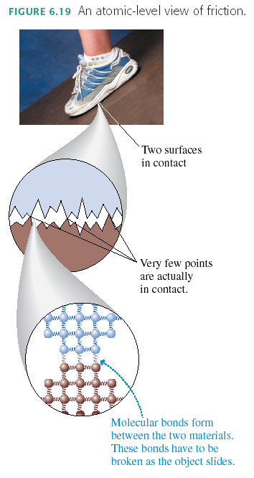
Why does friction exist?
Because at the microscopic level, nothing is smooth!

Slide 7
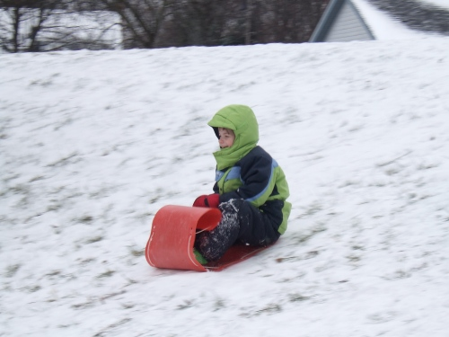
“Kinetic Friction”
Also called “sliding friction”
When two flat surfaces are in contact and sliding relative to one another, heat is created, so it slows down the motion (kinetic energy is being converted to thermal energy).
Many experiments have shown the following approximate relation usually holds for the magnitude of f_{k}:
where n is the magnitude of the normal force.
The direction of f_{k} is opposite the direction of motion.

Slide 8
Clicker Question
A wooden block weighs 100 N, and is sliding to the right on a smooth horizontal concrete surface at a speed of 5 m/s. The coefficient of kinetic friction between wood and concrete is 0.1.
A 5 N horizontal force is applied to the block, pushing toward the right. What is the force of kinetic friction of the concrete on the block?
100 N, to the left
10 N, to the left
5 N, to the left
10 N, to the right
5 N, to the right

Slide 9
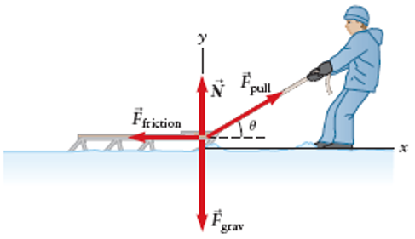
Example
A sled of mass 5.0 kg is pulled at a constant velocity by a rope which makes an angle of 20.0° above the horizontal.
The coefficient of kinetic friction between the sled and the snow is 0.030.
What is the tension in the rope? (F_{pull} in the diagram)

Slide 10
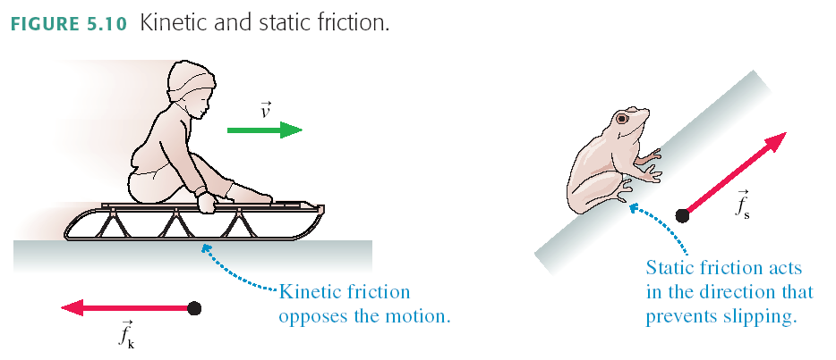
“Static Friction”
When two flat surfaces are in contact but are not moving relative to one another, they tend to resist slipping. They have “locked” together. This creates a force perpendicular to the normal force, called static friction.
There is no general equation for f_{s}.
The direction of f_{s} is whatever is required to prevent slipping.

Slide 11
Maximum Static Friction
There’s a limit to how big f_{s} can get. If you push hard enough, the object slips and starts to move. In other words, the static friction force has a maximum possible size f_{s max}.
The two surfaces don’t slip against each other as long as f_{s} ≤ f_{s max}.
A static friction force f_{s} > f_{s max} is not physically possible. Many experiments have shown the following approximate relation usually holds:
where n is the magnitude of the normal force, and the proportionality constant μ_{s} is called the “coefficient of static friction”.

Slide 12
Clicker Question
A wooden block weighs 100 N, and is sitting stationary on a smooth horizontal concrete surface. The coefficient of static friction between wood and concrete is 0.2.
A 5 N horizontal force is applied to the block, pushing toward the right, but the block does not move. What is the force of static friction of the concrete on the block?
100 N, to the left
20 N, to the left
5 N, to the left
20 N, to the right
5 N, to the right

Slide 13
Clicker Question
A wooden block weighs 100 N, and is sitting stationary on a smooth horizontal concrete surface. The coefficient of static friction between wood and concrete is 0.2.
A horizontal force is applied to the block, pushing toward the right. What is the magnitude of the maximum pushing force you can apply and have the block remain stationary?
200 N
100 N
20 N
10 N
5 N

Slide 14
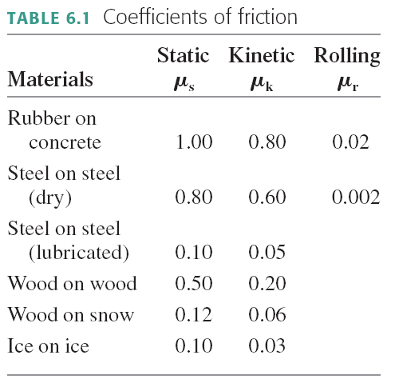

Slide 15
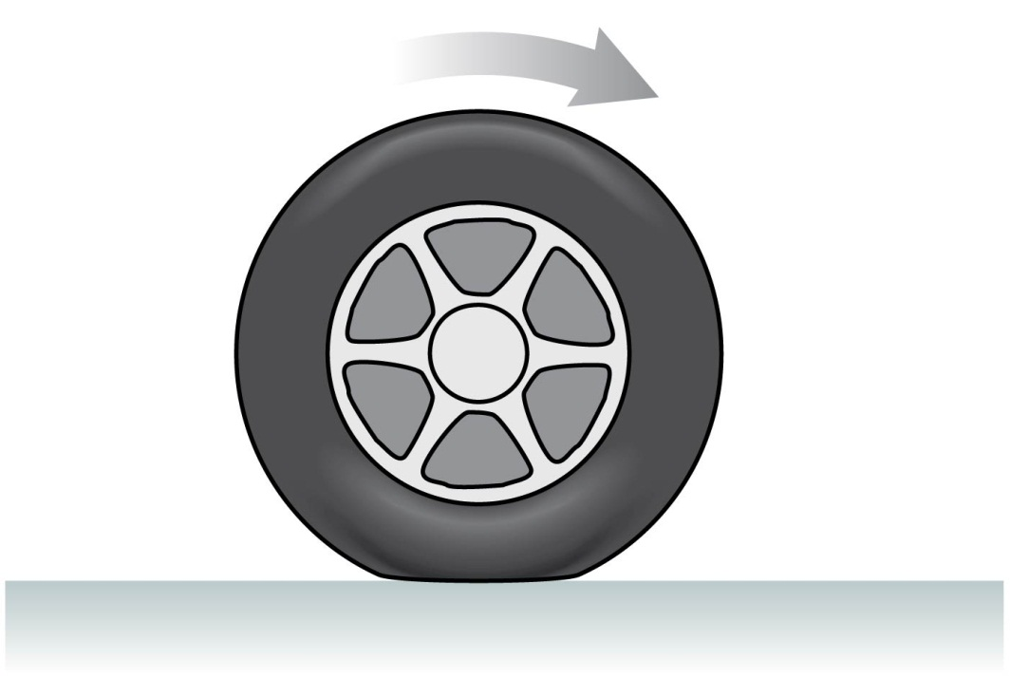
Rolling Without Slipping
Under normal driving conditions, the portion of the rolling wheel that contacts the surface is stationary, not sliding
In this case the speed of the centre of the wheel is:
$$v=\frac{C}{T}$$
where C = circumference [m] and T = Period [s]
If your car is accelerating or decelerating or turning, it is static friction of the road on the wheels that provides the net force which accelerates the car

Slide 16
Clicker Question
The circumference of the tires on your car is 0.9 m.
The onboard computer in your car measures that your tires rotate 10 times per second.
What is the speed as displayed on your speedometer?
0.09 m/s
0.11 m/s
0.9 m/s
1.1 m/s
9 m/s

Slide 17
Rolling without slipping
The axle of the wheel moves relative to the ground
Reference frame: the ground
ω
The wheel rotates with angular speed ω.
The tangential speed of a point on the rim is v = ωr, relative to the axle.
In “rolling without slipping”, the axle moves at speed v.

Slide 18
Rolling without slipping
The axle reference frame
The ground reference frame
1
4
2
3

Slide 19
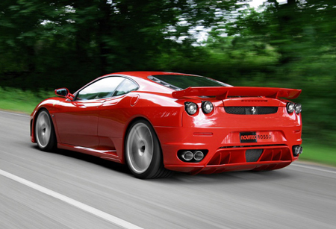
Four points on this Ferrari are at rest!

Slide 20
Clicker Question
When an object moves through the air, the magnitude of the drag force due to air resistance
increases as the object’s speed increases.
decreases as the object’s speed increases.
does not depend on the object’s speed.

Slide 21
Drag force in a fluid, such as air
Air resistance, or drag, is complex and involves fluid dynamics.
For objects on Earth, with speeds between 1 and 100 m/s and size between 1 cm and 2 m, there is an approximate equation which predicts the magnitude of air resistance
where A is the cross-sectional area of the object, ρ is the density of the air, C is the drag coefficient, and v is the speed.
The direction of air resistance, or Drag Force, is opposite to the direction of motion.
It depends on size and shape, but not mass.

Slide 22
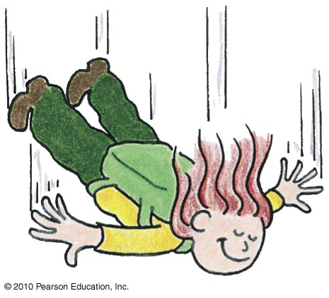
Non-Free Fall—Example
A skydiver jumps from plane.
Weight is the only force until air resistance acts.
As falling speed increases, air resistance on diver builds up, net force is reduced, and acceleration becomes less.
When air resistance equals the diver’s weight, net force is zero and acceleration terminates.
Diver reaches terminal velocity, then continues the fall at constant speed.

Slide 23
Cross Sectional Area depends on size, shape, and direction of motion.
…Consider the forces on a falling piece of paper, crumpled and not crumpled.

Slide 24
Example (suggested by student)
I throw my roommate out the window (we're on the fourth floor of Elmsley Hall). She has a mass of approximately 55 kg (her opinion), and a radius of 12 inches. The density of air at standard atmospheric pressure and "room temperature" is 1.2 kg/m³. Not very bright, she tries to land feet first (a.k.a., assume the drag coefficient is that of an upright cylinder = .8). What is her terminal velocity?

Slide 25
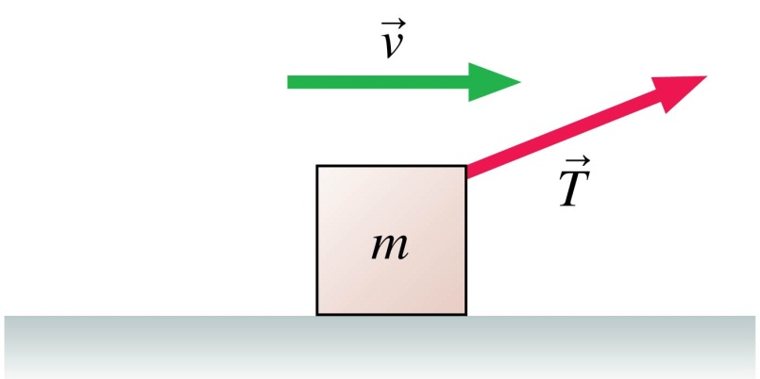
Clicker Question
A box is being pulled to the right at steady speed by a rope that angles upward. In this situation:
n > mg.
n = mg.
n < mg.
n = 0.
Not enough information to judge the size of the normal force.

Slide 26
Before Class 12 on Monday
Do the MasteringPhysics Problem Set 5 by Monday evening!
Please read Knight Chapter 7.
Something to think about:
Consider the following reasoning, and identify the mistake:
“When you pull a wagon, Newton’s 3rd Law states that the wagon pulls back on you with an equal and opposite force. These forces should cancel each other. So it is impossible to accelerate the wagon!”

