Slide 1
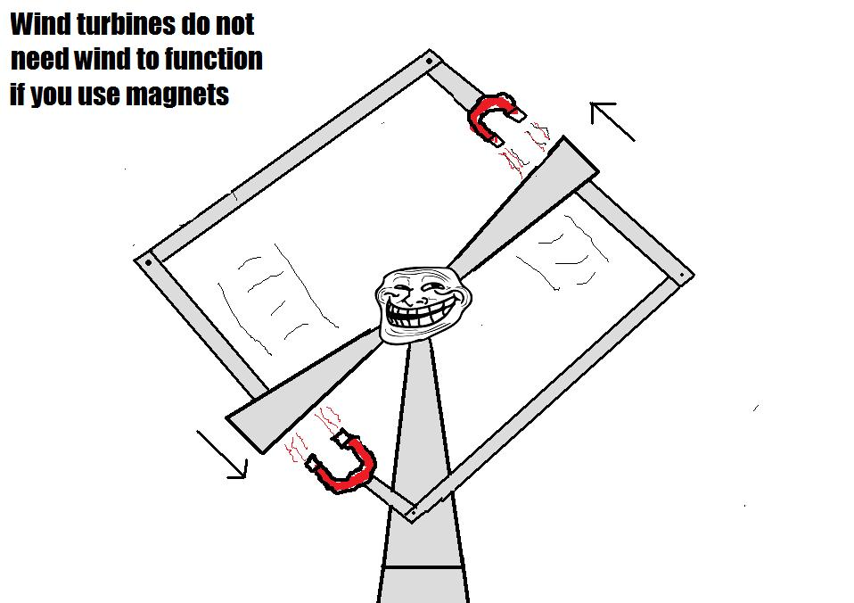
PHY131H1F - Class 12
From Avinash’s comment on Sep.22:
Today, Chapter 7:
Newton’s Third Law
Force Interaction Pairs
Ropes and Pulleys

Slide 2
A Mack Truck drives North on the highway, and collides head-on with a mosquito. Which is true?
The Mack Truck exerts a greater force on the mosquito than the mosquito exerts on the Mack Truck.
The mosquito exerts a greater force on the Mack Truck than the Mack Truck exerts on the mosquito.
The Mack Truck exerts the same force on the mosquito as the mosquito exerts on the Mack Truck.
Impossible to determine without knowing the speeds of the truck and mosquito.
Don’t know or none of the above

Slide 3
A Mack Truck drives North on the highway, and collides head-on with a mosquito. Which is true?
The Mack Truck exerts a greater force on the mosquito than the mosquito exerts on the Mack Truck.
The mosquito exerts a greater force on the Mack Truck than the Mack Truck exerts on the mosquito.
The Mack Truck exerts the same force on the mosquito as the mosquito exerts on the Mack Truck.
Impossible to determine without knowing the speeds of the truck and mosquito.
Don’t know or none of the above

Slide 4
Last day I asked at the end of class:
Consider the following reasoning, and identify the mistake:
“When you pull a wagon, Newton’s 3rd Law states that the wagon pulls back on you with an equal and opposite force. These forces should cancel each other. So it is impossible to accelerate the wagon!”
ANSWER:
First sentence is correct: the wagon really does pull back on you with an equal opposite force that you pull on the wagon!
Second and third sentences are not correct: forces cannot cancel each other if they are on different objects.
The forward static friction on your feet is larger than the backward rolling friction on the wheels of the wagon, so the system of you and the wagon has a forward net force, provided by the Earth (static friction). That is why you both accelerate.

Slide 5
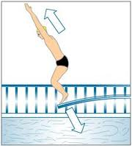
3
Newton’s Third Law
If object 1 acts on object 2 with a force, then object 2 acts on object 1 with an equal force in the opposite direction.

Slide 6
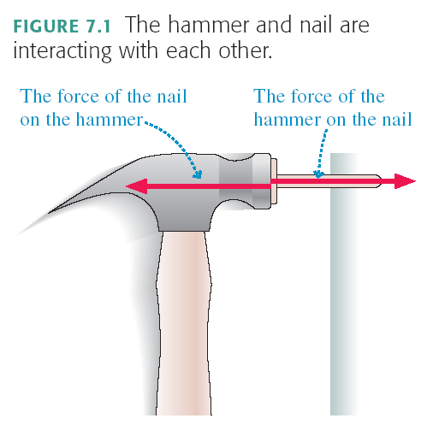

Slide 7
F = ma or a = F / m
If the force is equal on the truck and the mosquito, is the acceleration equal?
Acceleration is higher if m is lower ( F divided by m)
Mosquito accelerates more, so it receives more damage.

Slide 8
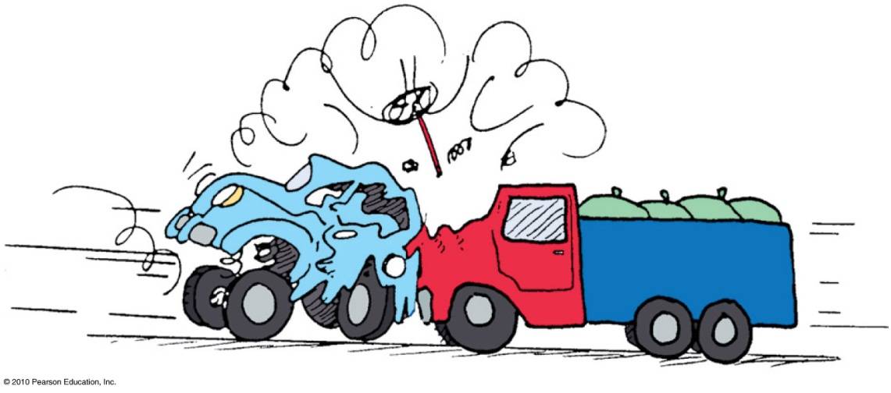
Forces always come in pairs
Every force interaction involves two objects, and two forces.
These forces
are equal in strength and opposite in direction.
are always the same kind of force (ie gravity, normal, friction, tension, etc.)
always act on different objects.

Slide 9
The entire Earth accelerates toward the Moon, due to this pulling force.
To find the total acceleration, you use the force as calculated for the centre-to-centre distance.
Since F_{G} = GMm/r², the force on the ocean nearer to the moon will be greater, so it will accelerate more than the rest of the Earth, bulging out.

Slide 10
Similarly, since F_{G} = GMm/r², the force on the ocean further from the moon will be less, so it will accelerate less than the rest of the Earth, remaining behind, forming a bulge.
In general, tidal effects tend to stretch objects both toward and away from the object causing the tides.

Slide 11
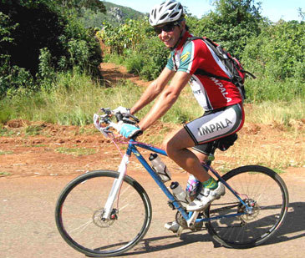
Clicker Question
A cyclist is pushing on his pedals, and therefore accelerating to the left.
What is the direction of the force of static friction of the ground on the back wheel?
Left
Right
Up
Down
zero

Slide 12
Clicker Question
A cyclist is pushing on his pedals, and therefore accelerating to the left.
What is the direction of the force of static friction of the ground on the front wheel?
Left
Right
Up
Down
zero

Slide 13
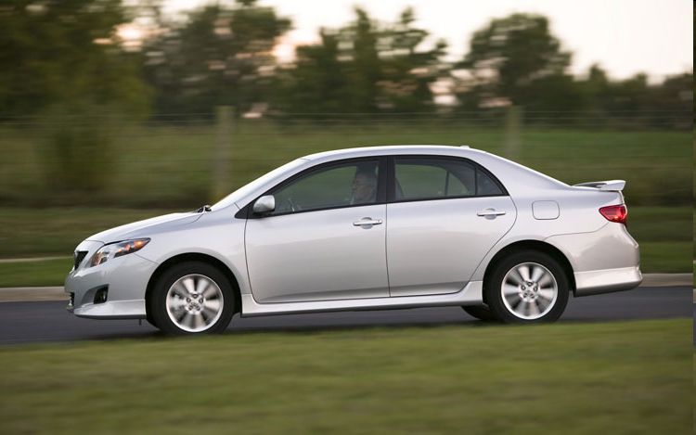
Car/Earth Friction Interaction
Consider an accelerating car.
The tires of the car are pushing backward on the Earth (static friction).
The Earth is pushing forward on the tires of the car (static friction).

Slide 14
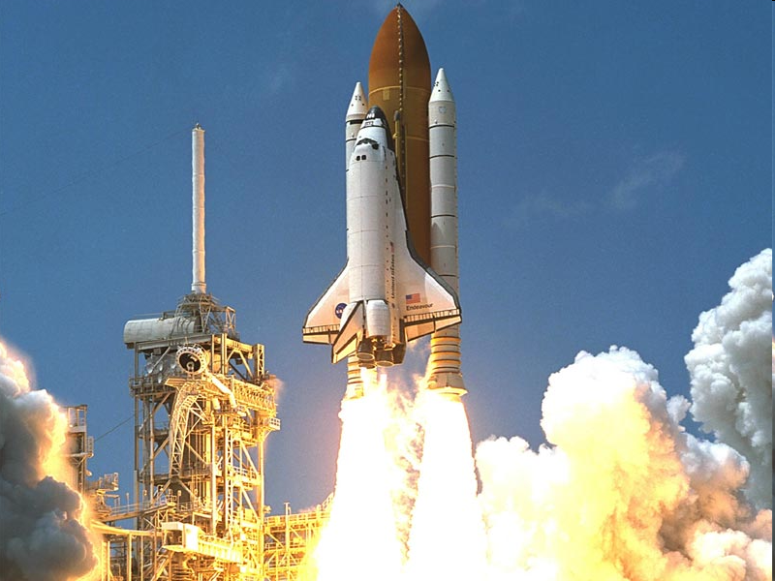
Rocket/Gas Pressure Interaction
Consider a rocket accelerating upward.
The rocket is pushing down on the expelled gas (pressure).
The expelled gas is pushing up on the rocket (pressure).

Slide 15
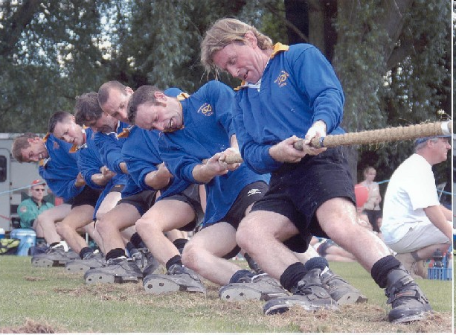
Man/Rope Tension Interaction
Clicker Question
This man is pulling the rope to the left.
What is the other force in this interaction?
His feet are pushing the ground to the right.
The ground is pushing his feet to the left.
The rope is pulling the man to the right.
Gravity of the Earth is pulling the man down.
Gravity of the man is pulling the Earth up.

Slide 16
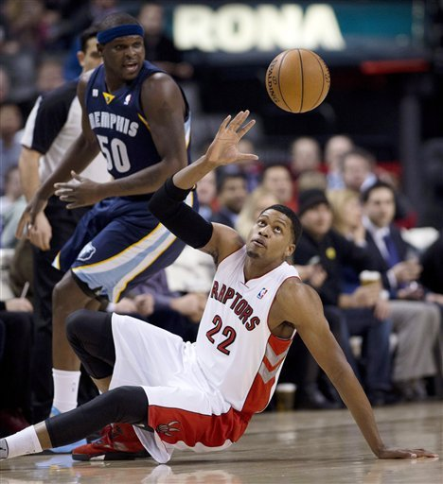
Basketball/Earth Gravity Interaction
Clicker Question
Consider a basketball in freefall.
Gravity is pulling this ball down.
What is the other force in this interaction?
The thrower’s feet are pushing the ground down.
The ground is pushing the thrower’s feet up.
Gravity of Earth is pulling the thrower down.
Gravity of the ball is pulling the Earth up.
Air is pushing the ball up.

Slide 17
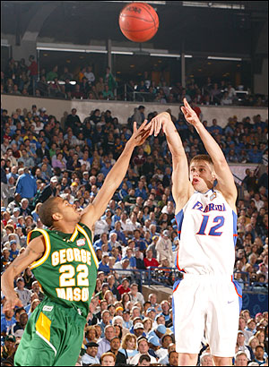
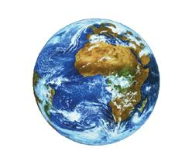
Basketball/Earth Gravity Interaction
F
a =
m
m
F
a =
The Earth is pulling down on the ball.
The ball is pulling up on the Earth.

Slide 18
The Massless String Approximation
Often in physics problems the mass of the string or rope is much less than the masses of the objects that it connects. In such cases, we can adopt the following massless string approximation:

Slide 19
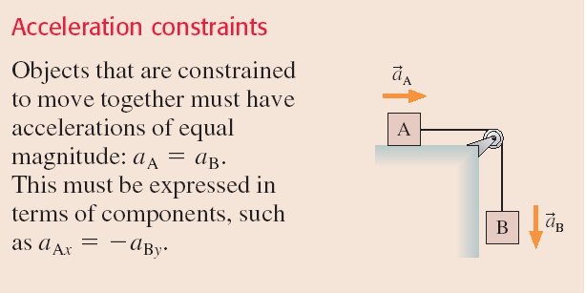
Pulleys

Slide 20
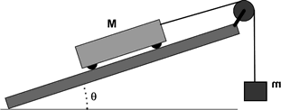
Example
A cart of mass M is on a track which is at an angle of θ above the horizontal.
The cart is attached to a string which goes over a pulley; the other end of the string is attached to a hanging mass, m.
What is the acceleration of the cart?

Slide 21
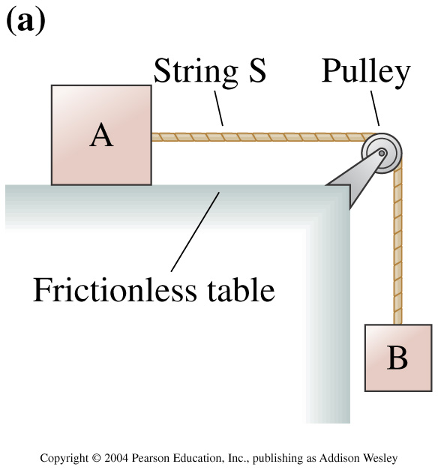
Clicker Question
In the figure to the right, is the tension in the string greater than, less than, or equal to the force of gravity on block B?
Equal to
Greater than
Less than
Notes:
Answer: C

Slide 22
Before Class 13 on Wednesday … my last class!
Please read the first 3 sections of Knight Chapter 8
If you haven’t done Problem Set 5 yet – it’s due tonight by 11:59pm!
Something to think about: A ball is whirled on a string in a vertical circle. As it is going around, the tension in the string is
constant.
greatest at the top of the motion
greatest at the bottom of the motion
greatest somewhere in between the top and bottom.

