Slide 1
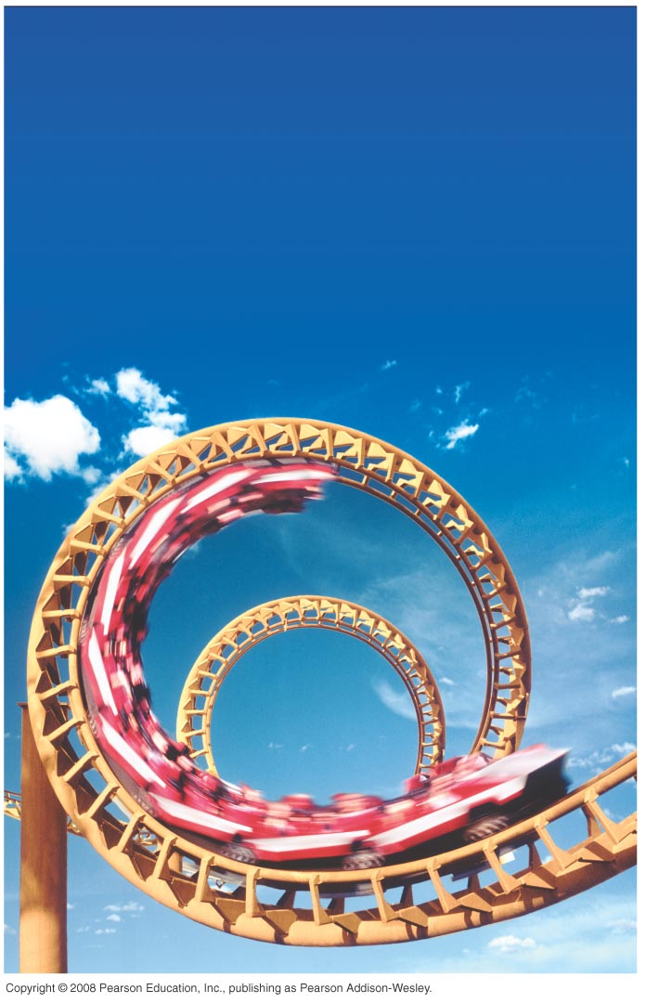
PHY131H1F - Class 13 Harlow’s Last Class this semester ☹ on Monday Prof. Meyertholen takes over! ☺
Today, Chapter 8 Sections 8.1-8.3:
Dynamics in Two Dimensions
Dynamics of Uniform Circular Motion
Banked Curves
Orbits
NOTE: We will not cover sections 8.4 and 8.5 in this course.

Slide 2
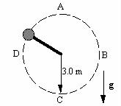
Clicker Question
Last day at the end of class I asked:
A ball is whirled on a string in a vertical circle. As it is going around, the tension in the string is
greatest at the top of the motion
constant.
greatest at the bottom of the motion
greatest somewhere in between the top and bottom.

Slide 4
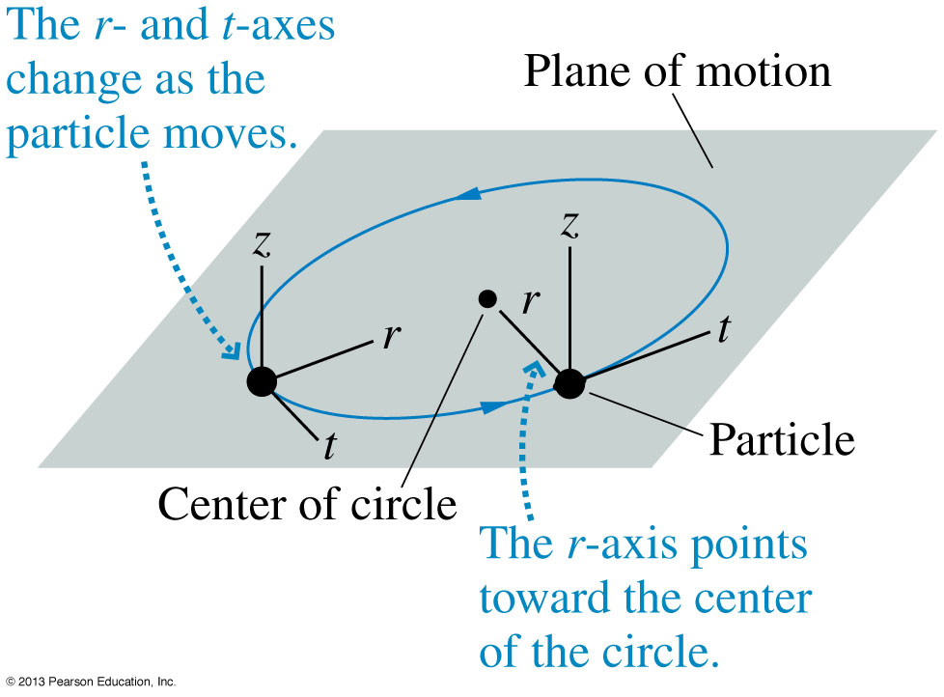
Class 13 Preclass Quiz on MasteringPhysics
This was due this morning at 8:00am
835 students submitted the quiz on time
74% of students answered correctly: Circular motion is best analyzed in a coordinate system with r-, t- and z- axes. If you use x- and y- axes, the x- and y- components are constantly changing!
http://uoft.me/rtzcoord

Slide 5
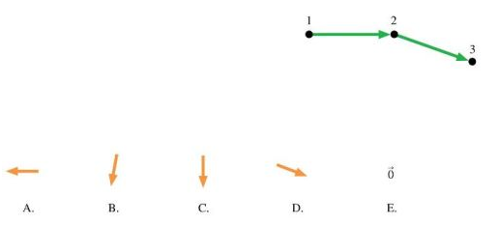
Class 13 Preclass Quiz on MasteringPhysics
Clicker Question – retry this morning’s pre-class reading question.
45% of students answered correctly: The diagram shows three points of a motion diagram. The particle changes direction with no change of speed. What is the acceleration at point 2?

Slide 6
Clicker Question – retry this morning’s pre-class reading question.
39% of students answered correctly: A string is attached to the rear-view mirror of a car. A ball is hanging on the other end of the string. The car is driving around in a circle, at a constant speed. Which of the following lists gives all of the forces directly acting on the ball?
A. Tension
B. Tension, gravity, the centripetal force and friction
C. Tension and gravity
D. Tension, gravity and the centripetal force

Slide 7
Class 13 Preclass Quiz on MasteringPhysics
Student feedback:
“I found banked curves to be the most confusing part of the reading.”
“centripetal force is not a force caused by any agent right? it is just a net component of gravity and normal force right?”
Harlow answer: right. Centripetal force is what you call the net force when the object is traveling in uniform circular motion.
“whats the point of the z component in circular motion?”
Harlow answer: Ya, it’s true you can forget about the z.. It’s just there for completeness.
“I'm still not totally clear on what the rho (p-looking constant) is and how to use it, in air resistance calculations.”
Harlow answer: rho = ρ = density of a fluid in kg/m³. ie for air just use 1.2

Slide 8
Class 13 Preclass Quiz on MasteringPhysics
Student feedback:
“All the mid terms are finished and my life is finished.”
Happy birthday Vanessa T!
“Guess you could say this was a pretty r(i)tz-y chapter.”
“what day is the exam on? Thanks!”
Harlow answer: Monday Dec. 15 at 2pm
“we have over thousand students registered to this class but usually only around 700 students answer the clicker questions, which mean around 300 students missing from the lecture or doesn't answer clicker questions. is this normal?”
Harlow answer: The 1000 includes the 200 students in the evening section.

Slide 9
Class 13 Preclass Quiz on MasteringPhysics
Student feedback:
“How do you pronounce the new professors last name?”
Harlow answer: “My - er - thow – len”
“Is Prof. Meyertholen as easygoing as you are? Tell us something about him! Something that he will never tell us would be better!”
Harlow answer: Yes. He is awesome.

Slide 10
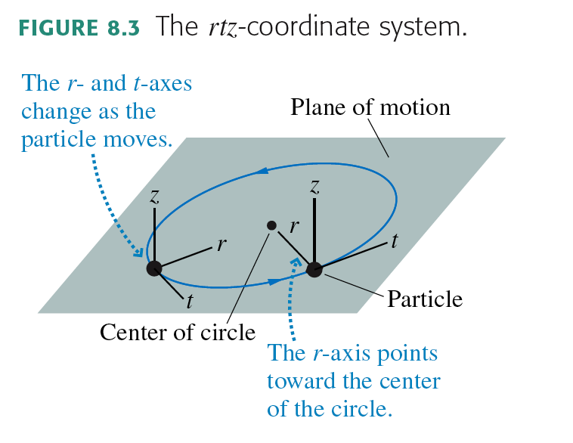
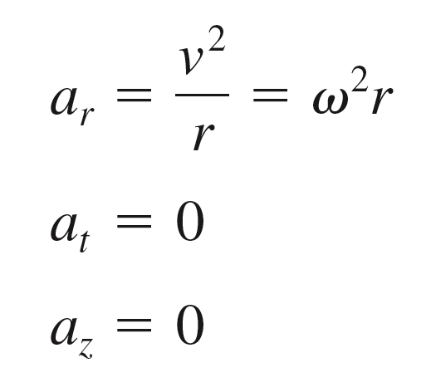
Uniform Circular Motion

Slide 11
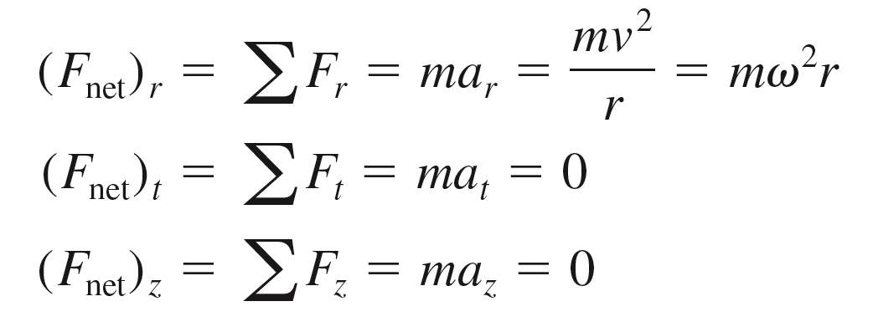
Dynamics of Uniform Circular Motion

Slide 12
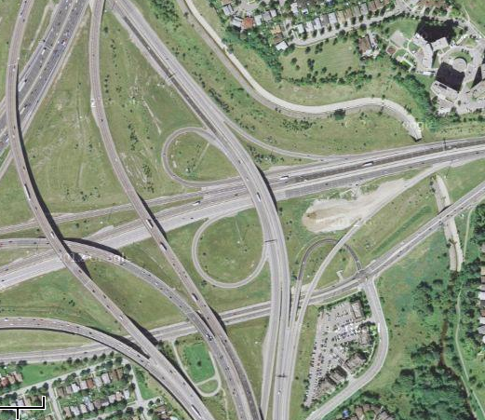
Every curve has a radius
r = 730 m
r = 75 m
r = 410 m
Intersection of Highway 427
And Highway 401

Slide 13
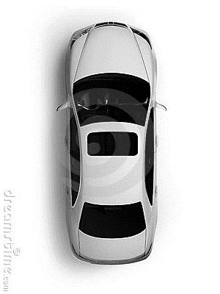
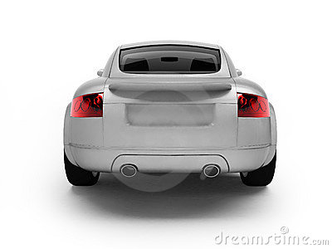
Unbanked Curve
Clicker Question
Top View
r
Back View
Gravity
Normal
Kinetic Friction
Static Friction
Rolling Friction
What horizontal force acts on the car to keep it on the curved path?

Slide 14
Class 13 Preclass Quiz on MasteringPhysics
Student feedback:
“In the previous chapter, you say the acceleration is zero for the horizontal component, and now, it seems the acceleration is not zero anymore. why is this the case? how do i know when the acceleration for the horizontal component will be zero or not?”
Harlow answer: That’s true! If the object is on a circular path (as viewed from above) then you know that a = v²/r sideways.

Slide 15
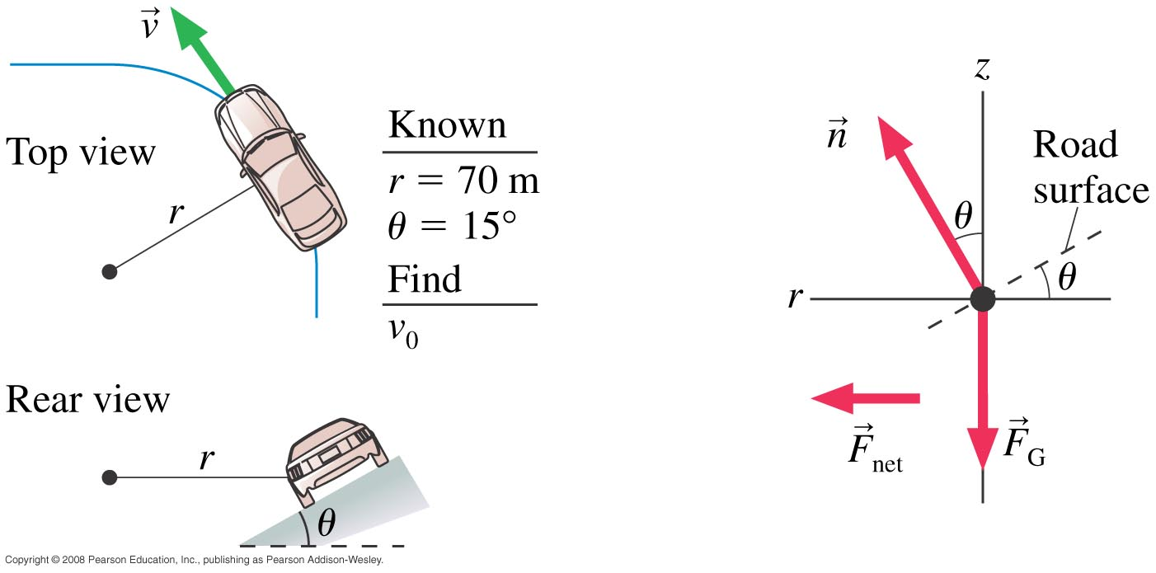
Banked Curve Example 8.5, pg. 197
A highway curve of radius 70.0 m is banked at a 15° angle. At what speed v₀ can a car take this curve without assistance from friction?

Slide 16
Class 13 Preclass Quiz on MasteringPhysics
Student feedback:
“Experimentally, I know that driving around a corner too fast causes the car to skid up the hill. But why? Which part of our formula suggests that increasing the velocity too much will change the direction of the centripetal acceleration?”
Harlow answer: to get F_{net} = mv²/r, you solve for f_{s} and n. If f_{s} > µ_{s}n, then that’s impossible, and the car can’t stay on the circular path of radius r.
“I don't really understand how centripetal force can be the net force. What forces are cancelling to have a net force that points inwards?”
Harlow answer: All the actual forces add to give the inward pointing net force.

Slide 17
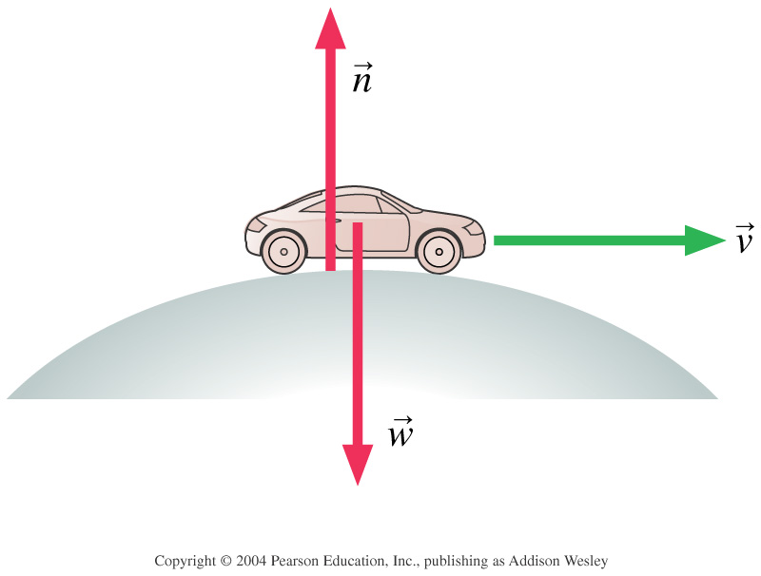
Clicker Question
A car is rolling over the top of a hill at speed v. At this instant,
n > F_{G}.
n < F_{G}.
n = F_{G}.
We can’t tell about n without knowing v.
Notes:
STT7.4
Answer: B

Slide 18
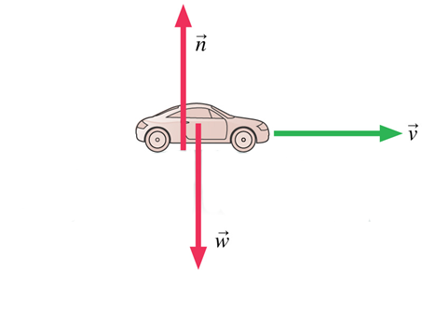
Clicker Question
A car is driving at the bottom of a valley at speed v. At this instant,
n > F_{G}.
n < F_{G}.
n = F_{G}.
We can’t tell about n without knowing v.
Notes:
STT7.4
Answer: B

Slide 19
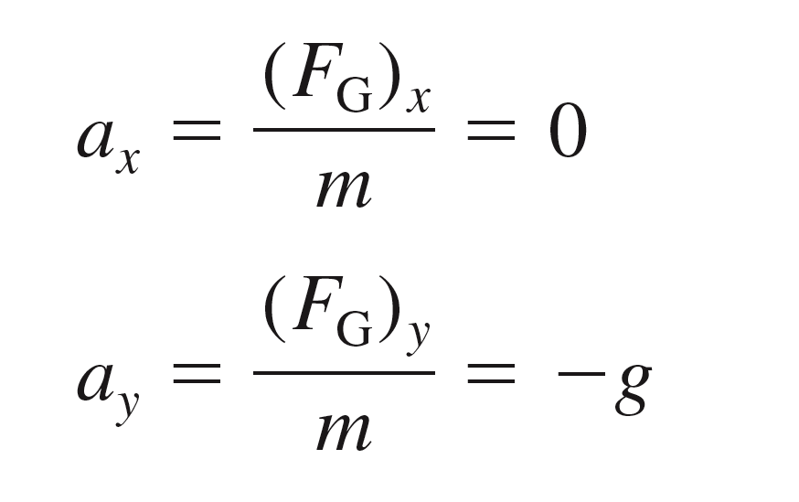
Projectile Motion
In the absence of air resistance, a projectile has only one force acting on it: the gravitational force, F_{G} = mg, in the downward direction. If we choose a coordinate system with a vertical y-axis, then
The vertical motion is free fall, while the horizontal motion is one of constant velocity.

Slide 20
A girl throws a ball in a horizontal direction (dashed line). After the ball leaves the girl’s hand, 1.0 seconds later it will have fallen
Clicker Question
A. 9.8 meters.
4.9 meters below the dashed line.
less than 4.9 meters below the straight-line path.
more than 4.9 meters below the straight-line path.

Slide 21
The Curvature of the Earth
Earth surface drops a vertical distance of 5 meters for every 8000 meters tangent to the surface.

Slide 22
Class 13 Preclass Quiz on MasteringPhysics
Student feedback:
“I don't really understand how an orbiting spacecraft is actually constantly in free fall...then wouldn't it fall down?”
Harlow answer: As it falls, it is moving so fast sideways, that the Earth curves away below it. It is moving at the exact right sideways speed so that the Earth is “curving away” at 9.8 m/s², so as it falls, it actually never gets closer to the surface!

Slide 23
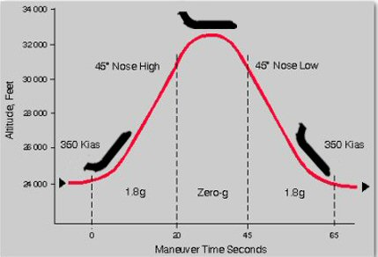
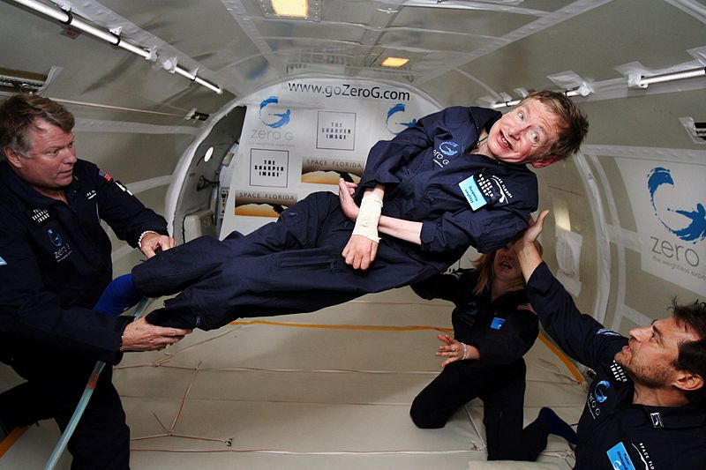
“Vomit Comet”
Physicist Stephen Hawking.

Slide 24
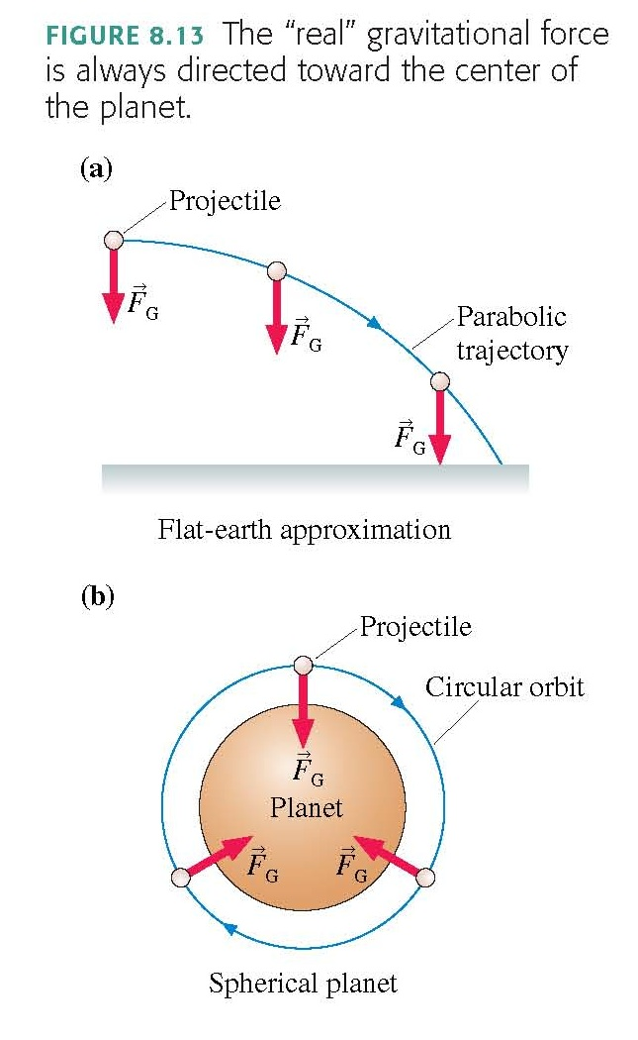

Slide 25
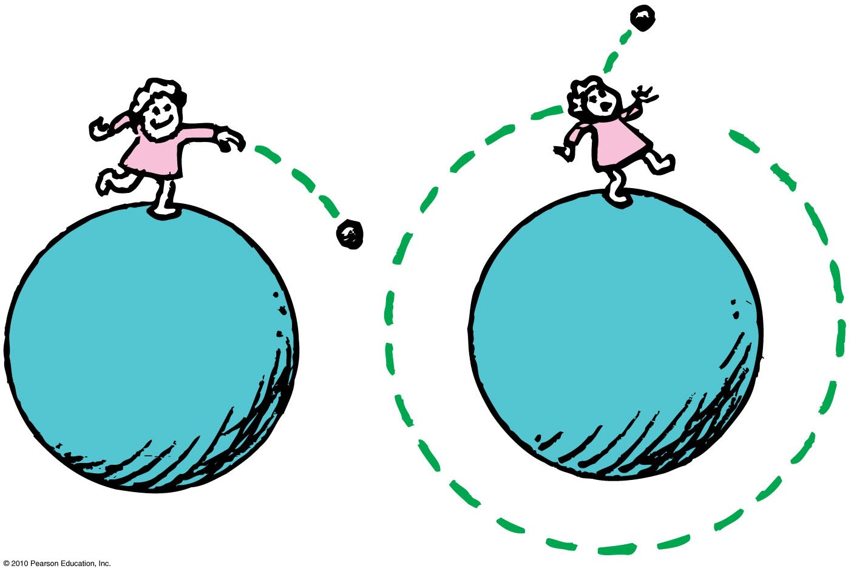
Circular Satellite Orbits
Satellite in circular orbit
Speed
must be great enough to ensure that its falling distance matches Earth’s curvature.
is constant—only direction changes.
is unchanged by gravity.

Slide 26
Example
How fast would you have to drive in order to be “weightless” – ie, no normal force needed to support your car?
How long would it take to drive around the world at this speed?

Slide 27
Circular Orbits
An object moving in a circular orbit of radius r at speed v_{orbit} will have centripetal acceleration of
That is, if an object moves parallel to the surface with the speed
then the free-fall acceleration provides exactly the centripetal acceleration needed for a circular orbit of radius r.
An object with any other speed will not follow a circular orbit.

Slide 28
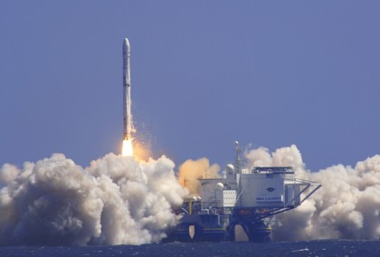
Why are communications satellites typically launched with rockets to heights of more than 100 km?
Clicker Question
To get outside Earth’s gravitational pull so the satellite doesn’t fall down
To get closer to the Sun in order to collect more solar power
To get above the Earth’s atmosphere in order to avoid air resistance
To get away from radio interference on Earth
Image from http://www.defenseindustrydaily.com/special-report-the-usas-transformational-communications-satellite-system-tsat-0866/
Image from http://www.zatznotfunny.com/2009-02/sirius-xm-headed-for-bankruptcy/ ]

Slide 29
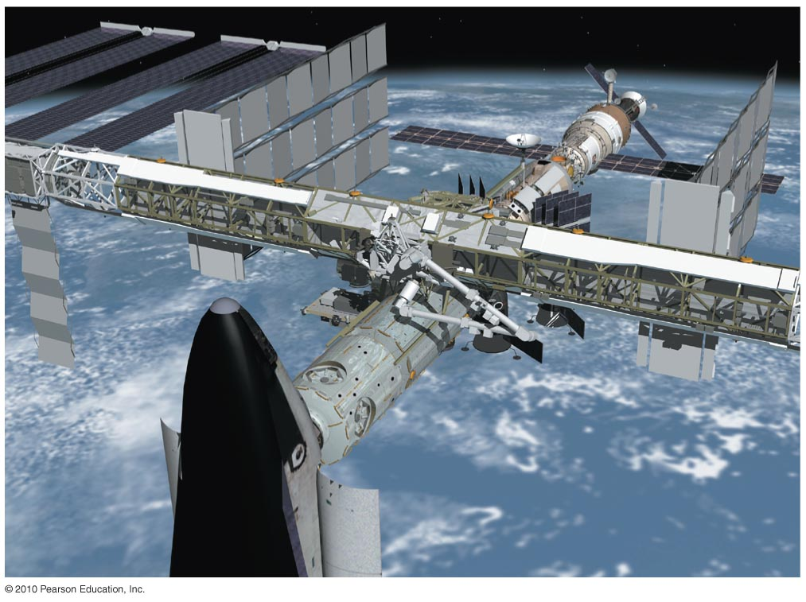
Circular Satellite Orbits
Positioning: beyond Earth’s atmosphere, where air resistance is almost totally absent
Example: Low-earth orbit communications satellites are launched to altitudes of 150 kilometers or more, in order to be above air drag
But even the ISS, as shown, experiences some air drag, which is compensated for with periodic upward boosts.

Slide 30
Before Class 14 on Monday
Please read the first three sections of Knight Chapter 9, and/or watch the Pre-Class Video, now on portal
MasteringPhysics Problem Set 6 is due on Monday evening.
It’s been a lot of fun – you are an excellent class!
I’ll be back! You will see me again in January for PHY132!
I hope you keep coming to my office hours T12-1 and F10-11 – I’d love to help!
The next test is Nov. 11 on Chs. 4-9, which includes forces and momentum!
And I will definitely see you at the Final Exam Dec. 15 2:00pm!
Image from http://wifflegif.com/tags/211457-i-ll-be-back-gifs

