Slide 1
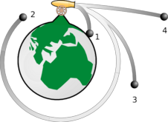
PHY131H1S Introduction to Physics I – Jason Harlow
Hello and welcome!
This is the first of a two-semester course to introduce physics to science students specializing disciplines other than physics.
This semester, we will study
Required Text: “Physics for Scientists and Engineers” 2nd Edition (Copyright 2008) by Randall Knight.

Slide 2
MEDICAL RADIATION SCIENCES PROGRAM Open house
Tonight: January 10, 2011 5pm – 7pm
The Michener Institute for Applied Health Sciences
222 St. Patrick Street, Toronto, Ontario
Food and Refreshments provided
Pre-register for our guided tours by visiting:
http://www.michener.ca/radsci/form.php
Guided tours every 30 minutes
Career opportunity info
In-depth info on our three program disciplines: Nuclear Medicine, Radiation Therapy and Radiological Technology
UNIVERSITY OF TORONTO/ THE MICHENER INSTITUTE
JOINT MEDICAL RADIATION SCIENCES DEGREE/ DIPLOMA PROGRAM
416-978-7837 email: hrocha@michener.ca
website: http://www.utoronto.ca/radiationsciences/

Slide 3
Welcome - please make yourself comfortable!
I am Jason Harlow. Here are some ways to reach me:
Telephone: 416-946-4071
Office: MP129-A
Email: jharlow at physics dot utoronto dot ca
Course web page is on http://portal.utoronto.ca Important course materials and links are all available on this web-site.
Make sure you get the one-page hand-out!

Slide 4
Class Participation will be measured using “i>clickers” – you can buy one at the bookstore for $42 new, or $32 used.
You will use your clicker every Monday and Wednesday class beginning this Wednesday. Don’t forget it!
If you can’t come, please do NOT ask a friend to bring your clicker for you!!

Slide 5
What is Physics?
Randall Knight, the author of the course textbook, states that Physics is
It is
This course has a bad reputation for being hard, but
The trick is to treat Physics Problem-Solving as Focus on the rather than memorizing equations.

Slide 6
About Learning Physics
In PHY131S, tests and the exam will involve
Each concept This will continue into the second half of the full course:
Assimilating any concept
Keep up with your studies.
The “last minute cram” before a test or exam is

Slide 7
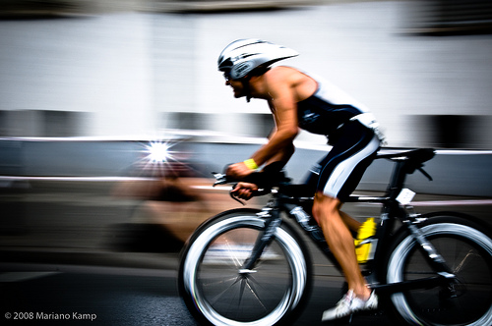
Today.. Motion!

Slide 8
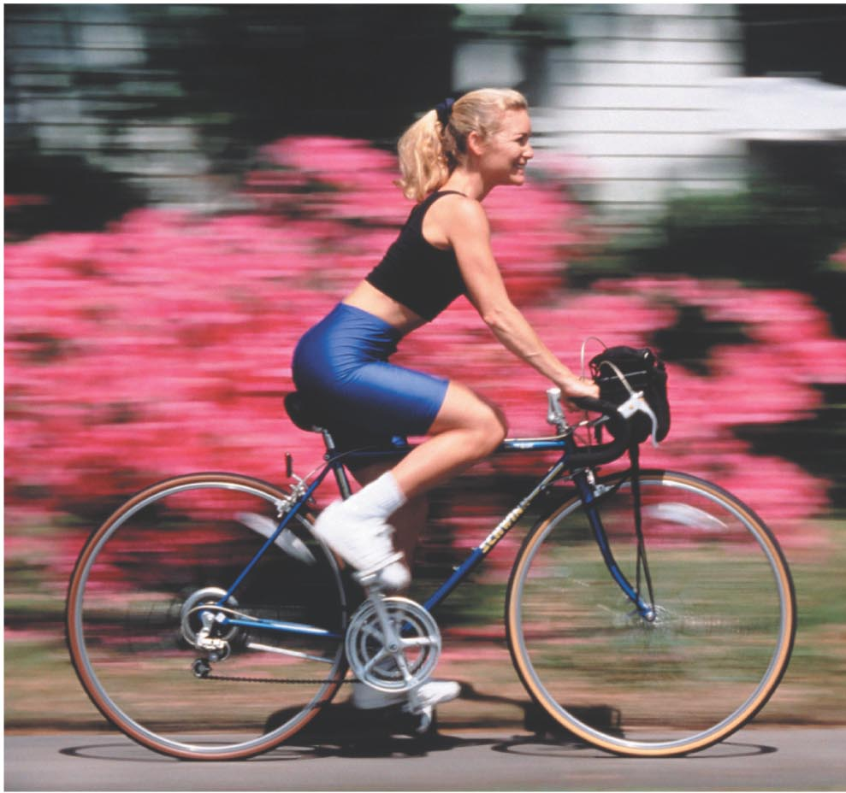
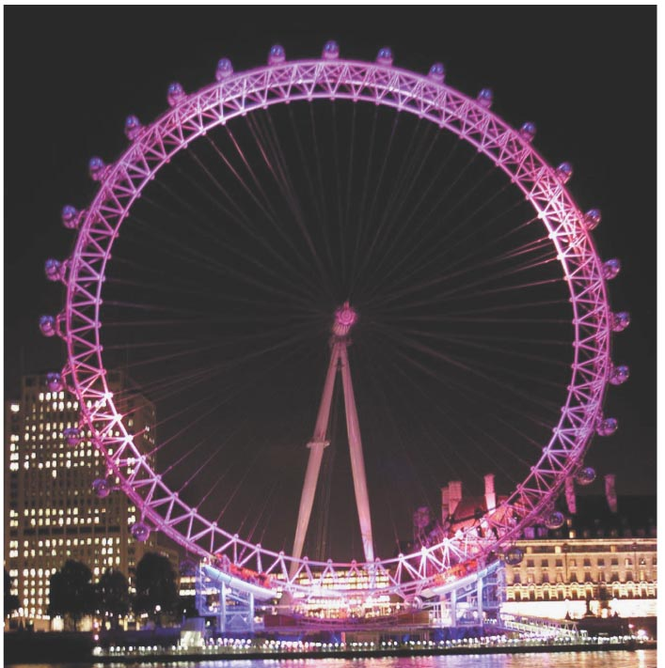
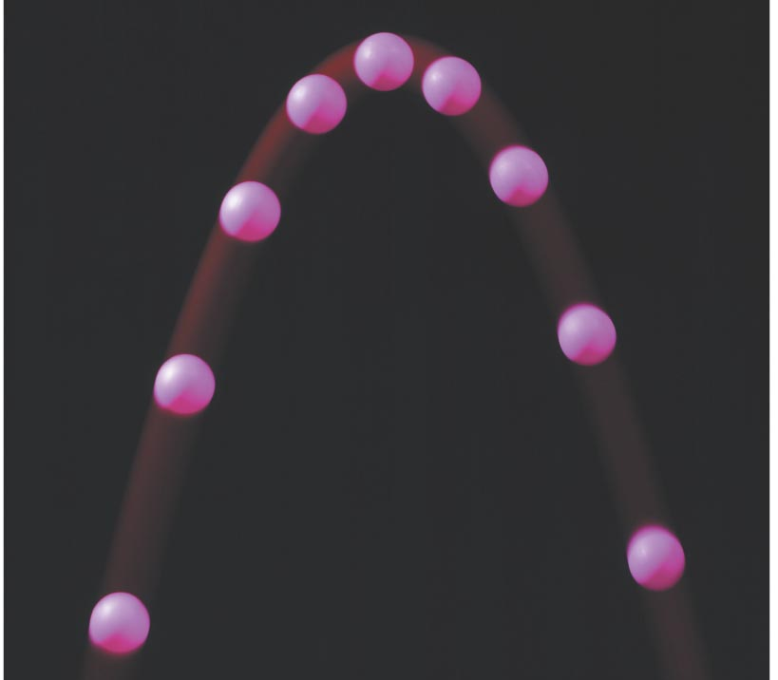
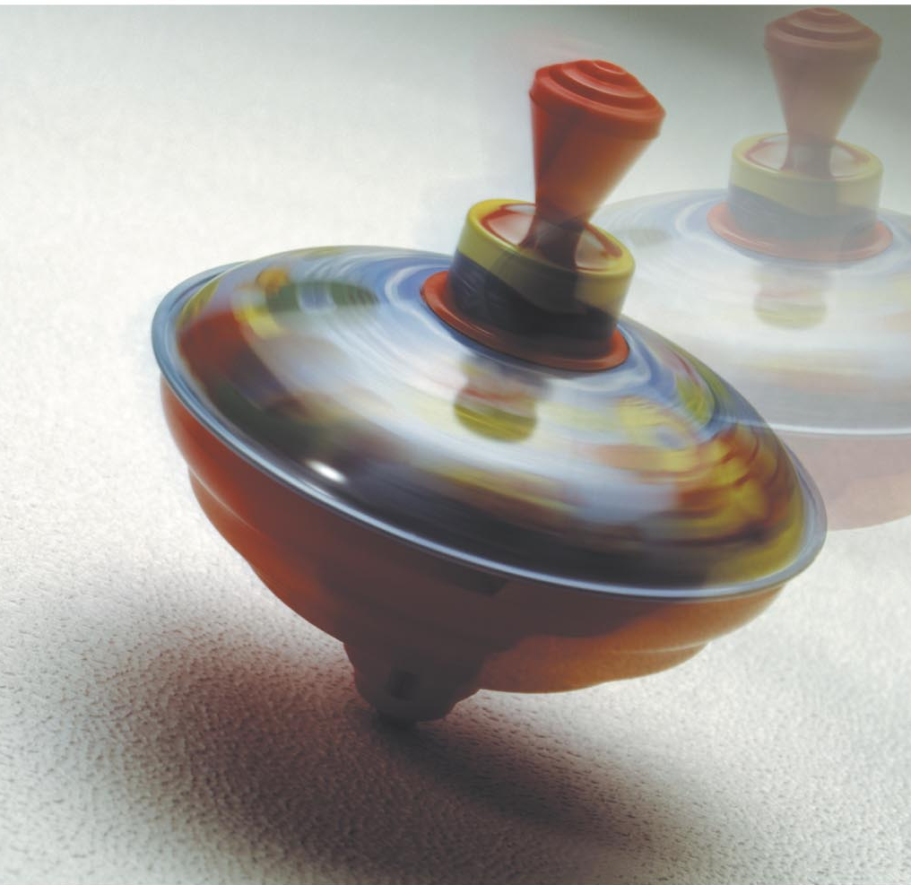

Slide 9
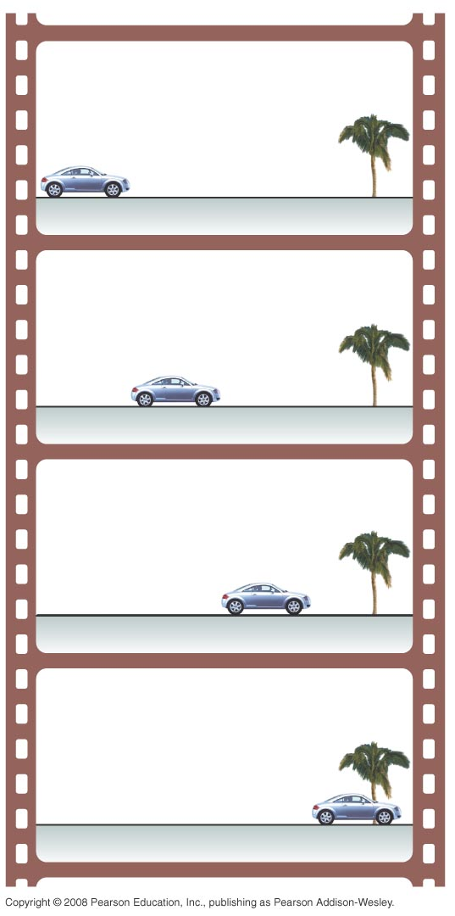
Making a Motion Diagram
An easy way to study motion is to
A movie camera takes
typically 30 photographs every second. Each separate photo is

Slide 10
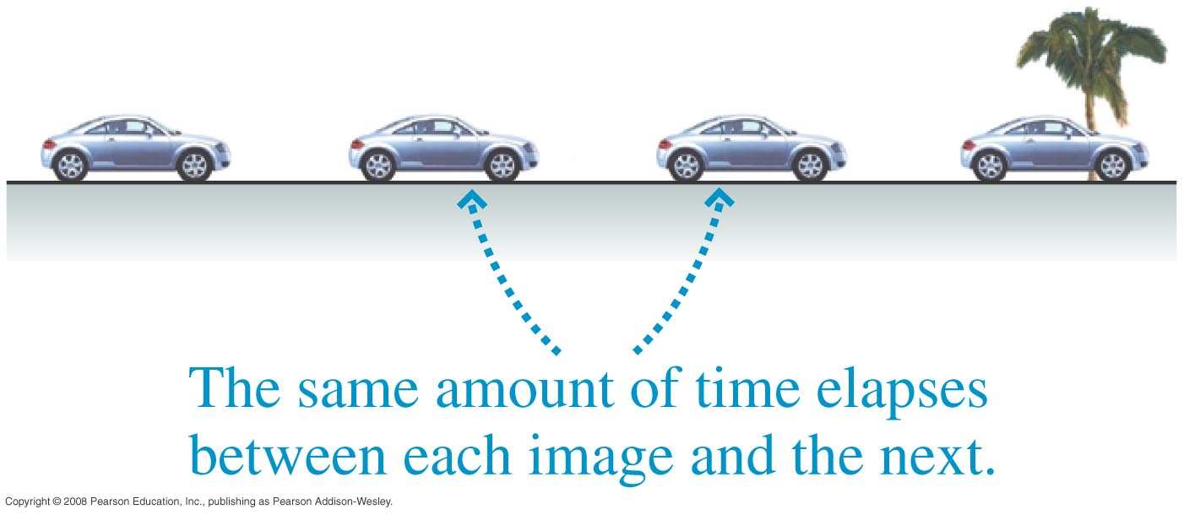
Making a Motion Diagram
Suppose
and project the entire stack at once onto a screen for viewing. The result is shown. This composite photo, showing an object’s position at several equally spaced instants of time, is called a

Slide 11
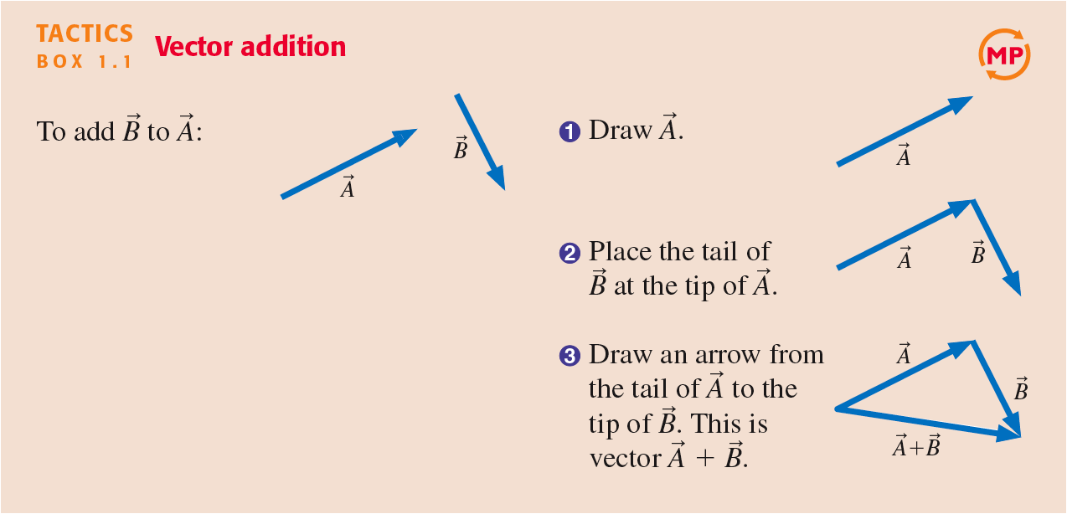
Tactics:

Slide 12
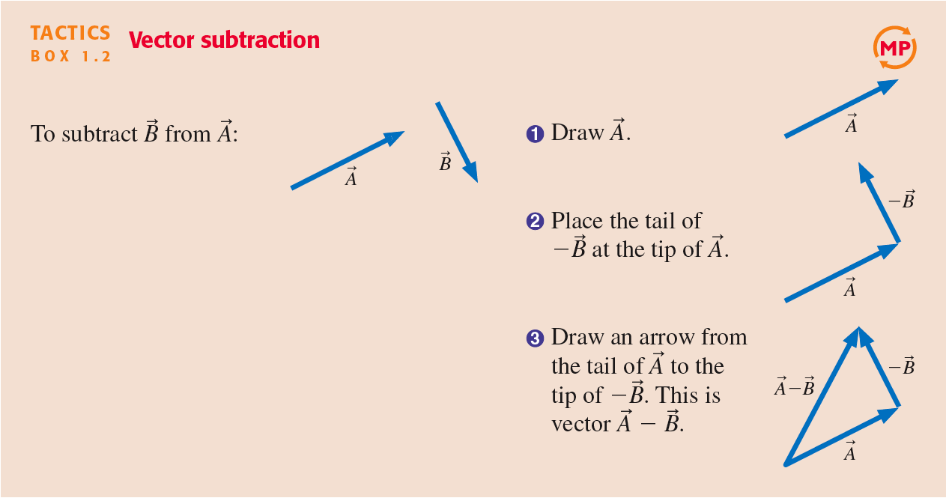
Tactics:

Slide 13
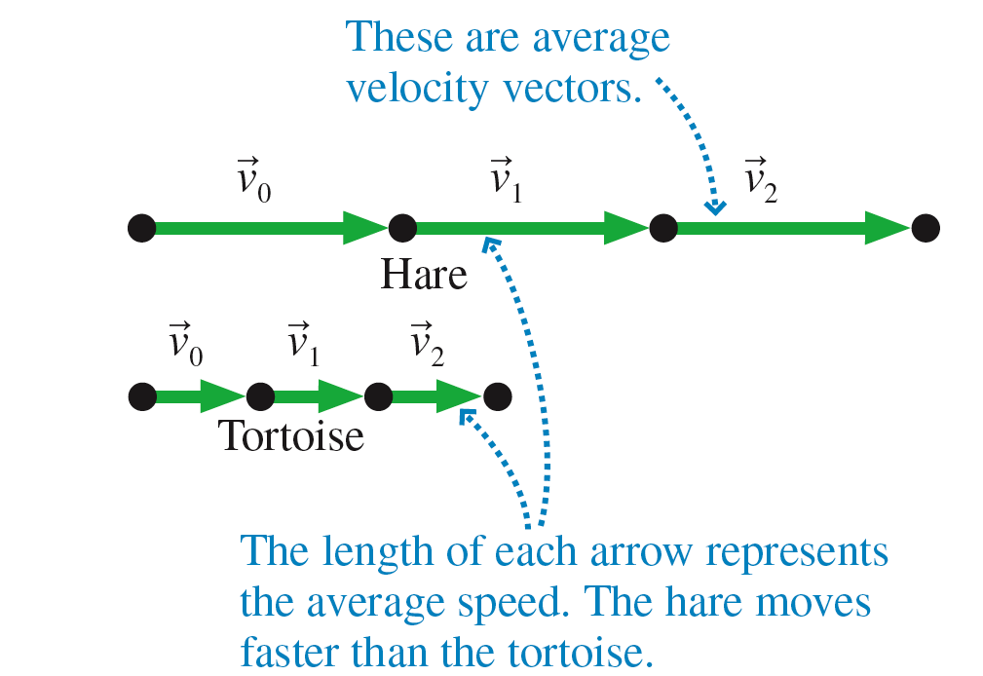
Motion Diagrams with

Slide 14
Before Class 2 on Wednesday
Please download and read the Course Outline, and the Preface, Introduction, and Chapter 1 of Knight
Establish your MasteringPhysics account
Register your clicker with your 9-digit Student Number at www.iclicker.com
(Note, you can register your clicker later in the semester and you will still get marks for the classes you attended before you registered.)

