Slide 1
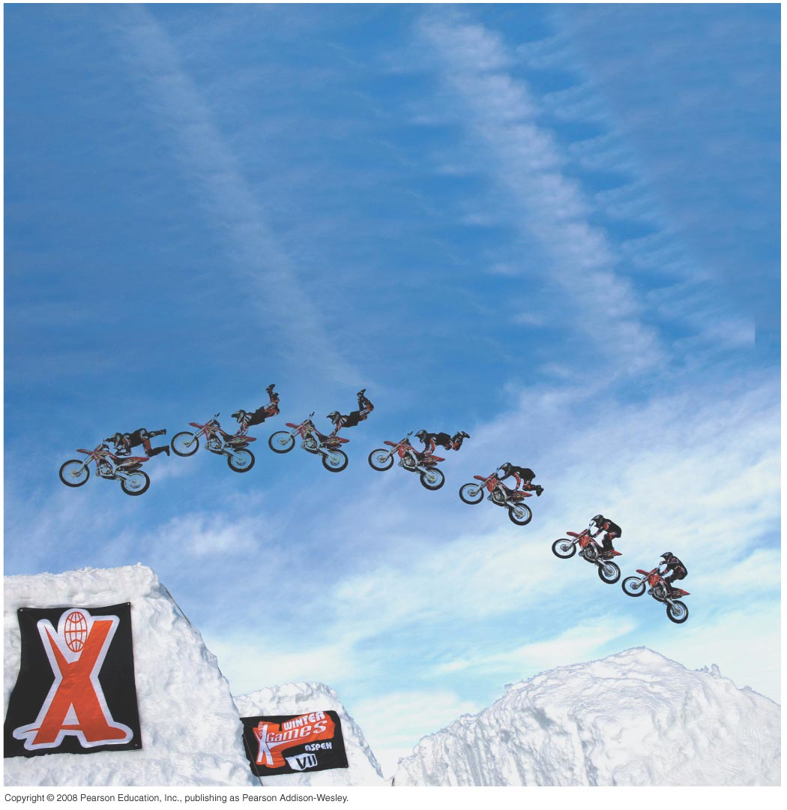
PHY131H1S – Introduction to Physics I Class 2
Today: finishing Chapter 1.
Position, velocity, and acceleration
Problem solving
Scaling
Significant Figures

Slide 2
Pre-Class Reading Quiz
Which car is going faster, A or B?
(Assume these are both motion diagrams.)
A
B
Notes:
Answer: B

Slide 3
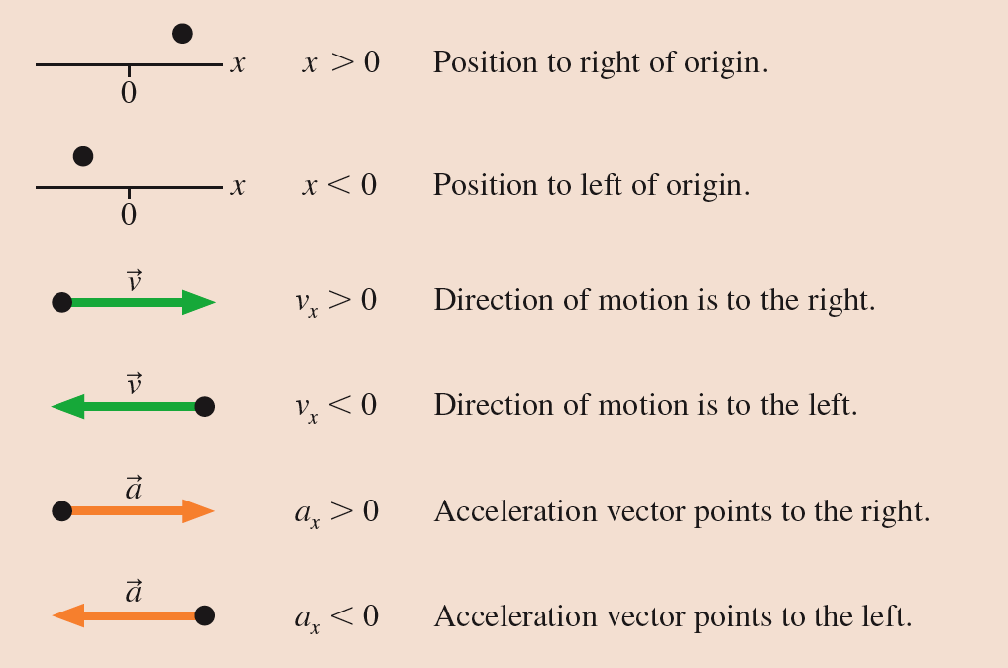
Tactics: Finding the acceleration vector

Slide 4
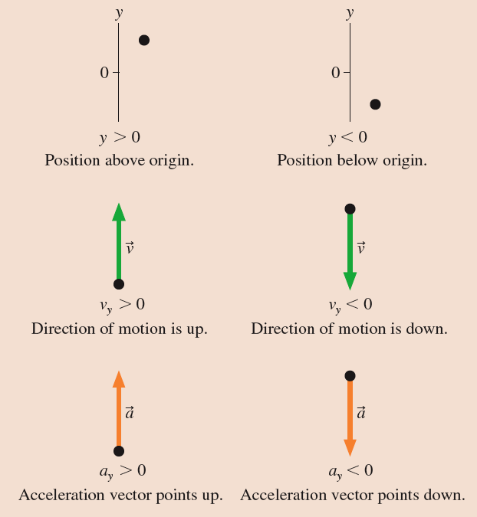
Tactics: Finding the acceleration vector

Slide 5
Tactics: Finding the acceleration vector

Slide 6
In Class Question:
A particle undergoes acceleration while moving from point 1 to point 2. Which of the choices shows the velocity vector as the object moves away from point 2?
Notes:
Answer: C

Slide 7
A ball rolls up a ramp, and then down the ramp. We keep track of the position of the ball at 6 instants as it climbs up the ramp. At instant 6, it stops momentarily as it turns around. Then it rolls back down. Shown below is the motion diagram for the final 6 instants as it rolls the ramp.

Slide 8
A ball rolls up a ramp, and then down the ramp. We keep track of the position of the ball at 6 instants as it climbs up the ramp. At instant 6, it stops momentarily as it turns around. Then it rolls back down. Shown below is the motion diagram for the final 6 instants as it rolls the ramp.

Slide 9
In Class Question:
Rank in order, from the most to the least, the number of significant figures in the following numbers.
a = b = d > c
b = d > c > a
d > c > b = a
d > c > a > b
b > a = c = d
Notes:
Answer: C

