Slide 1
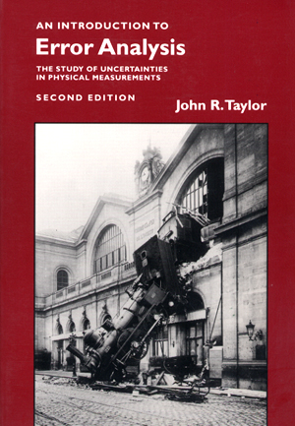
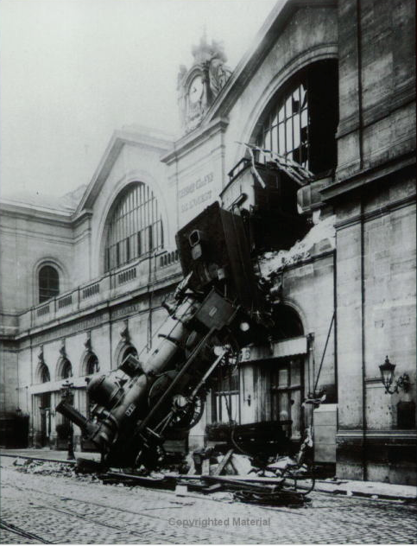
PHY131H1S Class 3
Today: Error Analysis
Significant Figures
Repeated measurements
Normal Distribution
Standard Deviation
Reading Error
Propagation of Errors
Error in the Mean

Slide 2
Pre-class reading quiz

Slide 3
Last Wednesday I asked at the end of class:
If your height is 150 cm, is there an error in that number?
ANSWER:

Slide 4
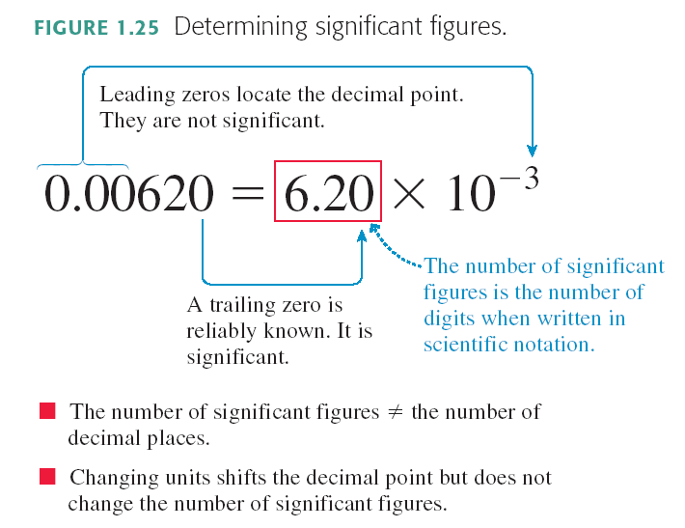
From Knight Chapter 1:

Slide 5
In Class Question:
Rank in order, from the most to the least, the number of significant figures in the following numbers.
a = b = d > c
b = d > c > a
d > c > b = a
d > c > a > b
b > a = c = d
Notes:
Answer: C

Slide 6
Two Kinds of Statements
Exact
(math)
(definition)
Approximate
(any physical law)
(all numerical measures of the universe)
Today: approximate statements

Slide 7
Period of a Pendulum
Procedure: Measure the time for 5 oscillations, t₅.
The period is calculated as T = t₅ / 5.
t₅ data:

Slide 8
Here were Harlow’s measurements of t₅:
Which of the following might be a good estimate for the error in Harlow’s first measurement of seconds?
s
s
s
s
Impossible to determine

Slide 10
7.53 s
7.38 s
7.47 s
7.43 s
7.44 s
7.56 s
7.48 s
7.40 s

Slide 14
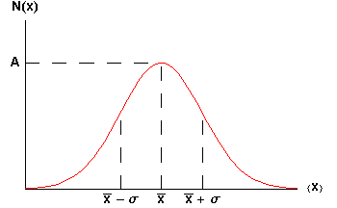
The Gaussian:
of data between the dotted lines on the graph.

Slide 15
of some People (London, 1886)
Gaussian Distributions turn up everywhere!
inches

Slide 16
Random Walk
Where does an object end up, if it takes N steps randomly left or right?
The final distribution is described by
!

Slide 17
The t₅ data
Numerically:
+ 0.06 s + 0.06 s + 0.06 s + 0.06 s

Slide 18
Propagation of Errors
z = A x
Δz = A Δx

Slide 19
Repeated Measurements
Repeated n times
Each individual measurement has an error of precision Δx

Slide 20
You wish to know the time it takes to travel from Finch station to Yonge/Bloor by subway. You ask 10 people to take a stopwatch and time the trip. After analyzing all the data you find that it takes an average of 26 minutes and 40 seconds, with an error in this average of ± 100 seconds.

Slide 21
Before Class 4 on Wednesday
Please read Chapter 2 of Knight.
Something to think about: Does constant velocity imply constant acceleration? Does constant acceleration imply constant velocity?

