Slide 1
PHY131H1S Class 4
Today, Chapter 2!
Constant Velocity Motion
Constant Acceleration Motion
Freefall, Motion on an inclined plane

Slide 2
Pre-class reading quiz

Slide 3
Practicals
Note that practicals begin this week.
You will be sitting with 3 other people from this course, and the 4 of you will form a team.
You will be working on practicals activities together
Teams are scrambled after Reading Week.
My message: “You are not alone!” Don’t try to get through this course all by yourself!

Slide 4
Last day I asked at the end of class:
Does constant velocity imply constant acceleration?
ANSWER:
Does constant acceleration imply constant velocity?
ANSWER:

Slide 5
Instantaneous Acceleration
The instantaneous acceleration a_{s} at a specific instant of time t is given by the derivative of the velocity
Note: Knight uses “s” to denote a distance in a general direction. Usually in problems we substitute x or y instead of s.

Slide 6
Finding Velocity from the Acceleration
If we know the initial velocity, v_{is}, and the instantaneous acceleration, a_{s}, as a function of time, t, then the final velocity is given by
Or, graphically,

Slide 7
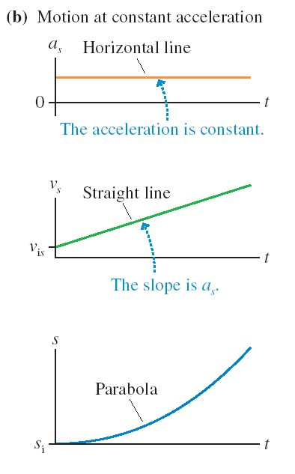

Slide 8
Which velocity-versus-time graph goes best with the position-versus-time graph on the left?
Notes:
Answer: C

Slide 9
Which position-versus-time graph goes with the velocity-versus-time graph at the top
Notes:
Answer: B

Slide 10
Which velocity-versus-time graph or graphs goes with this acceleration-versus-time graph?
Notes:
Answer: B

Slide 11
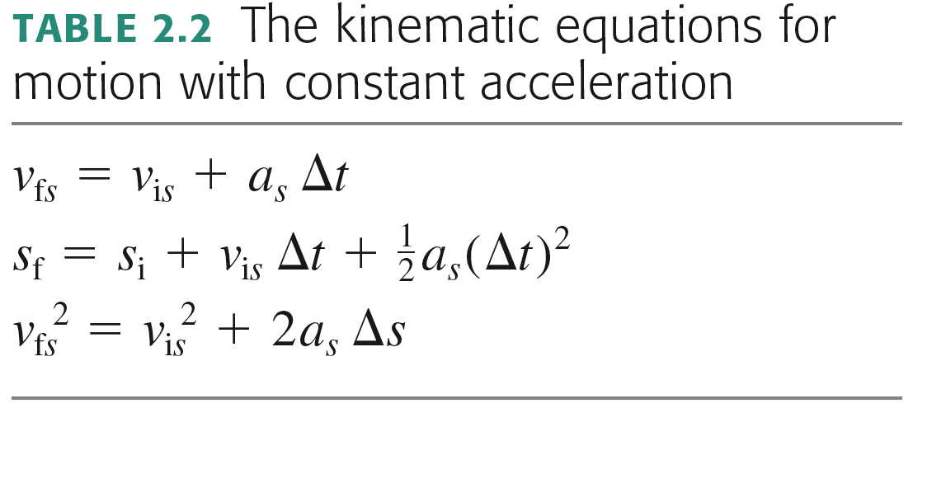
Motion with Constant Acceleration
Strategy: When a = constant, you can use one of these equations. Figure out which variable you don’t know and don’t care about, and use the equation which doesn’t contain it.

Slide 12
The Physics of Superheroes
©2009 by James Kakalios available at Chapters.ca for $15
In the original comic, Superman only had super-strength and very tough skin!
He could “leap tall buildings in a single bound.”
It was not until the 1940s that the writers changed his abilities to included guided flying.

Slide 13
Example Question.
Superman’s parents came from a planet where the gravity was much stronger. His race has legs strong enough to jump to a maximum height of 1.0 m on planet Krypton.
On Earth, Superman can jump to a maximum height of 25 m. (a tall building in 1938!)
What was the acceleration due to gravity on planet Krypton?

Slide 14
Example Question & Demo – using Error Analysis.
A small object is dropped from a height of y_{i} = 3.00 ± 0.01 m. y_{f} = 0 m.
The time of flight is Δt ± σ_{t}.
Estimate g in this room.
MODEL: Neglect air resistance: a = −g. This is called “free-fall”

Slide 15
Propagation of Errors
Sum rule:
Product rule:
Multiplying by exact constant:
z = A x
Δz = A Δx
Power rule:

Slide 16
Before Class 5 on Monday
Please read Chapter 3 of Knight.
Something to think about: Can you add a scalar to a vector? Can you multiply a vector by a scalar?

