Slide 1
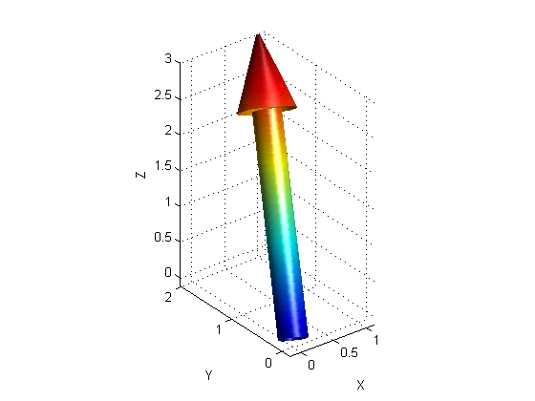
PHY131H1S - Class 5
Today:
Scalars and vectors
Coordinate systems, Components
Vector Algebra

Slide 2
Pre-class Reading Quiz. (Chapter 3)
Notes:
Answer: A

Slide 3
Last day I asked at the end of class:
Can you add a scalar to a vector?
ANSWER:
Can you multiply a vector by a scalar?
ANSWER:

Slide 4
Recall demonstration from last class:
Harlow dropped a ball from a height of y_{i} = 3.0 ± 0.01 m. Time of fall was
We also found that g is related to y_{i} and t by the equation: g = 2y_{i}/t². But how do you find the error?
I used three steps:
Find error in z = t² using Δt =
Find error in w = y_{i}/z using Δy_{i}, Δz and the product rule:
Find error in g = 2w using Δw and the multiply by exact constant rule:
Result:

Slide 5
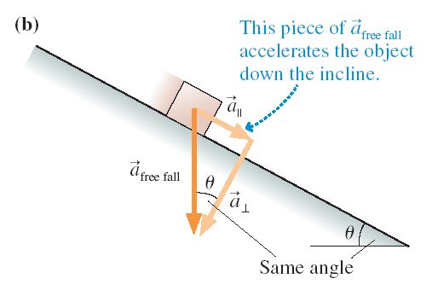
Motion on an Inclined Plane

Slide 6
The ball rolls up the ramp, then back down. Which is the correct acceleration graph?
Notes:
Answer: D

Slide 8
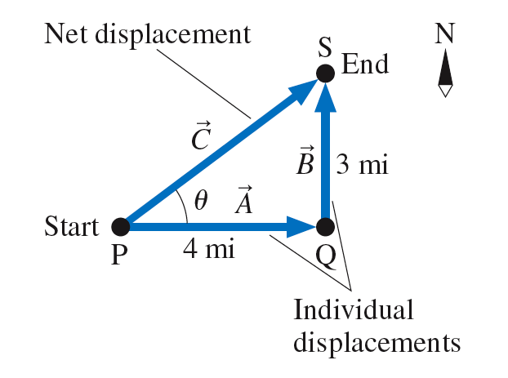

Slide 9
Which figure shows ?
Notes:
Answer C

Slide 10
Which figure shows 2 − ?
Notes:
Answer A

Slide 11
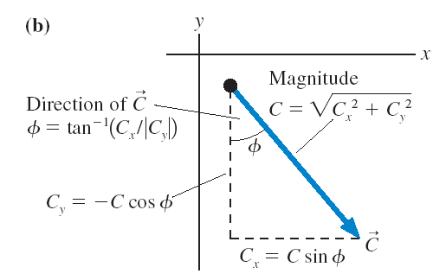

Slide 13
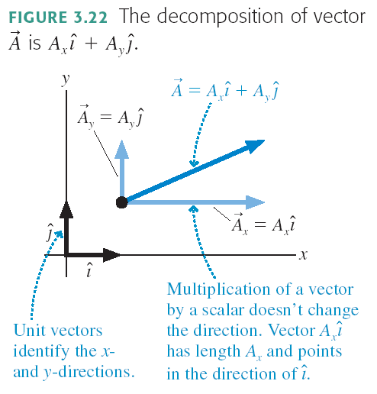

Slide 14
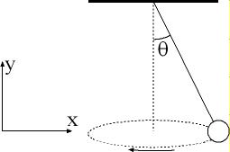
Example from a previous PHY131 Mid-Term Test
A ball is suspended on a string, and moves in a horizontal circle as shown in the figure. The string makes a constant angle θ = 10.0 degrees with the vertical. The tension in the string is 8.46 N, and the force of gravity on the ball is 8.33 N, in the negative-y direction. What is the net force on the ball?

Slide 15
Before Class 6 on Wednesday
Please read Chapter 4, sections 4.1 through 4.4
Something to think about: One bullet is fired horizontally at a very high speed. The other bullet is initially at rest, but is dropped at the exact same moment the first bullet is fired. Which bullet hits the ground first?

