Slide 1
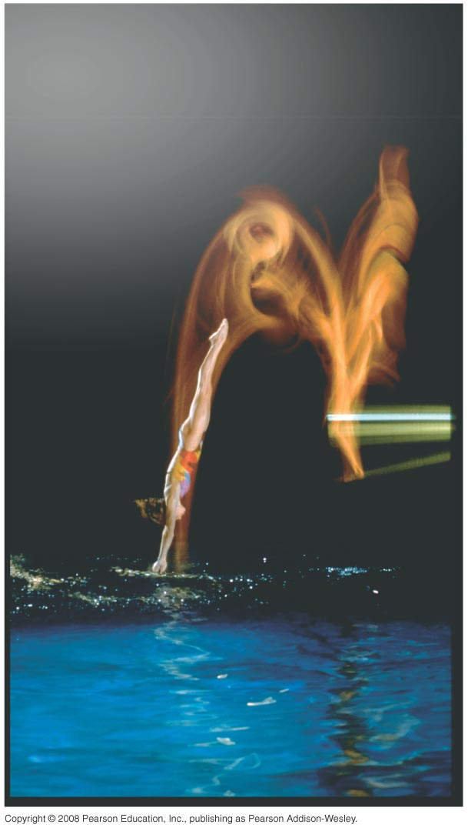
PHY131H1S - Class 6
Today:
Kinematics in One Dimension
Kinematics in Two Dimensions
Projectile Motion
Relative Motion
MasteringPhysics Problem Set 2 due today, before 11:59pm.

Slide 2
Pre-class Reading Quiz. (Chapter 4)
Notes:
Answer: A

Slide 3
Last day I asked at the end of class:
One bullet is fired horizontally at a very high speed. The other bullet is initially at rest, but is dropped at the exact same moment the first bullet is fired. Which bullet hits the ground first?
ANSWER:
x-motion and y-motion are independent of each other. All projectiles have

Slide 4
Horizontal Acceleration Example
v
A car starts from rest, then drives to the right. It speeds up to a maximum speed of 30 m/s. It coasts at this speed for a while, then the driver hits the brakes, and the car slows down to a stop.

Slide 5
Vertical Acceleration Example (freefall)
A ball starts with an upward velocity, reaches a maximum height, then falls back down again.
v

Slide 6
Acceleration in 2-D
The average acceleration of a moving object is defined as the vector
As an object moves, its velocity vector can change in two possible ways:
The
The
…or both!

Slide 7
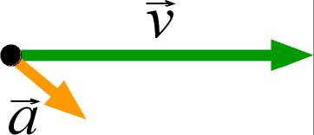
This acceleration will cause the particle to
Notes:
Answer: A

Slide 8
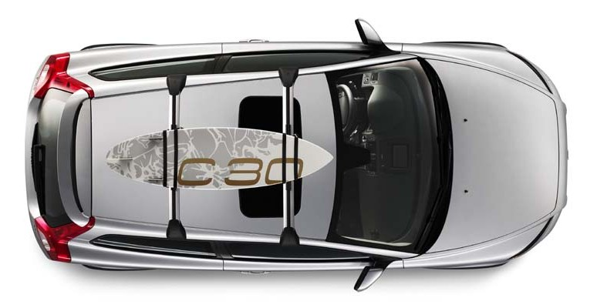
A car is traveling East at a constant speed of 100 km/hr. Without speeding up of slowing down, it is turning left, following the curve in the highway. What is the direction of the acceleration?
N
W
E
S

Slide 9
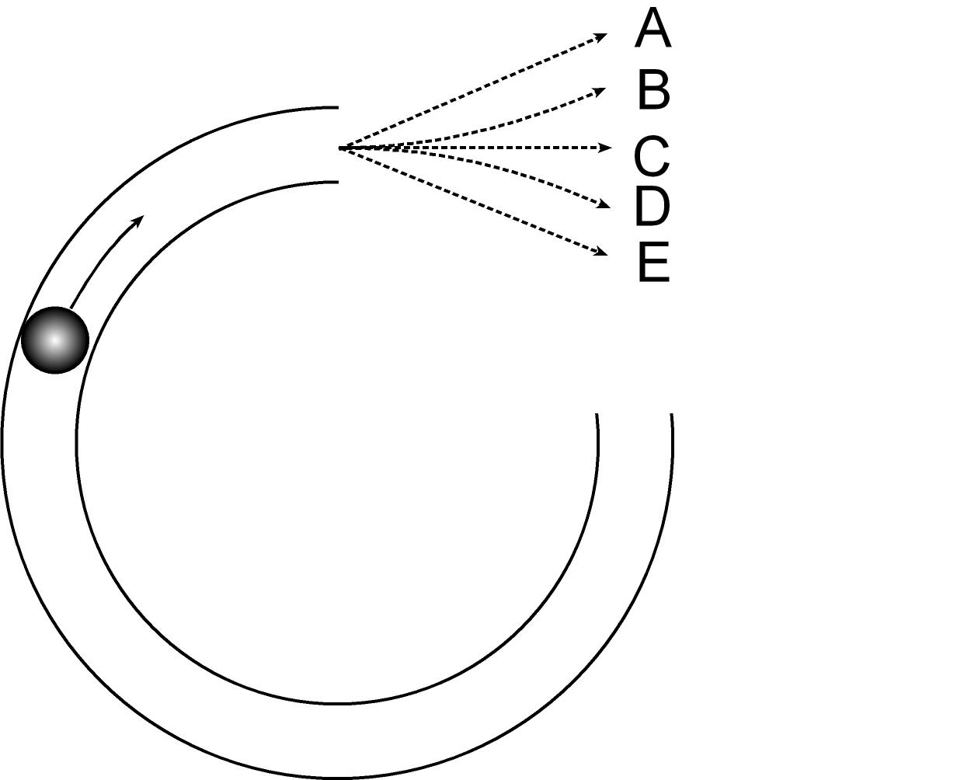
A ball rolls along a frictionless track on a horizontal table, as seen from above in the figure. The track is curved in ¾ of a circle. The ball rolls clockwise around this track and then emerges onto the flat, frictionless table.

Slide 10
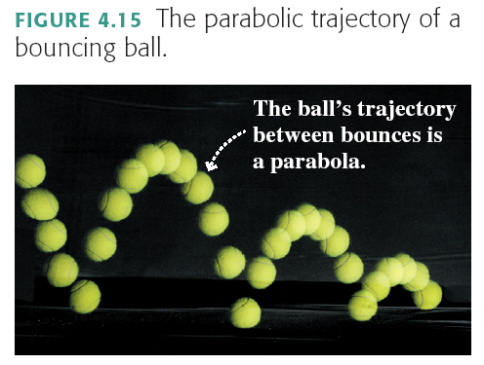
Projectile Motion

Slide 11
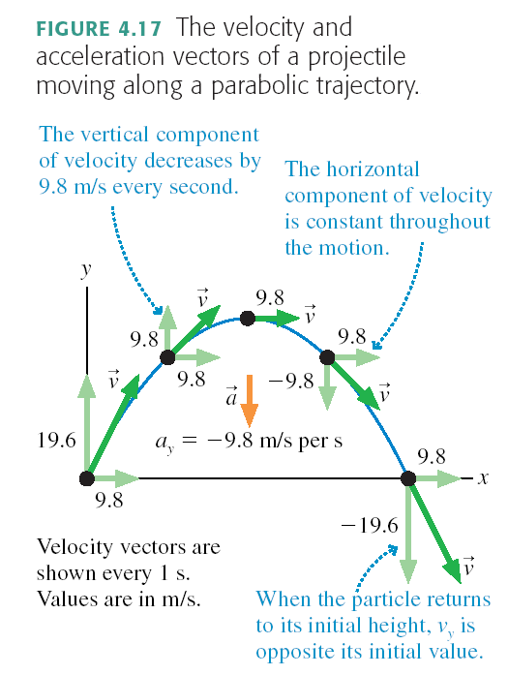

Slide 12
Projectile Motion
Projectile motion is made up of two independent motions: uniform motion at constant velocity in the horizontal direction and free-fall motion in the vertical direction. The kinematic equations that describe these two motions are

Slide 13
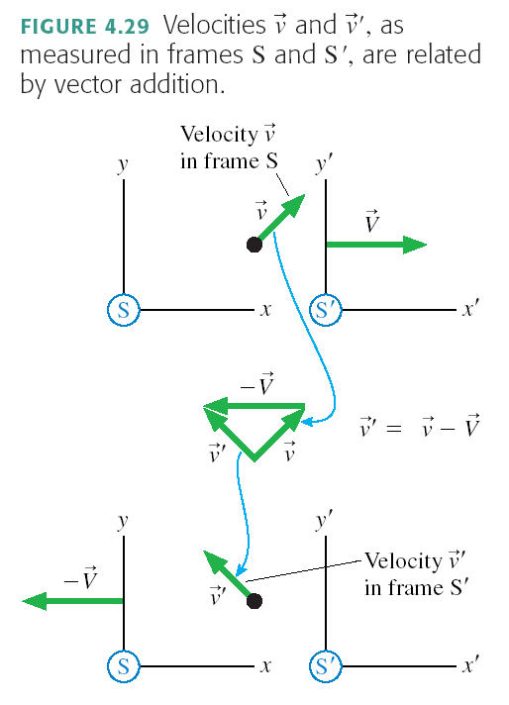
Relative Motion

Slide 14
Relative Motion
If we know an object’s velocity measured in one reference frame, S, we can transform it into the velocity that
would be measured by an experimenter in a different reference frame, S´, using the Galilean transformation of velocity.
Or, in terms of components,

Slide 15
Before Class 7 on Monday
Remember there is a MasteringPhysics.com problem set due today. If you haven’t already done it, please submit this before 11:59pm tonight.
Please finish reading Chapter 4.
Something to think about: You are driving North Highway 427, on the smoothly curving part that will join to the Westbound 401. Your speedometer is constant at 115 km/hr. Your steering wheel is not rotating, but it is turned to the left to follow the curve of the highway. Are you accelerating? If so, in what direction?

