Slide 1
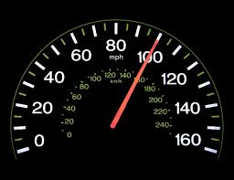
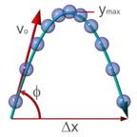
PHY131H1S - Class 7
Today:
Review for tomorrow’s test
In EX100, 6:00 – 7:30pm
On Chapters 1-3, Error Analysis Mini-Document, and Sections 4.1 through 4.4.
Bring a calculator and one 8.5x11’ aid sheet which you prepare, double-sided

Slide 3
A particle moves
Notes:
Answer: E

Slide 5
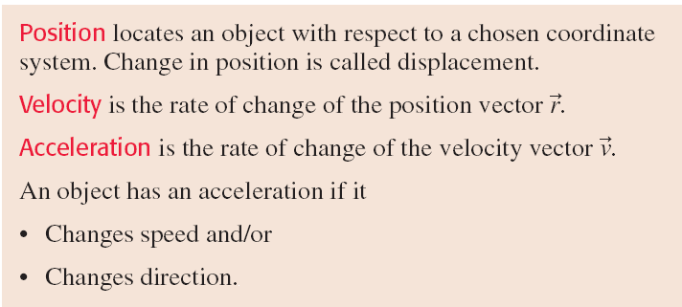

Slide 8
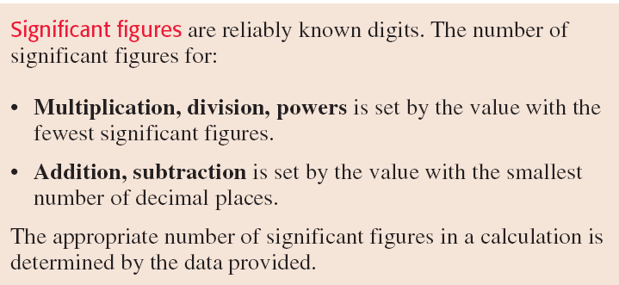

Slide 9
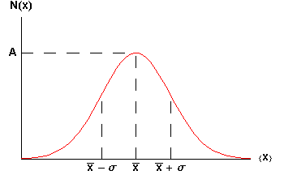
The Gaussian:
68% of data between the dotted lines on the graph.

Slide 10
Mean and Standard Deviation of a set of numbers
Repeat the same measurement N times. You measure the values x₁, x₂, x₃, …, x_{N}. In other words, you measure x_{i}, where i is an index which ranges from 1 up to N.
The estimated mean is
The estimated standard deviation is
You can estimate that σ is the error in any individual measurement x_{i} : Δx_{i} = σ.

Slide 11
Propagation of Errors
z = A x
Δz = A Δx

Slide 12
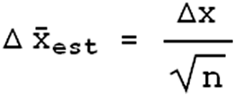
Repeated Measurements
Repeated n times
Each individual measurement has an error of precision Δx

Slide 13
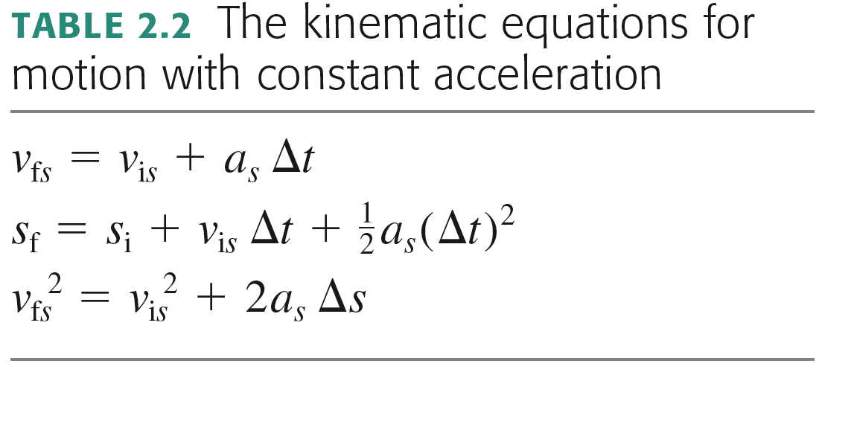
Motion with Constant Acceleration: another useful equation!
Does not contain s_{i} or s_{f} !
Does not contain v_{fs} !
Does not contain Δt !
Does not contain a_{s}! (..but it does require that a_{s} is a constant.)
This is just the average speed.

Slide 14
Projectile Motion Example
A car drives off a cliff of height d with speed v₀.
The ground is horizontal both at the top and bottom of the cliff.
How far from the base of the cliff does the car land?

Slide 15
Before Class 8 on Wednesday
Test is tomorrow! EX100, 6:00pm.
On Chs. 1-3, Error Analysis, and Sections 4.1 through 4.4.
Bring a calculator and one 8.5x11’ aid sheet which you prepare, double-sided
By Wednesday, please finish reading Chapter 4
Something to think about: You are driving North Highway 427, on the smoothly curving part that will join to the Westbound 401. Your speedometer is constant at 115 km/hr. Your steering wheel is not rotating, but it is turned to the left to follow the curve of the highway. Are you accelerating? If so, in what direction?

