Slide 1
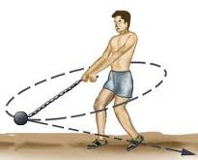
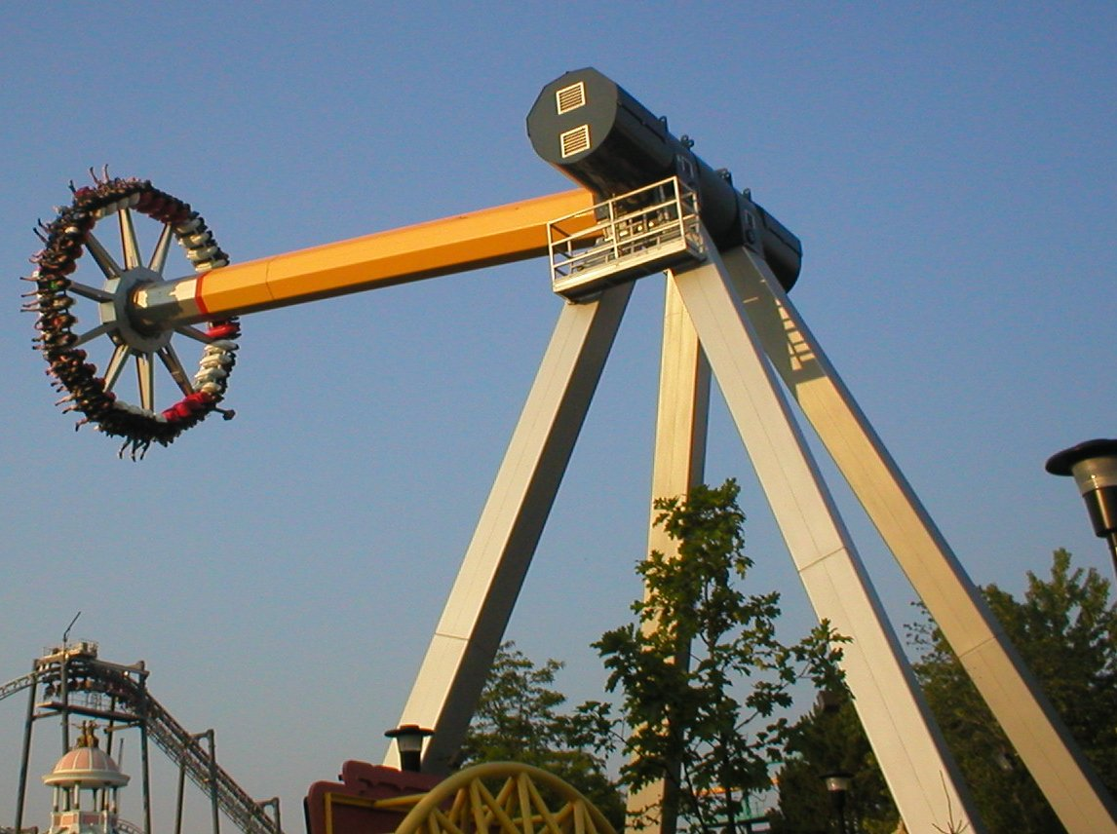
PHY131H1S - Class 8
Today:
Circular Motion
Rotation

Slide 2
Pre-class Reading Quiz. (Chapter 4)
Notes:
Answer: A

Slide 3
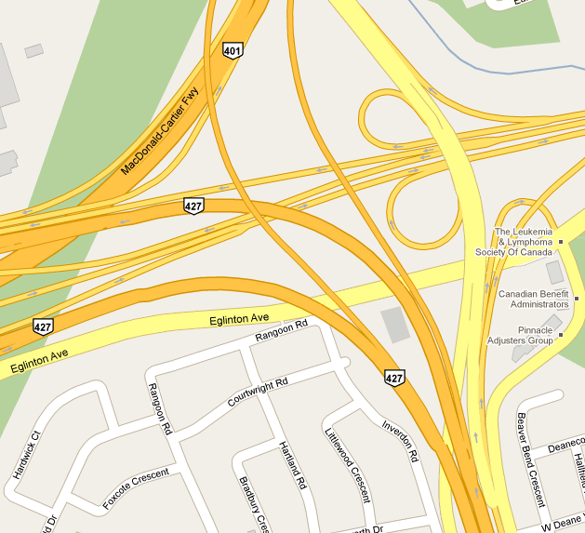
Last day I asked at the end of class:
You are driving North Highway 427, on the smoothly curving part that will join to the Westbound 401. Your speedometer is constant at 115 km/hr. Your steering wheel is not rotating, but it is turned to the left to follow the curve of the highway. Are you accelerating?
ANSWER:
If so, in what direction?
ANSWER:

Slide 4
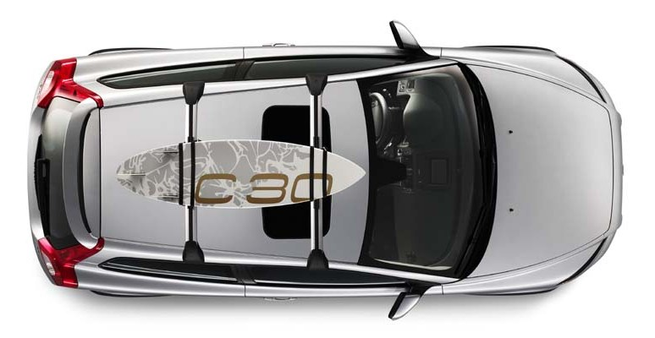
A car is traveling East at a constant speed of 100 km/hr. Without speeding up of slowing down, it is turning left, following the curve in the highway.
N
W
E
S

Slide 5
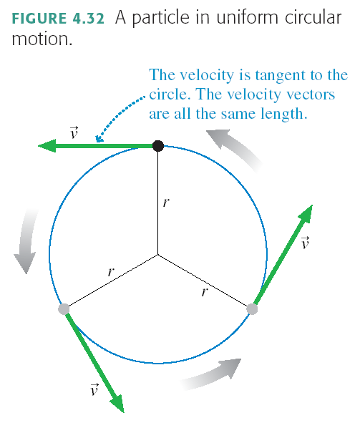

Slide 6
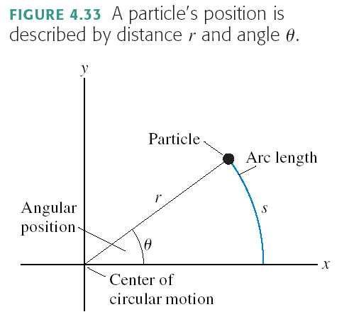

Slide 7
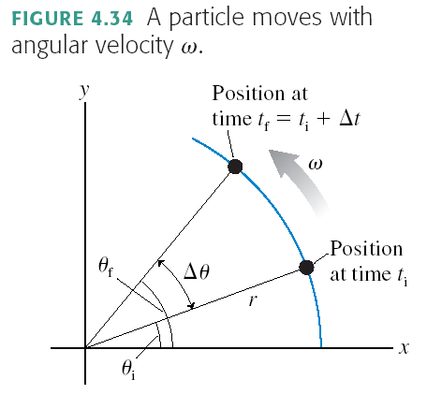

Slide 8
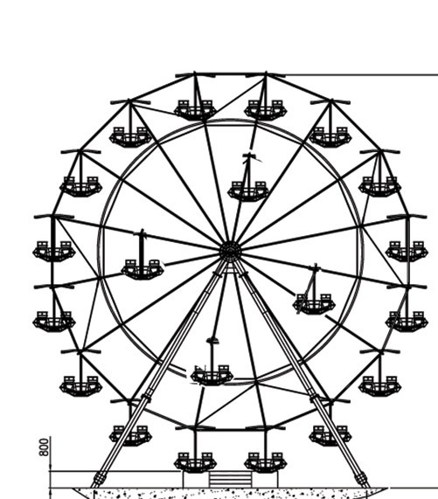
A carnival has a Ferris wheel where some seats are located halfway between the center and the outside rim.

Slide 9
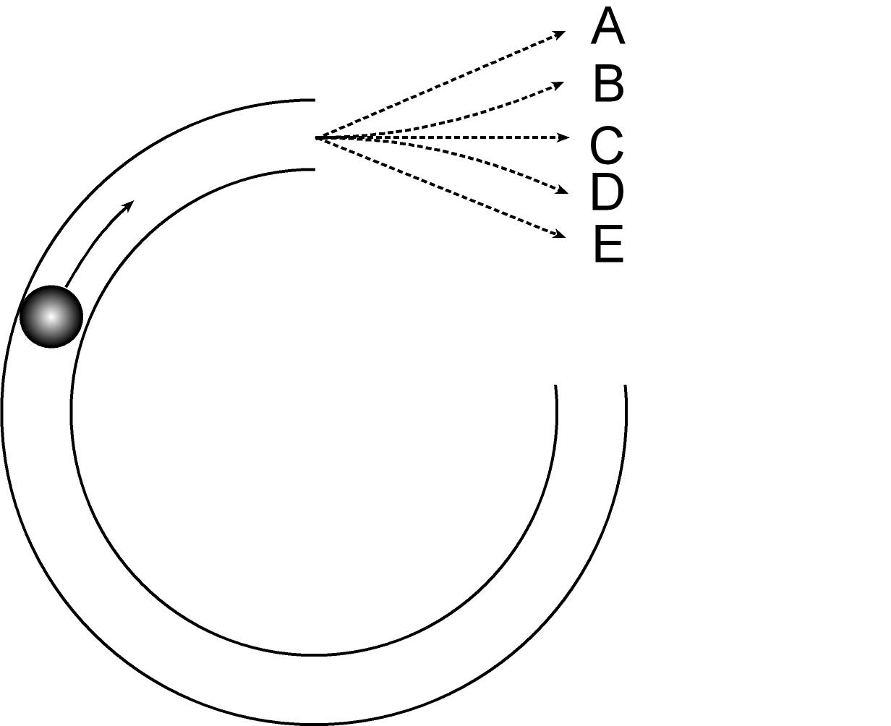
A ball rolls along a frictionless track on a horizontal table, as seen from above in the figure. The track is curved in ¾ of a circle. The ball rolls clockwise around this track and then emerges onto the flat, frictionless table.

Slide 11
Satellites in orbit are accelerating toward the earth, so

Slide 12
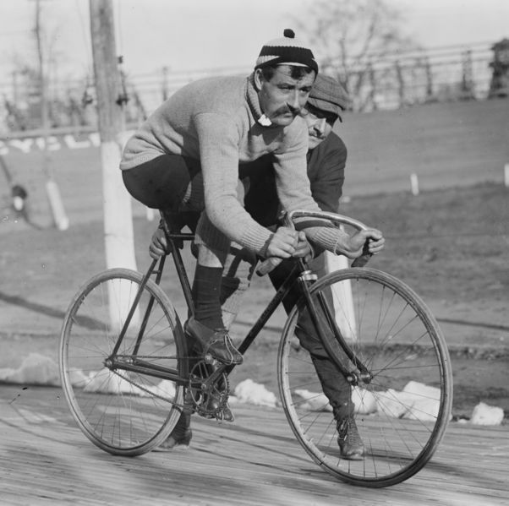
Centripetal Acceleration
A bike wheel of diameter 1.0 m turns 20 times per second. What is the magnitude of the centripetal acceleration of a yellow dot on the rim?

Slide 13
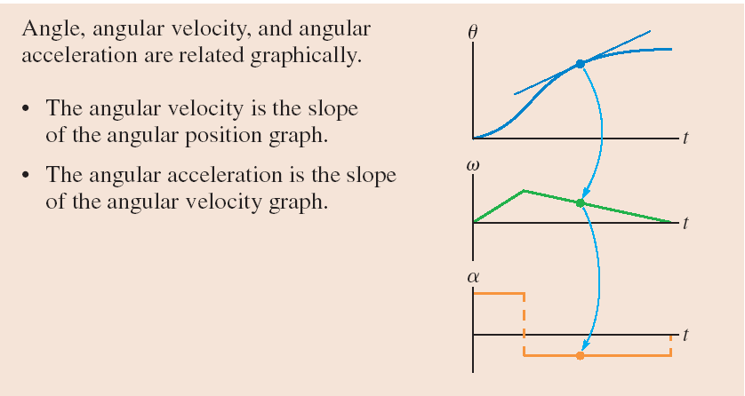

Slide 14
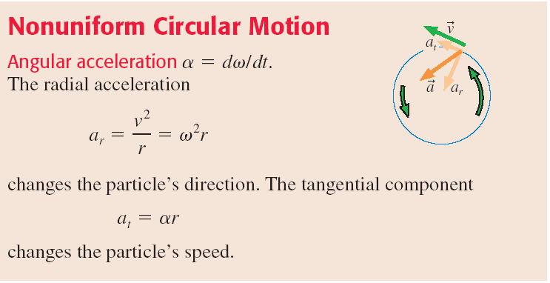
Nonuniform Circular Motion
Any object traveling along a curved path has centripetal acceleration, equal to
If, as it is traveling in a circle, it is speeding up or slowing down, it also has tangential acceleration, equal to
The total acceleration is

Slide 15
Summary of definitions:
θ is angular position. The S.I. Unit is
s is the path length along the curve:
when θ is in [rad].
ω is angular velocity. The S.I. Unit is
v_{t} is the tangential speed:
when ω is in [rad/s].
α is angular acceleration. The S.I. Unit is
a_{t} is the tangential acceleration:
when α is in [rad/s²].

Slide 16
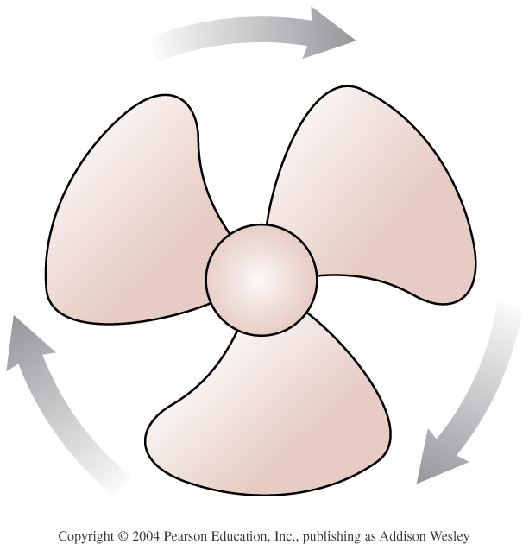
The fan blade is slowing down.
Notes:
Answer: B

Slide 17
Before Class 9 on Monday
Please read Chapter 5 of Knight.
Something to think about: A paperback novel has a mass of 0.3 kg and slides at a constant velocity of 5 m/s, to the right. A physics textbook has a mass of 3.0 kg, and slides at a constant velocity of 5 m/s, to the right. How does the net force on the textbook compare to the net force on the novel?

