Slide 1
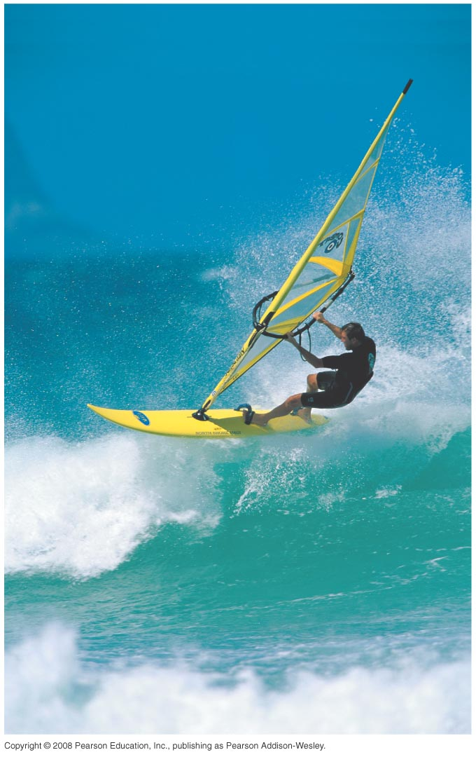
PHY131H1S - Class 9
Today:
Forces
Free Body Diagrams
Newton’s Second Law
Newton’s First Law
F

Slide 2
Pre-class Reading Quiz. (Chapter 5)
Notes:
Answer: A

Slide 3
Last day I asked at the end of class:
A paperback novel has a mass of 0.3 kg and slides at a constant velocity of 5 m/s, to the right. A physics textbook has a mass of 3.0 kg, and slides at a constant velocity of 5 m/s, to the right. How does the net force on the textbook compare to the net force on the novel?
ANSWER:
The net force on any object is
In the case of these two books, they are both
, meaning acceleration is
Any friction must be , not mentioned in the question.

Slide 4
Moving on to Chapters 5 and 6..
Up until now, we have been studying , a description of HOW things move and how to describe this.
In Chapter 5 we begin to study WHY things move the way they do: This is , which includes the important concepts of Force and Energy.

Slide 5
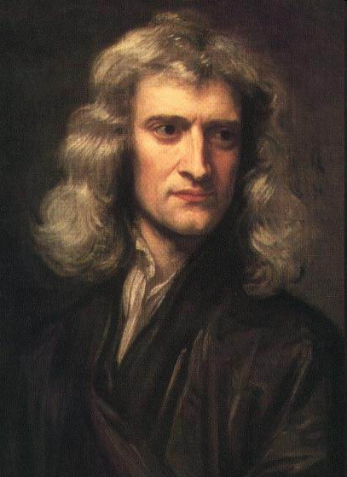
Isaac Newton
1643-1727
According to wiki, was a “ , mathematician, astronomer, natural philosopher, alchemist, and theologian and one of the most influential people in human history.”
In Philosophiæ Naturalis
Mathematica, published 1687, he described
and the
, laying the groundwork for classical mechanics.

Slide 6
What is a force?
A force is
A force is . It has both a magnitude and a direction.
A force requires
Something does the pushing or pulling, and something else gets pushed or pulled.
A force is either a
force. is the only long-range force we will deal with in PHY131.
Important contact forces are:

Slide 8
What is Mass?
Mass is a scalar quantity that describes an object’s . Loosely speaking, it also describes
Mass is an intrinsic property of an object. It tells us something about the object, regardless of where the object is, what it’s doing, or whatever forces may be acting on it.

Slide 10
A fan attached to a cart causes it to accelerate at 2 m/s². Suppose the same fan is attached to a second cart with smaller mass. The mass of the second cart plus fan is half the mass of the first cart plus fan.
Notes:
Answer: D

Slide 11
Three forces act on an object. In which direction does the object accelerate?
Notes:
Answer: D

Slide 12
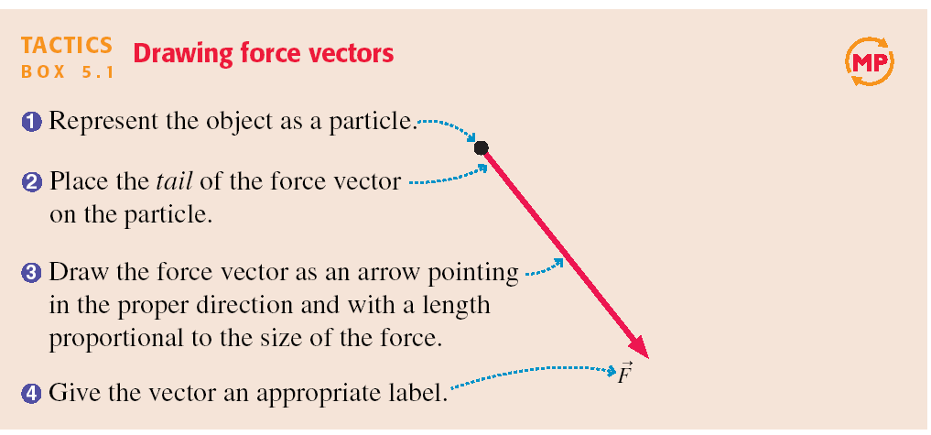
Tactics: Drawing force vectors

Slide 13
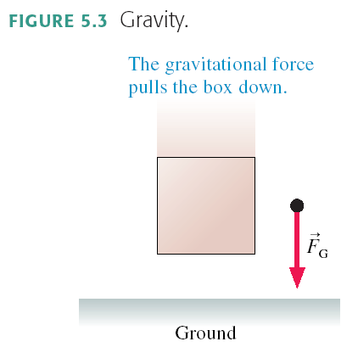
A Short Catalog of Forces

Slide 14
A Short Catalog of Forces

Slide 15
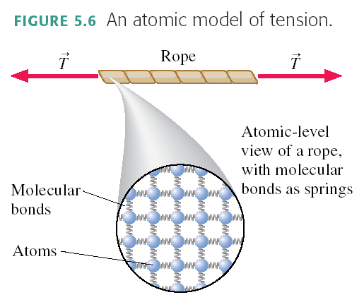
A Short Catalog of Forces

Slide 16
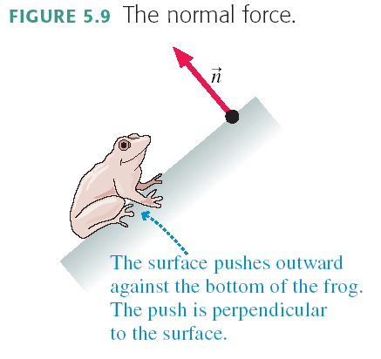
A Short Catalog of Forces

Slide 17
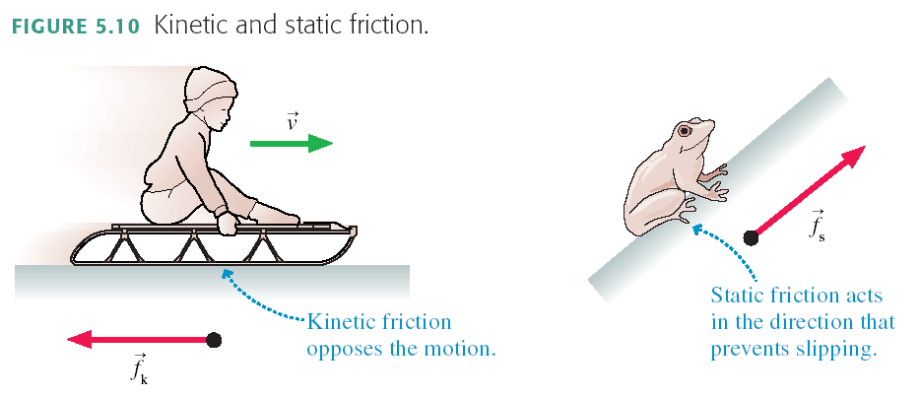
A Short Catalog of Forces

Slide 18
The “Fine Print”
WARNING: Newton’s Laws only apply in a
“ ”. They are not valid if your reference frame is accelerating!
An reference frame is one that is not accelerating.
The surface of the Earth can be treated as an inertial reference frame because
NOTE:

Slide 19
A car is
Quick quiz [1/4]: inside the car, is it…

Slide 20
A car is
Quick quiz [2/4]: inside the car, is it…

Slide 21
A car is
Quick quiz [3/4]: inside the car, is it…

Slide 22
A car is
Quick quiz [4/4]: inside the car, is it…

Slide 24
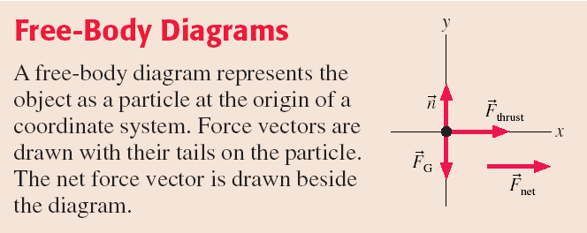

Slide 25
Before Class 10 on Wednesday
Please read Chapter 6 of Knight, sections 6.1 through 6.3.
Something to think about: A basketball and a tennis ball are in freefall.
Which, if either, has the larger mass?
Which, if either, experiences the larger force of gravity?
Which, if either, experiences the larger acceleration?
Which, if either, has the larger weight?

