Slide 1
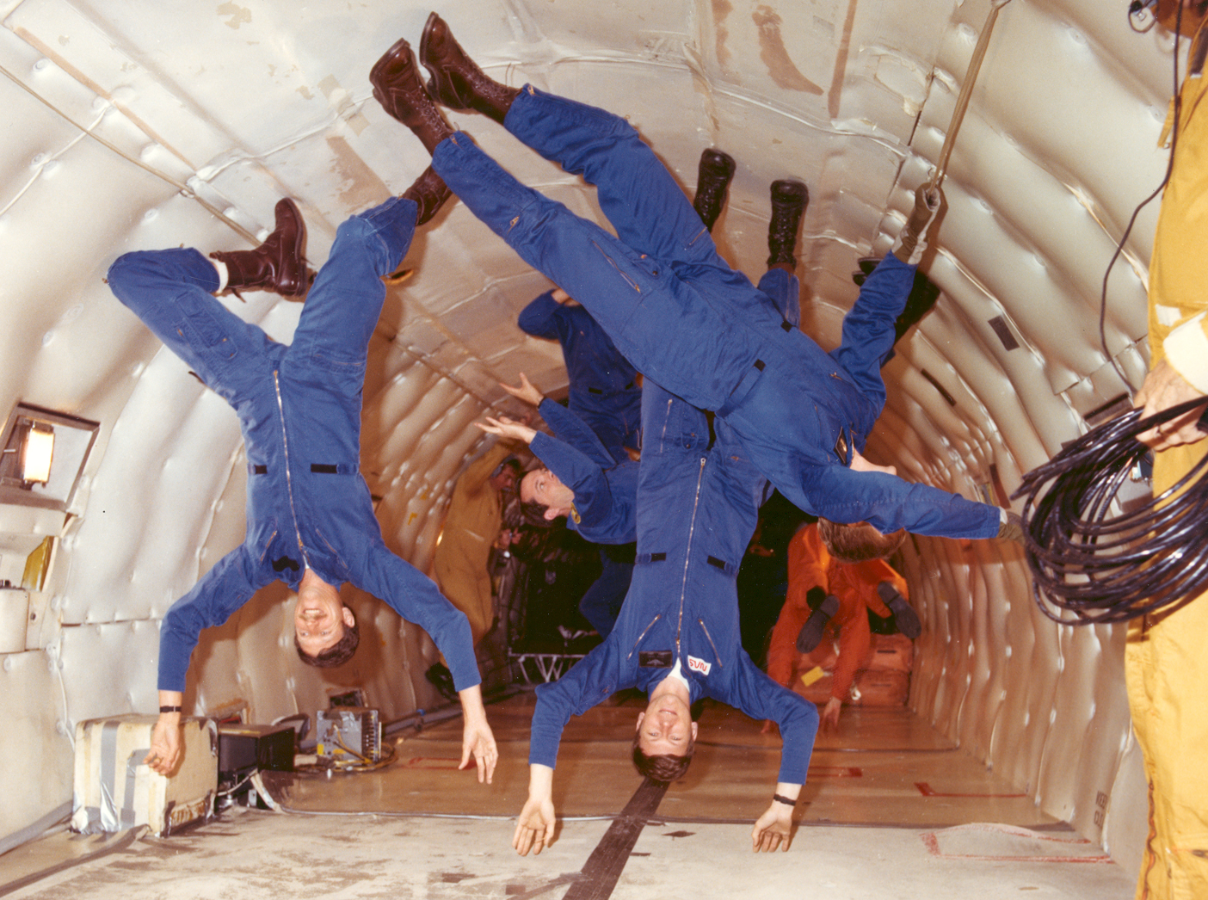
PHY131H1S - Class 10
Today:
Equilibrium
Mass, Weight, Gravity

Slide 2
Pre-class Reading Quiz. (Chapter 6)
Notes:
Answer: A

Slide 3
Last day I asked at the end of class:
A basketball and a tennis ball are in freefall.
1. Which, if either, has the larger mass?
ANSWER:
2. Which, if either, experiences the larger force of gravity?
ANSWER:
3. Which, if either, experiences the larger acceleration?
ANSWER:
4. Which, if either, has the larger weight?
ANSWER:

Slide 4
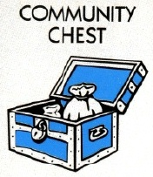
Preparation for Practicals this week:
Take a ride on the Burton Tower elevators!
All 4 elevators in the 14-storey tower of McLennan Physical Labs are equipped with a hanging spring-scale.
It measures the upward force necessary to support a 500 g mass. (a.k.a. “weight”)
You may find that the measured weight of this object changes as you accelerate – check it out!

Slide 5
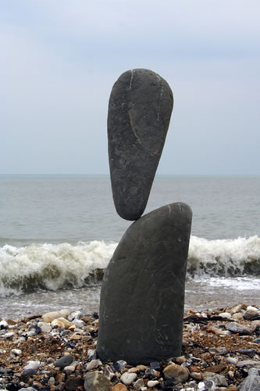
Equilibrium
An important problem solving technique is to identify when an object is in equilibrium.
An object has zero acceleration if and only if
This is called “equilibrium”.
If an object is in vertical equilibrium (ie it is confined to a stationary horizontal surface) then
The sum of y-components of all forces = 0.
If an object is in horizontal equilibrium (ie freefall) then

Slide 6
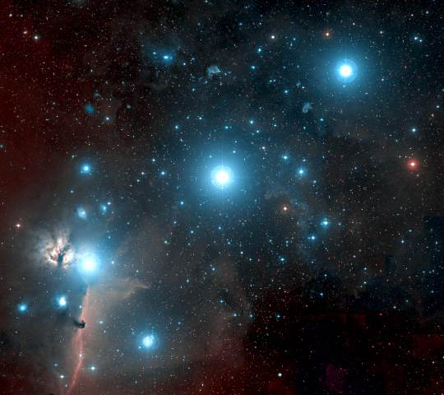
Gravity for the universe
It was Newton who first recognized that gravity is an attractive, long-range force between any two objects. Somewhat more loosely, gravity is a force that acts on mass. When two objects with masses m₁ and m₂ are separated by distance r, each object pulls on the other with a force given by Newton’s law of gravity, as follows:
(Sometimes called “Newton’s 4th Law”, or “Newton’s Law of Universal Gravitation”)

Slide 7
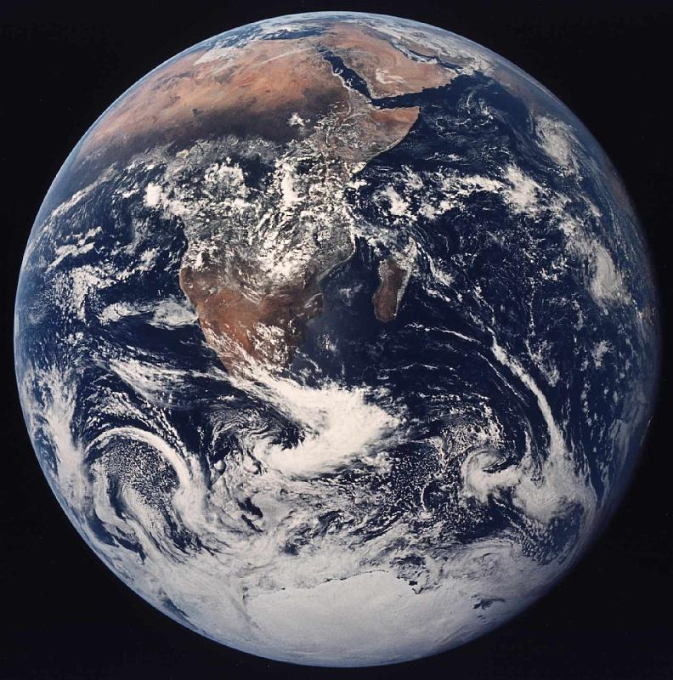
Gravity for Earthlings
If you happen to live on the surface of a large planet with radius R and mass M, you can write the gravitational force even more simply as
where the quantity g is defined to be:

Slide 8
Gravity: F_{G} = mg is just a short form!
and
are the same equation, with different notation!
The only difference is that in the second equation we have assumed that m₂ = M (mass of the earth) and r ≈ R (radius of the earth).

Slide 9
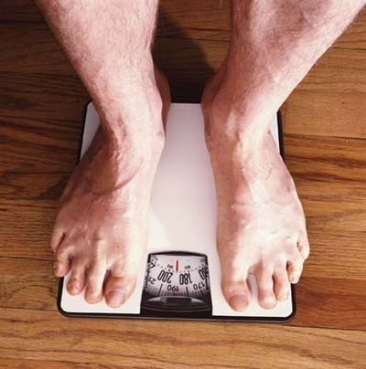
Weight ≠ Weight ??!?
Physics textbooks and physics teachers do not all agree on the definition of the word “weight”!
Sometimes “weight” means the exact same thing as “force of gravity”. That is not how Randall Knight uses the word. (I will follow Knight’s definitions.)
In Knight, “weight” means
If the object is at rest or moving at a constant velocity relative to the earth, then the object is in equilibrium. The upward supporting force exactly balances the downward gravitational force, so that

Slide 10
Weight - example
When I stand on a scale in my bathroom it reads 185 pounds. 2.2 pounds = 9.8 Newtons, so this means the upward force on my feet when I am standing still is 185 lbs (9.8 N / 2.2 lbs) = 824 N.
If I ride an elevator which is accelerating upward at 1.5 m/s², what is the upward force on my feet?

Slide 11
Knight’s Definition of weight, page 161:

Slide 12
Pan balance on an elevator
You are attempting to pour out 100 g of salt, using a pan balance on an elevator which is accelerating upward at 1.5 m/s².

Slide 13
What is the equation for normal force?
, upward
, downward
, perpendicular to surface
, perpendicular to surface
There is no generally applicable equation for normal force.

Slide 14
Normal Force is
Gravity, F_{G}, has an equation for it which predicts the correct magnitude (it’s always mg here on Earth).
Normal force, Tension and Static friction are all
Normal force is
Tension is
Static friction is
In all these cases, you must draw a free-body diagram and figure out by using equilibrium and Newton’s 2nd law what the needed force is.

Slide 15
Getting the piano on the truck
A piano has a mass of 225 kg.
What force is required to push the piano upwards at a constant velocity as you lift it into the truck?
What force is required to push the piano up a frictionless ramp at a constant velocity into the truck? Assume the ramp is 3 m long and the floor of the truck is 1 m high? What is the normal force of the ramp on the piano?

Slide 16
Bob stands under a low concrete arch, and presses upwards on it with a force of 100 N. Bob’s mass is 82 kg. He is in equilibrium. What is the total normal force of the ground on Bob? (Note that 82 × 9.8 = 800.)

Slide 17
Before Class 11 on Monday
Remember there is a MasteringPhysics.com problem set due today. If you haven’t already done it, please submit this before 11:59pm tonight.
Take a ride on the Burton Tower elevators, do prep-work for Mechanics Module 3 Activity 2.
Please read the rest of Knight Chapter 6.
Something to think about:
Does friction always slow things down? Can friction ever speed things up?

