Slide 1
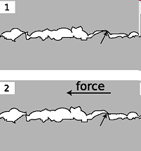
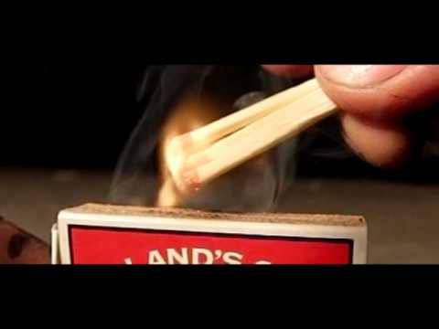
PHY131H1S - Class 11
Today:
Friction, Drag
Rolling without slipping
Examples of Newton’s Second Law
Microscopic bumps and holes crash into each other, causing a frictional force.

Slide 2
Pre-class Reading Quiz. (Chapter 6)
Notes:
Answer: A

Slide 3
Last day I asked at the end of class:
Does friction always slow things down?
ANSWER:
Can friction ever speed things up?
ANSWER:

Slide 4
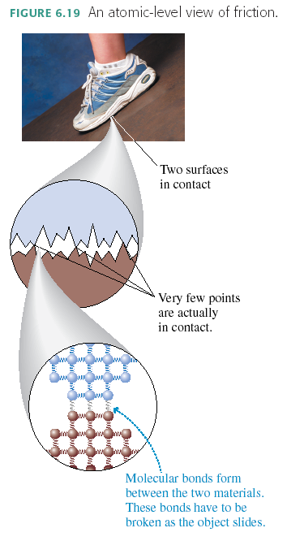

Slide 5
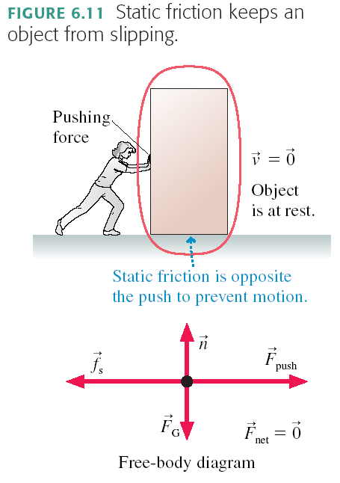
Static Friction
The box is in static equilibrium, so the static friction must exactly balance the pushing force:
This is not a general, “all-purpose” equation. It is found from looking at the free body diagram and applying horizontal equilibrium, since a_{x} = 0.

Slide 6
Static Friction
There’s a limit to how big f_{s} can get. If you push hard enough, the object slips and starts to move. In other words, the static friction force has a
The two surfaces don’t slip against each other as long as
The surfaces slip when
A static friction force is not physically possible. Many experiments have shown that:
where n is the magnitude of the normal force, and the proportionality constant μ_{s} is called the “coefficient of static friction”.

Slide 7
A wooden block weighs 100 N, and is sitting stationary on a smooth horizontal concrete surface. The coefficient of static friction between wood and concrete is 0.2. A 5 N horizontal force is applied to the block, pushing toward the right, but the block does not move. What is the force of static friction of the concrete on the block?

Slide 8
A wooden block weighs 100 N, and is sitting stationary on a smooth horizontal concrete surface. The coefficient of static friction between wood and concrete is 0.2. A horizontal force is applied to the block, pushing toward the right. What is the maximum pushing force you can apply and have the block remain stationary?

Slide 9
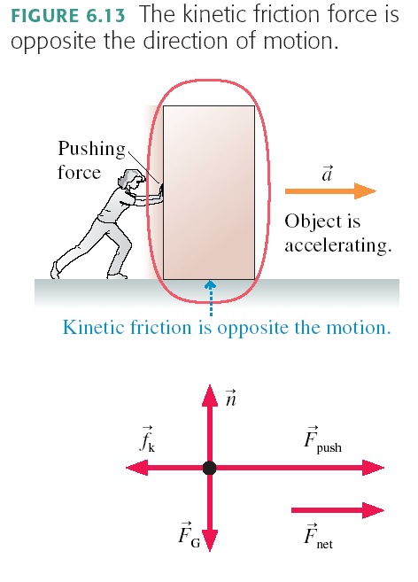
Kinetic Friction
The kinetic friction force is proportional to the magnitude of the normal force. Many experiments show the following approximate relation:
where n is the magnitude of the normal force, and the proportionality constant μ_{k} is called the “coefficient of kinetic friction”.

Slide 10
Forces with general, “all-purpose” equations:
The force of gravity on an object near the surface of the Earth is always:
The force of kinetic friction on an object which is sliding along a surface is always:

Slide 11
A wooden block weighs 100 N, and is sliding to the right on a smooth horizontal concrete surface at a speed of 5 m/s. The coefficient of kinetic friction between wood and concrete is 0.1. A 5 N horizontal force is applied to the block, pushing toward the right. What is the force of kinetic friction of the concrete on the block?

Slide 12
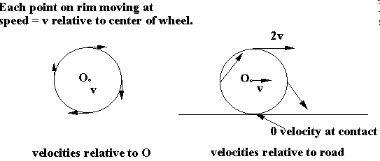
Rolling without slipping

Slide 13
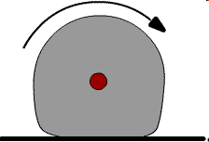
Rolling Friction
Due to the fact that the wheel is soft, and so is the surface upon which it is rolling. Plowing effect produces a force which slows down the rolling.

Slide 14
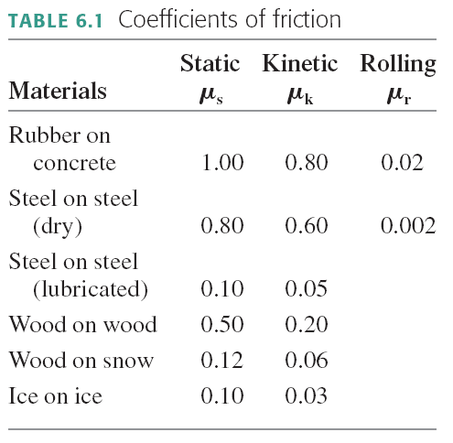

Slide 15
Drag force in a fluid, such as air
Air resistance, or drag, is complex and involves fluid dynamics.
For objects on Earth, with speeds between 1 and 100 m/s and size between 1 cm and 2 m, there is an approximate equation which predicts the magnitude of air resistance
where A is the cross-sectional area of the object, and v is the speed.
The direction of air resistance, or Drag Force, is opposite to the direction of motion.
It depends on size and shape, but not mass.

Slide 16
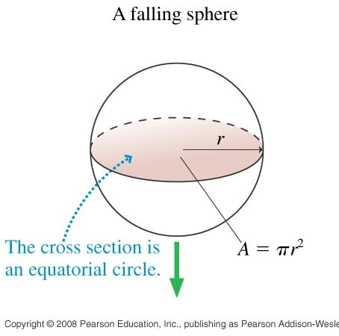
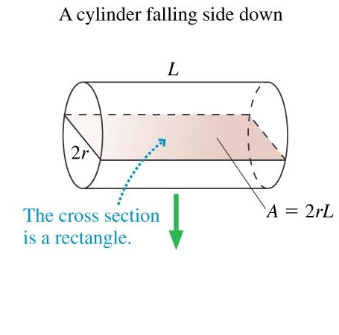
Cross Sectional Area depends on size, shape, and direction of motion.
…Consider the forces on a falling piece of paper, crumpled and not crumpled.

Slide 17
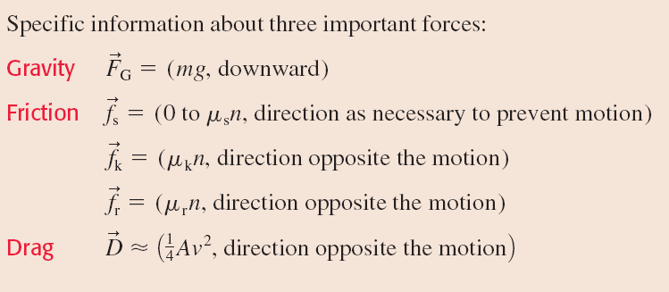
Ch.6 force summary

Slide 18
Analyzing problems in segments
The equations of chapters 1-6 help us solve problems in which the acceleration is constant.
Sometimes the acceleration changes abruptly.
In this case, divide the motion into segments: 1, 2, 3, …
The final position an velocity of segment 1
Solve using the equations of constant acceleration for each segment.

Slide 19
A cyclist is pushing on his pedals, and therefore accelerating to the left.
What is the direction of the force of static friction of the ground on the back / front wheel?
What is the direction of the force of rolling friction of the ground on the back front wheel?

Slide 20
Before Class 12 on Wednesday
Please read Knight Chapter 7.
Something to think about:
Consider the following reasoning, and identify the mistake:
“When you push a cart, Newton’s 3rd Law states that the cart pushes back on you with an equal and opposite force. These forces should cancel each other. So it is impossible to accelerate the cart.”

