Slide 1
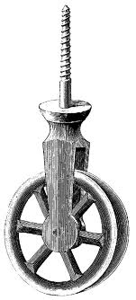
PHY131H1S - Class 12
Today:
Action / Reaction Pairs
Newton’s Third Law
Ropes and Pulleys

Slide 2
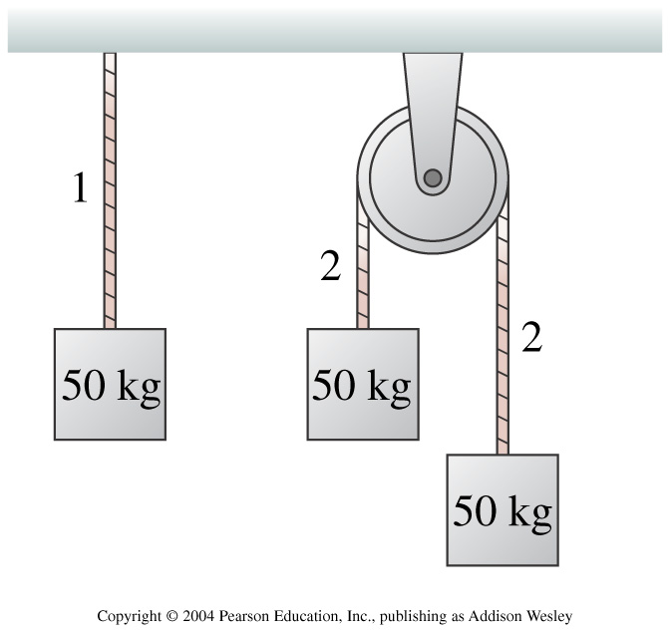
Pre-class Reading Quiz. (Chapter 7)
Notes:
Answer: A

Slide 3
Last day I asked at the end of class:
Consider the following reasoning, and identify the mistake:
“When you push a cart, Newton’s 3rd Law states that the cart pushes back on you with an equal and opposite force. These forces should cancel each other. So it is impossible to accelerate the cart.”
ANSWER:
First sentence
Second and third sentences

Slide 5
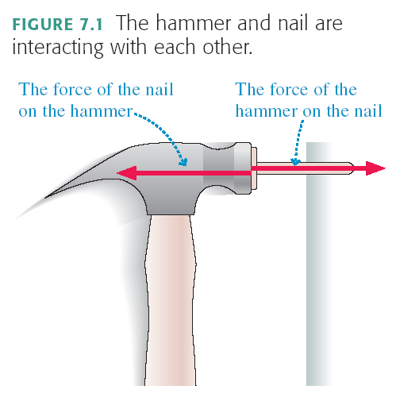

Slide 6
The entire Earth accelerates toward the Moon, due to this pulling force.
To find the total acceleration, you use the force as calculated for
Since F_{G} = GMm/r², the force on the ocean nearer to the moon will be , so it will accelerate than the rest of the Earth, bulging out.

Slide 7
Since F_{G} = GMm/r², the force on the ocean to the moon will be , so it will accelerate more than the rest of the Earth, bulging out.
Similarly, the force on the ocean from the moon will be , so it will accelerate less than the rest of the Earth, remaining behind, forming a bulge.
In general, tidal effects tend to stretch objects both toward and away from the object causing the tides.

Slide 8
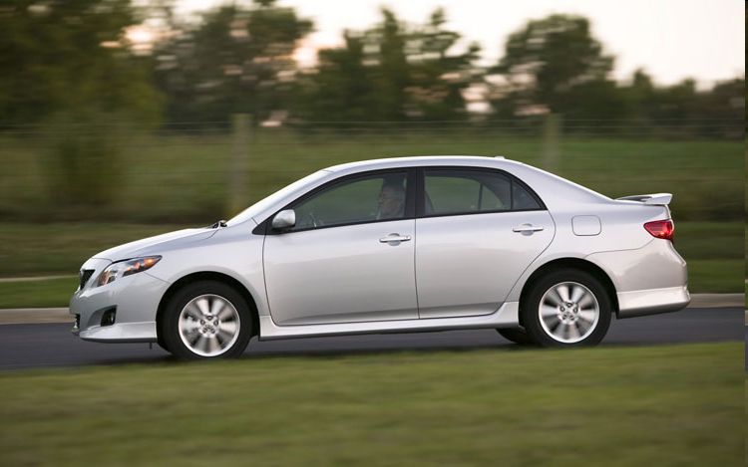
Identifying Action / Reaction Pairs
Consider an accelerating car.
Action:
Reaction:

Slide 9
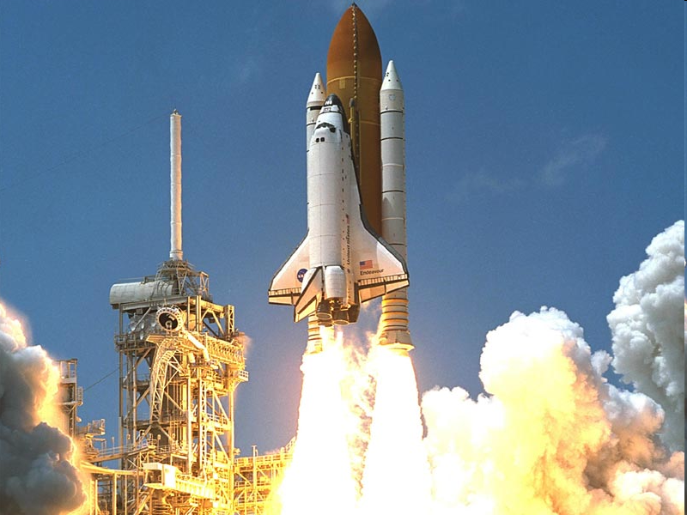
Identifying Action / Reaction Pairs
Consider a rocket accelerating upward.
Action:
Reaction:

Slide 10
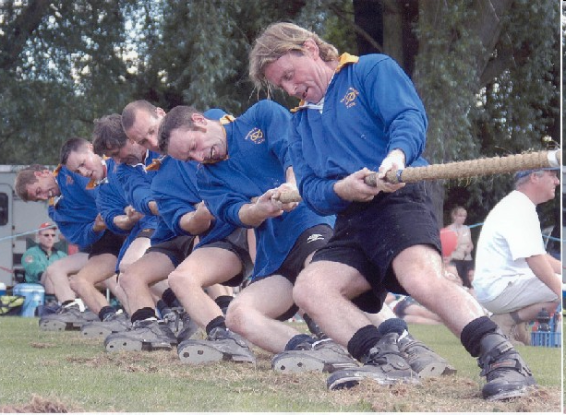
Identifying Action / Reaction Pairs
Action force:
Reaction force?

Slide 11
Identifying Action / Reaction Pairs
Consider a stationary man pulling a rope.
Action:
Reaction:

Slide 12
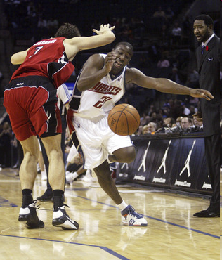
Identifying Action / Reaction Pairs
Action force:
Reaction force?

Slide 13
Identifying Action / Reaction Pairs
Consider a basketball in freefall.
Action:
Reaction:

Slide 14
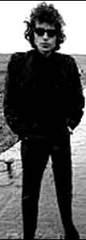
Test Question from PHY131 Spring 2009
Action force: Bob stands on a bathroom scale. There is an action force on Bob, which is
Reaction force?
scale

Slide 15
Identifying Action / Reaction Pairs
Action force: Bob stands on a bathroom scale in an elevator, which is accelerating upward. There is an action force on Bob, which is
Reaction force?
a
scale

Slide 16
The Massless String Approximation
Often in physics problems the mass of the string or rope is much less than the masses of the objects that it connects. In such cases, we can adopt the following massless string approximation:

Slide 17
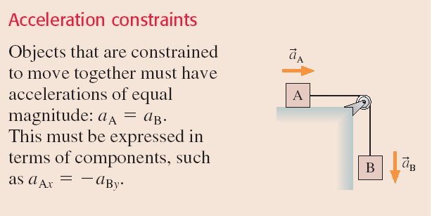
Pulleys

Slide 18
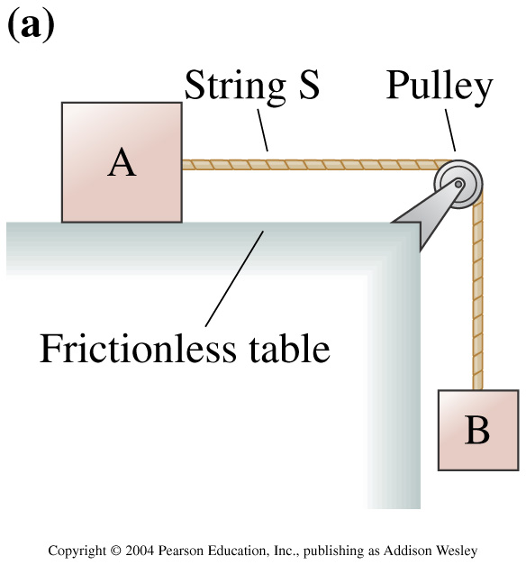
In the figure to the right, is the tension
Notes:
Answer: C

Slide 19
Before Class 13 on Monday
Remember there is a MasteringPhysics.com problem set due today. If you haven’t already done it, please submit this before 11:59pm tonight.
Please read Knight Chapter 8, and the Part I Summary.
Something to think about: A ball is whirled on a string in a vertical circle. As it is going around, the tension in the string is
constant.
greatest at the top of the motion
greatest at the bottom of the motion
greatest somewhere in between the top and bottom.

