Slide 1
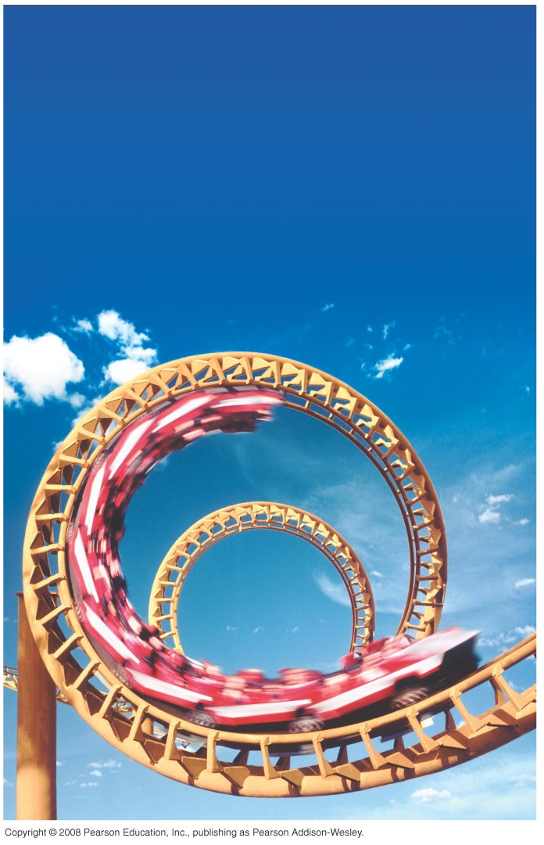
PHY131H1S - Class 13
Today:
Dynamics in Two Dimensions
Dynamics of Uniform Circular Motion
Fictitious Forces

Slide 2
Pre-class Reading Quiz. (Chapter 8)
Notes:
Answer: A

Slide 3
Last day I asked at the end of class:
A ball is whirled on a string in a vertical circle. As it is going around, the tension in the string is
constant.
greatest at the top of the motion
greatest at the bottom of the motion
greatest somewhere in between the top and bottom.
ANSWER:

Slide 4
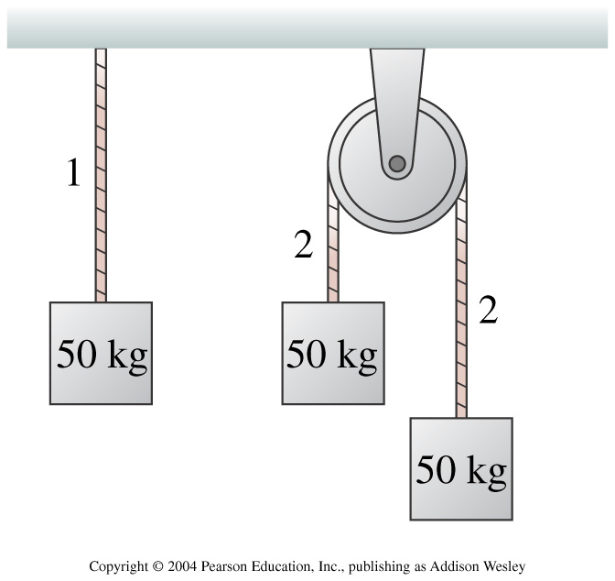
Chapter 7 Review Question.
Notes:
Answer: A

Slide 5
Dynamics in Two Dimensions
Chapter 8
Suppose the x- and y-components of acceleration are independent of each other. That is, a_{x} does not depend on y or v_{y}, and a_{y} does not depend on x or v_{x}.
You can then use Newton’s second law in component form:
The force components (including proper signs) are found from the free-body diagram. The kinematics equations apply to the x and y components, ie:

Slide 6
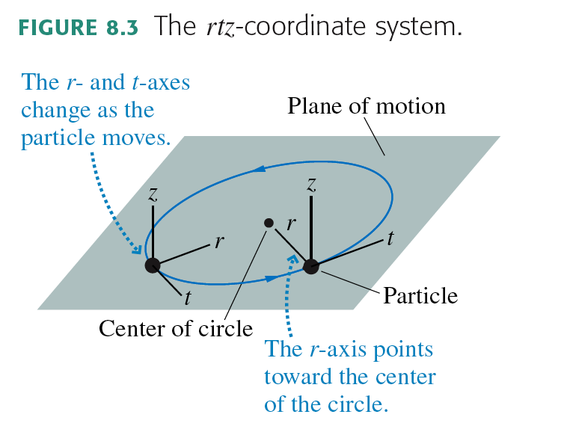
Uniform Circular Motion

Slide 7
Dynamics of Uniform Circular Motion

Slide 8
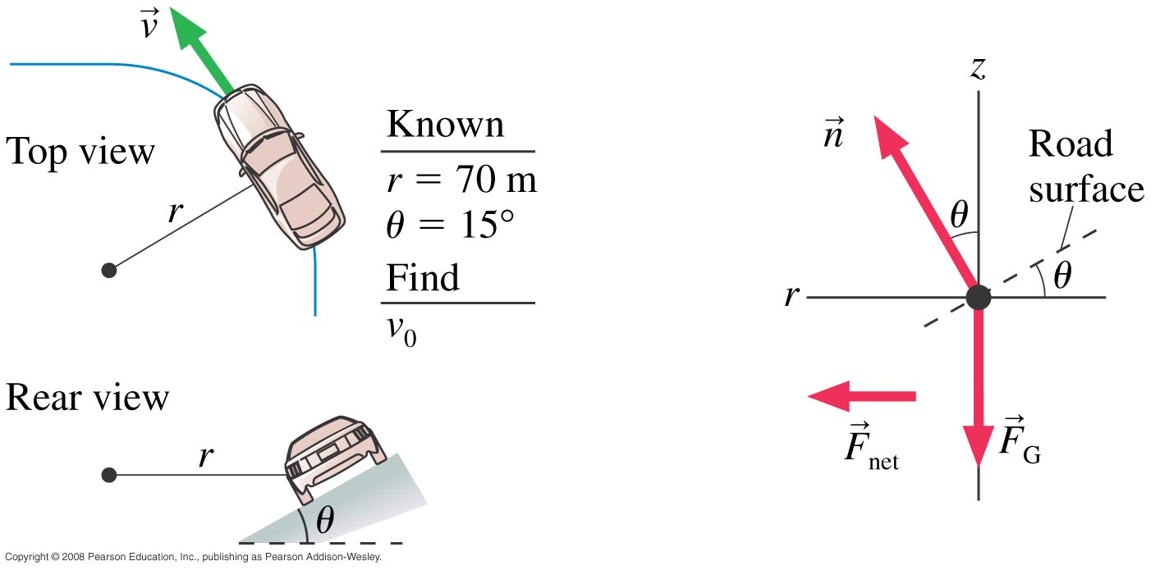
Example 8.5, pg.217
A highway curve of radius 70 m is banked at a 15° angle. At what speed v₀ can a car take this curve without assistance from friction?

Slide 9
A car is rolling over the top of a hill at speed v. At this instant,
Notes:
STT7.4
Answer: B

Slide 10
A car is driving at the bottom of a valley at speed v. At this instant,
Notes:
STT7.4
Answer: B

Slide 11
Projectile Motion
In the absence of air resistance, a projectile has only one force acting on it: the gravitational force, F_{G} = mg, in the downward direction. If we choose a coordinate system with a vertical y-axis, then
The vertical motion is free fall, while the horizontal motion is one of constant velocity.

Slide 12
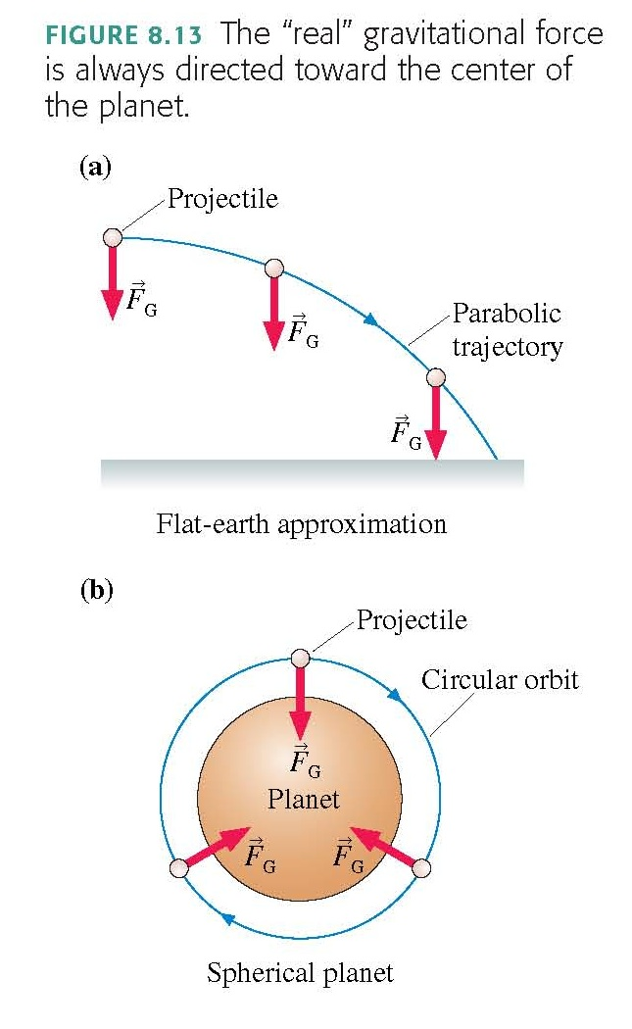

Slide 13
Circular Orbits
An object moving in a circular orbit of radius r at speed v_{orbit} will have centripetal acceleration of
That is, if an object moves parallel to the surface with the speed
then the free-fall acceleration provides exactly the centripetal acceleration needed for a circular orbit of radius r. An object with any other speed will not follow a circular orbit.

Slide 14
Fictitious Forces
If you are riding in a car that makes a sudden stop, you may feel as if a force “throws” you forward toward the windshield.
There really is
Nonetheless, the fact that you seem to be hurled forward relative to the car is a very real experience!
You can describe your experience in terms of what are called fictitious forces.
These are not real forces because no agent is exerting them, but they describe your motion

Slide 15
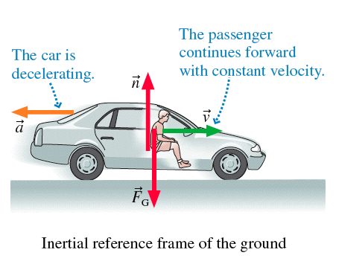

Slide 16
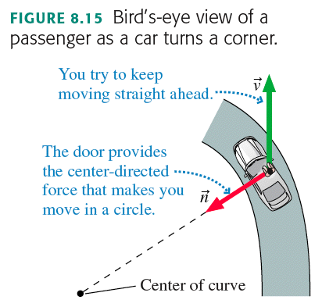
“Centrifugal Force” (a fictitious force)
If the car you are in turns a corner quickly, you feel “thrown” against the door.
The “force” that seems to push an object to the outside of a circle is called the
It describes your experience relative to a noninertial reference frame, but

Slide 17
Why Does the Water Stay in my coffee cup?
Watch Harlow swing a cup of water over his head. If he swings the cup quickly, the water stays in. But the students in the front row will get a shower if he swings too slowly.
The critical angular velocity ω_{c} is that at which gravity alone is sufficient to cause circular motion at the top.

Slide 18
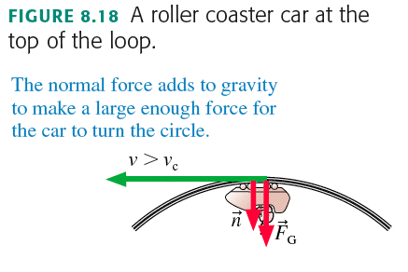
More than enough angular speed
The point is: Normal force

Slide 19
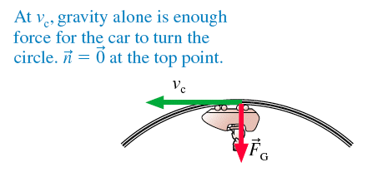
Just enough angular speed

Slide 20
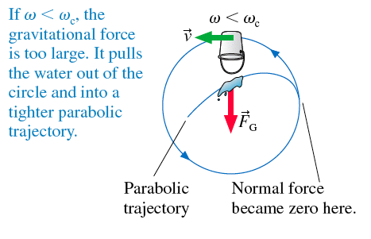
Not enough angular speed

Slide 21
Before Class 14 on Wednesday
Please read the Knight Part II Overview, and Chapter 9
Something to think about:
Consider a car accident in which a car, initially traveling at 50 km/hr, collides with a large, massive bridge support.
The car comes to an abrupt stop, and so does its only occupant, the driver (who is intoxicated).
The airbag inflates, saving the driver.
Why is the force of the hard plastic steering wheel worse than the force of the airbag in stopping the driver?

