Slide 1
PHY131H1S - Class 14
Today:
Momentum and Impulse
Conservation of Momentum
Collisions, Explosions

Slide 2
Pre-class Reading Quiz. (Chapter 9)
Notes:
Answer: A

Slide 3
Last day I asked at the end of class:
Consider a car accident in which a car, initially traveling at 50 km/hr, collides with a large, massive bridge support.
The car comes to an abrupt stop. The airbag inflates, saving the driver.
Why is the force of the hard plastic steering wheel worse than the force of the airbag in stopping the driver?
ANSWER:

Slide 4
Momentum
Momentum is the product of a particle’s mass and velocity, has units of kg m/s, and is given by
An object can have a larger momentum if it is:
moving faster or,
has more mass
Note: Momentum is a vector quantity. It has both x and y components.

Slide 5
A basketball with mass 0.1 kg is traveling down and to the right with v_{xi} = +5 m/s, and v_{yi} = –5 m/s. It hits the horizontal ground, and then is traveling up and to the right with v_{xf} = +5 m/s, and v_{yf} = +4 m/s.
x

Slide 6
A basketball with mass 0.1 kg is traveling down and to the right with v_{xi} = +5 m/s, and v_{yi} = –5 m/s. It hits the horizontal ground, and then is traveling up and to the right with v_{xf} = +5 m/s, and v_{yf} = +4 m/s.

Slide 7
Impulse
The impulse upon a particle is defined as
Impulse has units of N s, but you should be able to show that N s are equivalent to kg m/s.
The impulse-momentum theorem states that the change in a particle’s momentum is equal to the impulse on it.

Slide 8
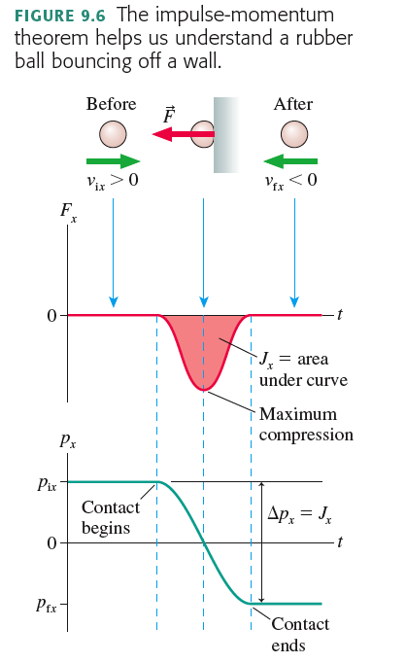

Slide 9
A 100 g rubber ball and a 100 g damp cloth are dropped on the floor from the same height. They both are traveling at the same speed just before they hit the floor. The rubber ball bounces, the damp cloth does not.
Notes:
STT9.2

Slide 10
Chapter 9 big idea: “Conservation of Momentum”
A system of particles has a total momentum,
If the system is isolated, meaning that there is no external net-force acting on the system, then:
This means the momentum is “conserved”;

Slide 11
Conservation of Momentum

Slide 12
Two particles collide, one of which was initially moving, and the other initially at rest.

Slide 13
Two particles collide, one of which was initially moving, and the other initially at rest.

Slide 14
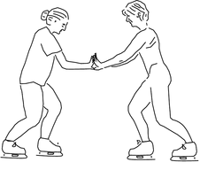
Two ice skaters, Paula and Ricardo, push off from each other. They were both initially at rest. Ricardo has a greater mass than Paula.

Slide 15
Two ice skaters, Paula and Ricardo, push off from each other. They were both initially at rest. Ricardo has a greater mass than Paula.

Slide 16
Before Class 15 on Monday
Masteringphysics Problem Set 5 is due today. If you haven’t already done so, please submit this by 11:59pm tonight.
Please read the Knight Chapter 10, Sections 10.1 through 10.5
Something to think about:
Can “energy” ever be negative?
Can kinetic energy be negative?
Can potential energy be negative?

