Slide 1
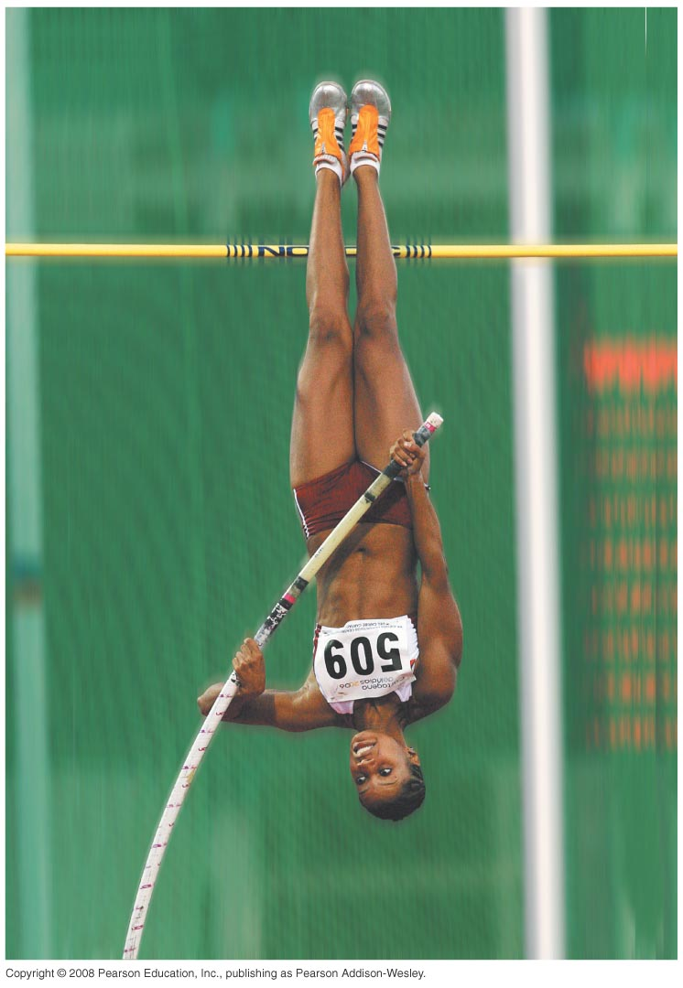
PHY131H1S - Class 15
Today:
Conservation of Energy
Kinetic Energy
Gravitational Potential Energy
Hooke’s Law
Elastic Potential Energy

Slide 2
Pre-class Reading Quiz. (Chapter 10)
Notes:
Answer: A

Slide 3
Last day I asked at the end of class:
Can kinetic energy be negative?
ANSWER:
Can potential energy be negative?
ANSWER:
Can energy ever be negative?
ANSWER:

Slide 4
Momentum and Energy
If a net force acts on a system, then, over time, its momentum will change. Impulse describes the change in momentum, and is equal to the integral of
Not only is the momentum changing in time, the system also gains as it moves.
If a net force acts on a system, then, over distance, its energy will change. Work describes the change in energy, and is equal to the integral of (this is a Chapter 11 concept)
The SI unit of Work comes from force × distance. 1 N × 1 m =

Slide 5
Kinetic and Potential Energy
Work is a form of energy which gets transferred to an object when a force is acted upon it over a certain distance.
There are many other forms of energy. For examples:
Kinetic energy is an energy of motion:
Gravitational potential energy is an energy of position:

Slide 6
Chapter 10 big idea: “Conservation of Energy”
A system of particles has a total energy, E.
If the system is isolated, meaning that there is no work or heat being added or removed from the system, then:
This means the energy is “conserved”; it doesn’t change over time.
This is also the first law of thermodynamics; “You can’t get something for nothing.”

Slide 7
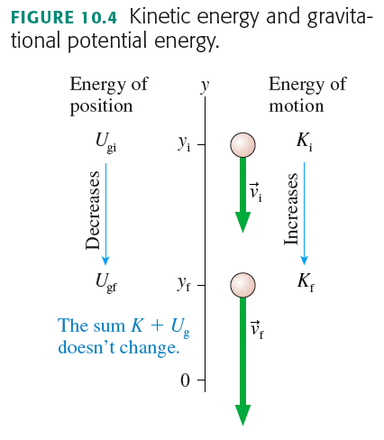

Slide 8
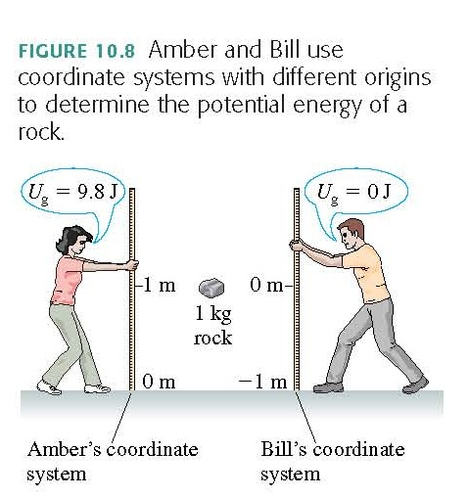
NOTE: The Zero of Potential Energy
You can place the origin of your coordinate system, and thus the “zero of potential energy,” wherever you choose and be assured of getting the correct answer to a problem.
The reason is that only has physical significance, not itself.

Slide 9
EXAMPLE: The speed of a sled
QUESTION:
Sidra runs forward with her sled at 2.0 m/s. She hops at the top of a very slippery slope. The slope is 7.0° below the horizontal, and extends down a total vertical distance of 5.0 m. What is her speed at the bottom?

Slide 10
EXAMPLE: The speed of a sled
QUESTION:
Sidra runs forward with her sled at 2.0 m/s. She hops at the top of a very slippery valley. The valley goes down to 5.0 m below her starting position, then back up to the same initial height. What is her speed when she reaches the other side of the valley? [neglect friction]

Slide 11
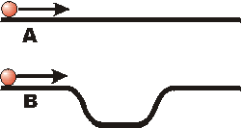
Two balls are launched along a pair of tracks with equal velocities, as shown. Both balls reach the end of the track. Predict: Which ball will reach the end of the track first?
A
B
C: They will reach the end of the track at the same time

Slide 12
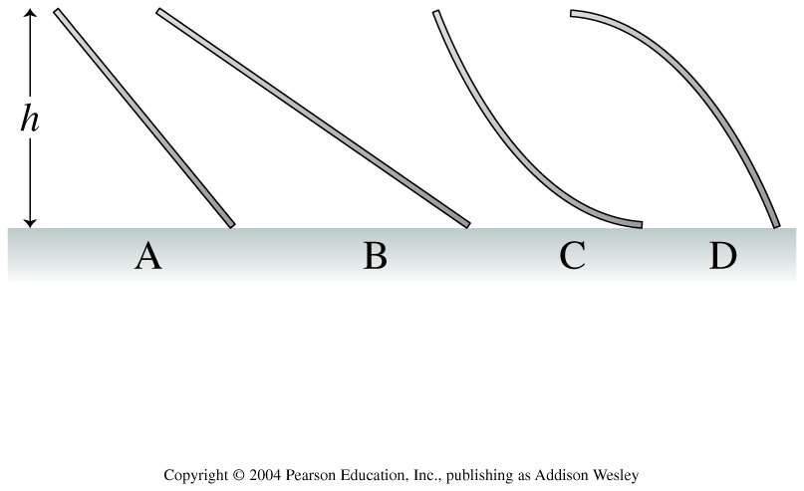
A small child slides down the four frictionless slides A–D.
Notes:
STT10.2
Answer: D

Slide 13
Hooke’s Law
If you stretch a rubber band, bend a ruler or other solid object, a force appears that tries to pull the object back to its equilibrium, or unstretched, state.
A force that restores a system to an equilibrium position is called a restoring force.
If s is the position, and s_{e} is the equilibrium position, we define Δs = s – s_{e}.
where (F_{sp})_{s} is the s-component of the restoring force, and k is the spring constant of the spring.
The minus sign reminds you that it is a

Slide 14
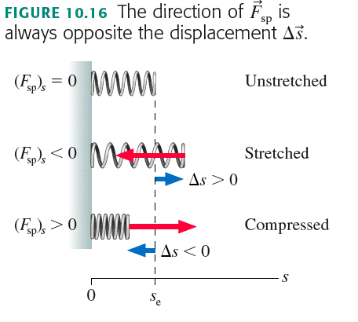
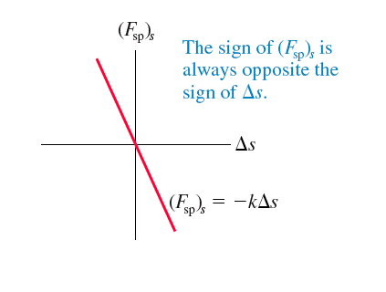

Slide 15
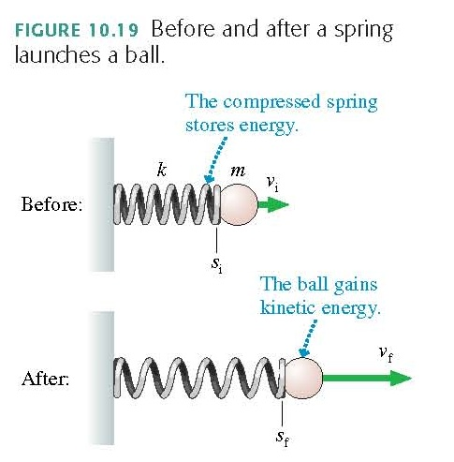
Elastic Potential Energy
Consider a before-and-after situation in which a spring launches a ball. The compressed spring has “stored energy,” which is then transferred to the kinetic energy of the ball. We define the elastic potential energy U_{s} of a spring to be

Slide 16
Before Class 16 on Wednesday
Please read the Knight Chapter 10, Sections 10.6 and 10.7 Also Chapter 11, Sections 11.1 through 11.3.
Something to think about:
If one object does work on another object, does energy always get transferred from one object to the other?

