Slide 1
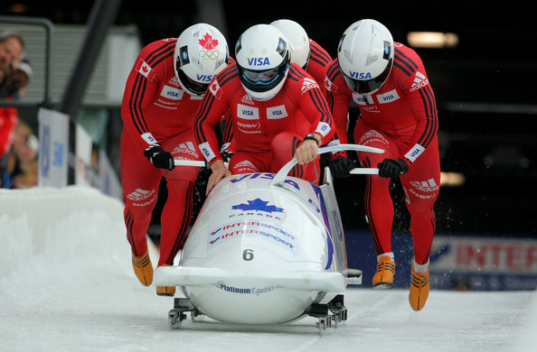
PHY131H1S - Class 16
Today:
Energy in Collisions
Work

Slide 2
Reading Quiz:

Slide 3
Last day I asked at the end of class:
If one object does work on another object, does energy always get transferred from one object to the other?
ANSWER:

Slide 4
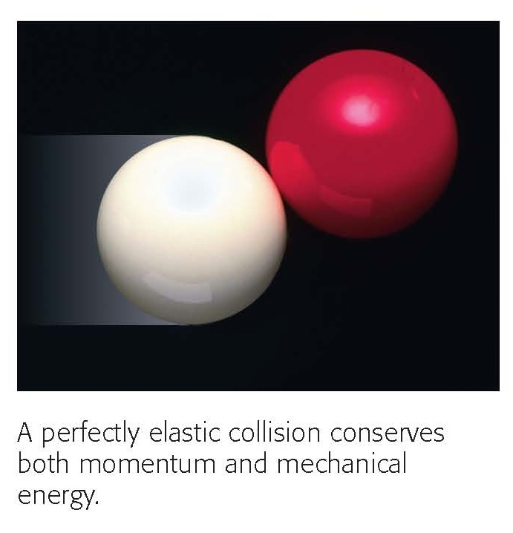
Elastic Collisions

Slide 5
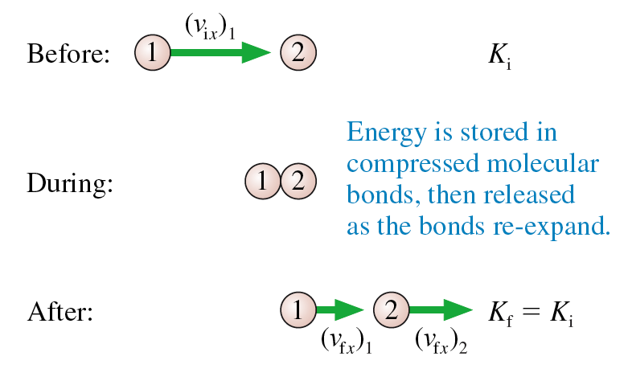
Elastic Collision when ball 2 is initially at rest.
Consider a head-on, perfectly elastic collision of a ball of mass m₁ having initial velocity (v_{ix})₁, with a ball of mass m₂ that is initially at rest.
The balls’ velocities after the collision are

Slide 6
Elastic Collision when ball 2 is initially at rest.
There are two equations, and two unknowns: v_{fx1} and v_{fx2}. You can solve this! Don’t be afraid!
Eq. 10.43:

Slide 7
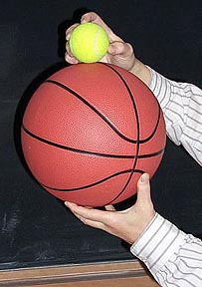
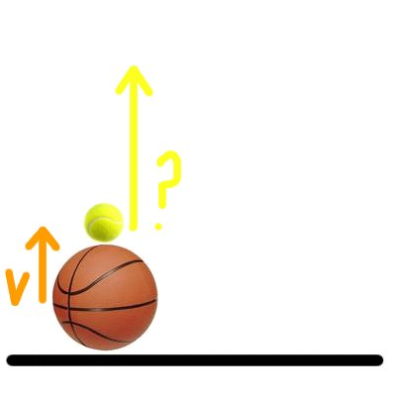
Demonstration and Example
A 0.50 kg basketball moving at 2.0 m/s upward strikes a 0.10 kg tennis ball, initially at rest.
Their collision is perfectly elastic.
What is the speed of each ball immediately after the collision?

Slide 8
Chapter 11: Work
Consider a force acting on a particle as the particle moves along the s-axis from s_{i} to s_{f}.
The force component F_{s} parallel to the s-axis causes the particle to speed up or slow down, thus transferring energy to or from the particle.
We say that the force does work on the particle:
The unit of work is J, or Joules.

Slide 9
Work Done by a Constant Force
Consider a particle which experiences a constant force which makes an angle θ with respect to the particle’s displacement.
The work done on the particle is
Both F and θ are constant, so they can be taken outside the integral. Thus
or:

Slide 10
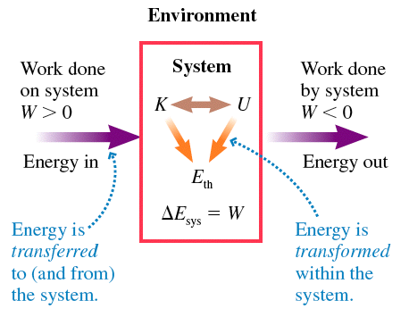
: The environment does work on the system and the system’s energy increases.
: The system does work on the environment and the system’s energy decreases.

Slide 11
Leo is doing a bench press, and he holds the bar above him for 0.30 seconds while pushing upwards on the bar with a force of 200 N. The bar does not move.

Slide 12
Leo is doing a bench press, and he slowly pushes the bar up a distance of 0.30 m while pushing upwards on the bar with a force of 200 N. The bar moves with a constant velocity during this time.

Slide 13
Leo is doing a bench press, and he slowly lowers the bar down a distance of 0.30 m while pushing upwards on the bar with a force of 200 N. The bar moves with a constant velocity during this time.

Slide 14
Leo is doing a bench press, and he slowly lowers the bar down a distance of 0.30 m while pushing upwards on the bar with a force of 200 N. He then pushes it up slowly the same distance of 0.30 m back to its starting position, also pushing upwards on the bar with a force of 200 N.

Slide 15
Before Class 17 on Monday
Remember there is a MasteringPhysics.com problem set due today. If you haven’t already done it, please submit this before 11:59pm tonight.
Monday’s class will be review for the test, which is on Tuesday at 6:00pm.
The test will cover Chapters 4-10, and Sections 11.1 through 11.3.
You must bring a calculator and one 8.5x11’ aid sheet which you prepare, double-sided

