Slide 1
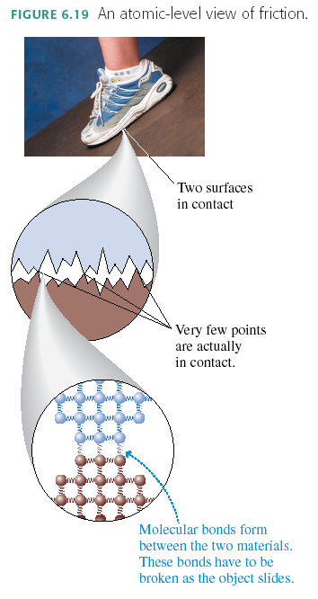
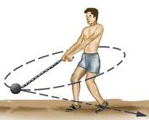
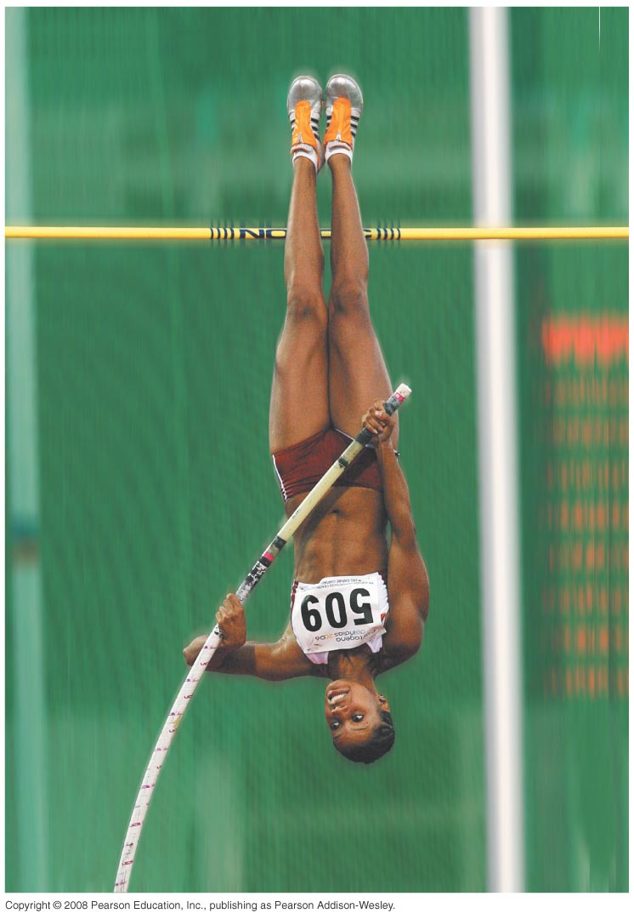
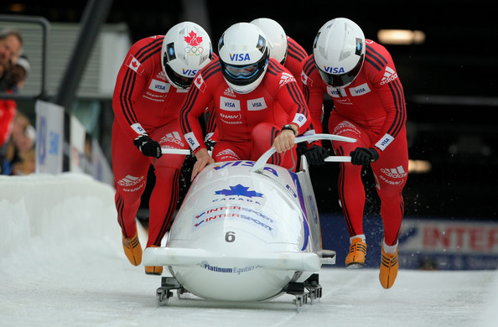
PHY131H1S - Class 17
Today:
Review for Test 2!

Slide 3
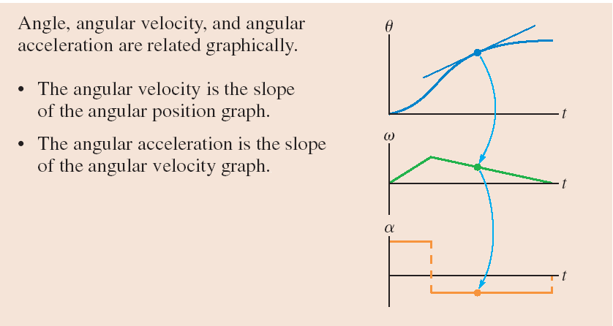
Determines the Tangential acceleration

Slide 4
Summary of definitions:
θ is angular position. The S.I. Unit is radians, where 2π radians = 360°.
s is the path length along the curve: s = θr when θ is in [rad].
ω is angular velocity. The S.I. Unit is rad/sec.
v_{t} is the tangential speed: v_{t} = ωr when ω is in [rad/s].
α is angular acceleration. The S.I. Unit is rad/sec².
a_{t} is the tangential acceleration: a_{t} = αr when α is in [rad/s²].

Slide 5
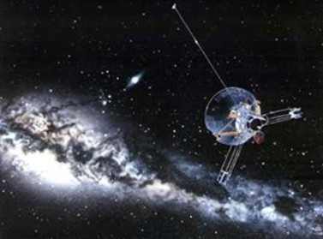
1
Newton’s First Law
The natural state of an object with no net external force on it is to either remain at rest or continue to move in a straight line with a constant velocity.

Slide 6
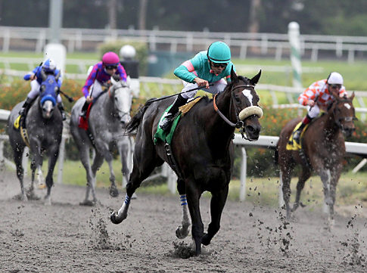
2
Newton’s Second Law
The acceleration of an object is directly proportional to the net force acting on it, and inversely proportional to its mass.

Slide 7
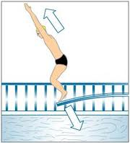
3
Newton’s Third Law
If object 1 acts on object 2 with a force, then object 2 acts on object 1 with an equal force in the opposite direction.

Slide 8
4
Newton’s Universal Law of Gravitation
Two particles of mass m₁ and m₂, a distance r apart, will experience an attractive force:
where G = 6.67 × 10^{–11} Nm² kg^{–2}. Near the surface of the Earth, the dominant source of gravity is from the Earth itself. On an object of mass, m, this force is:
where g = 9.80 N kg^{–1}.

Slide 9
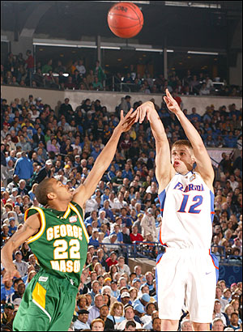
Consider a basketball in freefall.
Action: Earth pulls down on ball
Reaction: ball pulls up on Earth, with equal force. But the acceleration is not equal.
F_{net}
a =
m
m
F_{net}
=
a

Slide 10
The “Fine Print”
WARNING: Newton’s Laws only apply in a “inertial reference frames”. They are not valid if your reference frame is accelerating!
An inertial reference frame is one that is not accelerating.
If you are in a reference frame that is accelerating, your own inertia will cause you to accelerate relative to this frame. Since acceleration is normally caused by outside forces, some people describe such acceleration as due to “fictitious forces”. But fictitious forces do not exist in inertial reference frames.

Slide 11
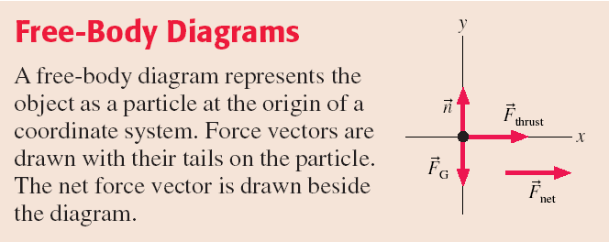

Slide 12
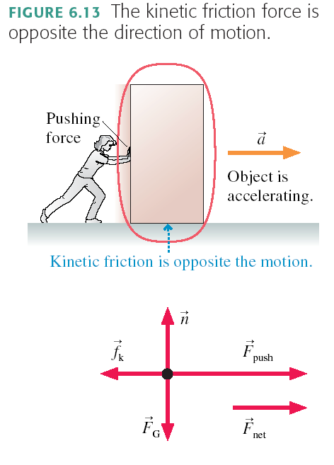
Kinetic Friction
When two surfaces slide against one another, the size of the normal force is related to the size of the kinetic friction force. Many experiments show the following approximate relation:
where n is the magnitude of the normal force, and the proportionality constant μ_{k} is called the “coefficient of kinetic friction”.

Slide 13
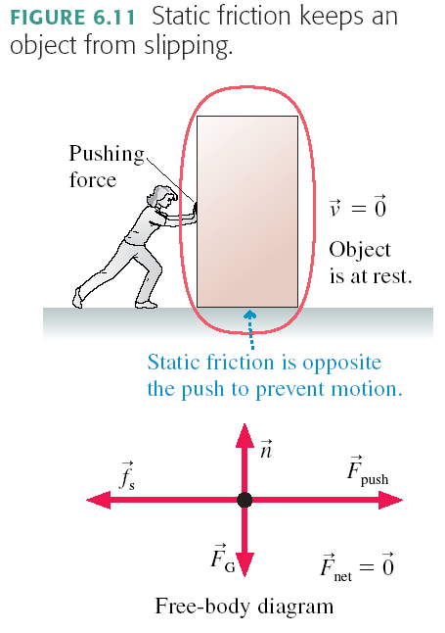
Static Friction
Example: The box is in static equilibrium, so the static friction must exactly balance the pushing force:
This is not a general, “all-purpose” equation. It is found from looking at the free body diagram and applying horizontal equilibrium, since a_{x} = 0.

Slide 14
Static Friction
There’s a limit to how big f_{s} can get. If you push hard enough, the object slips and starts to move. In other words, the static friction force has a maximum possible size f_{s max}.
The two surfaces don’t slip against each other as long as f_{s} ≤ f_{s max}.
A static friction force f_{s} > f_{s max} is not physically possible. Many experiments have shown the following approximate relation usually holds:
where n is the magnitude of the normal force, and the proportionality constant μ_{s} is called the “coefficient of static friction”.

Slide 15
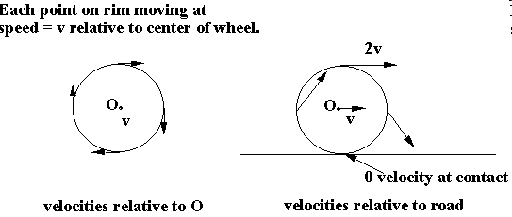
Rolling without slipping

Slide 16
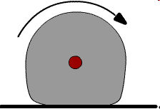
Rolling Friction
Due to the fact that the wheel is soft, and so is the surface upon which it is rolling. Plowing effect produces a force which slows down the rolling.

Slide 17
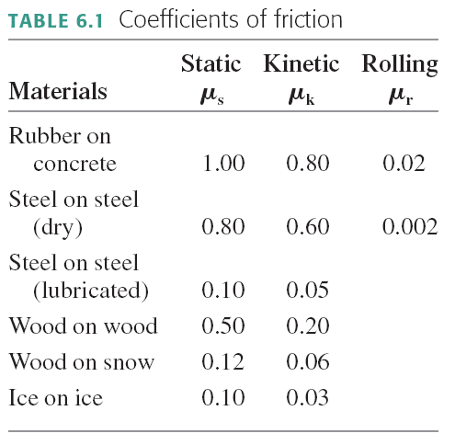

Slide 18
Drag force in a fluid, such as air
Air resistance, or drag, is complex and involves fluid dynamics.
For objects on Earth, with speeds between 1 and 100 m/s and size between 1 cm and 2 m, there is an approximate equation which predicts the magnitude of air resistance
where A is the cross-sectional area of the object, and v is the speed.
The direction of air resistance, or Drag Force, is opposite to the direction of motion.
It depends on size and shape, but not mass.

Slide 19
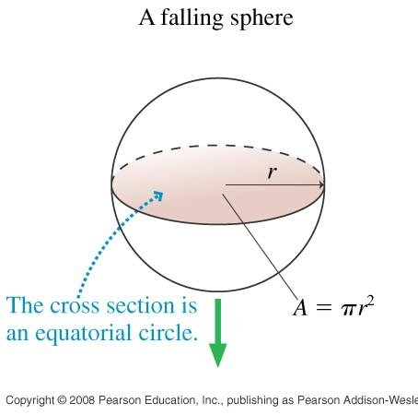
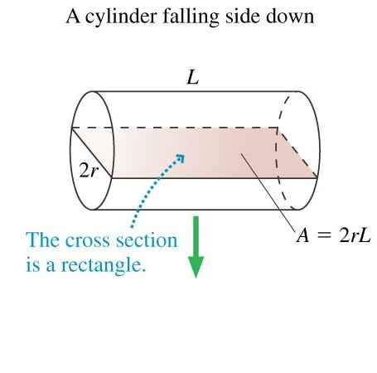
Cross Sectional Area depends on size, shape, and direction of motion.
…Consider the forces on a falling piece of paper, crumpled and not crumpled.

Slide 20
The Massless String Approximation
If the string has mass, m, and the system is accelerating toward the right, then there must be a net force on the string toward the right equal to ma. Therefore:
T_{B on S} = T_{A on S} + ma
This tension will vary linearly between the left and right end.

Slide 21
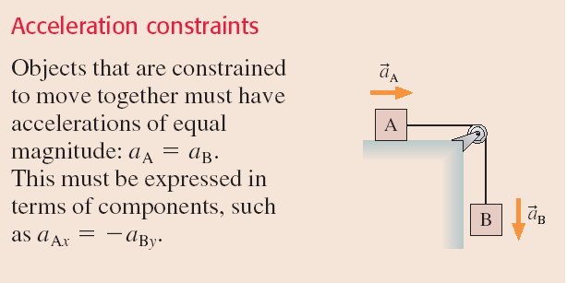
Pulleys

Slide 22
Dynamics in Two Dimensions
Suppose the x- and y-components of acceleration are independent of each other. That is, a_{x} does not depend on y or v_{y}, and a_{y} does not depend on x or v_{x}.
You can then use Newton’s second law in component form:

Slide 23
Momentum
Momentum is the product of a particle’s mass and velocity, has units of kg m/s, and is given by
An object can have a larger momentum if it is:
moving faster or,
has more mass
Note: Momentum is a vector quantity. It has both x and y components.

Slide 24
Impulse
The impulse upon a particle is defined as
Impulse has units of N s, but you should be able to show that N s are equivalent to kg m/s.
The impulse-momentum theorem states that the change in a particle’s momentum is equal to the impulse on it.

Slide 25
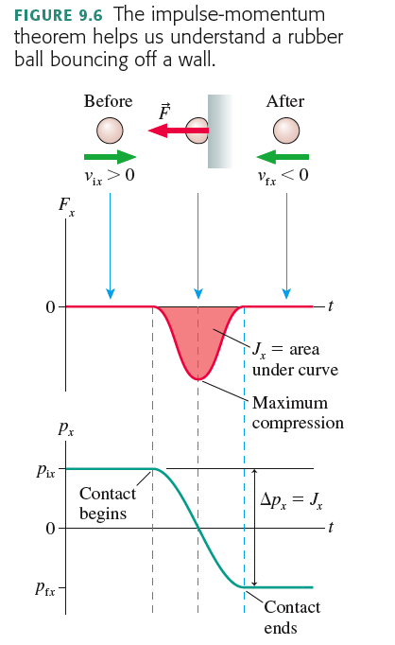

Slide 26
Chapter 9 big idea: “Conservation of Momentum”
A system of particles has a total momentum,
If the system is isolated, meaning that there is no external net-force acting on the system, then:
This means the momentum is “conserved”; it doesn’t change over time.

Slide 27
Kinetic and Potential Energy
Work is a form of energy which gets transferred to an object when a force is acted upon it over a certain distance.
There are many other forms of energy. For examples:
Kinetic energy is an energy of motion:
Gravitational potential energy is an energy of position:

Slide 28
Chapter 10 big idea: “Conservation of Energy”
A system of particles has a total energy, E.
If the system is isolated, meaning that there is no work or heat being added or removed from the system, then:
E_{f} = E_{i}
This means the energy is “conserved”; it doesn’t change over time.
This is also the first law of thermodynamics; “You can’t get something for nothing.”

Slide 29
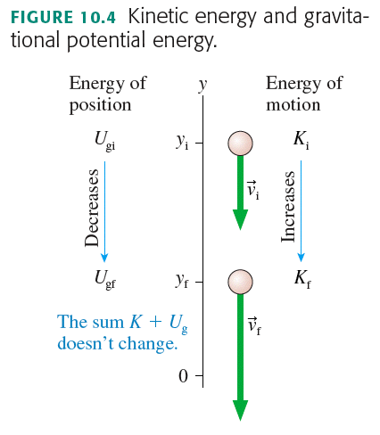

Slide 30
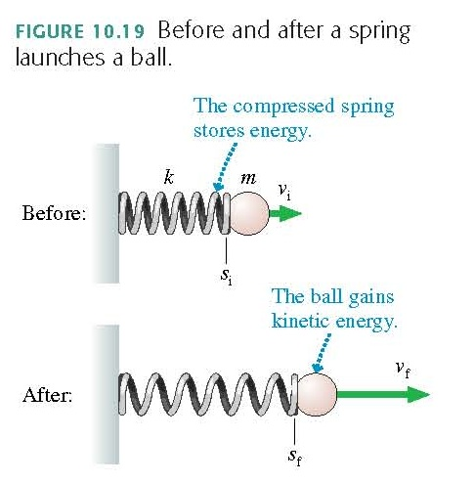
Elastic Potential Energy
Consider a before-and-after situation in which a spring launches a ball. The compressed spring has “stored energy,” which is then transferred to the kinetic energy of the ball. We define the elastic potential energy U_{s} of a spring to be

Slide 31
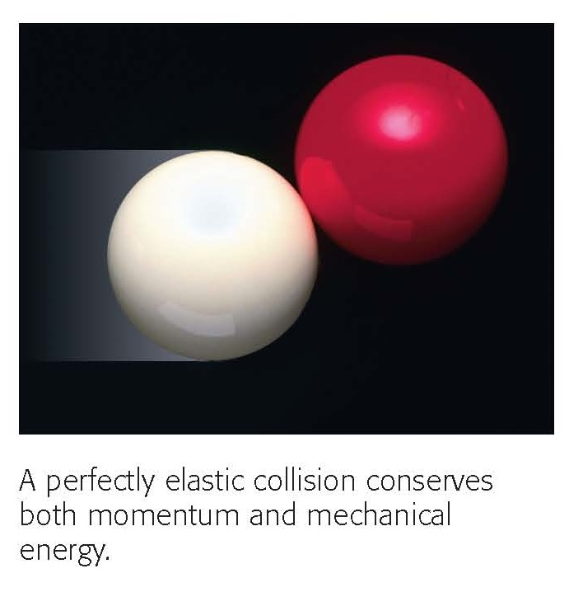
Elastic Collisions

Slide 32
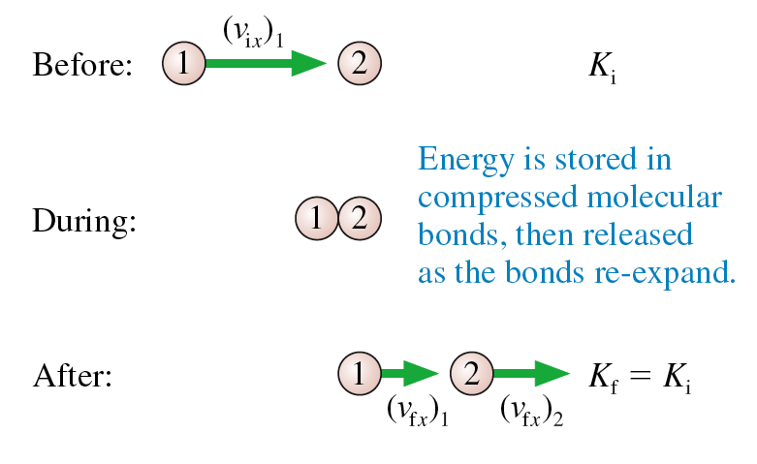
1D Elastic Collision when ball 2 is initially at rest.
Consider a head-on, perfectly elastic collision of a ball of mass m₁ having initial velocity (v_{ix})₁, with a ball of mass m₂ that is initially at rest.
The balls’ velocities after the collision are (v_{fx})₁ and (v_{fx})₂.

Slide 33
Elastic Collision when ball 2 is initially at rest.
The answer is Eqs. 10.43:
These equations come in especially handy, because you can always switch into an inertial reference frame in which ball 2 is initially at rest!

Slide 34
Work
A force is applied to an object.
The object moves while this force is being applied.
The work done by a constant force is the dot-product of the force and the displacement:
W = F r cosθ

Slide 35
Work
W = F r cosθ
If the force has a component in the direction of the displacement, the work is positive.
If the force has a component opposite the direction of the displacement, the work is negative (energy is removed from the object by the force)
If the force is perpendicular to the displacement, work=0 and the object’s energy does not change. Normal force often has this property.

Slide 36
Calories
One food Calorie (note the capital “C”, also sometimes called a kilocalorie) is equal to 4186 Joules.
Fat is a good form of energy storage because it provides the most energy per unit mass.
1 gram of fat provides about 9.4 (food) Calories.
Example. Your mass is 70 kg. You climb the stairs of the CN Tower, a vertical distance of 340 m. How much energy does this take (minimum)?
How much fat will you burn doing this?

Slide 37
Before Class 18 on Wednesday
Please read the rest of Chapter 11: Sections 11.4 through 11.9, and the Part II Summary
Something to think about: What’s the difference between a Watt, a kiloWatt, and a kiloWatt-hour?

