Slide 1
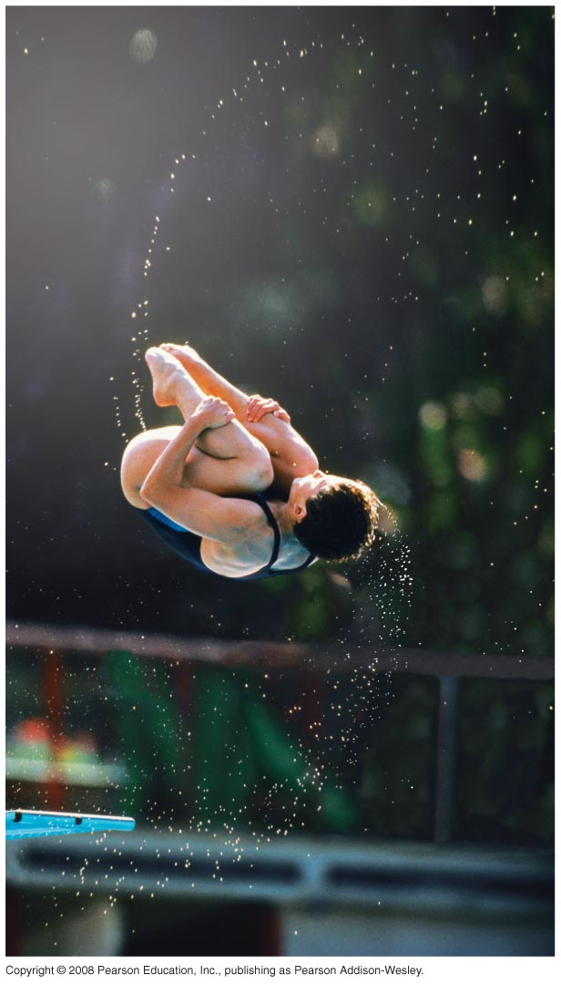
PHY131H1S - Class 19
Today:
Rotational Motion, Rotational Kinematics (some review of Ch.4)
Newton’s 2nd Law of Rotation
Torque
Moment of Inertia
Centre of Mass
Gravitational Torque

Slide 2
Pre-class reading quiz on Chapter 12
Notes:
Answer: A

Slide 3
Last day I asked at the end of class:
Why is a door easier to open when the handle is far from the hinge, and more difficult to open when the handle is in the middle?
ANSWER:

Slide 4
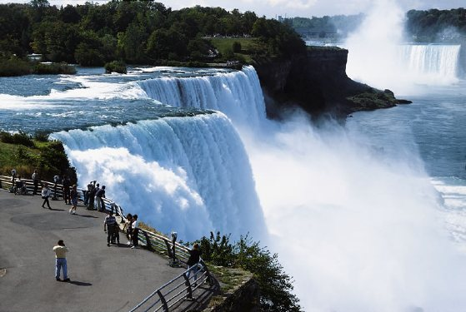
Power
The rate at which energy is transferred or transformed is called the power, P, and it is defined as
The unit of power is the watt, which is defined as 1 watt = 1 W = 1 J/s. Energy is measured by Ontario Hydro in kWh = “kiloWatt•hours”.

Slide 5
Recall from Chapters 1-4:
Linear
Rotational Analogy
specifies position.
Velocity:
Acceleration:
is angular position. The S.I. Unit is radians, where 2π radians = 360°.
Angular velocity:
Angular acceleration:

Slide 6
Linear / Rotational Analogy
Linear
Rotational Analogy
x
v_{x}
a_{x}
Force:
Mass:
θ
ω
α
Torque:
Moment of Inertia:
Newton’s Second Law:

Slide 7
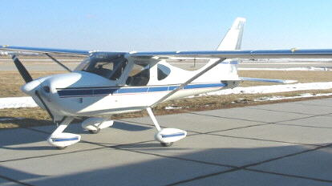
Example 12.12
The engine in a small airplane is specified to have a torque of 60.0 N m. This engine drives a propeller whose moment of inertia is 13.3 kg m². On start-up, how long does it take the propeller to reach 200 rpm?

Slide 8
Torque
Consider the common experience of pushing open a door. Shown is a top view of a door hinged on the left. Four pushing forces are shown, all of equal strength. Which of these will be most effective at opening the door?

Slide 9
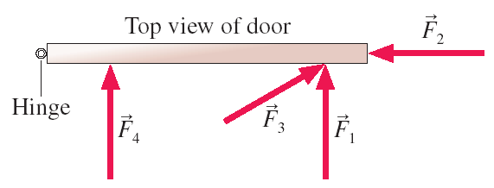
Torque
Consider the common experience of pushing open a door. Shown is a top view of a door hinged on the left. Four pushing forces are shown, all of equal strength. F₁ is most effective at opening the door.
The ability of a force to cause a rotation depends on three factors:
the
the
the

Slide 10
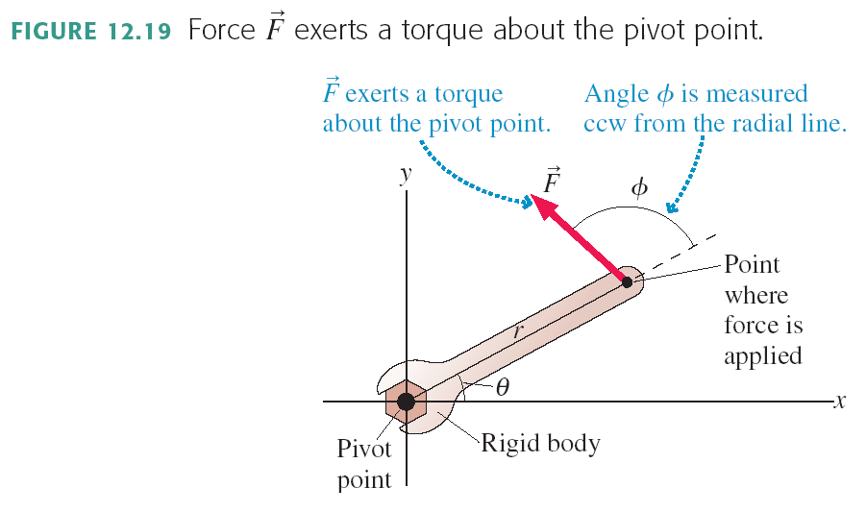

Slide 11
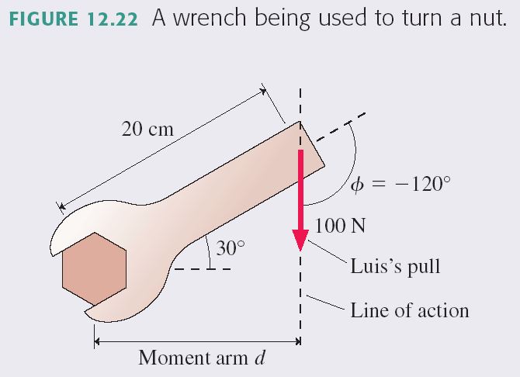

Slide 12
Consider a body made of N particles, each of mass m_{i}, where i = 1 to N. Each particle is located a distance r_{i} from the axis of rotation. We define moment of inertia:
The units of moment of inertia are kg m². An object’s moment of inertia depends on the axis of rotation.

Slide 13
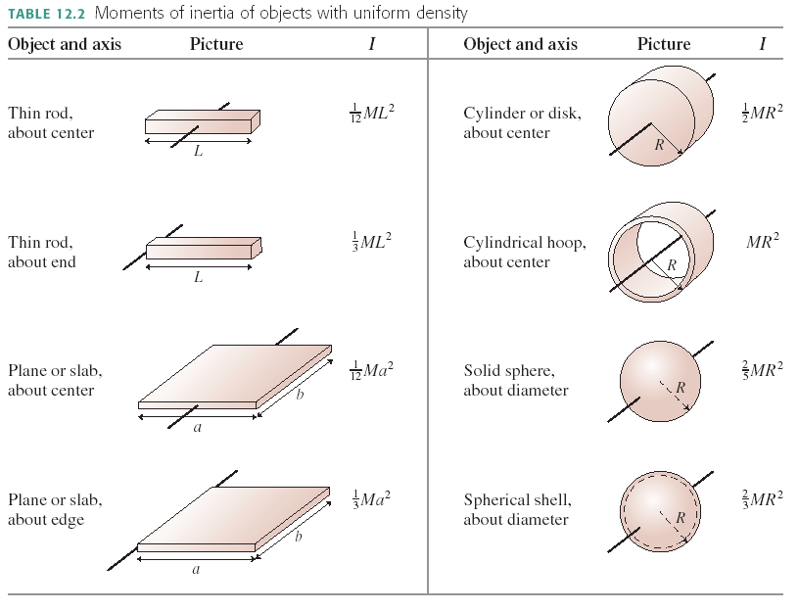

Slide 17
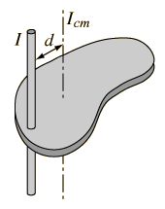
The Parallel-Axis Theorem
Suppose you know the moment of inertia of an object when it rotates about axis 1: I₁
You can find the moment of inertia when it is rotating about an axis 2, (I₂) which is a distance d away:

Slide 18
Four Ts are made from two identical rods of equal mass and length. Rank in order, from largest to smallest, the moments of inertia I_{a} to I_{d} for rotation about the dotted line.
Notes:
Answer: A

Slide 19
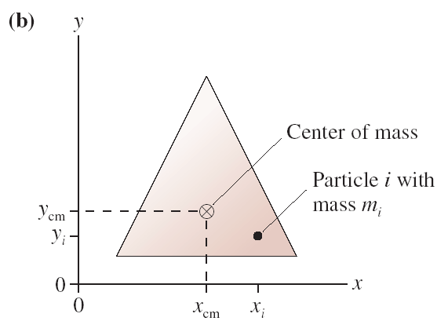
Center of Mass
The center of mass is the mass-weighted center of the object.

Slide 20
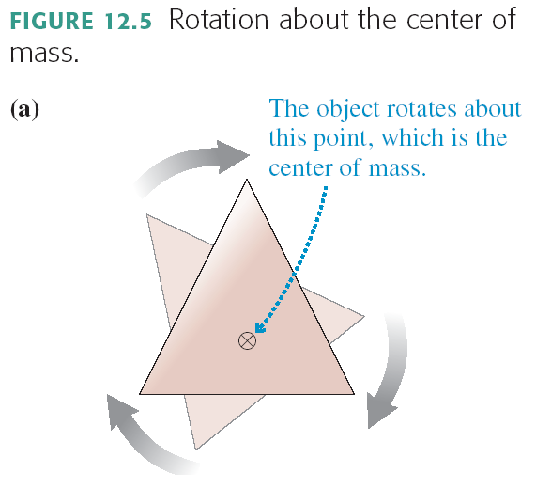
Rotation About the Center of Mass
An unconstrained object (i.e., one not on an axle or a pivot) on which there is no net force rotates about a point called the center of mass. The center of mass remains motionless while every other point in the object undergoes circular motion around it.

Slide 21
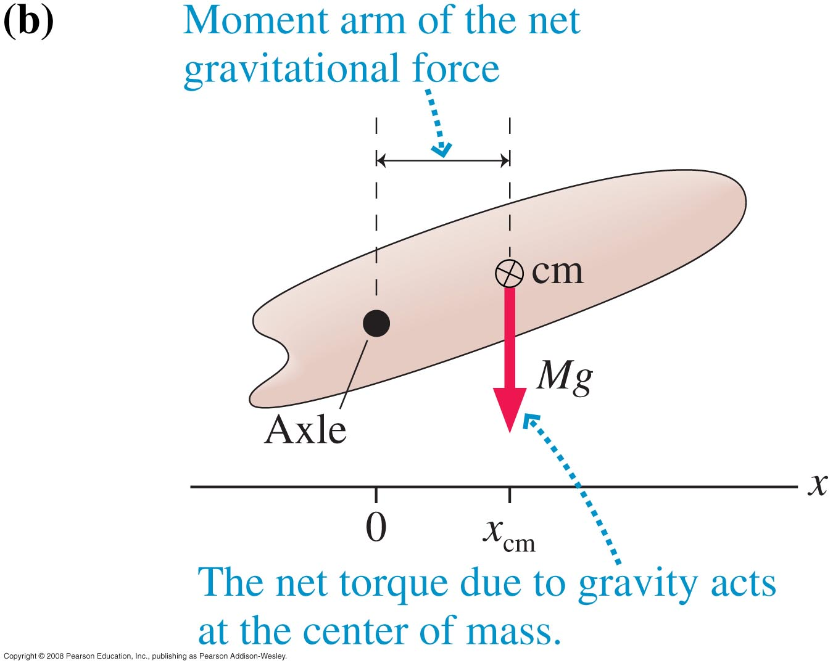
Gravitational Torque
When calculating the torque due to gravity, you may treat the object as if all its mass were concentrated at the centre of mass.

Slide 22
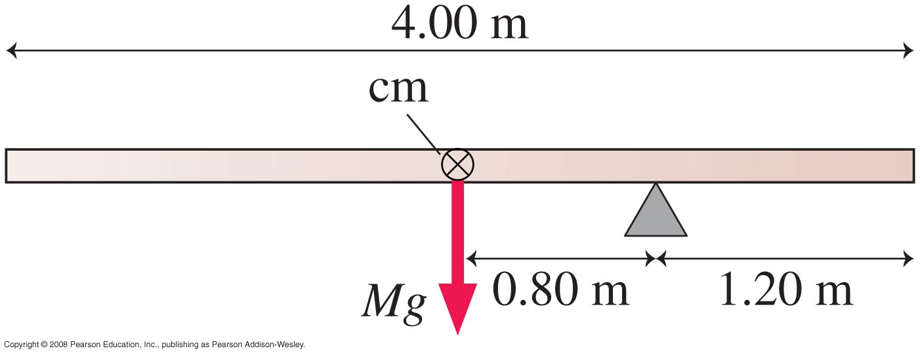
Example 12.10
A 4.00 m long, 500 kg steel beam is supported 1.20 m from the right end. What is the gravitational torque about the support?

Slide 23
A metal hoop has the same mass and radius as a wooden disk. They are both released from rest at the top of an incline, and allowed to roll down, without slipping. Which will roll faster down the incline?
Metal hoop
Wooden disk
Neither; both will roll at the same speed.

Slide 24
Before Class 20 on Wednesday
Please finish reading Chapter 12 of Knight.
Something to think about:
As an object rolls down a hill, it loses gravitational potential energy and picks up kinetic energy. The change in potential energy comes from the change in height only.
So why did that wooden disk roll faster down the hill than the metal hoop?

