Slide 1
PHY131H1S - Class 20
Today:
Gravitational Torque
Rotational Kinetic Energy
Rolling without Slipping
Equilibrium with Rotation
Rotation Vectors
Angular Momentum

Slide 2
Pre-class reading quiz on Chapter 12
Notes:
Answer: E

Slide 3
Last day I asked at the end of class:
Why did that wooden disk roll faster down the hill than the metal hoop?
ANSWER:

Slide 4
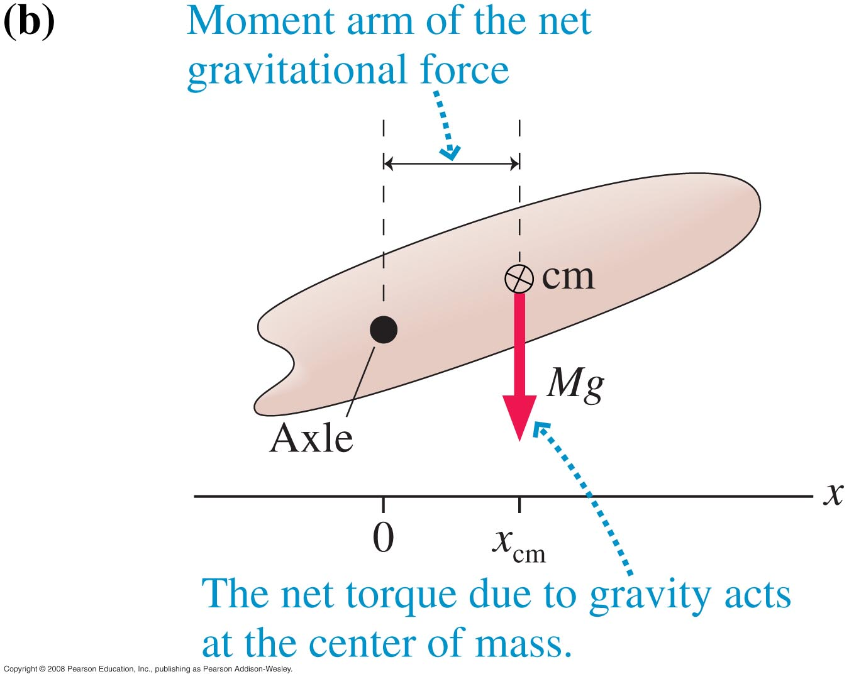
Gravitational Torque
When calculating the torque due to gravity, you may treat the object as if

Slide 5
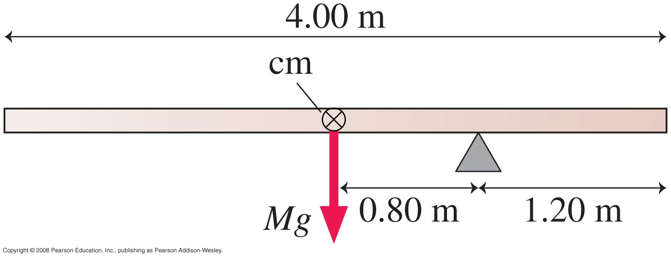
Example 12.10
A 4.00 m long, 500 kg steel beam is supported 1.20 m from the right end. What is the gravitational torque about the support?

Slide 6
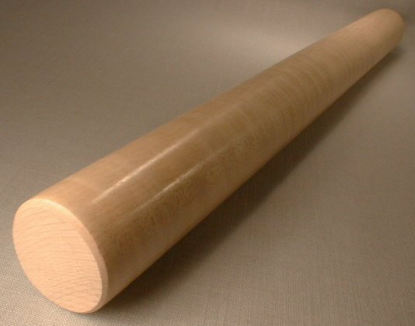
“Rolling Without Slipping”
When a round object rolls without slipping, the distance the axis, or centre of mass, travels is equal to the change in angular position times the radius of the object.
The speed of the centre of mass is
The acceleration of the centre of mass is

Slide 7
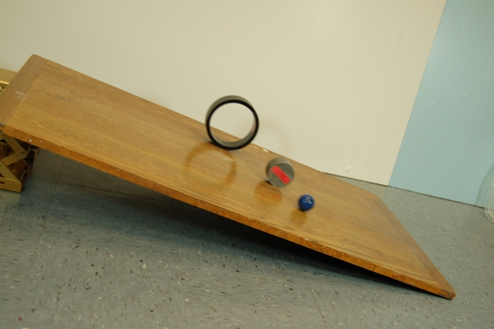
Examples:
What is the acceleration of a slipping object down a ramp inclined at angle θ? [assume no friction]
What is the acceleration of a solid disk rolling down a ramp inclined at angle θ? [assume rolling without slipping]
What is the acceleration of a hoop rolling down a ramp inclined at angle θ? [assume rolling without slipping]

Slide 8
Linear / Rotational Analogy
Linear
Rotational Analogy
, ,
Force:
Mass: m
θ, ω, α
Torque: τ
Moment of Inertia: I
Newton’s 2nd law:
Kinetic energy:

Slide 9
Rotational Energy
A rotating rigid body has kinetic energy because all atoms in the object are in motion. The kinetic energy due to rotation is called rotational kinetic energy.
Example: A 0.50 kg basketball rolls along the ground at 1.0 m/s. What is its total kinetic energy? [linear plus rotational]

Slide 10
Summary of some Different Types of Energy:
Kinetic Energy due to linear motion of centre of mass:
Gravitational Potential Energy
Spring Potential Energy:
Rotational Kinetic Energy:
Thermal Energy (often created by friction)
An object can possess any or all of the above.
One way of transferring energy to or out of an object is work:
Work done by a constant force:

Slide 11
Updated Conservation of Energy…

Slide 12
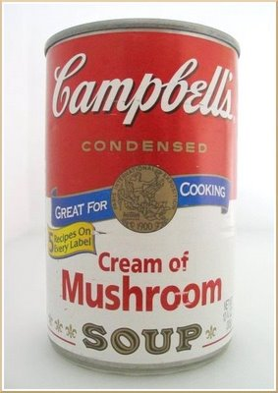
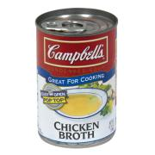
Compare and Contrast Soup Cans
About same mass
About same radius and shape
Thick paste, so when this can is rolling, the contents rotate along with the can as one solid object, like a solid cylinder
Low viscosity liquid, so the can itself rolls while the liquid may just “slide” along.

Slide 13
Soup Race
Two soup cans begin at the top of an incline, are released from rest, and allowed to roll without slipping down to the bottom. Which will win?
Predict:
Cream of Mushroom will win
Chicken Broth will win
Both will reach the bottom at about the same time.

Slide 14
Equilibrium When Rotation is Possible
The condition for a rigid body to be in static equilibrium is that there is no net force and no net torque.
An important branch of engineering called statics analyzes buildings, dams, bridges, and other structures in total static equilibrium.
No matter which pivot point you choose, an object that is not rotating is not rotating about that point.
For a rigid body in total equilibrium, there is no net torque about any point.

Slide 15
Static Equilibrium Problems
In equilibrium, an object has no net force and no net torque.
Draw an extended free-body diagram that shows where each force acts on the object.
Set up x and y axes, and choose a rotation axis. All of these choices should be done to simplify your calculations.
Each force has an x and y component and a torque. Sum all of these up.
Three equations which you can use are:

Slide 16
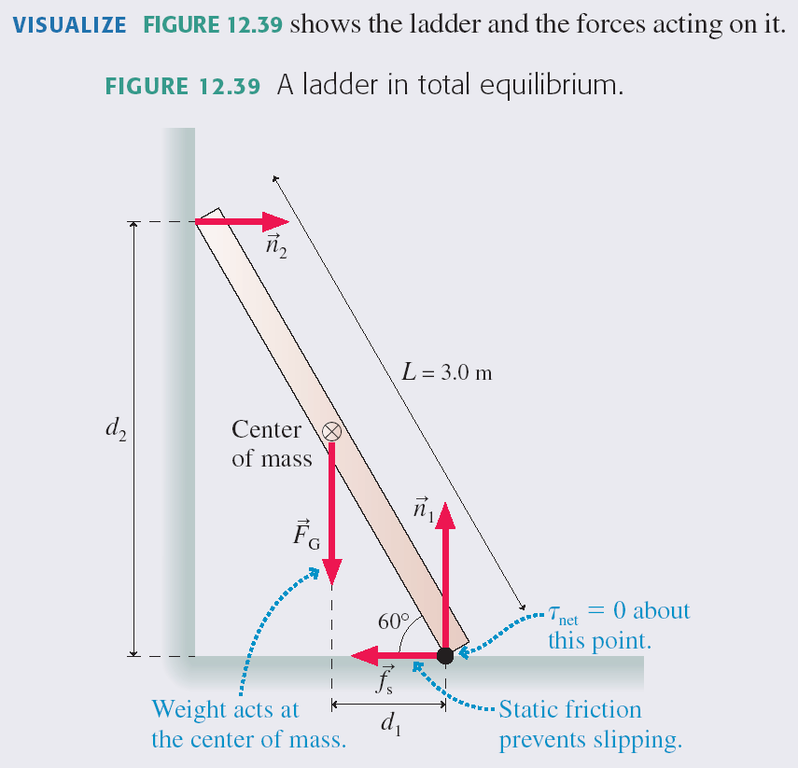

Slide 17
A student holds a meter stick straight out with one or more masses dangling from it. Rank in order, from most difficult to least difficult, how hard it will be for the student to keep the meter stick from rotating.
Notes:
Answer: D

Slide 18
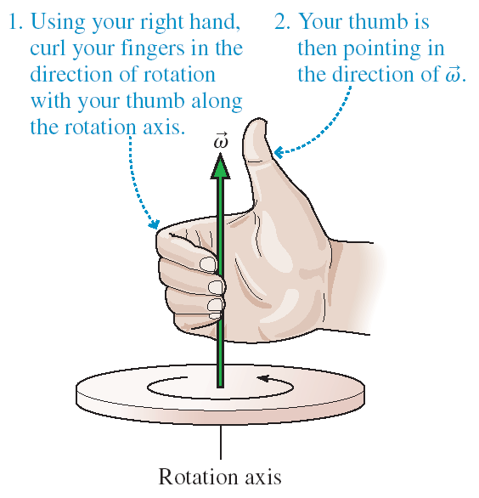
The Angular Velocity Vector
The magnitude of the angular velocity vector is ω.
The angular velocity vector points along the axis of rotation in the direction given by the right-hand rule as illustrated above.

Slide 19
Linear / Rotational Analogy
Linear
Rotational Analogy
, ,
Force:
Mass: m
θ, ω, α
Torque: τ
Moment of Inertia: I
Newton’s 2nd law:
Kinetic energy:
Momentum:

Slide 20
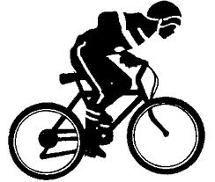
A bicycle is traveling toward the right.

Slide 21
If there is no net external force on a system, then its momentum is a constant.
If there is no work or heat being exchanged with a system and its surroundings, then its energy is constant.
If there is no net external torque on a system, then its angular momentum is a constant.

Slide 22
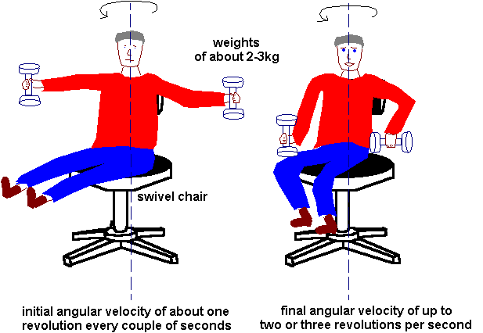
I is high
I is low
is constant when there are no external torques.

Slide 23
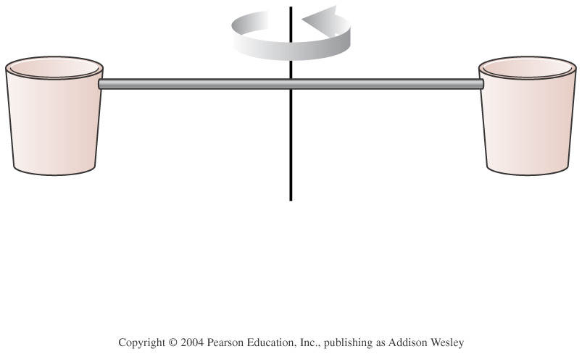
Two buckets spin around in a horizontal circle on frictionless bearings. Suddenly, it starts to rain. As a result,
Notes:
Answer: C

Slide 24
Before Class 21 on Monday
There is a MasteringPhysics problem set due tonight! Please submit this before 11:59pm if you have not already done so.
Please read Knight Chapter 14, sections 14.1 through 14.3.
Something to think about: A block is oscillating on a spring with a period of 2 seconds.
What is the period if the mass is doubled?
What is the period if the spring constant is doubled?

