Slide 1
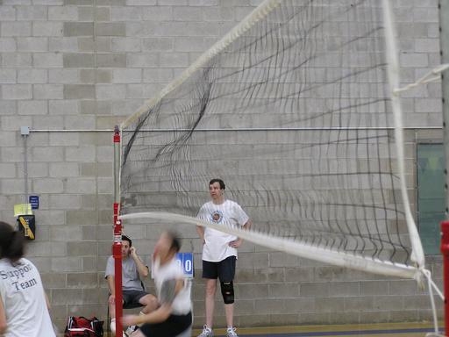
PHY131H1S - Class 21
Today:
Oscillations, Repeating Motion
Simple Harmonic Motion
Oscillations / Circular Motion Connection
Potential and Kinetic Energy in Oscillations

Slide 2
A little pre-class reading quiz on Ch.14…
Notes:
Answer: B

Slide 3
Last day I asked at the end of class:
A block is oscillating on a spring with a period of 2 seconds.
What is the period if the mass is doubled?
ANSWER:
What is the period if the spring constant is doubled?
ANSWER:

Slide 4
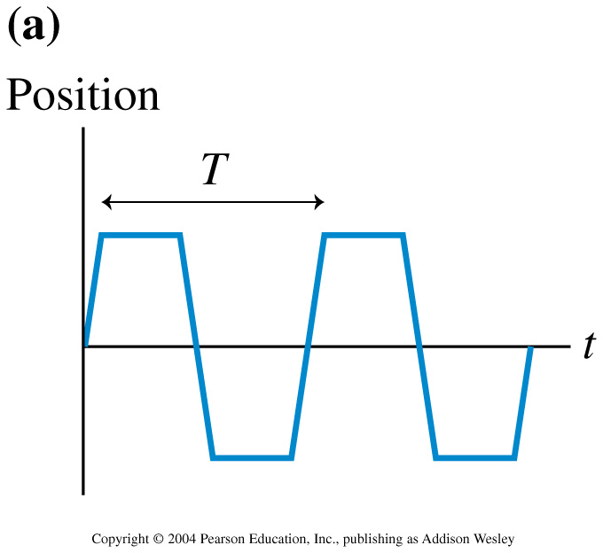
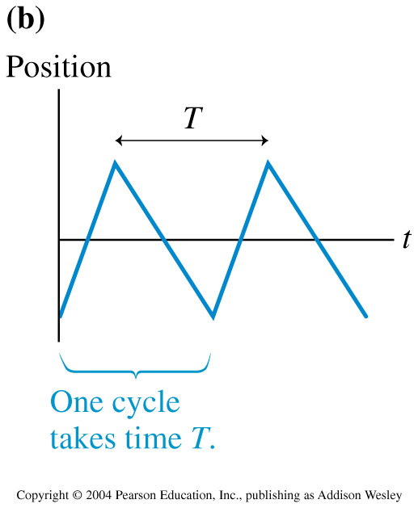
Some oscillations are not sinusoidal:

Slide 5
Period, frequency, angular frequency
The time to complete one full cycle, or one oscillation, is called the period, T.
The frequency, f, is the number of cycles per second. Frequency and period are related by
The oscillation frequency f is measured in cycles per second, or Hertz.
We may also define an angular frequency ω in radians per second, to describe the oscillation.

Slide 6
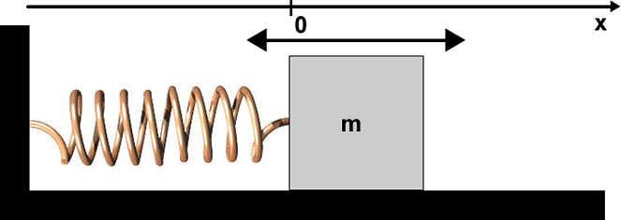
The Spring-Mass System
The force exerted on the mass by the spring: F = −k x (Hooke’s Law)
F = m a (Newton’s Second Law)
Combine to form a differential equation:

Slide 7
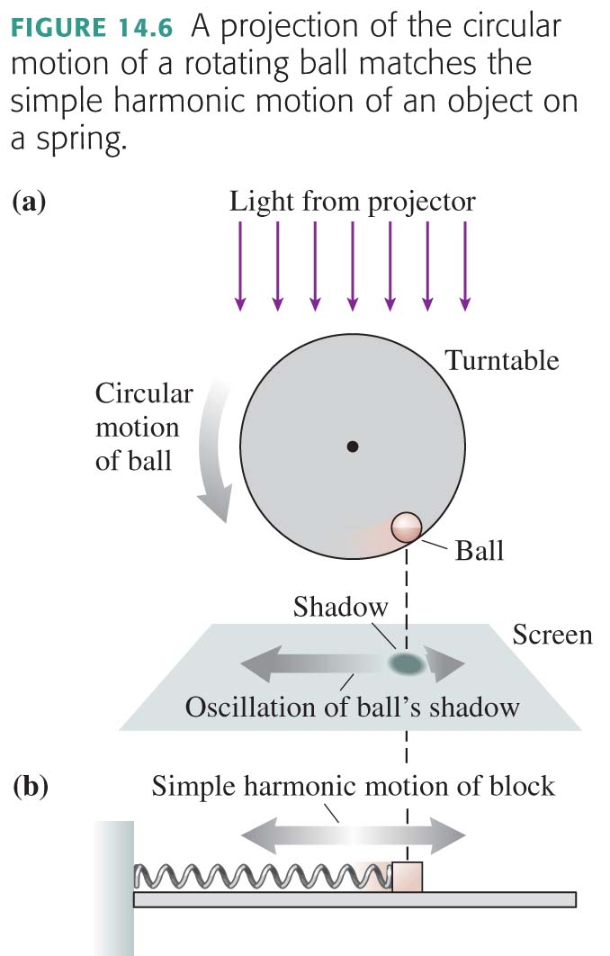
Weird coincidence noted by Knight:

Slide 8
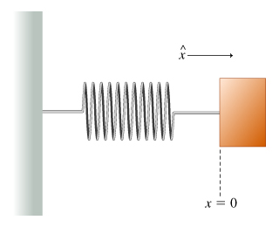
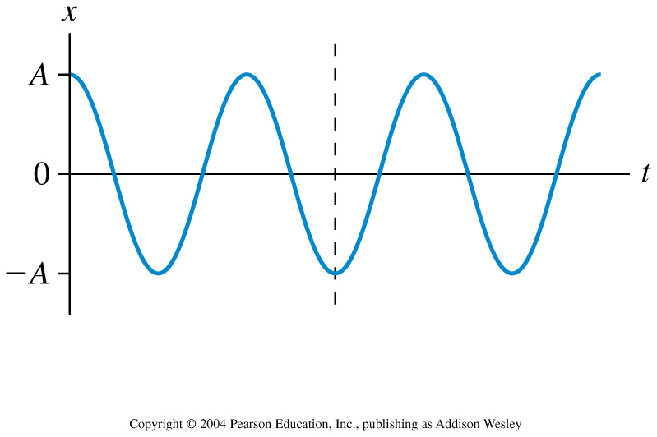
This is the position graph of a mass on a spring. What can you say about the velocity and the force at the instant indicated by the dotted line?
Notes:
STT14.4

Slide 9
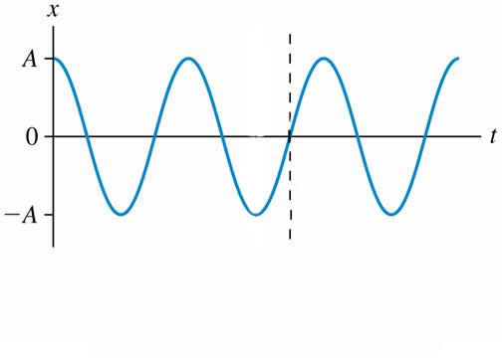
This is the position graph of a mass on a spring. What can you say about the velocity and the force at the instant indicated by the dotted line?
Notes:
STT14.4

Slide 10
Simple Harmonic Motion
If the initial position of an object in SHM is not A, then we may still use the cosine function, with a phase constant measured in radians.
In this case, the two primary kinematic equations of SHM are:

Slide 11
An object moves with simple harmonic motion. If the amplitude and the period are both increased by a factor of 2, the object’s maximum speed is

Slide 12
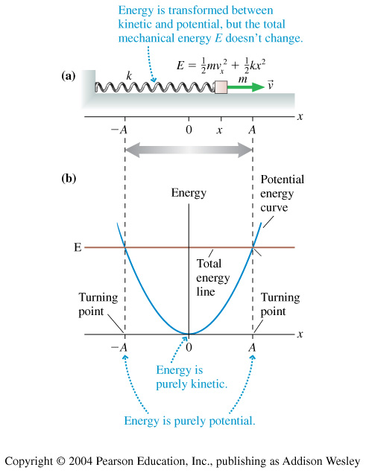
equilibrium

Slide 13
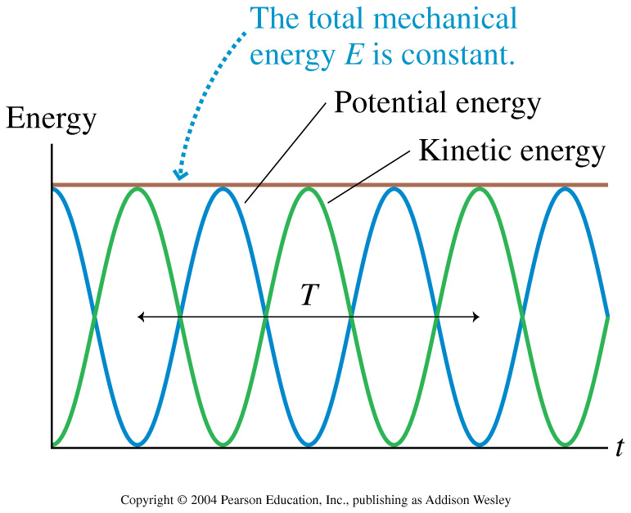

Slide 14
Gravitational Potential Energy increases with height. Elastic Potential Energy increases as a spring is stretched. Kinetic Energy increases with speed.

Slide 15
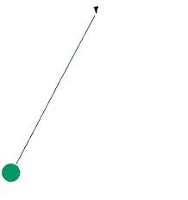
Before Class 22 on Wednesday
Please finish reading Knight Chapter 14
Something to think about: A mass hanging from a string is swinging back and forth with a period of 2 seconds.
What is the period if the mass is doubled?
What is the period if the length of the string is doubled?

