Slide 1
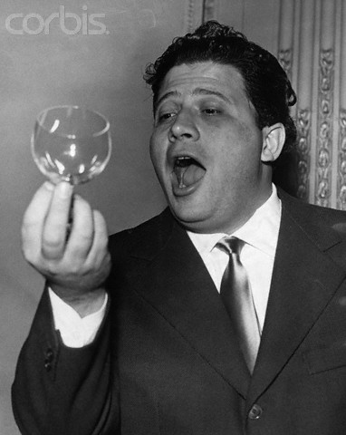
PHY131H1S - Class 22
Today:
Hanging Springs
The Pendulum
Damped Oscillations
Driven Oscillations; Resonance
Italian opera singer Luigi Infantino tries to break a wine glass by singing top 'C' at a rehearsal.

Slide 2
A little pre-class reading quiz on Ch.14…
Notes:
Answer: B

Slide 3
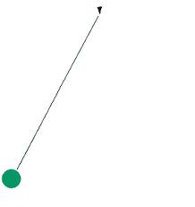
Last day I asked at the end of class:
A mass hanging from a string is swinging back and forth with a period of 2 seconds.
What is the period if the mass is doubled?
ANSWER:
What is the period if the length of the string is doubled?
ANSWER:

Slide 8
The Pendulum
Suppose we restrict the pendulum’s oscillations to small angles (< 10°). Then we may use the small angle approximation sin θ ≈ θ, where θ is measured in radians. Since θ = s/L, the net force on the mass is
and the angular frequency of the motion is found to be

Slide 9
Mass on Spring versus Pendulum
 | Mass on a Spring | Pendulum
Condition for S.H.M. | Small oscillations | Small angles
Angular frequency
Period

Slide 10
Two pendula have the same length, but different mass. The force of gravity, F=mg, is larger for the larger mass.

Slide 11
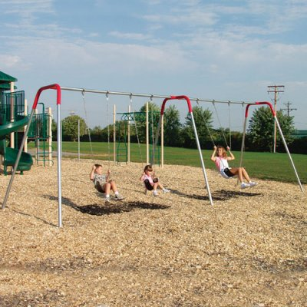
A person swings on a swing. When the person sits still, the swing oscillates back and forth at its natural frequency.

Slide 12
A person swings on a swing. When the person sits still, the swing oscillates back and forth at its natural frequency.

Slide 14
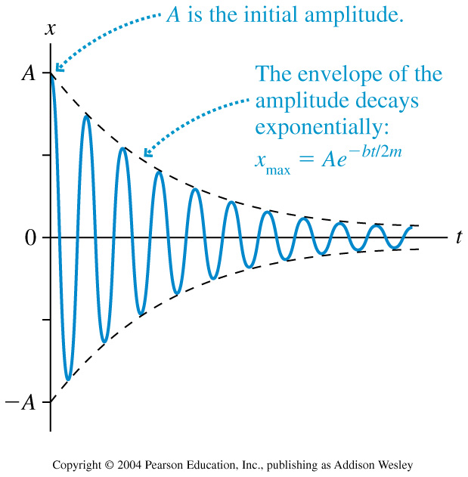
Damped Oscillations
When a mass on a spring experiences the force of the spring as given by Hooke’s Law, as well as a drag force of magnitude |D|=bv, the solution is

Slide 15
Driven Oscillations and Resonance
Consider an oscillating system that, when left to itself, oscillates at a frequency f₀. We call this the natural frequency of the oscillator.
Suppose that this system is subjected to a periodic external force of frequency f_{ext}. This frequency is called the driving frequency.
The amplitude of oscillations is generally not very high if
As gets closer and closer to , the amplitude of the oscillation rises dramatically.

Slide 16
14.8 Externally Driven Oscillations
Resonance!

Slide 17
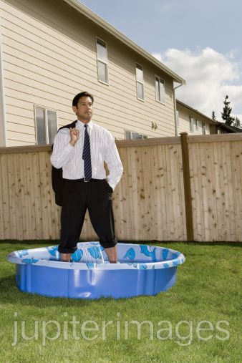
Before Class 23 on Monday
Tonight there is a MasteringPhysics Problem Set due. If you have not already done so, please submit your problem set by 11:59pm tonight.
Over the weekend, please read the first 4 sections of Chapter 15 of Knight.
Something to think about: If you stand on a waterproof bathroom scale in a wading pool, so that part of your legs are immersed in the water, will your measured weight be different than normal? If so, why?

