Slide 1
PHY131H1S - Class 24
Today:
Course Review!
The final exam, will be on Wednesday April 20 at 9:00am in BN3. (two weeks from today)
Note there are no practicals this week.
The final exam will cover Chapters 1-15, excluding unlucky Chapter 13 and the last 2 sections of chapter 15. The final exam will also cover the Error Analysis Mini-version document you were asked to read.
You are allowed TWO double-sided aid-sheets for the final exam, which you must prepare yourself.

Slide 2
A cart is covered by an enclosed transparent box. A ball is attached to the top of the box by a string. Predict: As the box is accelerating toward the right, which will be the best sketch of the situation?

Slide 3
A cart is covered by an enclosed transparent box. A helium-balloon is attached to the bottom of the box by a string. Predict: As the box is accelerating toward the right, which will be the best sketch of the situation?

Slide 4
As the cart accelerates to the right, the heavier air molecules are left behind, to the left, creating a tilted pressure gradient
Lower air Density, Pressure
Higher air Density, Pressure
Isobars (planes of equal pressure)

Slide 5
Another way of looking at it: Gravity acts like a pseudo-force, similar to the result of acceleration. This was noted by Einstein and lead to his theory of General Relativity in 1915.
Einstein’s Equivalence Principle states that “the gravitational ‘force’ as experienced locally while standing on a massive body (such as the Earth) is actually the same as the pseudo-force experienced by an observer in a non-inertial (accelerated) frame of reference.” http://en.wikipedia.org/wiki/Equivalence_principle

Slide 6
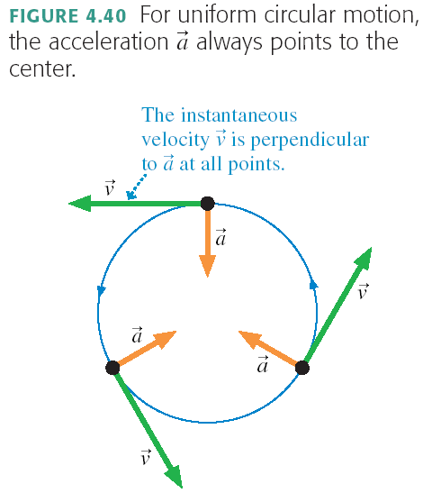
Some Review: Centripetal Acceleration

Slide 7
What is a force?
A force is a push or a pull on an object.
A force is a vector. It has both a magnitude and a direction.
A force requires an agent and a recipient. Something does the pushing or pulling, and something else gets pushed or pulled.
A force is either a contact force or a long-range force. Gravity is the only long-range force we dealt with in PHY131.
Important contact forces are: Normal, Tension and Friction (static and kinetic).

Slide 8
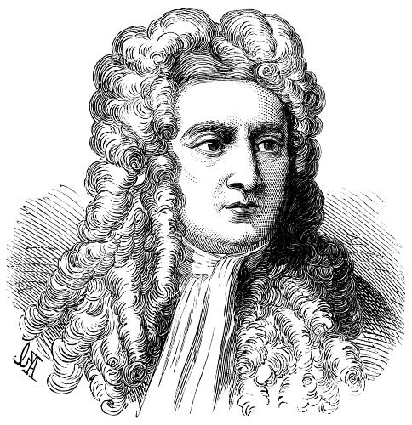
Isaac Newton
1643-1727
According to wiki, was a “physicist, mathematician, astronomer, natural philosopher, alchemist, and theologian and one of the most influential people in human history.”
In Philosophiæ Naturalis Principia Mathematica, published 1687, he described universal gravitation and the three laws of motion, laying the groundwork for classical mechanics.

Slide 9
If no force:
Newton’s first law is also known as the law of inertia. If an object is at rest, it has a tendency to stay at rest. If it is moving, it has a tendency to continue moving with the same velocity.
If object is forced:

Slide 10
Bob stands under a low concrete arch, and presses upwards on it with a force of 100 N. Bob’s mass is 82 kg. What is the normal force of the arch on Bob?

Slide 11
Bob stands under a low concrete arch, and presses upwards on it with a force of 100 N. Bob’s mass is 82 kg. What is the normal force of the ground on Bob? (Note that 82 × 9.8 = 800.)

Slide 12
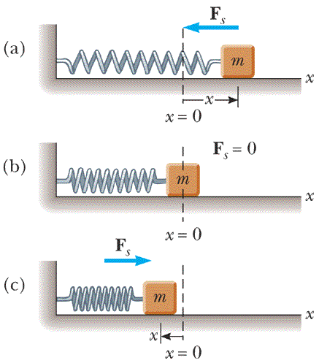
Simple Harmonic Motion: Restoring Force provided by Hooke’s Law

Slide 13
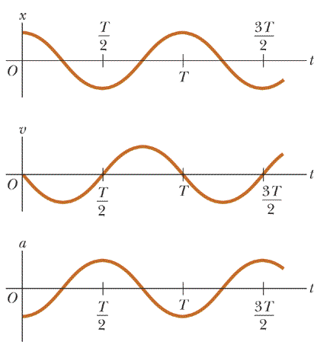
x,v,a for Simple Harmonic Motion

Slide 14
x
P
t

Slide 15
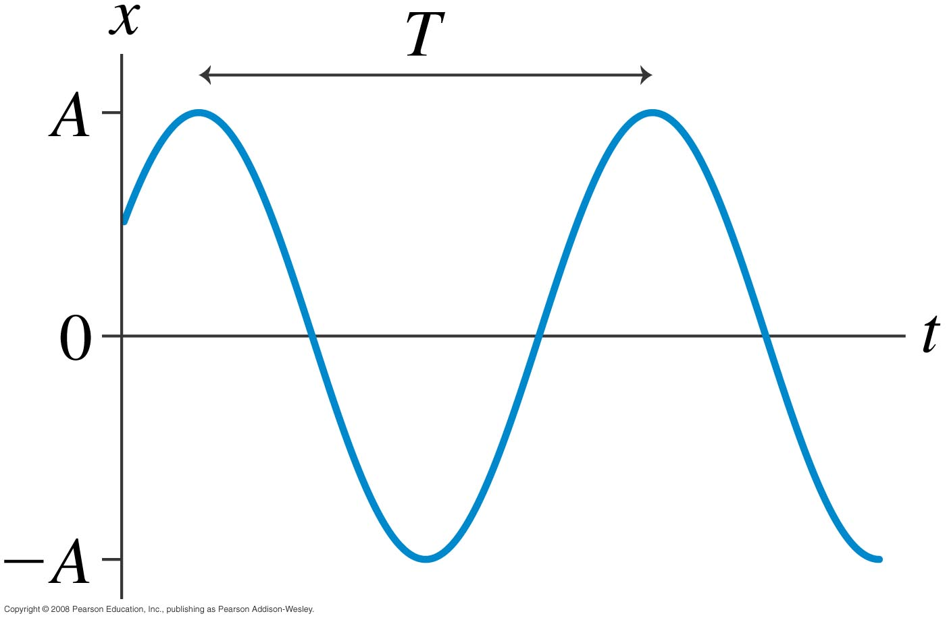
Simple Harmonic Motion notes…
S.H.M. is not constant acceleration, or constant force – both vary with time.
S.H.M. results when restoring force is proportional to displacement. Other types of oscillatory motion are possible, but not discussed in this course.
Angular frequency ω = 2π/T, where T = period.
(T = 2π/ω)
“frequency” f = 1/T (in Hertz)

Slide 16
Gravitational Field Note: Prep for PHY132
When a mass m is near the surface of the Earth, it has a potential energy, given by
where y is the vertical height, and U₀ is an arbitrary constant, in Joules.
Since m is so much smaller than the mass of the Earth, we can think of m as a “test particle”.
No matter where we place m, it has a gravitational potential energy due to the Earth.
We can think of this as a property of the space itself: the gravitational potential energy field.
This is a scalar field: a number is associated with every (x,y,z) point in space.

Slide 17
Gravitational Field Note: Prep for PHY132
Recall from section 11.6, eq.11.28: The Force on an object is the negative of the gradient of its potential energy.
No matter where we place m, there is a gravitational force at every point in space due to the Earth, which is the negative gradient of the potential energy.
We can think of this as a property of the space itself: the gravitational force field.
This is a vector field. A vector is associated with every (x,y,z) point in space.

Slide 18
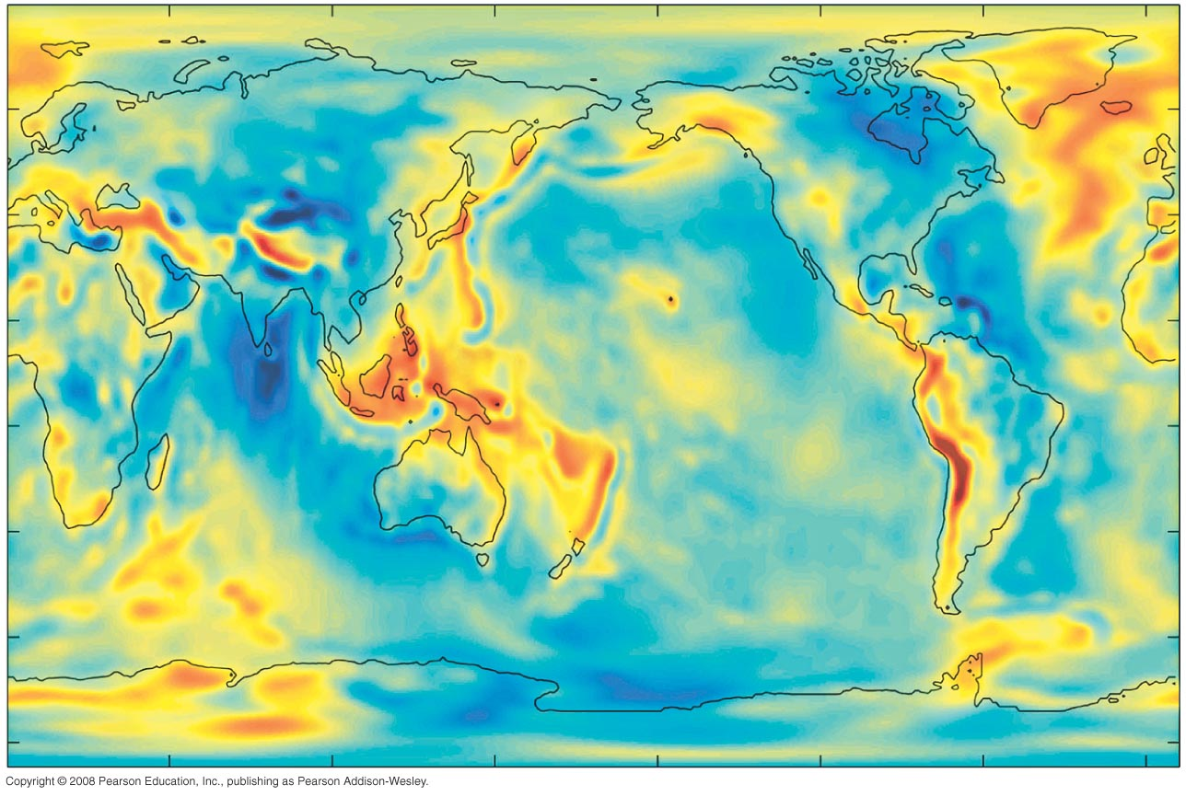
The Gravitational Field
Equipotential surfaces map where the potential energy is constant.
From Knight Ch.13, pg.393
An equipotential around the Earth is not quite spherical. It has bumps (red regions) and dips (blue regions)
The gravitational force vectors are perpendicular to the equipotential surfaces.

Slide 19
A former exam question…
C
B
f
F
A
Table

Slide 20
A former exam question…
C
B
f
F
A
Table

Slide 21
Between now and the Final Exam
There is a MasteringPhysics Problem Set due tonight. If you haven’t already finished it, please submit this by 11:59pm tonight.
The 3 hour final exam will cover the entire course, including all of the assigned reading plus Practicals materials and what was discussed in class
Approximately even spread over the course material
I recommend you be familiar with all Masteringphysics problem sets and all Practicals work you did.
Please email me ( jharlow @ physics.utoronto.ca ) with any questions. Keep in touch! It’s been a really fun course for me!

