Slide 1


Jason Harlow
Monday Apr. 7
11:00-12:00
SS2118
PHY132
1st half
Exam
Jam
Position, Velocity, Acceleration
Significant Figures, Measurements, Errors
Vectors, Relative Motion
Studying Tips
Equilibrium and Non-equilibrium Problems
Circular Motion, Centripetal Force

Slide 2
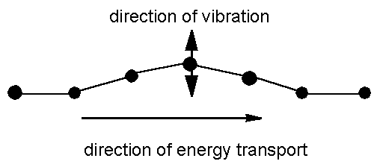
Transverse waves
Medium vibrates perpendicularly to direction of energy transfer
Side-to-side movement
Example:
  Vibrations in stretched strings of musical instruments
[image from http://www.maths.gla.ac.uk/~fhg/waves/waves1.html ]

Slide 3
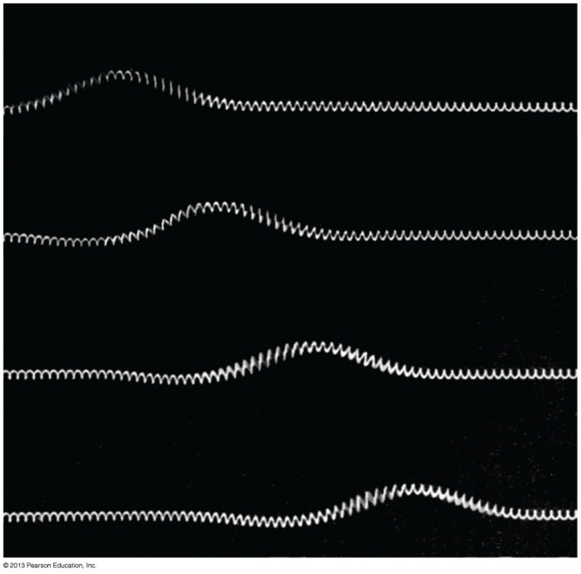
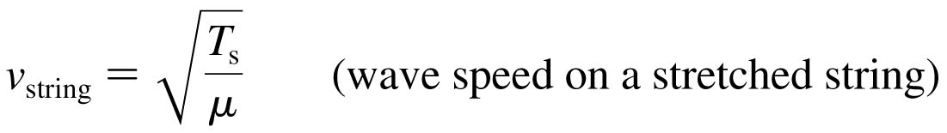
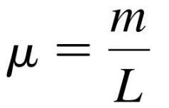
Transverse waves
The speed of transverse waves on a string stretched with tension T_{s} is:
Where μ is the string’s mass-to-length ratio, also called the linear density:
Units: [kg/m]

Slide 4
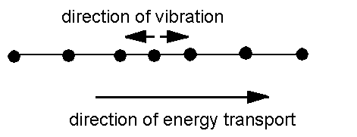
Longitudinal waves
Medium vibrates parallel to direction of energy transfer
Backward and forward movement consists of
  compressions (wave compressed)
  rarefactions (stretched region between compressions)
  Example: sound waves in solid, liquid, gas
[image from http://www.maths.gla.ac.uk/~fhg/waves/waves1.html ]

Slide 5
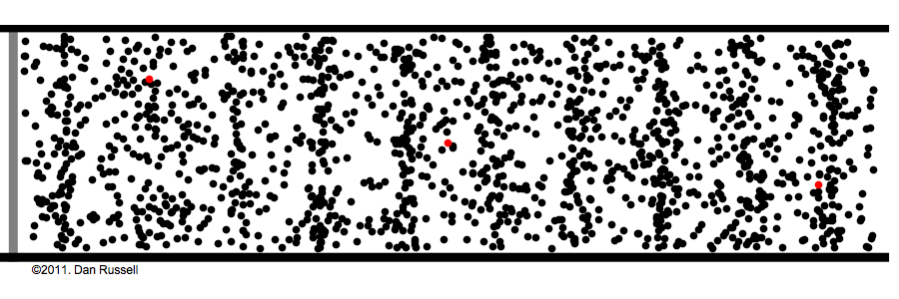
Longitudinal Waves
  Sound is a longitudinal wave.
  Compression regions travel at the speed of sound.
  In a compression region, the density and pressure of the air is higher than the average density and pressure.

Slide 6

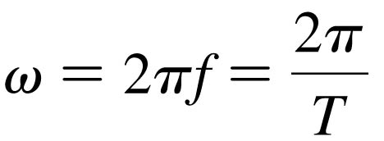
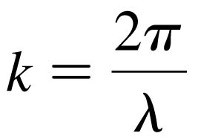

The Mathematics of Sinusoidal Waves
The angular frequency of the wave is omega:
The wave number of the wave is k:
This wave travels at a speed: $v=\frac{ω}{k}$.

Slide 7
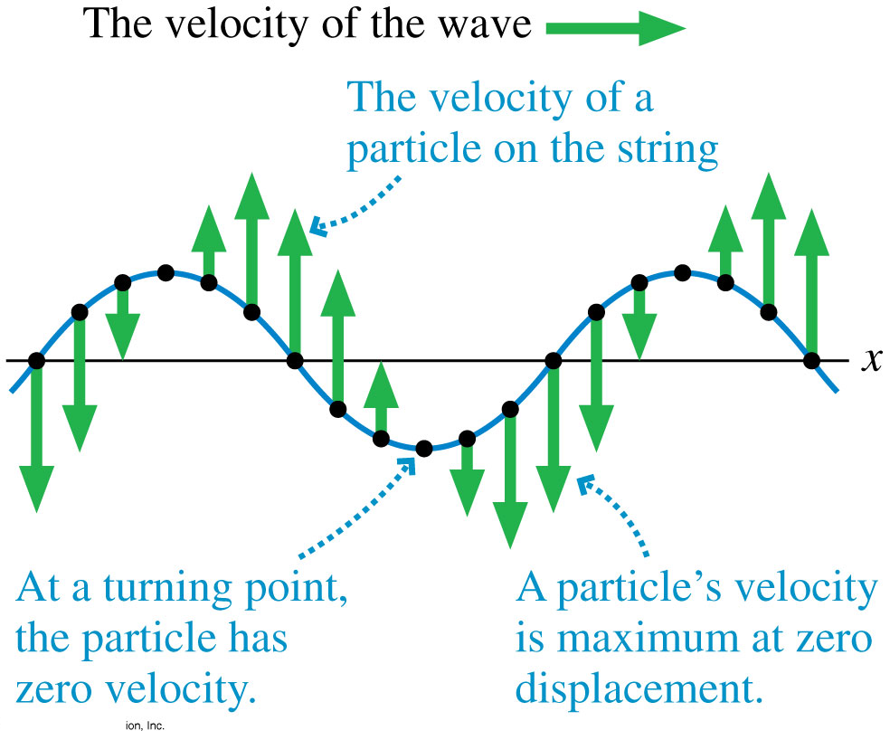
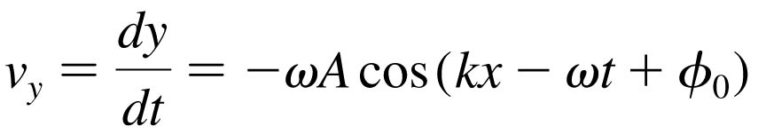
Sinusoidal Waves
As the wave moves along x, the velocity of a particle on
the string is in the
y-direction.

Slide 8
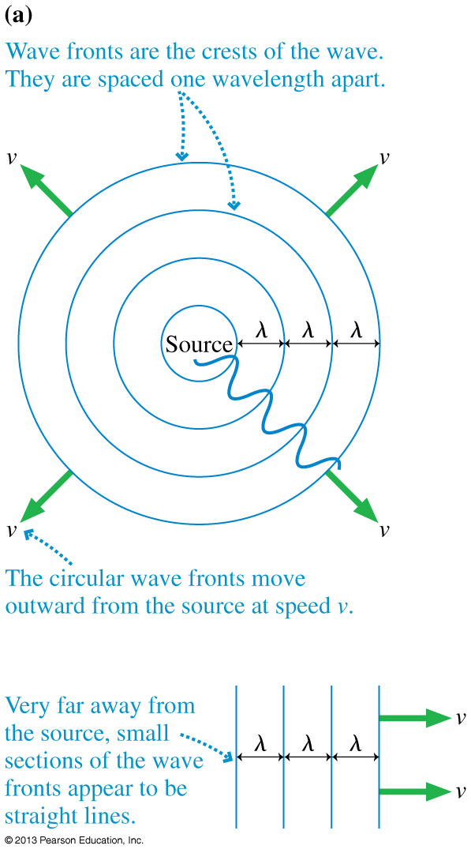
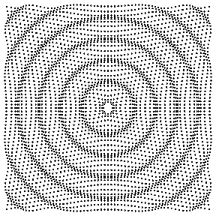
Waves in Two and Three Dimensions
[Animation courtesy of Dan Russell, Penn State]

Slide 9
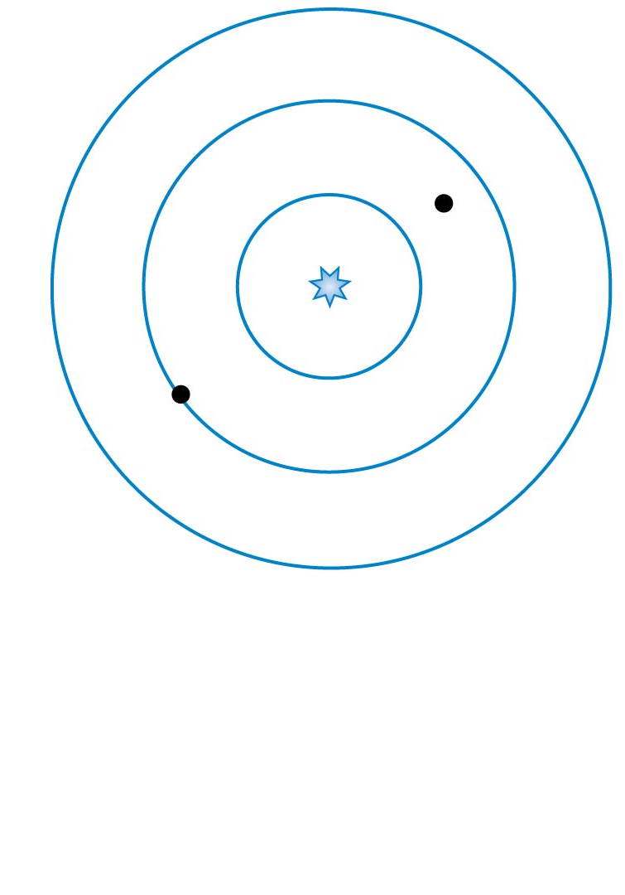
QuickCheck 20.8
A spherical wave travels outward from a point source. What is the phase difference between the two points on
the wave marked with dots?
π/4 radians.
π /2 radians.
π radians.
7π /2 radians.
7π radians.
Notes:
9

Slide 10
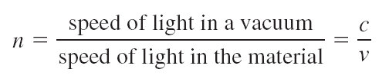
The Index of Refraction
Light waves travel with speed c in a vacuum, but they slow down as they pass through transparent materials such as water or glass or even, to a very slight extent, air.
The speed of light in a material is characterized by the material’s index of refraction n, defined as

Slide 11
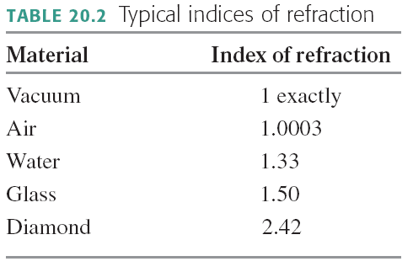
The Index of Refraction

Slide 12
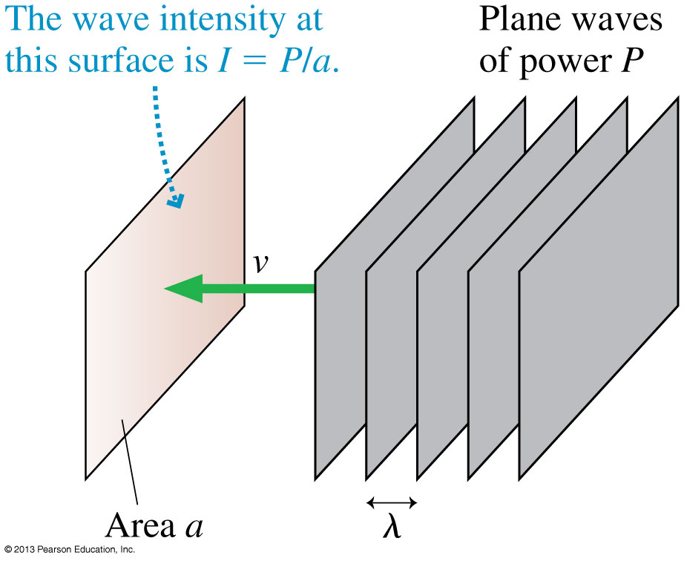
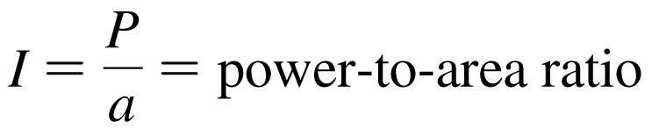
Power and Intensity
The power of a wave is the rate, in joules per second, at which the wave transfers energy.
When plane waves of power P impinge on area a, we define the intensity I to be:

Slide 13
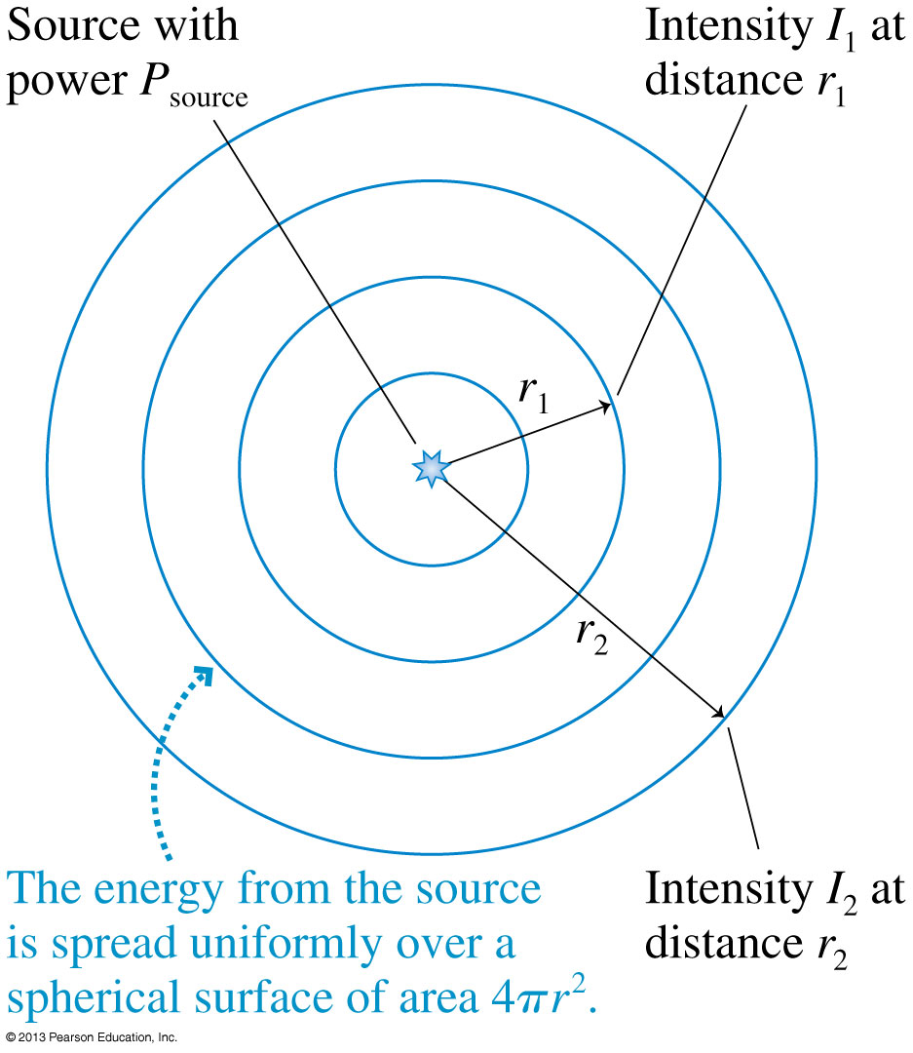
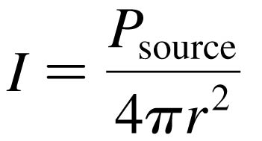
Intensity of Spherical Waves
If a source of spherical waves radiates uniformly in all directions, then the power at distance r is spread uniformly over the surface of a sphere of radius r.
The intensity of a uniform spherical wave is:

Slide 14
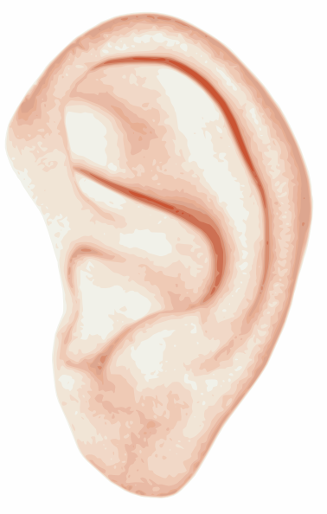
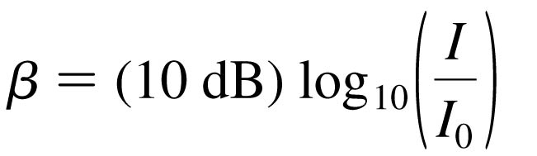
Intensity and Decibels
Human hearing spans an extremely wide range of intensities, from the threshold of hearing at
≈ 1 × 10⁻¹² W/m² (at midrange frequencies) to the threshold of pain at ≈ 10 W/m².
If we want to make a scale of loudness, it’s convenient and logical to place the zero of our scale at the threshold of hearing.
To do so, we define the sound intensity level, expressed in decibels (dB), as:
where I₀ = 1 × 10⁻¹² W/m².

Slide 15
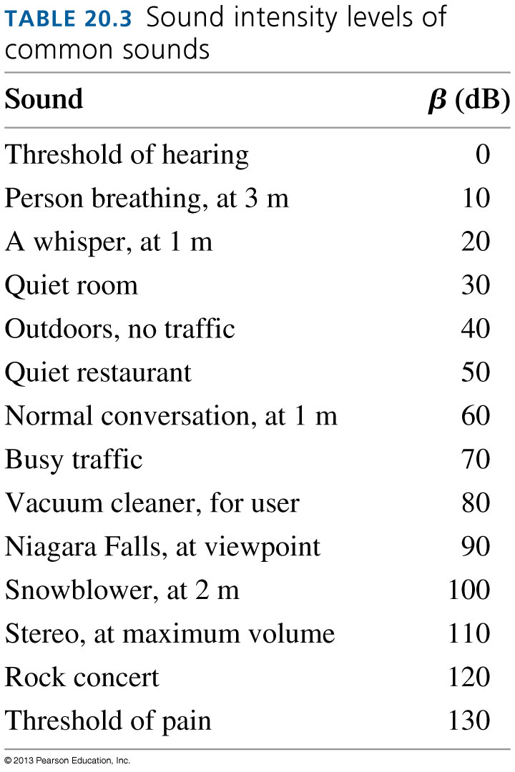
Intensity and Decibels

Slide 16
When you turn up the volume on your ipod, the sound originally entering your ears at 50 decibels is boosted to 80 decibels. By what factor is the intensity of the sound has increased?
1 (no increase)
30
100
300
1000

Slide 17

Doppler Effect
If a sound source is not moving relative to you, you hear the “rest frequency” of the emitted sound.
If the source is moving toward you, you will hear a frequency that is higher than the rest frequency.
If the source is moving away from you, you will hear a frequency that is lower than the rest frequency.
By measuring the difference between the observed and known rest frequencies, you can determine the speed of the source.

Slide 18
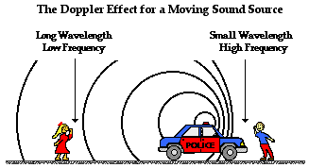
Doppler Effect
[image from http://www.physicsclassroom.com/class/waves/u10l3d.cfm ]

Slide 19
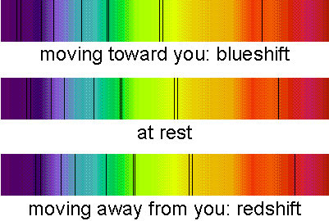
Doppler Shift for Light
The Doppler shift can be observed with carefully obtained spectra of very fast moving objects like stars
There is a slight shift in “absorption lines”

Slide 20
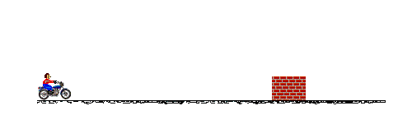
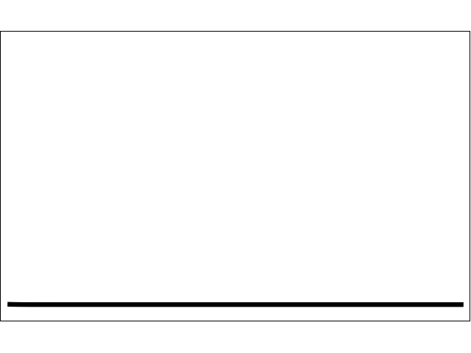
Waves in Two and Three Dimensions
Particles and Waves
Particles cannot occupy the same space. They collide.
Waves pass right through each other. They interfere.
[Animations from http://www.physicsclassroom.com/mmedia/newtlaws/mb.cfm and http://www.acs.psu.edu/drussell/demos/superposition/superposition.html ]

Slide 21
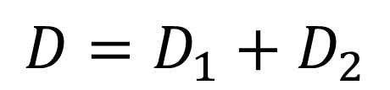
Waves in Two and Three Dimensions
The Principle of Superposition
If two or more waves combine at a given point, the resulting disturbance is the sum of the disturbances of the individual waves.
$$D=D_{1}+D_{2}$$

Slide 22
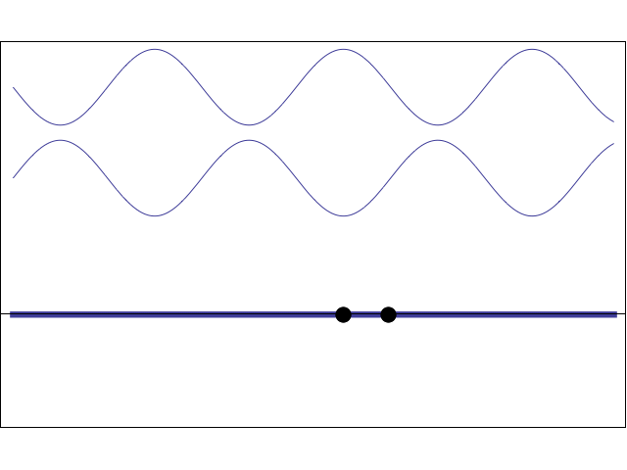
Standing Wave:
The superposition of two 1-D sinusoidal waves traveling in opposite directions.
[Animation courtesy of Dan Russell, Penn State]

Slide 23
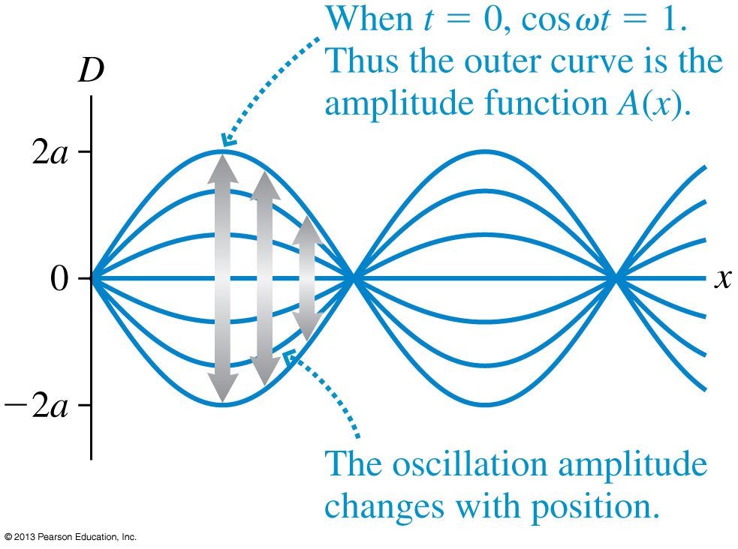
The Mathematics of Standing Waves
The amplitude reaches a maximum value of A_{max} = 2a at points where sin (kx) = 1.

Slide 24
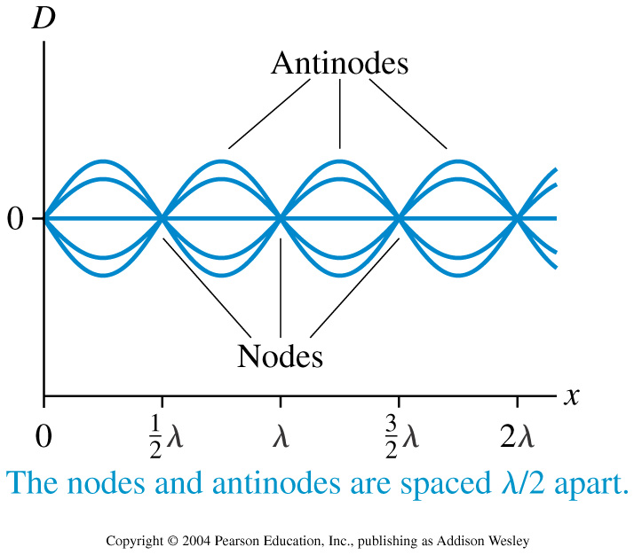
Node Spacing on a String

Slide 25
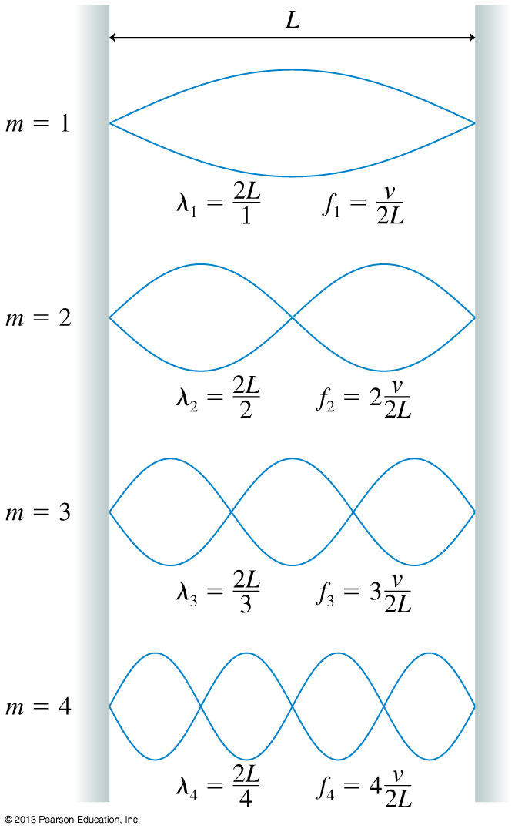
On a string of length L with fixed end points,
Only oscillations with specific wavelengths are allowed.

Slide 26
Standing Waves on a String
There are three things to note about the normal modes of a string.
m is the number of antinodes on the standing wave.
The fundamental mode, with m = 1, has λ₁ = 2L.
The frequencies of the normal modes form a series: f₁, 2f₁, 3f₁, …These are also called harmonics. 2f₁ is the “second harmonic”, 3f₁ is the “third harmonic”, etc.

Slide 27
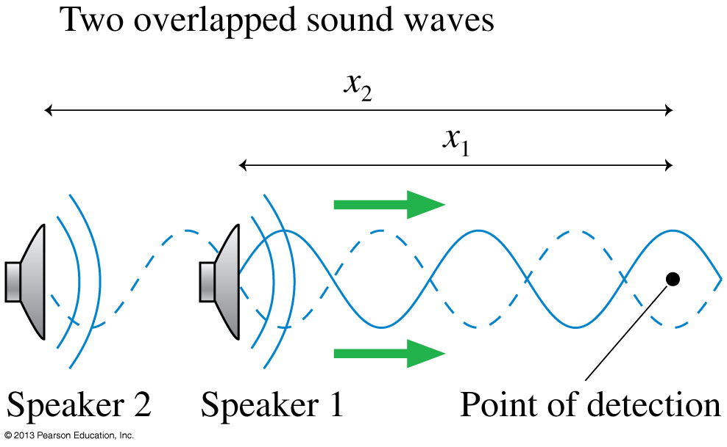
Wave Interference
The pattern resulting from the superposition of two waves is called interference. Interference can be
constructive, meaning the disturbances add to make a resultant wave of larger amplitude, or
destructive, meaning the disturbances cancel, making a resultant wave of smaller amplitude.

Slide 28
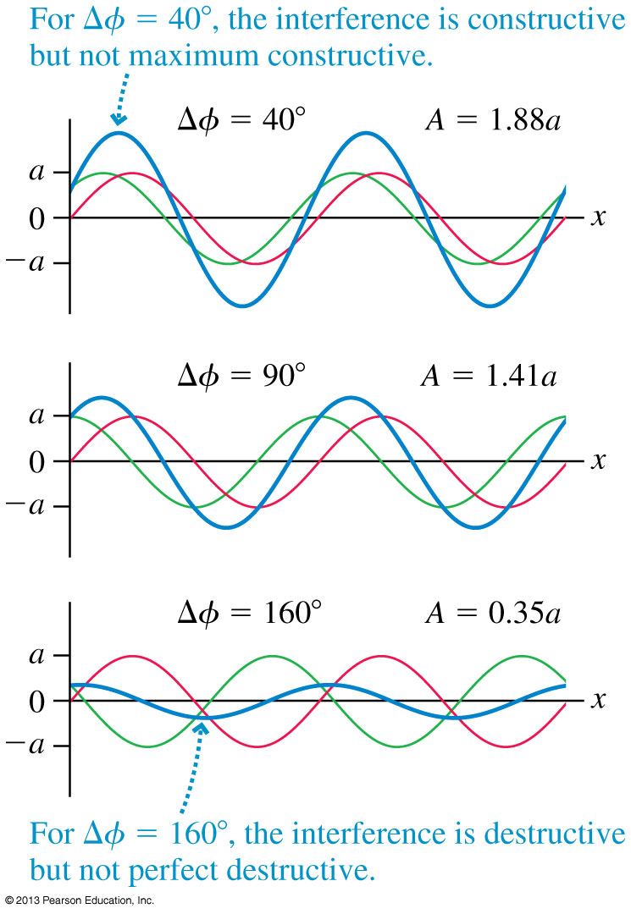
The Mathematics of Interference
It is entirely possible, of course, that the two waves are neither exactly in phase nor exactly out of phase.

Slide 29
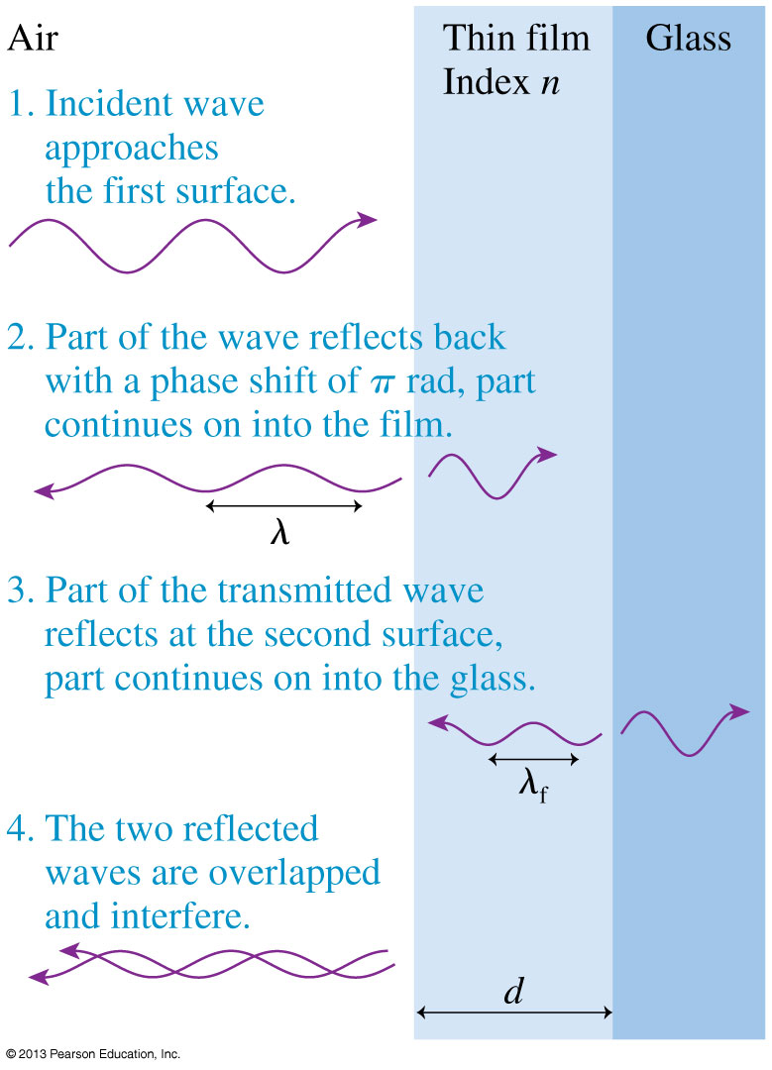
Thin-Film Optical Coatings
Thin transparent films, placed on glass surfaces, such as lenses, can control reflections from the glass.
Antireflection coatings on the lenses in cameras, microscopes, and other optical equipment are examples of thin-film coatings.

Slide 30
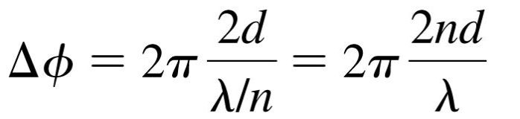
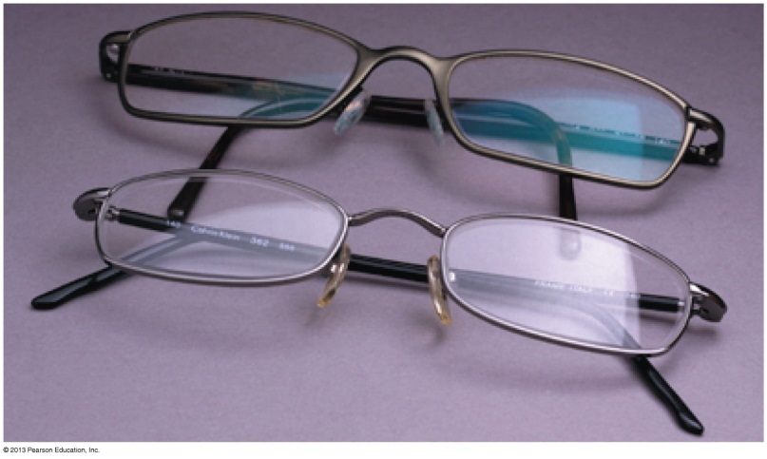
Application: Thin-Film Optical Coatings
The phase difference between the two reflected waves is:
where n is the index of refraction of the coating, d is the thickness, and λ is the wavelength of the light in vacuum or air.
For a particular thin-film, constructive or destructive interference depends on the wavelength of the light:

Slide 31
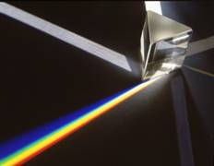
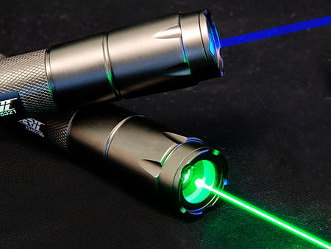
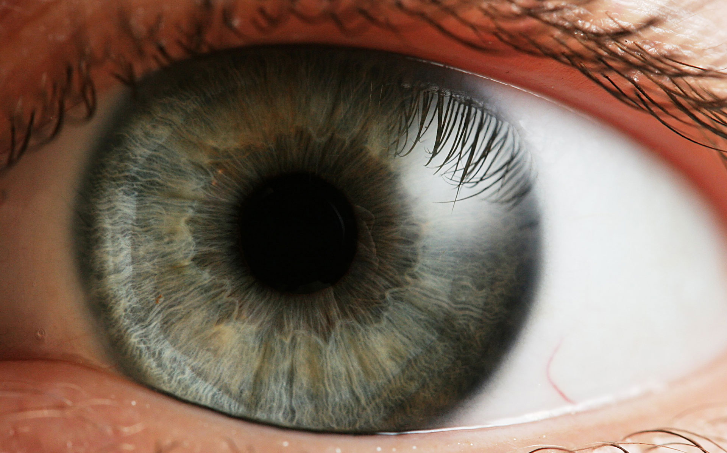
What is light?
Light is an electromagnetic wave – and is highly useful in our everyday life!

Slide 32
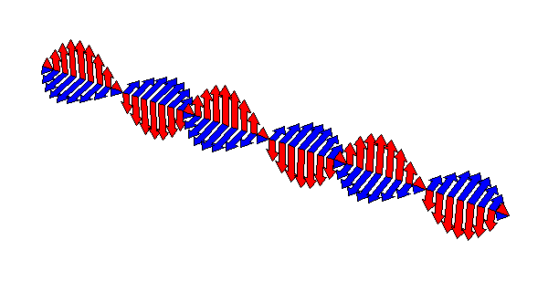
A changing electric field creates a magnetic field, which then changes in just the right way to recreate the electric field, which then changes in just the right way to again recreate the magnetic field, and
so on.
This is an electromagnetic wave.
It travels at 300,000 km/s.

Slide 33
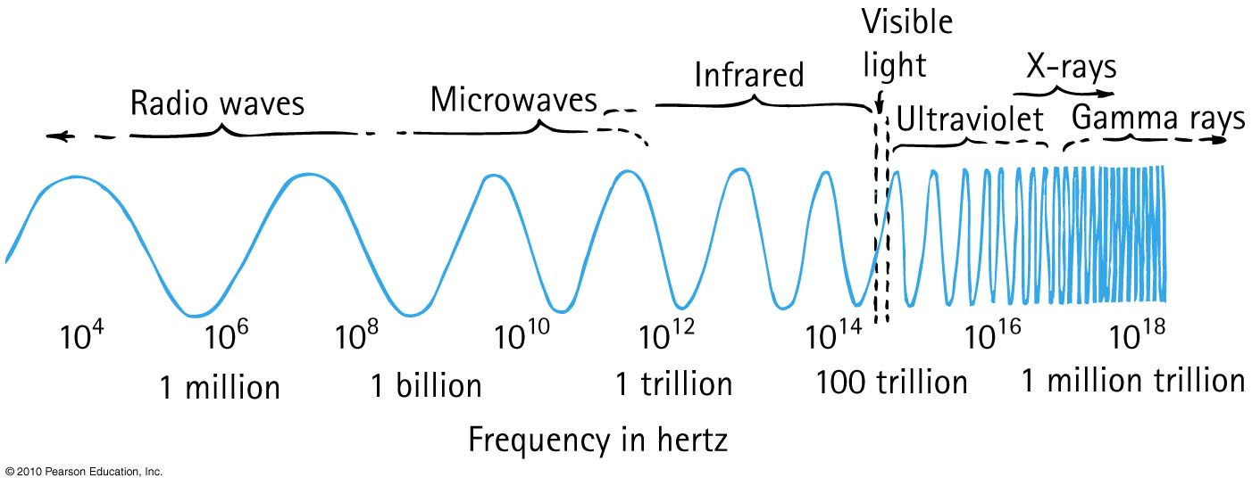
Electromagnetic Spectrum
In a vacuum, all electromagnetic waves move at the same speed
We classify electromagnetic waves according to their frequency (or wavelength)
Light is one kind of electromagnetic wave

Slide 34
Which reflects more light, a white piece of paper or a mirror?
Reflection
CHECK YOUR NEIGHBOUR
White Paper
Mirror
About the same

Slide 35
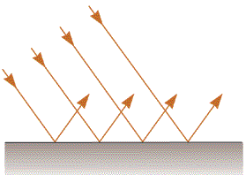
Specular Reflection
Mirrors
The surface is flat at distance scales near or above the wavelength of light
It looks “shiny”, and you can see images in it.

Slide 36
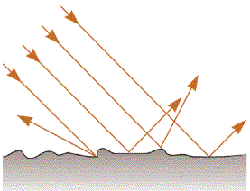
Diffuse Reflection
White Paper
The surface is rough at distance scales near or above the wavelength of light
Almost all surfaces reflect in this way!

Slide 37
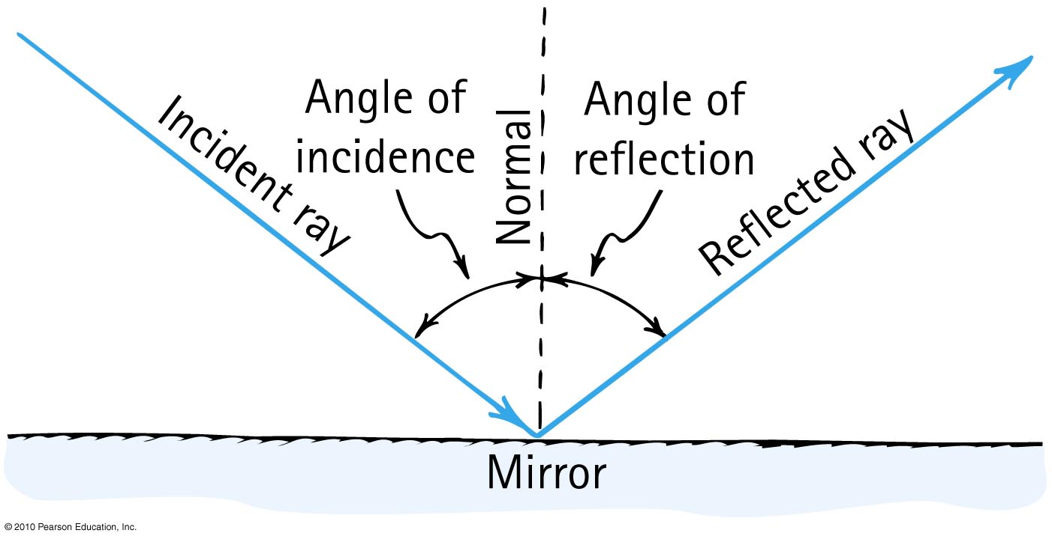
Law of Specular Reflection
The angle of reflection equals the angle of incidence.

Slide 38
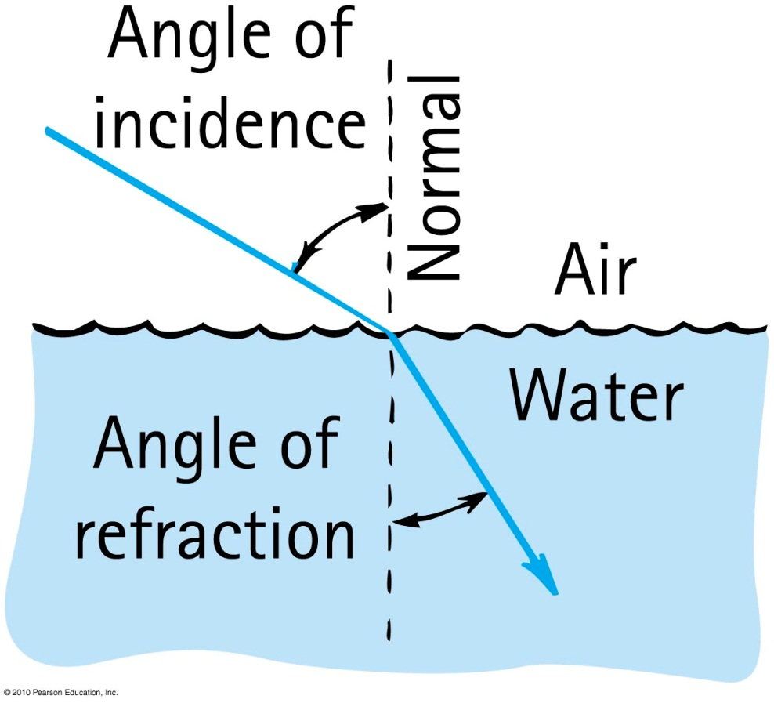
Refraction
When light bends in going obliquely from one medium to another, we call this process refraction.

Slide 39
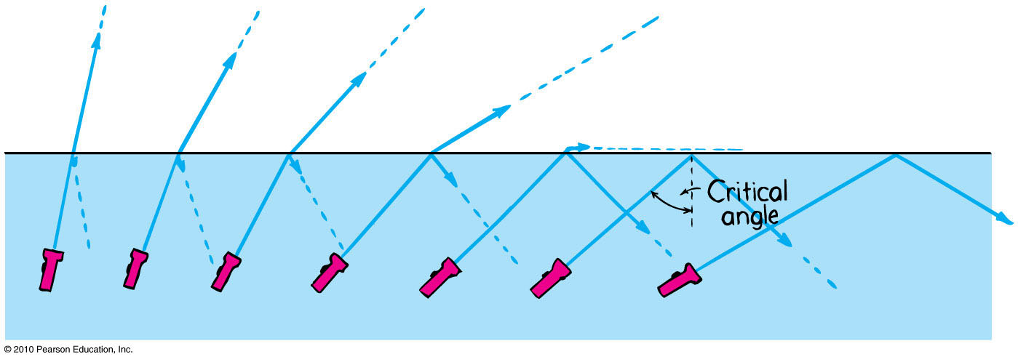
Total Internal Reflection
Total reflection of light traveling within a medium that strikes the boundary of another medium at an angle at, or greater than, the critical angle

Slide 40
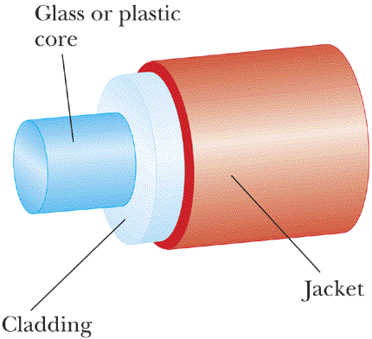
An Optical Fibre
Speed of light in cladding is higher than speed of light in core.

Slide 41
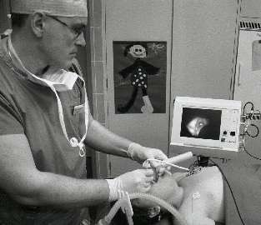
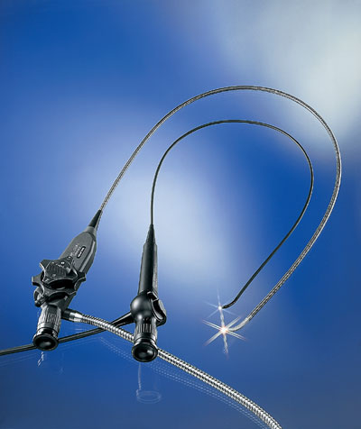
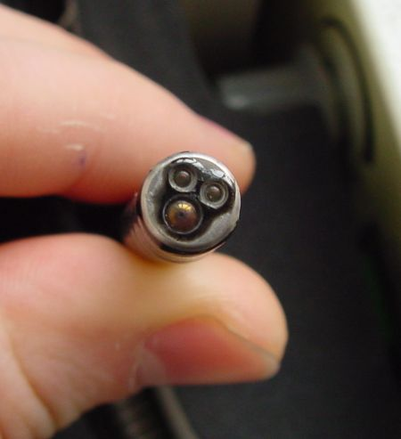
Medical Fibrescopes
Video-laryngoscopy with a flexible fiberscope

Slide 42
air
water
A fish swims directly below the surface of the water. An observer sees the fish at:
A. a greater depth than it really is.
B. its true depth.
C. a smaller depth than it really is.

Slide 43
Converging Lens
Focal length, f
Focal Point
NOTE: Focal length is defined for initially parallel rays.

Slide 44
Diverging Lens
Negative Focal length, −f
Virtual Focal Point
Rays appear to emerge from Virtual Focal Point

Slide 45


Focusing Power
Traditionally, lenses are specified not by their focal length, but by the inverse of their focal length.
This is called “focusing power”
$$P=\frac{1}{f}$$
The S.I. unit of focusing power is m^{–1}
Traditionally, this unit is called the “diopter,” abbreviated D.
$$1 D=1 m^{−1}$$

Slide 46
Diverging rays through a Converging Lens
Focal length, f
If an object emits rays at the focal point, they end up being parallel on the other side of the converging lens.

Slide 47
Diverging rays through a Converging Lens
Focal length, f
s
s’
Thin Lens Equation:

Slide 48
Thin Lens Equation: sign conventions
object
image
f
s
s’
s is positive for objects to the left of lens, negative for objects to the right of lens (virtual objects).
s’ is positive for images to the right of lens, negative for images to the left of lens (virtual images).
f is positive for converging lenses, negative for diverging lenses.

Slide 49
Lateral Magnification
The absolute magnitude of the magnification |M | is defined to be the ratio of image height to object height.
A positive value of M indicates that the image is upright relative to the object. A negative value of M indicates the image is inverted relative to the object.
Note that when s and s’ are both positive, M is negative.

Slide 50

The Camera
A camera “takes a picture” by using a lens to form a real, inverted image on a light-sensitive detector in a light-tight box.
We can model a combination lens as a single lens with an effective focal length (usually called simply “the focal length”).
A zoom lens changes the effective focal length by varying the spacing between the converging lens and the diverging lens.

Slide 51

The Detector
Figure (a) shows a CCD “chip.”
To record color information, different pixels are covered by red, green, or blue filters.
The pixels are so small that the picture looks “smooth” even after some enlargement.
As you can see in figure (b), sufficient magnification reveals the individual pixels.

Slide 52

Vision
The human eye is roughly spherical, about 2.4 cm in diameter.
The transparent cornea and the lens are the eye’s refractive elements.
The eye is filled with a clear, jellylike fluid called the aqueous humor and the vitreous humor.

Slide 53

Vision
The indices of refraction of the aqueous and vitreous humors are 1.34, only slightly different from water.
The lens has an average index of 1.44.
The pupil, a variable-diameter aperture in the iris, automatically opens and closes to control the light intensity.

Slide 54
Focusing and Accommodation
The eye focuses by changing the focal length of the lens by using the ciliary muscles to change the curvature of the lens surface.
Tensing the ciliary muscles causes accommodation, which decreases the lens’s radius of curvature and thus decreases its focal length.

Slide 55

Focusing and Accommodation
The farthest distance at which a relaxed eye can focus is called the eye’s far point (FP).
The far point of a normal eye is infinity; that is, the eye can focus on objects extremely far away.

Slide 56

Focusing and Accommodation
The closest distance at which an eye can focus, using maximum accommodation, is the eye’s near point (NP).

Slide 57

Hyperopia
A person who is farsighted can see faraway objects (but even then must use some accommodation rather than a relaxed eye), but his near point is larger than 25 cm, often much larger, so he cannot focus on nearby objects.

Slide 58

Hyperopia
The cause of farsightedness — called hyperopia — is an eyeball that is too short for the refractive power of the cornea and lens.

Slide 59

Hyperopia
With hyperopia, the eye needs assistance to focus the rays from a near object onto the closer-than-normal retina.
This assistance is obtained by adding refractive power with the positive (i.e., converging) lens.

Slide 60

Myopia
A person who is nearsighted can clearly see nearby objects when the eye is relaxed (and extremely close objects by using accommodation), but no amount of relaxation allows her to see distant objects.

Slide 61

Myopia
Nearsightedness—called myopia—is caused by an eyeball that is too long.
Rays from a distant object come to a focus in front of the retina and have begun to diverge by the time they reach the retina.

Slide 62

Myopia
To correct myopia, we needed a diverging lens to slightly defocus the rays and move the image point back to the retina.

Slide 63

Optical Systems That Magnify
The easiest way to magnify an object requires no extra optics at all; simply get closer!
Closer objects look larger because they subtend a larger angle θ, called the angular size of the object.

Slide 64


Optical Systems That Magnify
You can’t keep increasing an object’s angular size because you can’t focus on the object if it’s closer than your near point, which is ≈ 25 cm.
The maximum angular size viewable by your unaided eye is:

Slide 65

The Magnifier
Suppose we view an object of height h through a single converging lens.
If the object’s distance from the lens is less than the lens’s focal length, we’ll see an enlarged, upright image.
Used in this way, the lens is called a magnifier.

Slide 66


The Magnifier
When using a magnifier, your eye sees a virtual image subtending an angle θ = h/s.
If we place the image at a distance s′ ≈ ∞ the object distance is s ≈ f, so:
Angular magnification is the ratio of the apparent size of the object when using a magnifying lens rather than simply holding the object at your near point:
M = θ/θ_{NP}
Combining these equations, we find the angular magnification of a magnifying glass is:

Slide 67
The Microscope
A microscope, whose major parts are shown in the next slide, can attain a magnification of up to 1000× by a two-step magnification process.
A specimen to be observed is placed on the stage of the microscope, directly beneath the objective, a converging lens with a relatively short focal length.
The objective creates a magnified real image that is further enlarged by the eyepiece.

Slide 68


The Microscope

Slide 69


The Microscope
The lateral magnification of the objective is:
Together, the objective and eyepiece produce a total angular magnification:
The minus sign shows that the image seen in a microscope is inverted.
Most biological microscopes are standardized with a tube length L = 160 mm.

Slide 70

The Final Exam Cometh…
Course | Last Name | Date | Time | Location
PHY132H1S | A - KH | MON 14 APR | EV 7:00 - 9:00 | EX 100
PHY132H1S | KI - WA | MON 14 APR | EV 7:00 - 9:00 | EX 200
PHY132H1S | WE - Z | MON 14 APR | EV 7:00 - 9:00 | EX 310
EX is Central Exams Facility, 255 McCaul St. (just south of College St.)

Slide 71









Aids Allowed on the Final Exam
Any calculator without communication capability.
Aid sheet: one single, original, handwritten 8 1/2 × 11 inch sheet of paper, which may be written on both sides.
A ruler.
A paper copy of an English translation dictionary.
Also:

Slide 72

Sun. Apr. 13 evening: Go see a movie!
The evening before a test is NOT the best time to study (it is just the most popular)
Don’t worry – you have been studying since the 1st week of classes!
If you can, sleep in Monday morning – you want to still be wide awake at 9pm!

Slide 73




During the Exam
Exam begins at 7:00pm SHARP!!!
Skim over the entire exam from front to back before you begin. Look for problems that you have confidence to solve first.
If you start a problem but can’t finish it, leave it, make a mark on the edge of the paper beside it, and come back to it after you have solved all the easy problems.
When you are in a hurry and your hand is not steady, you can make little mistakes; if there is time, do the calculation twice and obtain agreement.
Bring a snack or drink.
Don’t leave a test early!

Slide 74

Benjamin Franklin (1706-1790)
Recognized that there were two types of electric charge.
When a glass rod was rubbed with silk, it became charged in one way; Franklin called this “positive”
When a piece of amber was rubbed with animal fur, it became charged in the opposite way; Franklin called this “negative”.

Slide 75

Electric Force
When two objects have electric charges, there is a long-range force between them called the electric force.
The rule for the electric force is:
Opposite charges attract one another;
like charges repel.

Slide 76

20th Century Discovery:
Atomic Structure
Protons
Positive electric charges
Repel positives, but attract negatives
Electrons
Negative electric charges
Repel negatives, but attract
positives
Neutrons
No electric charge
“neutral”

Slide 77

Fundamental facts about atoms
1. Every atom is composed of a positively charged nucleus surrounded by negatively charged electrons.
2. Each of the electrons in any atom has the same quantity of negative charge and the same mass.
Lithium Atom
Net charge = 0
[Image retrieved Jan.10, 2013 from http://www.safetyoffice.uwaterloo.ca/hse/radiation/rad_sealed/matter/atom_structure.htm ]

Slide 78
Fundamental facts about atoms
3. Protons and neutrons compose the nucleus. Protons are about 1800 times more massive than electrons, but each one carries an amount of positive charge equal to the negative charge of electrons. Neutrons have slightly more mass than protons and have no net charge.
Lithium Atom
Net charge = 0
[Image retrieved Jan.10, 2013 from http://www.safetyoffice.uwaterloo.ca/hse/radiation/rad_sealed/matter/atom_structure.htm ]

Slide 79
Fundamental facts about atoms
4. Atoms usually have as many electrons as protons, so the atom has zero net charge.
Lithium Atom
Net charge = 0
[Image retrieved Jan.10, 2013 from http://www.safetyoffice.uwaterloo.ca/hse/radiation/rad_sealed/matter/atom_structure.htm ]

Slide 80
An “Ion” is a charged atom
Positive ion — an atom which has lost one or more of its electrons, and so has a positive net charge.
Negative ion — an atom which has gained one or more electrons, and so has a negative net charge.

Slide 81



Coulomb’s Law
$$q_{1}$$
$$d$$
$$q_{2}$$
The magnitude of the force, F, between two point charges depends on the product of their charges, and the distance between them.
In equation form:
k = 9×10⁹ Nm²/C²
Unit of charge is coulomb, C
Similar to Newton’s law of gravitation for masses
Underlies the bonding forces between molecules
Electrical forces may be either attractive or repulsive.
Gravitational forces are only attractive.
$$F=k\frac{q_{1}q_{2}}{d^{2}}$$

Slide 82

Charge Polarization

Slide 83
Charge Polarization
When two small electrically charged objects are brought together, opposites attract and sames repel.
When the objects have finite size and one of them is neutral or has very little charge on it, it will become polarized.
The resulting force is always attractive. Both positive and negative objects tend to attract neutral objects due to charge polarization.

Slide 84


Coulomb’s Law, and
The Permittivity Constant
We can make many future equations easier to use if we rewrite Coulomb’s law in a somewhat more complicated way.
Let’s define a new constant, called the permittivity constant ₀:
∋
Rewriting Coulomb’s law in terms of ₀ gives us:
∋

Slide 85

The Electric Field
A charged particle with charge q at a point in space where the electric field is experiences an electric force:
If q is positive, the force on the particle is in the direction of .
The force on a negative charge is opposite the direction of .
The units of the electric field are N/C. The magnitude E of the electric field is called the electric field strength.

Slide 86

The Electric Force

Slide 87

The Electric Field

Slide 88
The Electric Field of a Point Charge
The electric field at a distance r away from a point charge, q, is given by:

Slide 89

The Electric Field of a Point Charge

Slide 90
The Electric Field of a Point Charge

Slide 91
The Electric Field of a Point Charge

Slide 92

The Electric Field of a Point Charge
If we calculate the field at a sufficient number of points in space, we can draw a field diagram.
Notice that the field vectors all point straight away from charge q.
Also notice how quickly the arrows decrease in length due to the inverse-square dependence on r.

Slide 93


The Electric Field of a Point Charge
Using unit vector notation, the electric field at a distance r from a point charge q is:
A negative sign in front of
a vector simply reverses
its direction.
The figure shows the electric field of a negative point charge.

Slide 94


The Electric Field of Multiple Point Charges
Suppose the source of an electric field is a group of point charges q₁, q₂, …
The net electric field E_{net} at each point in space is a superposition of the electric fields due to each individual charge:

Slide 95


Continuous Charge Distributions
The linear charge density of an object of length L and charge Q is defined as
Linear charge density, which has units of C/m, is the amount of charge per meter of length.

Slide 96


Continuous Charge Distributions
The surface charge density of a two-dimensional distribution of charge across a surface of area A is defined as:
Surface charge density, with units C/m², is the amount of charge per square meter.

Slide 97



An Infinite Line of Charge
The electric field of a thin, uniformly charged rod may be written:
If we now let L → ∞, the last term becomes simply 1 and we’re left with:

Slide 98

A Plane of Charge
The electric field of a plane of charge is found from the on-axis field of a charged disk by letting the radius R → ∞.
The electric field of an infinite plane of charge with surface charge density η is:
For a positively charged plane, with η > 0, the electric field points away from the plane on both sides of the plane.
For a negatively charged plane, with η < 0, the electric field points towards the plane on both sides of the plane.

Slide 99


A Plane of Charge

Slide 100

QuickCheck 26.9
Two protons, A and B, are next to an infinite plane of positive charge. Proton B is twice as far from the plane as proton A. Which proton has the larger acceleration?
Proton A.
Proton B.
Both have the same acceleration.
Notes:
100

Slide 101

The Parallel-Plate Capacitor
The figure shows two electrodes, one with charge +Q and the other with −Q placed face-to-face a distance d apart.
This arrangement of two electrodes, charged equally but oppositely, is called a parallel-plate capacitor.
Capacitors play important roles in many electric circuits.

Slide 102

The Parallel-Plate Capacitor
The figure shows two capacitor plates, seen from the side.
Because opposite charges attract, all of the charge is on the inner surfaces of the two plates.
Inside the capacitor, the net field points toward the negative plate.
Outside the capacitor, the net field is zero.

Slide 103

The Parallel-Plate Capacitor
The electric field inside a capacitor is
where A is the surface area of each electrode. Outside the capacitor plates, where E₊ and E₋ have equal magnitudes but opposite directions, the electric field is zero.

Slide 104

Motion of a Charged Particle in an Electric Field
Consider a particle of charge q and mass m at a point where an electric field E has been produced by other charges, the source charges.
The electric field exerts a force F_{on q} = qE.

Slide 105


Motion of a Charged Particle in an Electric Field
The electric field exerts a force F_{on q} = qE on a charged particle.
If this is the only force acting on q, it causes the charged particle to accelerate with
In a uniform field, the acceleration is constant:

Slide 106

Motion of a Charged Particle in an Electric Field
“DNA fingerprints” are measured with the technique of gel electrophoresis.
A solution of negatively charged DNA fragments migrate through the gel when placed in a uniform electric field.
Because the gel exerts a drag force, the fragments move at a terminal speed inversely proportional to their size.

Slide 107

QuickCheck 26.11
A proton is moving to the right in a vertical electric field. A very short time later, the proton’s velocity is
Notes:
107

Slide 108

Electric Potential Energy in a Uniform Field
A positively charged particle gains kinetic energy as it moves in the direction of decreasing potential energy.

Slide 109

Electric Potential Energy in a Uniform Field
The figure shows the energy diagram for a positively charged particle in a uniform electric field.
The potential energy increases linearly with distance, but the total mechanical energy E_{mech} is fixed.

Slide 110

The Potential Energy of Point Charges
The Potential Energy of Two Point Charges
Consider two point charges, q₁ and q₂, separated by a distance r. The electric potential energy is
This is explicitly the energy of the system, not the energy of just q₁ or q₂.
Note that the potential energy of two charged particles approaches zero as r → ∞.

Slide 111

The Potential Energy of Multiple Point Charges
The Potential Energy of Multiple Point Charges
Consider more than two point charges, the potential energy is the sum of the potential energies due to all pairs of charges:
where r_{ij} is the distance between q_{i} and q_{j}.
The summation contains the i < j restriction to ensure that each pair of charges is counted only once.

Slide 112


The Electric Potential
We define the electric potential V (or, for brevity, just the potential) as
This is NOT the same as electric potential energy. (different units, for one thing).
The unit of electric potential is the joule per coulomb, which is called the volt V:

Slide 113

A proton is released from rest at the dot. Afterward, the proton
Remains at the dot.
Moves upward with steady
speed.
Moves upward with an increasing speed.
Moves downward with a steady speed.
Moves downward with an increasing speed.
Notes:
113

Slide 114


The Electric Field Inside a Parallel-Plate Capacitor
This is a review of Chapter 26.

Slide 115

The Electric Potential Inside a Parallel-Plate Capacitor
The electric potential inside a parallel-plate capacitor is
where s is the distance from the negative electrode.
The potential difference ΔV_{C}, or “voltage” between the two capacitor plates is

Slide 116

Units of Electric Field
If we know a capacitor’s voltage ΔV and the distance between the plates d, then the electric field strength within the capacitor is:
This implies that the units of electric field are volts per meter, or V/m.
Previously, we have been using electric field units of newtons per coulomb.
In fact, these units are equivalent to each other:
1 N/C = 1 V/m

Slide 117

QuickCheck 28.9
Two protons, one after the other, are launched from point 1 with the same speed. They follow the two trajectories shown. The protons’ speeds at points 2 and 3 are related by
v₂ > v₃.
v₂ = v₃.
v₂ < v₃.
Not enough information to compare their speeds.
Notes:
117

Slide 118

The Parallel-Plate Capacitor
The figure shows the contour lines of the electric potential and the electric field vectors inside a parallel-plate capacitor.
The electric field vectors are perpendicular to the equipotential surfaces.
The electric field points in the direction of decreasing potential.

Slide 119

The Zero Point of Electric Potential
Where you choose V = 0 is arbitrary. The three contour maps below represent the same physical situation.

Slide 120


The Electric Potential of a Point Charge
Let q in the figure be the source charge, and let a second charge q', a distance r away, probe the electric potential of q.
The potential energy of the two point charges is

Slide 121

The Electric Potential of a Point Charge
The electric potential due to a point charge q is
The potential extends through all of space, showing the influence of charge q, but it weakens with distance as 1/r.
This expression for V assumes that we have chosen V = 0 to be at r = ∞.

Slide 122

QuickCheck 28.10
What is the ratio V_{B}/V_{A} of the electric potentials at the two points?
9.
3.
1/3.
1/9.
Undefined without knowing the charge.
Notes:
122

Slide 123

The Electric Potential of Many Charges
The Electric Potential of Many Charges
The electric potential V at a point in space is the sum of the potentials due to each charge:
where r_{i} is the distance from charge q_{i} to the point in space where the potential is being calculated.
The electric potential, like the electric field, obeys the principle of superposition.

Slide 124

Good Luck!!
I’ll see you on Monday, Apr. 14 at 7:00pm
Then I hope to see you again in the future – please say hi if you see me around campus, and feel free to stop by my office any time you see my open door.
It’s been a lot of fun teaching you physics this year – have a fantastic rest of your life!!!!
Next up: Andrew at 12:00pm

