Slide 1
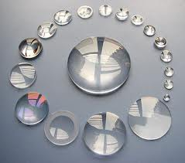
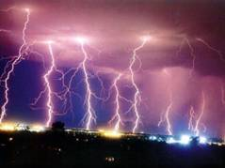
PHY132H1F Introduction to Physics II
You recognize these guys?
Hello and welcome!
This is the second course of a 1-year sequence: PHY131/132.
We will study waves, sound, light, electricity, magnetism and special relativity.
Required Text: “Physics for Scientists and Engineers” 3rd Edition (Copyright 2011) by Randall Knight.

Slide 2
Course Overview
First half, now until Feb. 14:
Jason Harlow
Waves
Optics
Electric Charges
Electric Field
Second half, February 24 to April 2:
Andrew Meyertholen
Electric Circuits
Magnetism
Electromagnetic Induction
Einstein’s Theory of Relativity

Slide 3
My contact information
Jason Harlow
jharlow@physics.utoronto.ca
Office: MP121B – right beside the Practicals rooms
www.facebook.com/harlowphysics
Twitter @jasonjbharlow
Voice line (no texts): 416-946-4071
Winter/Spring 2014 office hours: Mondays: 3-4PM, Thursdays and Fridays: 11AM-12 noon.
In addition to these hours, you have are invited to call or email for an appointment, or just drop by my office.

Slide 4
Other important contacts
Dr. Pierre Savaria, Course Coordinator
phy132@physics.utoronto.ca
Office: MP129E
Voice line (no texts): 416-978-4135
Ms. April Seeley, Course Administrator
seeley@physics.utoronto.ca
Office: MP129
Voice line (no texts): 416-946-0531
Office hours: Monday,Tuesday, Thursday, Friday 9:30am to 5:00pm, and Wednesdays from 9:30am to 4:30pm

Slide 5
Clickers…
Beginning Wednesday, we will be asking in-class clicker questions every class.
You will receive marks participation only; there is no penalty for getting the wrong answer.
Clicker Participation is worth 2% of your course mark.
In this course you have the option of using an i>clicker, i>clicker+, or i>clicker2 remote, or using i>clicker GO, which enables you to vote via a web-enabled device like a laptop or smart phone.
You do not need to re-register your remote if you’re using the same one as last semester (fall 2013)

Slide 6
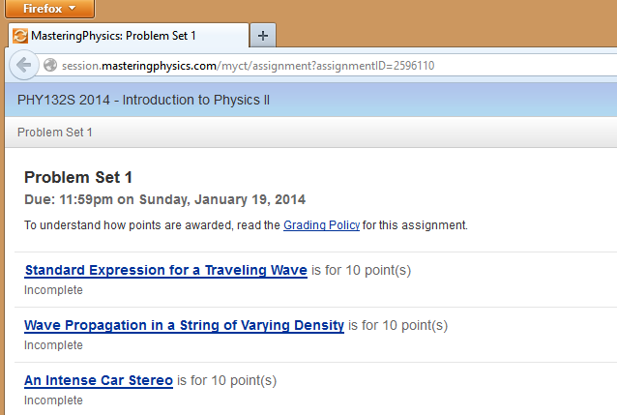
Online Homework:
Hopefully you still have your MasteringPhysics account from PHY131.
Enrol in this course: MPPHY132S14
Problem Sets (worth 9% of course mark) are quite long – make take between 1 and 3 hours per week

Slide 7
Pre-Class Reading Quizzes:
In order to get the best out of our classes (which will include lots of clicker questions and discussion) you must read the chapters before coming to class
If you hate reading, I have also posted pre-class videos, which go over the main points from each day’s reading
Beginning this Wednesday, there will be a short online multiple choice quiz on MasteringPhysics due by 8:00am before class.
The quiz will be based on your reading or watching of the pre-class video.
The questions are not too tricky – if you’ve read the material, you should find them quite straightforward.
These quizzes are worth 2% of your course mark

Slide 8
Tests and Exam
Test 1 is Tuesday February 4, 6:00-7:30PM in room(s) to be announced
An alternate sitting will be scheduled just before the main sitting of the test for students who demonstrate a conflict with another academic activity at U of T – you must visit April in MP129
Test 1 is worth 15% of the course mark, and covers Chapters 20, 21, 23, 24 and 25
Test 2, also worth 15%, is Tue. March 11, 6:00PM
The Final Exam is worth 40% of the course mark, covers the entire course, and will be held some time TBA between April 9-30.

Slide 9
Practicals
Note that Practicals begin this week, starting today. This week is a short Practical.
All Practicals are either in MP125A or MP125B, which are right beside each other – lists will be posted so you know which room to go to
You will be assigned to sit with 3 other people from this course, and the 4 of you will form a team for the next five practical sessions.
You will be working on Practicals activities together and sharing a mark on the notebooks.

Slide 10
Pre- and Post-course quiz
1% of your mark is reserved for the pre and post course quizzes
We use these tests as one way to measure how the course is going
The first you will take in practicals this week
The second you will take at the end of the semester

Slide 11
Piazza
Online discussion board (invites go out today)
https://piazza.com/utoronto.ca/winter2014/phy132/home
Fastest way to get help
We will check this as often as we do e-mail
Please be nice!

Slide 12
How to get more information
The main way of keeping up with what’s going on in the course is the web-site at:
https://portal.utoronto.ca
The Course Information page on the portal page for this course has all the rules for the course – PLEASE READ IT!
Also, we will email you from time to time at your utoronto.ca email address
The above forms of electronic communication are mandatory – please use them!

Slide 13
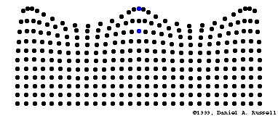
Chapter 20. Traveling Waves
A vibration is a periodic linear motion of a particle about an equilibrium position.
When many particles vibrate and carry energy through space, this is a wave. A wave extends from one place to another.
Examples are:
water waves
light, which is an electromagnetic wave
sound
[image from https://webspace.utexas.edu/cokerwr/www/index.html/waves.html ©1999 by Daniel A. Russell ]

Slide 14
Amplitude and Wavelength
Amplitude
distance from the midpoint to the crest or to the trough
Wavelength
distance from the top of one crest to the top of the next crest, or distance between successive identical parts of the wave

Slide 15
Wave speed
Describes how fast a disturbance moves through a medium
Related to frequency and wavelength of a wave
Example:
A wave with wavelength 1 meter and frequency of
1 Hz has a speed of 1 m/s.
Wave speed = frequency × wavelength

Slide 16
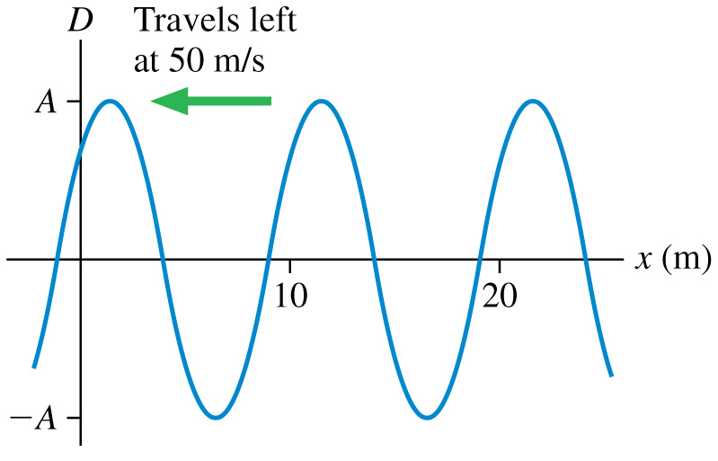
What is the frequency of this traveling wave?
0.1 Hz
0.2 Hz
2 Hz
5 Hz
10 Hz
Notes:
Answer: D

Slide 17
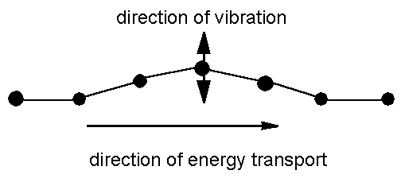
Transverse waves
Medium vibrates perpendicularly to direction of energy transfer
Side-to-side movement
Example:
Vibrations in stretched strings of musical instruments
[image from http://www.maths.gla.ac.uk/~fhg/waves/waves1.html ]

Slide 18
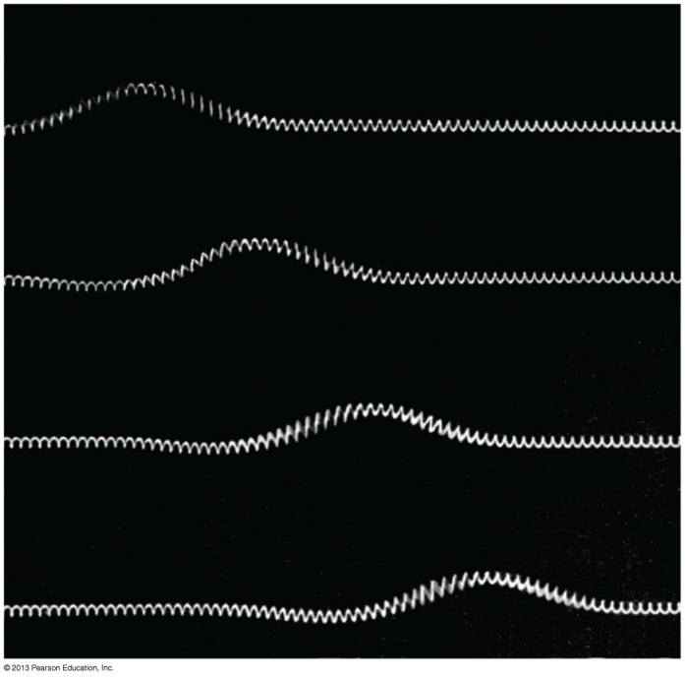
Transverse waves
The speed of transverse waves on a string stretched with tension T_{s} is:
Where μ is the string’s mass-to-length ratio, also called the linear density:
Units: [kg/m]

Slide 19
Example.
An 80 kg climber hangs from a rope, 20 m below a rocky overhang. The rope has a linear density of 37 g/m.
Approximately how long would it take a transverse pulse to travel the length of the rope from the climber to the overhang?

Slide 20
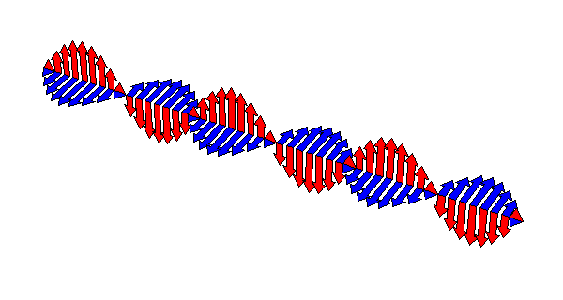
Transverse Waves Maxwell’s Theory of Electromagnetic Waves
A changing electric field creates a magnetic field, which then changes in just the right way to recreate the electric field, which then changes in just the right way to again recreate the magnetic field, and so on.
This is an electromagnetic wave.
It travels at 300,000 km/s.

Slide 21
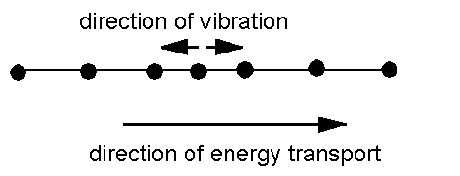
Longitudinal waves
Medium vibrates parallel to direction of energy transfer
Backward and forward movement consists of
compressions (wave compressed)
rarefactions (stretched region between compressions)
Example: sound waves in solid, liquid, gas
[image from http://www.maths.gla.ac.uk/~fhg/waves/waves1.html ]

Slide 22
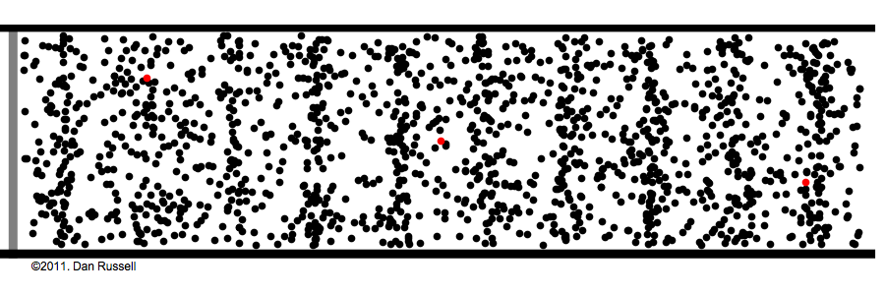
Longitudinal Waves
Sound is a longitudinal wave.
Compression regions travel at the speed of sound.
In a compression region, the density and pressure of the air is higher than the average density and pressure.

Slide 23
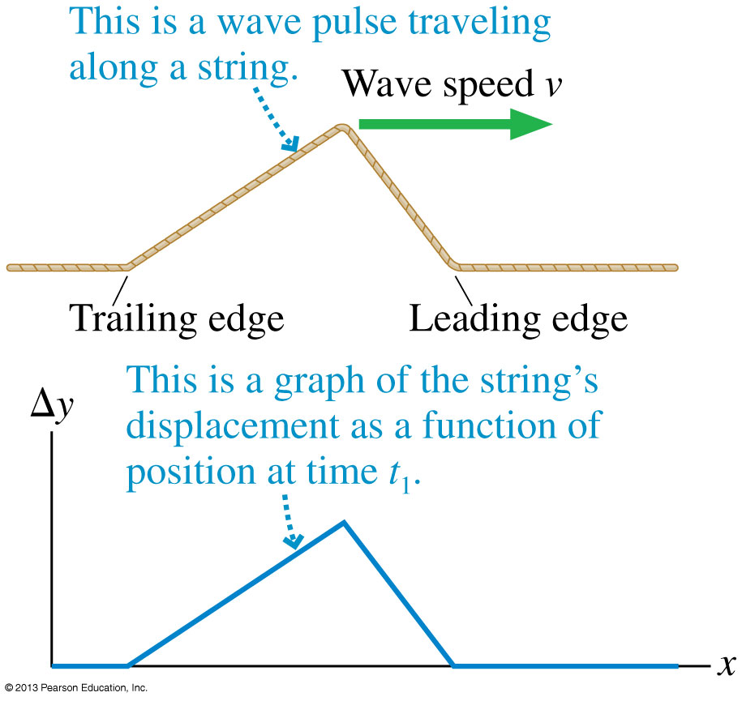
Snapshot Graph
A graph that shows the wave’s displacement as a function of position at a single instant of time is called a snapshot graph.
For a wave on a string, a snapshot graph is literally a picture of the wave at this instant.

Slide 24
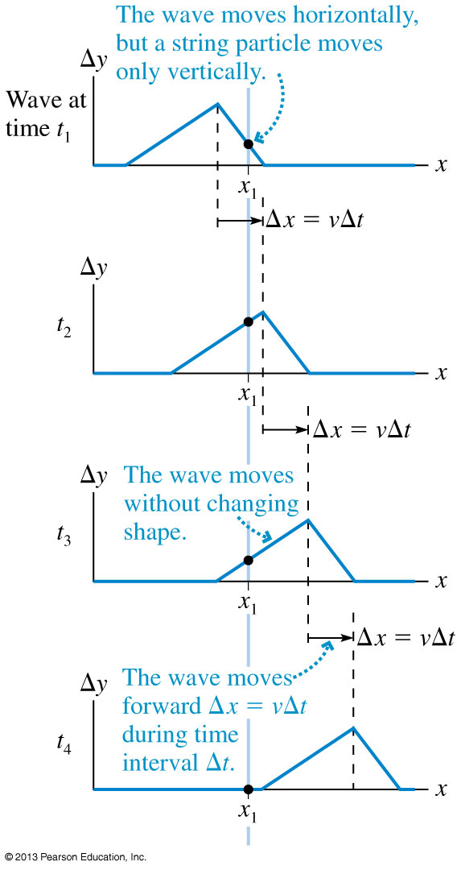
One-Dimensional Waves
The figure shows a sequence of snapshot graphs as a wave pulse moves.
These are like successive frames from a movie.
Notice that the wave pulse moves forward distance Δx = vΔt during the time interval Δt.
That is, the wave moves with constant speed.

Slide 25
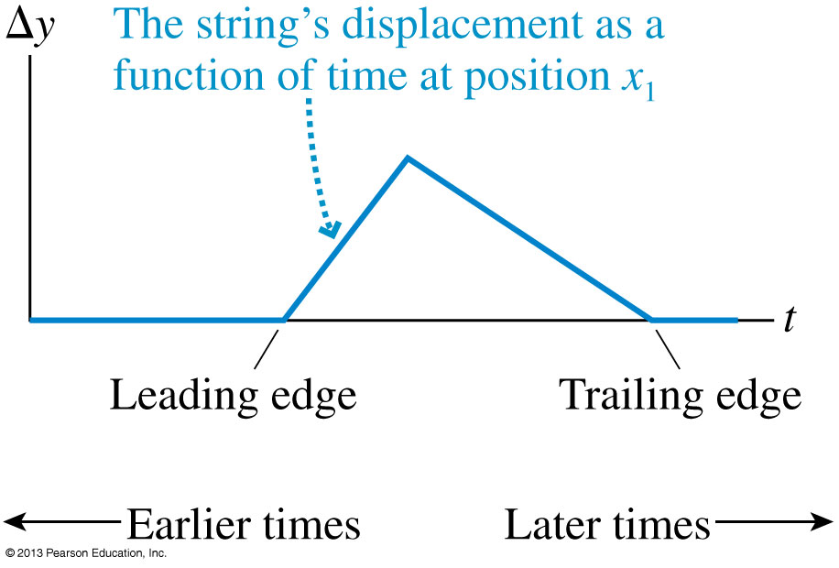
History Graph
A graph that shows the wave’s displacement as a function of time at a single position in space is called a history graph.
This graph tells the history of that particular point in the medium.
Note that for a wave moving from left to right, the shape of the history graph is reversed compared to the snapshot graph.

Slide 26
The Mathematics of Sinusoidal Waves
The angular frequency of the wave is omega:
The wave number of the wave is k:
This wave travels at a speed: $v=\frac{ω}{k}$.

Slide 27
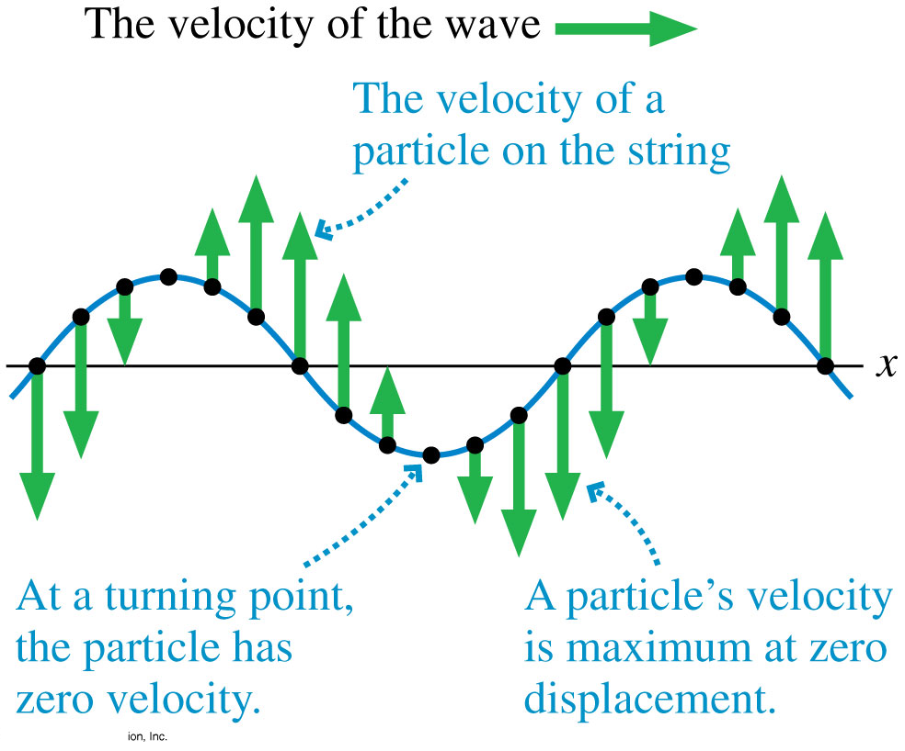
Wave Motion on a String
Shown is a snapshot graph of a wave on a string with vectors showing the velocity of the string at various points.
As the wave moves along x, the velocity of a particle on the string is in the y-direction.

Slide 28
Before Class 2 on Wednesday
Please read all of Chapter 20: pages 560-583 in Knight.
Please do the short pre-class quiz on MasteringPhysics by tomorrow evening.
Problem Set 1 on MasteringPhysics is due Jan.19: take a look at it. Don’t leave problem sets until the last minute!
Don’t forget to bring your clicker!
Something to think about: As a police siren is approaching you, does its frequency get higher and higher as it approaches?

